Slide 1
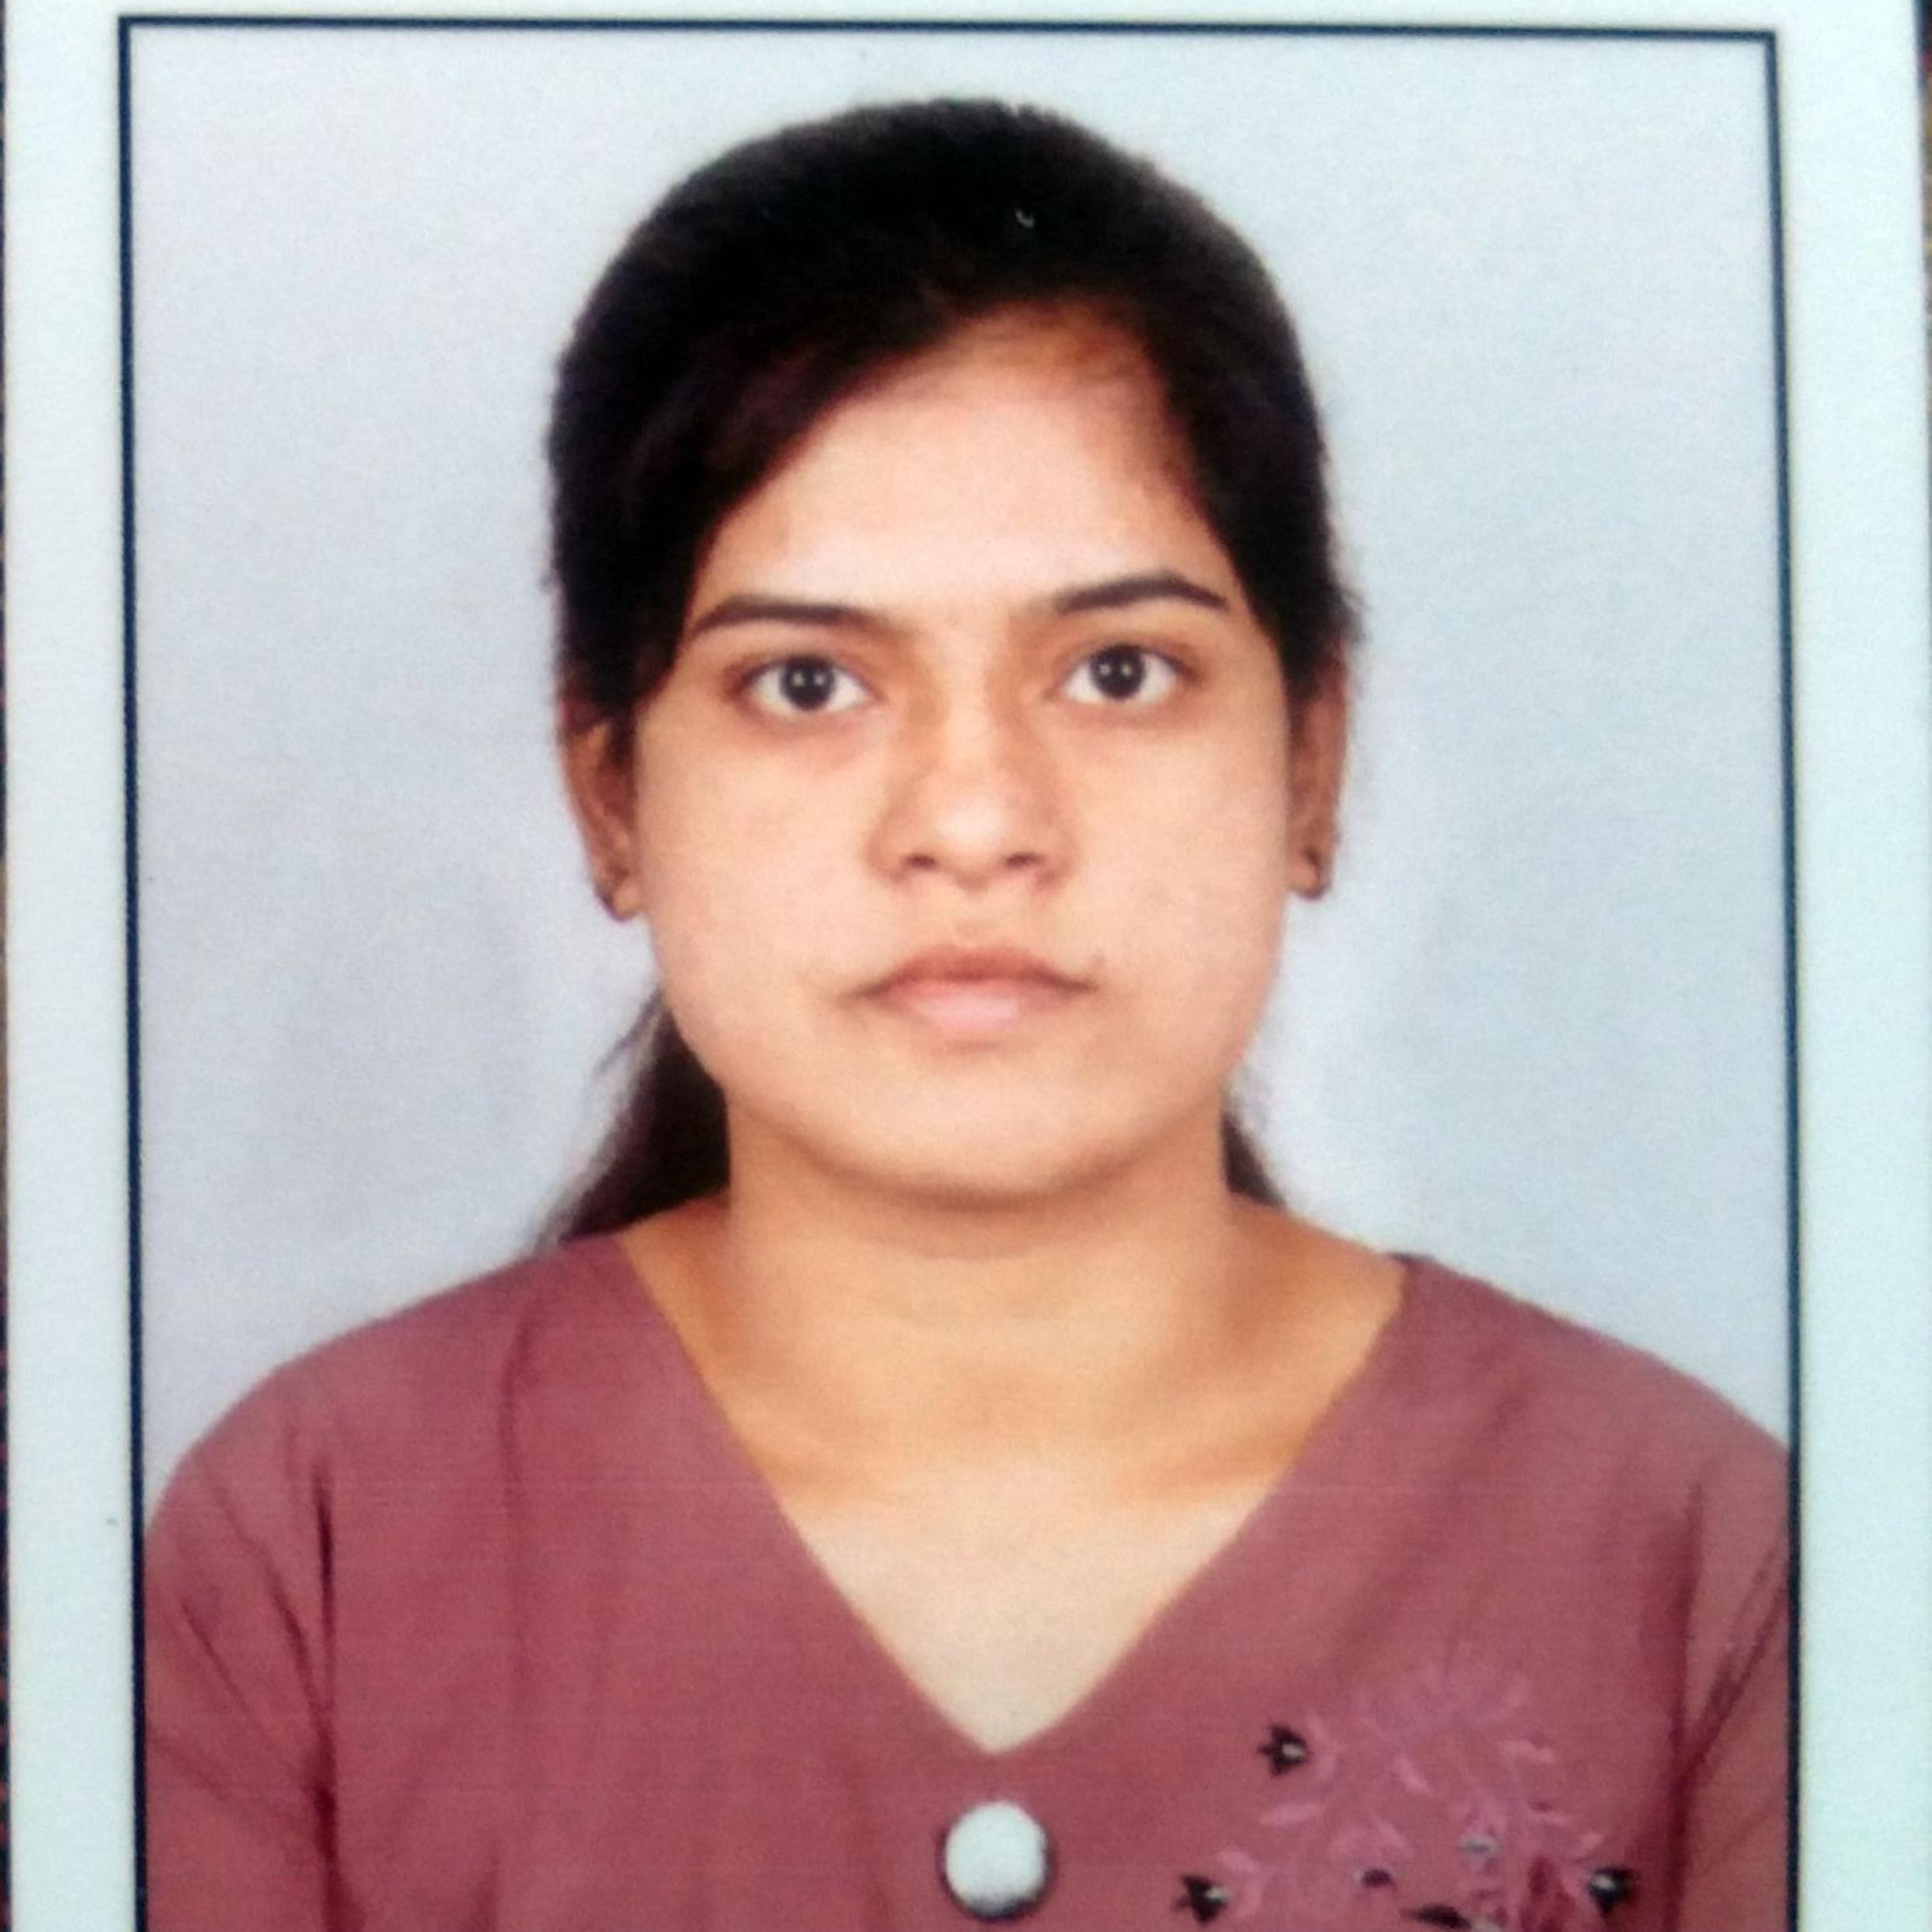


RATHOD RAJKUMAR
Analyst/Software Engineer
Bachelor of Engineering
Electronic and tele Engineering
2017 - 2021
Skills Java 8
Spring Boot
Spring Core
Database
SQL database
PostgreSQL
Backend
Spring Boot
Spring Core
Rest API
Node Js
Web Technologies
HTML5
CSS3
Bootstrap
Javascript,ES6
AddOns
Github
Gradle
Swagger,Eclipse
Additional Details
Leadership
Proficient Communication
Team management
Mumbai
nikita.fulare@capgemini.com
7620961676
A4
Have knowledge about Java ,spring framework and sql using eclipse and SQL database and PostgreSQL.
Have Knowledge in developing Web Application in react using HTML,CSS and JS.
Has working on React and Java development Appling using Spring Boot .
Have ability to learn new things and technologies.
htthttps://github.com/Phulare123/One-Page-Resume.git
e-health insurance :
Created a e-health insurance application with spring boot as backend along with swagger for testing .
React as frontend, used HTML5 ,CSS ,ES6 and bootstrap for designing responsive web pages .
Learn New Technologies IN Training :
Spring framework ,SQL database, React.

