Slide 1
Welcome

Slide 2
Top 5 Tallest Building in the World

Slide 3
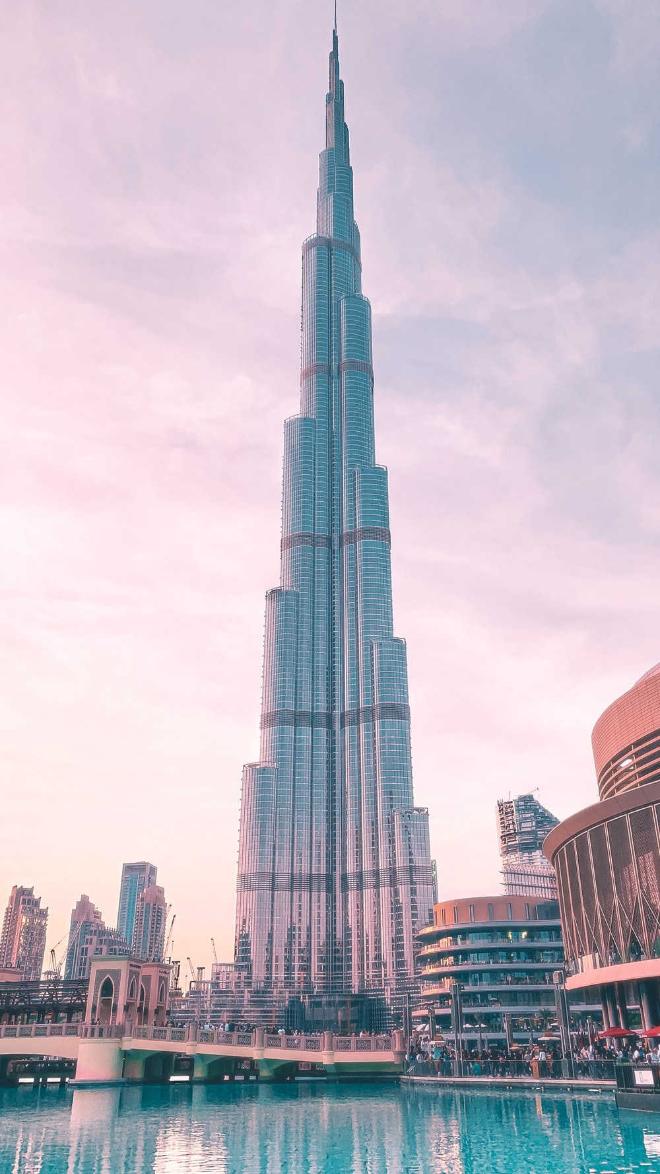
Burj Khalifa

Slide 4
Country : United Arab Emirates
City : Dubai
Height : 818 metres
Floors :160
Built : 2010

Slide 5
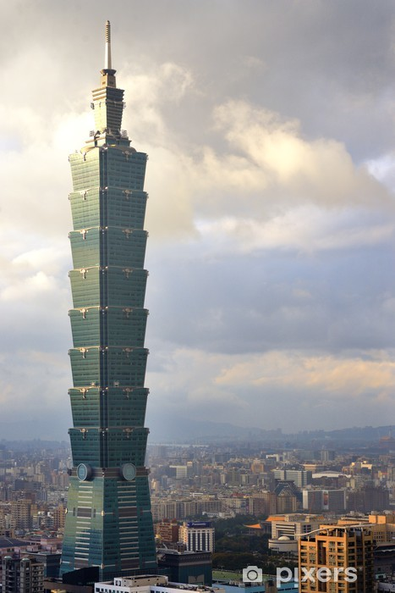
Taipei 101

Slide 6
Country : Taiwan
City : Taipei
Height : 509 metres
Floors : 101
Built : 2004

Slide 7
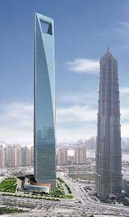
Shanghai World Financial Center

Slide 8
Country : China
City : Shanghai
Height : 492 metres
Floors :101
Built :2008

Slide 9
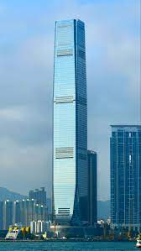
International Commerce Center

Slide 10
Country : Hong Kong
City : Hong Kong
Height : 484 metres
Floors : 118
Built : 2009

Slide 11
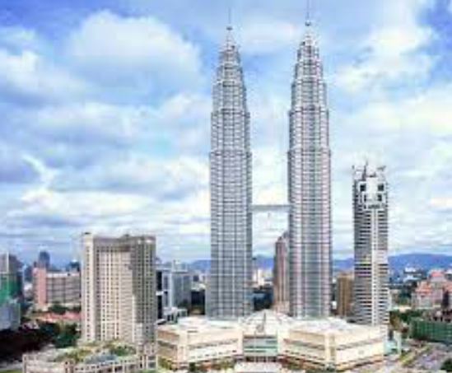
Petronas Tower 1

Slide 12
Country : Malaysia
City : Kuala Lumper
Height : 452 metres
Floors : 88
Built : 1998

Slide 13
Thank You

