Slide 1

DataQuest2026: Building Interpretable Credit Models
Phumlani Mnguni
+27 63 6259 456
phumlanimnguni6@gmail.com

Slide 2

Contents
01 Project Overview and Objectives
02 Constraints & Business Problem Framing
03 Key Research Concepts in Credit Modeling
04 Exploratory Data Analysis Tool Design
05 Data Cleaning
06 Data Preparation, Feature Engineering
07 Build Model: Results & Performance Metrics
08 Business Value and Decision Dashboard
09 AI Usage Reflection
10 Closing & Thank You

Slide 3
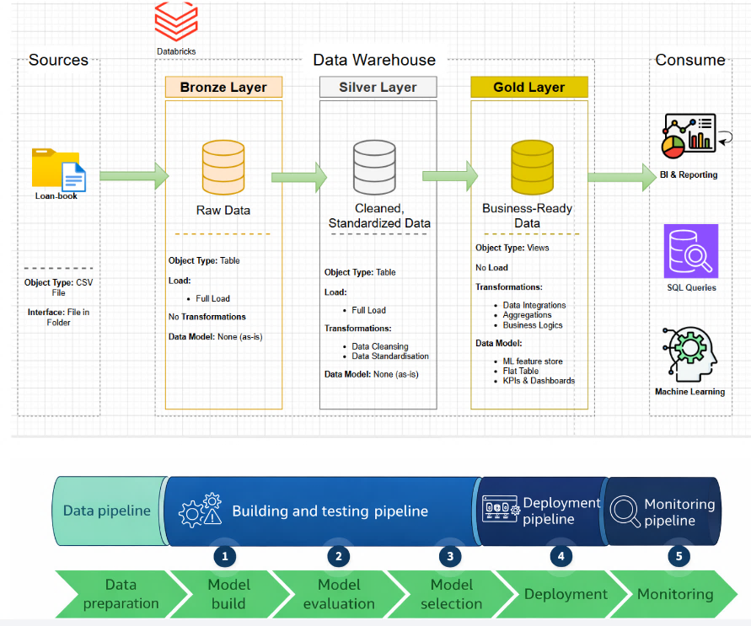
Complete Data Story

Slide 4
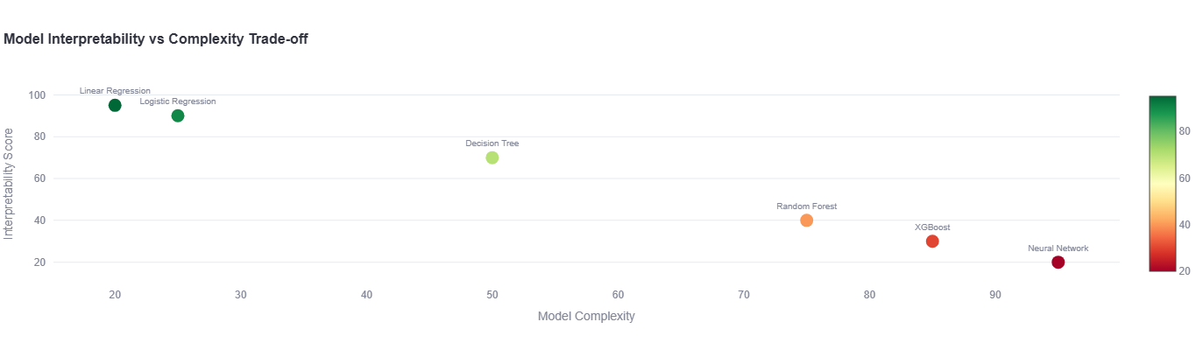
01 Project Overview and Objectives
DataQuest2026 empowers data scientists using Generative AI as a productivity companion in the retail lending space. This artificial intelligence must be trained on quality data.
Focusing on improving consumer loan evaluations by building interpretable predictive models for default risk analysis.
Constraint: Mandated Logistic Regression ensures regulatory transparency, balancing complexity with business explainability.

Slide 5
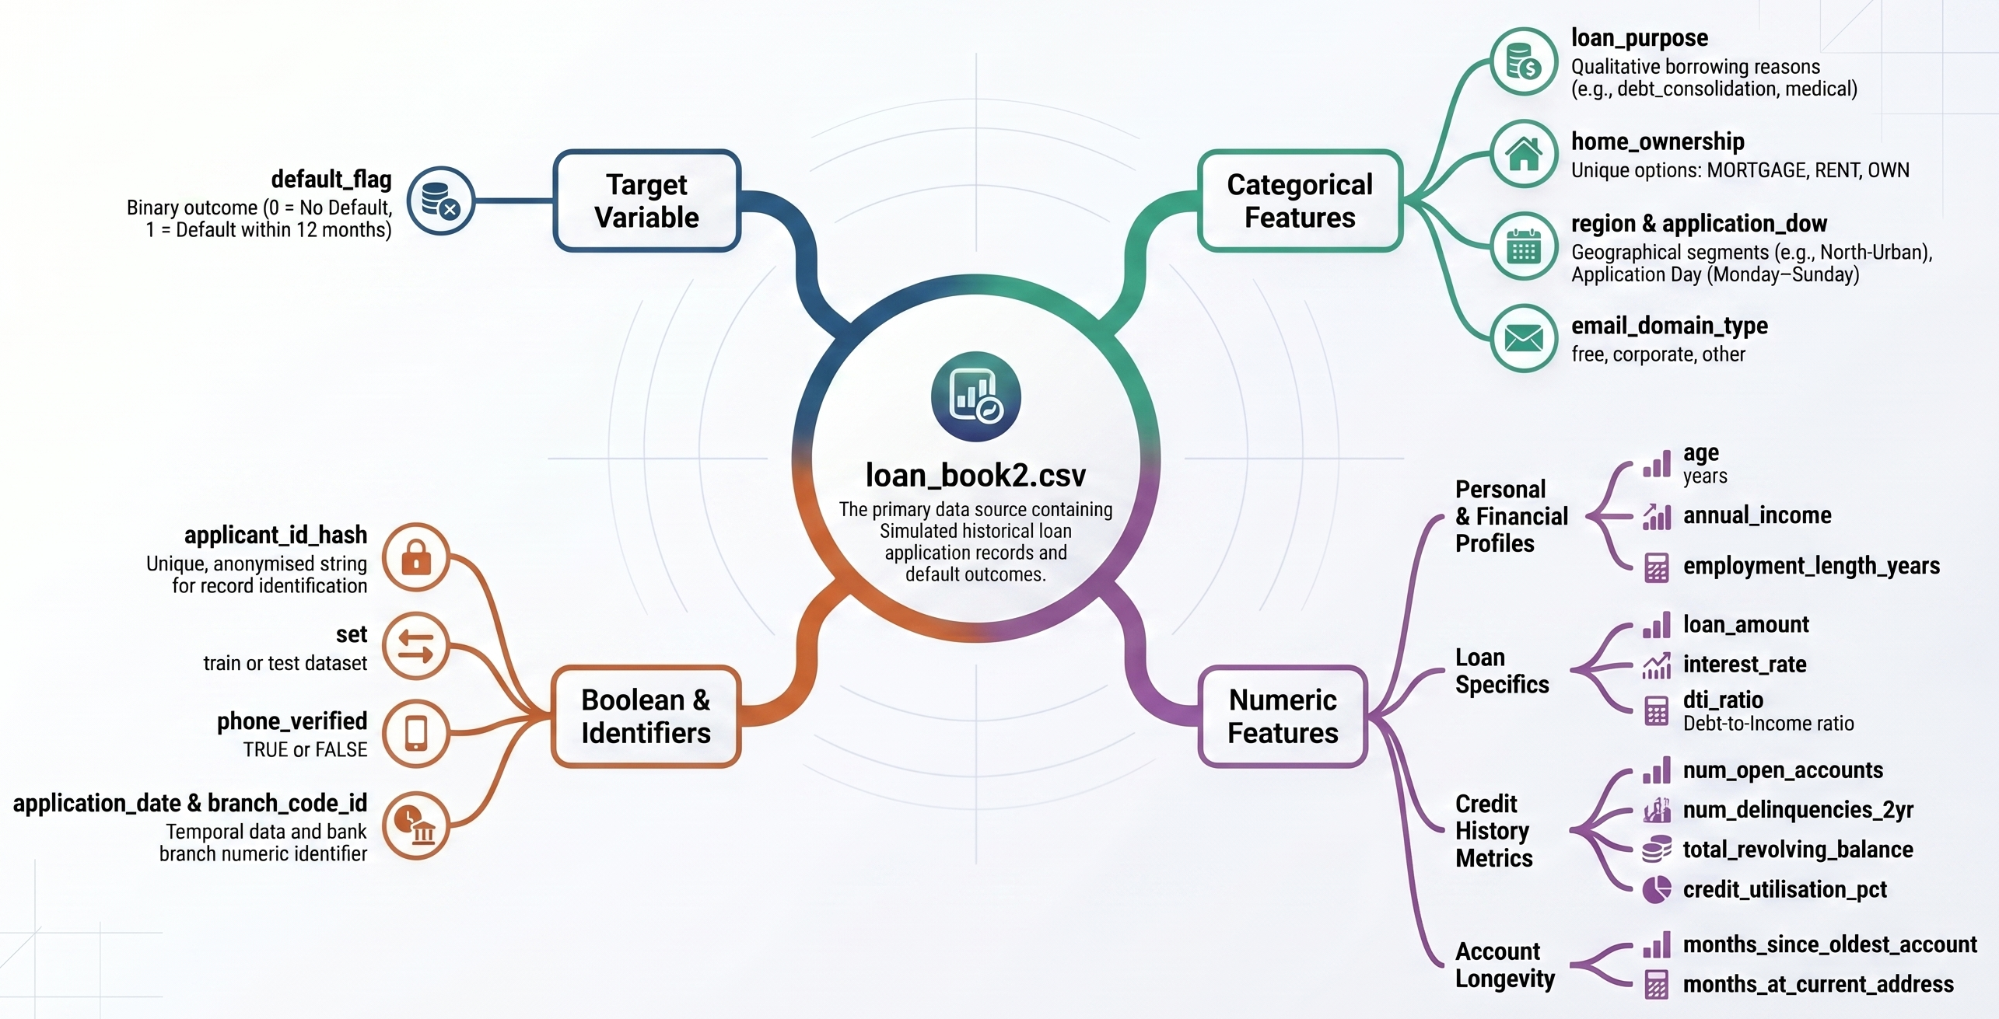
02 Constraints & Business Problem Framing
Constraints:
The solution must be interpretable, specifically logistic regression, so that risk managers, business stakeholders, and regulators can trust and understand the decisions.
🧩 Problem Statement
The challenge is to improve how a retail lending company evaluates loan applications.
key Questions to help understand the business problem better
How can we make better loan approval decisions?
How do we balance loan volume against portfolio risk?
What is the business cost of our prediction errors?
How do we maintain transparency and regulatory compliance?

Slide 6
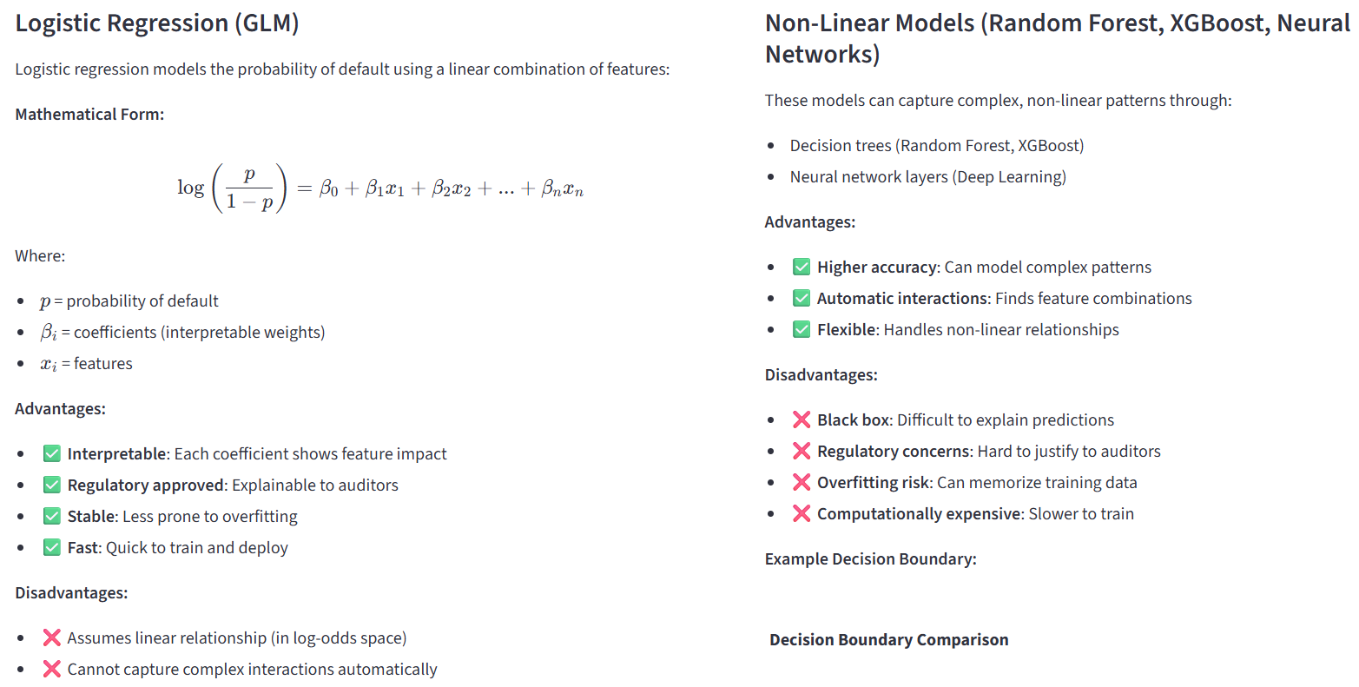
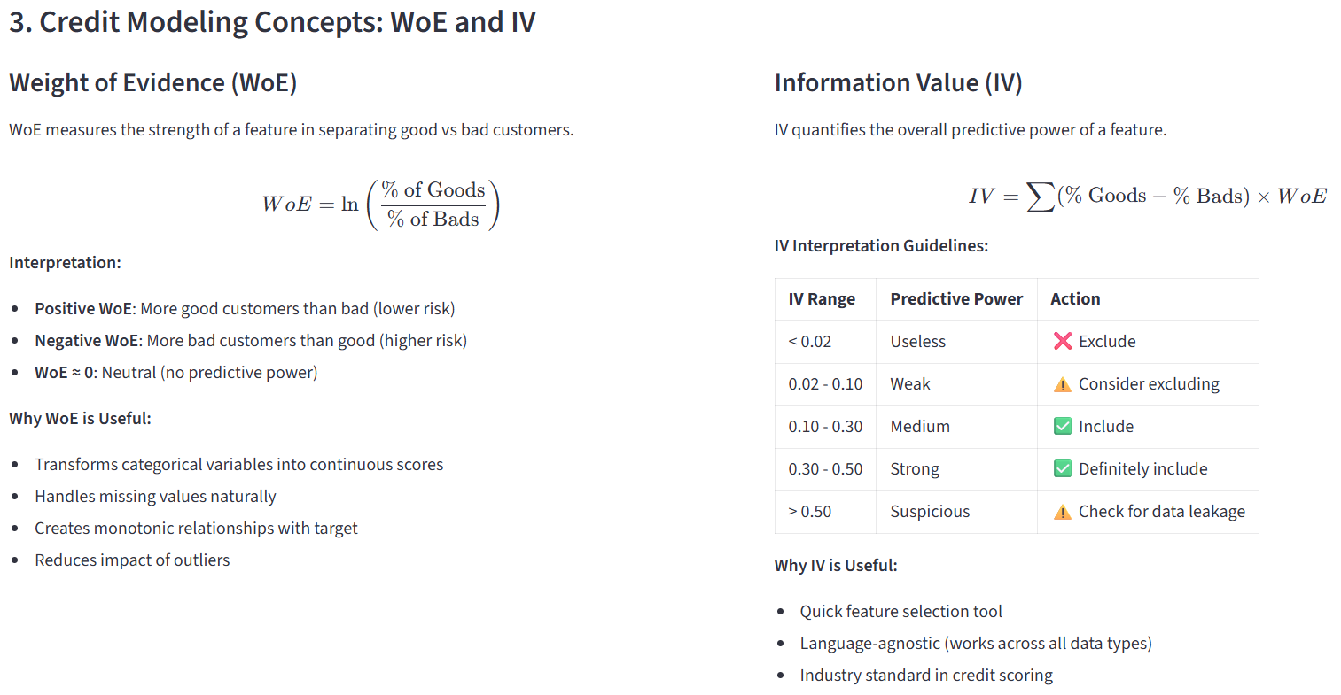
03 Key Research Concepts in Credit Modeling
Prohibited Features
Age
Region
Branch code
Success Metrics
Evaluate default risk using AUC, Gini, Precision, Recall, Accuracy and F1 score to ensure robust lending.

Slide 7
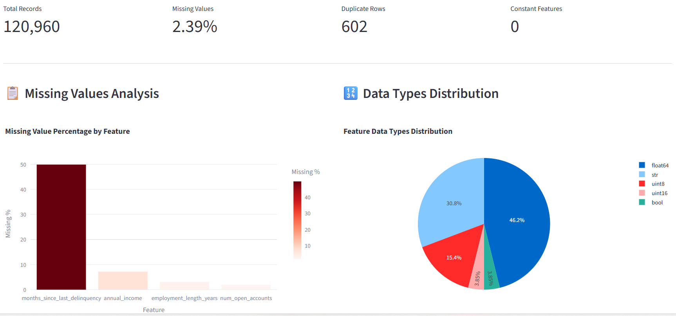
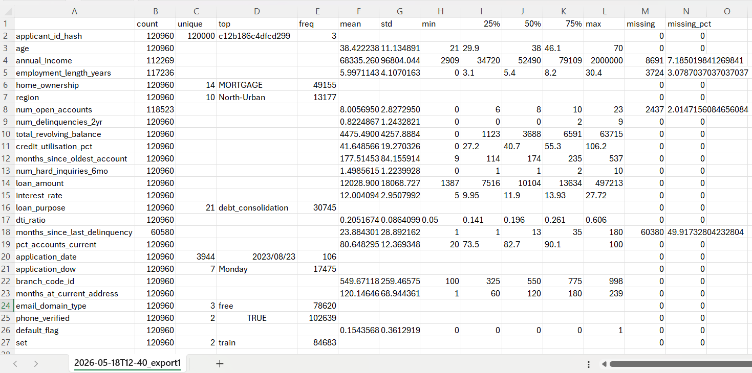
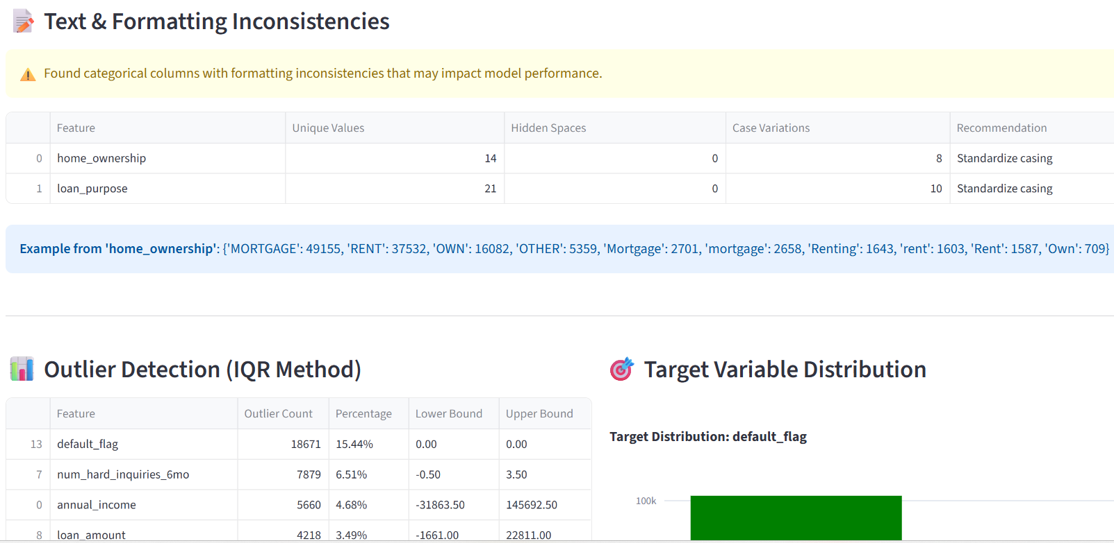
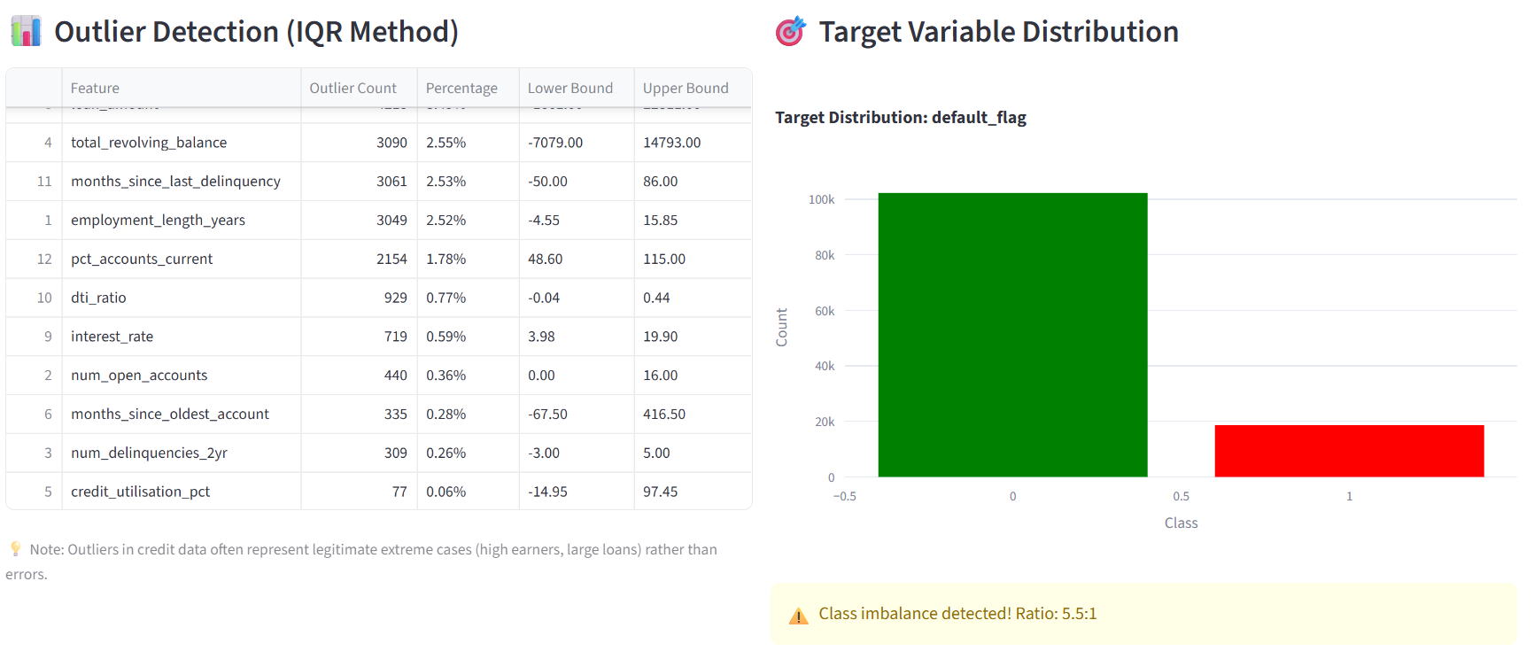
04 Exploratory Data Analysis Tool Design
Data Quality Reports
Summary Statistics

Slide 8
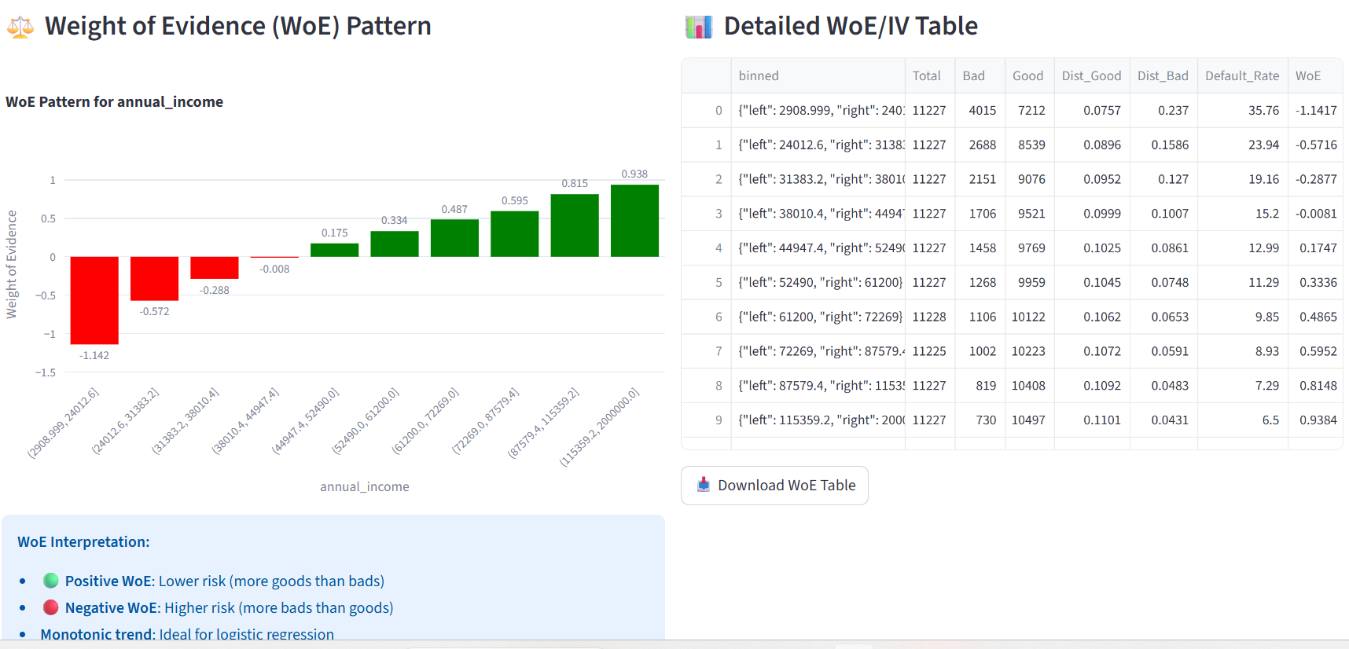
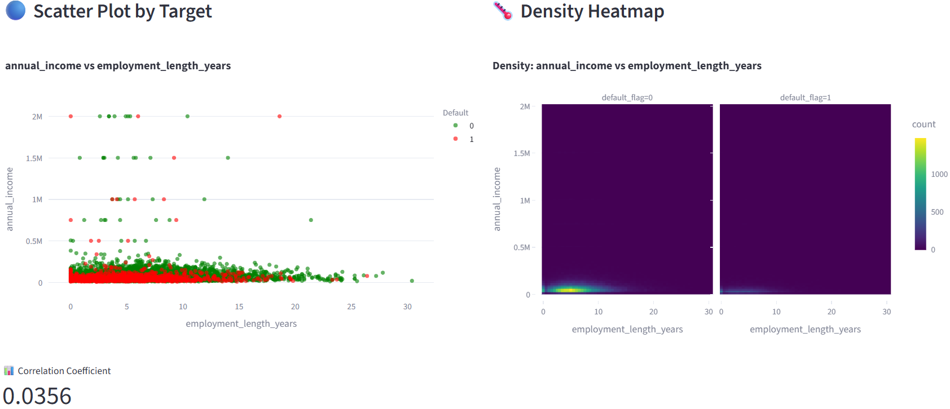
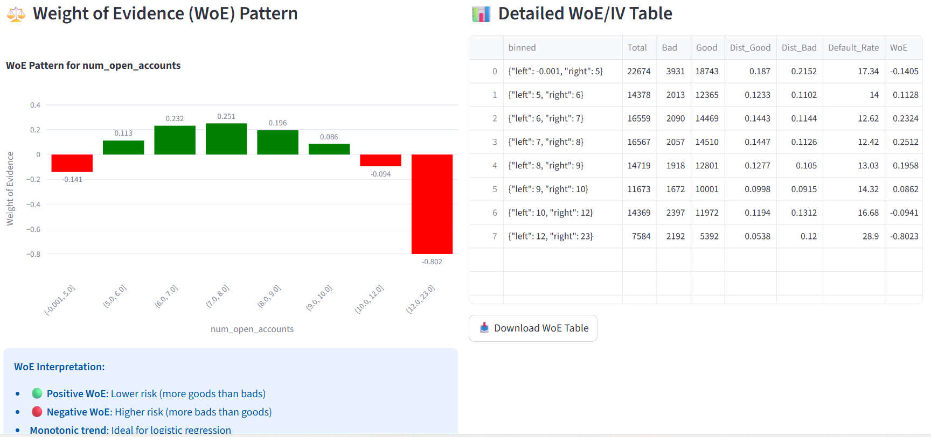
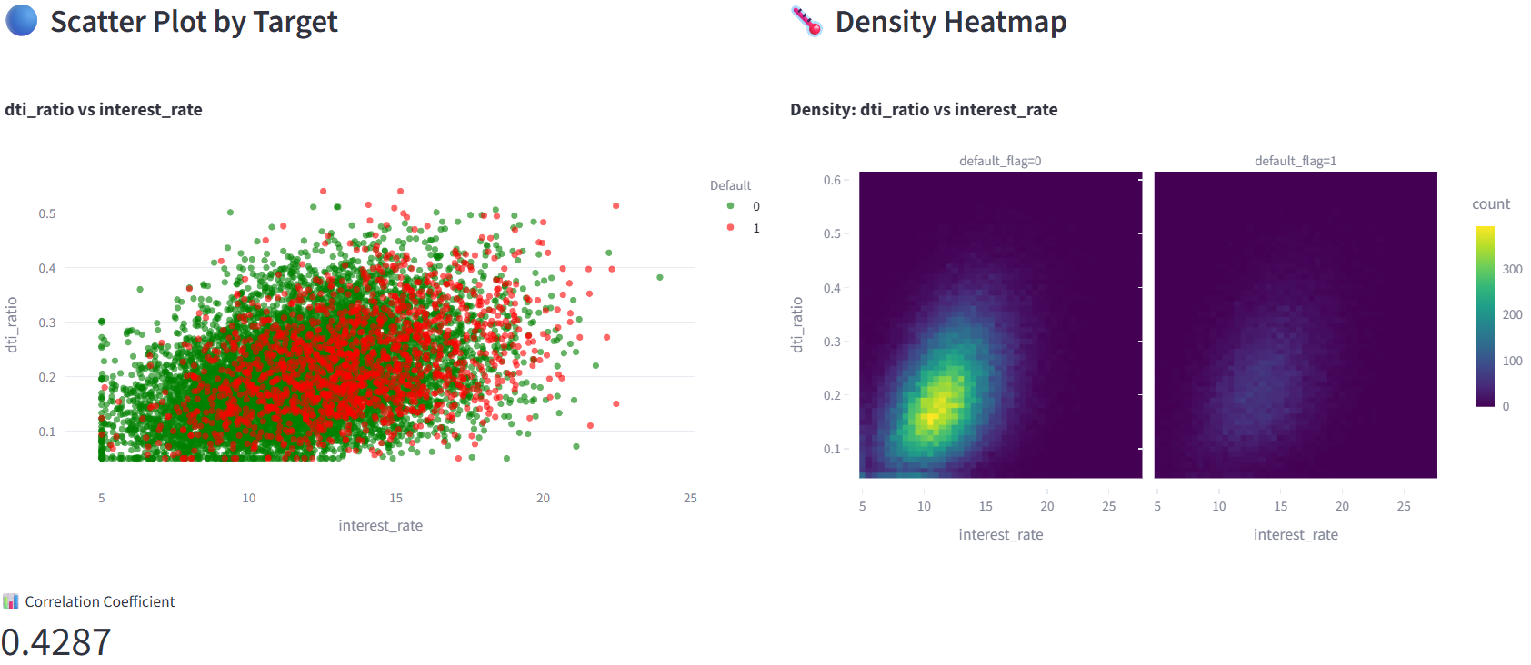
04 Exploratory Data Analysis Tool Design
Univariate Exploration WoE/IV:
2. Bivariate: Heatmaps & Interactions

Slide 9
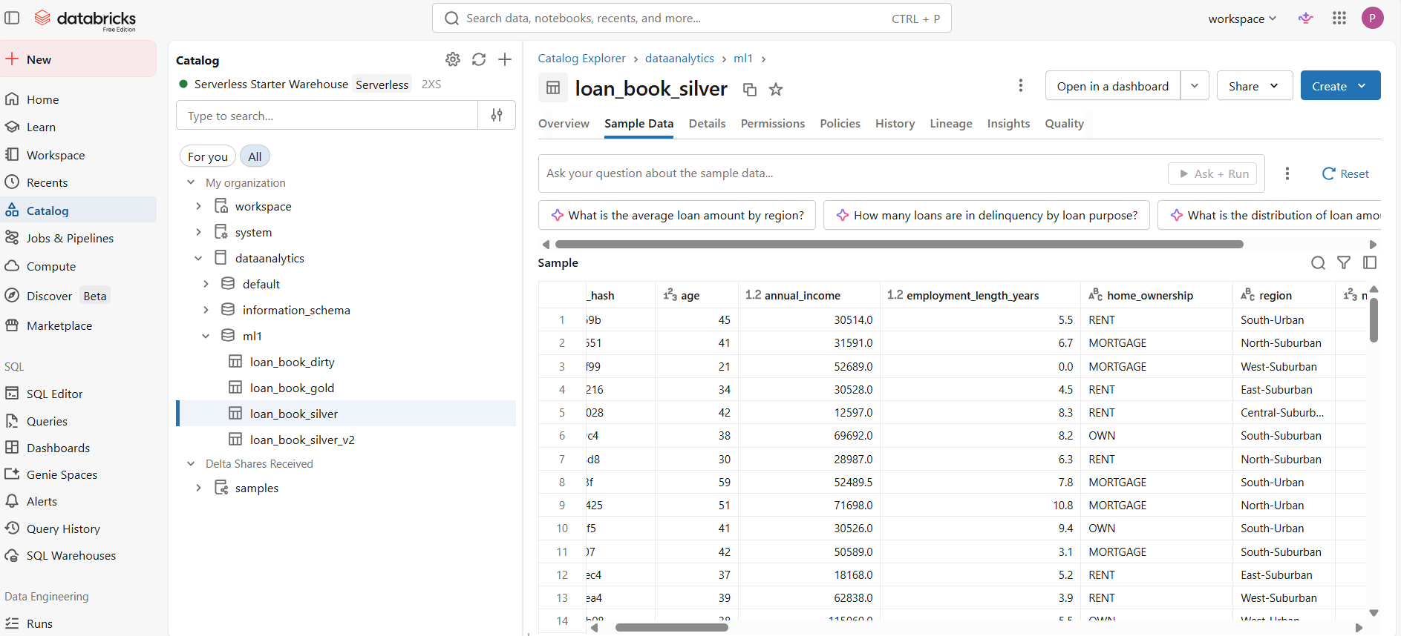
05 Data Preparation & Cleaning
🧩 Data Cleaning in Databricks platform
Fixed data issues:
Correcting wrong data types
Removed Duplicate rows
Standardising formats
fixing missing values
Handling outliers

Slide 10
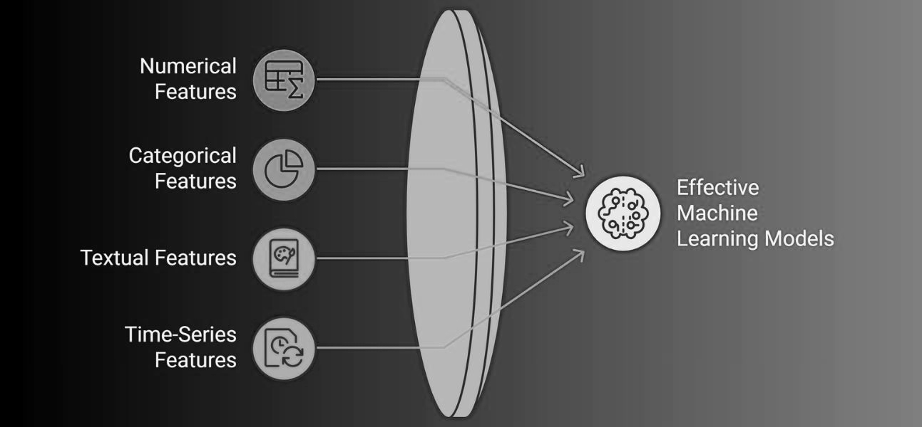
06 Data Preparation, Feature Engineering
4 New Features
Loan to income ratio
Debt servicing stress index
Delinquency concentration
High earner low stability flag
Feature selection
By dropping low predictors of credit risk features

Slide 11
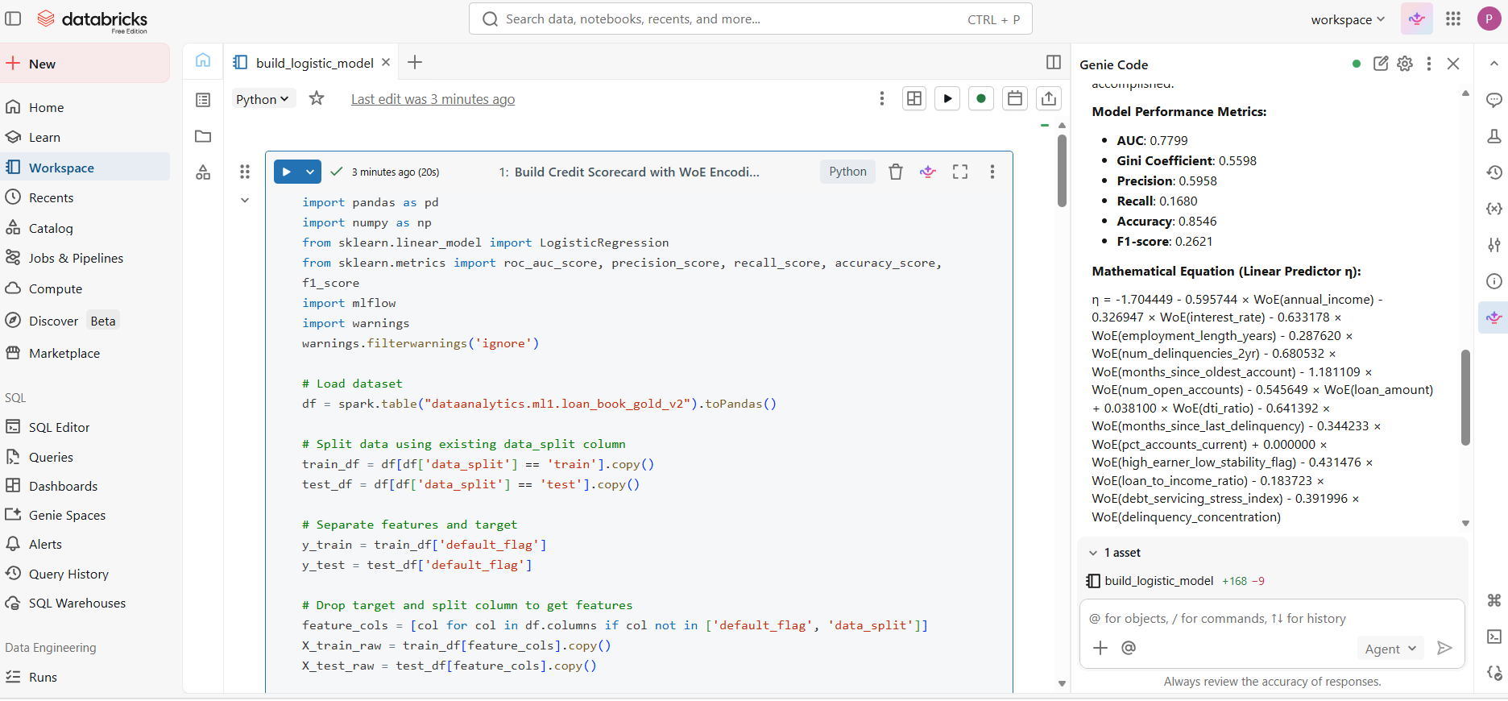
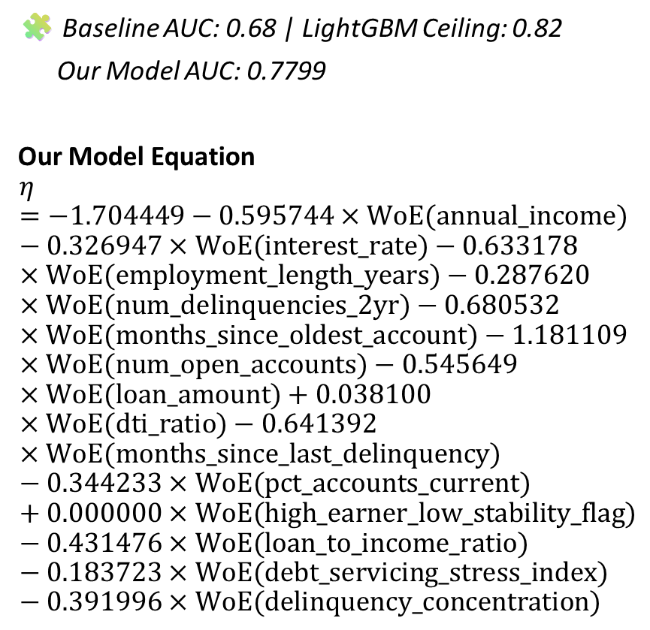
07 Build model: Results & performance metrics
Our Model Metrics:
AUC = 0.78; Gini = 0.56; Precision = 0.6
Recall = 0.17; Accuracy = 0.85; F1-score = 0,26
🧩 Baseline AUC: 0.68 | LightGBM Ceiling: 0.82
Our Model AUC: 0.7799
Our Model Equation
$$η=−1.704449−0.595744×\text{WoE}\text{(}\text{annual}\text{_}\text{income}\text{)}−0.326947×\text{WoE}\text{(}\text{interest}\text{_}\text{rate}\text{)}−0.633178×\text{WoE}\text{(}\text{employment}\text{_}\text{length}\text{_}\text{years}\text{)}−0.287620×\text{WoE}\text{(}\text{num}\text{_}\text{delinquencies}\text{_}\text{2}\text{yr}\text{)}−0.680532×\text{WoE}\text{(}\text{months}\text{_}\text{since}\text{_}\text{oldest}\text{_}\text{account}\text{)}−1.181109×\text{WoE}\text{(}\text{num}\text{_}\text{open}\text{_}\text{accounts}\text{)}−0.545649×\text{WoE}\text{(}\text{loan}\text{_}\text{amount}\text{)}+0.038100×\text{WoE}\text{(}\text{dti}\text{_}\text{ratio}\text{)}−0.641392×\text{WoE}\text{(}\text{months}\text{_}\text{since}\text{_}\text{last}\text{_}\text{delinquency}\text{)}−0.344233×\text{WoE}\text{(}\text{pct}\text{_}\text{accounts}\text{_}\text{current}\text{)}+0.000000×\text{WoE}\text{(}\text{high}\text{_}\text{earner}\text{_}\text{low}\text{_}\text{stability}\text{_}\text{flag}\text{)}−0.431476×\text{WoE}\text{(}\text{loan}\text{_}\text{to}\text{_}\text{income}\text{_}\text{ratio}\text{)}−0.183723×\text{WoE}\text{(}\text{debt}\text{_}\text{servicing}\text{_}\text{stress}\text{_}\text{index}\text{)}−0.391996×\text{WoE}\text{(}\text{delinquency}\text{_}\text{concentration}\text{)}$$

Slide 12
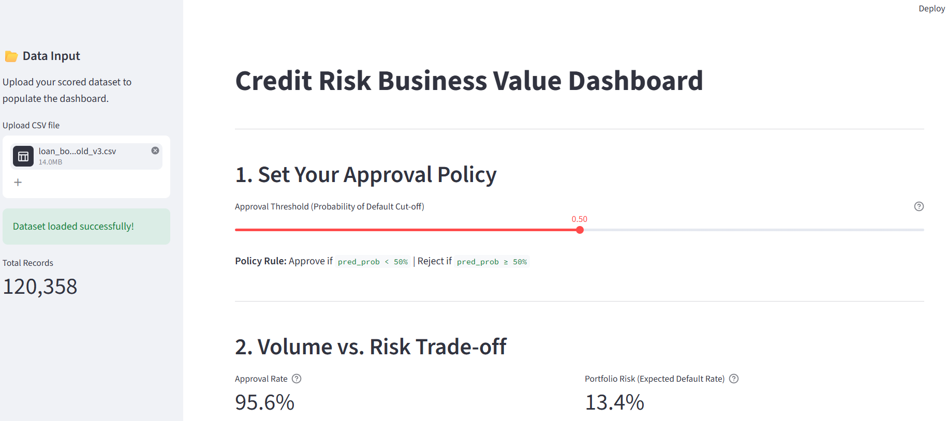
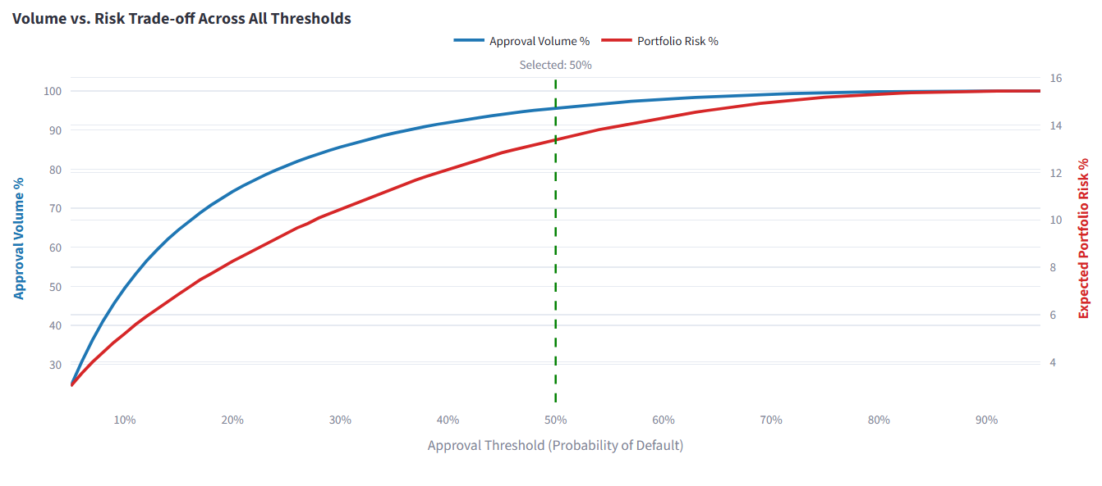
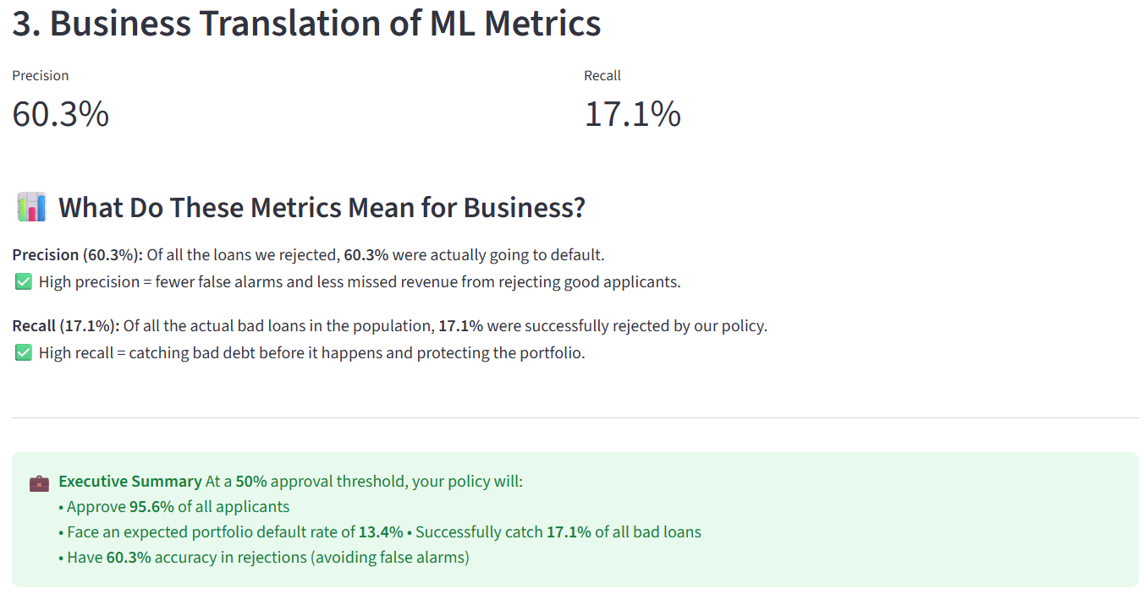
08 Business Value and Decision Dashboard
Business problem our Low Recall model’s value
at the default 50% threshold, the model only catches 17.1% of bad loans (Recall)
the dashboard solves this by allowing the business to lower the threshold, trade off some volume, and catch more bad debt

Slide 13
09 AI Usage Reflection
AI Usage
Prompted AI to build the interactive Streamlit EDA tool and calculate WoE bins.
Prompted AI to clean my loan book dataset
Prompted AI to build logistic model
Prompted AI to build the business dashboard
AI REFLECTION
Rejected AI's advice to use StandardScaler on numeric variables, as we knew this would destroy the regulatory interpretability of our logistic regression coefficients.

Slide 14

Thank you
Phumlani Mnguni
+27 63 6259 456
phumlanimnguni6@gmail.com

