Slide 1
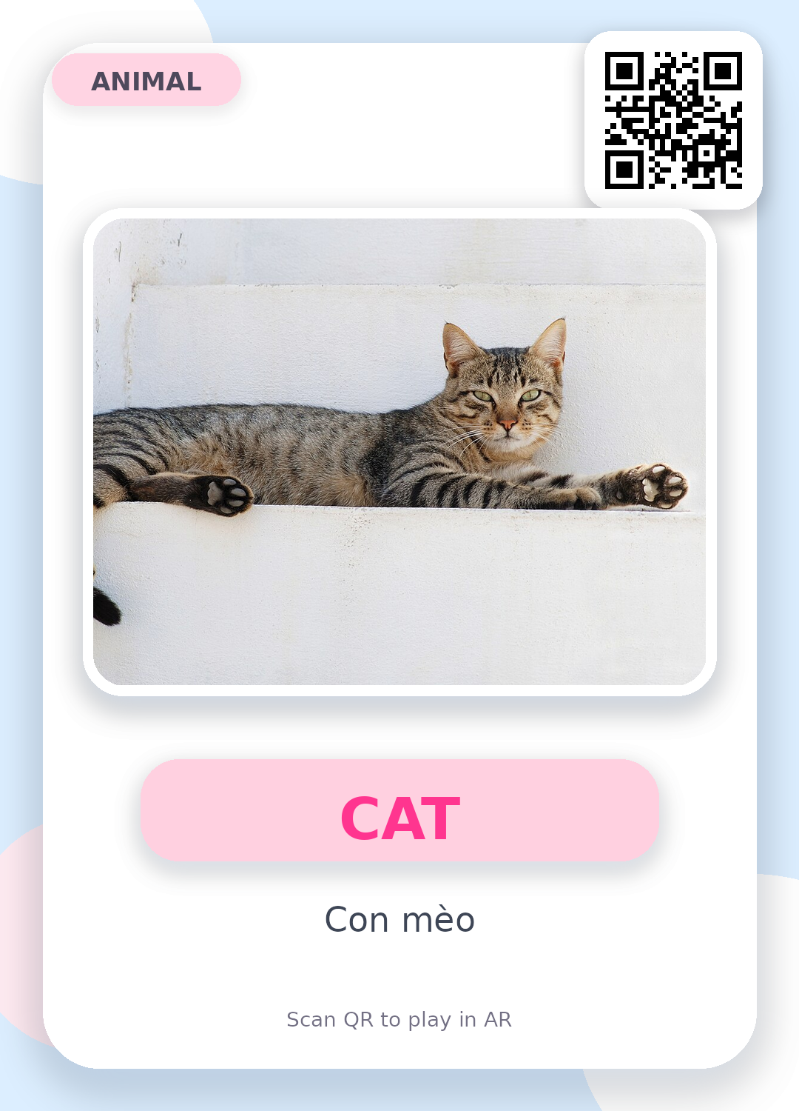
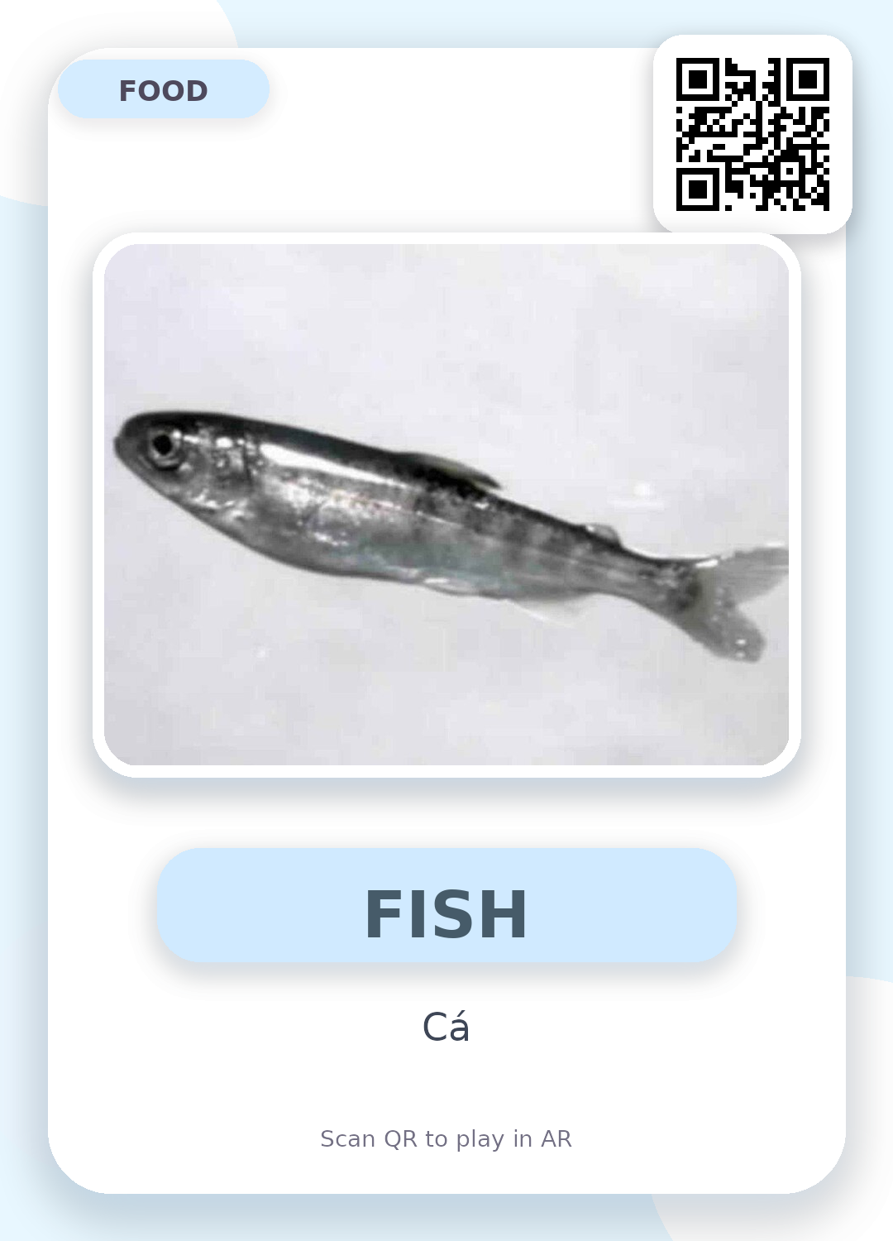
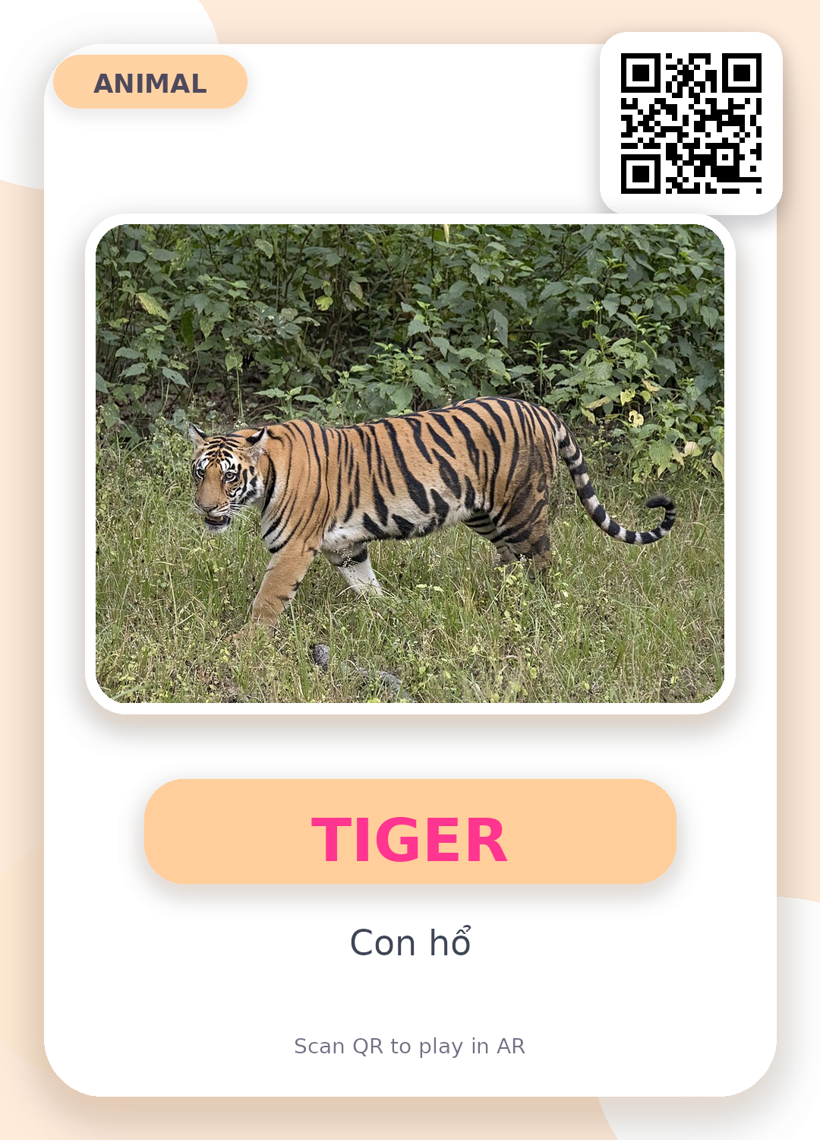
AR Animal Flashcards
10 flashcards • animal + food pairing • QR text payloads
Claymorphic pastel style for kids
Notes:
Overview slide. Cards in the deck include QR codes that encode the text payloads; the payload text is not printed on the flashcard artwork.

Slide 2
CAT + FISH
The cat eats fish.
Mã flashcard: cat001 + fish001
Notes:
QR text payloads for this slide: - cat001 - fish001 Interaction sentence: The cat eats fish.

Slide 3
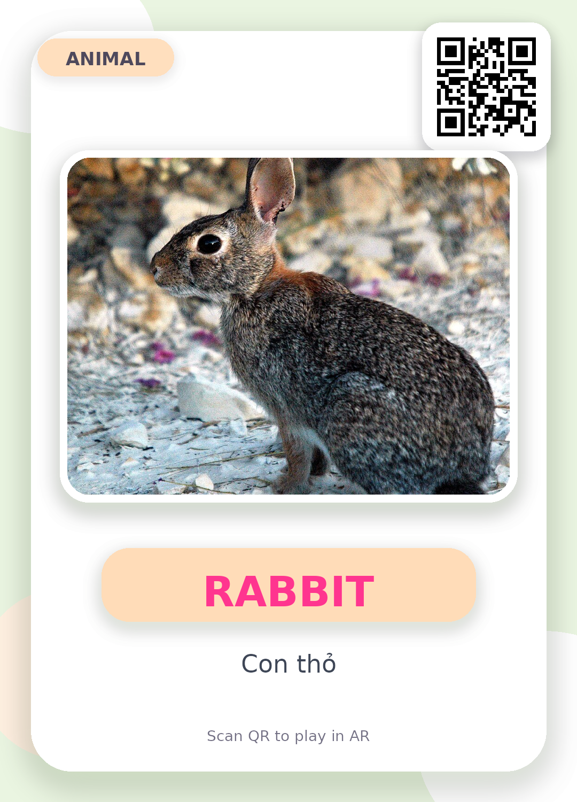
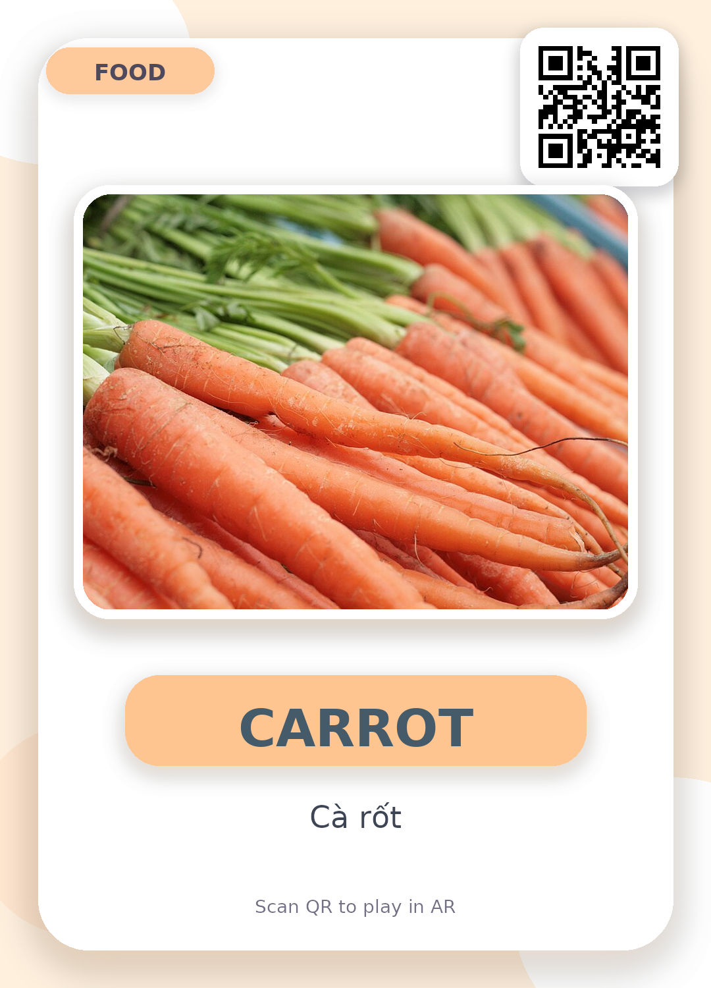
RABBIT + CARROT
The rabbit eats a carrot.
Mã flashcard: rabbit001 + carrot001
Notes:
QR text payloads for this slide: - rabbit001 - carrot001 Interaction sentence: The rabbit eats a carrot.

Slide 4
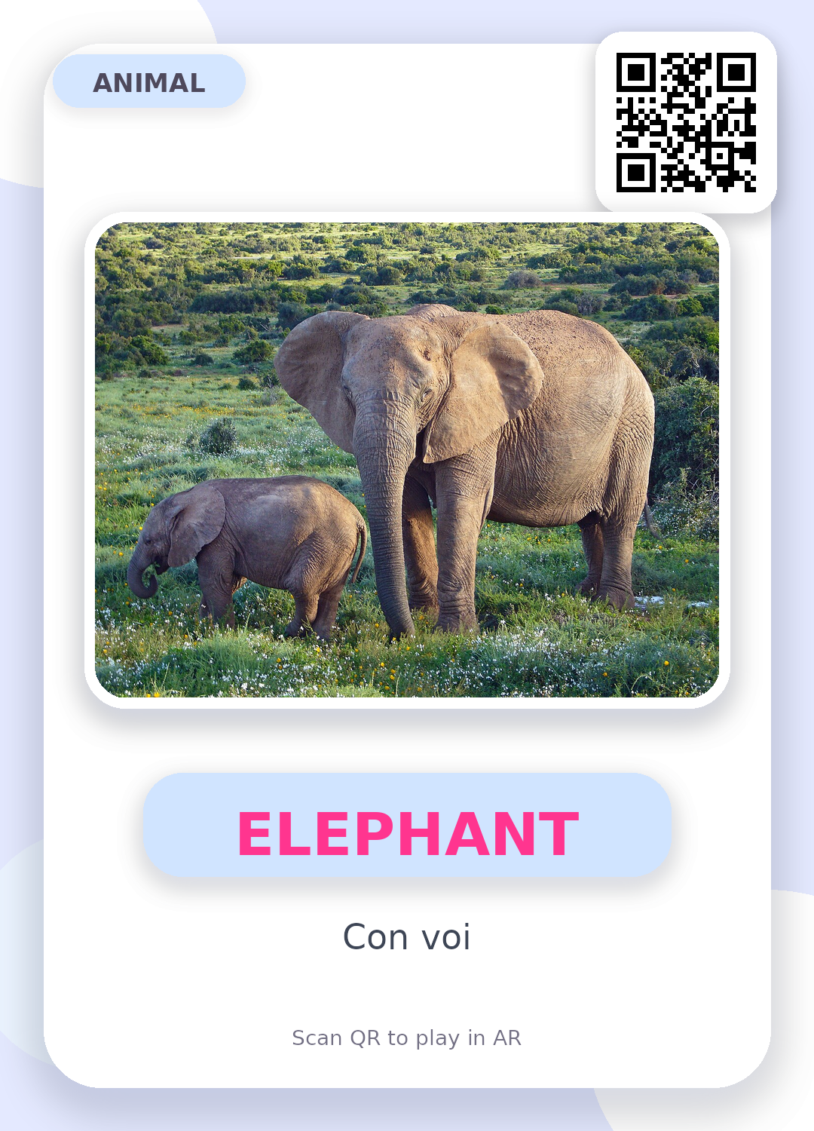
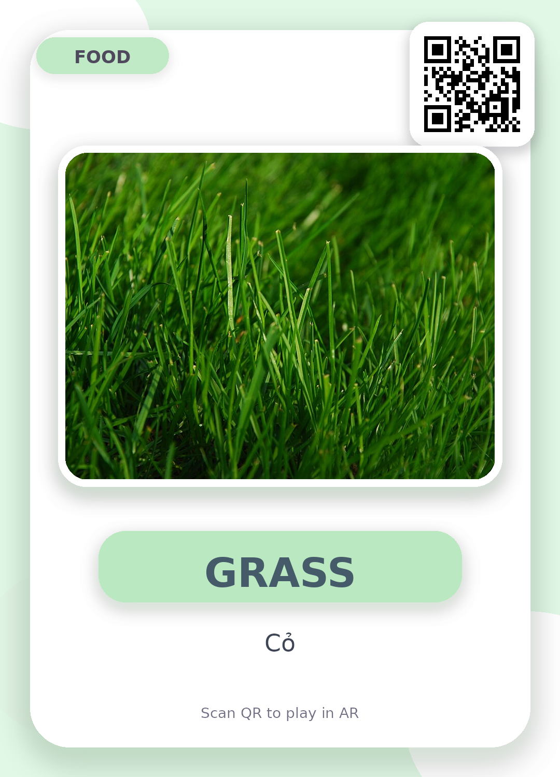
ELEPHANT + GRASS
The elephant eats grass.
Mã flashcard: elephant001 + grass001
Notes:
QR text payloads for this slide: - elephant001 - grass001 Interaction sentence: The elephant eats grass.

Slide 5
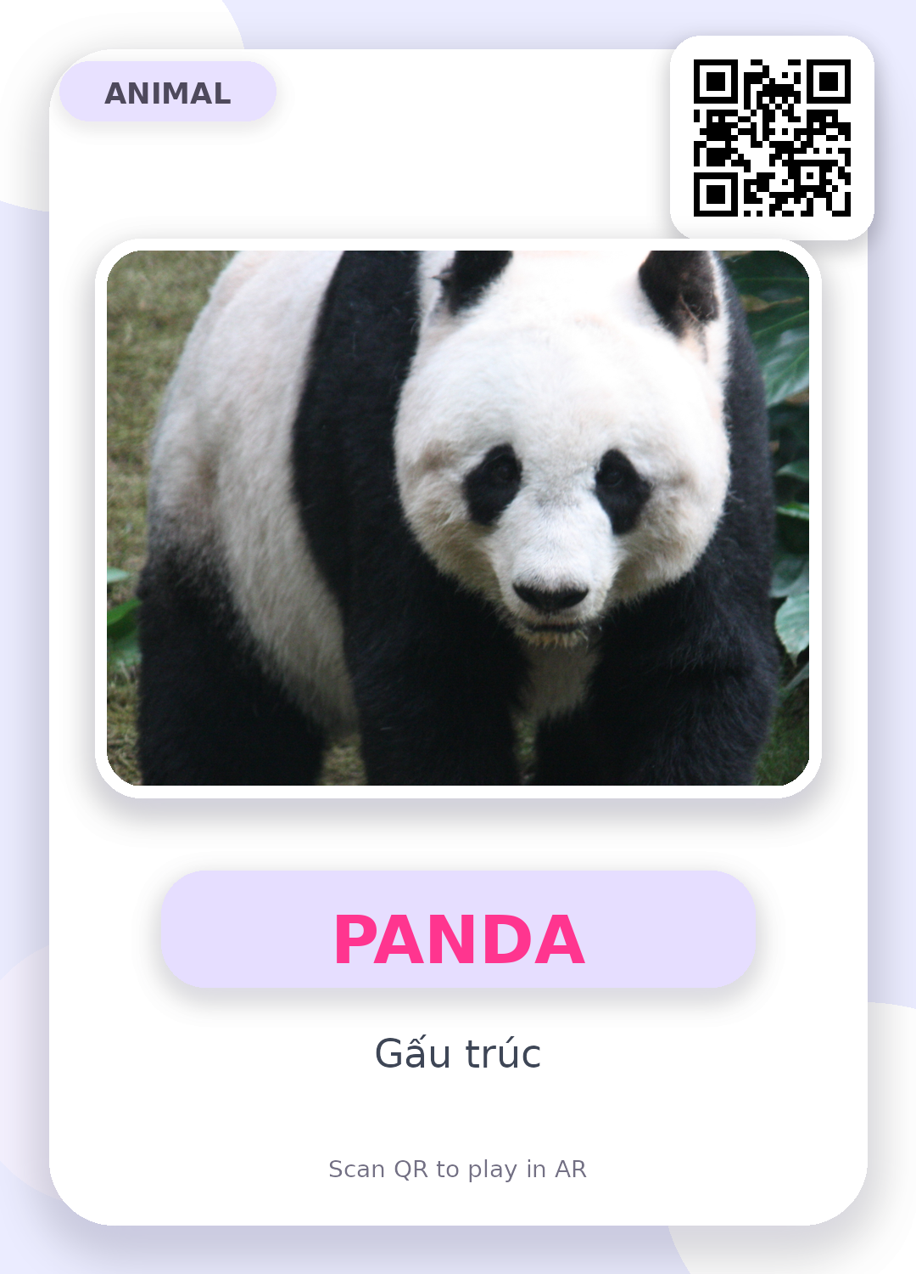
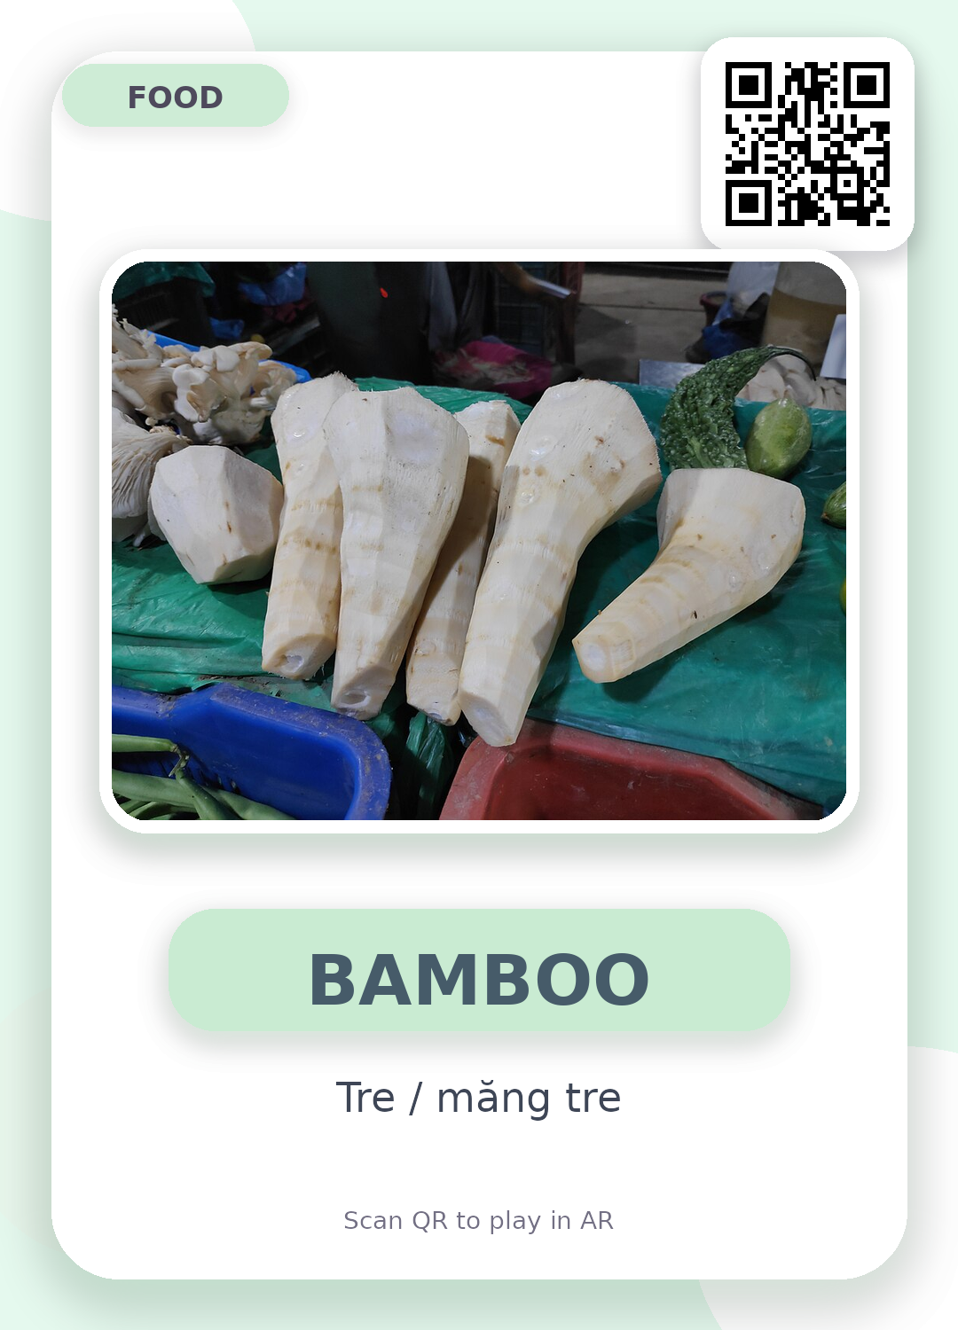
PANDA + BAMBOO
The panda eats bamboo.
Mã flashcard: panda001 + bamboo001
Notes:
QR text payloads for this slide: - panda001 - bamboo001 Interaction sentence: The panda eats bamboo.

Slide 6
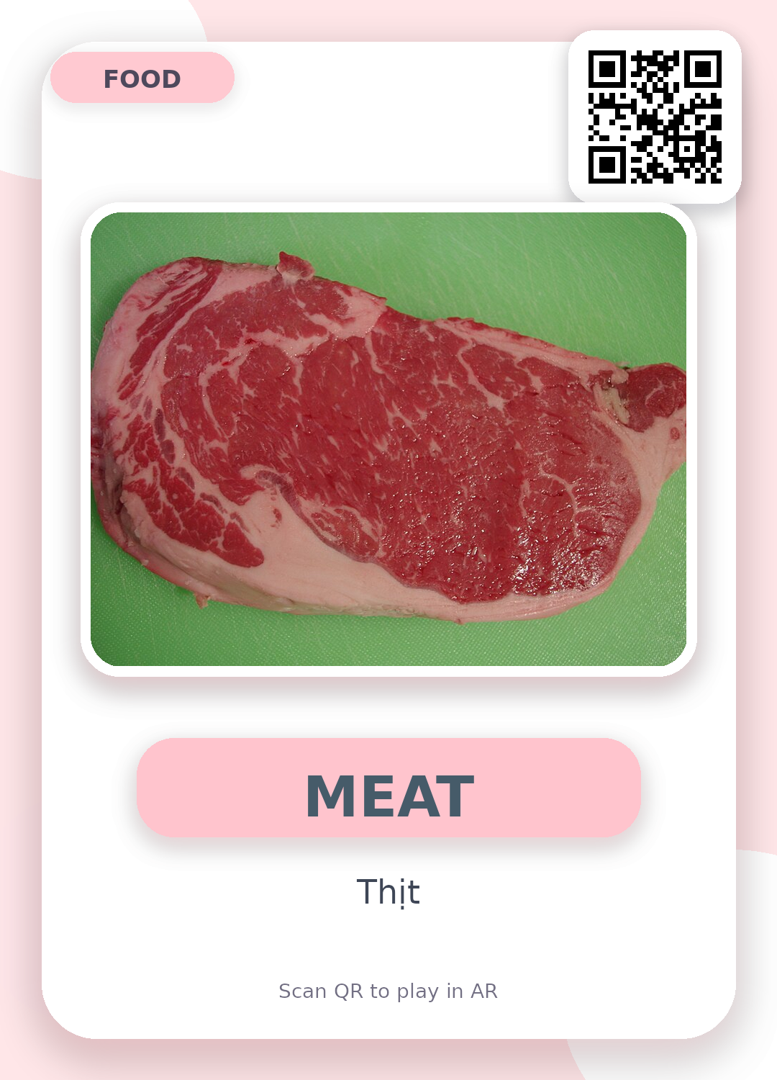
TIGER + MEAT
The tiger eats meat.
Mã flashcard: tiger001 + meat001
Notes:
QR text payloads for this slide: - tiger001 - meat001 Interaction sentence: The tiger eats meat.

Slide 7
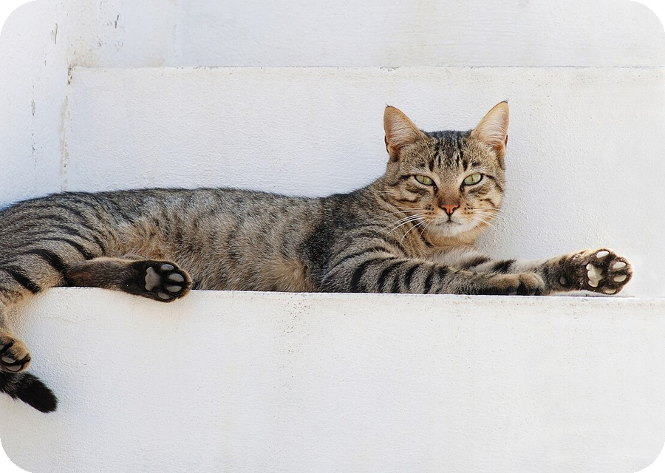
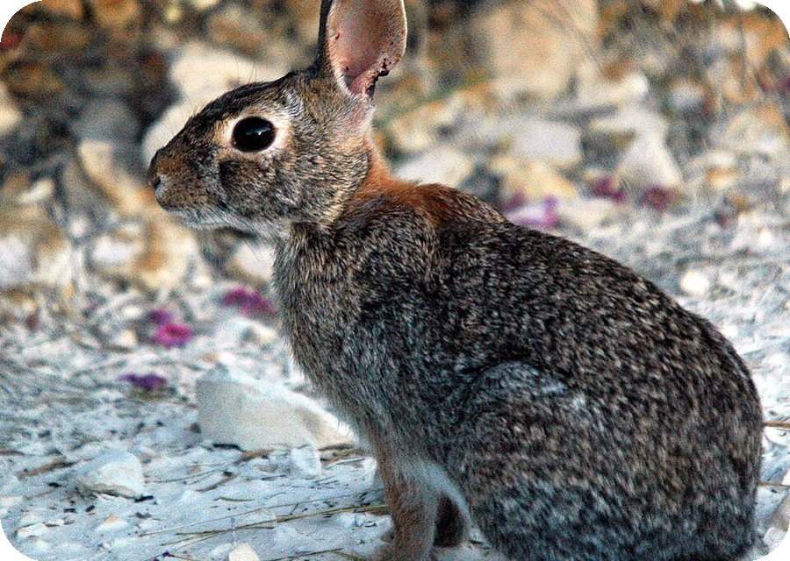
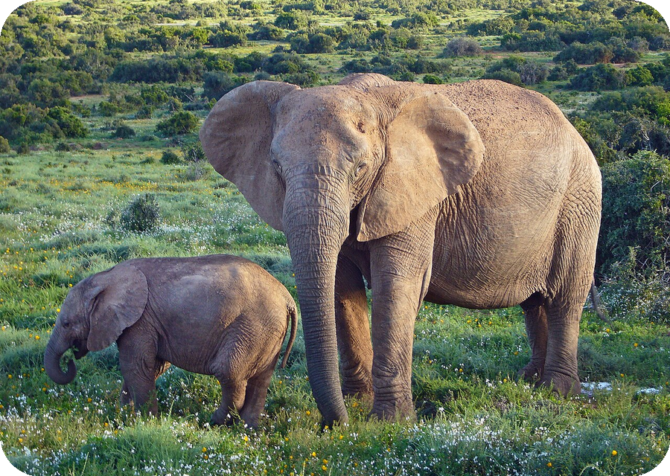
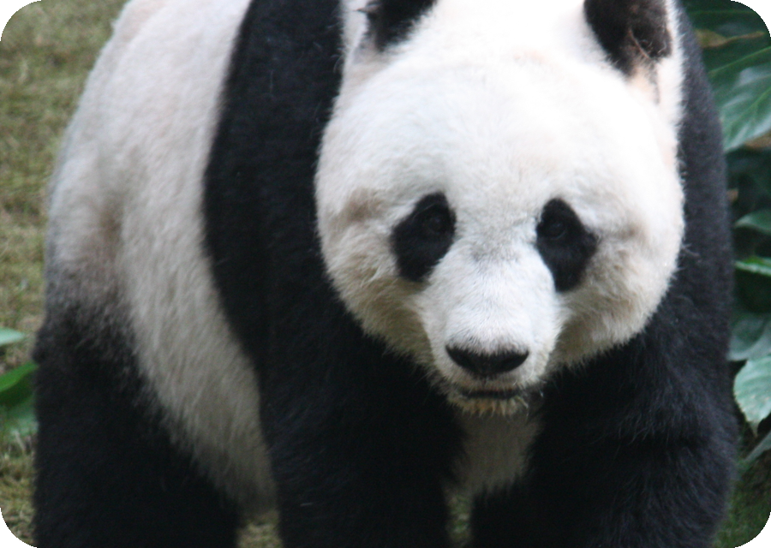
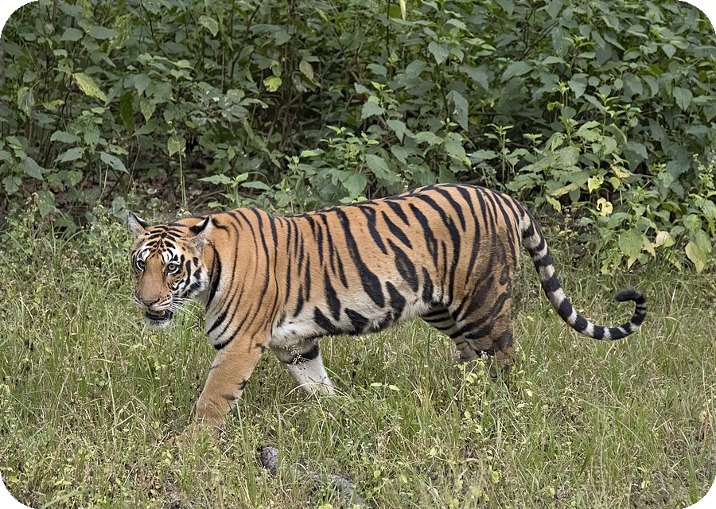
PNG animal assets used
Các ảnh động vật đã được dùng để tạo flashcard
CAT
RABBIT
ELEPHANT
PANDA
TIGER
cat001
rabbit001
elephant001
panda001
tiger001
Server map được gửi riêng trong file TXT kèm theo.
Notes:
This slide contains PNG versions of the animal images used in the flashcards: cat001, rabbit001, elephant001, panda001, tiger001.

