Slide 1
ASSET MANAGEMENT SYSTEM
Lecturer
Le Thanh Trong

Slide 2
ABOUT US
Group 15
Phung Thanh Tu – 19522455
Le Thanh Tuan – 19522467
Pham Hieu Vy – 19520358

Slide 3
TABLE OF CONTENTS
01
02
03
04
05
06
Project Statement
Requirement analysis
Project Overview
Purpose, target customer, document update history
Functional, non- functional, use case diagram
Overview structure and specification
Database and backend
Frontend Design
Summary
ERD, web server design
Class diagram, User Interface design, and sequence diagram
Install and demo, task assignment, Update plan in future

Slide 4
01
Project Statement

Slide 5
Project Statement
To re-evaluate the quality of each type of equipment so as to have an appropriate equipment distribution plan
1. Purpose of the system
- Kindergartens, primary, high schools and universities in the country.
- Kindergarten, primary and high schools abroad.
2. Description of users/forms and related entities

Slide 6
3. Description of processes (business operations)
Milestones Date | Milestones Date
Build project idea | 25/09/2021
Analyze national and international schools | 01/10/2021
Complete the development of the project's approach and charter | 18/10/2021
Complete database design | 03/11/2021
Complete interface design | 05/11/2021
Complete database construction | 10/11/2021
Complete interface construction, connect database | 12/12/2021
Software testing | 3/1/2021
Software release | 8/1/2021

Slide 7
02
Requirement analysis

Slide 8
REQUIREMENTS
functional
non-functional
- List of devices is managed by each unit.
- Equipment repair situation of all units in a certain period of time, repair costs.
- Asset inventory of each unit (qualification sheet for each device).
- List of equipment to be liquidated according to a certain decision or to a certain year.
- Information about equipment in a certain economic contract.
- Status of devices.
- Statistics of the number of assets by group of the whole school, the increase or decrease in the number of devices over a certain period of time.
- List assets subject to liquidation (remaining use value is less than 50%).
- Software must be released on October 3, 2021 by the customers’ requirements and sent to them for checking.
- Edit, supplement and complete customer requirements after submitting the demo. Release the official version on February 3, 2022.
- All security services must be carefully guaranteed.
- The system needs to be deployed in the corporate intranet.
- User Interface must meet expectation about UI Design (5 principle)

Slide 9
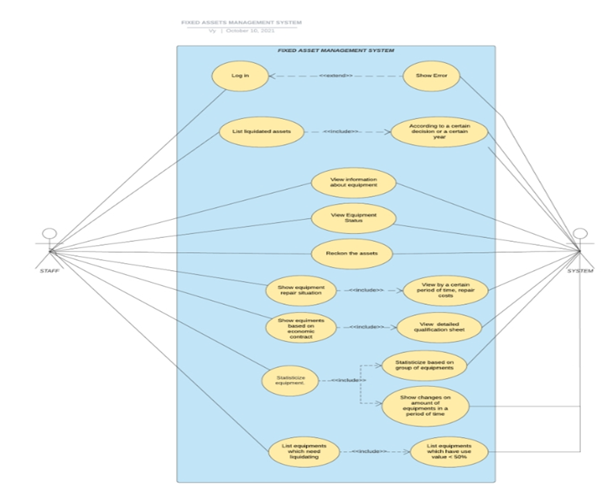
Use-case diagram

Slide 10
03
Project Overview

Slide 11
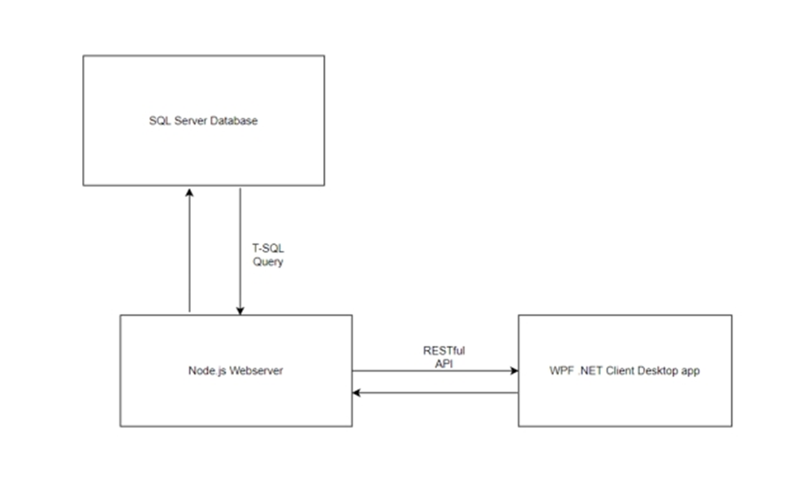
Overview
This system consist of 3 parts:
- The SQL Server Database
- The Node.js Webserver
- The WPF.NET Desktop App

Slide 12
04
Database and backend

Slide 13
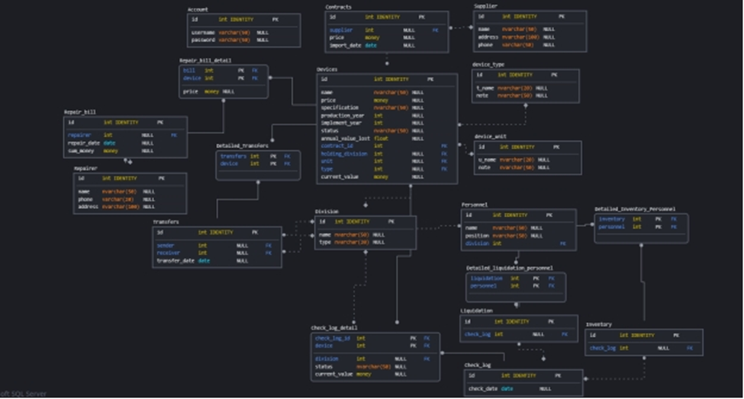
ERD

Slide 14
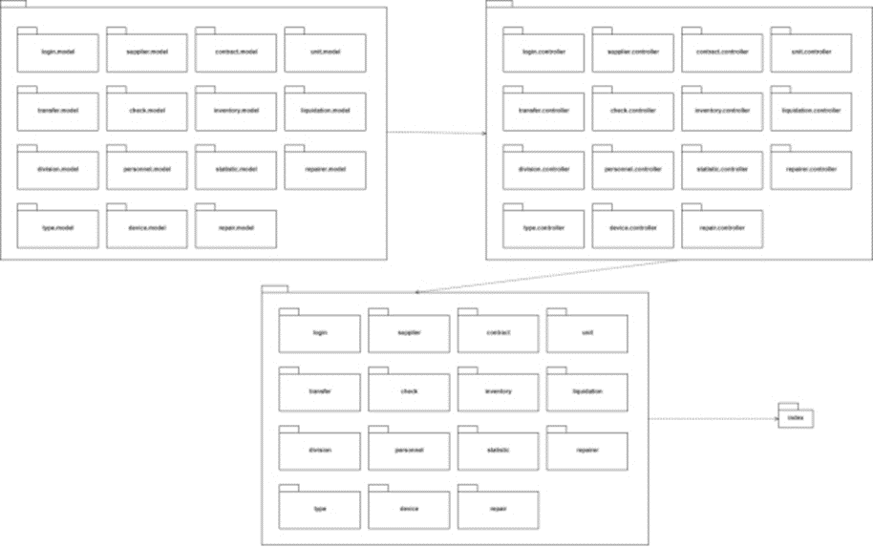
Webserver package
diagram

Slide 15
05
Frontend Design

Slide 16
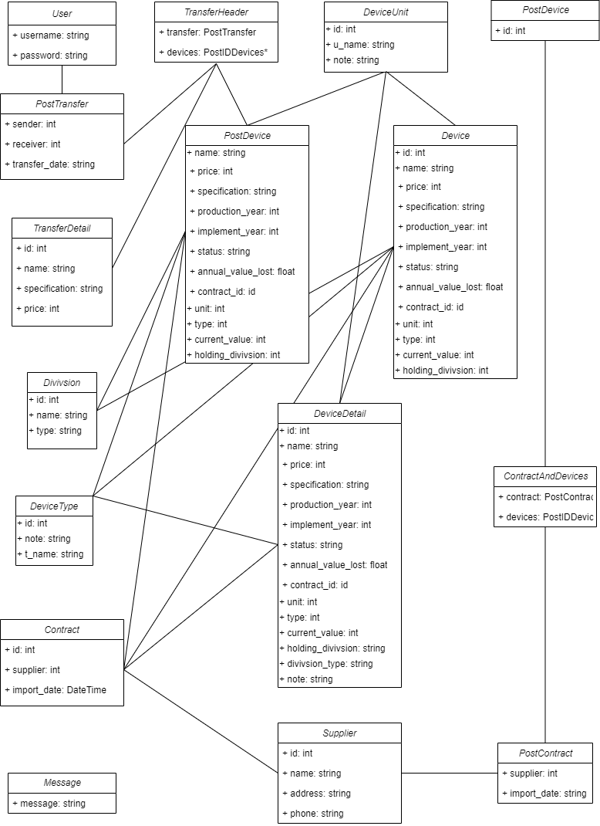
Class Diagram
1. Data

Slide 17
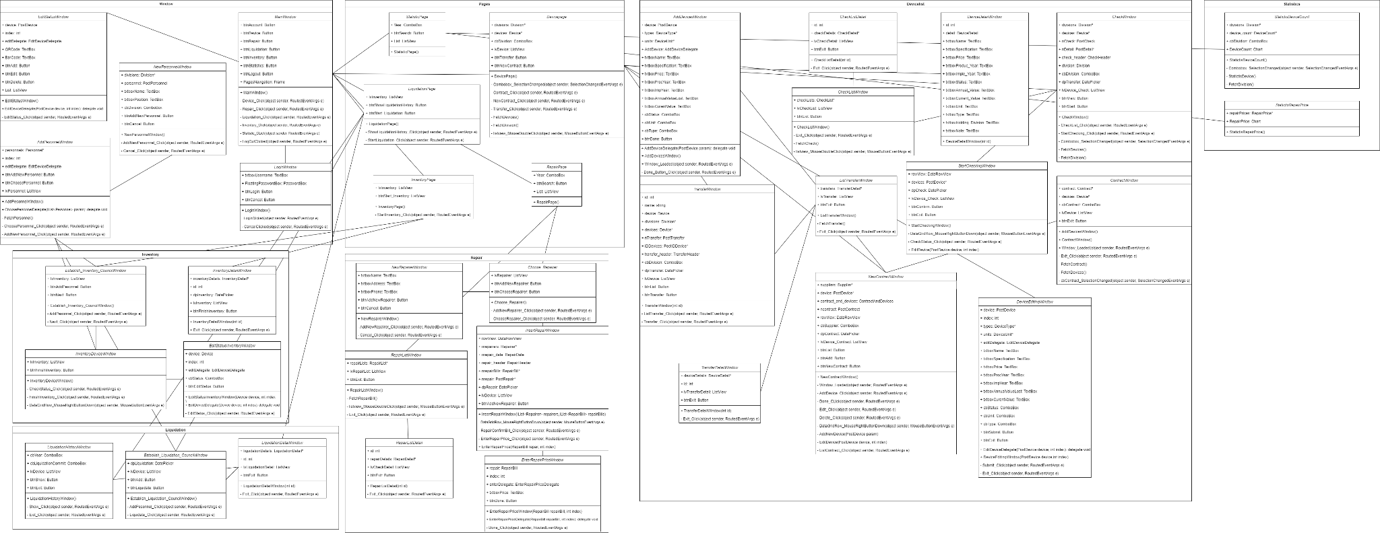
Class Diagram
2. WPF Client

Slide 18
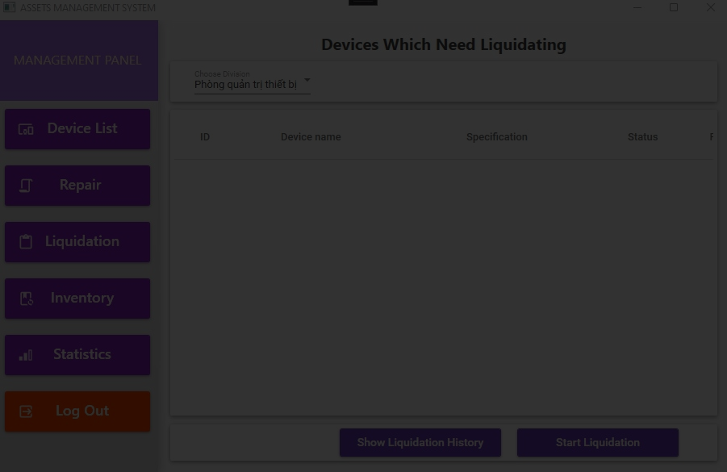
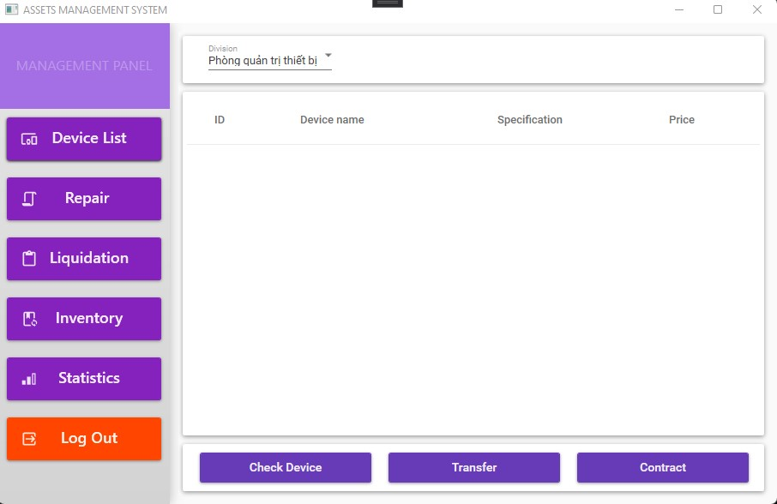
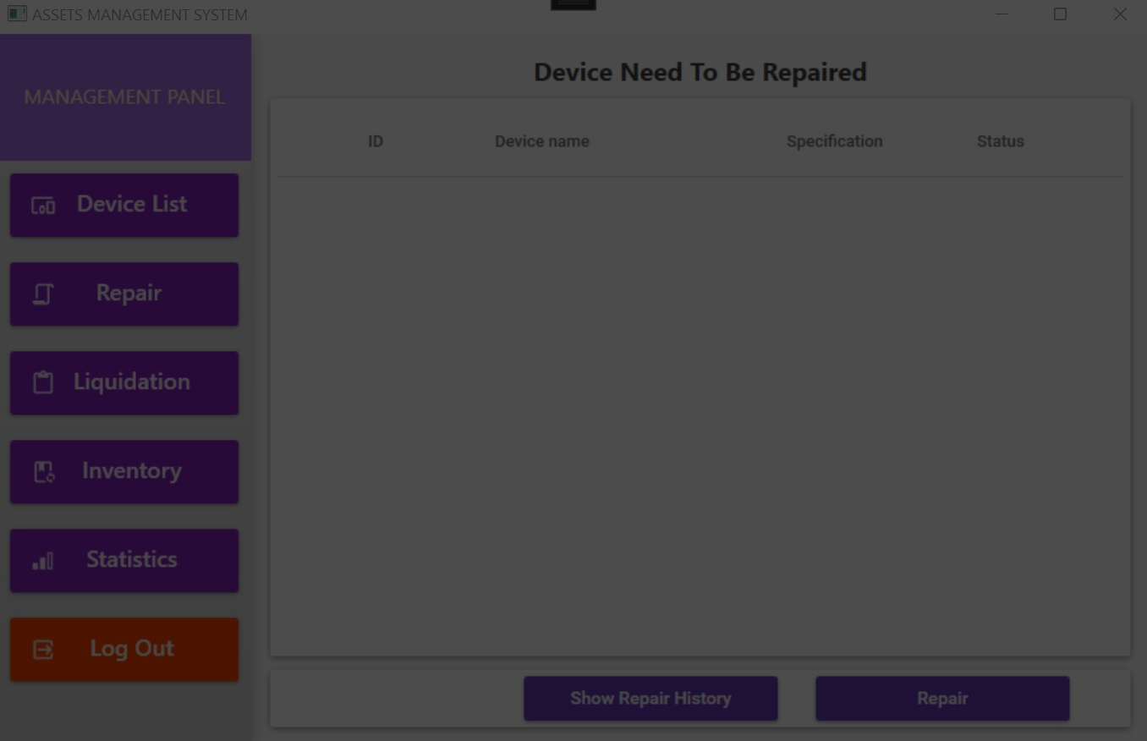
USER INTERFACE DESIGN
DEVICE PAGE

Slide 19
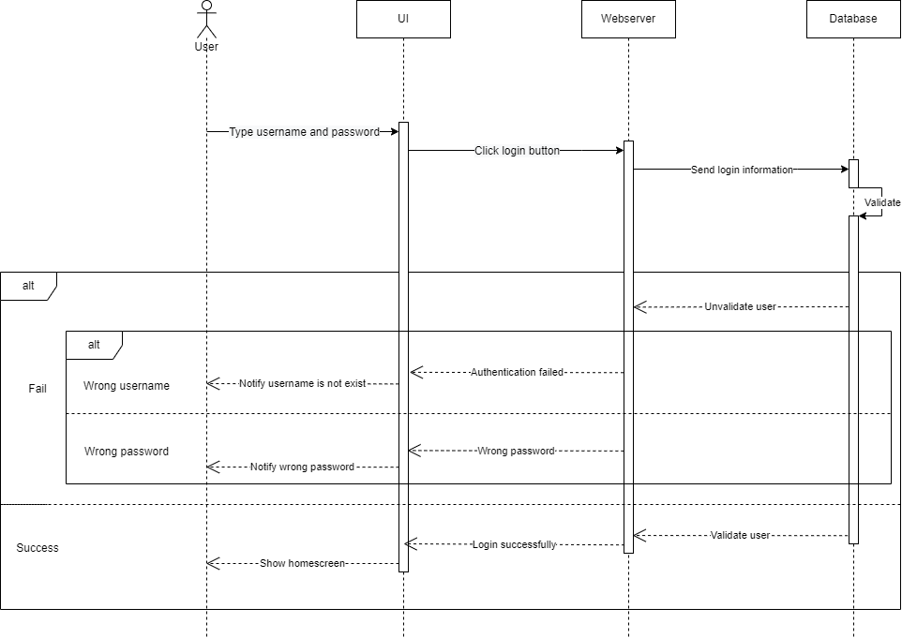
SEQUENCE DIAGRAM
LOG IN

Slide 20
06
Summary

Slide 21
INSTALLATION
System Requirement
How to Install
- .NET Framework v5.0
- Window 7/10/11 64 bit
- At least 1GB or RAM, 5GB of memory
- Internet connection
- Download Installer in the link in the document
- Open the installer
- Follow Installer’s instruction
Notes:
https://drive.google.com/file/d/1K7SfnHui-u5wLYU8zgfXyRzhg5sKyHew/view

Slide 22
Future Update
- Security
- User Interface
- More feature
- Refactor and Optimize current source code
- Fix current existing bugs.

Slide 23
TASK ASSIGNMENT
NAME | CODE | TASK
Phung Thanh Tu | 19522455 | Project Manager, Team Leader, Backend Developer, Write Backend Documentation, Support Team member to fix bug or to accomplish the features
Le Thanh Tuan | 19522467 | Frontend Developer, Design UI, Frontend Tester
Pham Hieu Vy | 19520358 | Write Documentation, Design and Develop Database, Test API and Database.

Slide 24
THANKS
Do you have any questions?

