Slide 1
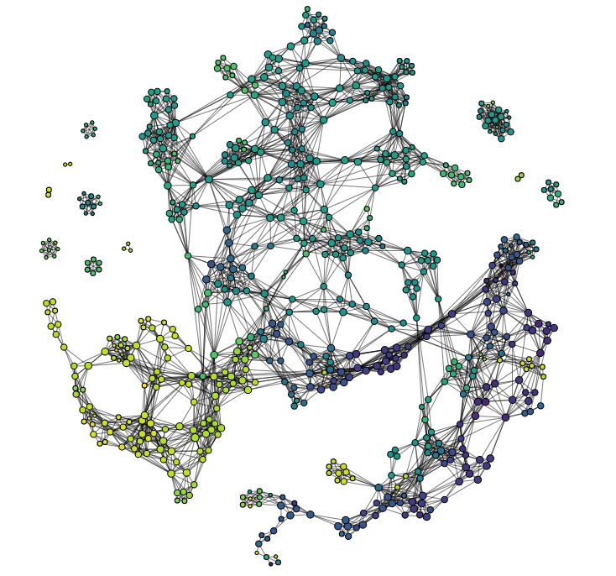
ENZYMES, PROTEINS, NCI1,MUTAG
BZR,COX2,DHFR
REDDIT-MULTI-5K,
REDDIT-MULTI-12K

