Slide 1
Javascript - Core Concepts
- A Practical Approach

Slide 2
Javascript - introduction
Developed by Brenden Eich, 1995 as Mocha
Netscape Communications Corporation
Also lived as LiveScript
Scripting Language, mostly used on browsers
NodeJs with Chromes V8 engine on server
Follows EcmaScript International Standards like Jscript and ActionScript
Most Used Programming language in web dev
Jquery, Angular, React, Vue, Backbone or any other library
Survey : Most Used Language in programming 2022

Slide 3
Introduction – Contd. Tech.
Compiled as well as Interpreted Mixed
It is Case Sensitive
UnTyped - a variable can be assigned any value
Dynamic Typing - The value type of a variable can change during the execution of a program and JavaScript takes care of it automatically. This feature is termed as dynamic typing.
Literals − Represents constant/fixed values.e.g. Key Value Pair Object to avoid global access of a variable
Operators − Symbols that define how the operands will be processed.
Comments − Used to improve code readability. These are ignored by the JavaScript engine. Single(//) and MultiLine (/**/)
Semicolons are Optional - Each line of instruction is called a statement. Semicolons are optional in JavaScript.

Slide 4
Intro – Contd. Tech.
Keywords − Words that have a special meaning in the context of a language.
Break | As | Any | Switch
Case | If | Throw | Else
Var | Number | String | Get
TypeOF | Type | InstanceOf | Module
Finally | For | Enum | Export
While | Void/Catch | New | Null
Let/Const | Static | Return | True/False

Slide 5
Javascript Basics
Modules : Represents code blocks that can be reused across different programs/scripts.
This expression is most useful when attempting to preserve the global namespace as any variables declared within the function body will be local to the closure but will still live throughout runtime.
This is a popular means of encapsulating source code for applications and frameworks, typically exposing a single global interface in which to interact
(function(window) {
var foo, bar;
function private()
{// do something}
window.Module = {
public: function()
{// do something}};
})(this);

Slide 6
Javascript Basics
Types (Data Type) :
Identifiers − These are the names given to elements in a program like variables, functions, etc. Rules :-
Primitive Type - Six | Non-Primitive Type
Boolean, Null, Undefined, Number, String, Symbol (new in ECMAScript 6) | Object
Identifiers can include both, characters and digits. However, the identifier cannot begin with a digit/number.
Identifiers cannot contain spaces and special characters, except the underscore (_) and the dollar ($) sign.
Identifiers cannot be keywords. They must be unique and are case sensitive.
Tip : variable can be auto cast even after declaration - except const
Notes:
6

Slide 7
Objects : Javascript
Value in memory, possibly referenced by an identifier,
Collection of properties, Identified as Key/Value Pair
Property values can be values of any type, including other objects, which enables building complex data structures
// Object initialiser or literal { [ nameValuePair1[, nameValuePair2[, ...nameValuePairN] ] ] } // Called as a constructor new Object([value])
The Object constructor creates an object wrapper for the given value. If the value is null or undefined, it will create and return an empty object, otherwise, it will return an object of a Type that corresponds to the given value.
Object Constructor Props : Object.length - Has a value of 1. Object.prototype - Allows the addition of properties to all objects of type Object.

Slide 8
Important Methods on Object Cntr.
Object.assign() | Copies the values of all enumerable own properties from one or more source objects to a target object
Object.create() | Creates a new object with the specified prototype object and properties.
Object.values() | Returns an array containing the values that correspond to all of a given object's own enumerable string properties.
Object.setPrototypeOf() | Sets the prototype (i.e., the internal [[Prototype]] property).
Object.seal() | Prevents other code from deleting properties of an object.
Object.preventExtensions() | Prevents any extensions of an object.
Object.is() | Compares if two values are the same value. Equates all NaN values (which differs from both Abstract Equality Comparison and Strict Equality Comparison).
Object.getOwnPropertyNames() | Returns an array containing the names of all of the given object's own enumerable and non-enumerable properties.

Slide 9
A Little More On Objects
All objects in JavaScript are descended from Object
All objects inherit methods and properties from Object.prototype, although they may be overridden
Changes to the Object prototype object are propagated to all objects unless the properties and methods subject to those changes are overridden further along the prototype chain
Object.prototype.constructor | Specifies the function that creates an object's prototype.
Object.prototype.hasOwnProperty() | Returns a boolean indicating whether an object contains the specified property as a direct property of that object and not inherited through the prototype chain.
Deleting A Property | There isn't any method in an Object itself to delete its own properties (e.g. like Map.prototype.delete()). To do so one has to use the delete operator.

Slide 10
Functions : Javascript
Fundamental building blocks, A JavaScript procedure - a set of statements that performs a task or calculates a value.
A function definition (also called a function declaration, or function statement) consists of the function keyword, followed by the name of the function.
A list of parameters to the function, enclosed in parentheses and separated by commas, known as arguments.
The JavaScript statements that define the function, enclosed in curly brackets, { }.
Eg : function square(number) { return number * number; }
Function expressions - While the function declaration above is syntactically a statement, functions can also be created by a function expression. Such a function can be anonymous; it does not have to have a name.
var square = function(number) { return number * number; }; var x = square(4); // x gets the value 16
Calling functions : square(n)

Slide 11
Scope : Javascript
Scope | Scope pertains to the variable access of a function when it is invoked and is unique to each invocation.
Function Scope | Variables defined inside a function cannot be accessed from anywhere outside the function, because the variable is defined only in the scope of the function. However, a function can access all variables and functions defined inside the scope in which it is defined.
Variable Scope | A variable can be defined in either local or global scope, which establishes the variables’ accessibility from different scopes during runtime.
Global Scope | Any global defined variable, meaning any variable declared outside of a function body will live throughout runtime and can be accessed and altered in any scope.
Local Scope | Local variables exist only within the function body of which they are defined and will have a different scope for every call of that function. There it is subject for value assignment, retrieval, and manipulation only within that call and is not accessible outside of that scope.

Slide 12
Context : Javascript
Context | Context is always the value of the this keyword which is a reference to the object that “owns” the currently executing code.
Scope and Context | Every function invocation has both a scope and a context associated with it. Fundamentally, scope is function-based while context is object-based.
What is “this” Context | Context is most often determined by how a function is invoked. When a function is called as a method of an object, this is set to the object the method is called on
var obj = { foo: function() { return this; } }; obj.foo() === obj; // true |  | function foo() { alert(this); } foo() // window new foo() // foo The same principle applies when invoking a function with the new operator to create an instance of an object.

Slide 13
Execution Context : Javascript
JavaScript is a single threaded language, meaning only one task can be executed at a time. When the JavaScript interpreter initially executes code, it first enters into a global execution context by default.
Each invocation of a function from this point on will result in the creation of a new execution context.
“execution context” is actually for all intents and purposes referring more to scope and not context, terminology as defined by the ECMAScript specification
Each time a new execution context is created it is appended to the top of the execution stack. The browser will always execute the current execution context that is atop the execution stack.
Once completed, it will be removed from the top of the stack and control will return to the execution context below.
An execution context can be divided into a creation and execution phase. In the creation phase, the interpreter will first create a variable object (also called an activation object) that is composed of all the variables, function declarations, and arguments defined inside the execution context. From there the scope chain is initialized next, and the value of this is determined last. Then in the execution phase, code is interpreted and executed.

Slide 14
Scope Chain : Javascript
Each time you attempt to access a variable within a function’s execution context, the look-up process will always begin with its own variable object. If the identifier is not found in the variable object, the search continues into the scope chain. It will climb up the scope chain examining the variable object of every execution context looking for a match to the variable name.
function first() {
second();
function second() {
third();
function third() {
fourth();
function fourth() {
// do something
}}}}
first();

Slide 15
Hoisting : Javascript
The JavaScript engine, by default, moves declarations to the top. This feature is termed as hoisting. This feature applies to variables and functions. Hoisting allows JavaScript to use a component before it has been declared
Variable Hoisting | Function Hoisting
The core concept in variable hoisting is that variable declarations (only declarations, and not the definitions!) are hoisted to the top of their scope before the program is executed. | Function declarations are hoisted to the top of their enclosing scope. Remember that JavaScript function declarations contain the body of the function.
console.log("Before: ", a); var a = 10; console.log("After: ", a); //What Acutally Happens // var a = undefined var a; console.log(a); // undefined a = 10; console.log(a); // 10 | funcHoist(); function funcHoist() { console.log("I am being hoisted.");} Observe the code that the interpreter sees due to hoisting: // its a function declaration// Thus, it’s hoisted function funcHoist() { console.log("I am being hoisted.");} funcHoist();
Scope can refer to global scope or function scope. Though you might declare and define a variable in a single statement, JavaScript processes them separately: declaration followed by a definition. | Function expressions are not hoisted. However, if they are assigned to a variable, JavaScript follows variable hoisting and hoists the variable declaration, but not the assignment, that is, the function.

Slide 16
Closures : Javascript
Accessing variables outside of the immediate lexical scope creates a closure
A closure is formed when a nested function is defined inside of another function, allowing access to the outer functions variables. Returning the nested function allows you to maintain access to the local variables, arguments, and inner function declarations of its outer function.
This encapsulation allows us to hide and preserve the execution context from outside scopes while exposing a public interface and thus is subject to further manipulation.
function foo() { var localVariable = 'private variable'; return function() { return localVariable; } } var getLocalVariable = foo(); getLocalVariable() // "private variable"
One of the most popular types of closures is what is widely known as the module pattern; it allows you to emulate public, private, and privileged members.

Slide 17
Call and Apply : Javascript
These two methods inherent to all functions allow you to execute any function in any desired context. This makes for incredibly powerful capabilities. The call function requires the arguments to be listed explicitly while the apply function allows you to provide the arguments as an array:
function user(firstName, lastName, age) { // do something } | user.call(window, 'John', 'Doe', 30); user.apply(window, ['John', 'Doe', 30]);
ECMAScript 5 (ES5) introduced the Function.prototype.bind method that is used for manipulating context. It returns a new function which is permanently bound to the first argument of bind regardless of how the function is being used. It works by using a closure that is responsible for redirecting the call in the appropriate context. Used where context is commonly lost; object-orientation and event handling. The addEventListener method of a node will always execute the callback in the context of the node the event handler is bound to. For Example :
function Widget() {
this.element = document.createElement('div');
this.element.addEventListener('click', this.onClick.bind(this), false);
}

Slide 18
Prototype : Javascript
JS provided property on functions, itself an object , no special characteristics. But, it is the only means to incorporate inheritance in javascript.
Placeholder object for custom methods, used to create new object with new keyword
Every object has a prototype, prototypes are object, so they have prototypes Exception is Object prototype
//1 ({}).prototype
//2 var a = { key: 5, value: 'may' }; a.prototype

Slide 19
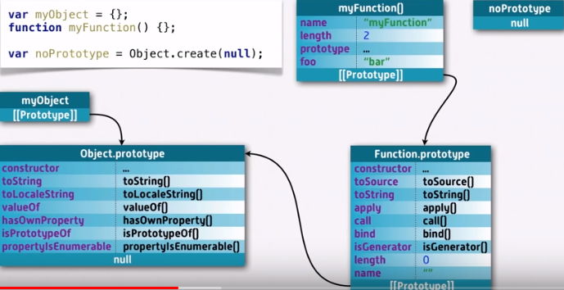
Prototype : Javascript

Slide 20
Call Stack : Javascript
A mechanism for an interpreter (like the JavaScript interpreter in a web browser) to keep track of its place in a script that calls multiple functions — what function is currently being run, what functions are called from within that function and should be called next, etc.
When a script calls a function, the interpreter adds it to the call stack and then starts carrying out the function.
Any functions that are called by that function are added to the call stack further up, and run where their calls are reached.
When the current function is finished, the interpreter takes it off the stack and resumes execution where it left off in the last code listing.
If the stack takes up more space than it had assigned to it, it results in a "stack overflow" error.
Never blocking : A very interesting property of the event loop model is that JavaScript, unlike a lot of other languages, never blocks. Handling I/O is typically performed via events and callbacks, so when the application is waiting for an IndexedDB query to return or an XHR request to return, it can still process other things like user input. Legacy exceptions exist like alert or synchronous XHR, but it is considered as a good practice to avoid them.

Slide 21
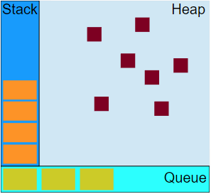
Concurrency Model : Javascript
function foo(b) { var a = 10; return a + b + 11; } function bar(x) { var y = 3; return foo(x * y); } console.log(bar(7)); //returns 42
Stack : When calling bar, a first frame is created containing bar's arguments and local variables. When bar calls foo, a second frame is created and pushed on top of the first one containing foo's arguments and local variables. When foo returns, the top frame element is popped out of the stack (leaving only bar's call frame). When bar returns, the stack is empty.
HEAP : Objects are allocated in a heap which is just a name to denote a large mostly unstructured region of memory.
QUEUE : A JavaScript runtime uses a message queue, which is a list of messages to be processed. Each message has an associated function which gets called in order to handle the message. At some point during the event loop, the runtime starts handling the messages on the queue, starting with the oldest one.

Slide 22
Event Loop : Javascript
The event loop got its name because of how it's usually implemented, which usually resembles: while (queue.waitForMessage()) { queue.processNextMessage();} queue.waitForMessage() waits synchronously for a msg to arrive if none currently.
Run-to-completion : Each message is processed completely before any other message is processed. This offers some nice properties when reasoning about your program, including the fact that whenever a function runs, it cannot be pre-empted and will run entirely before any other var a = 5; var b = 10; console.log(`Fifteen is ${a + b} and not ${2 * a + b}.`); code runs (and can modify data the function manipulates). This differs from C, for instance, where if a function runs in a thread, it may be stopped at any point by the runtime system to run some other code in another thread.
Adding messages : In web browsers, messages are added anytime an event occurs and there is an event listener attached to it. If there is no listener, the event is lost. So a click on an element with a click event handler will add a message--likewise with any other event.
Zero Delays : The execution depends on the number of waiting tasks in the queue.
Several runtimes communicating together : A web worker or a cross-origin iframe has its own stack, heap, and message queue. Two distinct runtimes can only communicate through sending messages via the postMessagemethod. This method adds a message to the other runtime if the latter listens to messageevents.
Notes:
22

Slide 23
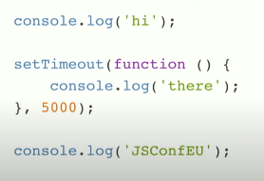
Event Loop : Definition
The Entity that handles external events and converts them into callback invocations
A loop that picks events from event queue and pushes their callbacks to the call stack
Even Loop is not part of V8 Engine it comes to us Libuv and present in association with another set of API’s like settimeout or xhr
Notes:
23

Slide 24
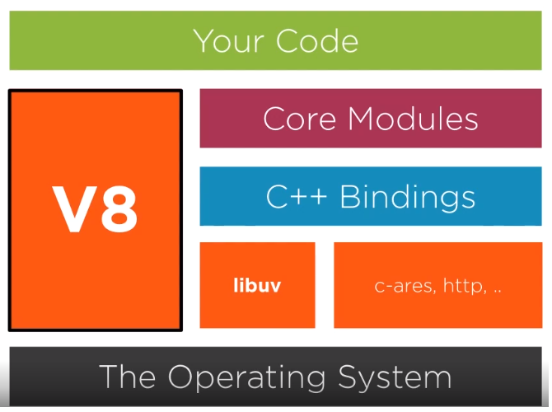

Slide 25
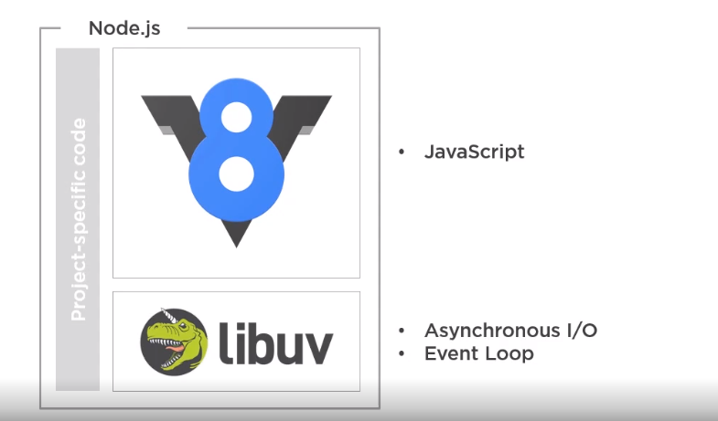

Slide 26
Console.log(“Hi”)
HEAP (Scattered Memory, Objects, Variables, etc)
Event Loop
Console.log(“I did it”)
Main
Cb1 (cnsl.lg ()))
Stack LIFO
Cb2 (cnsl.lg ()))
WEB API / C++ API’s (Set TimeOut, XHR and Other CallBacks)
SetTimeout -Cb 1 (cnsl.lg))
Cb3 (cnsl.lg ()))
SetTimeout -Cb 2 (cnsl.lg))
Cb1.1 (cnsl.lg ()))
SetTimeout -Cb 3 (cnsl.lg))
SetTimeout -Cb 1.1 (cnsl.lg))
Event Loop
Event Queue FIFO
When Stack Is Empty

