Slide 1




SQA - Group 4 - Tutorial 02
Members: 1. An Thị Phương
2. Trần Thị Ngọc Ánh
3. Trương Quốc Đạt
4. Vũ Ngọc Hà Minh

Slide 2
Bank Management System
1
Introduction
2
How we did the project?
3
How we organized our team?
4
Recommendation

Slide 3
Bank Management System
1
Introduction
The project entitled “Bank management system” :
Is a computerized telecommunications application
Provides the customers of a financial institution with access to financial transactions in a public space without the need for a human clerk or bank taller (manpower).
Provides a tool to manage bank’s tasks for bank staff and bank managers
Notes:
When conducting research, it is easy to go to one source: Wikipedia. However, you need to include a variety of sources in your research. Consider the following sources:
Who can I interview to get more information on the topic?
Is the topic current and will it be relevant to my audience?
What articles, blogs, and magazines may have something related to my topic?
Is there a YouTube video on the topic? If so, what is it about?
What images can I find related to the topic?

Slide 4
Bank Management System
1
Introduction
A web application to perform bank tasks
2 main functions:
Manage user’s account
Manage transaction
Two spaces are considered:
User space
Admin Space
Notes:
When conducting research, it is easy to go to one source: Wikipedia. However, you need to include a variety of sources in your research. Consider the following sources:
Who can I interview to get more information on the topic?
Is the topic current and will it be relevant to my audience?
What articles, blogs, and magazines may have something related to my topic?
Is there a YouTube video on the topic? If so, what is it about?
What images can I find related to the topic?

Slide 5
Bank Management System
1
Introduction
As a user, he can:
Sign up
Sign in
Sign out
Make a transaction
View transaction logs
View balance
View/Edit Profile
As a admin, he can:
Sign in
Sign out
Manage user’s account (CRUD)
Manage transaction (CRUD)
Search an account/ transactions by account number
View/Edit Profile
Notes:
When conducting research, it is easy to go to one source: Wikipedia. However, you need to include a variety of sources in your research. Consider the following sources:
Who can I interview to get more information on the topic?
Is the topic current and will it be relevant to my audience?
What articles, blogs, and magazines may have something related to my topic?
Is there a YouTube video on the topic? If so, what is it about?
What images can I find related to the topic?

Slide 6
Slide 3
2
Our team
How we organize our team?
Task | Candidate
Project Manager | An Thị Phương
Analyst | Trần Thị Ngọc Ánh
Designer | An Thị Phương
Developer | Trương Quốc Đạt
Tester | Vũ Ngọc Hà Minh

Slide 7
Bank Management System
3
How we did the project?
Analysis requirements
Design
Code
Test
Notes:
When conducting research, it is easy to go to one source: Wikipedia. However, you need to include a variety of sources in your research. Consider the following sources:
Who can I interview to get more information on the topic?
Is the topic current and will it be relevant to my audience?
What articles, blogs, and magazines may have something related to my topic?
Is there a YouTube video on the topic? If so, what is it about?
What images can I find related to the topic?

Slide 8
Bank Management System
3
How we did the project?
3.1 Analysis requirements
Identify functional requirement, specified by:
Use case diagrams for user and admin
Entity Relationship Diagram
Activity diagrams
Using diagrams.net
Notes:
When conducting research, it is easy to go to one source: Wikipedia. However, you need to include a variety of sources in your research. Consider the following sources:
Who can I interview to get more information on the topic?
Is the topic current and will it be relevant to my audience?
What articles, blogs, and magazines may have something related to my topic?
Is there a YouTube video on the topic? If so, what is it about?
What images can I find related to the topic?

Slide 9
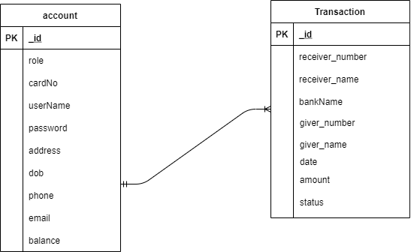
Bank Management System
3
How we did the project?
3.2 Design
Create user interface with interactive prototypes using Figma
Update ERD
Notes:
When conducting research, it is easy to go to one source: Wikipedia. However, you need to include a variety of sources in your research. Consider the following sources:
Who can I interview to get more information on the topic?
Is the topic current and will it be relevant to my audience?
What articles, blogs, and magazines may have something related to my topic?
Is there a YouTube video on the topic? If so, what is it about?
What images can I find related to the topic?

Slide 10
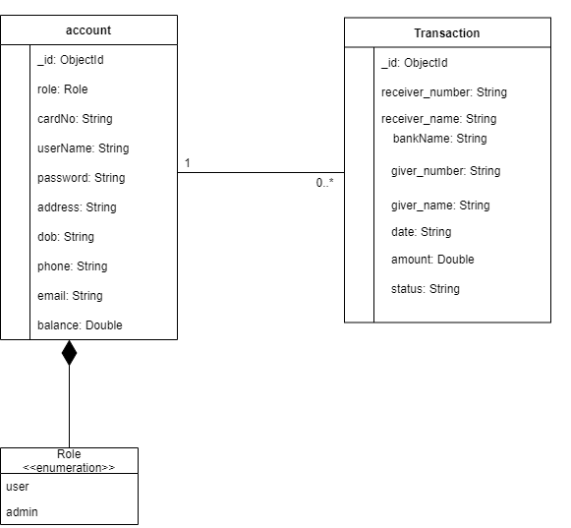
Bank Management System
3
How we did the project?
3.2 Design
Design class diagram as conceptual model
Notes:
When conducting research, it is easy to go to one source: Wikipedia. However, you need to include a variety of sources in your research. Consider the following sources:
Who can I interview to get more information on the topic?
Is the topic current and will it be relevant to my audience?
What articles, blogs, and magazines may have something related to my topic?
Is there a YouTube video on the topic? If so, what is it about?
What images can I find related to the topic?

Slide 11
Bank Management System
3
How we did the project?
3.2 Design
Update UI design
Design database
Specify sequence diagrams for each use case using Visual Paradigm
Notes:
When conducting research, it is easy to go to one source: Wikipedia. However, you need to include a variety of sources in your research. Consider the following sources:
Who can I interview to get more information on the topic?
Is the topic current and will it be relevant to my audience?
What articles, blogs, and magazines may have something related to my topic?
Is there a YouTube video on the topic? If so, what is it about?
What images can I find related to the topic?

Slide 12
Bank Management System
3
How we did the project?
3.3 Implementation
Front-end: Create User Interface using HTML, CSS with the big help of Bootstrap.(Admin -> User)
Back-end: create RESTful API and manipulate data using NodeJs and MongoDB.
Demo video: https://drive.google.com/file/d/15UpDiNpCNqAOhB-rCIzm7UiQdd59gaEM/view?fbclid=IwAR2bwuodifXo76_LqpvZDCSKUUCDc6X-eZ0mzBwP524nTLnPNj5JEcnWOvc
Notes:
When conducting research, it is easy to go to one source: Wikipedia. However, you need to include a variety of sources in your research. Consider the following sources:
Who can I interview to get more information on the topic?
Is the topic current and will it be relevant to my audience?
What articles, blogs, and magazines may have something related to my topic?
Is there a YouTube video on the topic? If so, what is it about?
What images can I find related to the topic?

Slide 13

Bank Management System
3
How we did the project?
3.4 Testing
In progress
Notes:
When conducting research, it is easy to go to one source: Wikipedia. However, you need to include a variety of sources in your research. Consider the following sources:
Who can I interview to get more information on the topic?
Is the topic current and will it be relevant to my audience?
What articles, blogs, and magazines may have something related to my topic?
Is there a YouTube video on the topic? If so, what is it about?
What images can I find related to the topic?

Slide 14
Bank Management System
4
Recommendation
Framework:
Bootstrap:
Strength: Easy to use, fast, effective responsiveness
Weakness: update frequently
NodeJS:
Strength: Robust technology stack: speed and performance, huge number of free tool, rich ecosystem, strong corporate support
Drawbacks: heavy computation tasks, callback hell issue,…
Notes:
When conducting research, it is easy to go to one source: Wikipedia. However, you need to include a variety of sources in your research. Consider the following sources:
Who can I interview to get more information on the topic?
Is the topic current and will it be relevant to my audience?
What articles, blogs, and magazines may have something related to my topic?
Is there a YouTube video on the topic? If so, what is it about?
What images can I find related to the topic?

Slide 15
Thank you for your attention!
Any questions?
Notes:
You can use this slide as your opening or closing slide. Should you choose to use it as a closing, make sure you review the main points of your presentation. One creative way to do that is by adding animations to the various graphics on a slide. This slide has 4 different graphics, and, when you view the slideshow, you will see that you can click to reveal the next graphic. Similarly, as you review the main topics in your presentation, you may want each point to show up when you are addressing that topic.
Add animation to images and graphics:
Select your image or graphic.
Click on the Animations tab.
Choose from the options. The animation for this slide is “Split”. The drop-down menu in the Animation section gives even more animations you can use.
If you have multiple graphics or images, you will see a number appear next to it that notes the order of the animations.
Note: You will want to choose the animations carefully. You do not want to make your audience dizzy from your presentation.

