Slide 1




SQA - Group 4 - Tutorial 02
Members: 1. An Thị Phương
2. Trần Thị Ngọc Ánh
3. Trương Quốc Đạt
4. Vũ Ngọc Hà Minh

Slide 2
Bank Management System
Introduction
1
2
Project Progress
3
Frameworks & Tools
4
Final Product

Slide 3

Bank Management System
1
Introduction
Bank management system:
Computerized telecommunications application
Online transaction
Tools for managing system(admin & user)
Notes:
When conducting research, it is easy to go to one source: Wikipedia. However, you need to include a variety of sources in your research. Consider the following sources:
Who can I interview to get more information on the topic?
Is the topic current and will it be relevant to my audience?
What articles, blogs, and magazines may have something related to my topic?
Is there a YouTube video on the topic? If so, what is it about?
What images can I find related to the topic?

Slide 4
Bank Management System
1
Introduction
A web application to perform bank tasks
2 main functions:
Manage user’s account
Manage transaction
Two spaces are considered:
User space
Admin Space
Notes:
When conducting research, it is easy to go to one source: Wikipedia. However, you need to include a variety of sources in your research. Consider the following sources:
Who can I interview to get more information on the topic?
Is the topic current and will it be relevant to my audience?
What articles, blogs, and magazines may have something related to my topic?
Is there a YouTube video on the topic? If so, what is it about?
What images can I find related to the topic?

Slide 5
Bank Management System
1
Introduction
As a user, he can:
Sign up
Sign in
Sign out
Make a transaction
View transaction logs
View balance
View/Edit Profile
As a admin, he can:
Sign in
Sign out
Manage user’s account (CRUD)
Manage transaction (CRUD)
Search an account/ transactions by account number
View/Edit Profile
Notes:
When conducting research, it is easy to go to one source: Wikipedia. However, you need to include a variety of sources in your research. Consider the following sources:
Who can I interview to get more information on the topic?
Is the topic current and will it be relevant to my audience?
What articles, blogs, and magazines may have something related to my topic?
Is there a YouTube video on the topic? If so, what is it about?
What images can I find related to the topic?

Slide 6
Bank Management System
2
Project Progress
Analysis requirements
Design
Implementation
Test
Notes:
When conducting research, it is easy to go to one source: Wikipedia. However, you need to include a variety of sources in your research. Consider the following sources:
Who can I interview to get more information on the topic?
Is the topic current and will it be relevant to my audience?
What articles, blogs, and magazines may have something related to my topic?
Is there a YouTube video on the topic? If so, what is it about?
What images can I find related to the topic?

Slide 7
Bank Management System
3
Frameworks & Tools
Analysis requirements
- Diagrams.net
Design
- Figma
- Visual Paradigm
Implementation
- NodeJs
- MongoDB
- Bootstrap
Test
- Jest
Notes:
When conducting research, it is easy to go to one source: Wikipedia. However, you need to include a variety of sources in your research. Consider the following sources:
Who can I interview to get more information on the topic?
Is the topic current and will it be relevant to my audience?
What articles, blogs, and magazines may have something related to my topic?
Is there a YouTube video on the topic? If so, what is it about?
What images can I find related to the topic?

Slide 8

Bank Management System
3
Frameworks & Tools
Analysis requirements
A free and open source web based diagramming and mind mapping software
Diagrams.net
Notes:
When conducting research, it is easy to go to one source: Wikipedia. However, you need to include a variety of sources in your research. Consider the following sources:
Who can I interview to get more information on the topic?
Is the topic current and will it be relevant to my audience?
What articles, blogs, and magazines may have something related to my topic?
Is there a YouTube video on the topic? If so, what is it about?
What images can I find related to the topic?

Slide 9
Bank Management System
3
Frameworks & Tools
Analysis requirements
Draw and style connectors
Use swim lanes with flowcharts
Work with entity relationship table shapes
Diagrams.net
UML shape library updated
Notes:
When conducting research, it is easy to go to one source: Wikipedia. However, you need to include a variety of sources in your research. Consider the following sources:
Who can I interview to get more information on the topic?
Is the topic current and will it be relevant to my audience?
What articles, blogs, and magazines may have something related to my topic?
Is there a YouTube video on the topic? If so, what is it about?
What images can I find related to the topic?

Slide 10
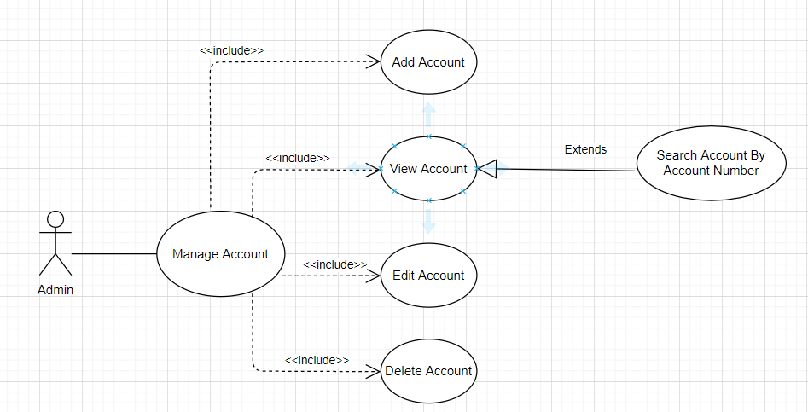
Bank Management System
3
Frameworks & Tools
Analysis requirements
Diagrams.net
Using diagrams.net for drawing Use case
Notes:
When conducting research, it is easy to go to one source: Wikipedia. However, you need to include a variety of sources in your research. Consider the following sources:
Who can I interview to get more information on the topic?
Is the topic current and will it be relevant to my audience?
What articles, blogs, and magazines may have something related to my topic?
Is there a YouTube video on the topic? If so, what is it about?
What images can I find related to the topic?

Slide 11

Bank Management System
3
Frameworks & Tools
Design
Figma is a design platform for teams who build products together.
Born on the Web, Figma helps the entire product team create, test, and ship better designs, faster.
Figma
Notes:
When conducting research, it is easy to go to one source: Wikipedia. However, you need to include a variety of sources in your research. Consider the following sources:
Who can I interview to get more information on the topic?
Is the topic current and will it be relevant to my audience?
What articles, blogs, and magazines may have something related to my topic?
Is there a YouTube video on the topic? If so, what is it about?
What images can I find related to the topic?

Slide 12
Bank Management System
3
Frameworks & Tools
Design
Works on any Platform
Figma Is Simple and Familiar
Slack for Team Communication
Sharing Is Uncomplicated and Flexible
Real-time Updating
Figma
Notes:
When conducting research, it is easy to go to one source: Wikipedia. However, you need to include a variety of sources in your research. Consider the following sources:
Who can I interview to get more information on the topic?
Is the topic current and will it be relevant to my audience?
What articles, blogs, and magazines may have something related to my topic?
Is there a YouTube video on the topic? If so, what is it about?
What images can I find related to the topic?

Slide 13
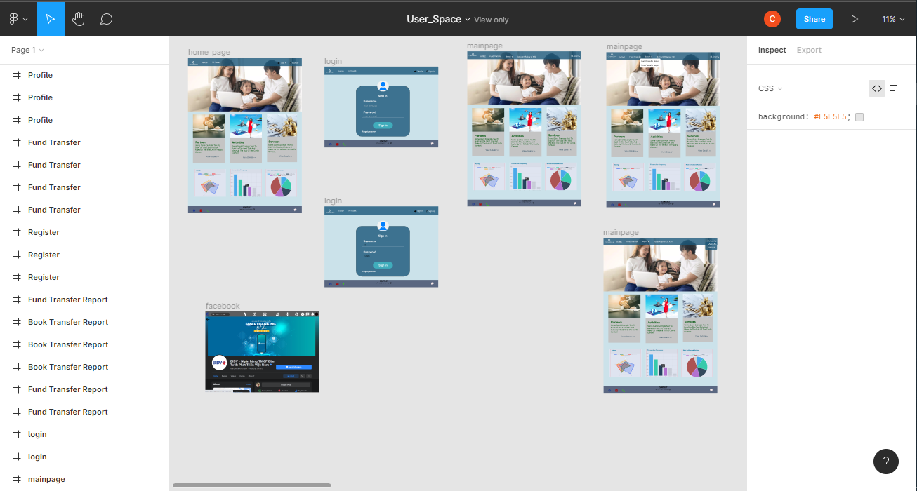
Bank Management System
3
Frameworks & Tools
Design
Using Figma for designing our Banking management system
Notes:
When conducting research, it is easy to go to one source: Wikipedia. However, you need to include a variety of sources in your research. Consider the following sources:
Who can I interview to get more information on the topic?
Is the topic current and will it be relevant to my audience?
What articles, blogs, and magazines may have something related to my topic?
Is there a YouTube video on the topic? If so, what is it about?
What images can I find related to the topic?

Slide 14

Bank Management System
3
Frameworks & Tools
Design
Visual Paradigm helps software development teams to capture correct requirements and transform them into accurate design
Visual Paradigm
Notes:
When conducting research, it is easy to go to one source: Wikipedia. However, you need to include a variety of sources in your research. Consider the following sources:
Who can I interview to get more information on the topic?
Is the topic current and will it be relevant to my audience?
What articles, blogs, and magazines may have something related to my topic?
Is there a YouTube video on the topic? If so, what is it about?
What images can I find related to the topic?

Slide 15
Bank Management System
3
Frameworks & Tools
Design
Easy-to-use and understand
Database reverse engineering
Database forward engineering
Visual Paradigm
Notes:
When conducting research, it is easy to go to one source: Wikipedia. However, you need to include a variety of sources in your research. Consider the following sources:
Who can I interview to get more information on the topic?
Is the topic current and will it be relevant to my audience?
What articles, blogs, and magazines may have something related to my topic?
Is there a YouTube video on the topic? If so, what is it about?
What images can I find related to the topic?

Slide 16
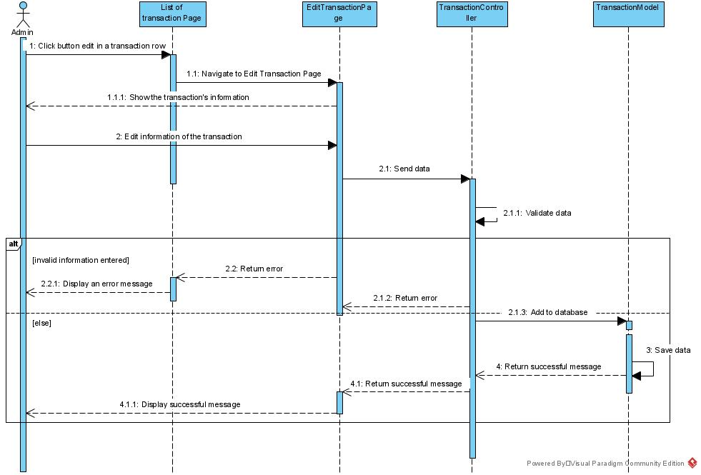
Bank Management System
3
Frameworks & Tools
Design
Create Sequence diagram for «Edit Transaction» in Visual Paradigm
Notes:
When conducting research, it is easy to go to one source: Wikipedia. However, you need to include a variety of sources in your research. Consider the following sources:
Who can I interview to get more information on the topic?
Is the topic current and will it be relevant to my audience?
What articles, blogs, and magazines may have something related to my topic?
Is there a YouTube video on the topic? If so, what is it about?
What images can I find related to the topic?

Slide 17

Bank Management System
3
Frameworks & Tools
Implementation
MongoDB is the leading modern, general purpose database platform, designed to unleash the power of software and data for developers and the applications they build
Notes:
When conducting research, it is easy to go to one source: Wikipedia. However, you need to include a variety of sources in your research. Consider the following sources:
Who can I interview to get more information on the topic?
Is the topic current and will it be relevant to my audience?
What articles, blogs, and magazines may have something related to my topic?
Is there a YouTube video on the topic? If so, what is it about?
What images can I find related to the topic?

Slide 18

Bank Management System
3
Frameworks & Tools
Implementation
Flexible Document Schemas
Code-native data access
Change-friendly design
Powerful querying and analytics
Easy horizontal scale-out
Notes:
When conducting research, it is easy to go to one source: Wikipedia. However, you need to include a variety of sources in your research. Consider the following sources:
Who can I interview to get more information on the topic?
Is the topic current and will it be relevant to my audience?
What articles, blogs, and magazines may have something related to my topic?
Is there a YouTube video on the topic? If so, what is it about?
What images can I find related to the topic?

Slide 19
Bank Management System
3
Frameworks & Tools
Implementation
MongoDB: Create & Update database MongoTools: Backup & Restore
Reference: https://docs.mongodb.com/manual/
Notes:
When conducting research, it is easy to go to one source: Wikipedia. However, you need to include a variety of sources in your research. Consider the following sources:
Who can I interview to get more information on the topic?
Is the topic current and will it be relevant to my audience?
What articles, blogs, and magazines may have something related to my topic?
Is there a YouTube video on the topic? If so, what is it about?
What images can I find related to the topic?

Slide 20
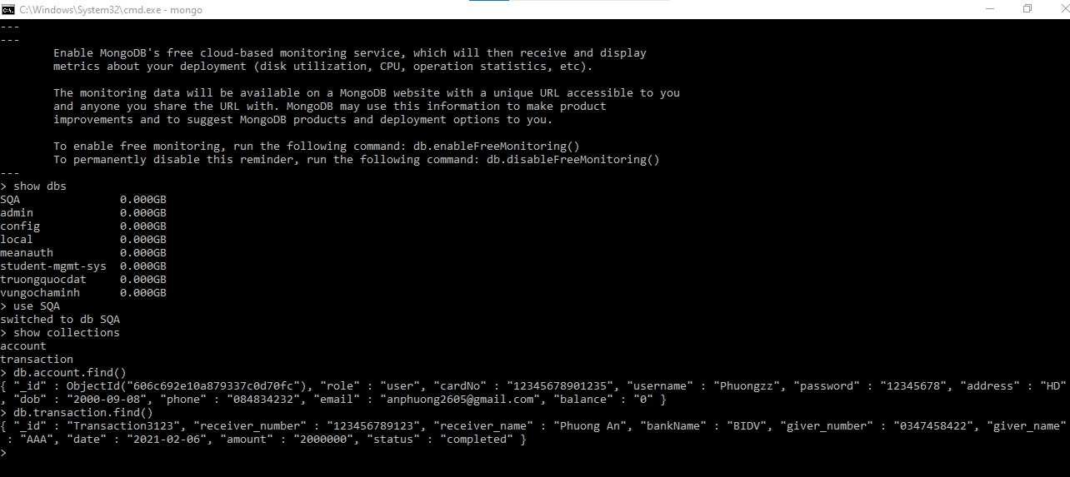
Bank Management System
3
Frameworks & Tools
Implementation
How to contact with mongo shell?
Notes:
When conducting research, it is easy to go to one source: Wikipedia. However, you need to include a variety of sources in your research. Consider the following sources:
Who can I interview to get more information on the topic?
Is the topic current and will it be relevant to my audience?
What articles, blogs, and magazines may have something related to my topic?
Is there a YouTube video on the topic? If so, what is it about?
What images can I find related to the topic?

Slide 21
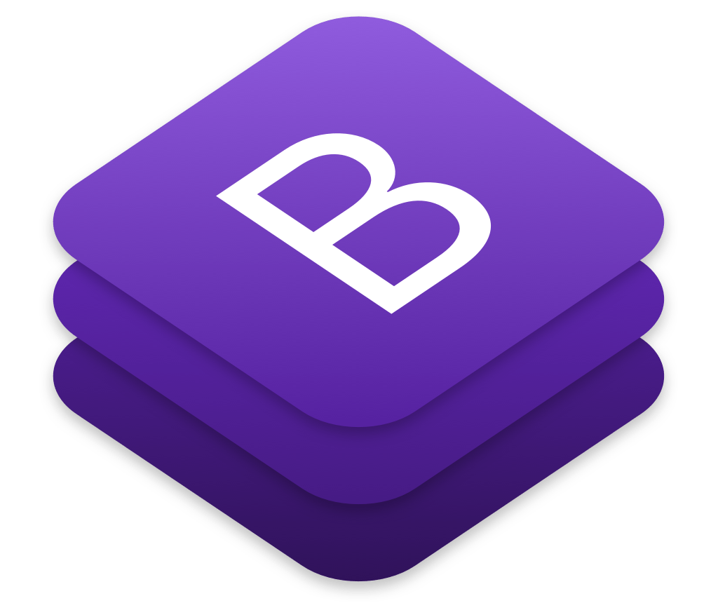
Bank Management System
3
Frameworks & Tools
Implementation
Bootstrap is an HTML, CSS, and JS framework used for developing responsive and mobile-first projects on the web.
Bootstrap
Notes:
When conducting research, it is easy to go to one source: Wikipedia. However, you need to include a variety of sources in your research. Consider the following sources:
Who can I interview to get more information on the topic?
Is the topic current and will it be relevant to my audience?
What articles, blogs, and magazines may have something related to my topic?
Is there a YouTube video on the topic? If so, what is it about?
What images can I find related to the topic?

Slide 22
Bank Management System
3
Frameworks & Tools
Implementation
A consistent framework that supports major of all browsers and CSS compatibility fixes
Lightweight and customizable
Responsive structures and styles
Several JavaScript plugins using the jQuery
Bootstrap
Notes:
When conducting research, it is easy to go to one source: Wikipedia. However, you need to include a variety of sources in your research. Consider the following sources:
Who can I interview to get more information on the topic?
Is the topic current and will it be relevant to my audience?
What articles, blogs, and magazines may have something related to my topic?
Is there a YouTube video on the topic? If so, what is it about?
What images can I find related to the topic?

Slide 23
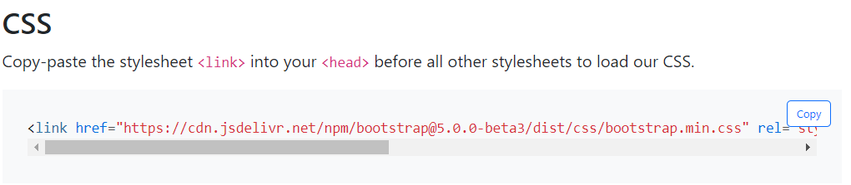
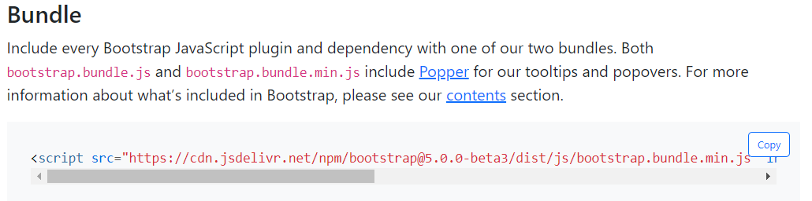
Bank Management System
3
Frameworks & Tools
Implementation
Front-end: Using Bootstrap Framework
Notes:
When conducting research, it is easy to go to one source: Wikipedia. However, you need to include a variety of sources in your research. Consider the following sources:
Who can I interview to get more information on the topic?
Is the topic current and will it be relevant to my audience?
What articles, blogs, and magazines may have something related to my topic?
Is there a YouTube video on the topic? If so, what is it about?
What images can I find related to the topic?

Slide 24
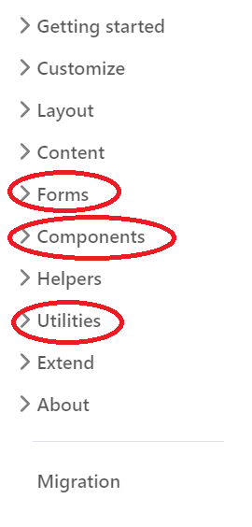
Bank Management System
3
Frameworks & Tools
Implementation
For beginner, focusing on the side bar with 3 important parts:
Components
Utilities
Forms
Reference: https://getbootstrap.com/
Front-end: Using Bootstrap Framework
Notes:
When conducting research, it is easy to go to one source: Wikipedia. However, you need to include a variety of sources in your research. Consider the following sources:
Who can I interview to get more information on the topic?
Is the topic current and will it be relevant to my audience?
What articles, blogs, and magazines may have something related to my topic?
Is there a YouTube video on the topic? If so, what is it about?
What images can I find related to the topic?

Slide 25

Bank Management System
3
Frameworks & Tools
Testing
Jest is a JavaScript testing framework, which provides multiple layers on top of Jasmine.
Jest
Notes:
When conducting research, it is easy to go to one source: Wikipedia. However, you need to include a variety of sources in your research. Consider the following sources:
Who can I interview to get more information on the topic?
Is the topic current and will it be relevant to my audience?
What articles, blogs, and magazines may have something related to my topic?
Is there a YouTube video on the topic? If so, what is it about?
What images can I find related to the topic?

Slide 26
Bank Management System
3
Frameworks & Tools
Testing
Open source
Parallel test running
Mock by default screws up your classes, breaking tests
Mock by default makes testing much simpler
Testing React Native Apps
Jest
Notes:
When conducting research, it is easy to go to one source: Wikipedia. However, you need to include a variety of sources in your research. Consider the following sources:
Who can I interview to get more information on the topic?
Is the topic current and will it be relevant to my audience?
What articles, blogs, and magazines may have something related to my topic?
Is there a YouTube video on the topic? If so, what is it about?
What images can I find related to the topic?

Slide 27

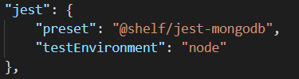

Bank Management System
3
Frameworks & Tools
Testing
Setup in terminal:
Package.json
Notes:
When conducting research, it is easy to go to one source: Wikipedia. However, you need to include a variety of sources in your research. Consider the following sources:
Who can I interview to get more information on the topic?
Is the topic current and will it be relevant to my audience?
What articles, blogs, and magazines may have something related to my topic?
Is there a YouTube video on the topic? If so, what is it about?
What images can I find related to the topic?

Slide 28
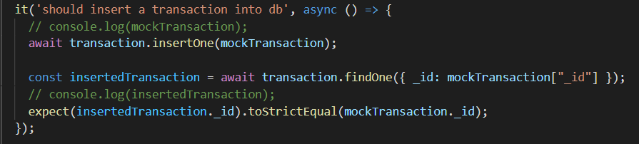
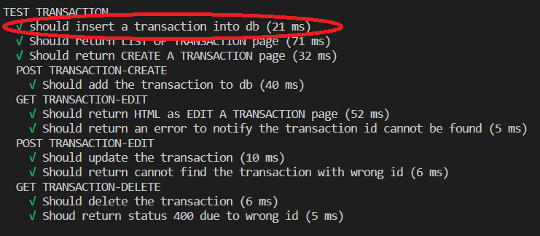
Bank Management System
3
Frameworks & Tools
Testing
How it is implemented in our code?
Notes:
When conducting research, it is easy to go to one source: Wikipedia. However, you need to include a variety of sources in your research. Consider the following sources:
Who can I interview to get more information on the topic?
Is the topic current and will it be relevant to my audience?
What articles, blogs, and magazines may have something related to my topic?
Is there a YouTube video on the topic? If so, what is it about?
What images can I find related to the topic?

Slide 29
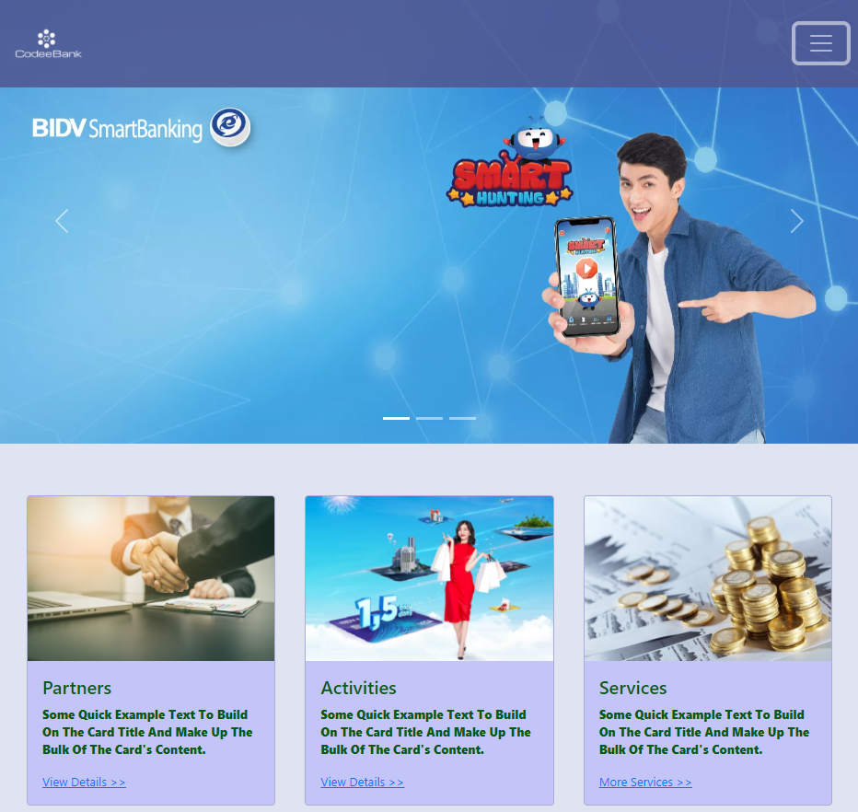
Bank Management System
4
Our Final Product
Demo video: https://drive.google.com/file/d/15UpDiNpCNqAOhB-rCIzm7UiQdd59gaEM/view?fbclid=IwAR23KQ4R-nU96ancXp_2dxq_x8rWvL_f8belumiIq3oCFTUgnwHdNT-7miw
Visit our app here:
https://sqa-bank.herokuapp.com/
Notes:
When conducting research, it is easy to go to one source: Wikipedia. However, you need to include a variety of sources in your research. Consider the following sources:
Who can I interview to get more information on the topic?
Is the topic current and will it be relevant to my audience?
What articles, blogs, and magazines may have something related to my topic?
Is there a YouTube video on the topic? If so, what is it about?
What images can I find related to the topic?

Slide 30
Thank you for your attention!
Any questions?
Notes:
You can use this slide as your opening or closing slide. Should you choose to use it as a closing, make sure you review the main points of your presentation. One creative way to do that is by adding animations to the various graphics on a slide. This slide has 4 different graphics, and, when you view the slideshow, you will see that you can click to reveal the next graphic. Similarly, as you review the main topics in your presentation, you may want each point to show up when you are addressing that topic.
Add animation to images and graphics:
Select your image or graphic.
Click on the Animations tab.
Choose from the options. The animation for this slide is “Split”. The drop-down menu in the Animation section gives even more animations you can use.
If you have multiple graphics or images, you will see a number appear next to it that notes the order of the animations.
Note: You will want to choose the animations carefully. You do not want to make your audience dizzy from your presentation.

