Slide 1
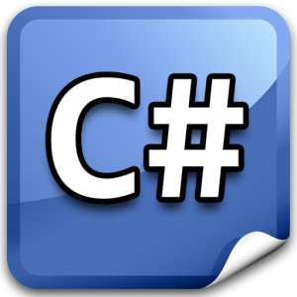

C# & .Net INSIGHTS
Presenter: PhuongNQK

Slide 2
Goals
Provide you insights into core concepts of .NET framework
Assembly
Application domain
MSIL

Slide 3
.NET Framework Overview
.NET framework SDK
Visual Studio .NET
C#
VB.NET
F#
J#
Managed C++
…
Common Language Specification (CLS)
Common Type System (CTS)
.NET framework redistributable
.NET Framework Class Library (FCL)
ASP.NET
Windows Forms
WPF
Silverlight
WCF & WWF (Communication & Workflow)
ADO.NET, LINQ, XML
Base Class Library (BCL)
Common Language Runtime (CLR)
Operating System

Slide 4
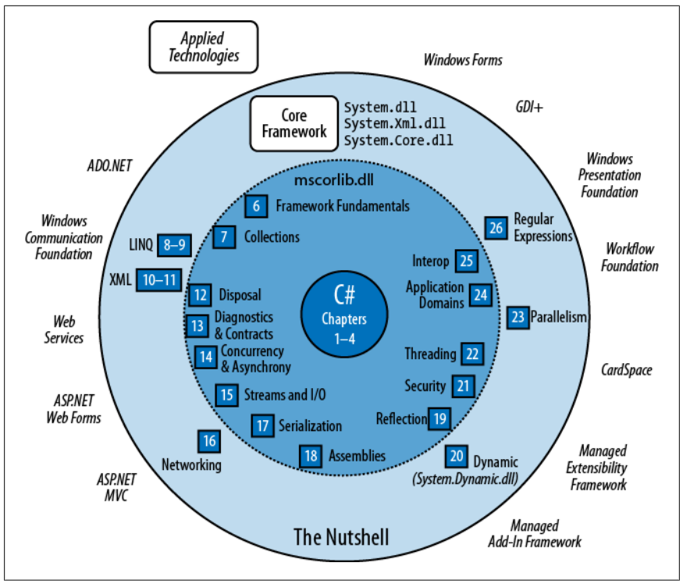
.NETf libraries

Slide 5
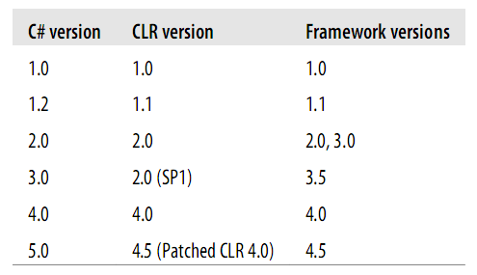
C#, CLR & .NETf versions

Slide 6
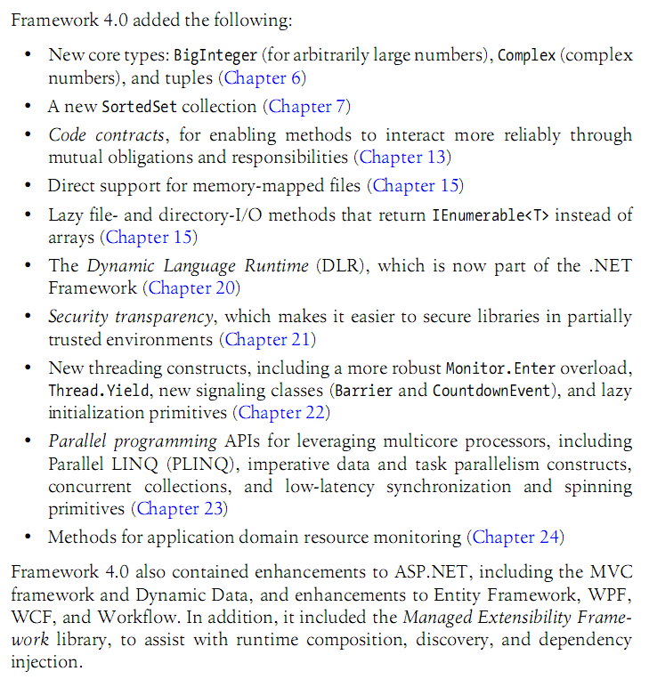
What’s new in .NETf 4.0?

Slide 7
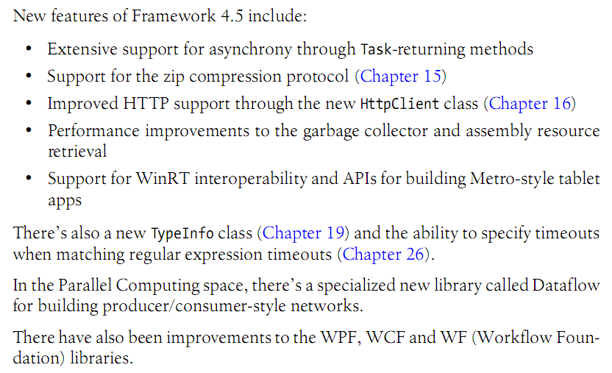
What’s new in .NETf 4.5?

Slide 8
.NET core concepts
Assembly
Application domain
MSIL

Slide 9
Assembly
Self-describing unit of deployment
Comprise 1 single Windows PE file
.exe (application) – defines 1 entry point
.dll (reusable library)
.winmd (WinRT library – contains only metadata)
Contain metadata
Container for all types
A boundary for type resolution and security permissioning

Slide 10
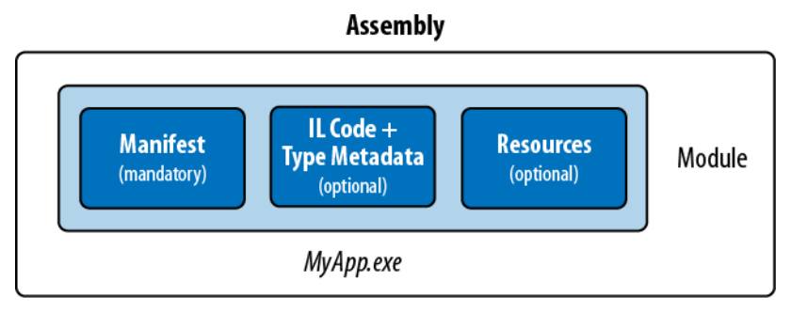
Assembly content
Assembly manifest (info to .NET) – REQUIRED
Application manifest (info to OS)
Compiled types (IL code + metadata)
Resources, e.g. images, localizable text

Slide 11
Assembly manifest
Functional data
Informational data
The simple name of the assembly
A version number (AssemblyVersion)
A public key and signed hash of the assembly, if strongly named
A list of referenced assemblies, including their version and public key
A list of modules that comprise the assembly
A list of types defined in the assembly and the module containing each type
An optional set of security permissions requested or refused by the assembly (SecurityPermission)
The culture it targets, if a satellite assembly (AssemblyCulture)
A full title and description (AssemblyTitle and AssemblyDescription)
Company and copyright info (AssemblyCompany and AssemblyCopyright)
A display version (AssemblyInformationalVersion)
Additional attributes for custom data
AssemblyXXXAttribute classes

Slide 12
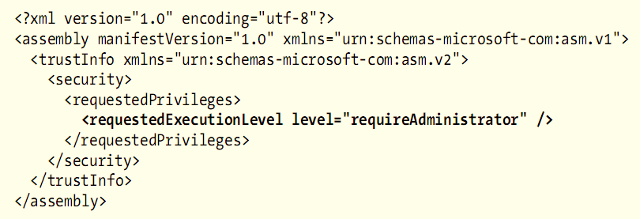
Application manifest
Read and processed before the .NET-managed hosting environment loads the assembly
Can influence how OS launches app’s process
Metro applications have a far more elaborate manifest, described in the Pack-
age.appxmanifest file. This includes a declaration of the program’s capabilities,
which determine permissions granted by OS.

Slide 13
Application manifest
How to deploy
As a specially named file located in the same folder as the assembly
MyApp.exe -> MyApp.exe.manifest
Embedded within the assembly itself
mt -manifest MyApp.exe.manifest -outputresource:MyApp.exe;#1

Slide 14
Assembly types
Single file vs. Multi-file
Main vs. Satellite
Private vs. Shared

Slide 15
Single-file assembly

Slide 16
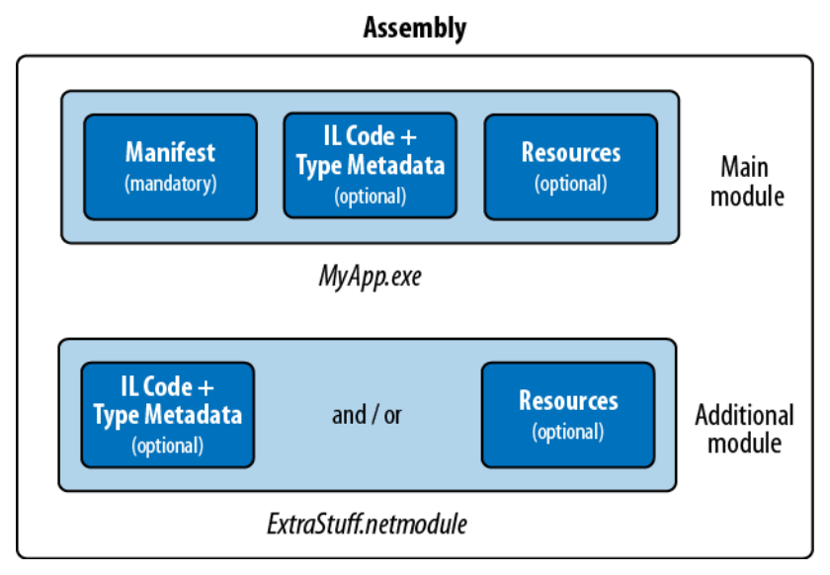
Multi-file assembly

Slide 17
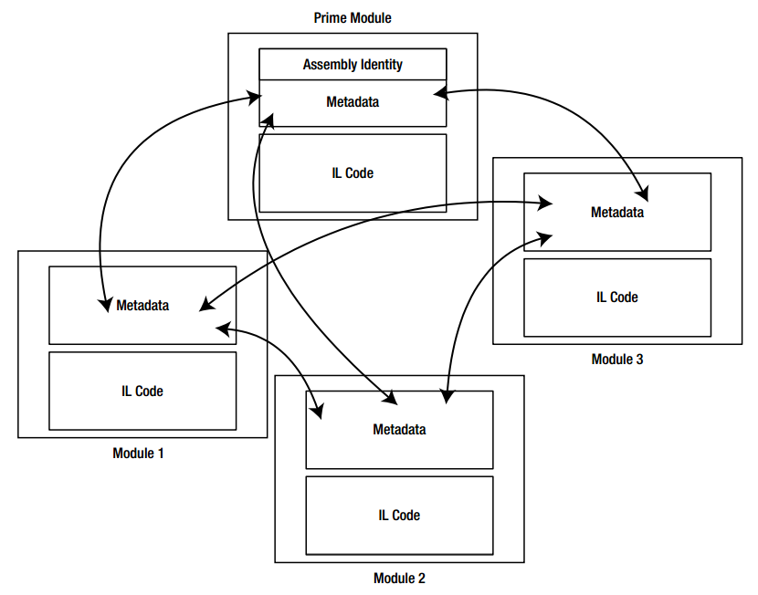
Multi-file assembly

Slide 18
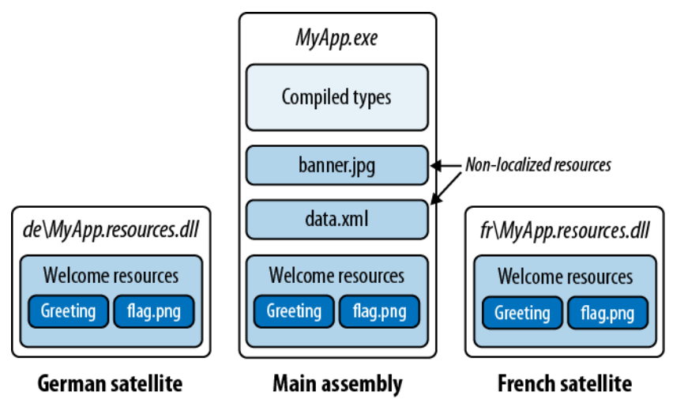
Main vs. Satellite assemblies

Slide 19
Private assembly
Also called weakly-named assembly
Usable by a single app
An assembly is private by default
A private assembly can reference any other assembly

Slide 20
Shared assembly
Also called strongly-named assembly
Must have
An assembly name
A version
A public key
Reside in GAC, hence sharable between apps
Multiple versions can co-exist side-by-side
A shared assembly can only reference other shared assemblies

Slide 21
How to create a shared assembly?
Generate a public/private key pair
sn -k key.snk
Use the private key to sign the assembly
Install it to GAC (%Windows%\Microsoft.NET\assembly\)
gacutil /i <assembly_path>

Slide 22
Assembly references
Private assembly
Private assembly
Shared assembly
Shared assembly
Private assembly
Shared assembly
Private assembly
Shared assembly
A \ B | x86 | x64 | Any
x86 | x |  | x
x64 |  | x | x
Any |  | x | x
A references B

Slide 23
A bit on versioning
Major | Minor | Build | Revision | Description
1 | 0 | 0 | 0 | Original version
1 | 0 | 0 | 1 | A revision (maybe a bugfix)
1 | 0 | 1 | 0 | A new build
1 | 1 | 0 | 0 | A new minor version
2 | 0 | 0 | 0 | A new major version
Note:
- Default version is 0.0.0.0
- 2 incompatible versions have different major and/or minor values
- <bindingRedirect> tells CLR to redirect references to a newer version
- CLR performs version checking on shared assemblies only

Slide 24
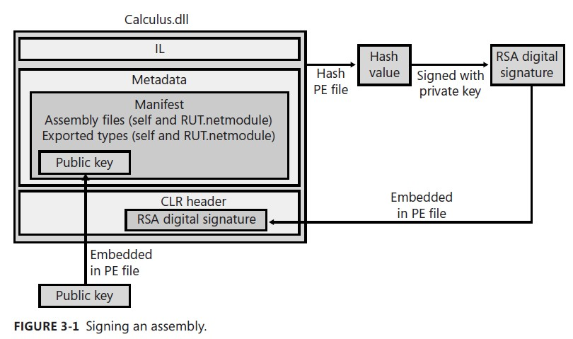
Signing assemblies
Note: We can delay-sign an assembly.

Slide 25
Assembly identity
Simple name
Come from the name of the file to which it was originally compiled (less any extension).
E.g. System.Xml.dll -> System.Xml
Not changed when the file is renamed
Version (“0.0.0.0” if not present)
AssemblyVersion
Culture (“neutral” if not a satellite)
AssemblyCulture
Public key token (“null” if not strongly-named)
Key file

Slide 26
Fully-qualified assembly name
simple-name, Version=version, Culture=culture, PublicKeyToken=public-key
System.Xml, Version=2.0.0.0, Culture=neutral, PublicKeyToken=b77a5c561934e089

Slide 27

Q & A

Slide 28
.NET core concepts
Assembly
Application domain
MSIL

Slide 29
Application domain
The runtime unit of isolation in which a .NET program runs
A managed memory boundary
A container for loaded assemblies and app config settings
A communication boundary for distributed apps
Each .NET process usually hosts just 1 app domain: the default domain, auto-created by CLR when the process starts
Can create 2+ app domains within the same process
Isolation with less overhead and communication complications (compared to having n processes)
Useful in scenarios such as load testing and app patching, and in implementing robust error recovery mechanisms
Win Metro apps can access to only 1 app domain

Slide 30
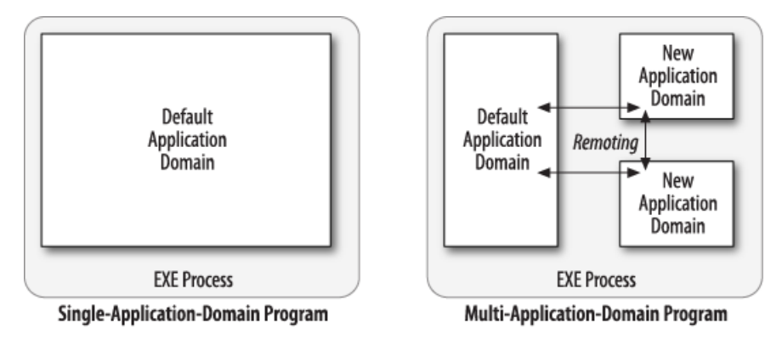
App domain architecture

Slide 31
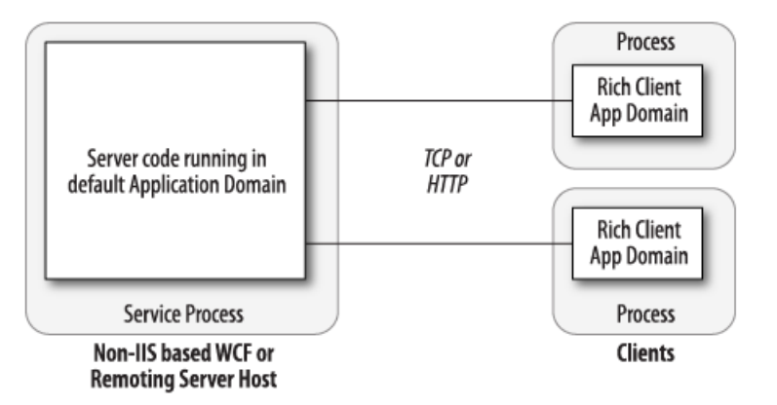
App domain architecture

Slide 32
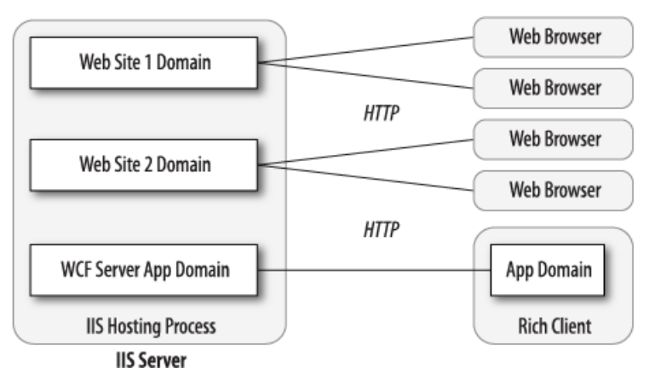
App domain architecture

Slide 33
Scenario - Problem
You’ve written a custom authentication system, and as part of unit testing, you want to stress-test the server code by simulating 20 clients logging in at once.
How will you simulate 20 clients?

Slide 34
Scenario - Solutions
Start 20 separate processes by calling Process.Start() 20 times
Start 20 threads in the same process and domain
Start 20 threads in the same process—each in its own app domain

Slide 35
Q & A

Slide 36
.NET core concepts
Assembly
Application domain
MSIL

Slide 37
.NET code lifecycle
Managed language code
(C#, VB.NET, F#, etc.)
Normal language code
(C++, VB, etc.)
.NET compiler
Normal compiler
Managed code
(MSIL)
Generated during compile time
Machine code
(x86, x64)
CLR-JIT compiler
Machine code
(x86, x64)
Generated during runtime

Slide 38
Compiler & Decompiler
Managed language code file
(.cs, .vb, etc.)
Dotpeek Reflector
csc, vbc
Managed code file
(.il)
ildasm
ilasm
Assembly file
(.exe, .dll, .mod)
SmartAssembly
Smart assembly file
(.exe, .dll, .mod)

Slide 39
Dynamic assembly
Namespace: System.Reflection.Emit
Types
AssemblyBuilder
ModuleBuilder
TypeBuilder
ILGenerator
MethodBuilder
DynamicMethod
http://blogs.msdn.com/b/haibo_luo/archive/2006/11/16/take-two-il-visualizer.aspx

Slide 40
Q & A

Slide 41
References
C# 5.0 in a Nutshell, by Joseph Albahari & Ben Albahari, O’Reilly
Microsoft .Net for Programmers, by Fergal Grimes, Manning

Slide 42
Thanks for coming.
See ya!
For more, please visit: http://phuonglamcs.com/relax/presentations/

