Slide 1
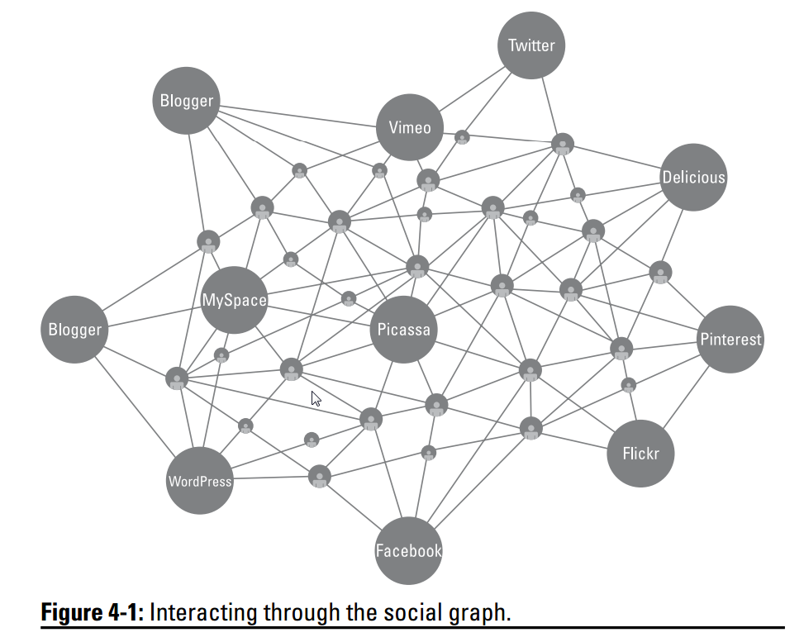
App architecture overview
Presenter: PhuongNQK

Slide 2
Goal
Give an overview of currently prominent app architectures in relation to each other

Slide 3
Old lessons
What is a software app?
A system designed to automate specific tasks in a logical manner to satisfy a set of requirements
Basic design principles
Interface > Implementation
Modularization
Design views
Conceptual -> Logical -> Physical

Slide 4
What is app architecture?
Organizational design of an entire software application, including all sub-components and external applications interchanges
Goals:
Complete the necessary business processes as defined in the system requirements
Support future growth

Slide 5
What will we look at?
Layered architecture
DDD (Domain-Driven Design)
Clean architecture
SOA (Service-Oriented Architecture)
Cloud-based architecture

Slide 6
Layered architecture
Use n layers for allocating the different responsibilities of a software product
A layer can depend on any lower layer, but can not depend on any higher one
Layer vs. tier
Layer N
Layer N-1
Layer 1
…
Layer 2

Slide 7
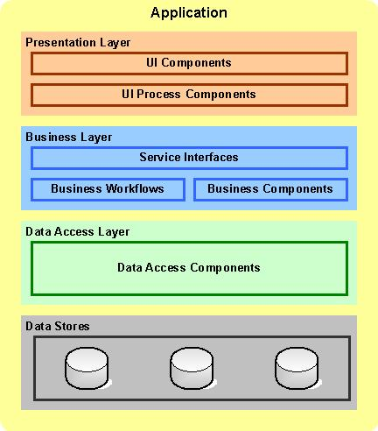
Traditional examples
A simple, typical example

Slide 8
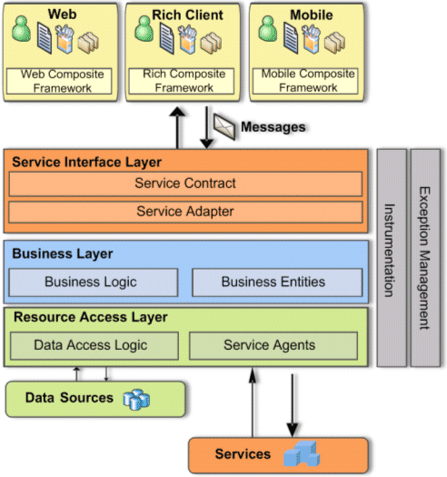
Traditional examples
Service Interface Layer is separated from Business Layer

Slide 9
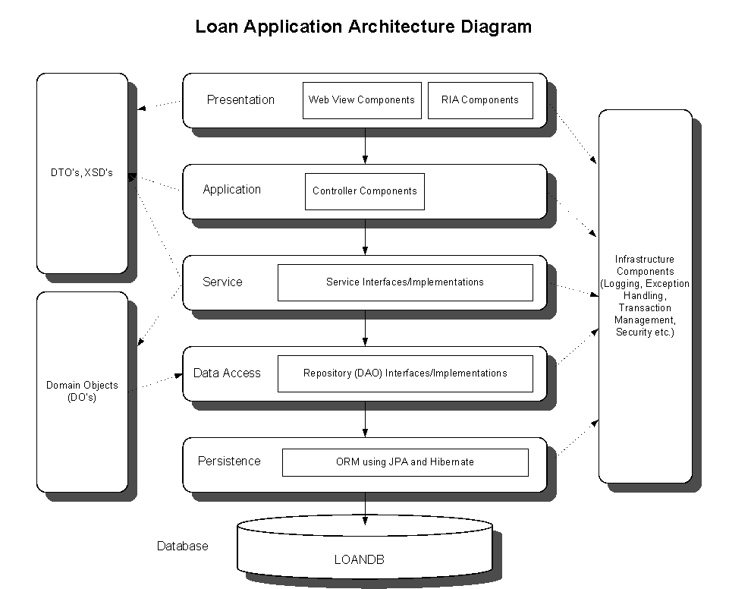
Traditional examples
Further layer separation

Slide 10
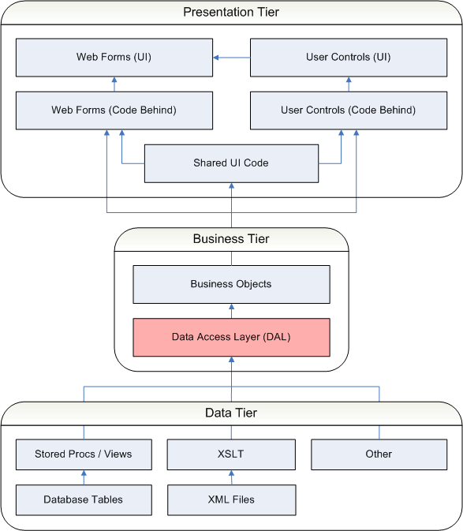
Traditional examples
Conceptual and physical views combined

Slide 11
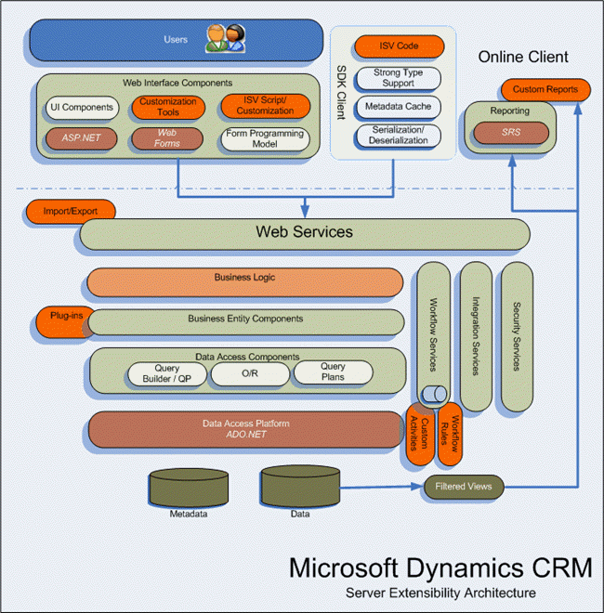
Traditional examples
So easy to understand something like this now, right ☺?

Slide 12
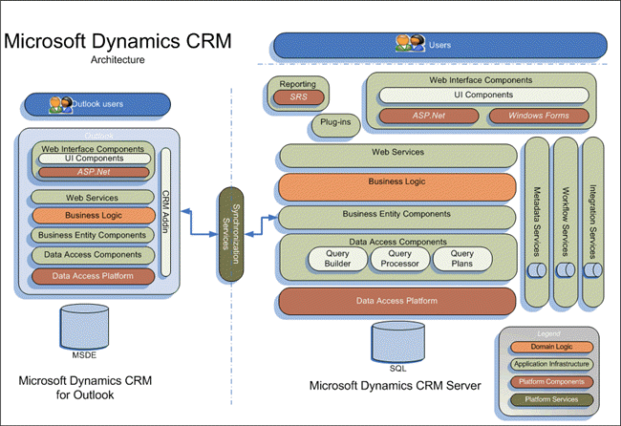
Traditional examples
Just to remind, layered architecture is applicable to any application: client-side, server-side, etc.

Slide 13
Q & A
What’s wrong with the examples?
They are similar, but not standardized.
How can we standardize them?
DDD.

Slide 14
What is DomainDrivenDesign?
A standardization of the best implementations of layered architecture
An approach to software development for complex needs by connecting the implementation to an evolving model

Slide 15
DDD premises
Primary focus = Domain layer
Base complex designs on a model of the domain
Initiate a creative collaboration between technical and domain experts to iteratively refine a conceptual model that addresses particular domain problems

Slide 16
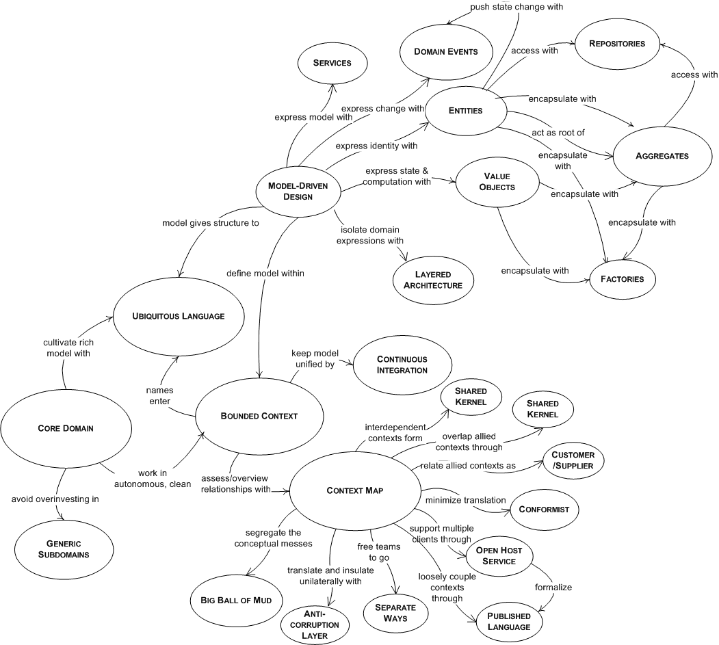
DDD Vocabulary
Visit here: http://en.wikipedia.org/wiki/Domain-driven_design

Slide 17
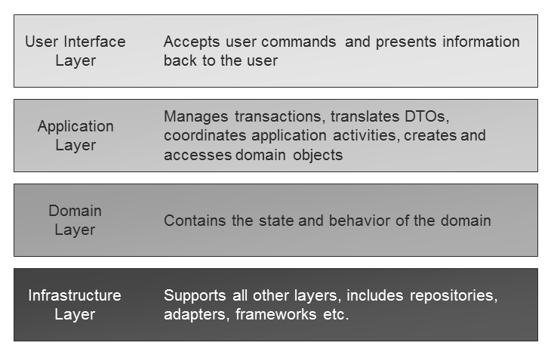
DDD – Typical layers

Slide 18
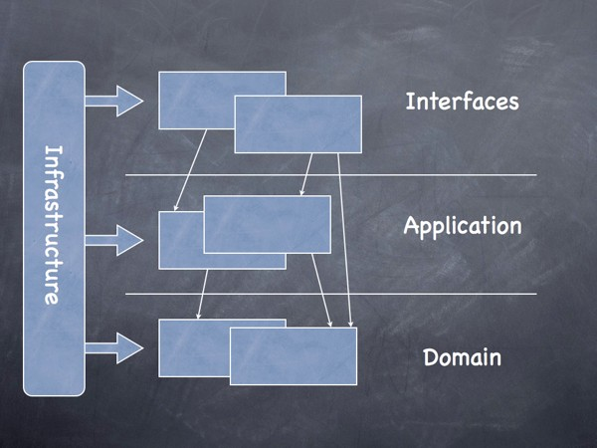
DDD – Typical layers
Visit here: http://dddsample.sourceforge.net/architecture.html

Slide 19
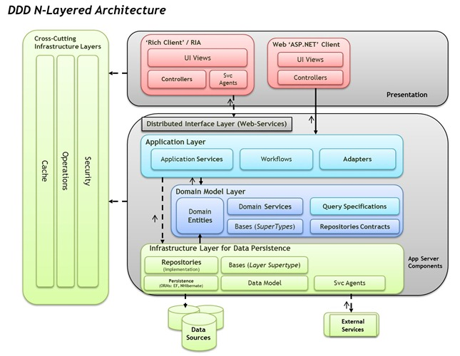
DDD N-layer architecture

Slide 20

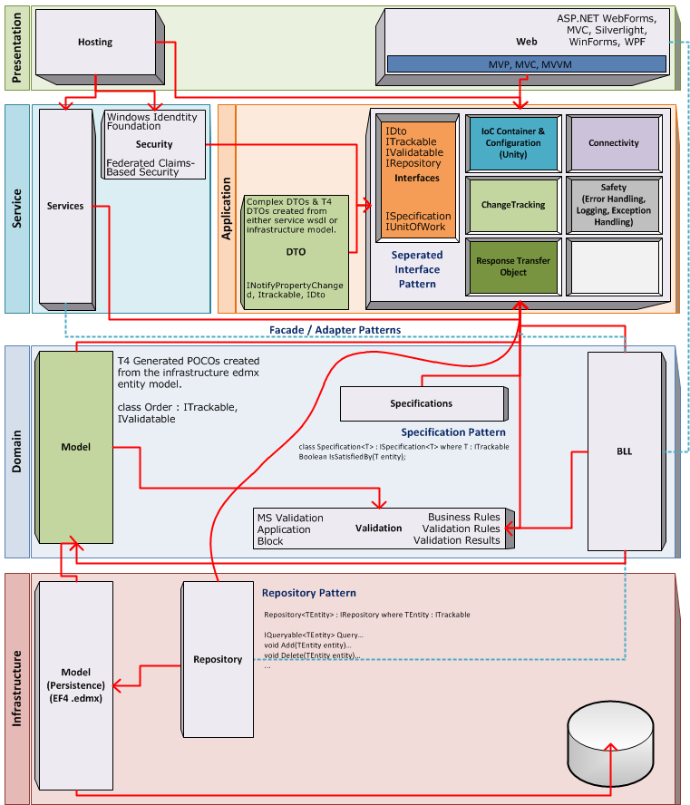
A bit deeper dive

Slide 21
Q & A
What’s wrong with that implementation?
Domain layer depends on Infrastructure layer.
Why is such dependency wrong?
Because real-world domains do not.
How to remove that dependency?
Clean architecture

Slide 22
What is clean architecture?
Aim to produce systems:
Testable
Independent of
Frameworks
UI
Database
Any External Agency
Dependency rule:
Source code dependencies can only point inwards

Slide 23
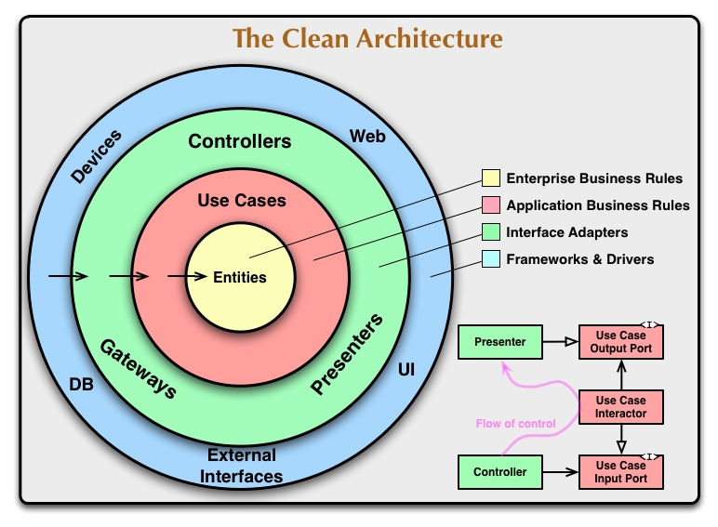
Clean architecture
Visit here: http://blog.8thlight.com/uncle-bob/2012/08/13/the-clean-architecture.html

Slide 24
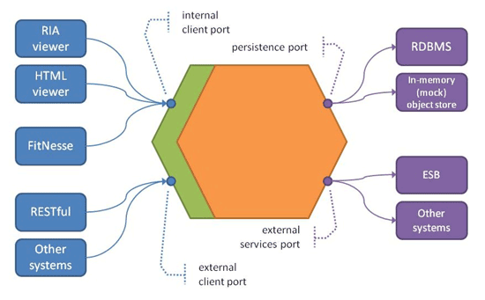
Examples
Hexagonal architecture: http://alistair.cockburn.us/Hexagonal+architecture

Slide 25
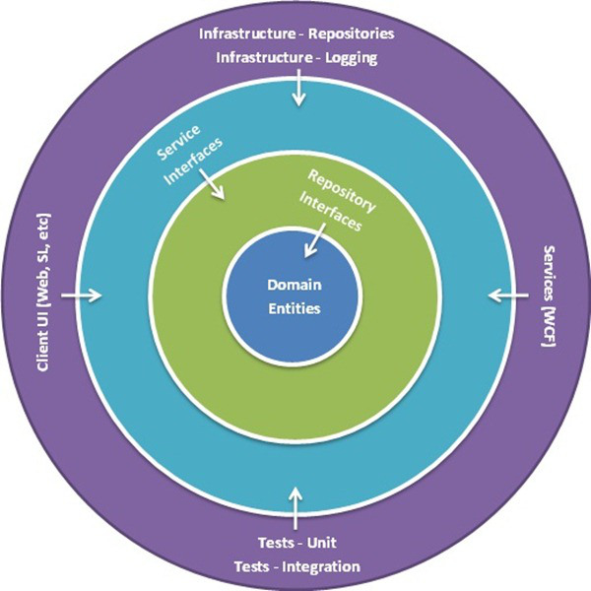
Onion architecture
Application core
Onion architecture: http://jeffreypalermo.com/blog/the-onion-architecture-part-1/

Slide 26
Q & A
What’s wrong with all aforementioned stuffs?
They have not focused on delivering sets of functionality independently as well as flexibly integrating with other apps.
But they can, using components / modules.
Not as well as SOA services.
How better?
They help to maximize the business values. You can deliver smaller parts at cheaper costs, and you can deliver more by better integrating with other apps.

Slide 27
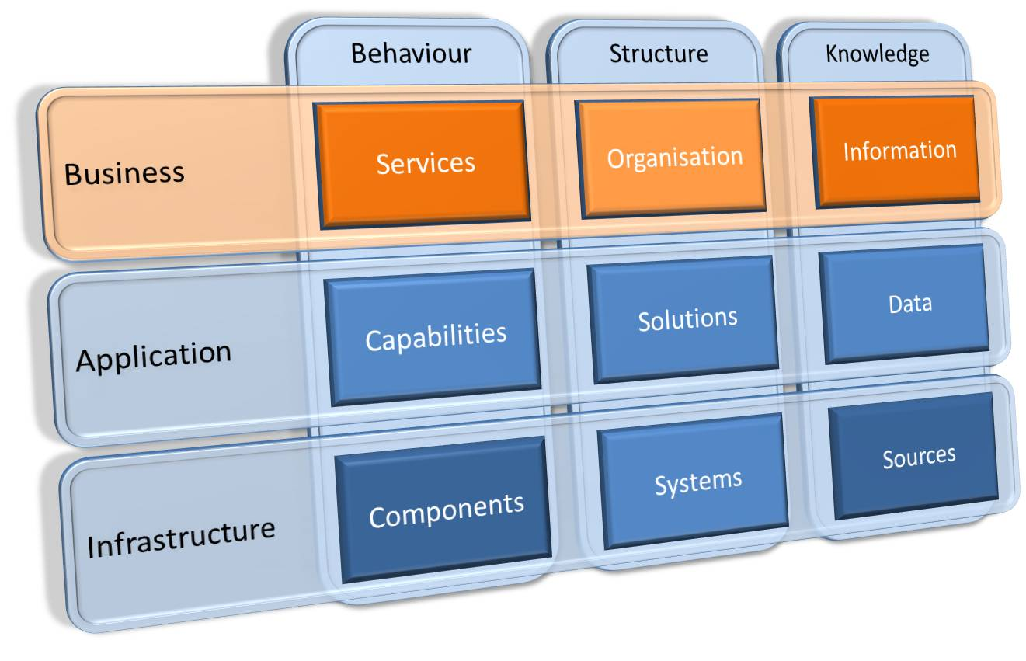
From business view
Enterprise Architecture: http://theenterprisingarchitect.blogspot.com/

Slide 28
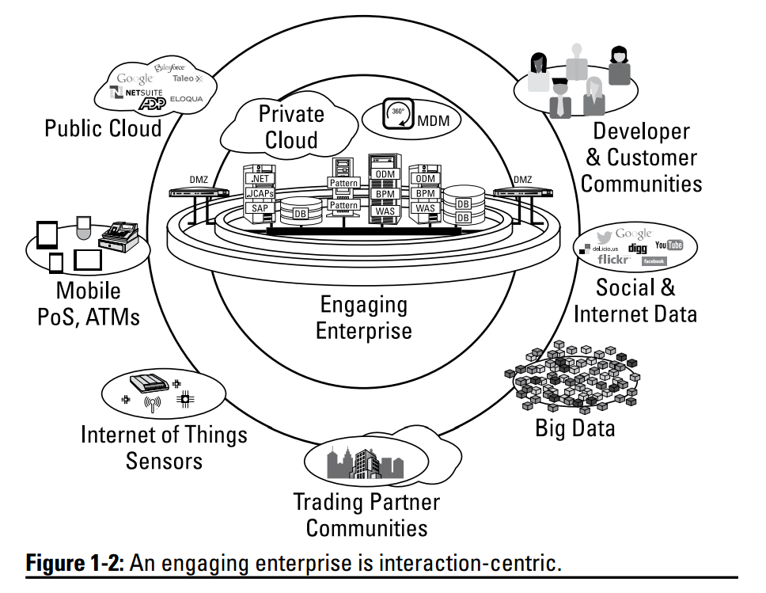
Needs for SOA

Slide 29
SOA principles
Service orientation at the core
Process integrity at Internet scale
Integration with enterprise capibilities and backend systems
A basis in industry standards
Leveraging and extending open-source techs
Providing the platform for a growing ecosystem

Slide 30
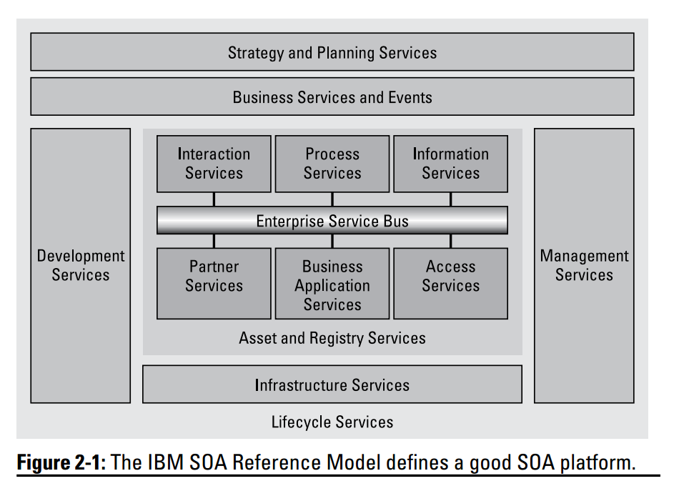
SOA platform

Slide 31
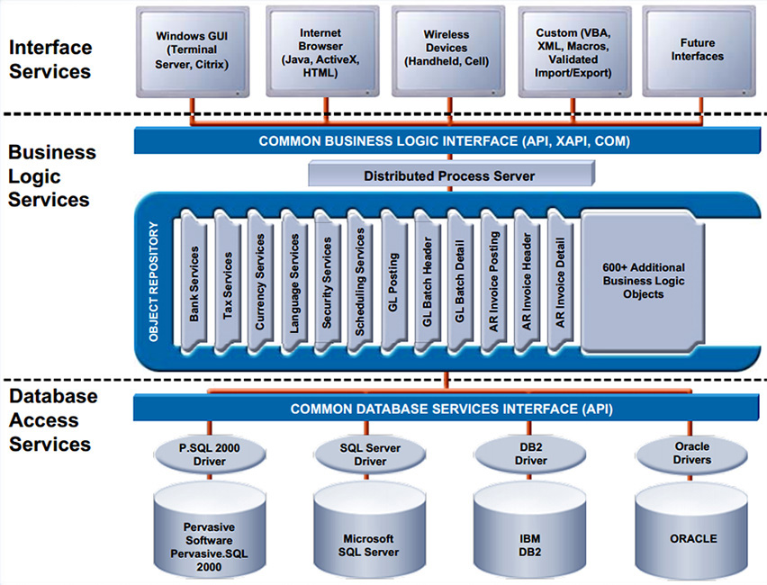
Example

Slide 32
Q & A
What’s wrong with SOA?
It’s just one side of a coin
What coin?
Cloud computing
What’s the other side?
Dynamic infrastructure
Oh, my god! What are they all about?

Slide 33
Sample need: Socializing with SOA

Slide 34
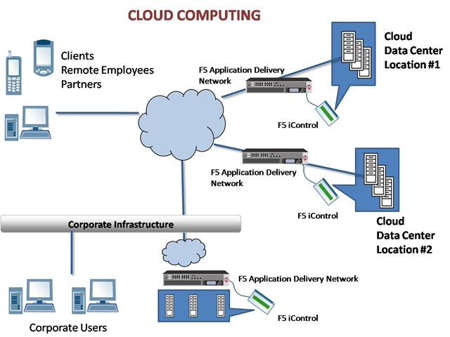
Cloud computing
We already have Internet as the backbone

Slide 35
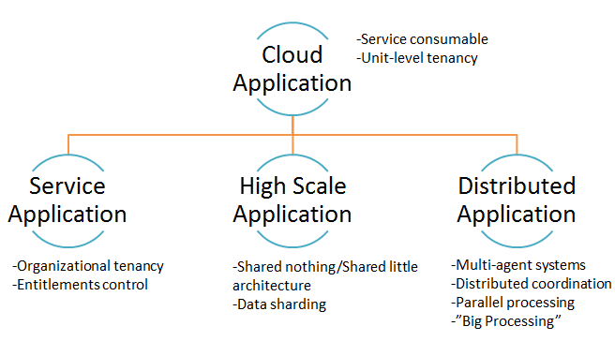
Cloud application
What remain are our applications need to be cloud-ready http://apprenda.com/blog/answer-this-what-is-a-cloud-application-to-you/

Slide 36
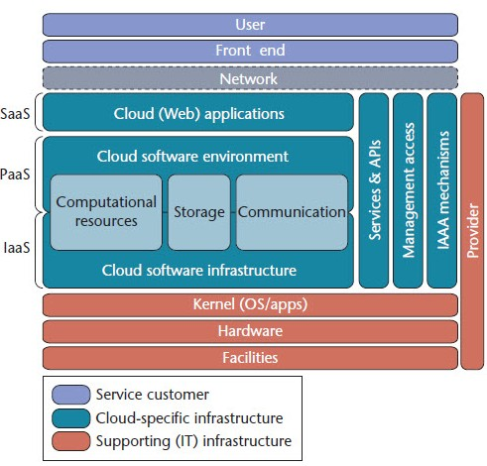
Dynamic infrastructure
… and dynamic infrastructure has to be available via Internet http://en.wikipedia.org/wiki/Dynamic_infrastructure

Slide 37
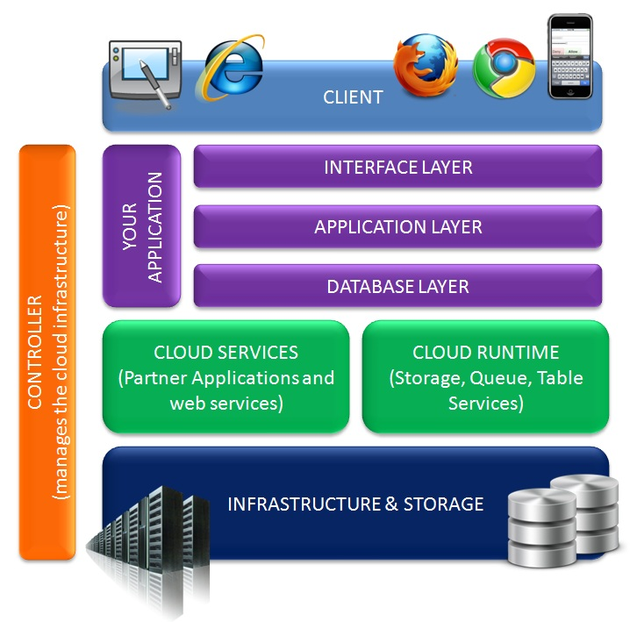
Cloud-based architecture is simple
Then our app architecture is as simple as we used to see

Slide 38
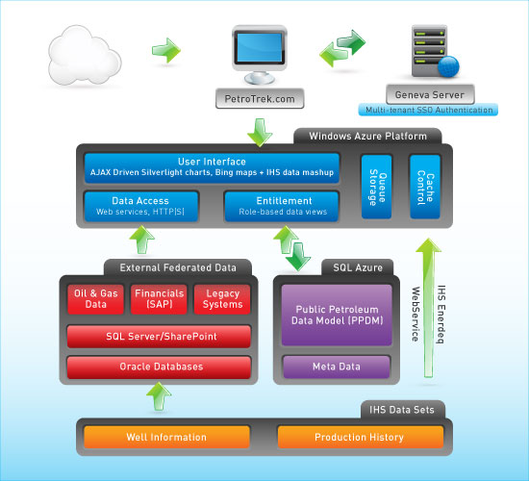
Example with Azure platform

Slide 39
Q & A
What’s wrong with the cloud?
Well, it is the current and future trend of software development. The cloud has changed medicine, real estate, small business, enterprise IT and a whole lot more. Engaging businesses will stick to the cloud. More here.
What’s after the cloud?
I’ve answered so far. It’s your turn now (tip in references) ☺.

Slide 40
As a summary
Layered Architecture solves biz requirements
DDD focuses on the Domain layer, thus increases biz semantics
Clean Architecture adds more technical value by making the app core technical-independent
SOA maximizes biz values by delivering functionality in industry-compliant units
Cloud-based Architecture maximizes technical values all over the Internet to deliver SOA services
… (You know what the next will do ☺?)

Slide 41

Q & A

Slide 42
References
Design views:
http://www.1keydata.com/datawarehousing/data-modeling-levels.html
http://it.toolbox.com/blogs/bridging-gaps/systems-architecture-fundamentals-conceptual-logical-physical-designs-11352
Layered architecture:
http://archfirst.org/books/layered-architecture
http://en.wikipedia.org/wiki/Multilayered_architecture
DDD (Domain-Driven Design):
http://en.wikipedia.org/wiki/Domain-driven_design
http://archfirst.org/books/domain-driven-design
http://dddsample.sourceforge.net/architecture.html
http://www.infoq.com/articles/ddd-in-practice
http://blogs.msdn.com/b/marblogging/archive/2011/05/23/domain-drive-design-n-layered-net-4-0-architecture-guide.aspx
Clean architecture:
http://alistair.cockburn.us/Hexagonal+architecture
http://blog.8thlight.com/uncle-bob/2012/08/13/the-clean-architecture.html
Enterprise Architect:
http://theenterprisingarchitect.blogspot.com/
SOA:
http://en.wikipedia.org/wiki/Service-oriented_architecture
http://searchsoa.techtarget.com/definition/service-oriented-architecture
SOA Design Principles for Dummies, IBM Limited Edition, Claus T.Jensen, A Wiley Brand
Cloud computing:
http://apprenda.com/blog/answer-this-what-is-a-cloud-application-to-you/
http://searchcloudcomputing.techtarget.com/definition/Software-as-a-Service
http://searchcloudcomputing.techtarget.com/definition/Platform-as-a-Service-PaaS
http://searchcloudcomputing.techtarget.com/definition/Infrastructure-as-a-Service-IaaS
http://en.wikipedia.org/wiki/Dynamic_infrastructure
http://www.onlinetech.com/resources/wiki/data-centers/after-the-cloud-what-next-mobile-technology-in-data-centers

Slide 43
Thanks for coming.
See ya!
For more, please visit: http://phuonglamcs.com/relax/presentations/

