Slide 1
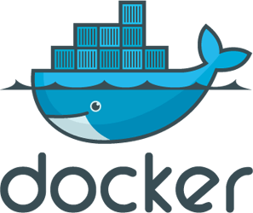
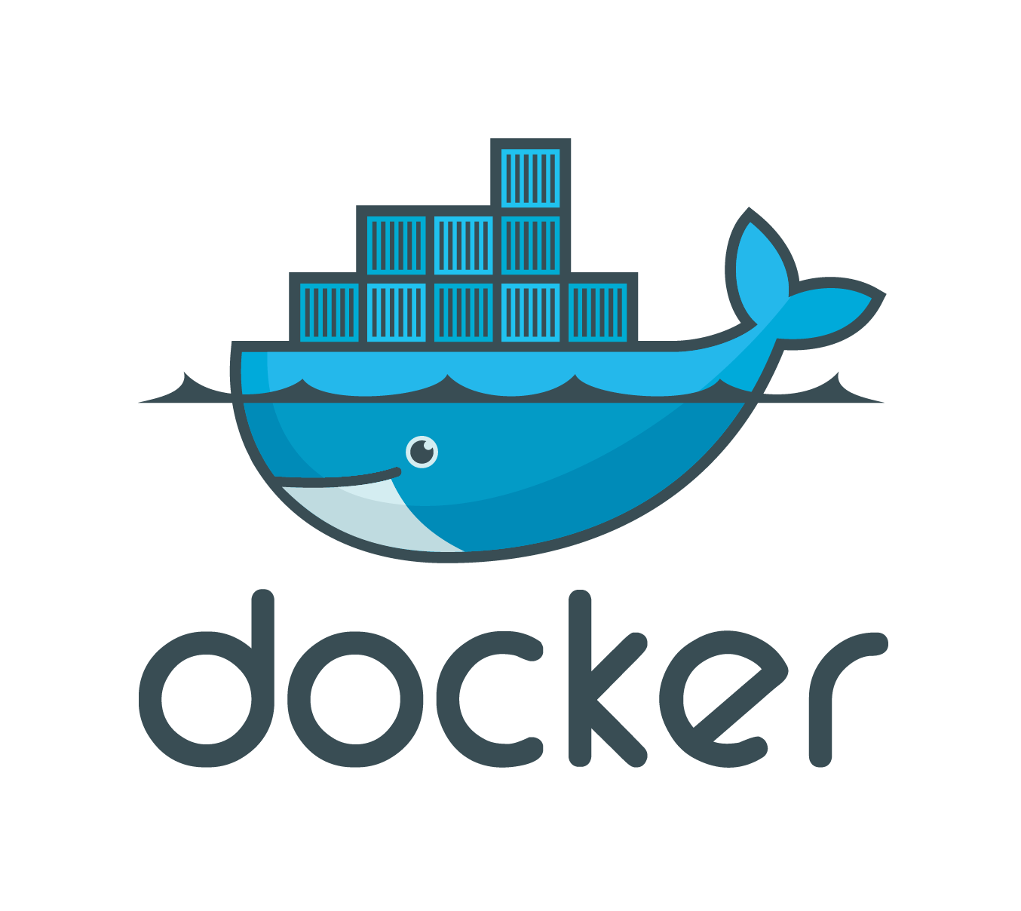

INTRO TO
Presenter: PhuongNQK

Slide 2
Goals
Introduce you to
The basics of Docker
At the end of this presentation, you will know
What Docker is
What Docker can do
How to work with Docker

Slide 3
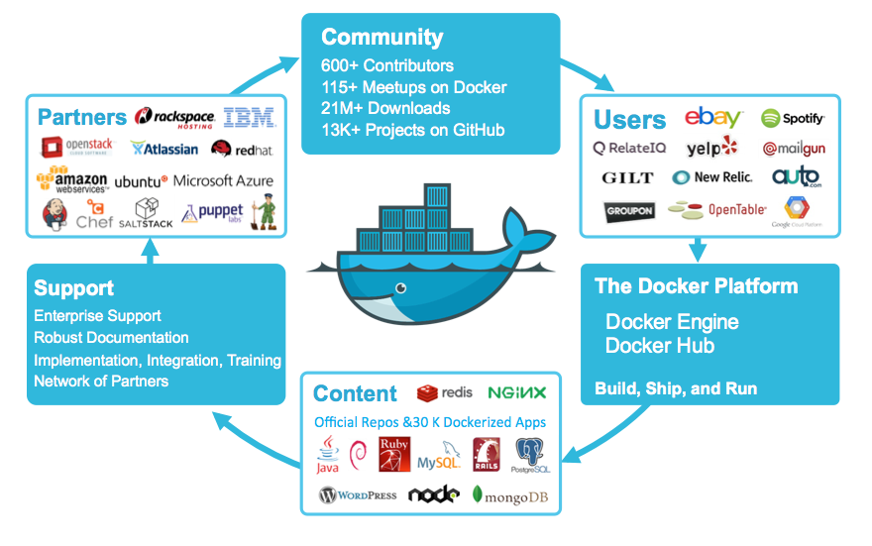
Brief view of Docker

Slide 4
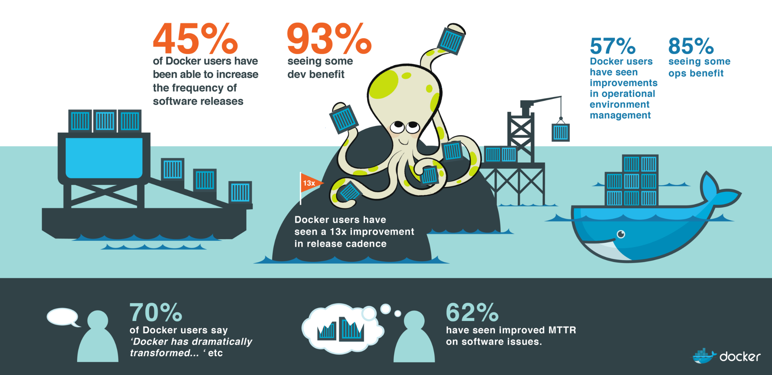
Docker has helped…
More: https://www.docker.com/survey-2016

Slide 5
What is Docker?

Slide 6
What is Docker?
According to https://www.docker.com/what-docker
Docker is the world’s leading software container platform.

Slide 7
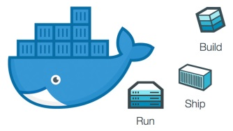


What is Docker?
Docker is a platform for developers and sysadmins to develop, ship, and run apps. It has rapidly gained popularity as one of the best tools to build, ship, and run software.

Slide 8
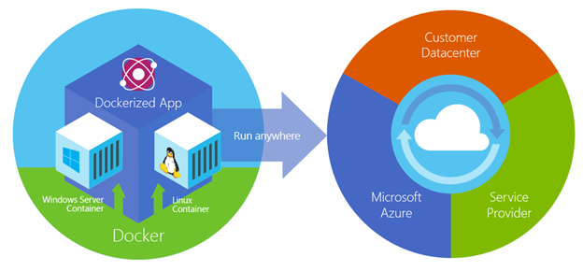
What can do?
Replicate the exact environment of the builds locally
Run deployments against different environments (i.e. QA or production) consistently
BUILD
SHIP
RUN
Any applications
Anywhere

Slide 9



Who and What can help?
Eliminate “works on my machine” problems when collaborating on code with co-workers
DEV
Run and manage apps side-by-side in isolated containers to get better compute density
OPERATOR
Build agile software delivery pipelines → ship new features faster, more securely and with confidence for both Linux and Windows Server apps

Slide 10
How can do that?

Slide 11
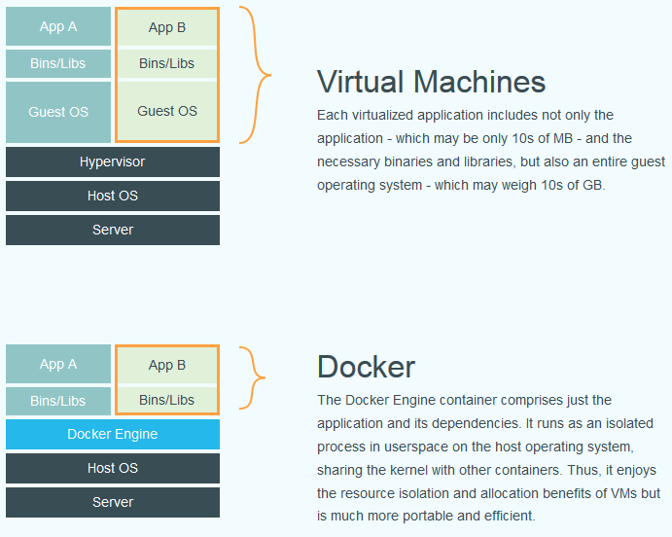
By refactoring VM architecture...
(From http://virtualization.info/en/news/2014/06/release-docker-docker-engine-1-0.html)

Slide 12
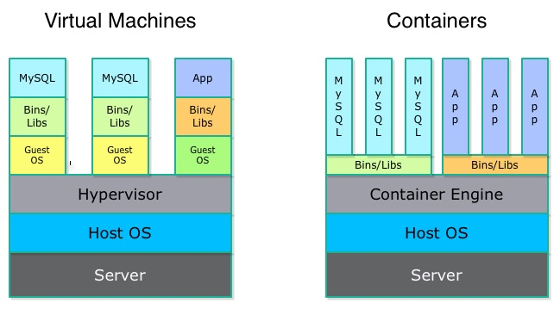

... to improve shareability
Bins/Libs and Guest OS layers cannot be shared between VMs
Bins/Libs layers are shareable between Containers
http://patg.net/containers,virtualization,docker/2014/06/05/docker-intro/
As a result, Docker has the combined strengths of:
- VMs: provide a portable environment
- Processes: are much faster and more lightweight than VMs
- app-get: can download apps from the Internet fast and easily

Slide 13
I want to know more.

Slide 14
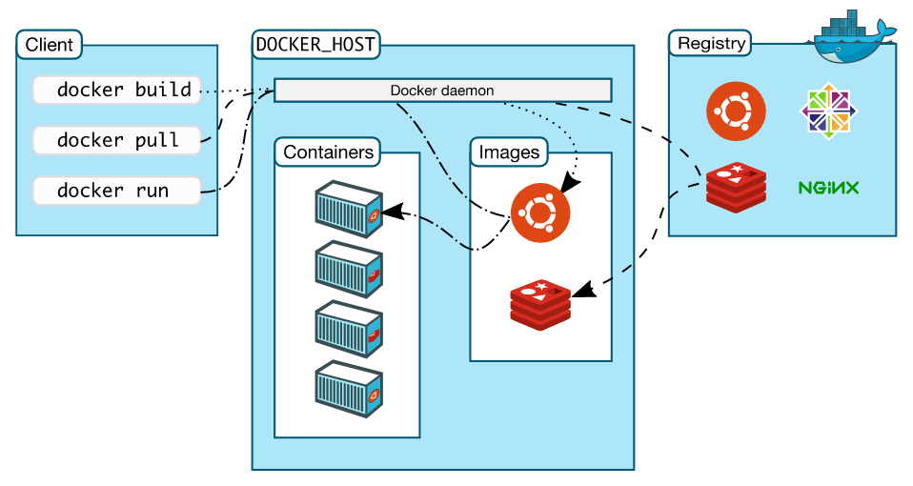
Docker architecture
https://docs.docker.com/engine/docker-overview/
Docker Hub
Docker Cloud
Docker Store
Trusted Registry
Private Registry
Local Registry
Docker Engine

Slide 15
Docker terminology
Build
Dockerfile, image
Ship
Registry, repository, index
Docker ID
Run
Engine
Container, machine
.yml, service, stack (service group), node – swarm
https://docs.docker.com/engine/docker-overview/ http://blog.thoward37.me/articles/where-are-docker-images-stored/

Slide 16
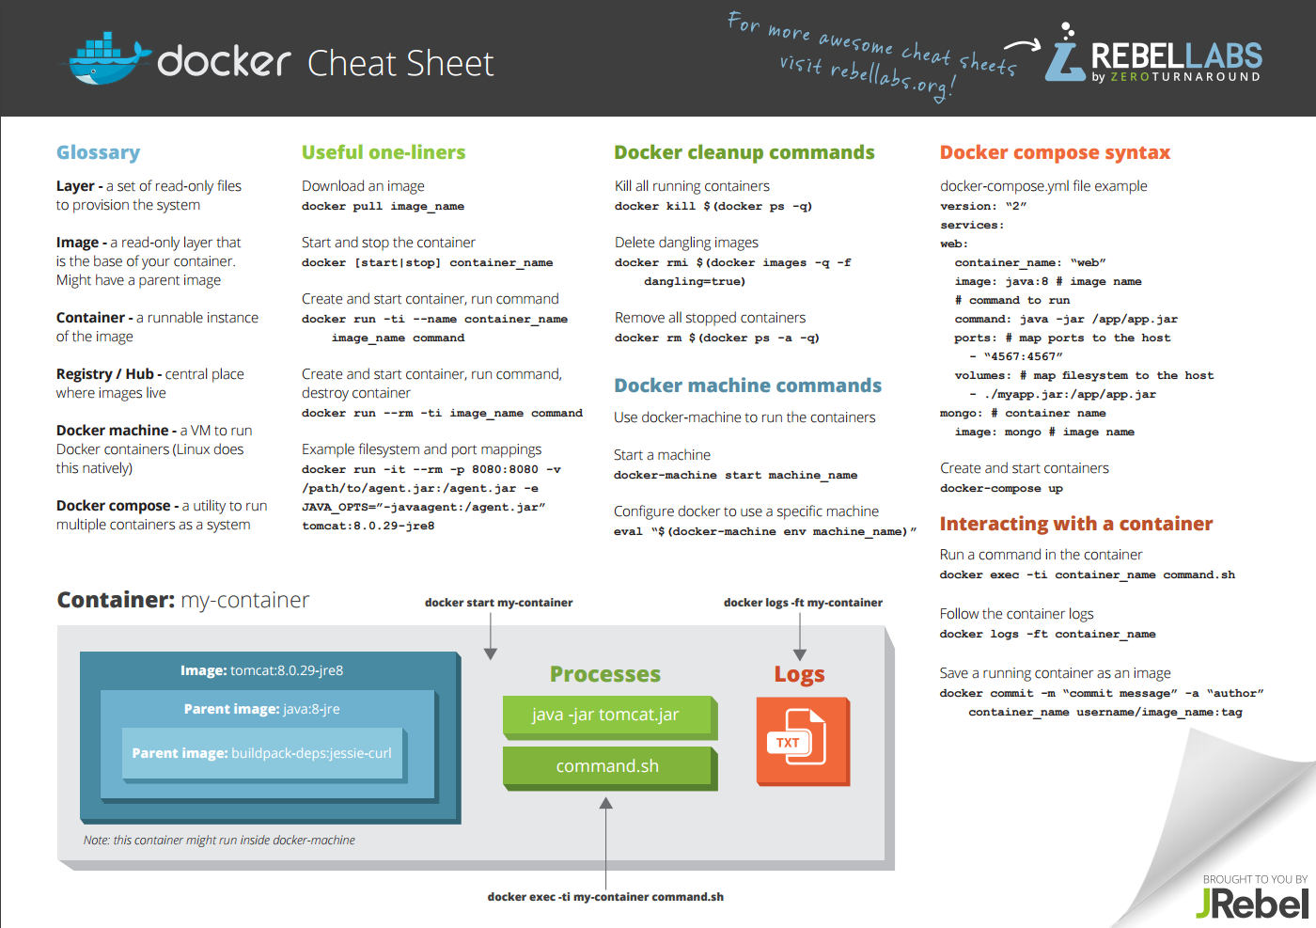
http://files.zeroturnaround.com/pdf/zt_docker_cheat_sheet.pdf

Slide 17
Let’s play…
Source
Run Docker client/daemon
Dockerfile and build
compose.yml and deploy
Docker ID and push
Now pull and run from anywhere

Slide 18
Q & A

Slide 19








Where to start?
Finish this first: https://docs.docker.com/get-started/
Then you are ready to dig deeper
For .NET: https://hub.docker.com/r/microsoft/dotnet/
For Java: https://hub.docker.com/_/java/
In general, visit https://hub.docker.com and search for what you need, e.g. python, php, ruby, golang, mongo, mysql, etc.
... and deeper: https://docs.docker.com/

Slide 20
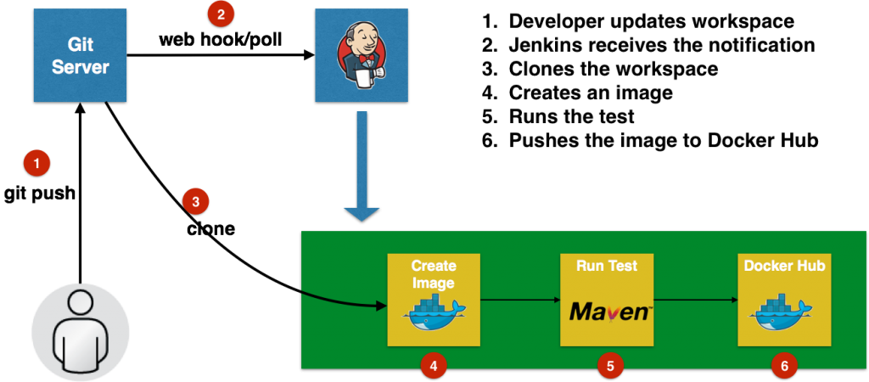
A sample workflow

Slide 21
Real-world applications
Atlassian
http://atlassianblog.wpengine.com/2013/06/deploy-java-apps-with-docker-awesome/
https://www.atlassian.com/blog/archives/docker-all-the-things-at-atlassian-automation-and-wiring
SevenBridges
http://docs.sevenbridges.com/docs/docker-basics
Spirula
https://www.spirulasystems.com/blog/2015/06/25/building-an-automatic-environment-using-consul-and-docker-part-1/
https://www.spirulasystems.com/blog/2015/07/02/automatic-environment-using-consul-and-docker-swarm-part-2/

Slide 22
Further references
https://docs.docker.com
https://zeroturnaround.com/rebellabs/docker-commands-and-best-practices-cheat-sheet/
http://docs.sevenbridges.com/docs/docker-basics
https://docs.microsoft.com/en-us/dotnet/standard/architecture/
https://www.assistanz.com/windows-container-docker-terminology-concepts/
https://www.stevejgordon.co.uk/docker-dotnet-developers-part-1
https://github.com/IdentityServer/IdentityServer4.Samples/tree/release/Docker
https://docs.docker.com/engine/userguide/eng-image/multistage-build/
https://blog.docker.com/2016/07/the-10-most-common-questions-it-admins-ask-about-docker/
https://www.slideshare.net/apemberton/reduce-friction-with-docker-jenkins
https://www.linkedin.com/pulse/microservices-devops-docker-new-soa-software-part-i-polero-baraldi

Slide 23
Thanks for coming.
See ya!
For more, please visit: http://phuonglamcs.com/relax/presentations/

