Slide 1
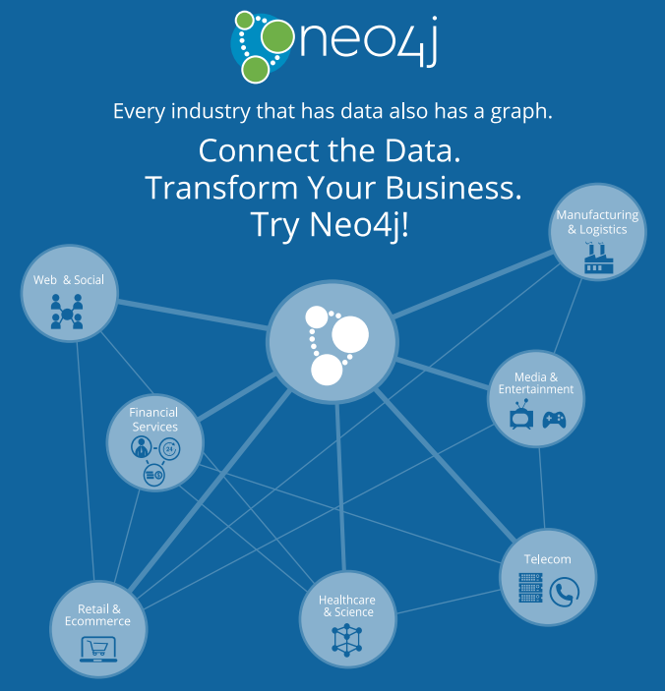
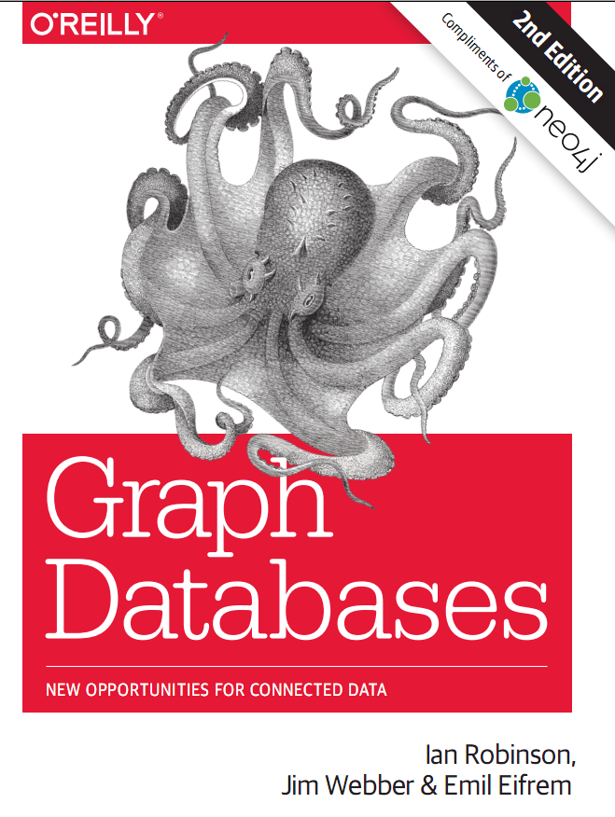
Graph databases
Presenter: PhuongNQK

Slide 2
Goals
Introduce you to
The basics of graph databases
Neo4j & Cypher
At the end of this presentation, you will be able to
Write basic graph queries using Cypher

Slide 3
What is a graph?
- A graph is just a collection of vertices and edges - or, in less intimidating language, a set of nodes and the relationships that connect them.
- Nodes often represent entities.
- Relationships describe how entities are connected. They can be undirected or directed (uni- or bi-directional).
- A graph can contain multiple subgraphs.
- The simplest graph contains only 1 node.
1
2
Node
5
3
Relationship
4
6
See: https://en.wikipedia.org/wiki/Graph_(mathematics)

Slide 4
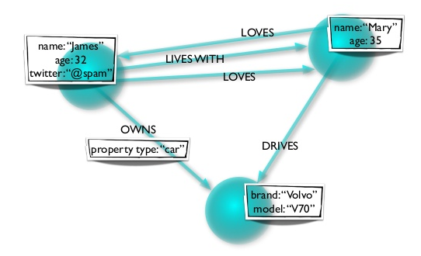
Graphs are everywhere
This general-purpose, expressive structure allows us to model all kinds of scenarios, from the construction of a space rocket, to a system of roads, and from the supply-chain or provenance of foodstuff, to medical history for populations, and beyond.

Slide 5
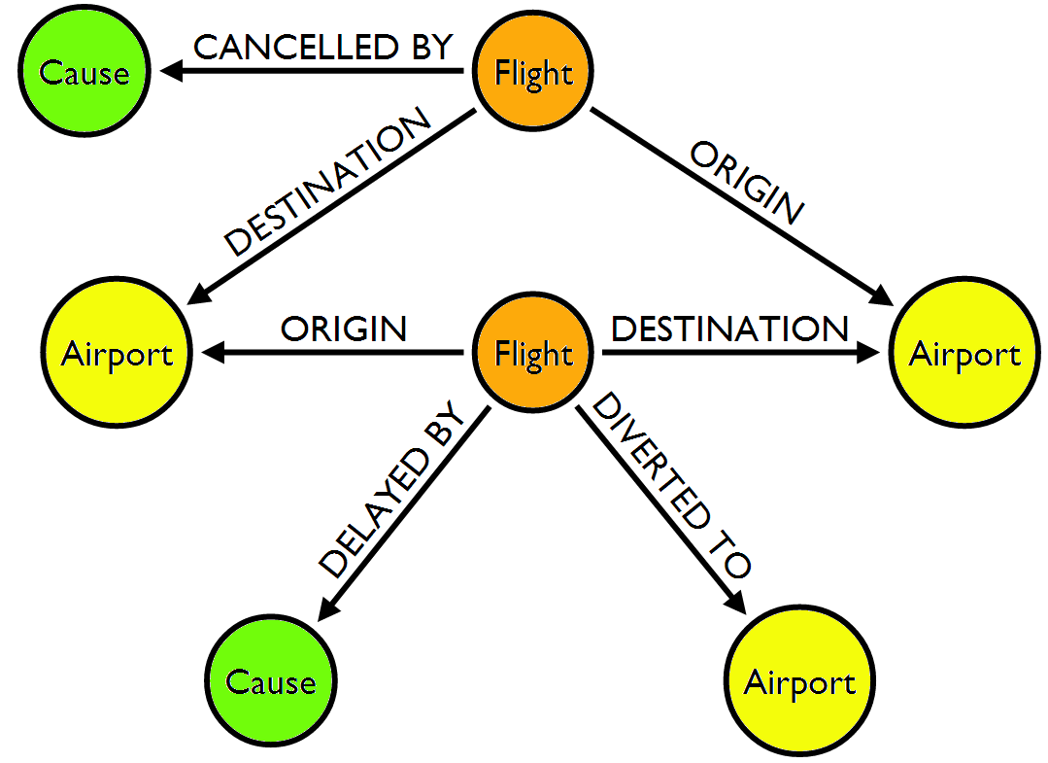
Graphs are everywhere
Graphs are easy to draw and understand.

Slide 6
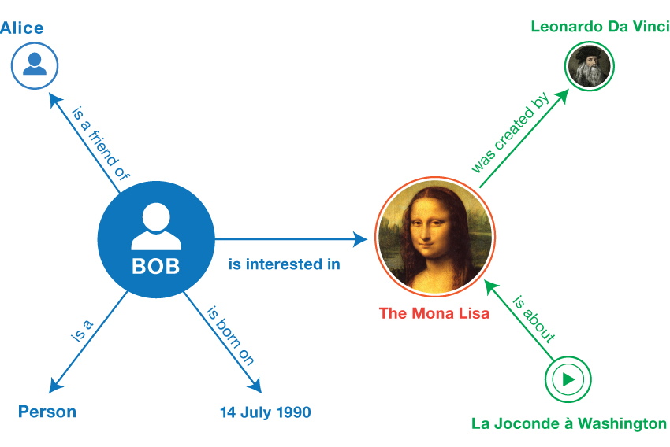
Graphs are everywhere
The direction of a relationship often depends on the entity selected as the subject.

Slide 7
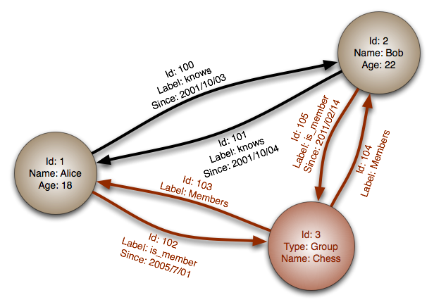
Graphs are everywhere
Both nodes and relationships can have properties.

Slide 8
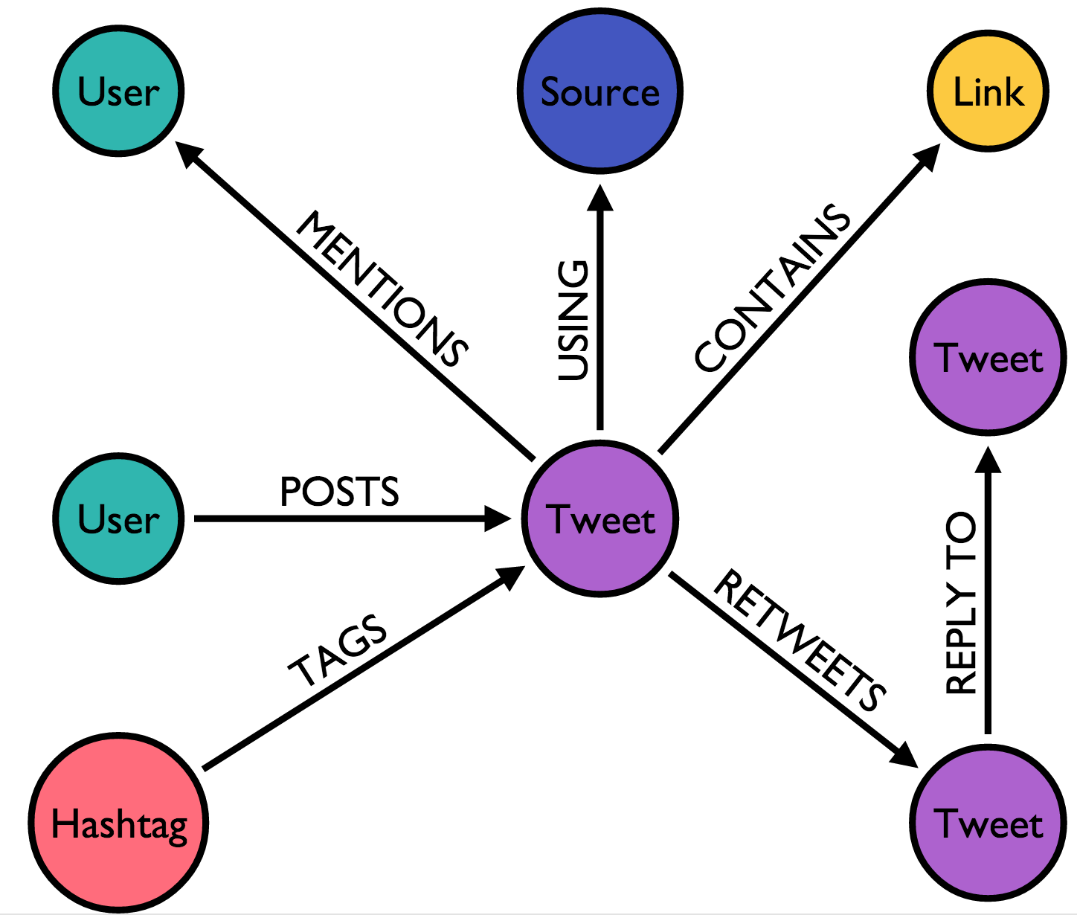
Graphs are everywhere
Graphs can expressively describe complex connections.

Slide 9
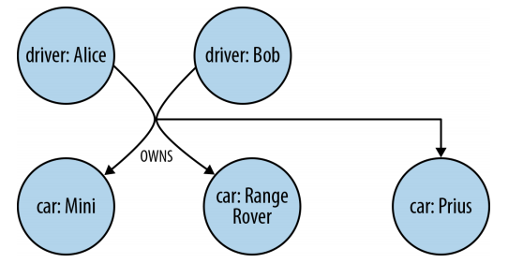
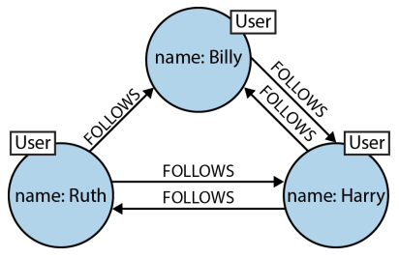
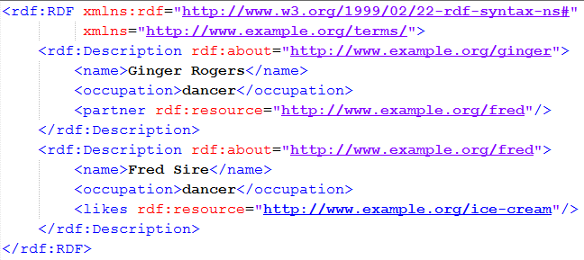
Graphs are modeled diversely
Hypergraph
Label Property Graph
Triple

Slide 10
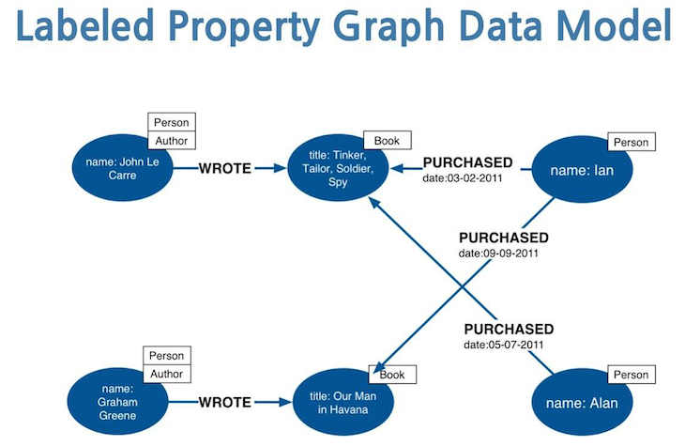
Most popular graph model
Graph contains nodes and relationships.
Relationships are named and directed, and always have a start and end node. They can also contain properties.
Nodes contain properties (key-value pairs) and can be labeled with one or more labels.

Slide 11

Q & A

Slide 12
What is a graph database?
An online DBMS with CRUD methods that expose a graph data model
Generally built for use with transactional (OLTP) systems → Normally:
Optimized for transactional performance
Engineered with transactional integrity and operational availability in mind

Slide 13
2 properties of graph databases
Underlying storage
Native graph storage
Relational db, OO db, general-purpose data store
Processing engine
Native graph processing (index-free adjacency)
Simulated graph processing

Slide 14
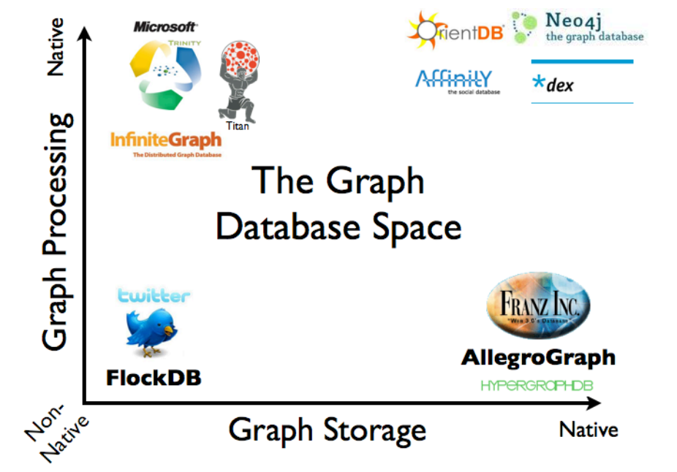
Graph database space

Slide 15
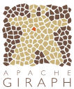

Graph DB is just a half of graph space
Graph compute engines (OLAP)
Technologies used primarily for offline graph analytics, typically performed as a series of batch steps
Graph databases (OLTP)
Technologies used primarily for transactional online graph persistence, typically accessed directly in real time from an application
Cassovary
Graph space

Slide 16
Q & A

Slide 17
What is Neo4j?
The world’s leading graph database

Slide 18
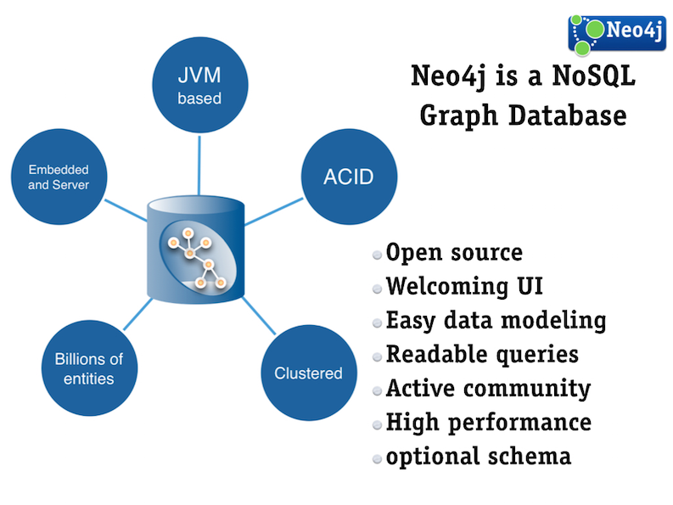
What is Neo4j?

Slide 19
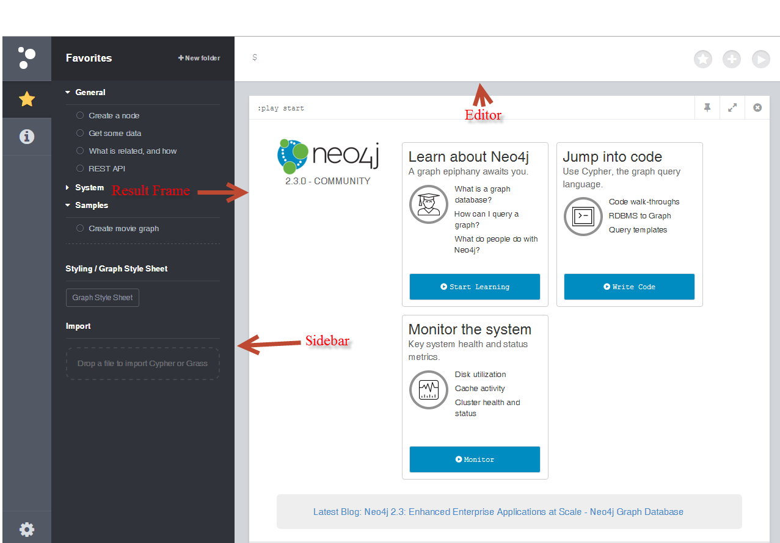
Neo4j
Neo4j is like a mashup of a REPL + lightweight IDE + graph visualization

Slide 20
Q & A

Slide 21
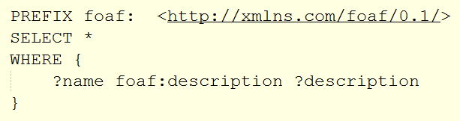



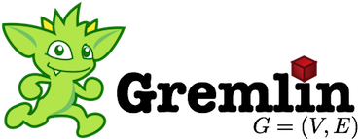
Graph query languages
Declarative Cypher
RDF-based SPARQL
MORE
MORE
Path-based
MORE

Slide 22
What is Cypher?
The easiest graph query language
Neo4j’s
A special-purpose programming language for describing queries and operations on a graph database, with accompanying natural language concepts

Slide 23
Cypher’s building blocks
Data types
number, string, boolean, collection, map
Special value: NULL
Concepts
node, relationship, property
label, identifier
path, pattern
Function targets
literal, node, relationship, property, label, path, index, constraint, map, collection

Slide 24
Cypher’s properties
Natural
Simple
SQL-like (textual, declarative)
Pattern-based

Slide 25
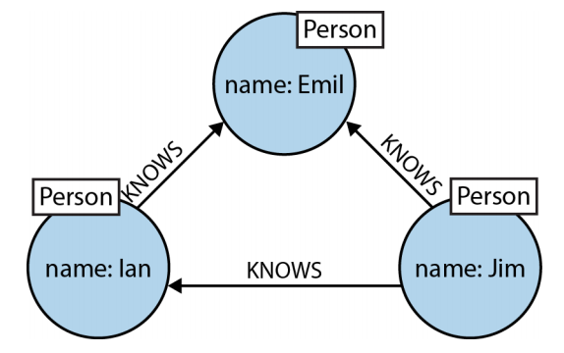
Cypher is natural
Cypher patterns follow very naturally from the way we draw graphs on the whiteboard.
Graph
Start node
Relationship
End node
ASCII art

Slide 26
Cypher is simple
Node: (expr)
Relationship: [expr]
Connector: - -> <-
Path: N1-R1->N2…Nn
expr: identifier:LABEL {key1: value1, …}
E.g.
(jim:PERSON)-[:KNOWS]->(mary:PERSON {id: 1})

Slide 27
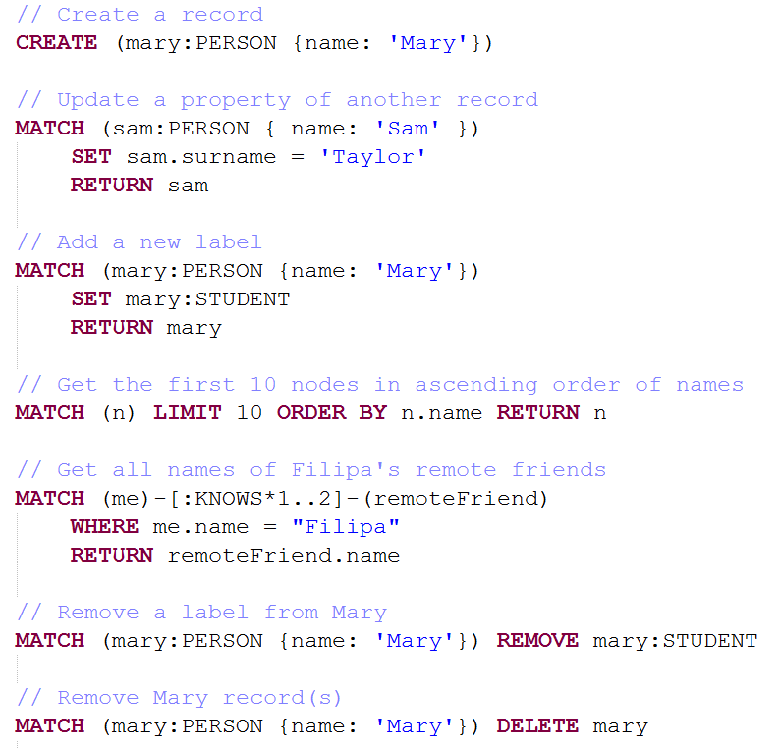
Cypher is SQL-like
MORE

Slide 28
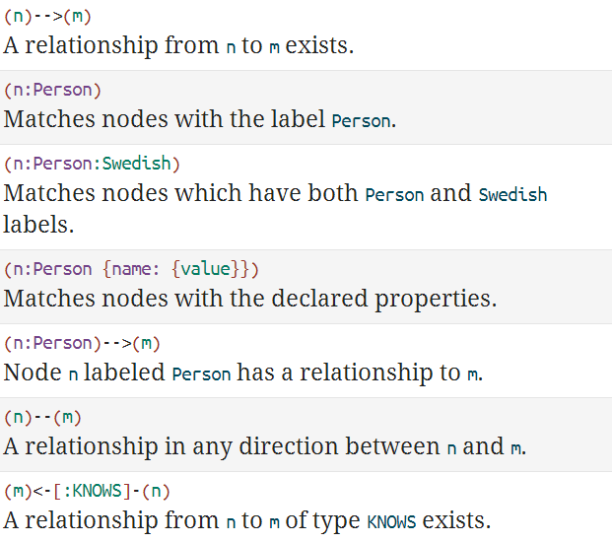
Cypher is pattern-based

Slide 29
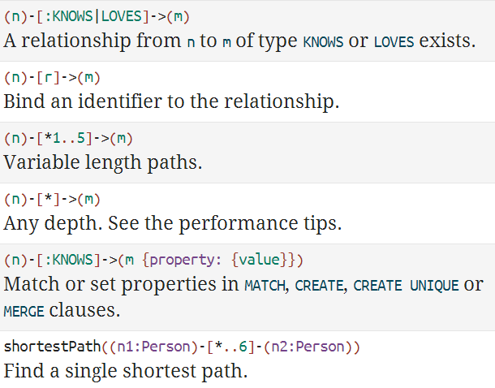
Cypher is pattern-based
MORE

Slide 30
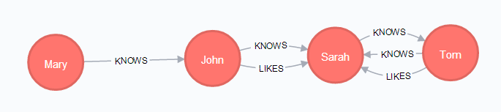
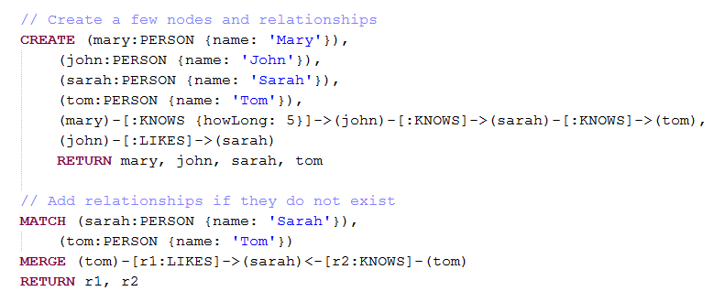
Exercise
Write your Cypher queries to create this graph
Sample answer to demonstrate both CREATE and MERGE

Slide 31
Exercise
Write queries to
Get all we have created so far
Update Mary's age to 18
Add label STUDENT to Mary
Get the first 10 nodes in ascending order of names
Find out who knows who directly
Find out who potentially knows who indirectly (via 1 person)
Find out who potentially knows who indirectly (via any number of people)
Add GAY label to male people who like another male person
Delete everything in the database

Slide 32
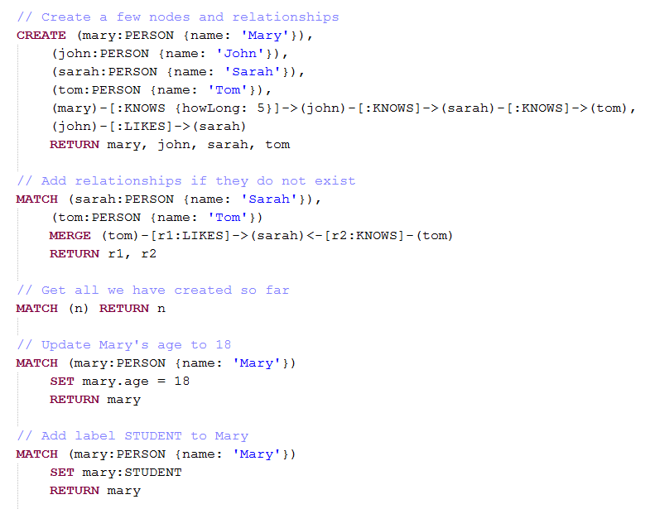
Answer key

Slide 33
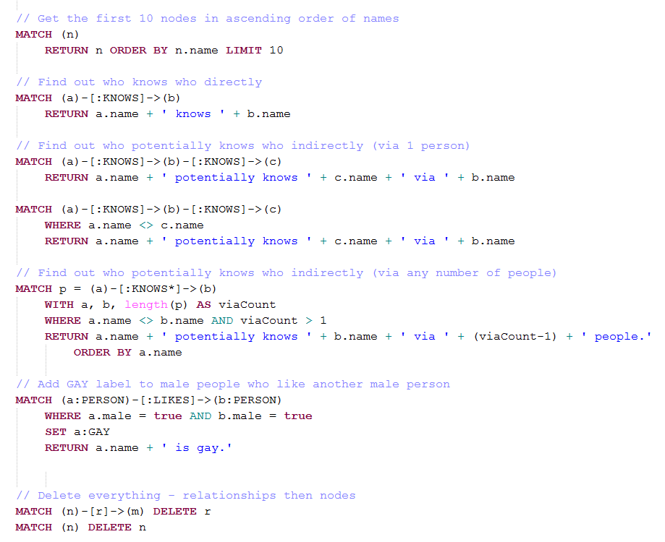
Answer key

Slide 34
Q & A

Slide 35
The power of graph databases
Simple, natural modeling
Super-fast performance
Independent of db size
Extremely flexible data model
Fewer migration
Mode of delivery aligned with today’s agile software delivery practices
Testability
index-free adjacency
Schema-free
No table joining

Slide 36
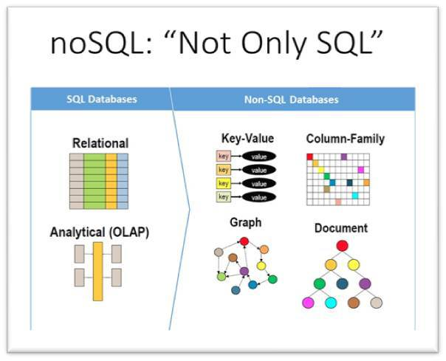
Graph DB vs. other data models

Slide 37
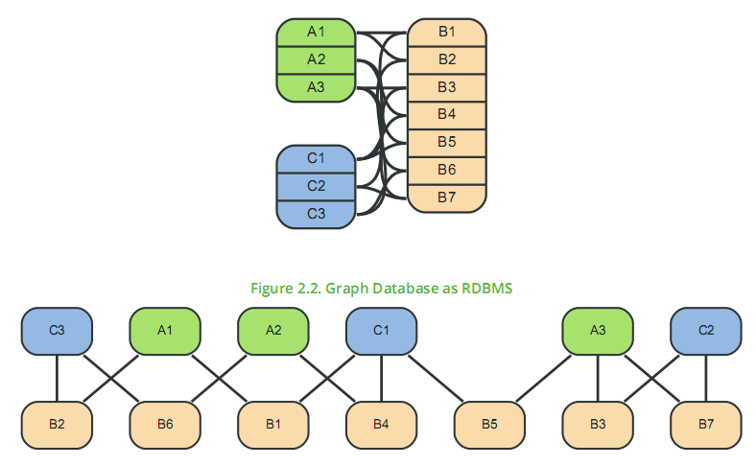
A Graph DB transforms an RDBMS
Relational DB
- Best choice for aggregated data
- A lot of table joining
Graph DB
- Best choice for connected data
- No table joining

Slide 38
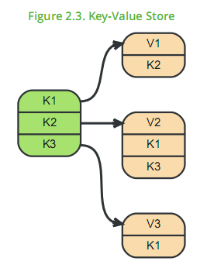
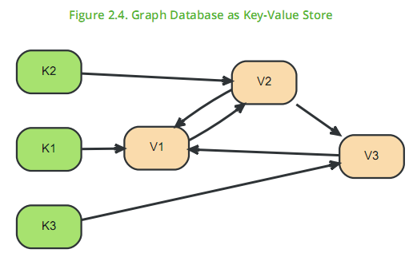
A Graph DB elaborates a Key-Value Store
- K* represents a key, V* a value. Note that some keys point to other keys as well as plain values.
- A Key-Value model is great for lookups of simple values or lists. When the values are themselves interconnected, you’ve got a graph. Neo4j lets you elaborate the simple data structures into more complex, interconnected data.

Slide 39
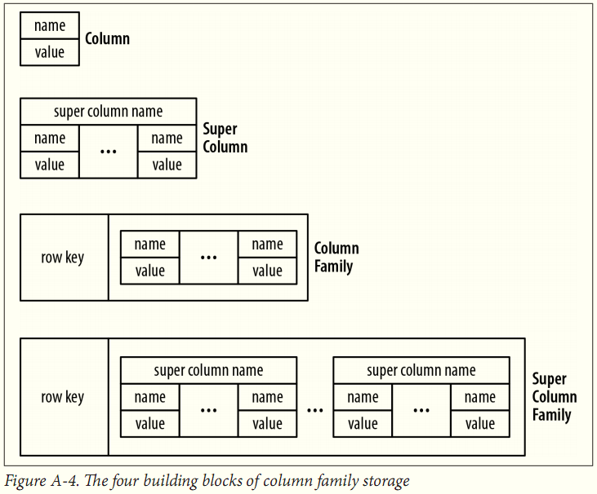
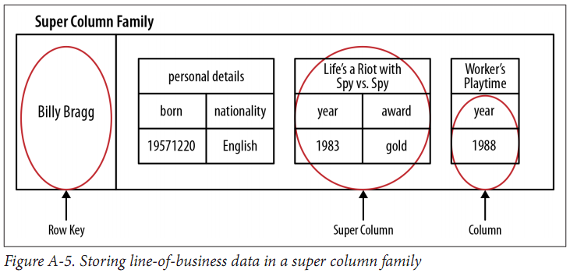
A Graph DB relates Column-Family
Column Family (BigTable-style) databases are an evolution of key-value, using "families" to allow grouping of rows. Stored in a graph, the families could become hierarchical, and the relationships among data becomes explicit.

Slide 40
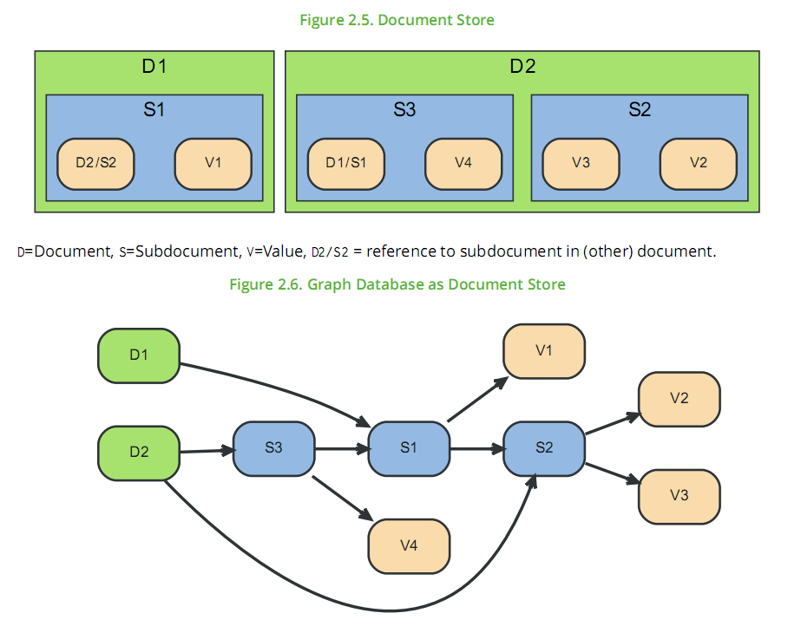
A Graph DB navigates a Document Store

Slide 41
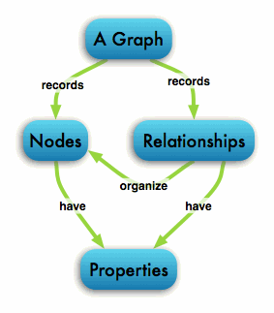
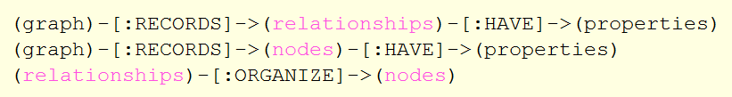
As a summary
A graph database stores data in a graph, the most generic of data structures, capable of elegantly representing any kind of data in a highly accessible way.
The more multi-level the data is connected, the more powerful graph DBs are compared to other DB models.

Slide 42
Q & A

Slide 43
References
Graph Databases – 2e, by Ian Robinson, Jim Webber & Emil Eifrem, O’Reilly
Neo4j Manual v.2.3.0– 2e, by Neo Team, neo4j.com
https://en.wikipedia.org/wiki/Graph_database
http://neo4j.com/developer/get-started/
Example project: http://neo4j.com/developer/example-project/
http://neo4j.com/blog/data-modeling-pitfalls/?utm_source=browser&utm_medium=motd&utm_content=blog&utm_campaign=browser
Cypher ref card: http://neo4j.com/docs/stable/cypher-refcard/?ref=gbd-book
Neo4j training: http://neo4j.com/graphacademy/
GraphGist: collection of community ideas
https://kvaes.wordpress.com/2015/01/21/database-variants-explained-sql-or-nosql-is-that-really-the-question/
Cypher & Notepad++: https://gist.github.com/nmwhite0131/6946677

Slide 44
Thanks for coming.
See ya!
For more, please visit: http://phuonglamcs.com/relax/presentations/

