Slide 1

INTro to html5
Presenter: PhuongNQK

Slide 2
Goals
Introduce HTML5 basics with some cool demos

Slide 3
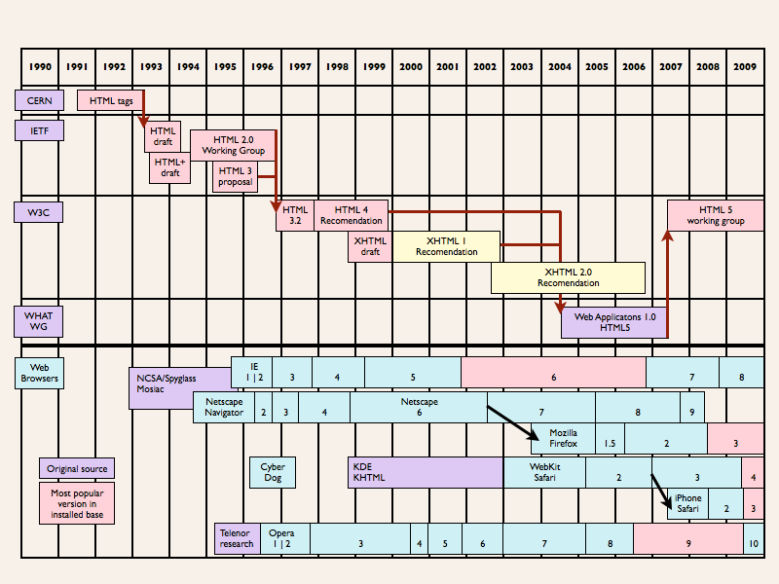
History of HTML

Slide 4
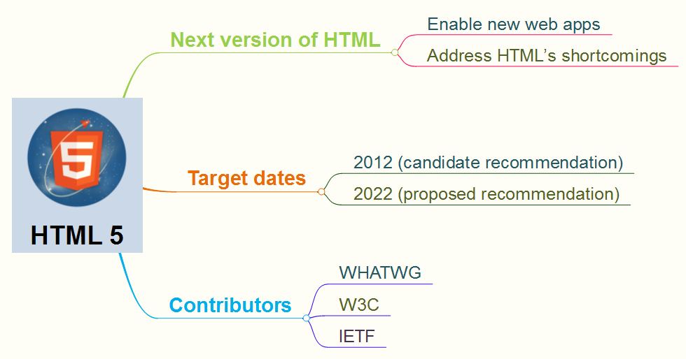
What is HTML5?

Slide 5
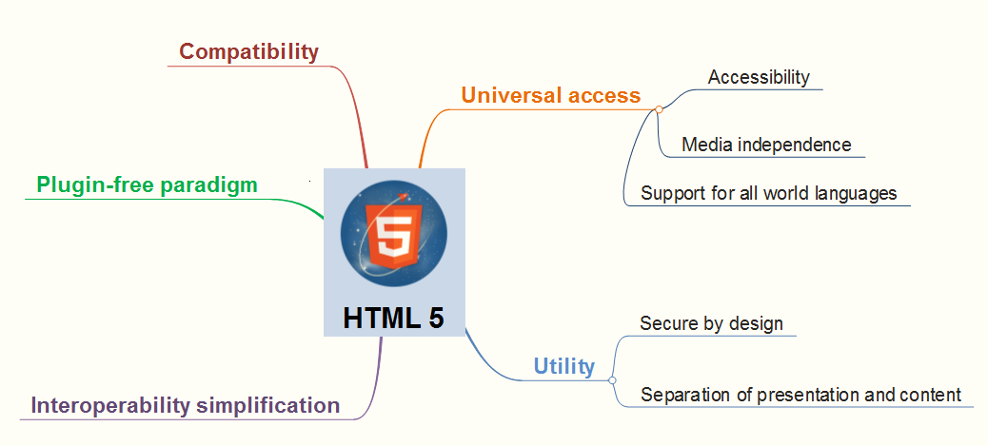
Design principles

Slide 6
What’s new in HTML5?
Added
Removed
Simpler DOCTYPE and charset
Many new semantic and embedded markups: header, footer, section, article, aside, nav, audio, video, canvas, etc.
New selectors API
Support for JSON
New APIs for graphics, communication, etc.
Many elements that perform inline styling, such as big, center, font, basefont, etc. → use CSS instead

Slide 7
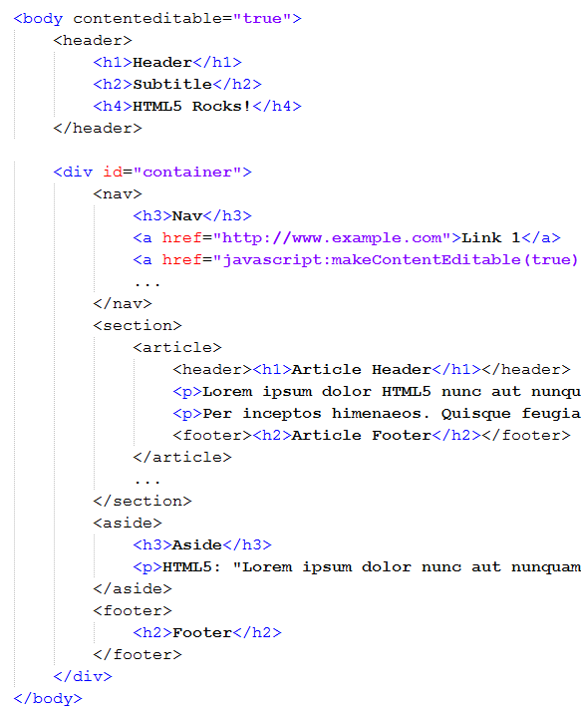
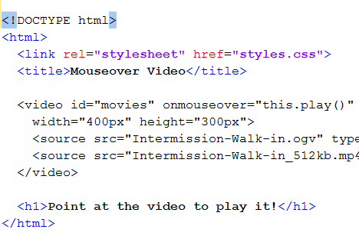
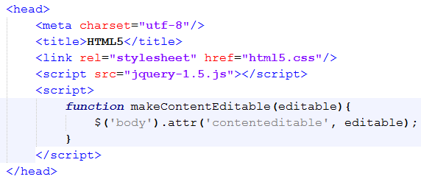
Quick examples

Slide 8
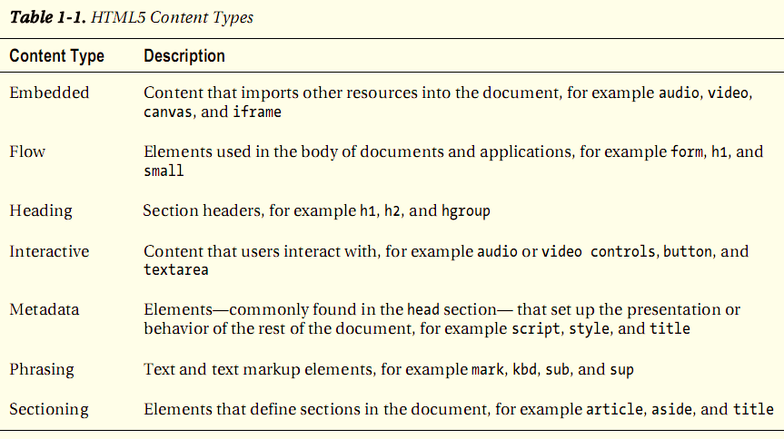
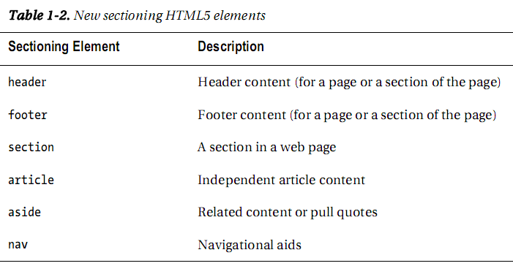
New Semantic Markups

Slide 9
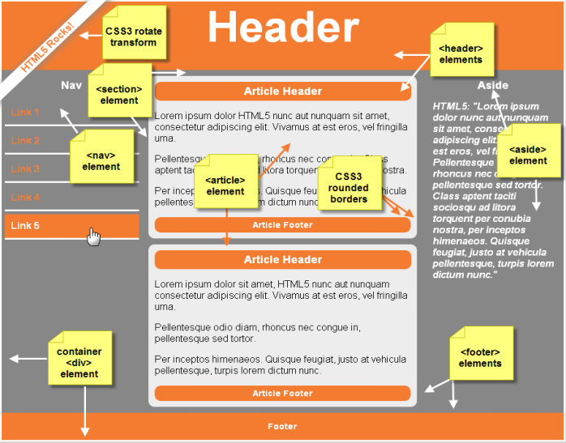
New Semantic Markups (cont.)

Slide 10
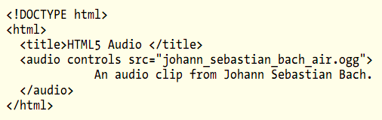
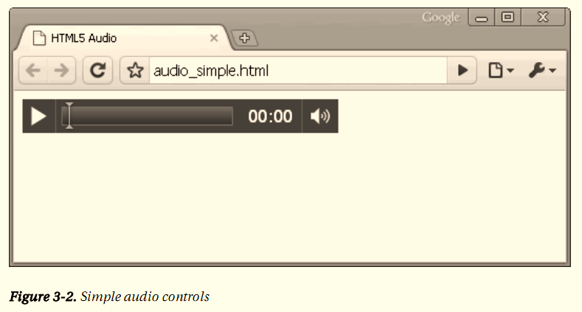

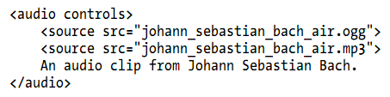
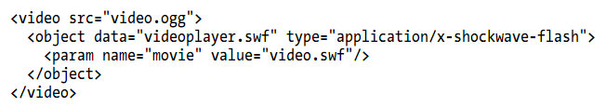
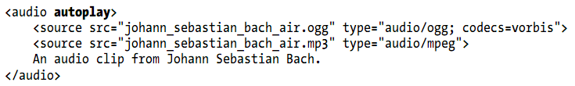
New embedded markups

Slide 11
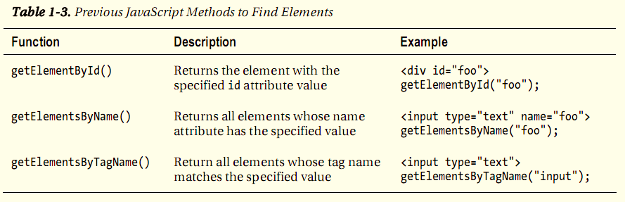
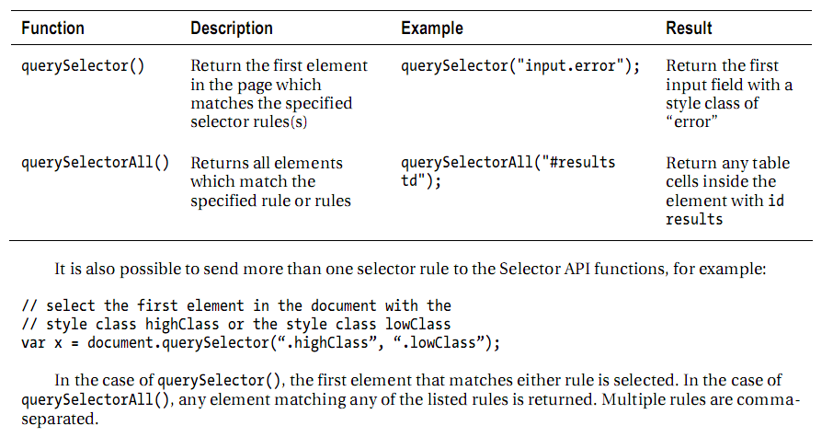
New Selector API

Slide 12
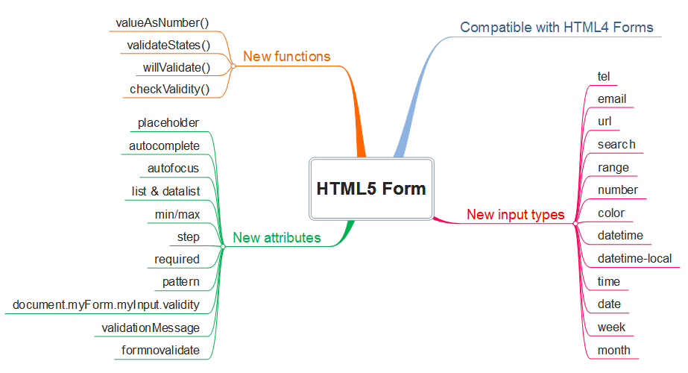
New Form API

Slide 13
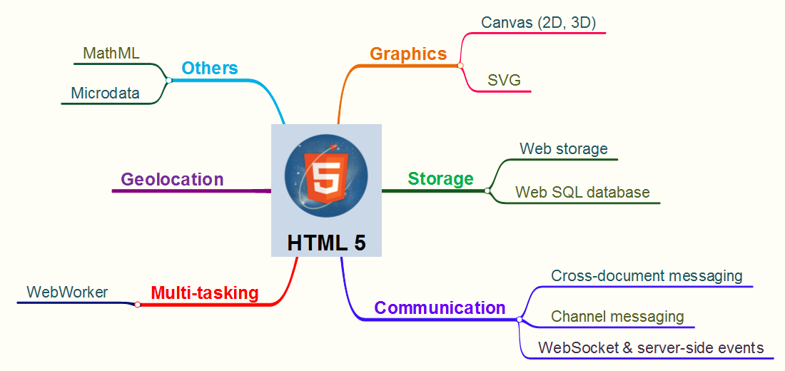
Other new HTML5 APIs

Slide 14
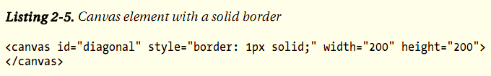
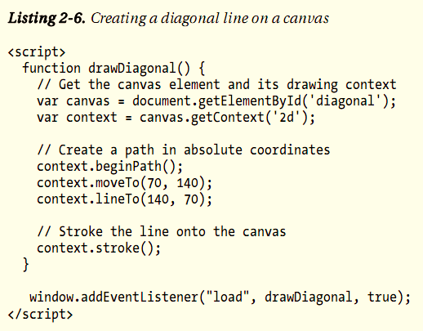
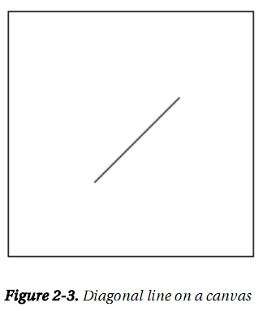
Canvas

Slide 15
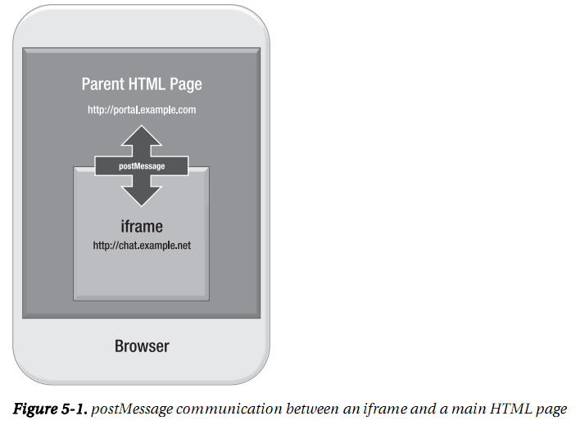
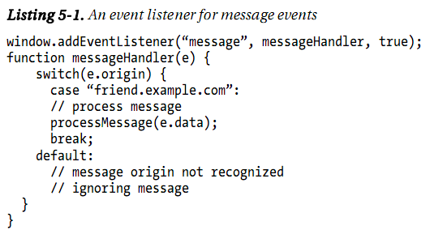
Communication

Slide 16
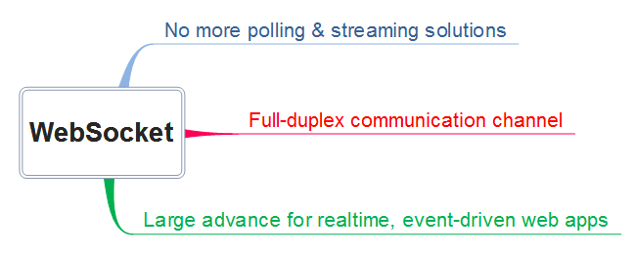
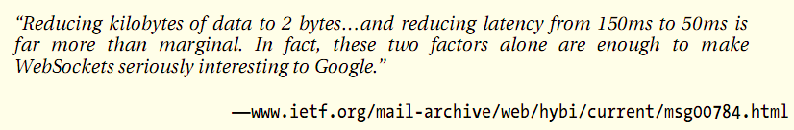
WebSocket

Slide 17
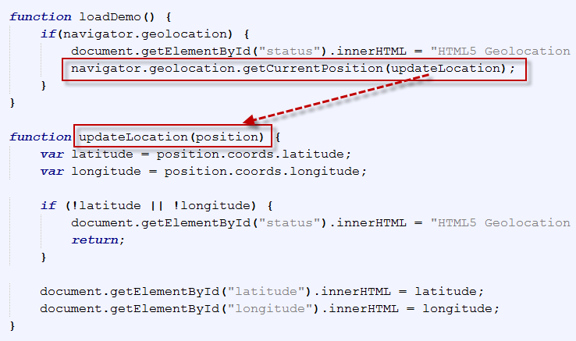
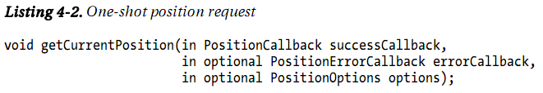
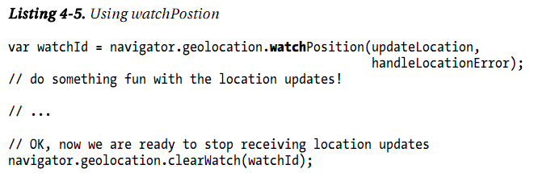
Geolocation
Where does location info come from?
IP address
GPS
Wi-Fi
Cell phone
User-defined
Position requests:
One-shot position request
Repeated position updates

Slide 18
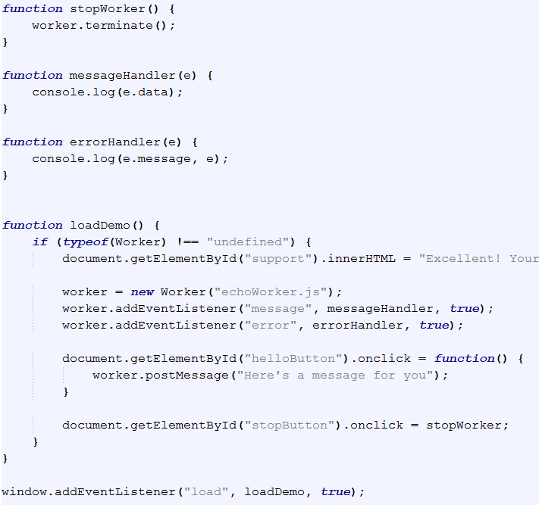
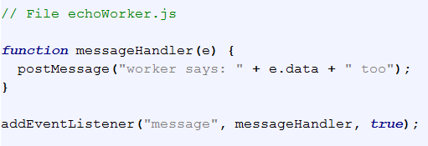
WebWorker

Slide 19
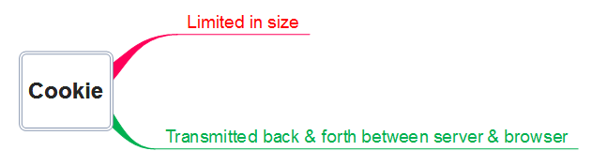
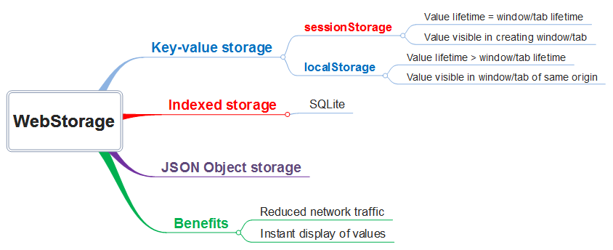
WebStorage

Slide 20
Browsers’ tests
www.caniuse.com
www.html5test.com
http://www.findmebyip.com/litmus/

Slide 21
Showcases
From Apple (here)
http://prohtml5.com/
http://html5demos.com/
http://www.benjoffe.com/code/
Chat demo (http://jwebsocket.org/)

Slide 22
HTML5 Future
What do you think?

Slide 23
References
Pro HTML5 Programming, by Peter Lubbers – Brian Albers – Frank Salim, Apress
http://www.tutorialspoint.com/html5/

Slide 24
Thanks for coming.
See ya!

