Slide 1




Intro to LINQ
Part 1: Overview of LINQ
Presenter: PhuongNQK

Slide 2
Overview
LINQ = Language INtegrated Query
Microsoft’s intention:
Provide a solution for ORM problem
Simplify and standardize the interaction between objects (= languages) and data sources
Introduce declarative and functional programming into .NET languages

Slide 3
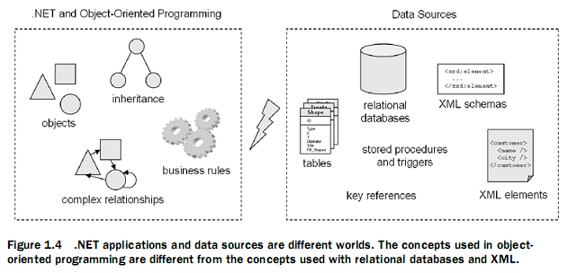
Why LINQ?
Impedance mismatch:
OOP languages, SQL, XML, etc are mixed and matched to build a rich and coherent solution
They represent different paradigms and do not play well with each other

Slide 4
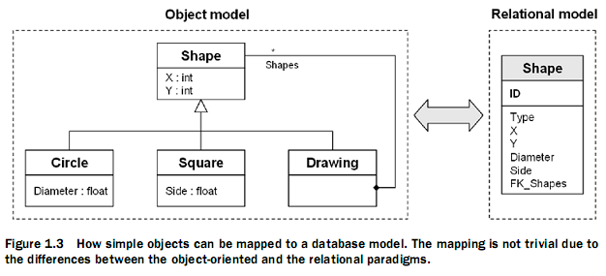
Why LINQ?
OR mappers’ limitations:
A good knowledge of the tools is required to use them efficiently and avoid performance issues.
Optimal use still requires knowledge of how to work with a relational database.
Mapping tools are not always as efficient as handwritten data-access code.
Not all the tools support compile-time validation.

Slide 5
Before LINQ
Distinct moves to data integration:
SQLXML 4.0 ties SQL to XSD
System.Xml spans XML/XML DOM/XSL/XPath and CLR
ADO.NET API bridges SQL and CLR data types
SQL Server 2005 includes CLR integration
Cω, ObjectSpaces, XQuery
etc.
➔ Difficult to use together

Slide 6
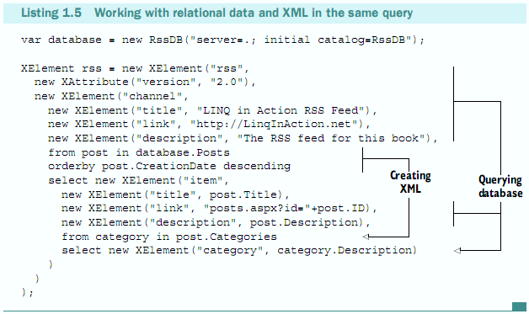
LINQ’s Main Goals
Deeply integrate the capabilities of data query and manipulation languages into programming languages
Removes as many barriers as possible among objects, databases, and XML. Enables us to work with each of these paradigms using the same language-integrated facilities.

Slide 7
LINQ’s Other Goals
Extensibility model for languages: Enable implementation for other programming languages.
Extensibility model for multiple data sources: Be able to access other data sources than relational databases or XML documents. Allow other frameworks to enable LINQ support for their own needs.
Type safety: Compile-time type checking to avoid problems that were previously discovered at run-time only. The compiler will catch errors in your queries.
Extensive IntelliSense support (enabled by strong-typing): Assist developers when writing queries to improve productivity and to help them get up to speed with the new syntax. The editor will guide you when writing queries.
Debugger support: Allow developers to debug LINQ queries step by step and with rich debugging information.
Build on the foundations laid in C# 1.0 and 2.0, VB.NET 7.0 and 8.0: Reuse the rich features that have been implemented in the previous versions of the languages.
Run on the .NET 2.0 CLR: Avoid requiring a new runtime and creating unnecessary deployment hassles.
Remain 100% backward compatible: Be able to use standard and generic collections, data binding, existing web and Windows Forms controls, and so on.

Slide 8
LINQ’s Requirements
LINQ’s features are a matter of compilers and libraries, not runtime:
Compiler: C# 3.0 or VB.NET 9.0
Runtime: .NET 2.0 CLR (SP1 for LINQ to SQL) or later
Development environment:
IDE:
Visual C# 2008 Express Edition
Visual Basic 2008 Express Edition
Visual Web Developer 2008 Express Edition
Visual Studio 2008 Standard Edition or higher
DB server (For LINQ to SQL):
SQL Server 2005 Express Edition or SQL Server 2005 CE (included with most versions of Visual Studio)
SQL Server 2005
SQL Server 2000a
A later version of SQL Server9

Slide 9
LINQ-Related Language Enhancements
Generics: List<T>
Delegate: delegate Boolean FilterDelegate(A obj)
Anonymous methods: delegate(Process p) { return p.WorkingSet64 >= 2 * 1024; }
Iterators: yield
Implicitly-typed local variables: var delta = 5
Object initializers: string[] values = {“A”, “B”}
Lambda expressions: address => address.City == “Paris”
Extension methods: static void Dump(this object o)
Anonymous types: var mica = new {Name = “Mica”}

Slide 10
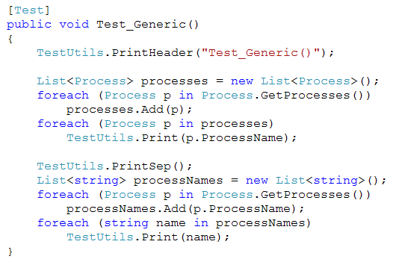
Example: Generic

Slide 11
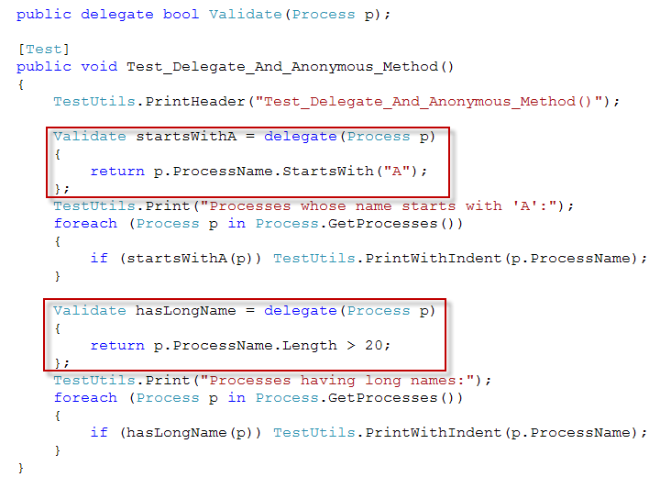
Example: Anonymous method

Slide 12
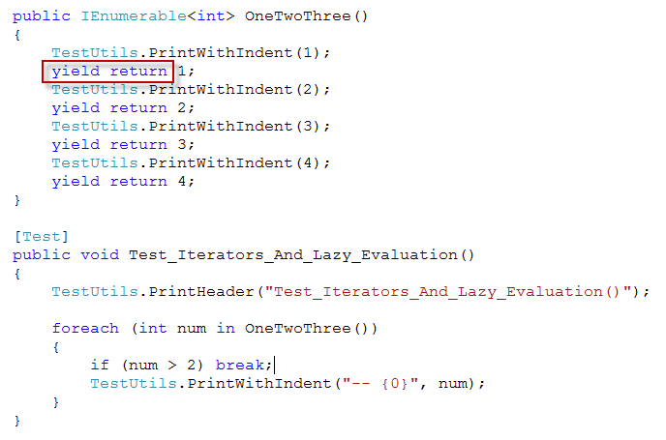

Example: Iterator

Slide 13
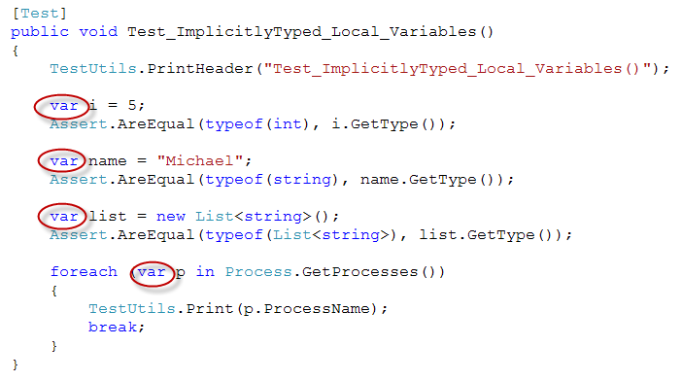
Example: Implicitly-typed local variables

Slide 14
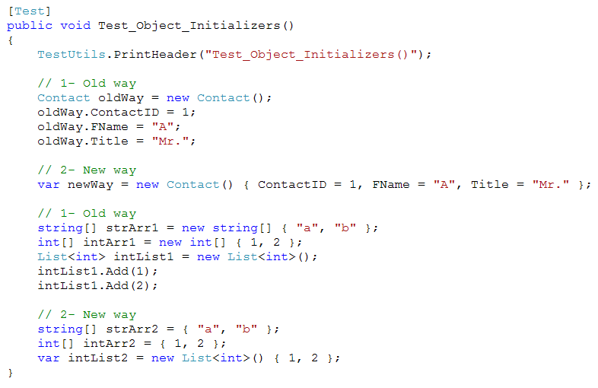
Example: Object initializers

Slide 15

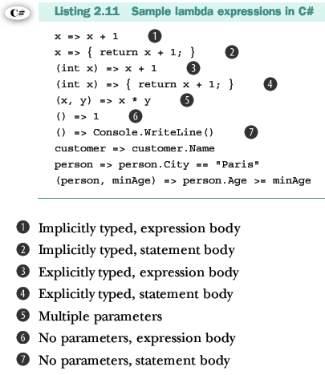

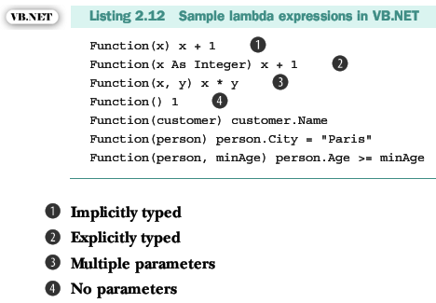
Lambda Expression

Slide 16
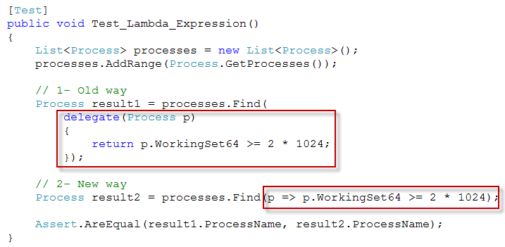
Example: Lambda Expression

Slide 17
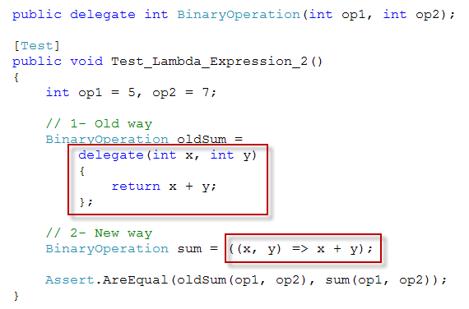
Example: Lambda Expression

Slide 18
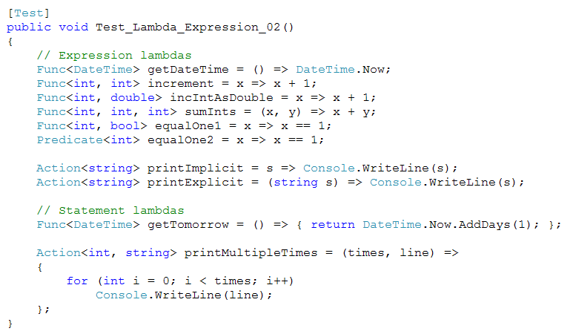
Example: Lambda Expression

Slide 19
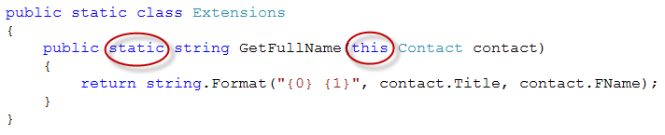
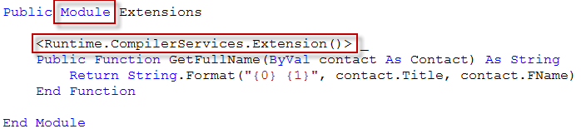
Extension Methods
C#
VB.NET
Declared in a non-generic static class
The first parameter must be of the type that is extended and preceded by the keyword this.
Should be declared in a module.
The method must be attributed with: Runtime.CompilerServices.Extension()

Slide 20
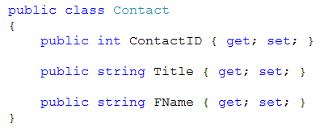
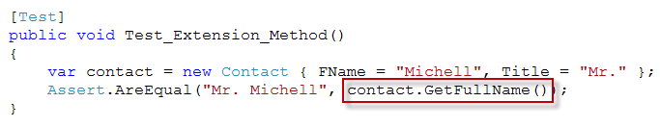
Example: Extension Methods

Slide 21
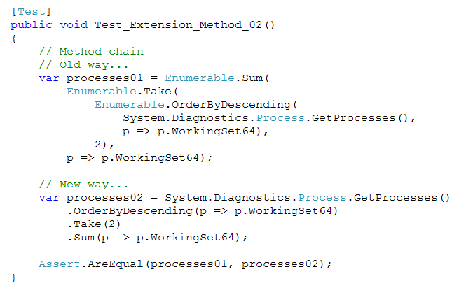
Example: Extension Methods

Slide 22
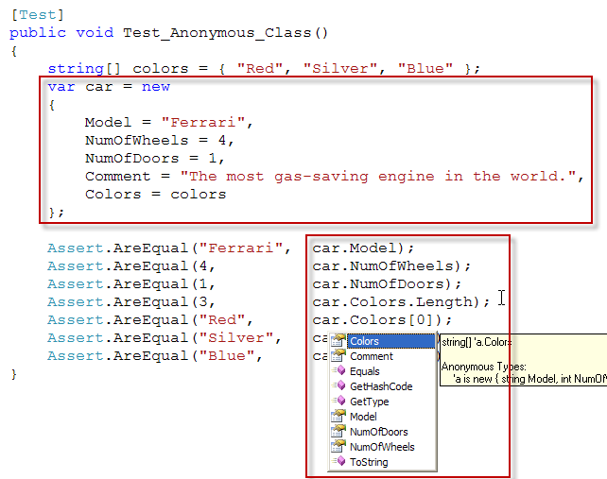
Example: Anonymous type

Slide 23
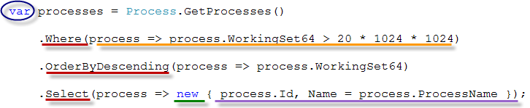
Language extensions – All in one
Implicitly-typed local variable
Lambda expression
Anonymous type
Object initializer
Extension methods

Slide 24
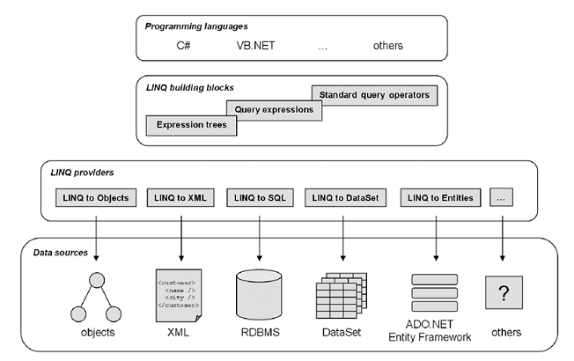
LINQ Architecture

Slide 25
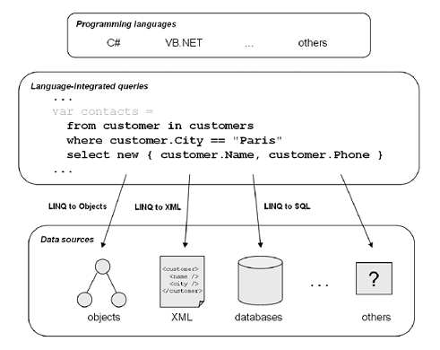
LINQ as Language Extensions

Slide 26
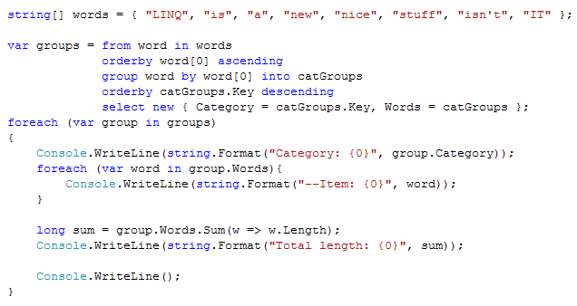
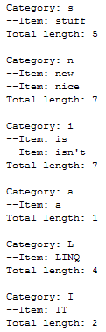
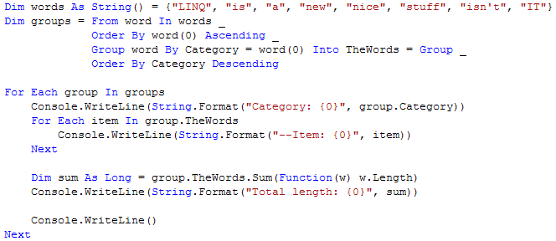
LINQ to Objects
C#
Result
VB.NET

Slide 27
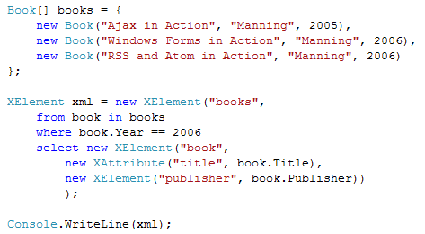
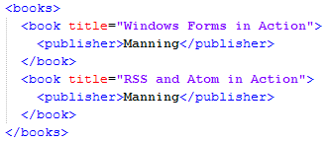
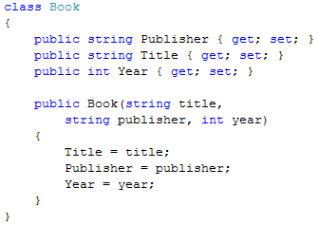
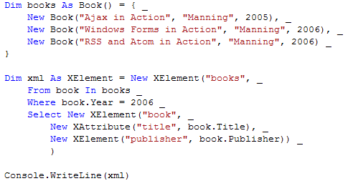
LINQ to XML (System.Xml.Linq)
C#
Result
VB.NET

Slide 28
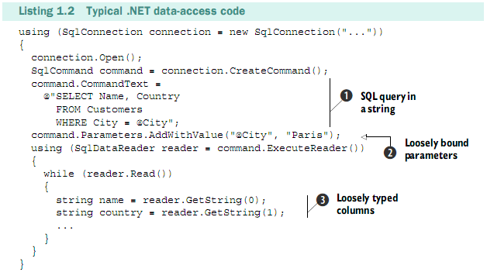
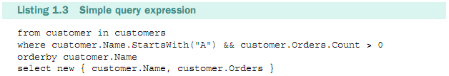
LINQ vs Traditional Ways

Slide 29
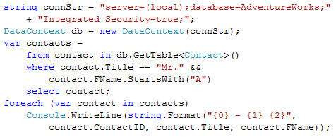
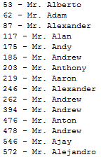
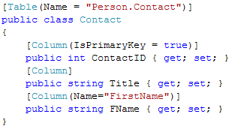
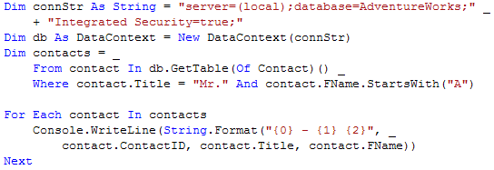
LINQ to SQL (System.Data.Linq.Mapping)
C#
Result
VB.NET

Slide 30
References
LINQ In Action, by Fabrice Maguerie - Steve Eichert - Jim Wooley, Manning

Slide 31
Thanks for coming.
See ya!

