Slide 1




Intro to LINQ
Part 2 – Concepts and LINQ to Objects
Presenter: PhuongNQK

Slide 2
Concepts
Sequence
Iterator
Query operator
Query expression
Deferred query execution
LINQ DLLs and namespaces

Slide 3
Sequence
Everything that implements IEnumerable<T>:
Arrays (typed and untyped)
Generic lists
Generic dictionaries
String
Custom collections

Slide 4
Iterator
An object that allows you to traverse through a collection’s elements.
The behavior of an iterator in C# 2.0 or 3.0 is very specific:
Instead of building a collection containing all the values and returning them all at once, an iterator returns the values one at a time.
This requires less memory and allows the caller to start processing the first few values immediately, without having the complete collection ready.
Keyword: yield

Slide 5
Query operator
Not a language extension, but an extension to the .NET Framework Class Library.
A set of extension methods that perform operations in the context of LINQ queries. They are the real elements that make LINQ possible.
Query operators are the key to LINQ, even more than language constructs like query expressions.
Mainly extension methods working with IEnumerable<T> objects → You can easily create your own query operators.

Slide 6
Standard query operators
Family | Query operators
Filtering | OfType, Where
Projection | Select, SelectMany
Partitioning | Skip, SkipWhile, Take, TakeWhile
Join | GroupJoin, Join
Concatenation | Concat
Ordering | OrderBy, OrderByDescending, Reverse, ThenBy, ThenByDescending
Grouping | GroupBy, ToLookup
Set | Distict, Except, Intersect, Union
Conversion | AsEnumerable, AsQueryable, Cast, ToArray, ToDictionary, ToList
Equality | SequenceEqual
Element | ElementAt, ElementAtOrDefault, First, FirstOrDefault, Last, LastOrDefault, Single, SingleOrDefault
Generation | DefaultIfEmpty, Empty, Range, Repeat
Quantifiers | All, Any, Contains
Aggregation | Aggregate, Average, Count, LongCount, Min, Max, Sum

Slide 7
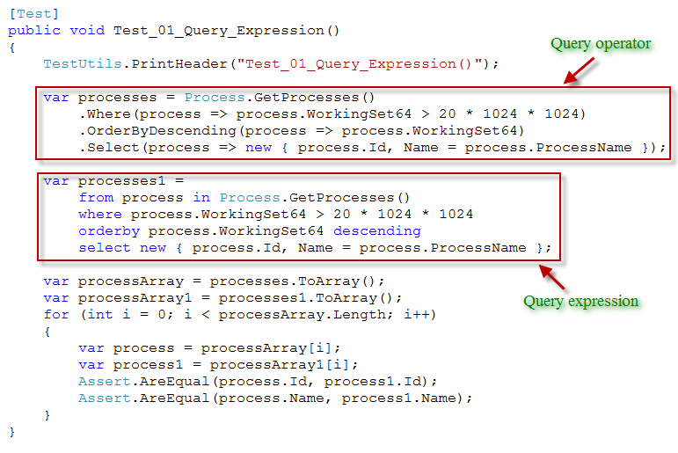
Query expression

Slide 8
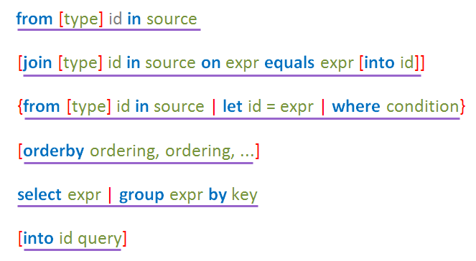
C# query expression syntax
Starts with from
Zero or more join
Zero or more
from, let
or where
Optional orderby
Optional into continuation
Ends with select
or group by

Slide 9
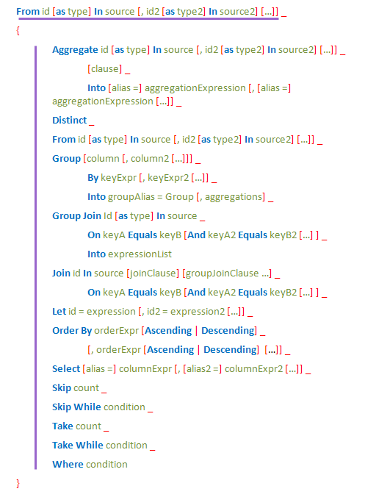
VB.NET query expression syntax
Starts with from
VB.NET query expression syntax is richer compared to C#. More of the standard query operators are supported in VB, such as Distinct, Skip, Take, and the aggregation operators.
Zero or more of any clause

Slide 10
Operators to expressions
Query operator | C# | VB.NET
All | N/A | Aggregate … In … Into All()
Any | N/A | Aggregate … In … Into Any()
Average | N/A | Aggregate … In … Into Average()
Cast | Use an explicitly typed range variable, e.g.: from int i in numbers | From … As …
Count | N/A | Aggregate … In … Into Count()
Distinct | N/A | Distinct
GroupBy | group … by … or group … by … into … | Group … By … Into
GroupJoin | join … in … on … equals … into … | Group Join … In … On …
Join | join … in … on … equals … | From x In …, y In … Where x.a = y.b or Join … [As …] In … On …
LongCount | N/A | Aggregate … In … Into LongCount ()
Max | N/A | Aggregate … In … Into Max()
Min | N/A | Aggregate … In … Into Min()

Slide 11
Operators to expressions (cont.)
Query operator | C# | VB.NET
OrderBy | orderby … | Order By …
OrderByDescending | orderby … descending | Order By … Descending
Select | Select | Select
SelectMany | Multiple from clauses | Multiple From clauses
Skip | N/A | Skip
SkipWhile | N/A | Skip While
Sum | N/A | Aggregate … In … Into … Sum()
Take | N/A | Take
TakeWhile | N/A | Take While
ThenBy | orderby …, … | Order By …, …
ThenByDescending | orderby …, … descending | Order By …, … Descending
Where | where | Where

Slide 12
Deferred query execution
The query is not executed at the point where it is defined, it is executed when you attempt to foreach over it.
A query declaration results in a first class object that represents the query, not the result of executing it.
Think of it like an ADO command object. Defining one and setting its command text does not cause it to execute the query, and you can exectute it multiple times.

Slide 13
LINQ DLLs and namespaces
Assembly | Namespace | Purpose
System.Core.dll | System.Linq | LINQ to Objects
 | System.Linq.Expressions | - Work with expression trees - Create your own IQueryable
System.Data.Linq.dll | (All) | LINQ to SQL
System.Xml.Linq.dll | (All) | LINQ to XML
System.Data.DataSetExtensions.dll | (All) | LINQ for DataSet

Slide 14
LINQ DLLs and namespaces (cont.)
Assembly | Namespace | Purpose
System.Core.dll
 | System | Action and Func delegate types
 | System.Linq | Enumerable class (Extension methods for IEnumerable<T>) IQueryable and IQueryable<T> interfaces Queryable class (extension methods for IQueryable<T>) IQueryProvider interface QueryExpression class Companion interfaces and classes for query operators: IGrouping<TKey, TElement> ILookup<TKey, TElement> IOrderedEnumerable<TElement> IOrderedQueryable IOrderedQueryable<T> Lookup<TKey, TElement>
 | System.Linq.Expressions | Expression<TDelegate> class and other classes that enable expression trees

Slide 15
LINQ DLLs and namespaces (cont.)
Assembly | Namespace | Purpose
System.Data.DataSetExtensions.dll
 | System.Data | Classes for LINQ to DataSet, such as TypedTableBase<T>, DataRowComparer, DataTableExtensions, and DataRowExtensions
System.Data.Linq.dll
 | System.Data.Linq | Classes for LINQ to SQL, such as DataContext, Table<TEntity>, and EntitySet<TEntity>
 | System.Data.Linq.Mapping | Classes and attributes for LINQ to SQL, such as ColumnAttribute, FunctionAttribute, and TableAttribute
 | System.Data.Linq.SqlClient | The SqlMethods and SqlHelpers classes

Slide 16
LINQ DLLs and namespaces (cont.)
Assembly | Namespace | Purpose
System.Xml.Linq.dll
 | System.Xml.Linq | Classes for LINQ to XML, such as XObject, XNode, XElement, XAttribute, XText, XDocument, and XStreamingElement
 | System. Xml.Schema | Extensions class that provides extension methods to deal with XML schemas
 | System. Xml.XPath | Extensions class that provides extension methods to deal with XPath expressions and to create XPathNavigator objects from XNode instances

Slide 17
About our examples
Requirement:
The object model should be rich enough to enable a variety of LINQ queries.
It should deal with objects in memory, XML documents, and relational data, both independently and in combination.
It should include ASP.NET web sites as well as Windows Forms applications.
It should involve queries to local data stores as well as to external data sources, such as public web services.

Slide 18
LINQ notes
A LINQ query:
Is lazy binding
Can be nested
Can be parameterized
There are many ways to write a query to achieve a goal:
Use query operators only
Use query expressions only
Use both
Change the order of query operators/phrase
etc.

Slide 19
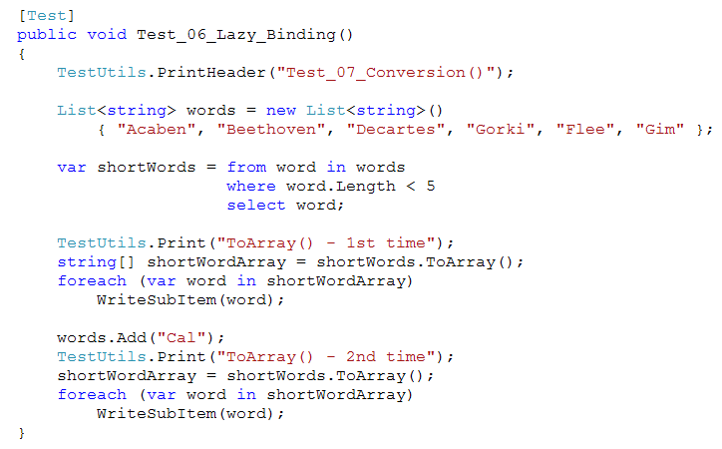
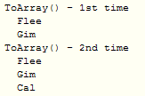
E.g. Lazy binding

Slide 20
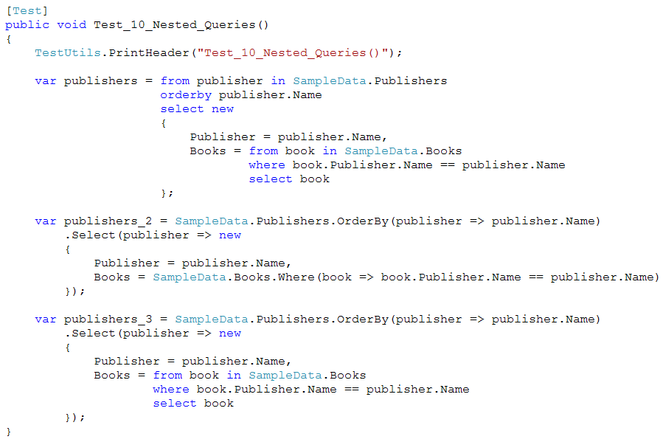
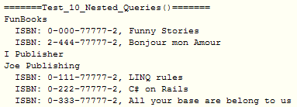
E.g. Nested queries

Slide 21
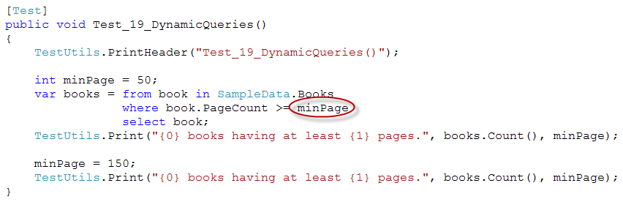

E.g. Parameterized queries

Slide 22
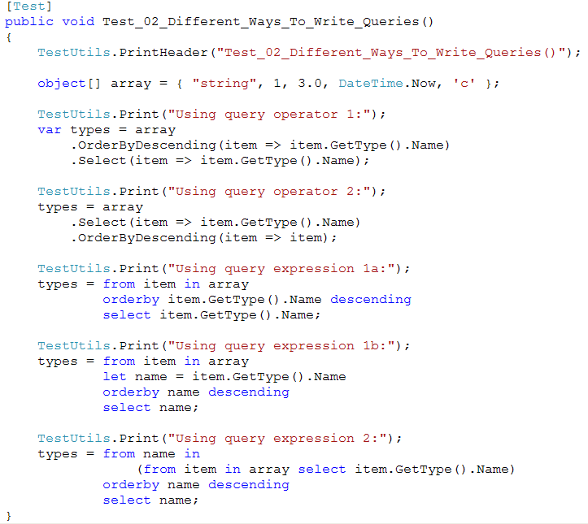
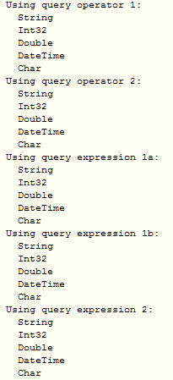
E.g. Different ways to write queries

Slide 23
LINQ to objects
Allows us to query collections of objects in memory
A collection queryable through LINQ to Objects has to and only has to implements the IEnumerable<T> interface:
Arrays (typed and untyped)
Generic lists
Generic dictionaries
String
Custom collections

Slide 24
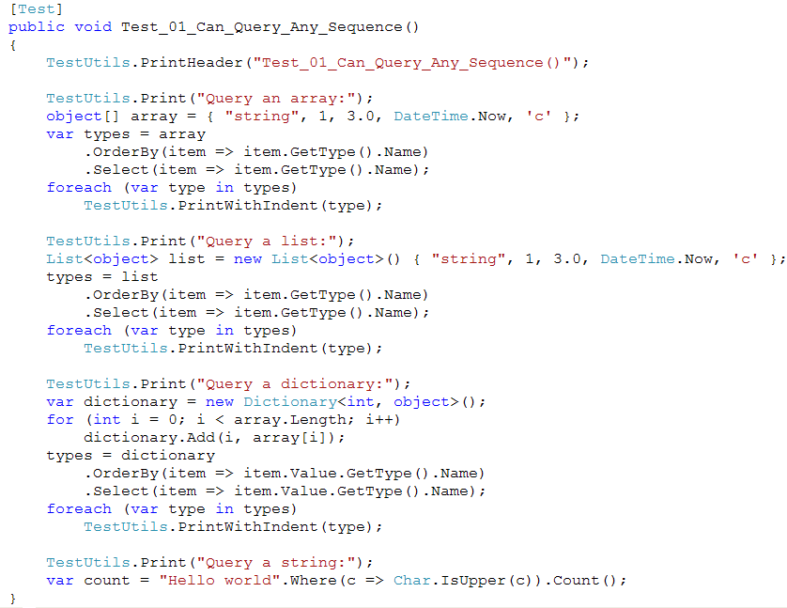
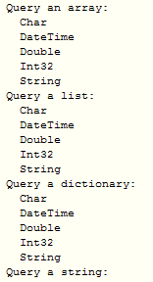
E.g. Query a sequence

Slide 25
Common operations
Projection
Filtering
Set
Conversion
Aggregate
Ordering
Grouping
Joining
Partitioning
Concatenation
Quantifier
Generation
Element
Equality

Slide 26
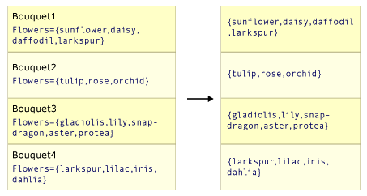
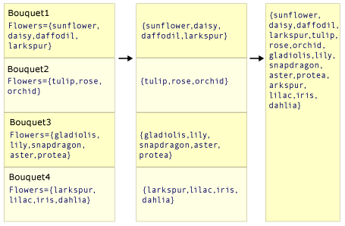
Projection
- Projection is transforming an object into a new form that often consists only of those properties that will be subsequently used.
- By using projection, you can construct a new type that is built from each object.
SelectMany() produces a single overall result that contains concatenated sub-collections from each source value.
Select() produces one result value for every source value
* Note: In the demo, the selector (transform) function selects the array of flowers from each source value.

Slide 27
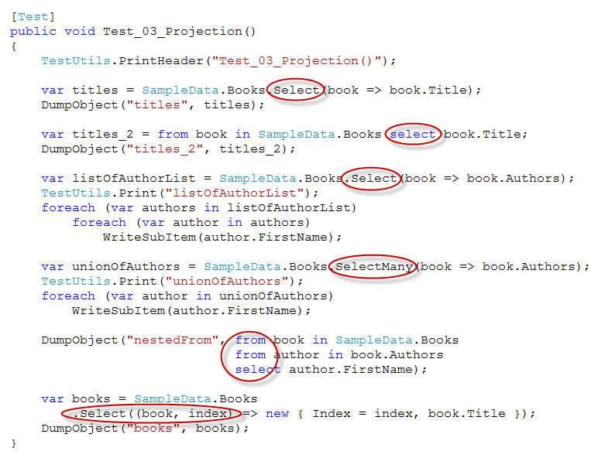
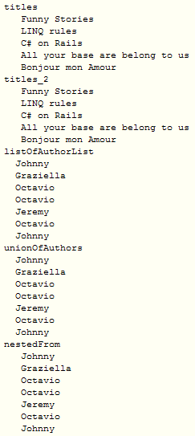
Projection (cont.)

Slide 28
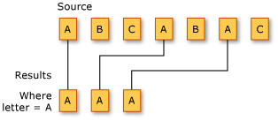
Filtering
Filtering (also selection) is restricting the result set to contain only those elements that satisfy a specified condition.
E.g. We want to filter a sequence of characters. The filtering predicate specifies that the character must be 'A'. Here is the result:

Slide 29
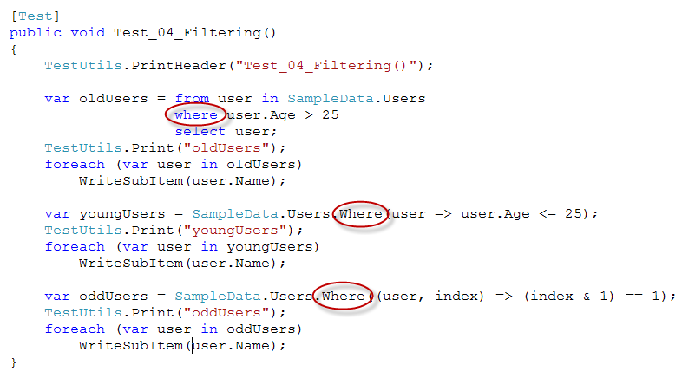
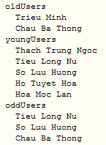
Filtering (cont.)

Slide 30
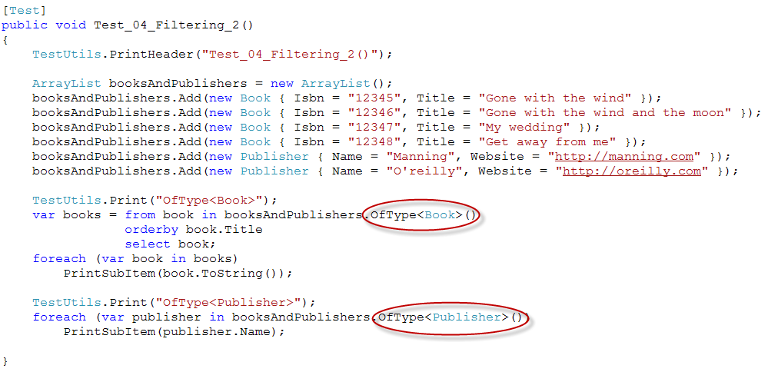
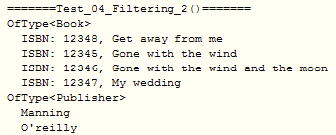
Filtering (cont.)

Slide 31



Set
- Distinct returns a sequence of unique elements from an input sequence.
- Except returns a sequence containing only the elements from the first input sequence that are not in the second input sequence.
- Intersect returns a sequence containing the elements that are common to both of the input sequences.
- Union returns a sequence containing the unique elements from both input sequences.

Slide 32
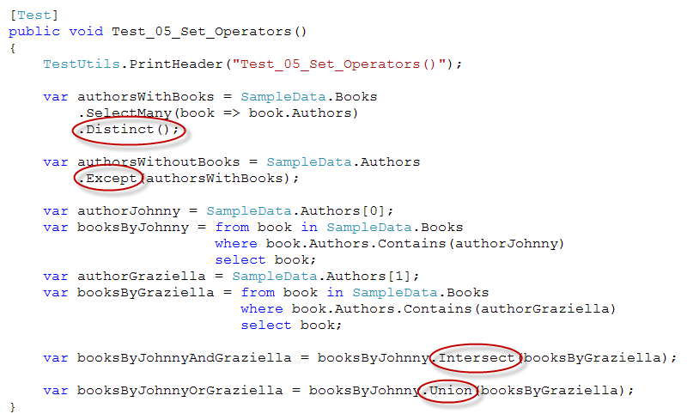
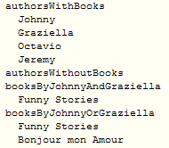
Set (cont.)

Slide 33
Conversion
Conversion methods change the type of input objects.
Examples:
The Enumerable.AsEnumerable(TSource) method can be used to hide a type's custom implementation of a standard query operator.
The Enumerable.OfType(TResult) method can be used to enable non-parameterized collections for LINQ querying.
The Enumerable.ToArray(TSource), Enumerable.ToDictionary, Enumerable.ToList(TSource), and Enumerable.ToLookup methods can be used to force immediate query execution instead of deferring it until the query is enumerated.

Slide 34
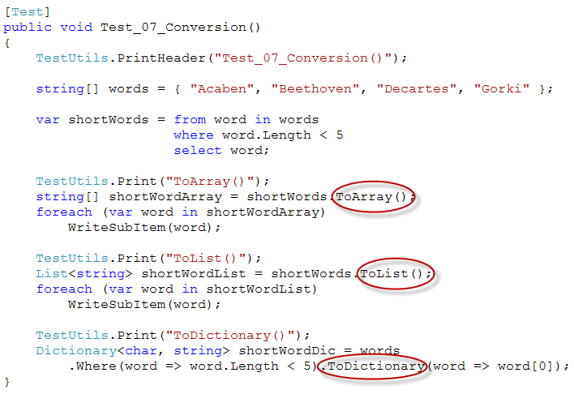
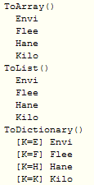
Conversion (cont.)

Slide 35
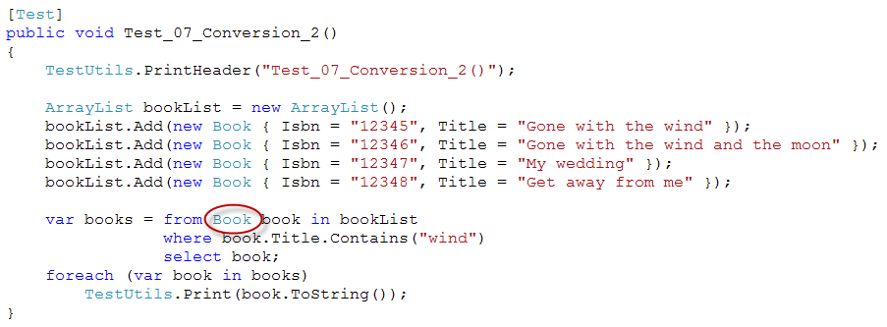

Conversion (cont.)

Slide 36
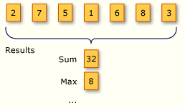
Aggregate
An aggregation operation computes a single value from a collection of values.
E.g. Calculate the average daily temperature from a month's worth of daily temperature values.
E.g. Consider the results of two aggregation operations on a sequence of numbers.
Operation: Sum the numbers
Operation: Find the maximum value in the sequence

Slide 37
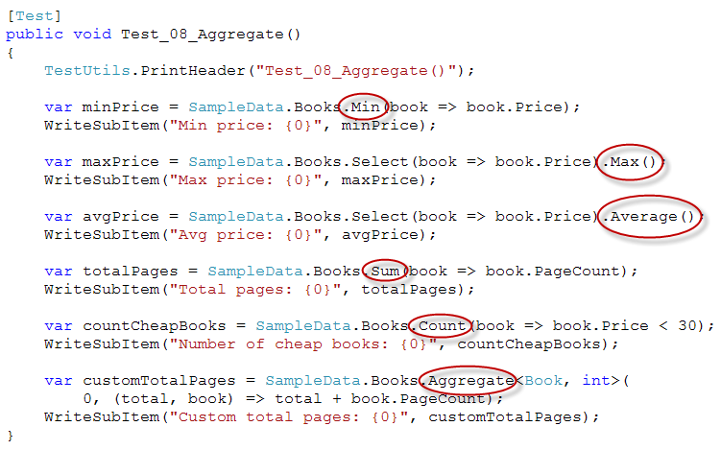
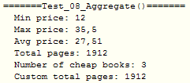
Aggregate (cont.)

Slide 38
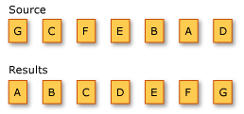
Ordering
A sorting operation orders the elements of a sequence based on one or more attributes.
1st criterion performs a primary sort on elements.
By a 2nd sort criterion, you can sort the elements within each primary sort group.
E.g. The results of an alphabetical sort operation on a sequence of characters.

Slide 39
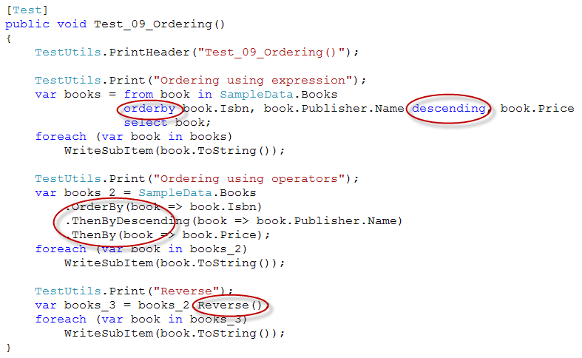
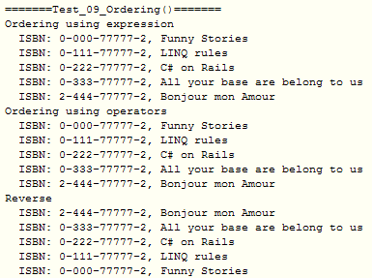
Ordering

Slide 40
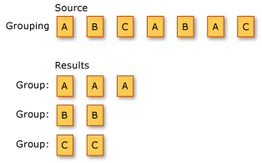
Grouping
Grouping is putting data into groups so that the elements in each group share a common attribute.
E.g. We want to group a sequence of characters. The key for each group is the character. Here is the result:

Slide 41
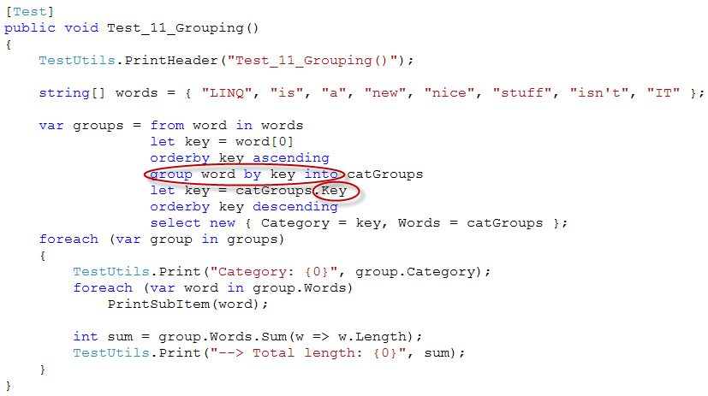
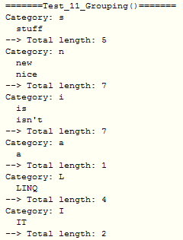
Grouping (cont.)

Slide 42
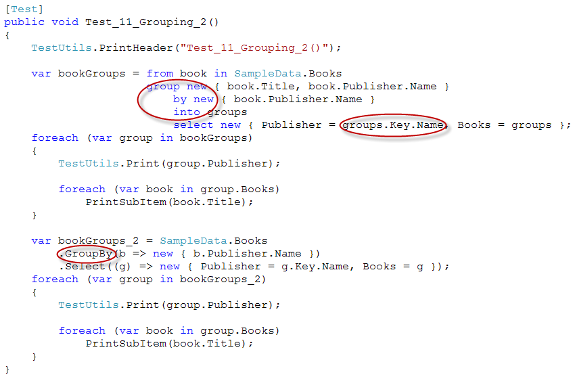
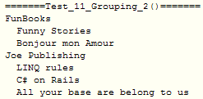
Grouping (cont.)

Slide 43
Grouping (cont.)

Slide 44
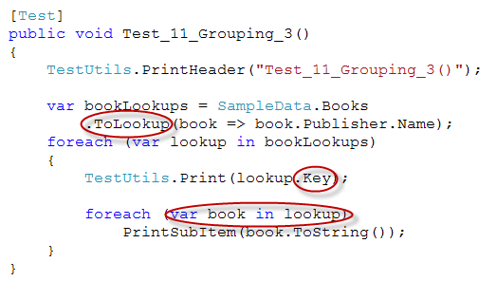
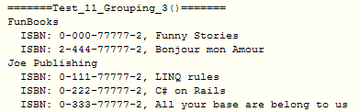
Grouping (cont.)

Slide 45
Joining
A join of two data sources is the association of objects in one data source with objects that share a common attribute in another data source.
Joining is an important operation in queries that target data sources whose relationships to each other cannot be followed directly. In object-oriented programming, this could mean a correlation between objects that is not modeled, such as the backwards direction of a one-way relationship.
E.g. A Customer class has a property of type City, but the City class does not have a property that is a collection of Customer objects. If you have a list of City objects and you want to find all the customers in each city, you could use a join operation to find them.
The join methods provided in the LINQ framework are Join and GroupJoin.

Slide 46
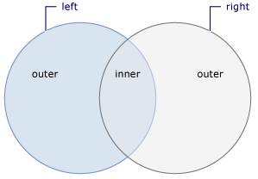
Joining (cont.)
GroupJoin
Join
Perform equijoins
Joins 2 sequences based on key selector functions and groups the resulting matches for each element.
The GroupJoin method has no direct equivalent in relational database terms, but it implements a superset of inner joins and left outer joins.
Perform equijoins
Joins 2 sequences based on key selector functions and extracts pairs of values.
In relational database terms, Join implements an inner join
A conceptual view of two sets and their elements that are included in either an inner/outer join

Slide 47
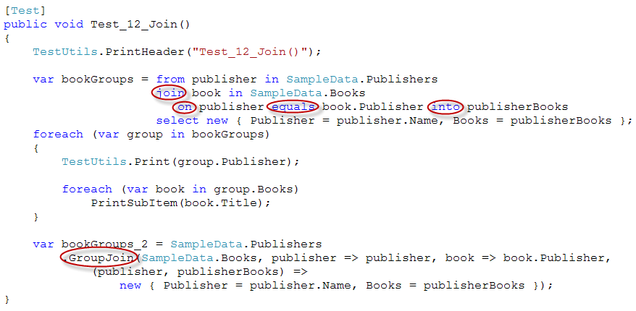
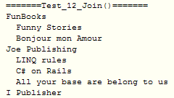
Joining (cont.) – GroupJoin
Same as nested queries and different from grouping, publisher with no books also appears.

Slide 48
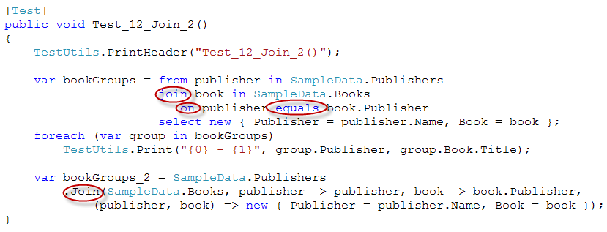

Joining (cont.) – Inner join

Slide 49
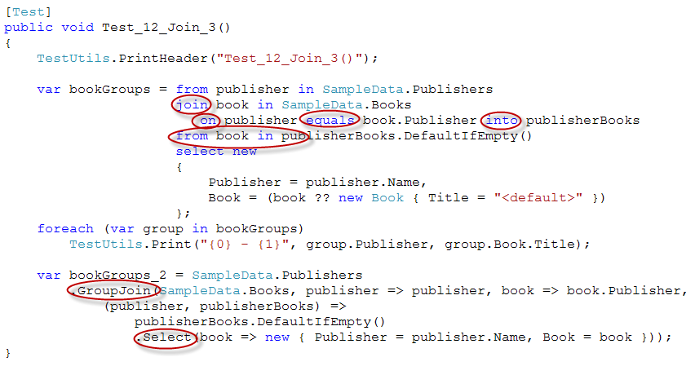
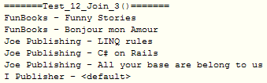
Joining (cont.) – Left outer join

Slide 50
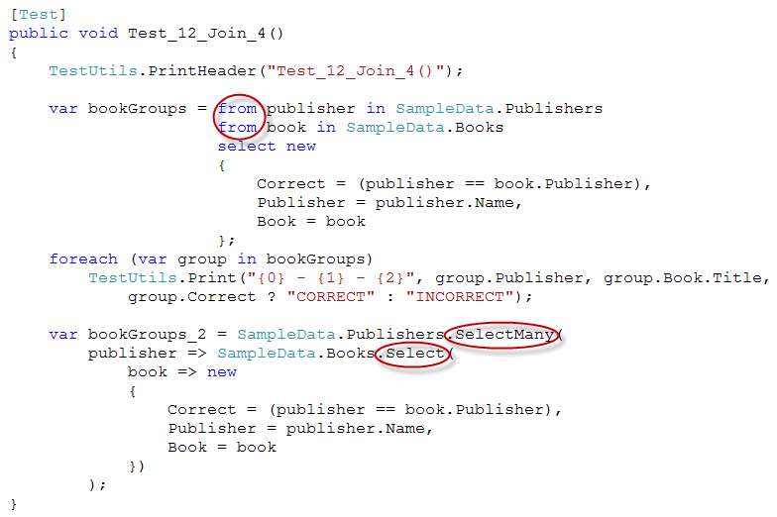
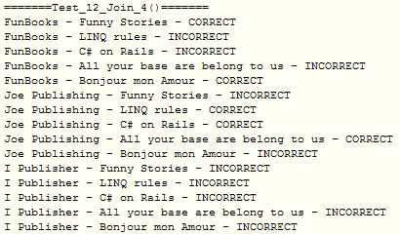
Joining (cont.) – Cross join

Slide 51
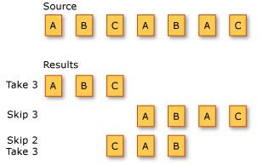
Partitioning
Partitioning in LINQ means dividing an input sequence into two sections, without rearranging the elements, and then returning one of the sections.
E.g. 3 different partitioning operations on a sequence of characters:
Returns the first 3 elements in the sequence.
Skips the first 3 elements and returns the remaining elements.
Skips the first 2 elements in the sequence and returns the next 3 elements.

Slide 52
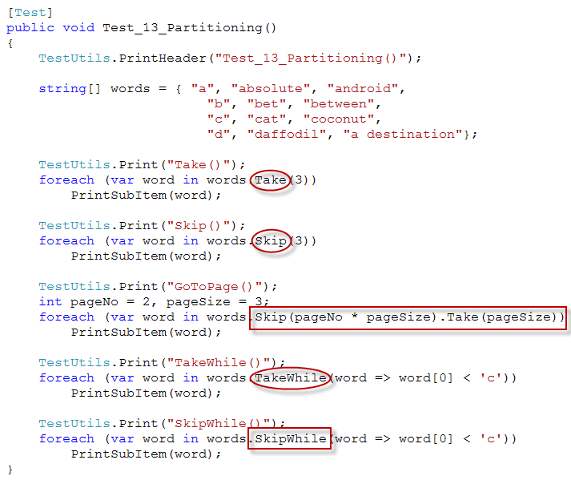
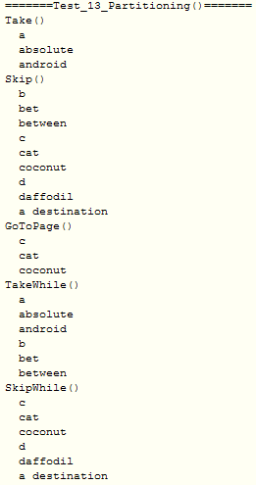
Partitioning (cont.)

Slide 53



Concatenation
Concatenation refers to the operation of appending one sequence to another

Slide 54



Quantifiers
Quantifier operations return a Boolean value that indicates whether some or all of the elements in a sequence satisfy a condition.

Slide 55


Generation
Generation refers to creating a new sequence of values.

Slide 56

Element operations
Element operations return a single, specific element from a sequence.
Single(), SingleOrDefault() will throw an exception if they find that there are more than 1 element to return

Slide 57



Equality

Slide 58

Equality (cont.)
Two sequences whose corresponding elements are equal and which have the same number of elements are considered equal.

Slide 59
LINQ and …
… .NET technologies:
ASP.NET
WinForms
… data sources
Files and folders
Text files
XML
SQL
… design patterns

Slide 60


E.g. LINQ and ASP.NET
Default.aspx
Default.aspx.cs

Slide 61



E.g. LINQ and ASP.NET (cont.)
Sample
data
Result
Class declaration

Slide 62


E.g. LINQ and WinForms

Slide 63

E.g. LINQ and WinForms (cont.)
Sample
data
Result
Class declaration

Slide 64
References
LINQ In Action, by Fabrice Maguerie - Steve Eichert - Jim Wooley, Manning
MSDN – Standard query operators overview

Slide 65
Thanks for coming.
See ya!

