Slide 1




Intro to LINQ
Part 3 –LINQ to SQL
Presenter: PhuongNQK

Slide 2
Notes
LINQ is database-specific:
LINQ to SQL: works with SQL Server/Express
LINQ to Oracle
LINQ to MySQL
…
Alternatives:
LINQ to DataSet
LINQ to Entities

Slide 3
Notes (cont.)
LINQ to SQL queries:
Return IQueryable<T>, which implements IEnumerable<T>
Are performed on classes that implement IQueryable<T>, such as Table<T>
Are translated to SQL
Are executed in a database
Are limited in some ways based on the translator’s capabilities

Slide 4
Necessary steps
Map object model to relational database
Create proper DataContext object:
Put objects into its fields/properties
Map database functions and stored procedures to its methods
Point it to a relational data source
Perform your query/non-query

Slide 5
1. Object-Relational mapping
Default type mappings
O/R designer
SQL Metal
DataContext.CreateDatabase()
Custom type mappings
DBML file
Mapping attributes

Slide 6
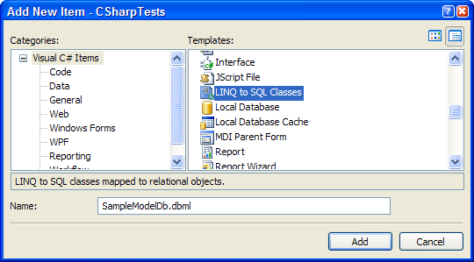
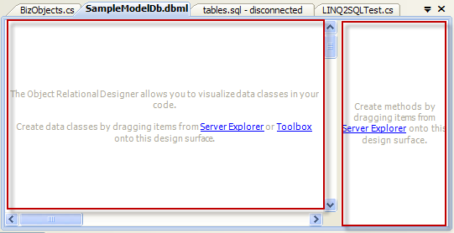
O/R Designer
Included in VS.NET IDE 2008
Supports only SQL Server 2000/2005/2008/ Express (not Compact 3.5) databases
Methods pane: displays the DataContext methods that are mapped to stored procedures and functions
Entities pane (main design surface): displays the entity classes, associations, and inheritance hierarchies
O/R designer generates:
.dbml file
Typed DataContext and entity classes

Slide 7
SqlMetal.exe
Is included in the Windows SDK (that is installed with Visual Studio or separately downloaded)
By default, is located at drive:\Program Files\Microsoft SDKs\Windows\vn.nn\bin
Functions:
Database
Source code + mapping attributes
DBML file
mapping file

Slide 8
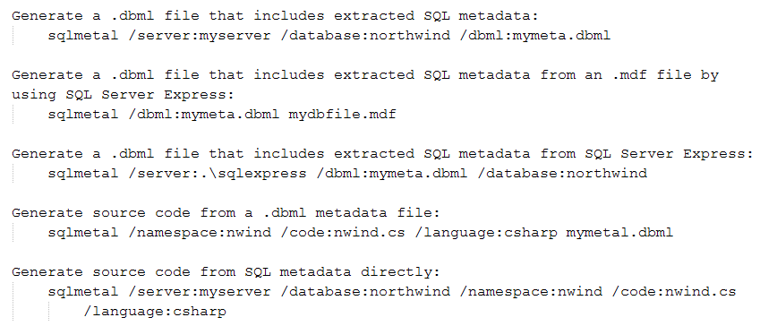
SqlMetal.exe (cont.)

Slide 9
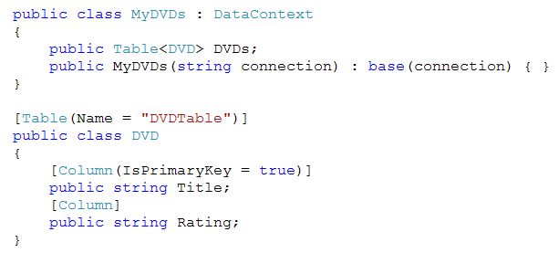
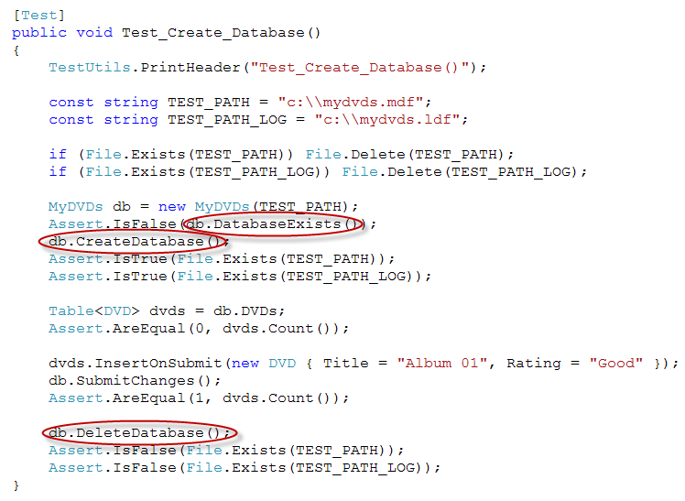
DataContext.CreateDatabase()

Slide 10
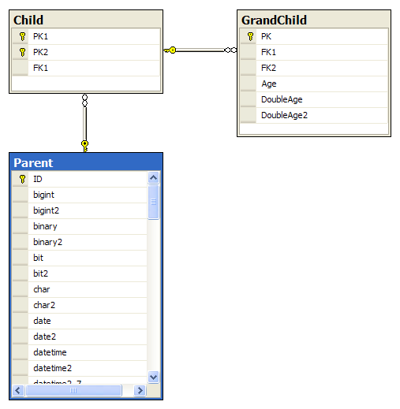
DBML file

Slide 11
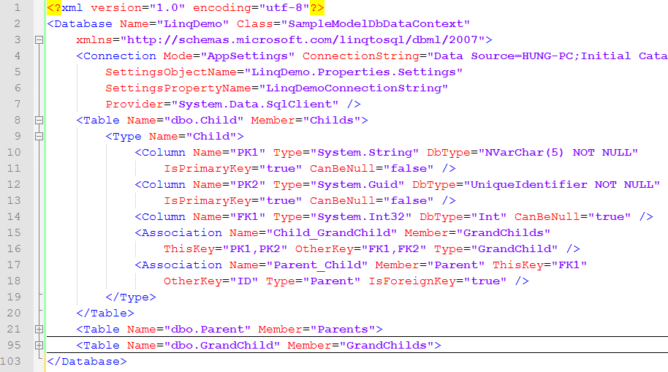
DBML file (cont.)

Slide 12
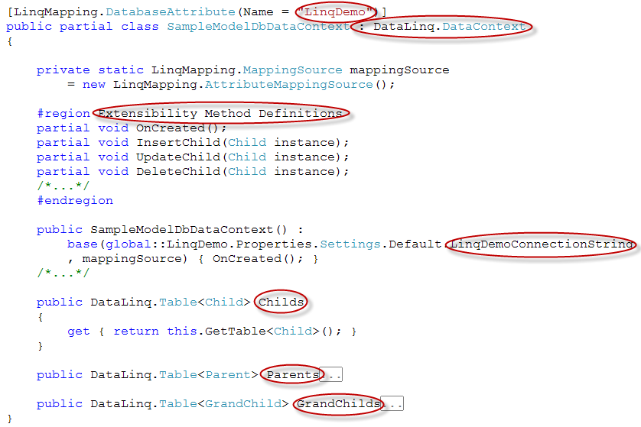
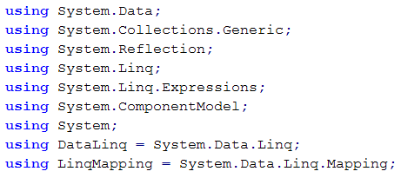
DBML file (cont.)

Slide 13
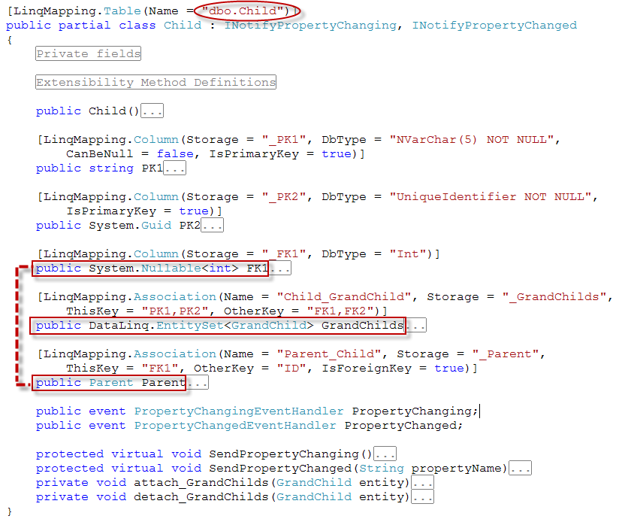
DBML file (cont.)

Slide 14
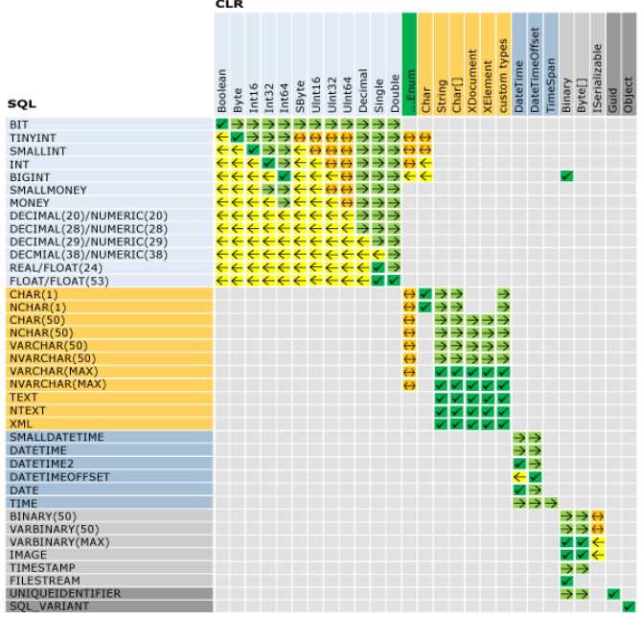
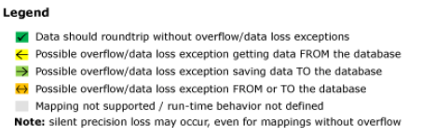
Type mapping run-time behavior matrix
With the exception of serialization, LINQ to SQL does not support mapping between any CLR or SQL Server data types that are not specified in this matrix: geography, geometry, hierarchyid, …

Slide 15
Concept mapping
Database
DataContext (DC)
Table/view
Column (field)
Record
Constraint:
Null/Default/PK
FK
Unique/Check
Function/Stored procedure
Function/Stored procedure result
Entity class (DC’s field/property)
Entity class’s field/property
Entity object
Attributes of fields/properties:
ColumnAttribute
AssociationAttribute
N/A
DataContext’s methods
Primitive types/Entity class

Slide 16
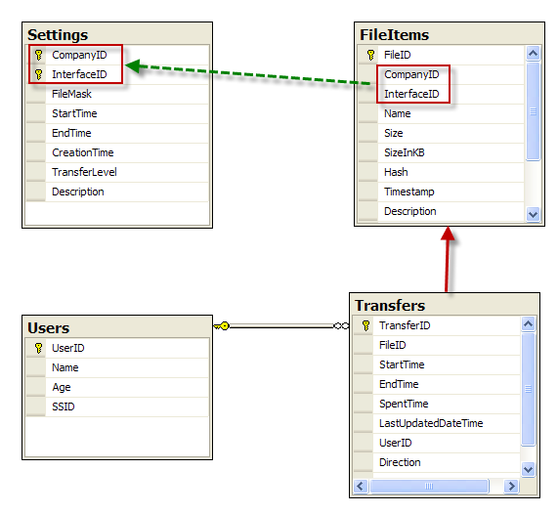
Custom mapping (CM)
This logical relation does not exist in database/mapping
This relation exists in the mapping, not in the database
This relation exists in the database and the mapping

Slide 17
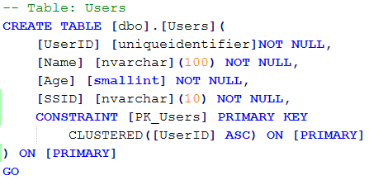
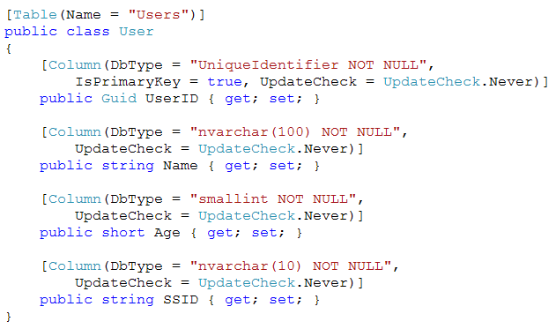
CM – SQL script vs Entity class

Slide 18
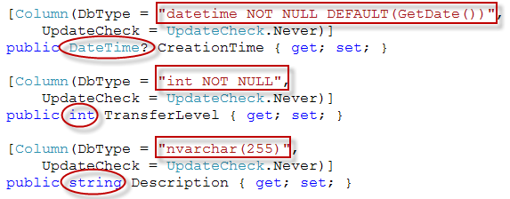
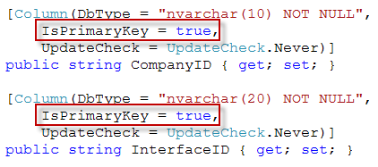
CM – Fields
Normal fields
Multi-field PK

Slide 19
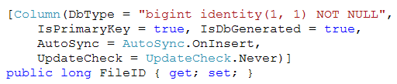
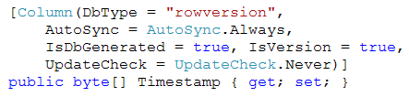

CM – Fields (cont.)
Identity field
Timestamp field
Computed field

Slide 20
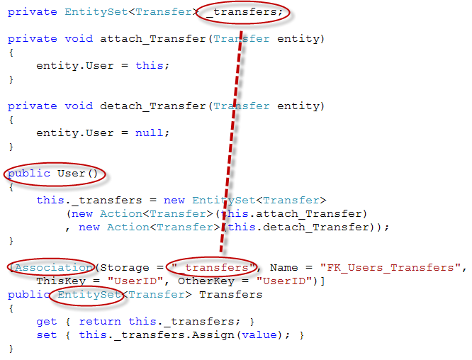

CM – Association
User class
(Parent)

Slide 21
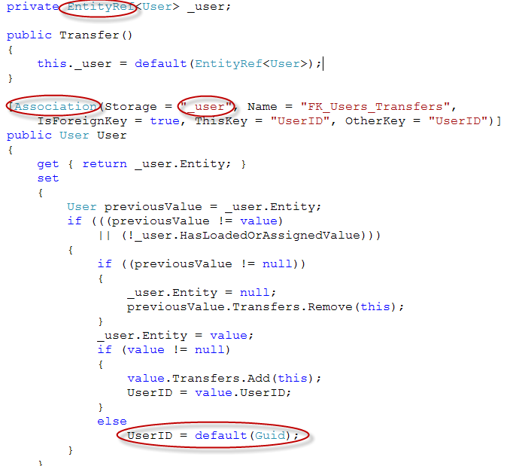

CM – Association (cont.)
Transfer class
(Child)

Slide 22
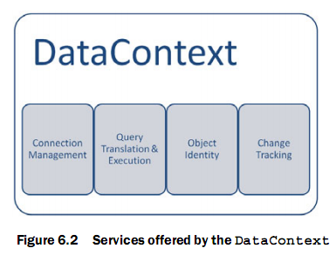
2. Building DataContext
DataContext:
Represents a complete database in object model
Is our connection to a real relational data source
Is the main conduit by which we'll query entities from the database as well as apply changes
Main methods:
GetTable()
Mapped SQL functions and stored procedures
Create/DeleteDatabase()

Slide 23
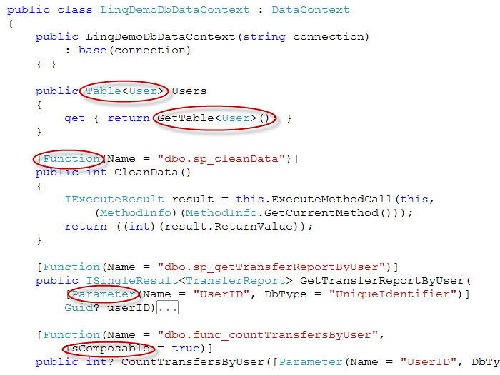
Custom DataContext sample
Constructor
Entity element
Function and stored procedure

Slide 24
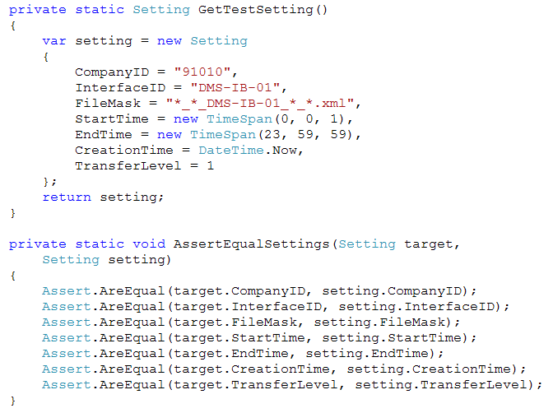
3. Performing query/non-query
Test utils

Slide 25
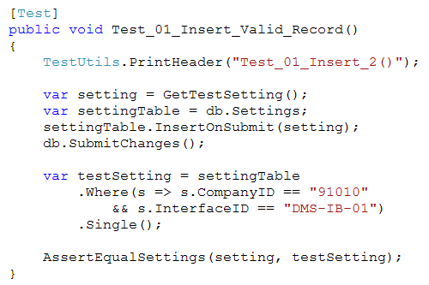
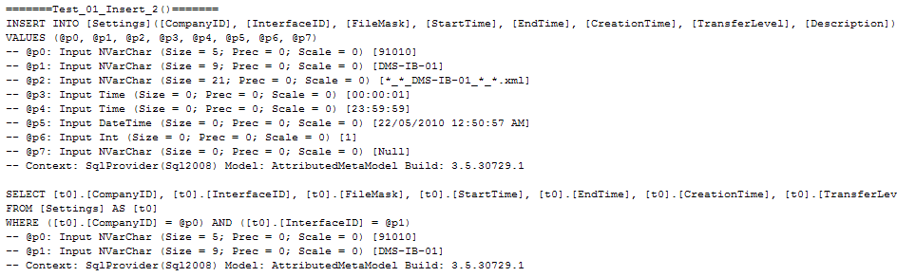
Insert

Slide 26
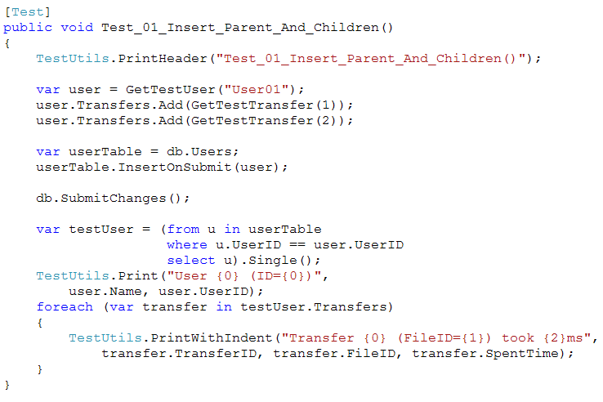
Insert (cont.)

Slide 27
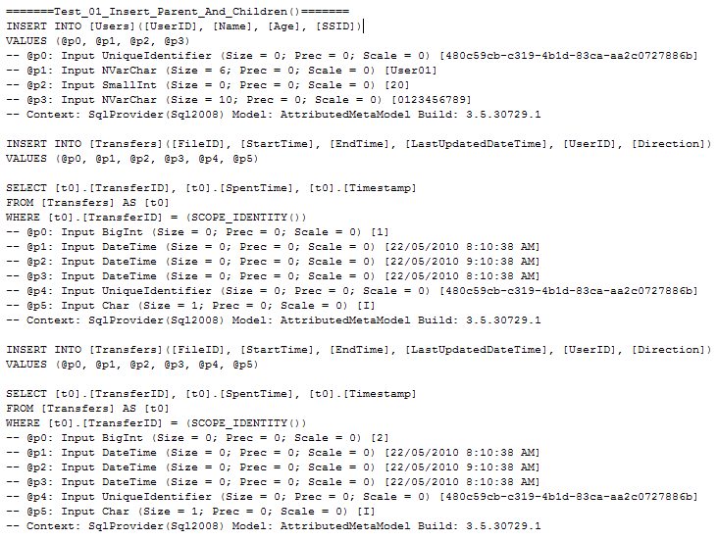
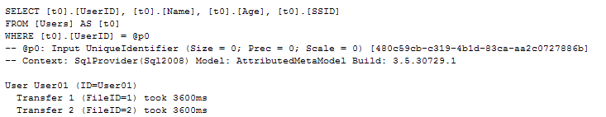
Insert (cont.)

Slide 28
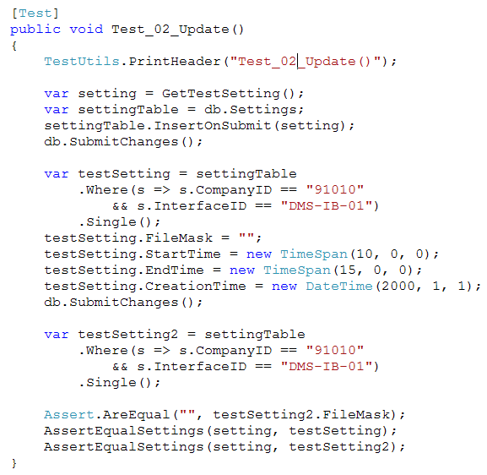
Update

Slide 29
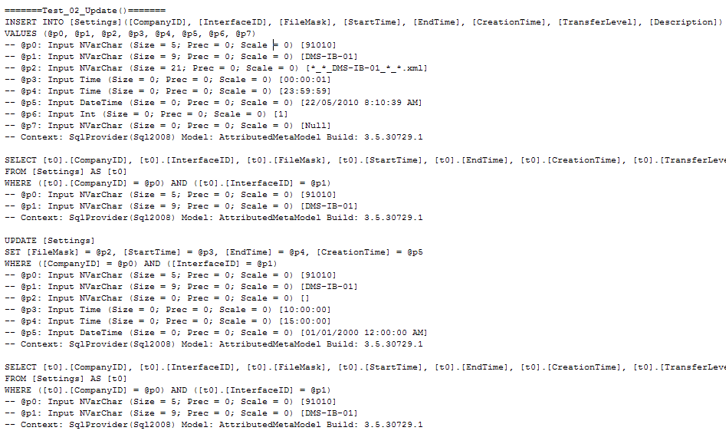
Update (cont.)

Slide 30
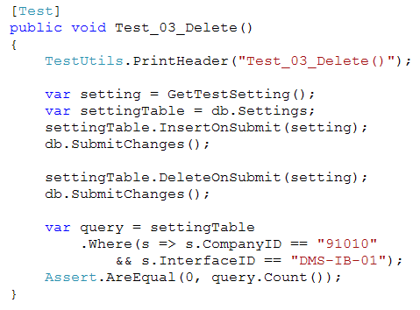
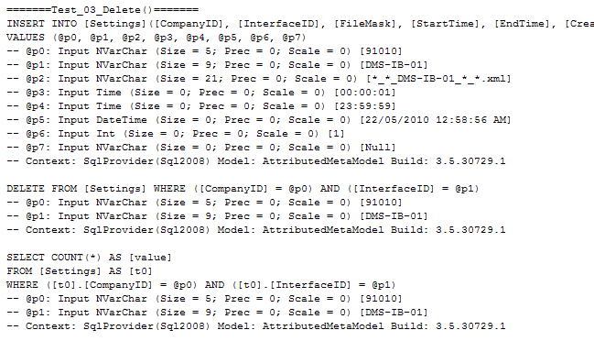
Delete

Slide 31
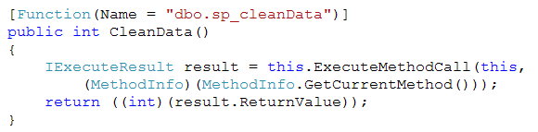
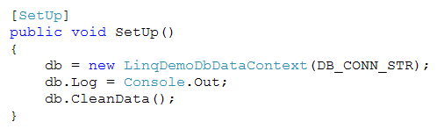

Call stored procedure

Slide 32
Tips
Use the DataContext.Log property
Use the GetChangeSet() method
Consider using partial classes or mapping files
Consider using partial methods
Consider using LoadOptions to perform immediate loading
Consider using UpdateCheck property (Column attribute) and try…catch (ChangeConflictException) to handle concurrency conflicts

Slide 33
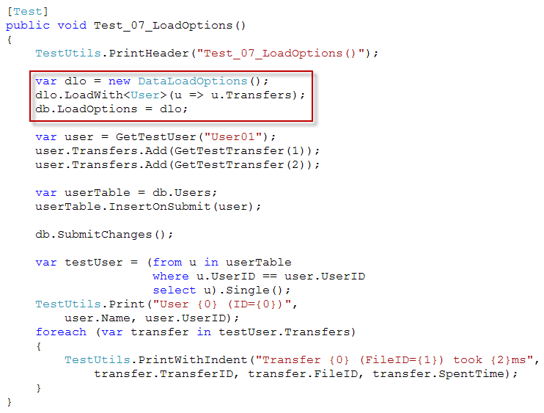
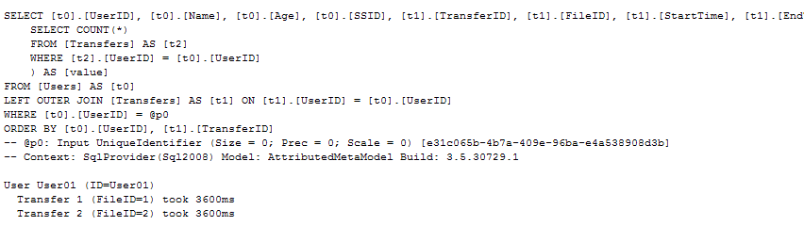
LoadOptions
Compare with Test_01_Insert_Parent_And_Children()

Slide 34

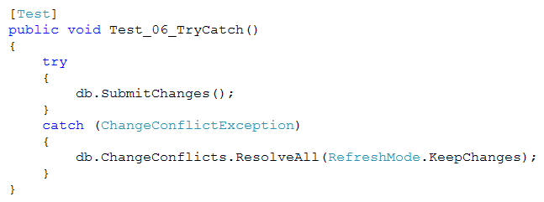
Concurrency conflict

Slide 35
Unsolved
I have a column that needs a default value on Insert only and I update it throughout my application. How?

Slide 36
References
LINQ In Action, by Fabrice Maguerie - Steve Eichert - Jim Wooley, Manning
Pro LINQ in C# 2008, by Joseph C.Rattz,Jr., Apress
MSDN:
O/R Designer Overview
SqlMetal.exe (Code Generation Tool)
How to: Dynamically Create a Database (LINQ to SQL)
SQL-CLR Type Mapping (LINQ to SQL)

Slide 37
Thanks for coming.
See ya!

