Slide 1

Quick guide to moq
Presenter: PhuongNQK

Slide 2
Goals
Introduce Moq basics with some readable examples
Introduce some Moq best practices

Slide 3
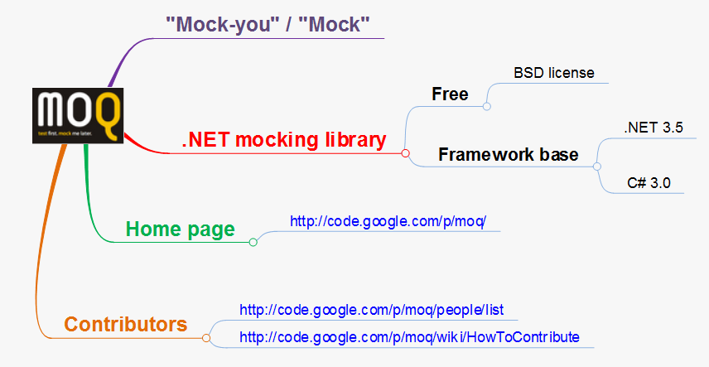
What is Moq?

Slide 4
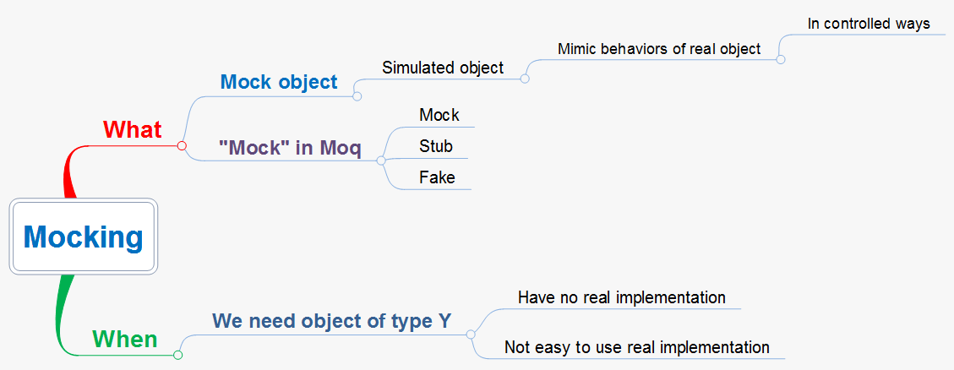
Concepts

Slide 5
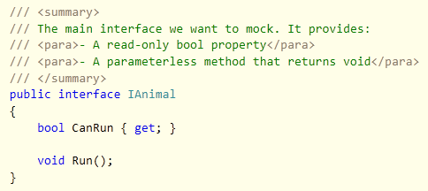
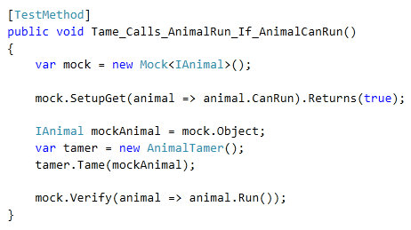
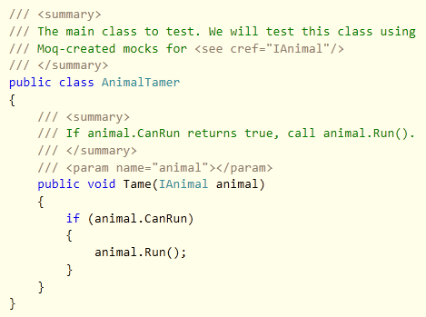
First examples

Slide 6
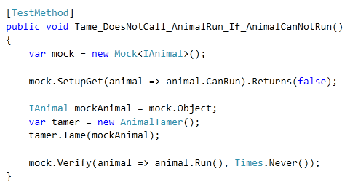
First examples (cont.)
First, we create a mock builder for the IAnimal interface. This builder will help us set up the behaviors of our mock.
Second, we set up what we expect from our mock. In this case, we expect that our mock will always return false for CanRun.
Third, we use the mock created by the builder. In this case, we pass the mock (i.e. mock.Object) to tamer.Tame().
Finally, we verify that our expectations have been met. In this case, we verify that Run() has never been called.

Slide 7
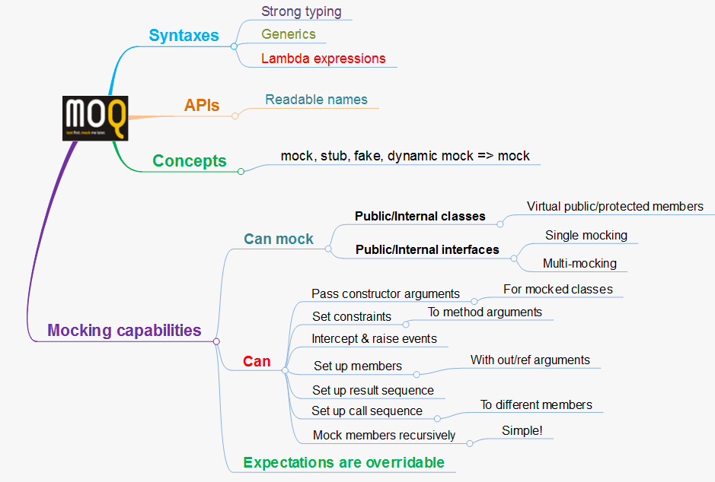
Features at a glance

Slide 8
Q & A
?

Slide 9
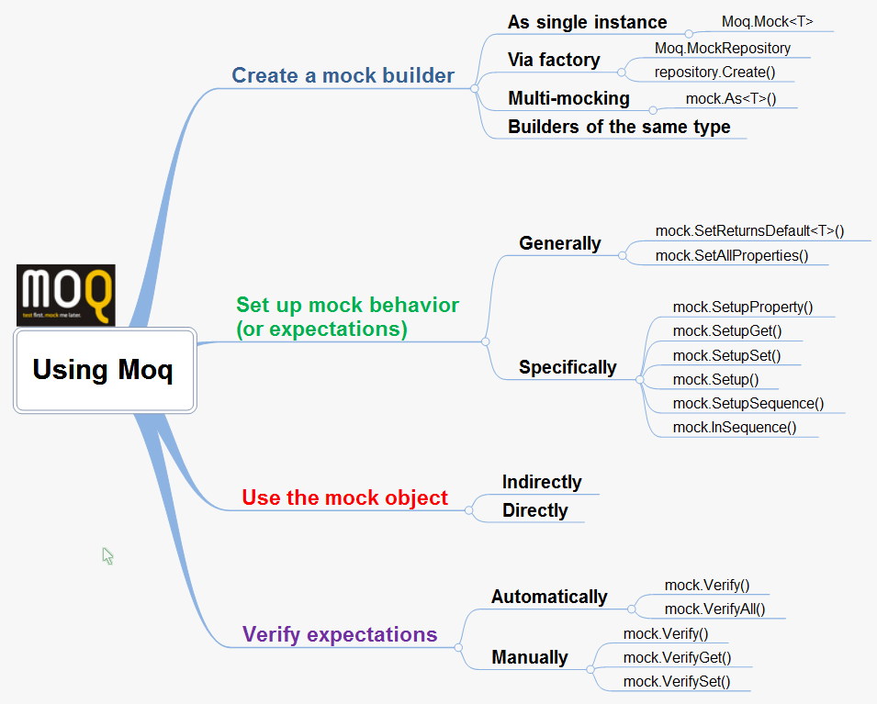
Moq API Summary

Slide 10
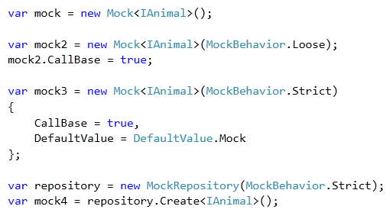
Step 1 - Create a mock builder

Slide 11
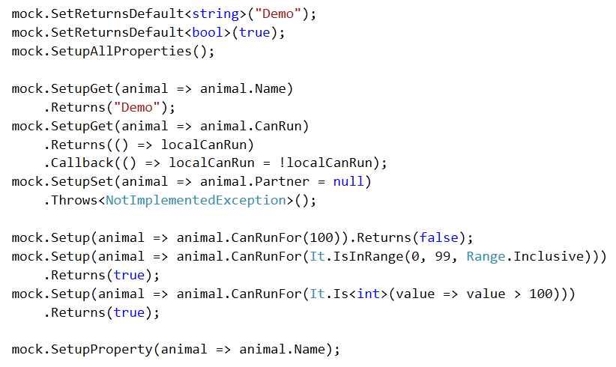
Step 2 - Set up mock behavior

Slide 12
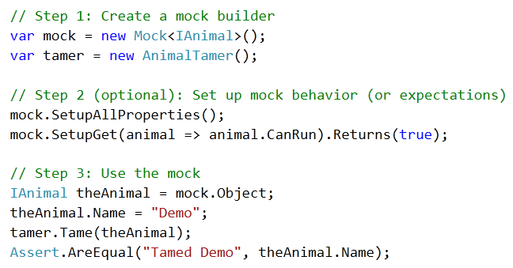
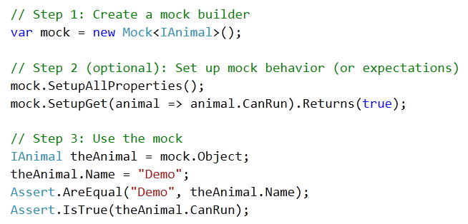
Step 3 - Use the mock object
Using a mock object indirectly means "Pass it to another object X, call X's member(s) and check for the changes".
Using a mock object directly means "Calling its member and check for the changes"

Slide 13
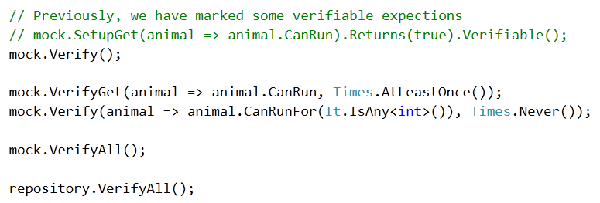
Step 4 - Verify expectations

Slide 14
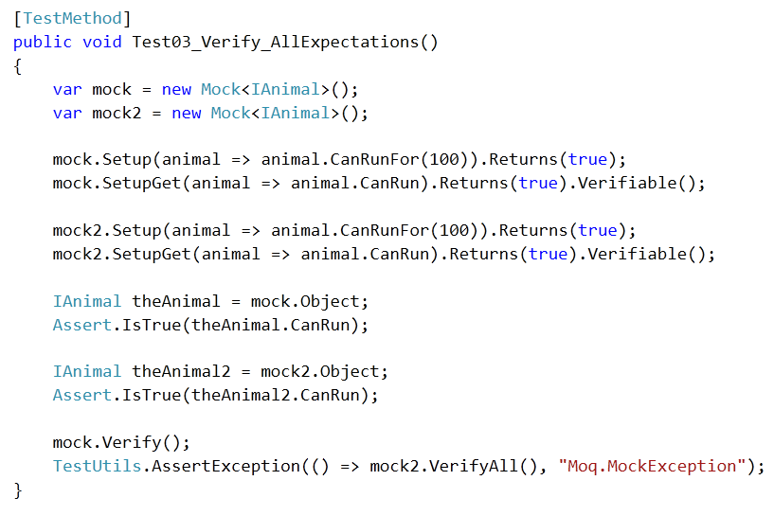
Closing Example

Slide 15
Q & A
?

Slide 16
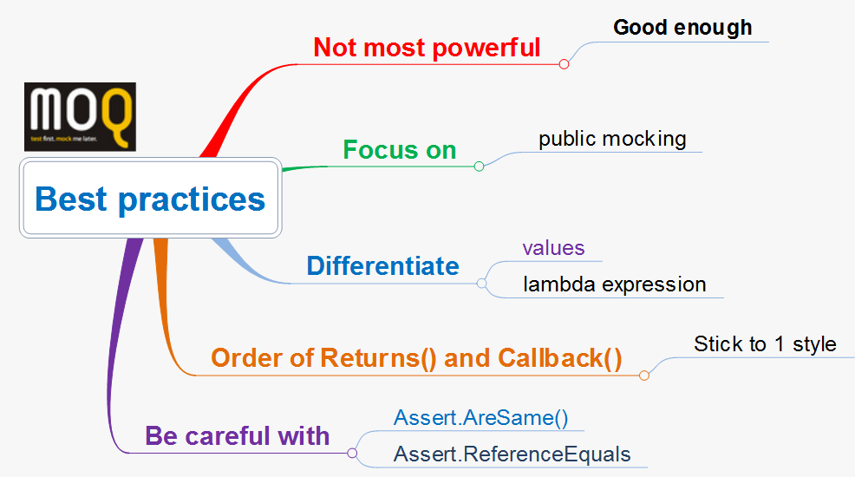
Best practices

Slide 17
References
http://code.google.com/p/moq/
http://code.google.com/p/moq/wiki/QuickStart

Slide 18
Q & A
?

Slide 19

Thanks for coming.
See ya!

