Slide 1
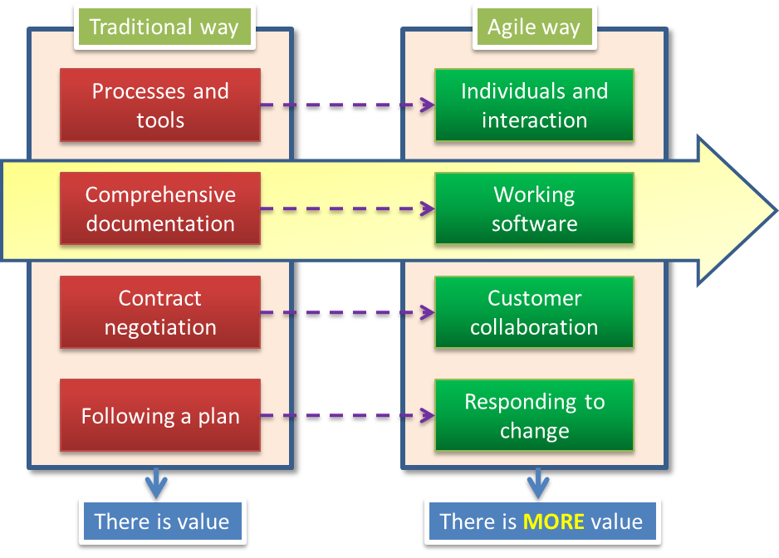
Tips on coding practices
Practice is learn by repetition. Daily practice, daily better.
Presenter: PhuongNQK

Slide 2
Basic mindset
Traditional way
Agile way
Processes and tools
Individuals and interaction
Comprehensive documentation
Working software
Contract negotiation
Customer collaboration
Following a plan
Responding to change
There is value
There is MORE value

Slide 3
OOP - What is it?
Object-oriented programming (OOP) is a programming paradigm that uses "objects" – data structures consisting of data fields and methods together with their interactions – to design applications and computer programs.
Programming techniques may include features such as:
Data abstraction
Encapsulation
Modularity
Polymorphism
Inheritance.
It was not commonly used in mainstream software application development until the early 1990s. Many modern programming languages now support OOP.

Slide 4

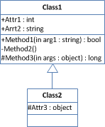



OOP concepts
Object
Class
Inheritance
Package
Interface
Inheritance provides a powerful and natural mechanism for organizing and structuring your software.
An object is a software bundle of related state and behavior.
Software objects are often used to model the real-world objects that you find in everyday life.
A class is a blueprint or prototype from which objects are created.
It allows classes to inherit state and behavior from their superclasses.
An interface is a contract between a class and the outside world.
When a class implements an interface, it promises to provide the behavior published by that interface.
A package is a namespace for organizing classes and interfaces in a logical manner.
Placing your code into packages makes large software projects easier to manage.

Slide 5
Basic OOAD principles
Imaginary abstraction > Blind simulation
Interface > Implementation
Composition > Inheritance
Single responsibility
No god class
Avoid having too many vapor classes

Slide 6
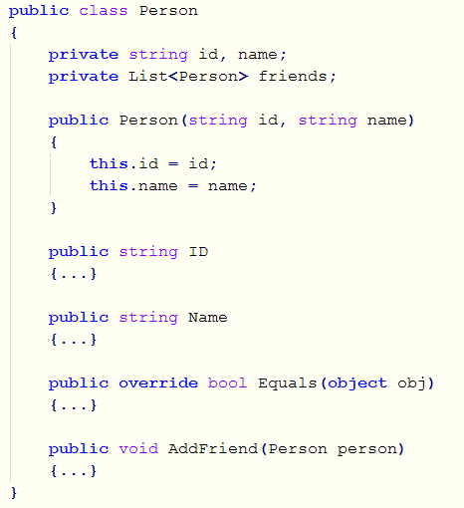
Naming code elements
Class name should be a capitalized noun
A name should be:
Expressive
Concise
It can be:
Noun
Adjective
Verb
Verb phrase
Relative pronoun: that, where, etc.
Similar elements should have similar names.
Non-public field name has a small initial letter
Argument name has a small initial letter
Property name should be a capitalized noun/adjective
Method name should be a capitalized verb …
… or a verb phrase

Slide 7
Working habits
Concentrate 100% of your performance
Write test when possible
Remove duplication
Refactor regularly
Use new syntaxes
Apply design patterns
Expressive code > lengthy comments
Learn something new everyday

Slide 8
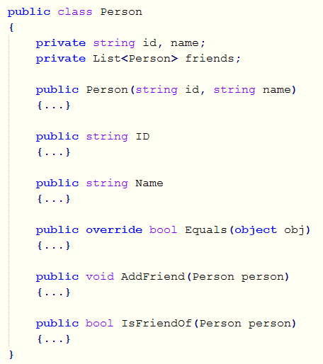
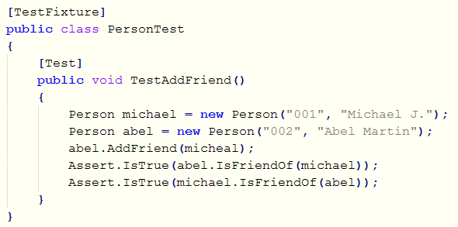
E.g. Write test when possible
Main class
Test class

Slide 9
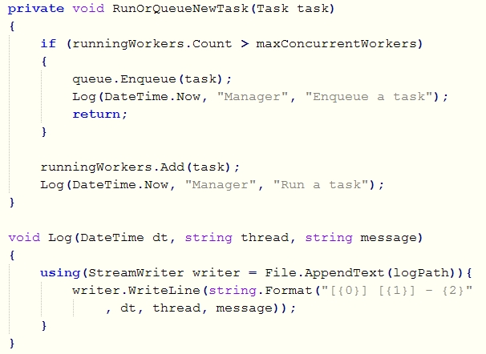
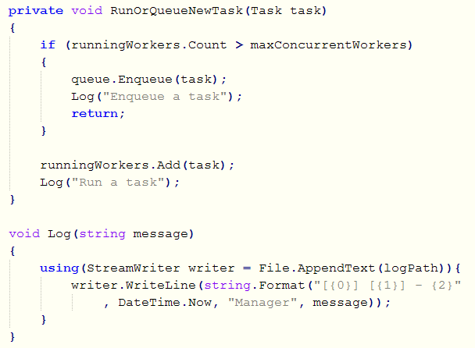
E.g. Remove duplication
Original
Revised

Slide 10
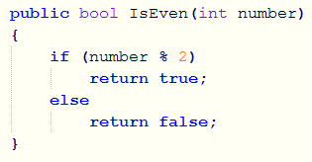
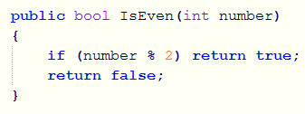
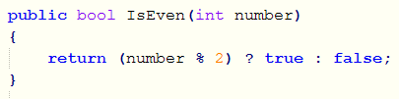

E.g. Refactor regularly

Slide 11
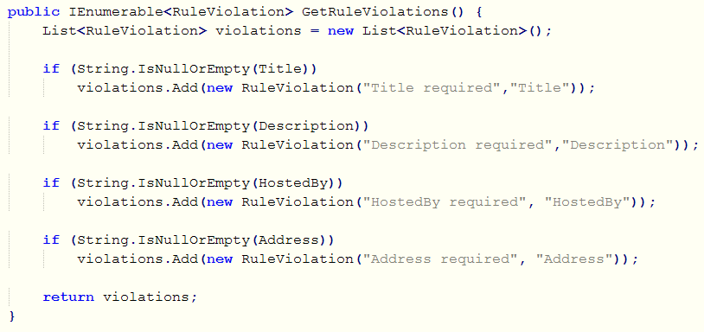
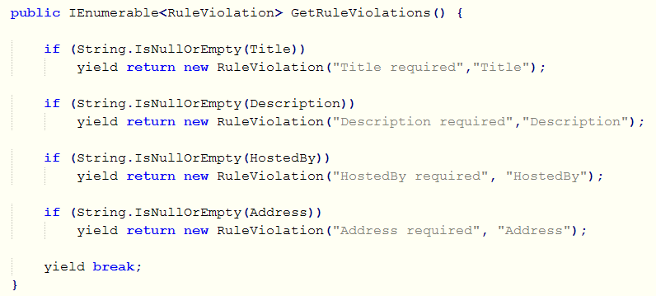
E.g. Use new syntaxes
Old way
New way

Slide 12
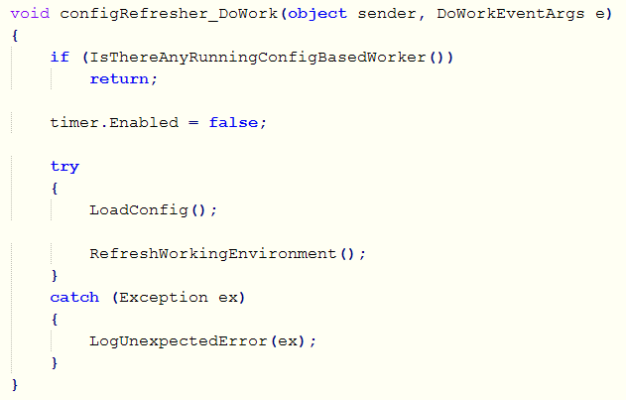
E.g. Expressive code > lengthy comments

Slide 13
Daily working schedule
Suggestion 1
1 hour
8 hours/day
(5 days/week)
Suggestion 2
Stay in one color at a time
Concentrate 100% of your performance
 | Coding
 | Refactoring
 | Spiking or learning something new
 | Side-works such as chatting, reading emails, web news, relaxing, etc.

Slide 14
Summary
Practice is the repetition of an activity to improve skill. No repetition, no improvement at all. You practice today for tomorrow effectiveness. You practice daily, you daily get better.
Trust me and give it a try!

Slide 15
Thanks for coming.
See ya!

