Slide 1
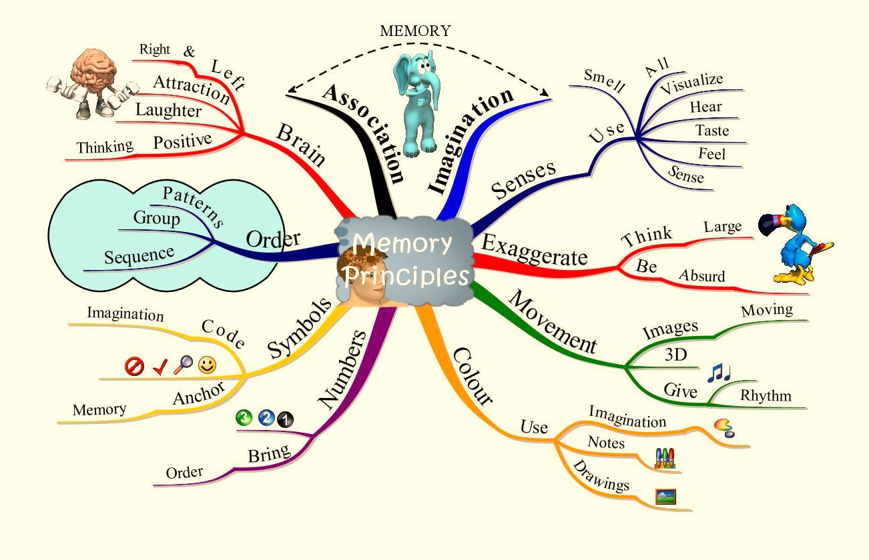
Memory techniques – p1
Presenter: PhuongNQK

Slide 2
Goals
Reveal some facts about your fantastic brain
Introduce some simple techniques to remember well

Slide 3
Getting started
Have you heard of any Guinness record relating to super-memory?
Have you known about any person with amazing memory?
Have you ever tested the limit of your own memory?
Let’s do it now ☺.

Slide 4
Self-tests: Is it TRUE?
You can usually remember:
Almost every single detail in a film you like
Almost every single detail in a conversation with someone, esp. someone you like
What happened to you:
Today
Some days / months / years ago
etc.
… you did not try to remember much then

Slide 5
Self-tests: Is it TRUE?
Sometimes, you can remember immediately and forever by the first time:
A number (SSID, phone, date, etc.)
A piece of knowledge
A face
etc.
… you did not try to remember much then

Slide 6
What does that mean?
Somehow, your brain can remember quite a lot without much effort

Slide 7
Self-tests: Is it TRUE?
You often try very hard to learn your lessons, but then you often forget them very easily. Even when you don’t want to forget.
You often admire other people of what they can do, but you rarely try if you can do the same.

Slide 8
What does that mean?
Your brain can not well remember many things?
Wrong. You have not utilized your brain well enough.
Why?
You don’t really care about that
You have not known about your brain well enough
You don’t believe that you can do it
Notes:
You may wonder why the others can do something, but ironically, you rarely continue to the next question: How can I do the same?

Slide 9
The good news is…
You are HERE because YOU CARE. So, issue 1 solved ☺.

Slide 10

What do you know about your BRAIN?

Slide 11
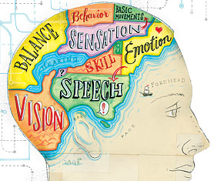
Our brain is capable of many things

Slide 12
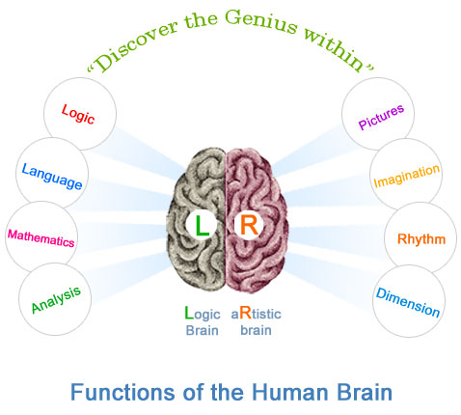
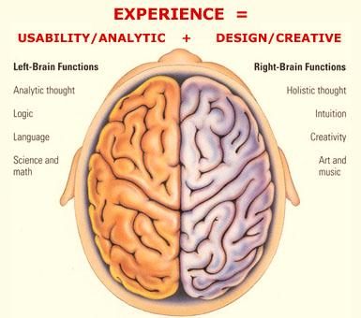
Our brain is divided into L & R

Slide 13
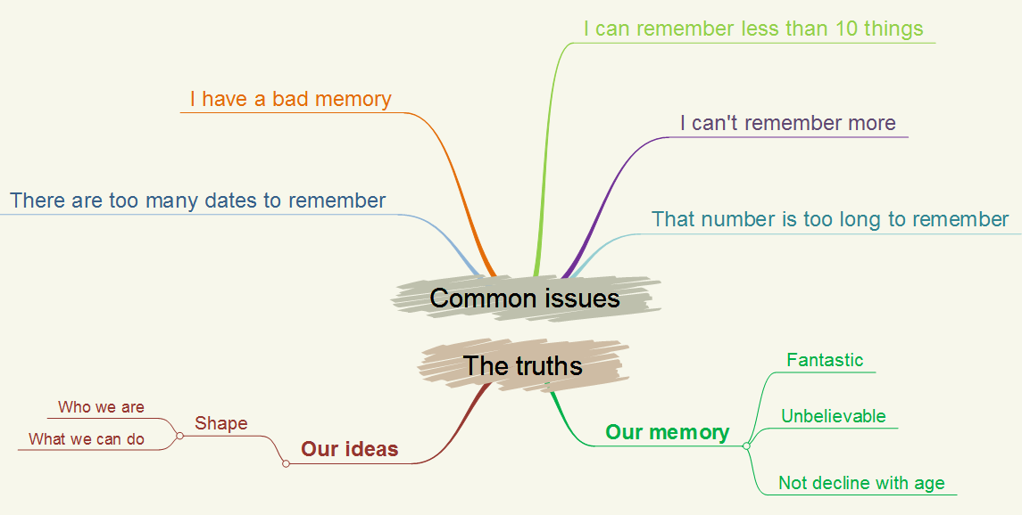
We have wrong belief about our brain

Slide 14
Some facts
Combining L & R brains make better memory
The brain gets older only when it is abused or unused
The brain fully functions when it is in sheer state of relax / focus / pressure
The brain remembers visual / colorful things better than monotone ones

Slide 15
Some facts
The brain remembers everything it knows, but it needs certain signals to recall them
If the brain has to remember 10 things every second, it is at most half-full when you die
Even geniuses can use no more than 10% of their brains
We greatly slow down our brains with our wrong belief

Slide 16
Last, but not least, fact
Those facts apply to everyone, although many do not believe ☺.
Issue 2 solved.

Slide 17
Issue 3
HOW ABOUT YOU? DO YOU BELIEVE?

Slide 18
Let’s find out…

Slide 19
Memory principles
You remember the most when you try to understand, not try to remember
The more visual / living, the easier
Anchor images make it greatly easier to recall what you remember
6 important reminding timepoints: 10’, 1h, 1 day, 1 week, 1 month, 6 months
Greater care makes better memory

Slide 20
Memory systems
What?
Set of rules to remember more and better
Characteristics?
Visualize the items to remember
Define a ordered set of anchor images

Slide 21


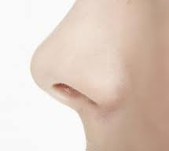
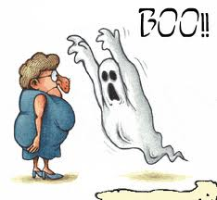
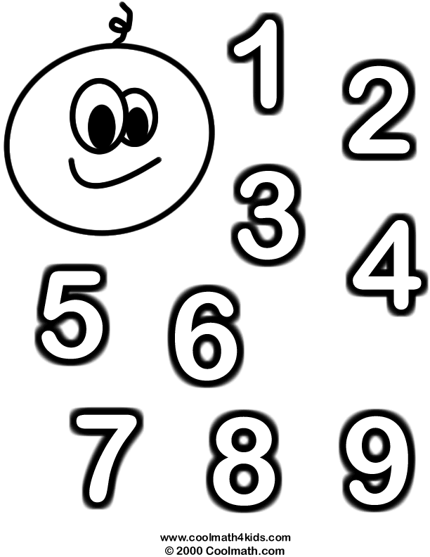
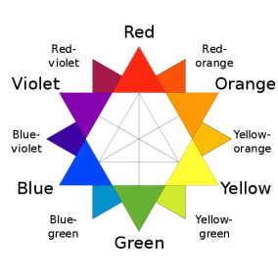
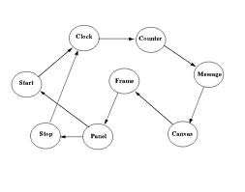





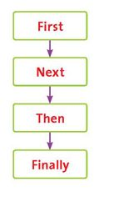




Visualizing factors
Synaesthesia
(Sensuality)
Number
Positive images
Association
Color
Smashin’ scope
Movement
Imagination
Order (Sequence)
Symbolism
Exaggeration
Sexuality

Slide 22
Basic memory systems
Link system
Number-Image system
Number-Syllable system
Character-Syllable system
Roman room system
Major system
etc.

Slide 23
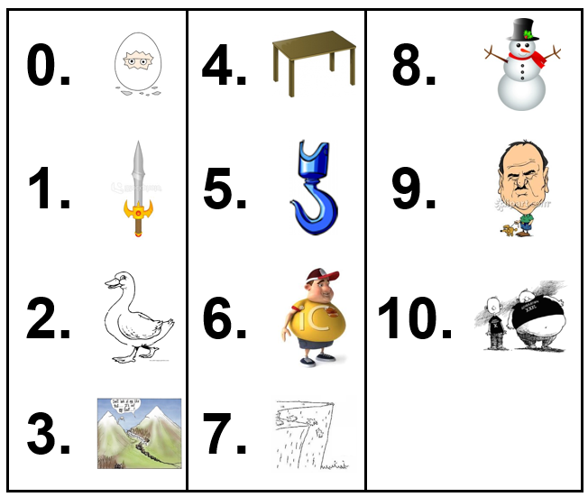
Number-Image system

Slide 24
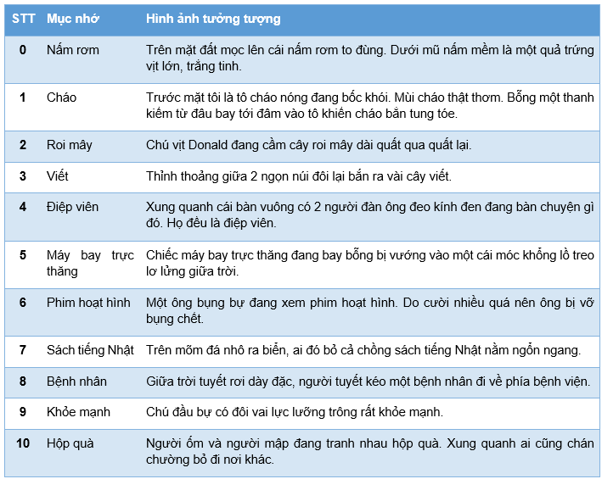
Exercise

Slide 25
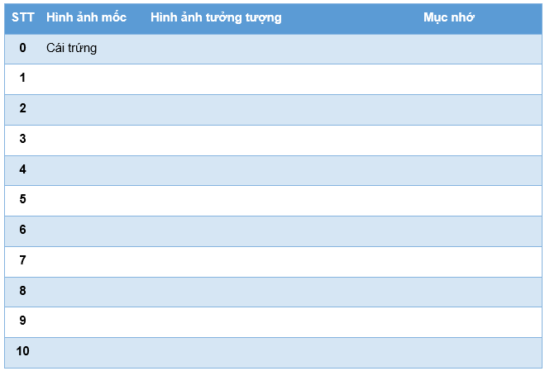
Exercise

Slide 26
Q & A

Slide 27
Do it yourself
Use number-image system to remember:
Facts about your brain
Memory principles
Daily practice with random things

Slide 28
References
Use Your Memory, by Tony Buzan, Pearson Education
Master Your Memory, by Tony Buzan, Pearson Education
Phương pháp rèn luyện trí nhớ (http://phuonglamcs.com/relax/memory-tester/Phuong%20phap%20ren%20luyen%20tri%20nho.pdf)

Slide 29
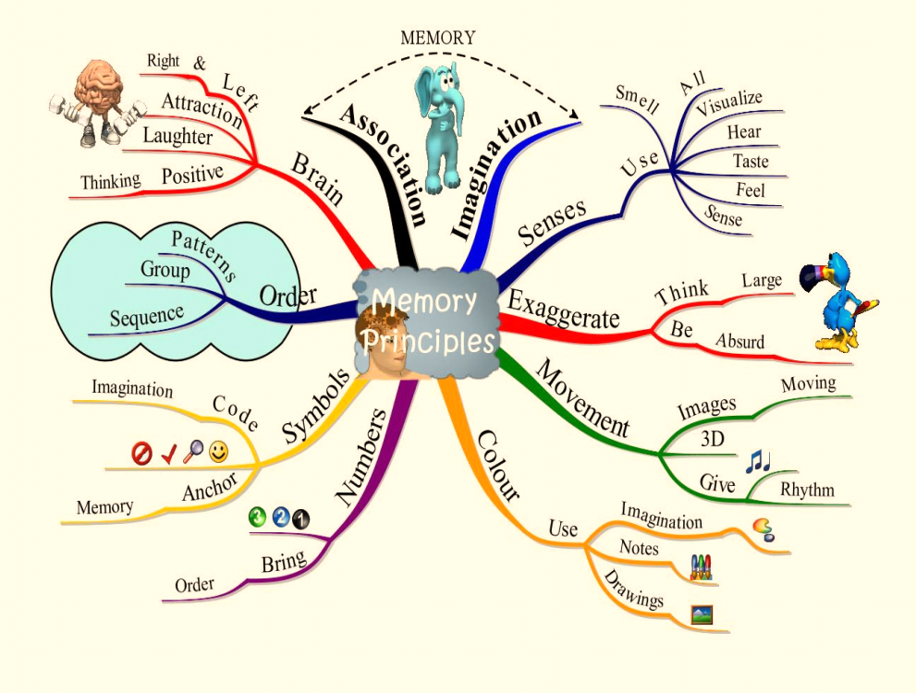
Thanks for coming.
See ya!
For more, please visit: http://phuonglamcs.com/relax/presentations/

