Slide 1
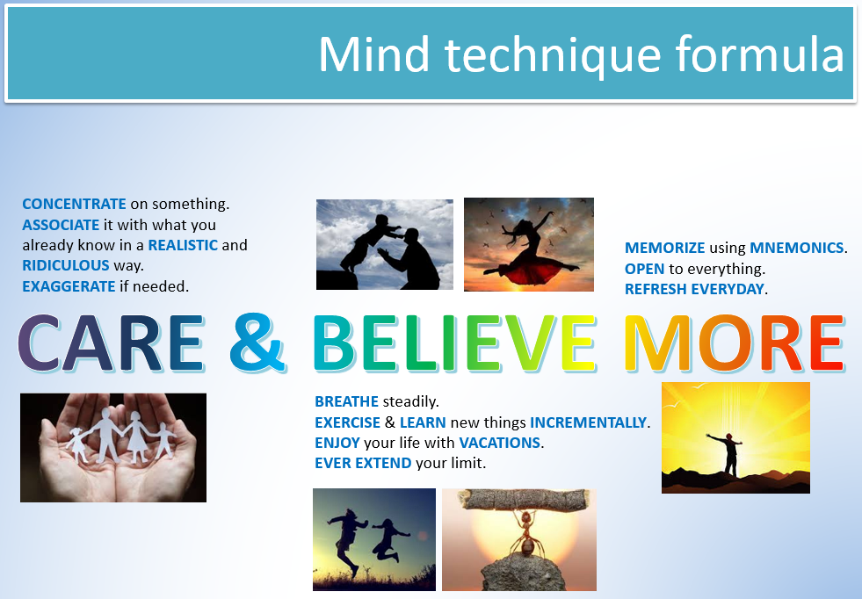
Mind techniques – p1
Adjust your behaviors and habits
Presenter: PhuongNQK

Slide 2
Goals
Introduce you to the basic formula of mind techniques
Give you some little practice as a preparation for the next part

Slide 3

What defines who we are?

Slide 4

What you do defines you

Slide 5

What you do defines you

Slide 6
Your thoughts define your behaviors
What you think will lead to what you do.

Slide 7
So, ultimately, your mind shapes who you are.

Slide 8
Can we control our mind?

Slide 9
Yes, you can control your mind. Moreover, you can program it.

Slide 10
How?

Slide 11





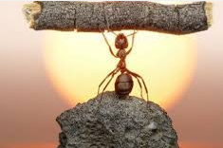
Firstly, care & believe more
CONCENTRATE on something.
ASSOCIATE it with what you already know in a REALISTIC and RIDICULOUS way.
EXAGGERATE if needed.
MEMORIZE using MNEMONICS.
OPEN to everything.
REFRESH EVERYDAY.
CARE & BELIEVE MORE
BREATHE steadily.
EXERCISE & LEARN new things INCREMENTALLY.
ENJOY your life with VACATIONS.
EVER EXTEND your limit.

Slide 12

Positive mindset

Slide 13
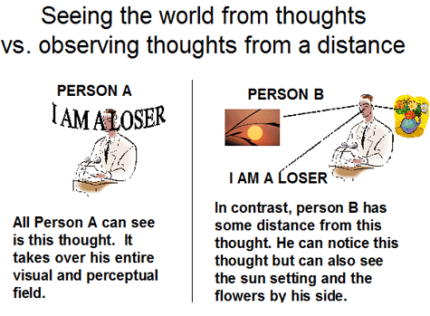
Positive mindset

Slide 14





Learn to feel good

Slide 15
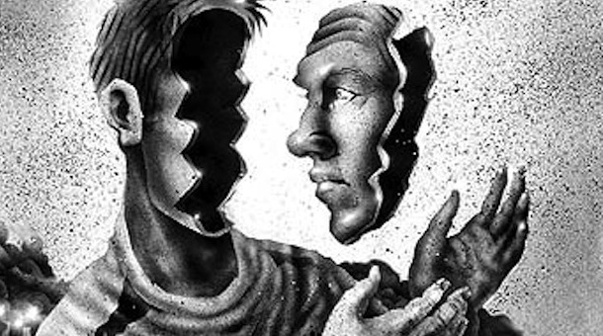
Disempower intrusive thoughts
http://www.theemotionmachine.com/how-to-disempower-intrusive-thoughts

Slide 16

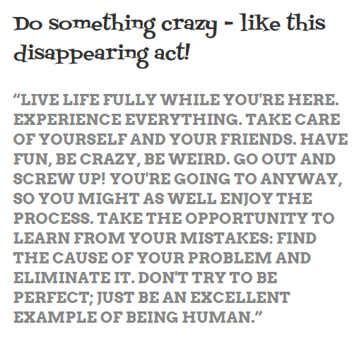
Do something crazy
http://www.schooloffinehearts.net/2014/01/do-something-crazy-like-this.html

Slide 17
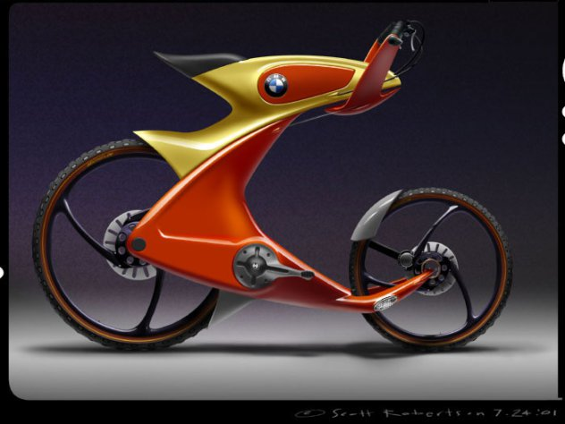
Enjoy crazy ideas

Slide 18
Secondly, program your mind
Concentrate and relax / breathe steadily
Visualize what you will do
Associate with a sure-to-see mnemonic
Review it for a few times, quickly and visually

Slide 19
How to concentrate?
Count 2 ways
Count with the clock
http://www.artofmanliness.com/2012/08/08/12-concentration-exercises-from-1918/

Slide 20
How to breathe steadily?
Count your breaths
5 – 5 (IN – OUT)
3 – 6 (IN – OUT)
5 – 5 – 5 (IN – HOLD – OUT)
4 – 4 – 8 – 4 (IN – HOLD – OUT – HOLD)
Breathe with your footsteps
Along the way
Upstairs

Slide 21
E.g. Learn a foreign language
Concentrate and relax / breathe steadily
Visualize the context you’re in
Use the words / phrases / sentences
Review the whole scene for a few times

Slide 22
E.g. Super deep nap
Concentrate and relax / breathe steadily
Tell yourself that you will wake up after 10’-15’
Visualize your tiredness as something
Running from your head
Down through every part of your body
To the centers of your feet
And out of your body
Repeat until you fall into sleep
When you wake up, check the clock. How long was your nap?

Slide 23
Applications
Memorize your schedules
Know exactly where you park your bikes
Remember your dreams
Adjust your feelings
Car sick, get away!
Fix your bad habits, e.g. always be late
Play as actors
Hypnotize -> Hypnosis therapy

Slide 24
Other useful exercises
Write (normal / speed / precise) with the other hand / both hands
Draw (normal / speed / precise) with the other hand / both hands
Practice with language study
Re-write an essay using the other hand (visualising the content at the same time)

Slide 25


Slide 26
Thanks for coming.
See ya!
For more, please visit: http://phuonglamcs.com/relax/presentations/

