Slide 1

Mind techniques – P2
Be a champion
Presenter: PhuongNQK

Slide 2
Goals
Introduce you to
3 principles of mind
4 basic states of mind
3 simple steps to build up new routines in mind
5 essentials of a champion
Show you how to apply that to
Playing fuss ball
Being a better developer

Slide 3
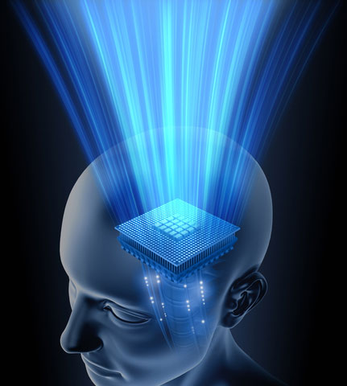
3 principles of mind
Your mind is powerful
You can control your mind
You have a choice in any situation

Slide 4
1- Your mind is powerful
Recall how your body reacts to your thoughts in these experiences
You have nightmares
Your fear comes
You feel in love
You do homework vs. You take an exam
Etc.
Now, make a pendulum move by thinking

Slide 5
2- You can control your mind
Think about your favorite song
Sing it in your mind
Sing it in your mind again, but more slowly
Sing it in your mind again, but more quickly
Again, but change the lyrics
Again, but with a high voice
Etc.

Slide 6
3- You have a choice in any situation
Describe a situation when you have no choice
2 basic choices
Feeling: feel nothing vs. feel something
Act: do nothing vs. do something
Describe your unsatisfactory situations
What were your choices?
Do you see any better choices now?

Slide 7
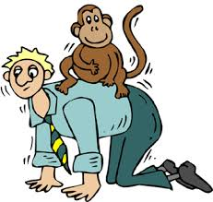
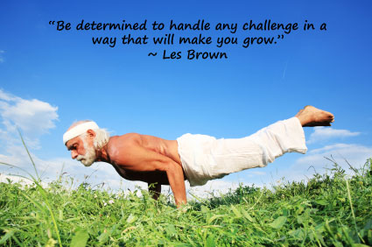
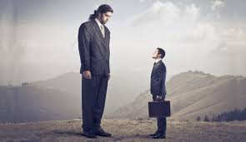

4 basic states of your mind
Determined
You focus on solving your problems. Repeated practice will make determined actions natural.
=> Practise regularly with determination
Monkey on your back
Monkey - the voice in your head - reminds you of past failures and tells you that you will make similar failures in the future.
=> Throw the monkey away, focus on supportive reality you have
MIND
Natural
You perform at max effectiveness with least effort. You fully believe in your skills and abilities.
=> Typically, we are ‘natural’ in 10% of our lives. Increase that number!
Intimidated
You exaggerate the inconveniences (obstacles, pressures) in the surrounding environment. You exaggerate others’ skills and abilities and underestimate your own ones.
=> Face the reality, focus on maximizing your own skills and abilities

Slide 8
4 basic states of your mind
List your thoughts
Group them into 4 states
List corresponding actions and their results
Now answer
Which state(s) consumed most of your time?
How did each state affect your action results?
What can you do to focus more resources on Natural and Determined states?

Slide 9
Easy to be in bad states
You get a challenge and doubt you can make it
You are afraid to work with a customer that used to complain you for a few times
You are flooded with tasks, you get stressed and your results are getting worse
You are not confident in your ability
You are afraid to lose a competition because you know your competitor is strong
Etc.

Slide 10

What to do to get out of bad states?

Slide 11
Mind -> Actions -> Results. When your results are no longer as expected, you need to build up new better routines in your mind and actions.

Slide 12


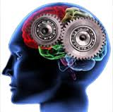
How to build up a new routine?
3R
ecognize
your current ways of doing things
efocus
on on some goal(s) of improvements
eprogram
your mind to follow new better routines

Slide 13
Recognize current routines
How do you do it now?
What is wrong with the current routine?
You can change your mind only if you have a real need for a better mind. So, are you sure you want a better routine?

Slide 14
Refocus on some improvement goal(s)
Refocus is NOT fool yourself
Refocus = pay attention to something else
Refocus on
A reasonably better target result
Necessary facts leading to the result
How to fix a mistake (rather than the mistake)

Slide 15
Reprogram new routines
Action routines come from mind routines
Common bad routines
Focus on successes less than enough
Overstate mistakes
Regret past experiences
Simply tell yourself that you won’t repeat a mistake

Slide 16
Reprogram new routines
Recommended routines
Review your successes so that you’ll repeat them
Review your mistakes / past experiences and develop a strategy to fix them (You can only avoid a mistake by knowing how to fix it, not by simply thinking you won’t make it again)
21 -> 28 tries is required to form a new routine

Slide 17

It sounds worth a try. But I want to build the best, not just better, routines. Is it possible with 3R?

Slide 18
Well, to be the best, you also need the mindset of a champion.

Slide 19
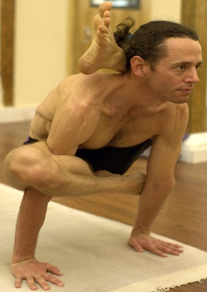
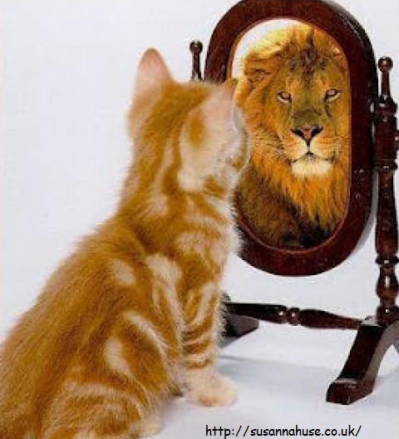
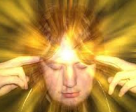
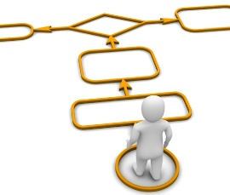

5 essentials of a champion
High confidence
Mental discipline
CHAMP
Concentration
Action plan to win
Participate competitively

Slide 20
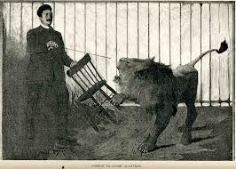
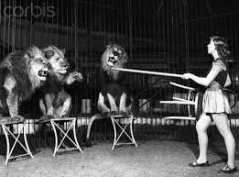
1- Concentration
On what?
What you have
The process, i.e. what-to-do, leading to the expected results
How to fix past mistakes
Not on what?
What you don’t have
Mistakes that you should avoid
Multi-focuses are distracting

Slide 21
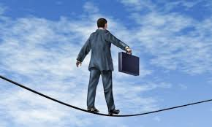
2- High confidence
In what?
Setting your target results
The process leading to the results
Your ability to repeat your successes
Not in what?
The results
Success is a luck
100% or 0%
We always need confidence

Slide 22
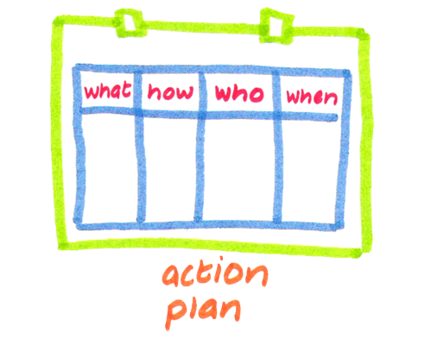
3- Action plan to win
Define your target results
Analyze effective steps leading to the results
Analyze ineffective steps
What were wrong with the underlying thoughts?
How to fix them?
Turn the fixes into new effective steps
Realize your plan
A good plan contains target results and effective steps to achieve those results

Slide 23
4- Mental discipline
Desire to self-improve
“I want to be better. What should I do?”
Do what you promise to
Be responsible for your own failures
Accept your own mistakes, analyze them and willingly seek help for fixing them
Be more stable in your thoughts and actions
No wait and see, just start to do!

Slide 24
5- Participate competitively
Desire to win
Take work / competition as a win-win game
“I want to raise the level of the game.”
One’s successes become others’ motivations
Be active in succeeding
Properly value your own contributions in your successes
Learn from all situations
Good moves are to be repeated
Bad moves are to be adjusted
Share your best experiences

Slide 25
Applications
Be a champion in your favorite sport, e.g. play fuss ball
Be a champion at your work, e.g. a developer
Be a champion in any other aspect of life

Slide 26
Q & A

Slide 27
Learn from the best to be the best.

Slide 28
Between the best, differences in skills are minor, differences in mindset are vital.

Slide 29
Many people believe human ability is limited.

Slide 30
Yes, that may be true.

Slide 31
But the only way to test that limit is never cease to expand it.

Slide 32
References
Performance Intelligence at Work: The 5 Essentials to Achieving The Mind of a Champion, by Julie Ness Bell and Robin Pou, McGraw Hill

Slide 33
Thanks for coming.
See ya!
For more, please visit: http://phuonglamcs.com/relax/presentations/

