Slide 1

Mind techniques – P3
Be always successful
Presenter: PhuongNQK

Slide 2

Goals
Define successes and failures
Show you 1 way to be always successful

Slide 3

What is/makes a success?

Slide 4
Well, everyone has their own answers.

Slide 5
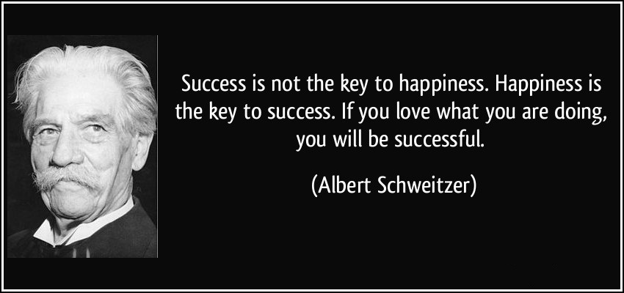
E.g.

Slide 6

E.g.

Slide 7

E.g.

Slide 8
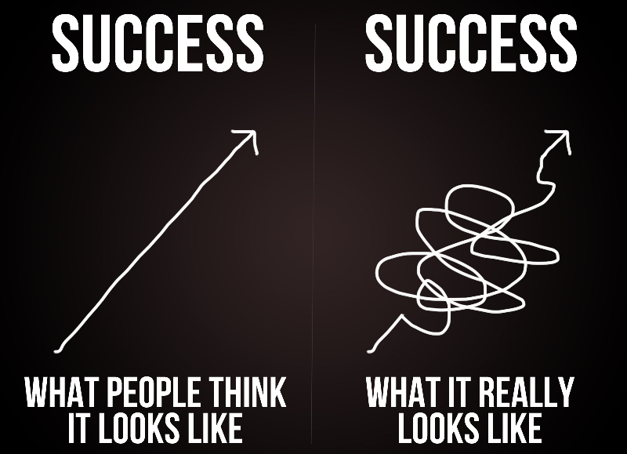
E.g.

Slide 9

E.g.
1- The achievement of something that you planned to do or attempted to do
2- A plan or an attempt that achieves good results
3- The fact that you are successful in your career or profession, especially when you become rich, famous, respected, etc

Slide 10
In our case, success is the achievement of something which we planned or attempted to do or which proves that we are getting better.

Slide 11
What is/makes a failure?

Slide 12
Again, everyone has their own answers.

Slide 13

E.g.

Slide 14
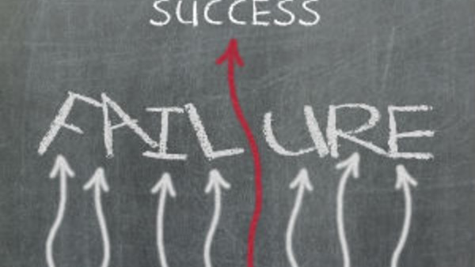
E.g.

Slide 15
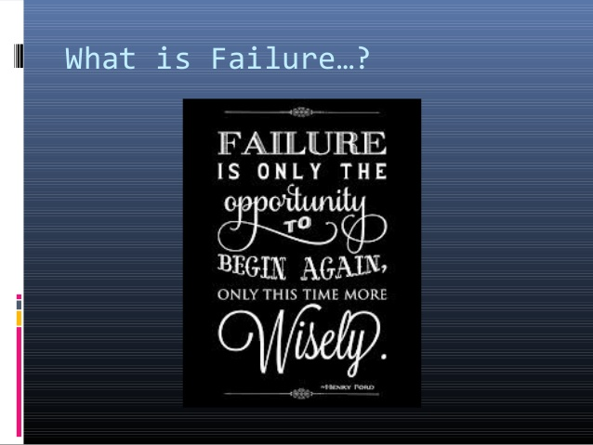
E.g.

Slide 16
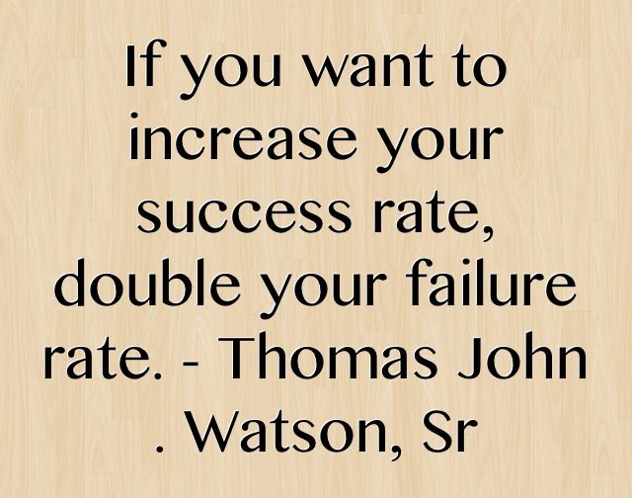
E.g.

Slide 17
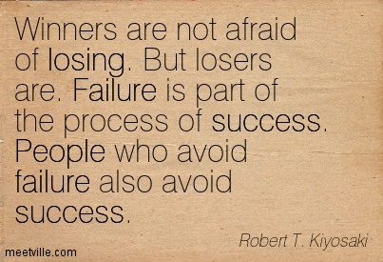
E.g.

Slide 18
E.g.
1- A lack of success in doing something
2- A situation in which you do not do something that someone expects you to do

Slide 19
Basically, failure and success are 2 sides of the same coin. They co-exist and together, they make the coin.

Slide 20
Why are successes / failures important?

Slide 21
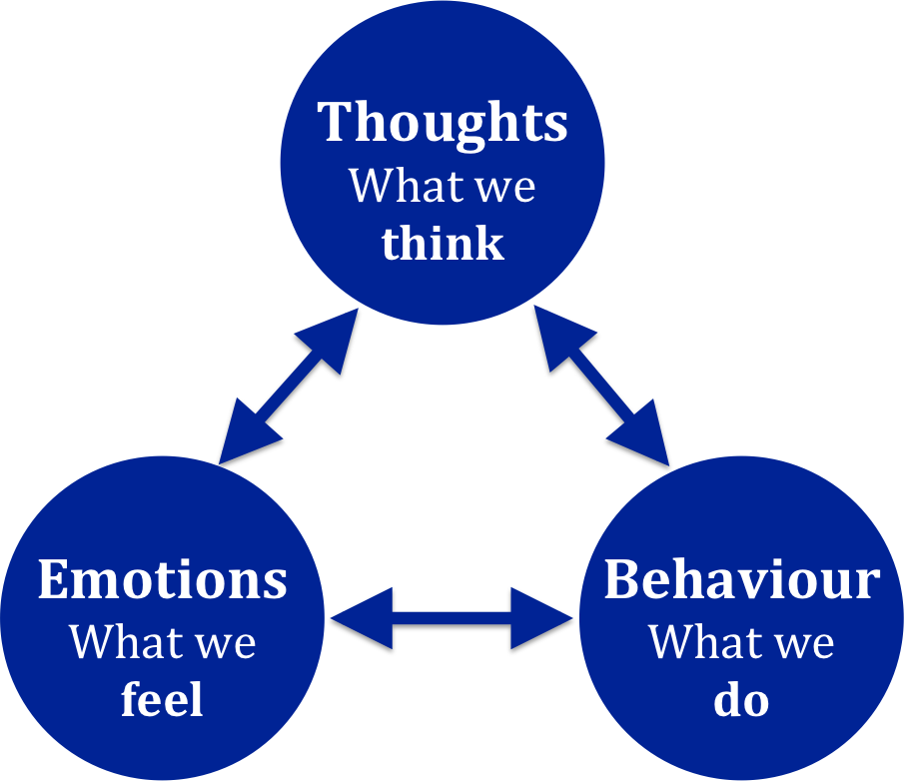
They are everywhere in our life!
We SUCCEED or FAIL all the time. Neither success nor failure is permanent. They are just changing regulators.
Successes can bring you joy, pride and confidence while failures can bring you worry, disappointment and disbelief.
Successes can make you overlook your weaknesses while failures can give you a chance to realize them and a determination to fix them.
Both success and failure can be GOOD or BAD. It’s all up to HOW YOU PERCEIVE them.

Slide 22
How to be always successful?

Slide 23

Way 1: Use a success-only process

Slide 24




Way 2: Use another success-only process
CARE & BELIEVE MORE
Have SMART goals
Be a CHAMP

Slide 25





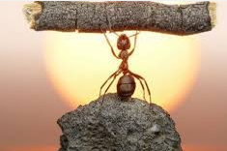
CARE & BELIEVE MORE
CONCENTRATE on something.
ASSOCIATE it with what you already know in a REALISTIC and RIDICULOUS way.
EXAGGERATE if needed.
MEMORIZE using MNEMONICS.
OPEN to everything.
REFRESH EVERYDAY.
CARE & BELIEVE MORE
BREATHE steadily.
EXERCISE & LEARN new things INCREMENTALLY.
ENJOY your life with VACATIONS.
EVER EXTEND your limit.

Slide 26

Have SMART goals
What exactly should be realised?
How will we measure this?
Is it feasible?
Do we have control over it?
Is this goal realistic and
relevant to our life now?
What is the timeframe
to achieve this?

Slide 27
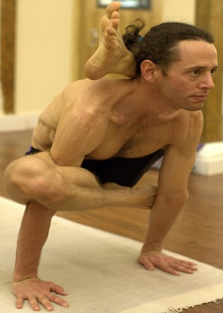

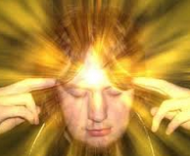


Be a CHAMPION
3R
ecognize
old ways of doing
High confidence
Mental discipline
efocus
on better goal
CHAMP
eprogram
better ways of doing
Concentration
Action plan
Participate competitively

Slide 28
How to measure your achievement?

Slide 29
Common measurement
Goal: finish 5/10 tasks a day
- Today: finish 7/10 tasks a day
- What to think about on the way to home: the finished 7 tasks or the unfinished 3 tasks?
Succeed
(only 1 chance)
0
9
10
Fail
(Less than 10)
Note: Many people think about the unfinished 3 tasks because they consider ‘less than 10’ a failure. They are thinking about their failures.
What do you feel when you think you are a loser like that?

Slide 30
Recommended measurement
Your own regular average performance
- A relative value that needs to be increased regularly
- E.g. now 5 means ‘you can finish 5 tasks a day’. 6 months later, 5 means ‘you can finish 7 tasks a day’.
0
5
10
Fail
(Less than 5)
Succeed
(More than 5, not only 10)
Note: Failure & Success ranges are equal in length. That prevents you from being too strict or too easy with yourself.
Note: Success is getting better. Today’s success is getting better than yourself yesterday.

Slide 31
Recommended measurement
Best comparison
You now and you yesterday
Bad comparison
You and him/her/them/etc. (compared to others)
That’s why people don’t want to join performance report meetings, except those who know they are the best ones.

Slide 32
Different types of successes / failures
Much effort
- About give-up time: “I can not change.” or “I can not do it.”
- Don’t give up, this is just the beginning!
All things here are successes you can be proud of
Your
average
Low performance
High performance
- Our bad/down time
- Should waste no more time on this by 3R:
+ Mind status: M -> D
+ Focus on what to do
- If we get stuck here forever, that is a failure.
- 80% our time in a day
- Routines are often ignored because they are duty
- All things here are successes that can be well-repeated
Little effort

Slide 33
How to apply it all to me?

Slide 34
Build up your exemplary person
Who do you admire the most? Why?
Who do you want to be the most? Why?
How is your exemplary person like?
What can he/she do?
What is his/her typical day like?
What will he/she get to in the long run?

Slide 35
Build up good daily habits
Day start
Wake up, wash up, warm up
Look at yourself in the mirror (re-inforce your confidence) and remind yourself of your exemplary person
What is your plan today?
During the day
Do your work with the mindset of your exemplary person
Whenever you realize your mistakes, quickly program in your mind a strategy to fix it next time
Mid-day
Take a super deep nap at noon
Day end
Review your successes & new lessons during the day
Completely relax and have a super deep sleep at night
To be always successful, you need to realize, repeat and enhance your successes everyday.

Slide 36
Build up good weekly/monthly habits
Challenge yourself with a tough thing
Sing a song
Learn new words
Do some exhausting exercises
etc.
Raise the level of your self-training exercises
Regularly: Be of gradually higher levels
Randomly: Be of 2x, 3x, 10x higher levels

Slide 37
Q & A

Slide 38
As you know, the only way to test your limit is never cease to expand it.

Slide 39
But no pain, no gain.
No failure, no success.

Slide 40
A billion failures can never imply the non-existence of a single possibility.

Slide 41
Similarly, a billion successes can only prove the limit is at least there.

Slide 42
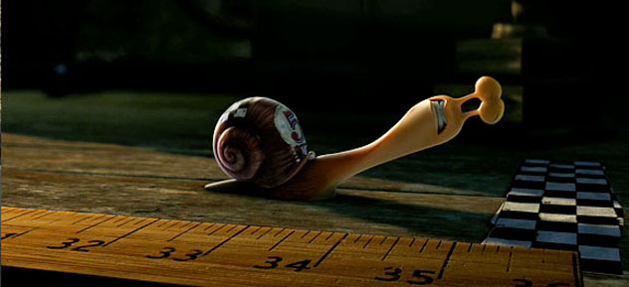
So, just go on and never give up.
You are always so close ☺!

Slide 43
References
Performance Intelligence at Work: The 5 Essentials to Achieving The Mind of a Champion, by Julie Ness Bell and Robin Pou, McGraw Hill

Slide 44

Thanks for coming.
See ya!
For more, please visit: http://phuonglamcs.com/relax/presentations/

