Slide 1
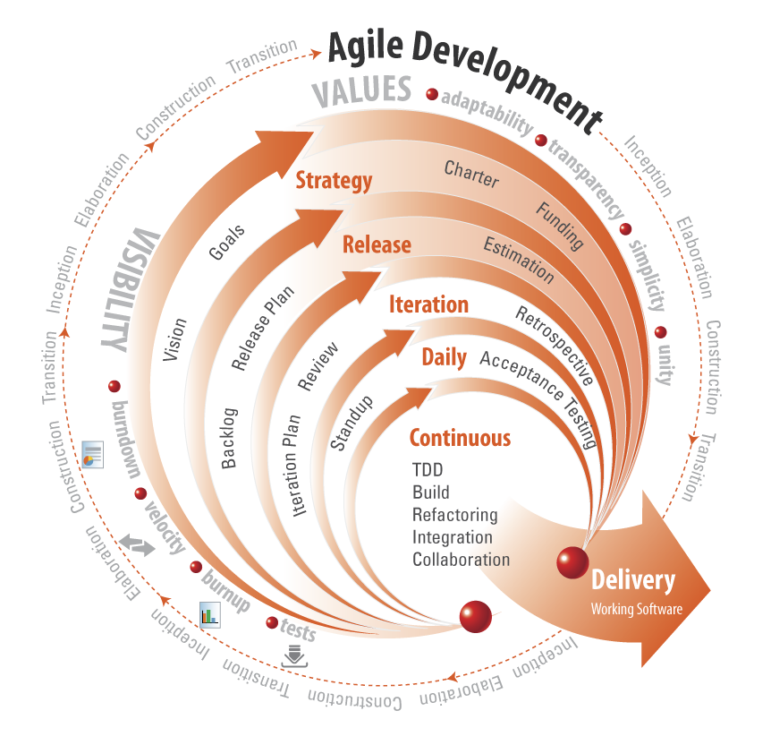

Agile mindset
Presenter: PhuongNQK

Slide 2
Goals
Introduce the concept of Agile and Agilist
Introduce Agile development, methodologies and applications

Slide 3
Starting point
We are born to work. It is what we do that defines us.

Slide 4
As a result…
We always need better ways to work.

Slide 5
You know…
Agile mindset will help us find such ways.

Slide 6
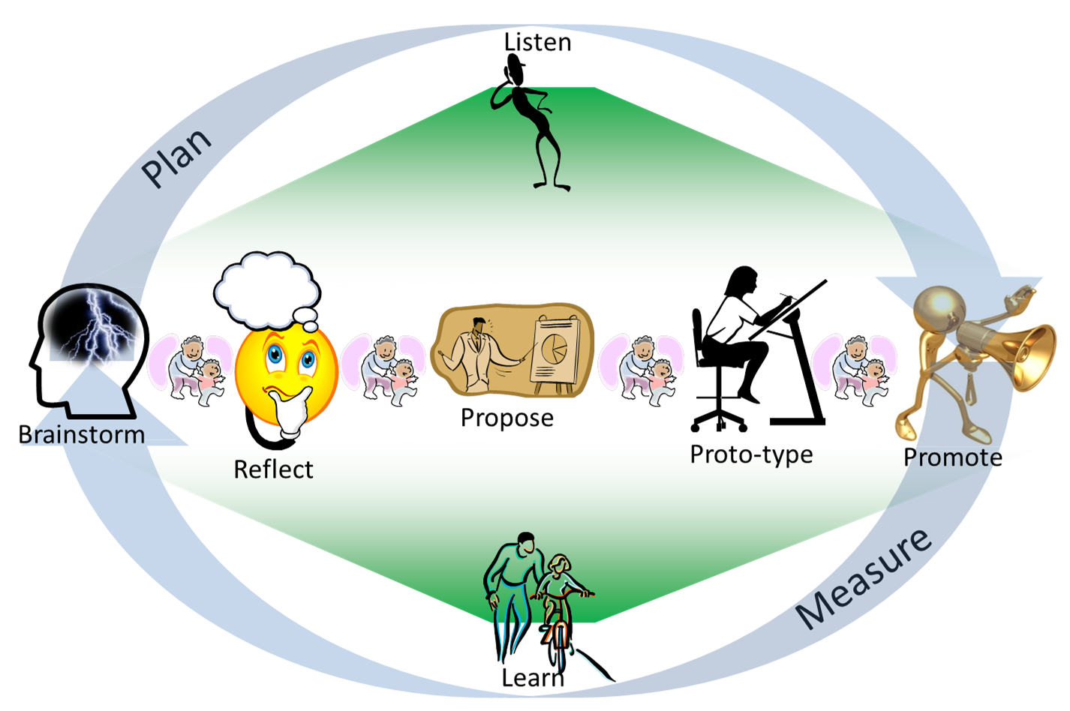
Generic Agile concept
Iterative
Incremental

Slide 7
Generic Agile concept
Development and delivery:
Iterative
Incremental
Requirements and solutions:
Evolve through collaboration between self-organizing, cross-functional teams
Others:
Adaptive planning
Rapid and flexible response to change

Slide 8
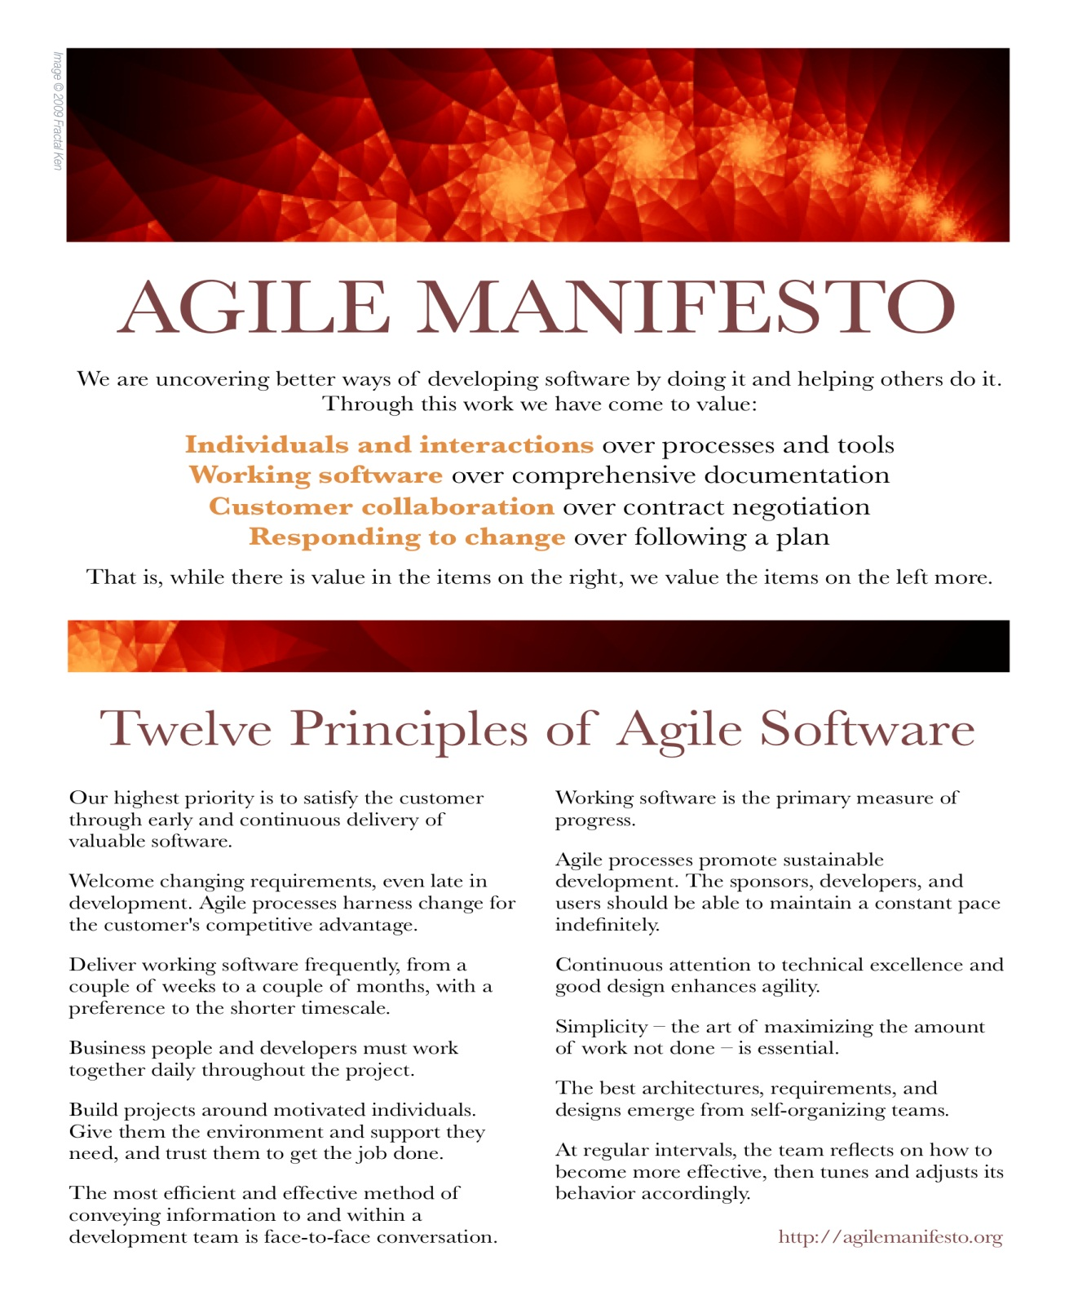

Slide 9
Traditional vs. Agile
Traditional way
Agile way
Processes and tools
Individuals and interaction
Comprehensive doc / theory
Usable products
Contract negotiation
Customer collaboration
Following a plan
Responding to change
There is value
There is MORE value
Notes:
Traditional way: the typical candidate is Waterfall method.

Slide 10
Agilist
An agilist practices and promotes agile mindset.

Slide 11
What makes a good worker?
Qualities
Passionate
Discipline
Self-improving
Truthful
Grateful
Active
Creative
Collabor-ative

Slide 12
What makes a good agilist?
A good worker
With SMART goals
Size tasks
Regularly review & learn
Start quickly
Prefer simplicity
Improve work daily
Interact face to face
Utilize limited resouces
A member & leader
Notes:
- Always start with a SMART goal: No goal, no move. SMART = Specific + Measurable + Achievable + Realistic + Timely.
- Size your tasks for easy planning and estimating. Too big tasks should be split, too small tasks should be merged.
- Start quickly with a working solution, then try a few different approaches if possible. Do not spend too much time thinking about a perfect solution because it does not exist. Yet there exist better and better solutions.
- Always try to utilize your limited resources
- Prefer simplicity: always try to make things simpler so that others can understand
- Daily improve your work bit by bit
- Prefer direct interaction if possible. E.g. do not send an email or chat message when a face-to-face conversation or small talk is not hard to make.
- Work in a team as a member: the whole team succeeds or the whole team fails.
Because every member is better than the others in some aspect(s), each member can be a context-sensitive leader depending on different situations. Do not let the nominal leader be responsible alone for the whole team.
- Regularly review and learn: learn from your own failures and successes, learn from others’ failures and successes.

Slide 13
Agile development

Slide 14
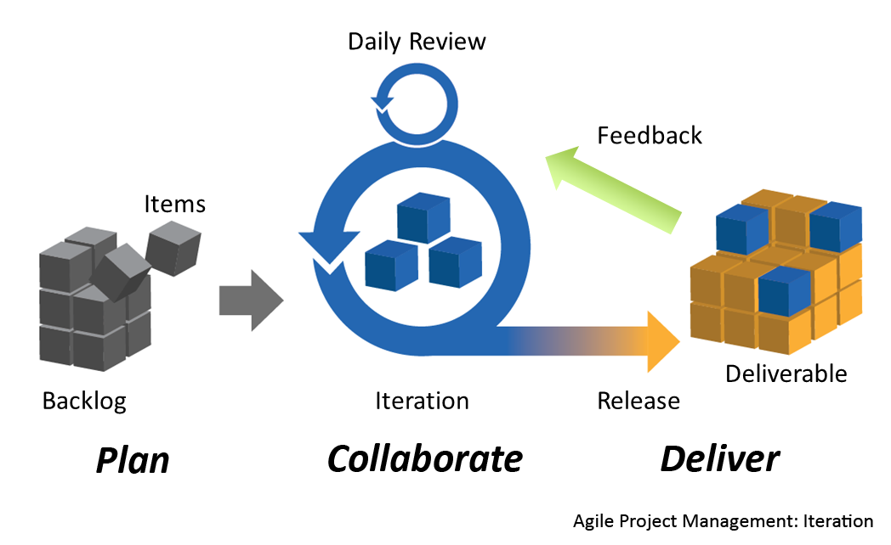
Agile project management

Slide 15
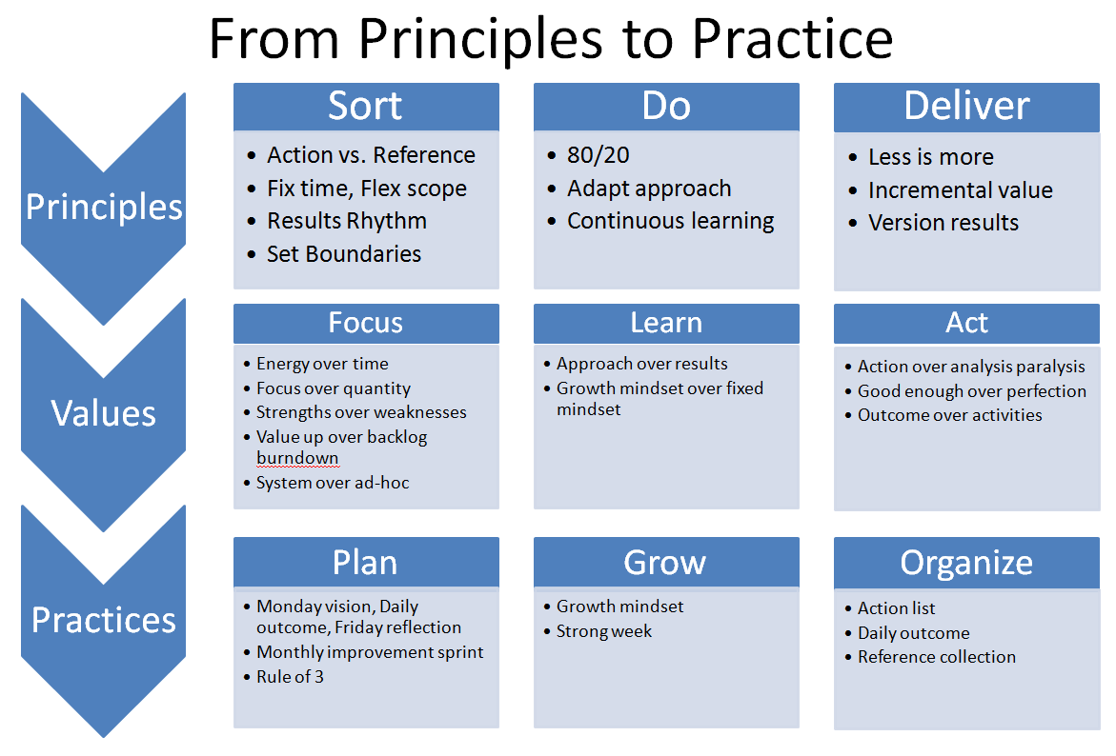
Agile results

Slide 16
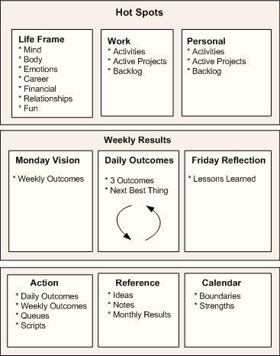
Agile results

Slide 17
Recipe to improve capacity
Visualize work-in-progress
Reduce multitasking or task switching
Improved focus
Cycle Time improves
Feedback frequency increases
Limit work-in-progress
Team maturity improves
Quality improves
Recipe to improve capacity

Slide 18

Agile is an umbrella…
Kanban
DSDM
SCRUM
Lean
XP
Crystal
FDD
DevOps
… Methodologies are Implementations
Notes:
Agile is an Umbrella – Methodologies are Implementations
Agile development is not a methodology in itself. It is an umbrella term that describes several agile methodologies. At the signing of the Agile Manifesto in 2001, these methodologies included Scrum, XP, Crystal, FDD, and DSDM. Since then, Lean practices have also emerged as a valuable agile methodology and so are included under the agile development umbrella in the illustration later in this topic.
See: http://msdn.microsoft.com/en-us/library/dd997578.aspx

Slide 19
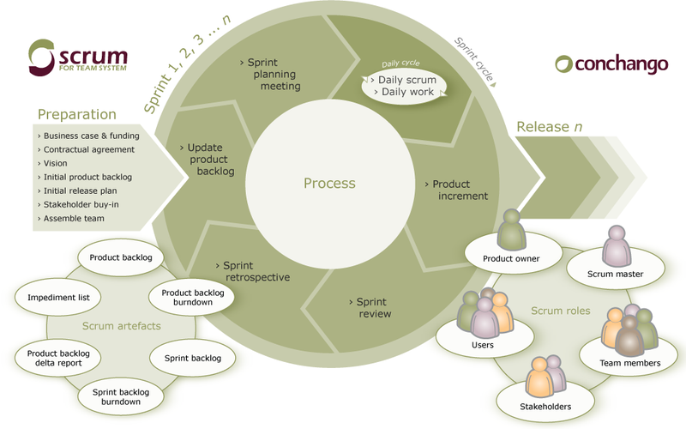
SCRUM methodology
Notes:
See: http://www.agilescrum.org/

Slide 20
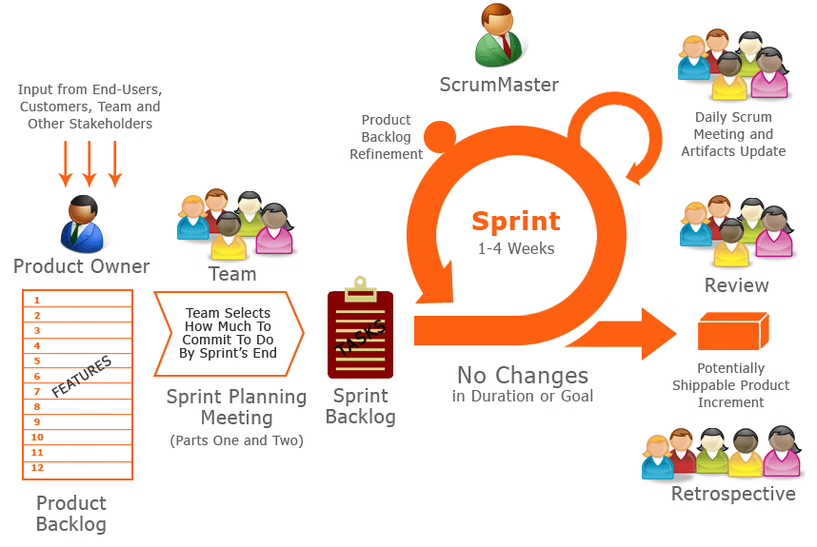
SCRUM methodology

Slide 21
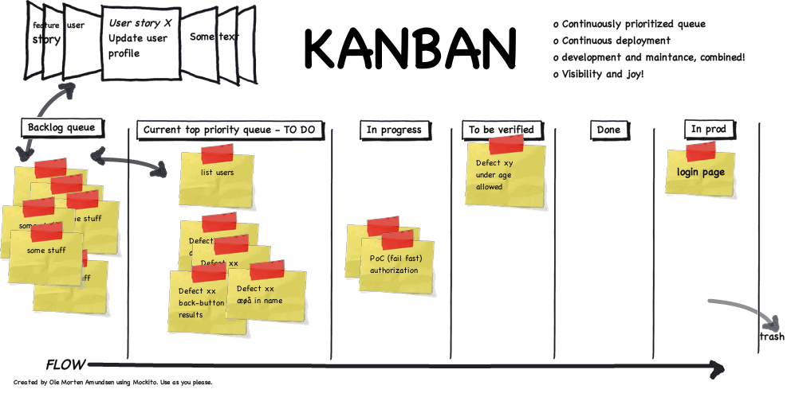
Kanban methodology
SCRUM is weekly / monthly Waterfall, while KANBAN is hourly / daily Waterfall
SCRUM is iterative, while KANBAN is flow (continuous)
Notes:
See: http://olemortenamundsen.wordpress.com/2010/03/19/kanban-and-scrum-combined/

Slide 22
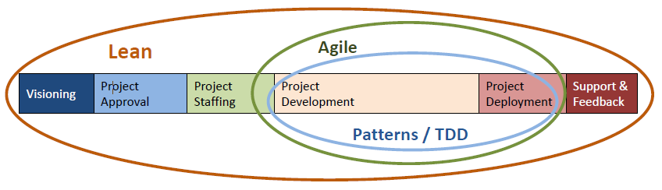
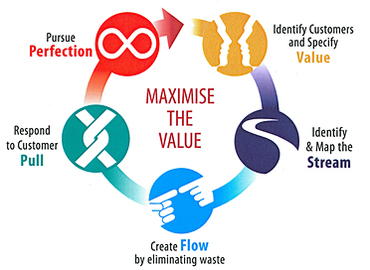
Lean methodology
Notes:
The core idea is to maximize customer value while minimizing waste. Simply, lean means creating more value for customers with fewer resources. See: http://www.lean.org/whatslean/.

Slide 23
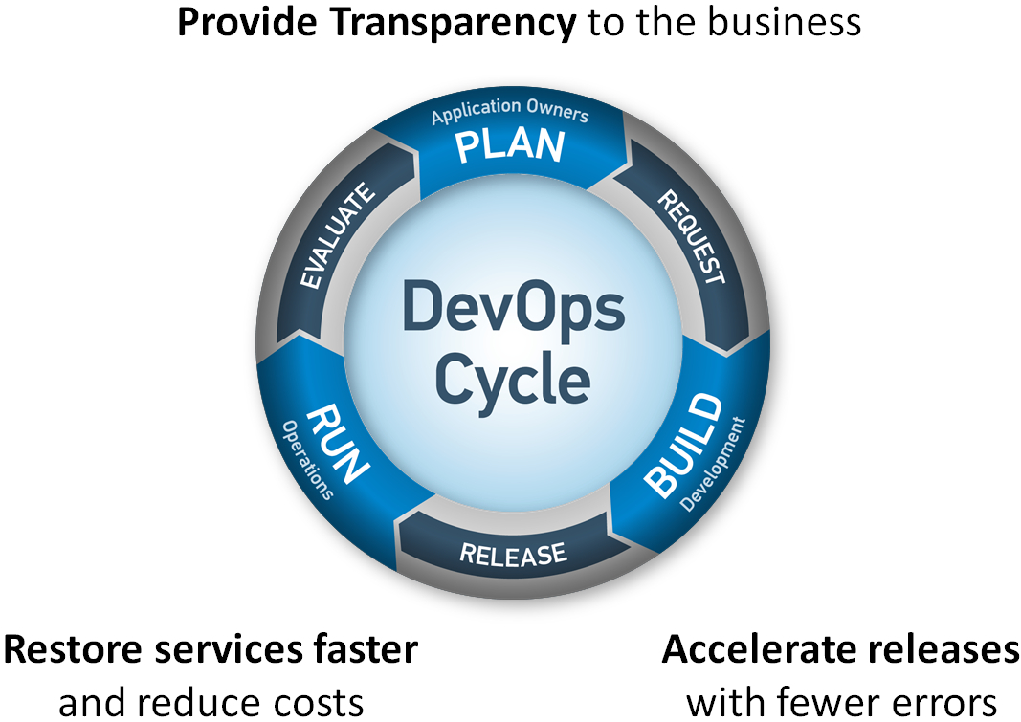
DevOps methodology
DevOps promotes a set of processes and methods for more effective communication and collaboration between depts.
In an organization with separate depts for Dev, IT operations and QA, deep cross-dept integration is often not effective.

Slide 24
Applications
Traditional
Agile
Fixed Constraints
Scope
Schedule
Cost
Plan-Driven
Value / Vision Driven
And then…
Estimate
Schedule
Cost
Scope
Notes:
Traditional vs. Agile: each methodology has its own area of applications. E.g. when traditional method is more suitable for projects with fixed scope, agile is more suitable for projects with changeable scopes.

Slide 25
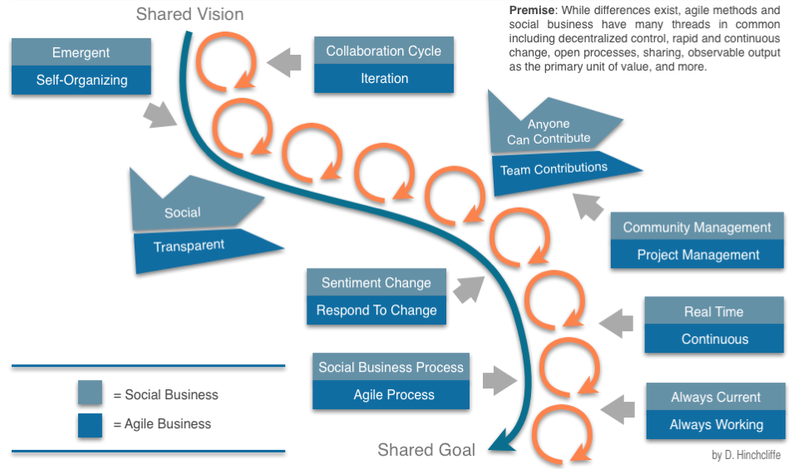
Social biz vs. Agile biz
Notes:
It is interesting to know that agility is the nature of social businesses, which constitute a major part of our world’s activities.

Slide 26
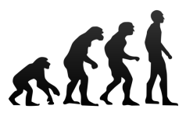





As a summary
Act / Accelerate Adaptively
Improve Incrementally / Iteratively
Evolve towards Excellence
AGILE
Guarantee Good enough products
Listen and Learn

Slide 27
References
Agile Estimating and Planning, by Mike Cohn, Prentice Hall
Scrum and XP from the Trenches, by Henrik Kniberg, InfoQ
http://msdn.microsoft.com/en-us/library/dd997578.aspx
http://www.agilescrum.org/
http://olemortenamundsen.wordpress.com/2010/03/19/kanban-and-scrum-combined/
http://www.lean.org/whatslean/
http://en.wikipedia.org/wiki/DevOps
http://gettingresults.com/wiki/Explained_-_Agile_Results_in_a_Nutshell
http://en.wikipedia.org/wiki/Social_business

Slide 28
Wait!
What if you find you can no longer do anything tomorrow?

Slide 29
I bet…
You gonna try your best today ☺
Notes:
This is the most important Agile principle: always try your best.

Slide 30
Thanks for coming.
See ya!
For more, please visit: http://phuonglamcs.com/relax/presentations/

