Slide 1
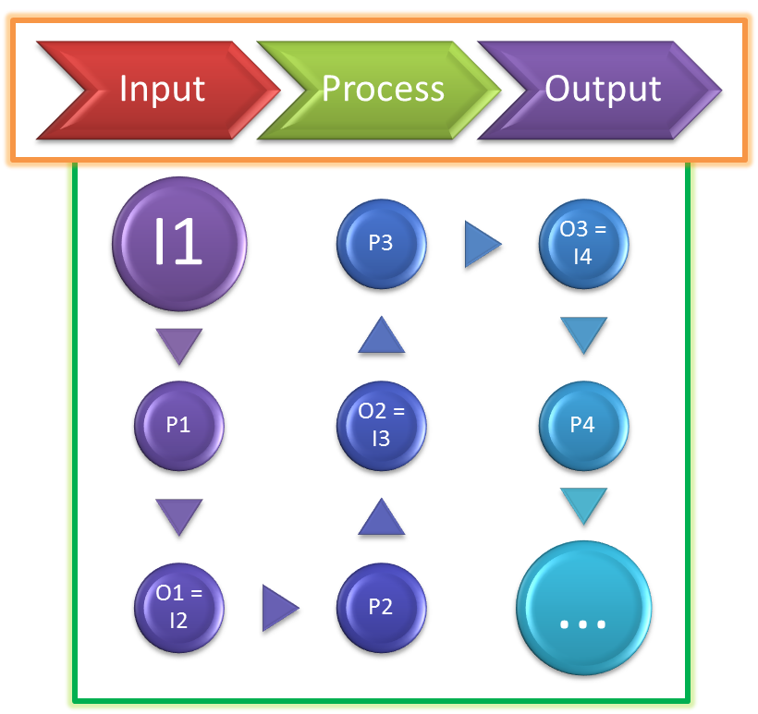
IPO model
Input
Process
Output
Input
Process
Output
I1
O3 = I4
P4
...
P1
O1 = I2
P3
P2
O2 = I3
I1
O3 = I4
P4
...
P1
O1 = I2
P3
P2
O2 = I3
Presenter: PhuongNQK

Slide 2
Goals
Introduce the IPO (or IPO + F) model
Showcase some applications

Slide 3
What is IPO?
The PATTERN of
Every action
Every process
Every change
Every project
Every system
Artificial
Natural

Slide 4
What is IPO?
Input
Process
Output

Slide 5
InputPO
What goes into the Process
Input
Process
Output
The starting point
Must be relevant
Should be just enough
May be known or need identifying
Be careful about salt/dust

Slide 6
IProcessO
In order or not
Each step is an IPO
Gradually or all at once
Steps are parallel or sequential
Accept Inputs
Often consist of steps
Input
Process
Output
Produce Outputs
Stateful or stateless
Cancellable or not
In order or not
Gradually or all at once

Slide 7
IPOutput
May be hard to predict
Direction, goal, etc.
Same I & P, same O
Predictable
Same I & P, different O
Often the focus
Changeable / Fixed
Input
Process
Output
Have tolerance
Feedback on I & P
Used to test I & P
0 is ideal
Is I / P good enough? How to improve?
Expected?

Slide 8
IPO -> IPO + F
Feedback
Input
Process
Output

Slide 9
IPO’s characteristics
Occurs in time order
Input
Process
Output
I
O
P
I
O
P
Mutual influence
E.g. changes in I may require certain changes in P and/or O
Independence
E.g. I may be changed without requiring any changes in P and O

Slide 10
IPOs in relations
IPOs
Alone
Chain
Tunnel
Grid
Tree

Slide 11
IPO chain
I1
P1
O1
I2
P2
O2
I3
P3
O3
I1
P1
O1=I2
P2
O2=I3
P3
O3

Slide 12
IPO tree
I4
P4
O4
I2
P2
O2
I5
P5
O5
I1
P1
O1
I6
P6
O6
I3
P3
O3
I7
P7
O7

Slide 13
IPO tunnel
I1
P1
O1
I5
P5
O5
I2
P2
O2
I7
P7
O7
I3
P3
O3
I6
P6
O6
I4
P4
O4

Slide 14
IPO grid
I1
P1
O1
I7
P7
O7
I5
P5
O5
I10
P10
O10
I2
P2
O2
I8
P8
O8
I3
P3
O3
I11
P11
O11
I6
P6
O6
I4
P4
O4
I9
P9
O9

Slide 15
IPO in real world
I
P
O
What we have: equity
What we want to have: goals, targets
How to do: methods
What to do: steps, actions, plans
What we can have: loans
What is needed: requirements
What to expect
When / why to do
… and MORE

Slide 16
What is IPO for?
ACTION
PROCESS
CHANGE
PROJECT
SYSTEM
Analyze
Study
Design
Explain
… MORE
Natural
Artificial

Slide 17
Applications
I
Money
Which type
P
Check money
Check goods
O
Expected goods (main O)
Change (side O)
How much
Deliver goods
Return change, if any
Buy some goods

Slide 18
Applications
Feedback
Information, new ideas, expertise and customer feedback
Input
Materials, components, labour, research and development
Processing
Production lines, assembly lines, management and skills
Output
End product, customer satisfaction and employee satisfaction
Manufacturing systems

Slide 19
Applications
Feedback
What to do, what not to do
Input
The conditions that exist prior to group activity
Processing
The interactions among group members
Output
The results of group activity, to be valued by the team or the org
Manage team effectiveness

Slide 20
Thanks for coming.
See ya!

