Slide 1
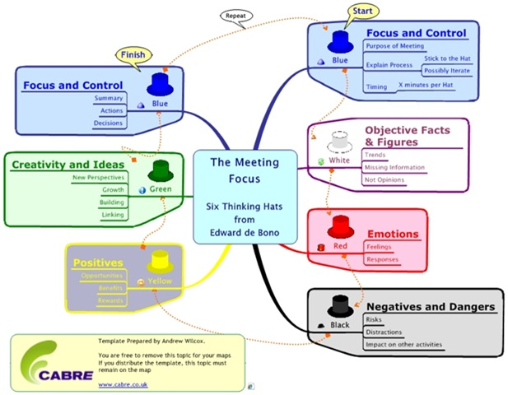

6 thinking hats
Edward de Bono’s key to resolve conflicting thoughts among team members
Presenter: PhuongNQK

Slide 2
Concepts
Scenario:
Your team needs to make a decision on some problem
There’re conflicting ideas among team members:
You dream! We gonna lose a lot coz…
It’s easy to implement
What a big profit it will bring us
No, it’s risky. We should do this way …
No, it’s impossible because…
We can do this way …
What a challenge! I love it!
I don’t know. I just feel that there is something wrong here.
There’re 3 reasons why we should do it. First, …
I hate doing things like that!

Slide 3
Concepts (cont.)
Solution: employ “6 thinking hats” technique
Conflicting ideas are not conflicting, but different ideas from different perspectives
You dream! We gonna lose a lot coz…
It’s easy to implement
What a big profit it will bring us
No, it’s risky. We should do this way …
No, it’s impossible because…
We can do this way …
What a challenge! I love it!
I don’t know. I just feel that there is something wrong here.
There’re 3 reasons why we should do it. First, …
I hate doing things like that!

Slide 4






Concepts (cont.)
Solution: 6 thinking hats (cont.)
There are 6 common perspectives corresponding to 6 hat colors
Start
Cool
Agenda, overview, process, organizer
Neutral, objective
Information, facts, figures
Finish
Cool
Summary, decision, actions
Emotional
Feelings, intuition
Creative
Solutions, ideas, growth
Critic, pessimistic
Logical negatives, risks
Optimistic
Logical positives, benefits, feasibility

Slide 5
Golden rule
Move from one perspective to another (i.e. at any time, all members must wear the same hat color)

Slide 6
Hat flow 1
Start
State the goal, agenda, and process of the discussion
Gathering information, facts, figures
List positives, benefits, feasibility (with reasons)
List emotions, feelings, intuitions
Finish
Suggest solutions, ideas
Summarize, make a decision, plan next actions
List negatives, risks (with reasons)
The hats and their symbolic meanings

Slide 7
Hat flow 2
Start
Do you see the difference between 2 hat flows?
- What is the purpose of our meeting?
- What is our process?
- How much time is allocated per each hat?
- What information/facts do we
have? need? miss?
Is it possible/feasible?
What are the bright sides?
What benefits will we get?
How can we solve this?
What are other solutions?
Are there any better solutions?
Finish
What do we feel?
Do we like or dislike it?
What is our decision?
Which steps should we take?
What is our plan?
What are the potential risks/dangers?
What troubles may we get?
The hats and their commonly associated questions

Slide 8
Sample scenarios
Should we train our employees? How?
Should we have lab days?
Should we open an office in India? Where?
Should we take this project?
Should we strictly not work overtime?
Should we replace our current Waterfall process with the Agile one?
etc.

Slide 9
Sample practice
Scenarios
ABC started as a small software company with 10 employees. Now it is big and has 500 employees. Its clients are national companies and international corporations from Vietnam, Singapore, India, Japan, USA, Australia, etc.
However, it is receiving more and more complaints about its product quality and maintenance service.
Moreover, it is facing a serious issue: key persons and qualified employees are leaving for better offers and working environment from competing companies while coming employees are not as qualified as expected.
How should we train our employees?

Slide 10
Sample practice (cont.)
Discussion agenda
Goal: we will determine how we should train our employees
Attendants: 6
Timing: 60 -> 120 minutes, or 10 -> 20 minutes/hat
Process: 6 thinking hats
Flow:
Start
Finish

Slide 11



Sample practice (cont.)
Information, facts, figures
Clients’ complaints:
The app contains too many technical bugs. It is very slow, too.
The GUI is not friendly, it’s difficult to use.
Deadlines are often missed.
Old bugs get fixed, new bugs come.
Documentation is not good: insufficient, out-of-date, ambiguous, etc.
IT develops quite fast, new technologies come into existence everyday
Newcomers are inexperienced

Slide 12
Sample practice (cont.)
Information, facts, figures
Current training policy:
We focus on English training and have budget for that
We also have budget for buying IT books
We don’t have official training courses
What other companies do:
Focus on English, technical and soft-skill training
Financially support their employees to achieve international IT certificates

Slide 13
Sample practice (cont.)
Ideas and solutions
We will apply new technical training policy, which is:
About general up-to-date technologies
Project-specific
As frequently as weekly or daily
Integrated as a part of the development process
Of higher budget
Make monthly/weekly presentations on soft-skills

Slide 14
Sample practice (cont.)
Ideas and solutions
Develop the habits of reading, self-improving own work and knowledge
About trainers:
We will use dedicated staffs for technical training
We will use dedicated staffs or prestigious training centers for soft-skill training
Dedicated staffs are selected among our best employees

Slide 15
Sample practice (cont.)
Logical positives, benefits, and feasibility
Investment on human resource returns long-term and intangible benefits:
Satisfy employees in term of working environment
Constantly improve employees’ performance and hence, product quality and clients’ satisfaction
Guarantee that every employee meets certain minimum standards
Attract new employees
Earn a good fame for the company

Slide 16
Sample practice (cont.)
Logical positives, benefits, and feasibility
Regular technical training/seminar:
Is quite feasible to have 1 or 2 presentations per month
Makes studying a habit of employees’ → keep them up-to-date with new technologies
Regular soft-skill training/seminar:
Is quite feasible to have 1 or 2 presentations per month
Makes using soft-skills a habit of employees’ → build up a professional and effective working style in view of teammates and clients

Slide 17
Sample practice (cont.)
Logical negatives, risks, and troubles
Long-term investment on human resource requires a lot of time and budget
After taking enough training, employees may leave the company for more attractive offers from competing companies → ABC becomes a free training center for other companies
Daily/weekly training may badly impact employees’ daily performance, since it takes up a portion of their time budget → they may have to work overtime to meet deadlines

Slide 18
Sample practice (cont.)
Logical negatives, risks, and troubles
If the training quality is poor
It will waste employees’ time and company’s money
It will disappoint employees and encourage them to leave the company
Employees are mature enough to self-train → such training is redundant
We’ll need many trainers, but we can not find enough qualified trainers
We should not dedicate our best employees to training purposes when we are lacking qualified workers and deadlines are always challenging

Slide 19
Sample practice (cont.)
Emotions, feelings, and intuitions
I agree that daily/weekly technical training and weekly/monthly soft-skill training is a must. All employees will like that.
No, I feel that we will waste our time and money.
I’m experienced. I don’t need training. So do many of my co-workers.
I like the idea of daily training. I’ll have a chance to constantly update my knowledge.

Slide 20
Sample practice (cont.)
Emotions, feelings, and intuitions
Why daily update your knowledge? You only use a fraction of that.
Oh, man! We’re overloaded with challenging deadlines. And we’ll get even more overloads with daily training.
I believe we’ll succeed. We’ll have a lot of well-trained employees.

Slide 21
Sample practice (cont.)
Summary and decision
OK, a new training policy is necessary. However, we’ll apply it step by step.
Here’s the plan:
Phase 1:
Dedicate personnel to training purposes
Start with monthly technical and soft-skill presentations
Encourage the habit of reading books and improving own work
Phase 2:
Make fortnight/weekly technical and soft-skill presentations

Slide 22
Sample practice (cont.)
Summary and decision
Phase 2:
Encourage the habit of making and giving presentations to teammates
Phase 3:
Encourage the habit of daily self-improving technical and soft skills
We’ll closely keep track of the training efficiency
We’ll have another meeting on WHO WILL DO WHAT
Thanks everybody for your contribution!

Slide 23
DIY practice
Scenario
How will we …?

Slide 24
DIY practice (cont.)
Discussion agenda
Goal: we will determine how we will …
Attendants:
Timing: 30 -> 60 minutes, or 5 -> 10 minutes/hat
Process: 6 thinking hats
Flow:
Start
Finish

Slide 25
DIY practice (cont.)
Information, facts, figures

Slide 26
DIY practice (cont.)
Ideas and solutions

Slide 27
DIY practice (cont.)
Logical positives, benefits, and feasibility

Slide 28
DIY practice (cont.)
Logical negatives, risks, and troubles

Slide 29
DIY practice (cont.)
Emotions, feelings, and intuitions

Slide 30
DIY practice (cont.)
Summary and decision
Thanks everybody for your contribution!

Slide 31
Advantages
Encourage parallel, comprehensive, and effective thinking
Combine individuals and team
Increase team communications and productivity
Improve product quality and management process effectiveness
Develop creativity, analytic thoughts, decision-making skill, and meeting organizing and controlling skill
…

Slide 32
Summary
“6 thinking hats” immediately utilizes individual thinking powers to create a best team solution, and gradually spread team thinking power into each member. The technique helps to produce better decisions by better team with better members.
Enjoy it! It’s time!

Slide 33

Thanks for coming.
See ya!

