Slide 1

Presenter: PhuongNQK

Slide 2
Goals
Introduce the concept of skills
Introduce basic necessary skills

Slide 3
What is a skill?
A skill is the learned capacity to carry out pre-determined results often with the minimum outlay of time, energy, or both.
Skill usually requires certain environmental stimuli and situations to assess the level of skill being shown and used.

Slide 4
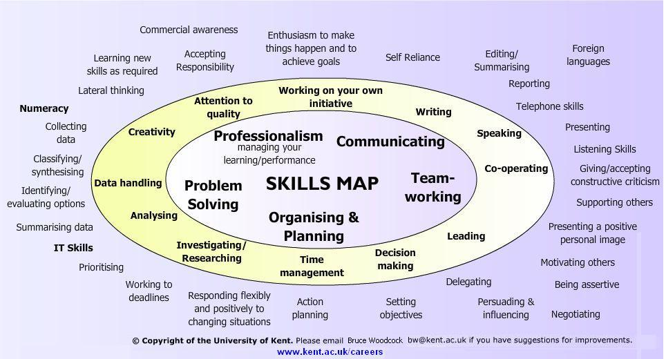
Sample skills map

Slide 5
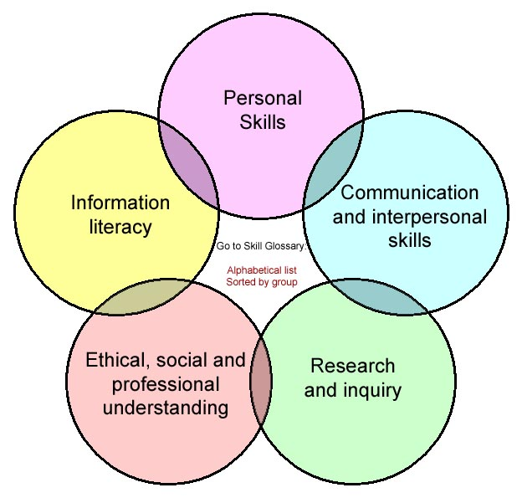
Skill groups

Slide 6
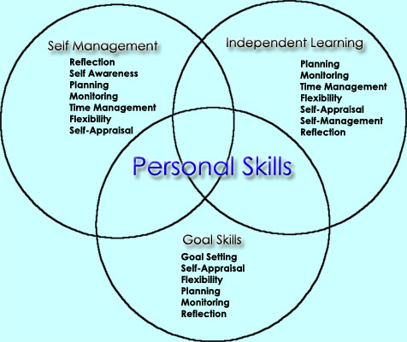
Personal skills

Slide 7
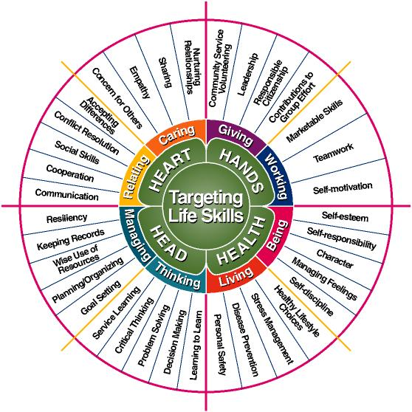
Targeting life skills

Slide 8
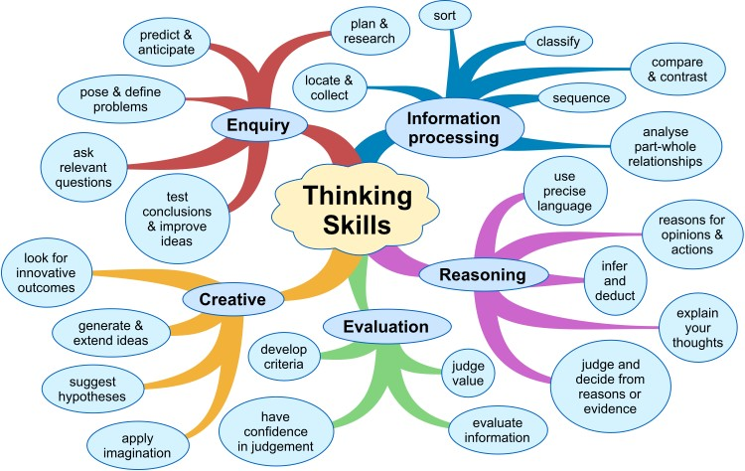
Thinking skills

Slide 9
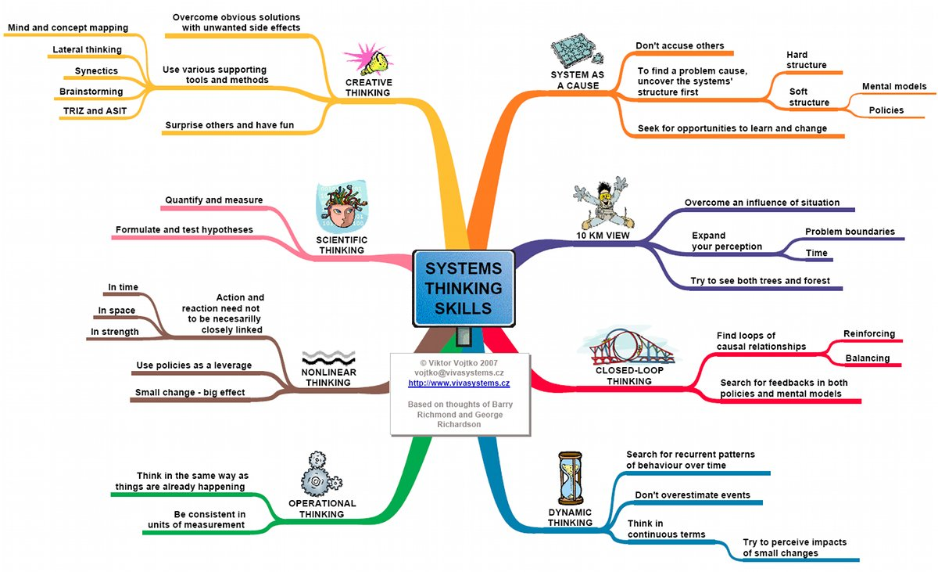
System thinking skills

Slide 10
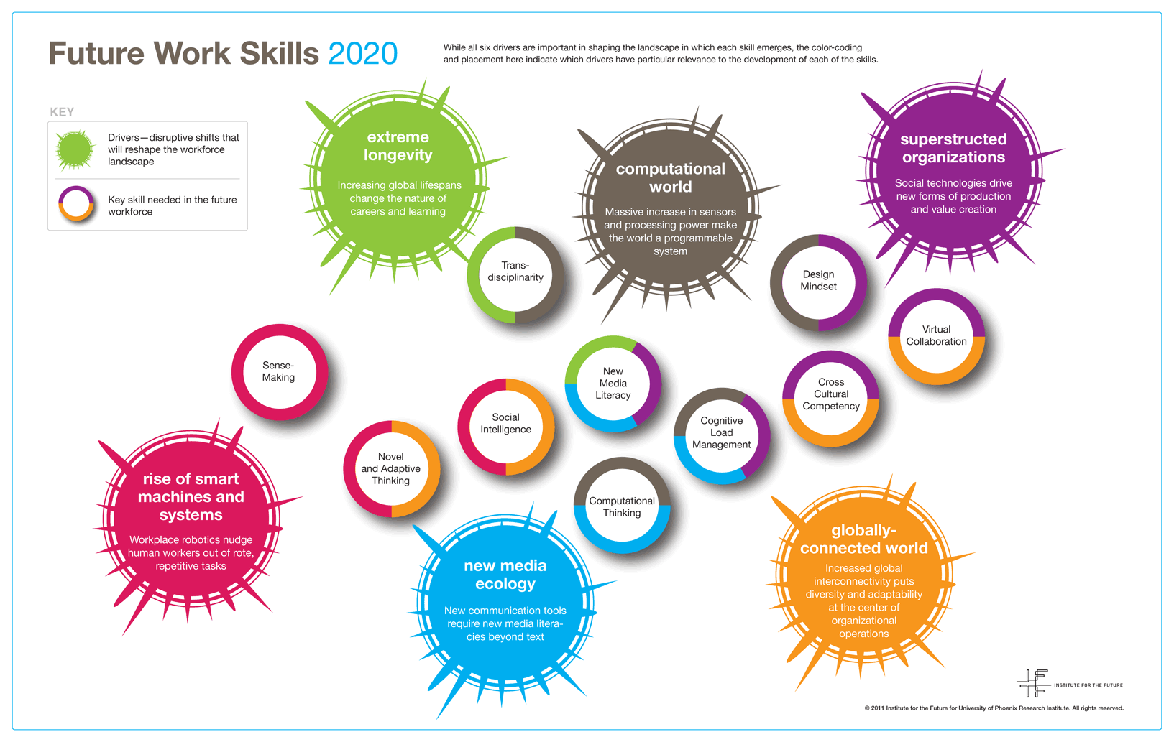
Future work skills 2020

Slide 11
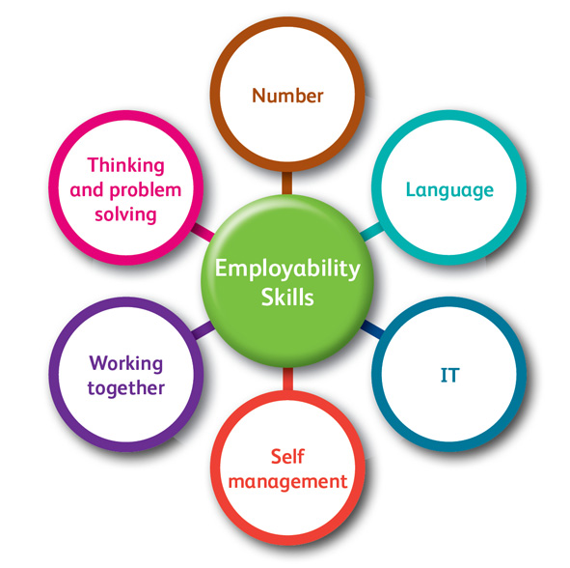
Employability skills

Slide 12
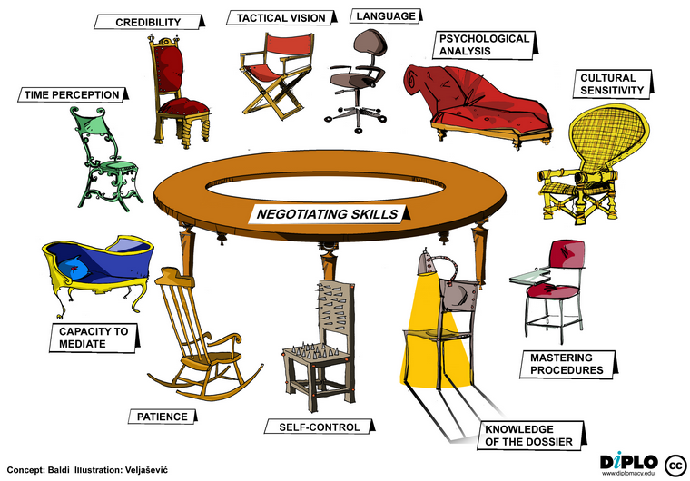
Negotiating skills

Slide 13
References
http://en.wikipedia.org/wiki/Skill
http://en.wikipedia.org/wiki/Critical_thinking
http://en.wikipedia.org/wiki/Service-learning
http://www.resiliencyskills.com/

Slide 14
Thanks for coming.
See ya!

