Slide 1
STREAM API
GV: KHUẤT THÙY PHƯƠNG
Nhóm thực hiện : VÕ VĂN MINH
NGUYỄN VĂN NHỰT
LÊ PHƯƠNG THANH

Slide 2

NỘI DUNG CƠ BẢN
Tìm hiểu thêm về Stream.

Slide 3

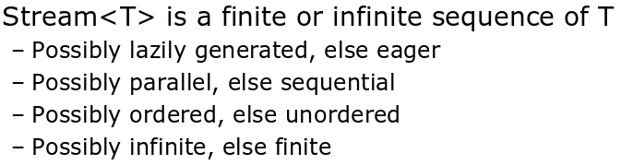
Stream

Slide 4
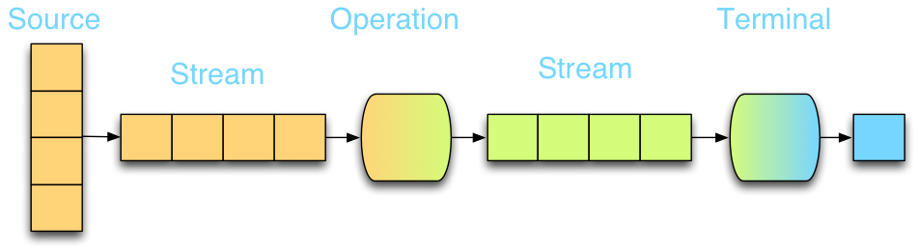
Stream() vs paralellStream()

Slide 5
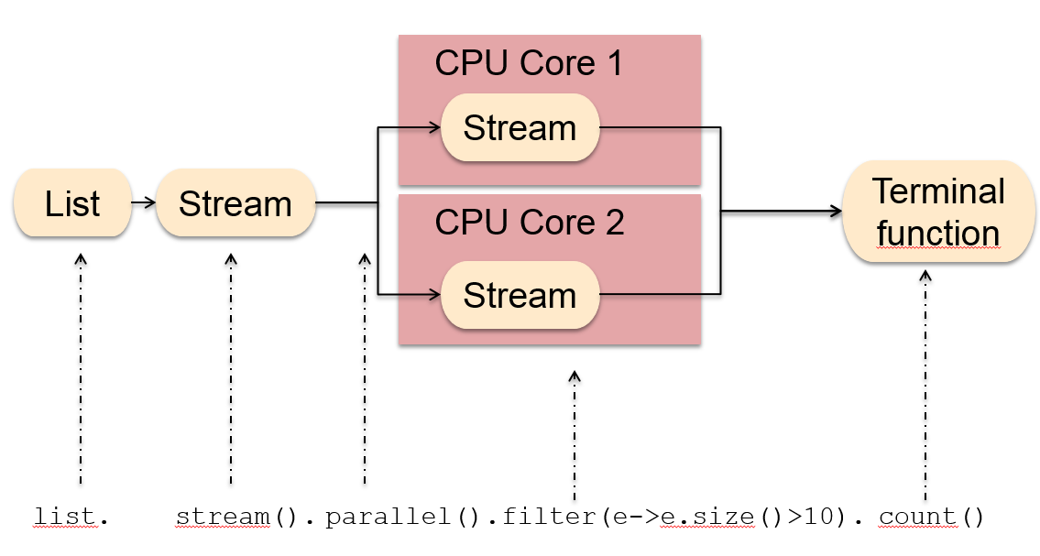
Stream() vs paralellStream()

Slide 6
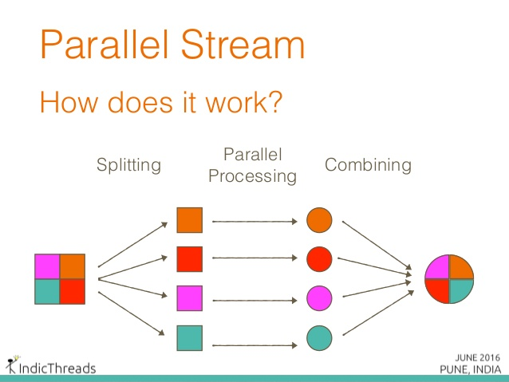
Stream() vs paralellStream()
Notes:
ForkJoinPool commonPool = ForkJoinPool.commonPool();
System.out.println(commonPool.getParallelism());
Mặc định là 3.

Slide 7
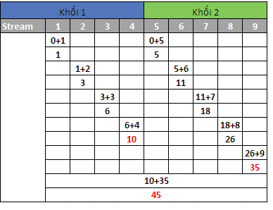
Stream() vs paralellStream()

Slide 8
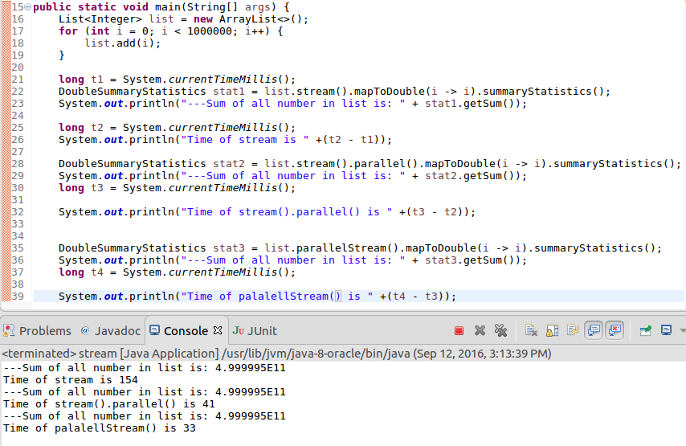
Stream() vs paralellStream()

Slide 9
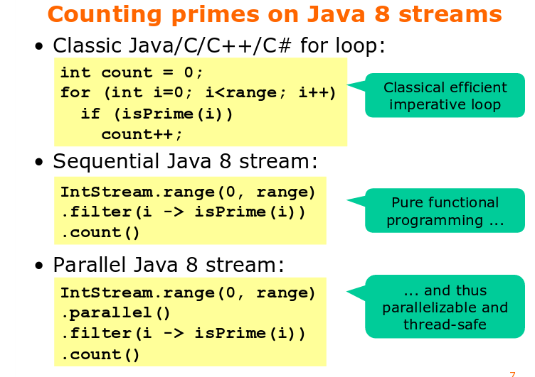
Stream() vs paralellStream()

Slide 10
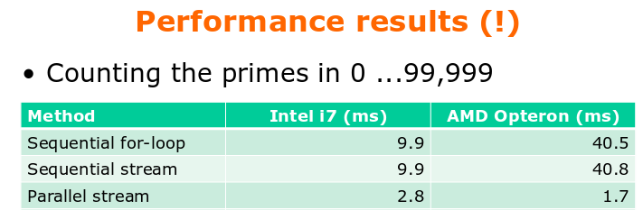
Stream() vs paralellStream()

Slide 11
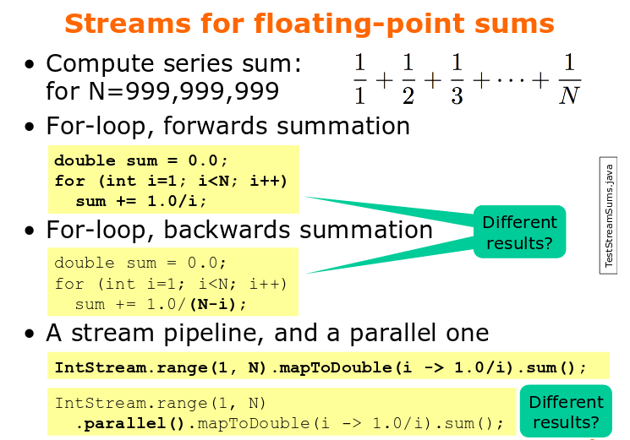
Stream() vs paralellStream()

Slide 12
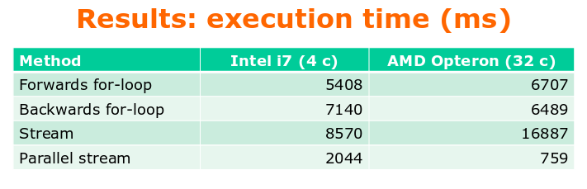
Stream() vs paralellStream()

Slide 13
Stream.generate() vs Steam.iterate()
Steam.iterate() | Stream.generate()
static <T> Stream<T> iterate(T seed, UnaryOperator<T> f) Returns an infinite sequential ordered Stream produced by iterative application of a function f to an initial element seed, producing a Stream consisting of seed, f(seed), f(f(seed)), etc. | static <T> Stream<T> generate(Supplier<T> s) Returns an infinite sequential unordered stream where each element is generated by the provided Supplier. This is suitable for generating constant streams, streams of random elements, etc.

Slide 14
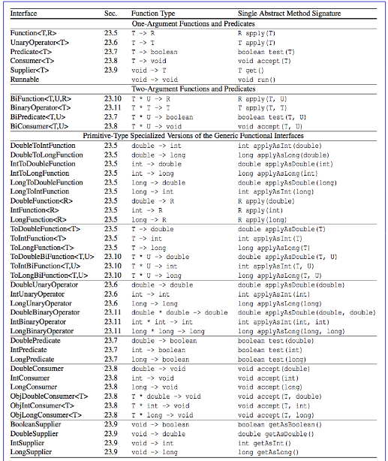

Slide 15
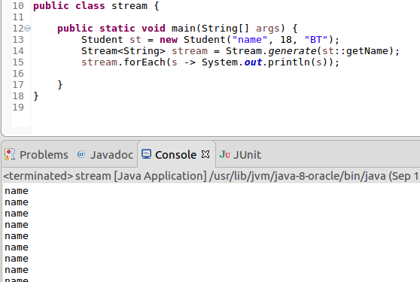
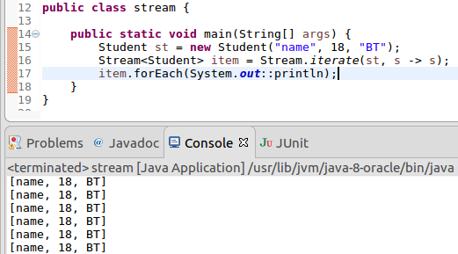
Stream.generate() vs Steam.iterate()

Slide 16
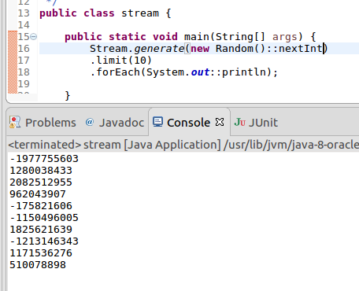
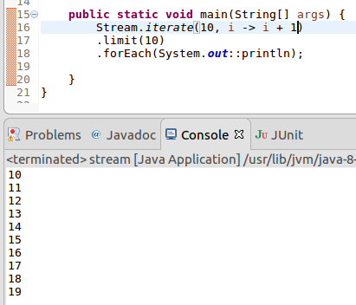
Stream.generate() vs Steam.iterate()

Slide 17
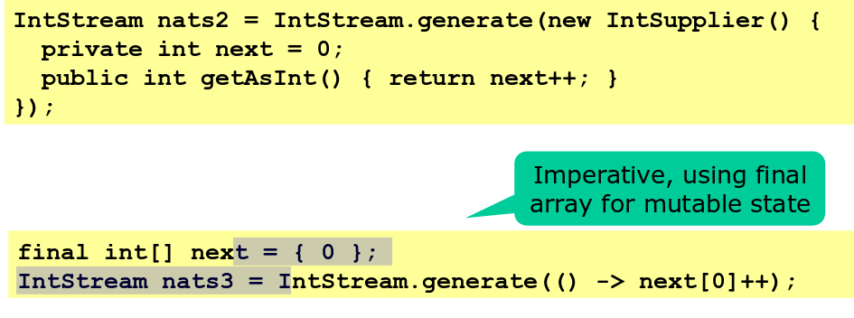
Stream.generate() vs Steam.iterate()

Slide 18
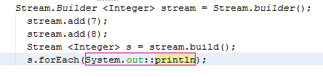

Stream.builder
Kết quả
Chúng ta có thể sử dụng Stream.Builder add(T t) để khởi tạo stream
ví dụ:

Slide 19
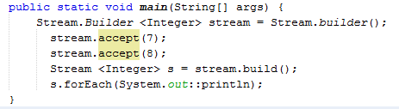

Stream.builder (tt)
Kết quả
Stream.Builder accept(T t)
Ví dụ:

Slide 20
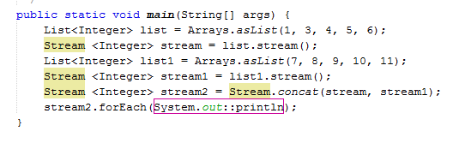

Stream.concat(stream1,Stream2)
Kết quả
Ví dụ:

Slide 21
Stream.toArray()
Stream<Integer> stream = Stream.of(1, 2, 3, 4);
Integer[] array = stream.toArray(size -> new Integer[size]);
System.out.println(Arrays.toString(array));
for (int i = 0; i < array.length; i++) {
System.out.println(array[i]);
}
output: 1, 2, 3, 4

Slide 22
References
https://docs.oracle.com/javase/8/docs/api/java/util/stream/Stream.html
https://learnit.itu.dk/pluginfile.php/131905/course/section/72476/adpro-2015-java-streams.pdf

Slide 23

Thank you for your time and attention!

