Slide 1
INHERITANCE – ABSTRACT CLASS – INTERFACE – INNER CLASS
Le Phuong Thanh
Bui Thi Thuy Quynh

Slide 2
Content
Inheritance
Abstract class
Interface
Inner class

Slide 3
Compare
 | Inheritance | Abstract class | Interface
Method | Normal methods Main method Constructor method Static method | Normal methods Abstract methods Main method Constructor method Static method | Only public abstract methods
Field | Non-static variables Static variable Final variables | Non-static variables Static variables Final variables | Only public final variables
Inner class | Yes | Yes | No
Modifier | public default protected private | public default protected private | public

Slide 4
Compare
 | Inheritance | Abstract class | Interface
Multiple inheritance | No | No | Yes
Keyword | extends for implementation | extends for implementation abstract to declare abstract class | implements for implementation interface to declare interface
Using new to initialize an object | Yes | No | No
Subclass | Can add new methods Can override normal methods | Can add new method Realization all of abstract method Can override normal methods | Can add new method Realization all of methods

Slide 5
Compare
 | Inheritance | Abstract class | Interface
Exception | Yes | Yes | No
Generic Classes | Yes | Yes | Yes
Implementation/Inheritance | Implements Interfaces Extend from a class or an abstract class | Implements Interfaces Extend from a class or an abstract class | Extend from interfaces

Slide 6

Compare
When to use Inheritance, Abstract class or Interface?

Slide 7
Inheritance
Inheritance used when:
Represent an “is-a” relationship and not a “has-a” relationship.
Can reuse code from the base classes.
Need to apply the same class and methods to different data types
The class hierarchy is reasonably shallow, and other developers are not likely to add many more levels.
You want to make global changes to derived classes by changing a base class.

Slide 8
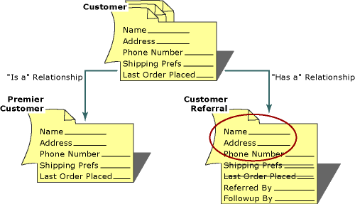
Inheritance
NOTE
This relationship helps to reduce duplication of code as well as bugs.
Using the instanceof keyword to check a class is subclass of superclass

Slide 9
Abstract Class
Abstract Class used when:
Share code among several closely related classes.
Classes that extend your abstract class have many common methods or fields, or require access modifiers other than public (such as protected and private).
Declare non-static or non-final fields.
Provide polymorphism to a group class.
Provide methods that have already been implemented and cannot with an interface.

Slide 10
Abstract Class
NOTE
abstract keyword is used to declare the method as abstract.
You have to place the abstract keyword before the method name in the method declaration.
An abstract method contains a method signature, but no method body.
Instead of curly braces an abstract method will have a semoi colon ( ; ) at the end.

Slide 11
Interface
Interface used when:
Unrelated classes would implement your interface. For examples, many unrelated objects can implement Serializable interface.
Specify the behaviour of a particular data type, but not concerned about who implements its behaviour.
Take advantage of multiple inheritance of type.

Slide 12
Interface
NOTE
Checked exceptions should not be declared on implementation methods other than the ones declared by the interface method or subclasses of those declared by the interface method.
The signature of the interface method and the same return type or subtype should be maintained when overriding the methods.
An implementation class itself can be abstract and if so interface methods need not be implemented

Slide 13
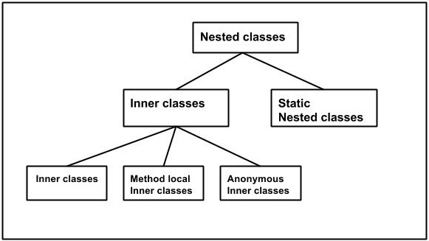
Inner class

Slide 14
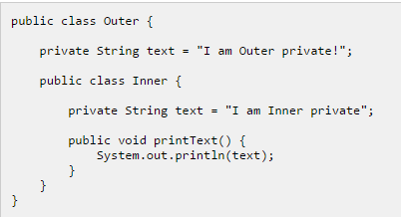
Inner class
Shadowing: fields or methods of inner class with the same names as fields or methods of outer class

Slide 15
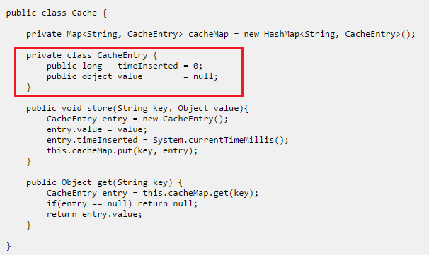
Inner class
Sometimes a nested class is only visible to the outer class and is thus never visible outside the outer class.

Slide 16
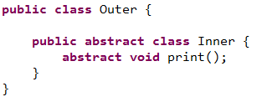

Inner class
If inner class is abstract, can not instantiate by use key word new

Slide 17
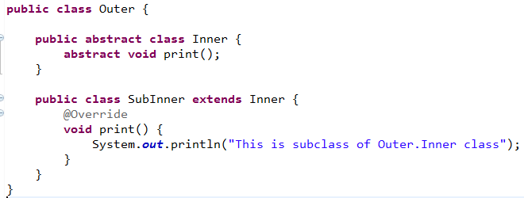
Inner class
A subclass can extends from an abstract inner class by two way.
Same outer class:

Slide 18
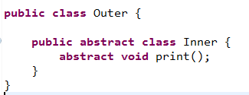
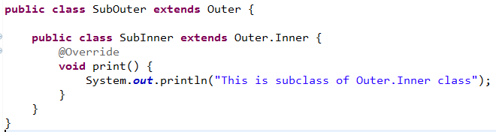
Inner class
A subclass can extends from an abstract inner class by two way.
Not same outer class:

Slide 19
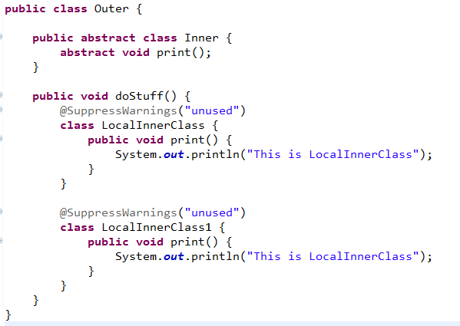
Inner class
A method can have multiple inner classes

Slide 20
References
http://www.javatpoint.com/difference-between-abstract-class-and-interface
http://tutorials.jenkov.com/java/nested-classes.html
https://msdn.microsoft.com/en-us/library/27db6csx(v=vs.90).aspx
https://msdn.microsoft.com/en-us/library/scsyfw1d(v=vs.71).aspx
https://docs.oracle.com/javase/tutorial/java/IandI/abstract.html
http://stackoverflow.com/questions/479142/when-to-use-an-interface-instead-of-an-abstract-class-and-vice-versa

Slide 21


