Slide 1
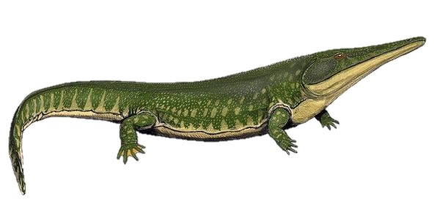
Temnospondyls: In Search of a New Phylogeny
Jens Sannerud

Slide 2
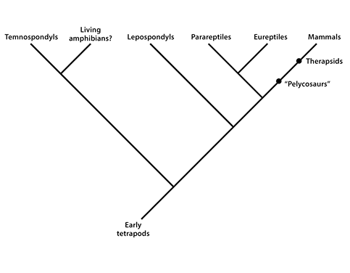

Slide 3
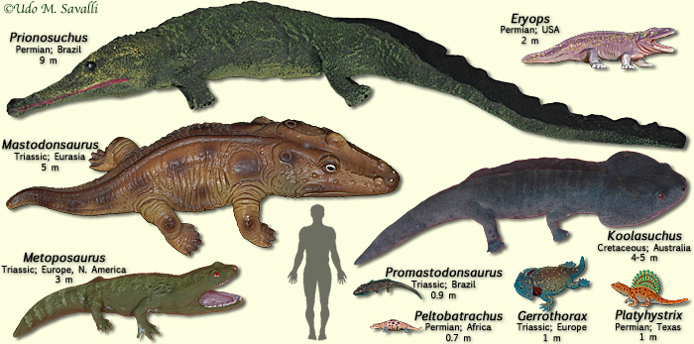

Slide 4
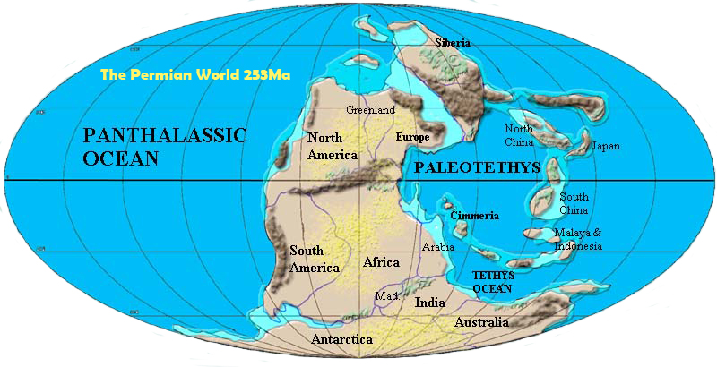

Slide 6
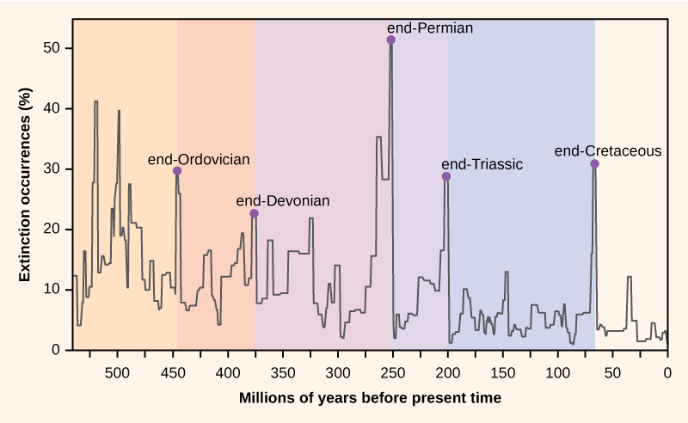

Slide 7
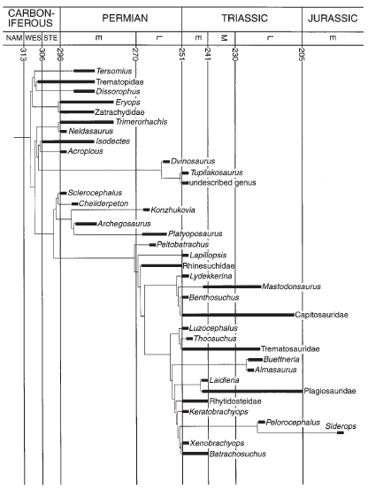
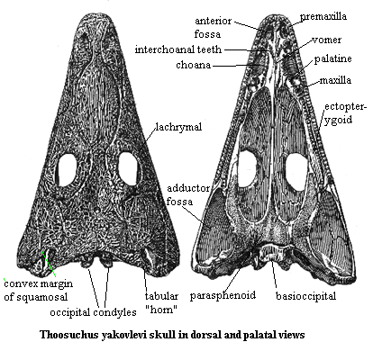
Yates & Warren 2000
Influential early computer-based phylogeny
Parsimony
38 taxa
121 characters
88 cranial

Slide 8
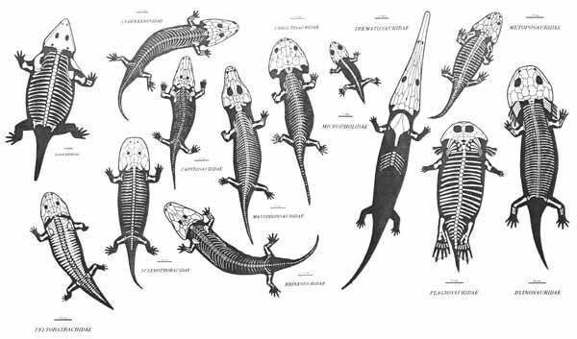
Goal
Can I make a phylogeny of Temnospondyli using ML?

Slide 9
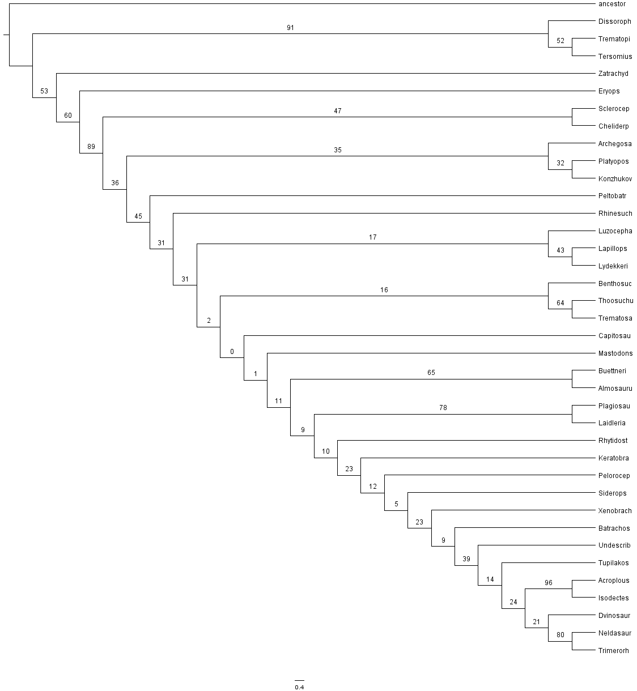

Slide 10
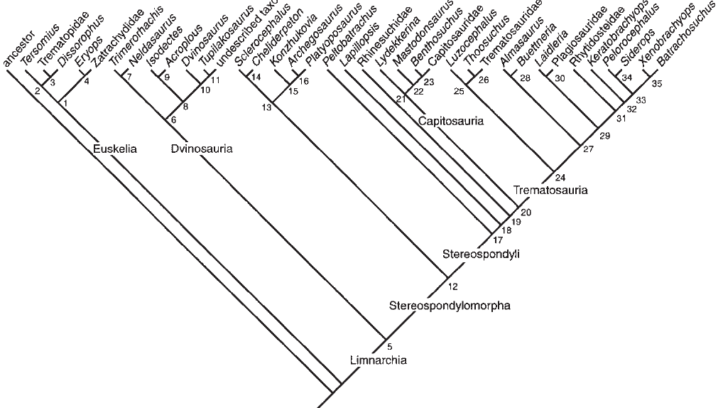
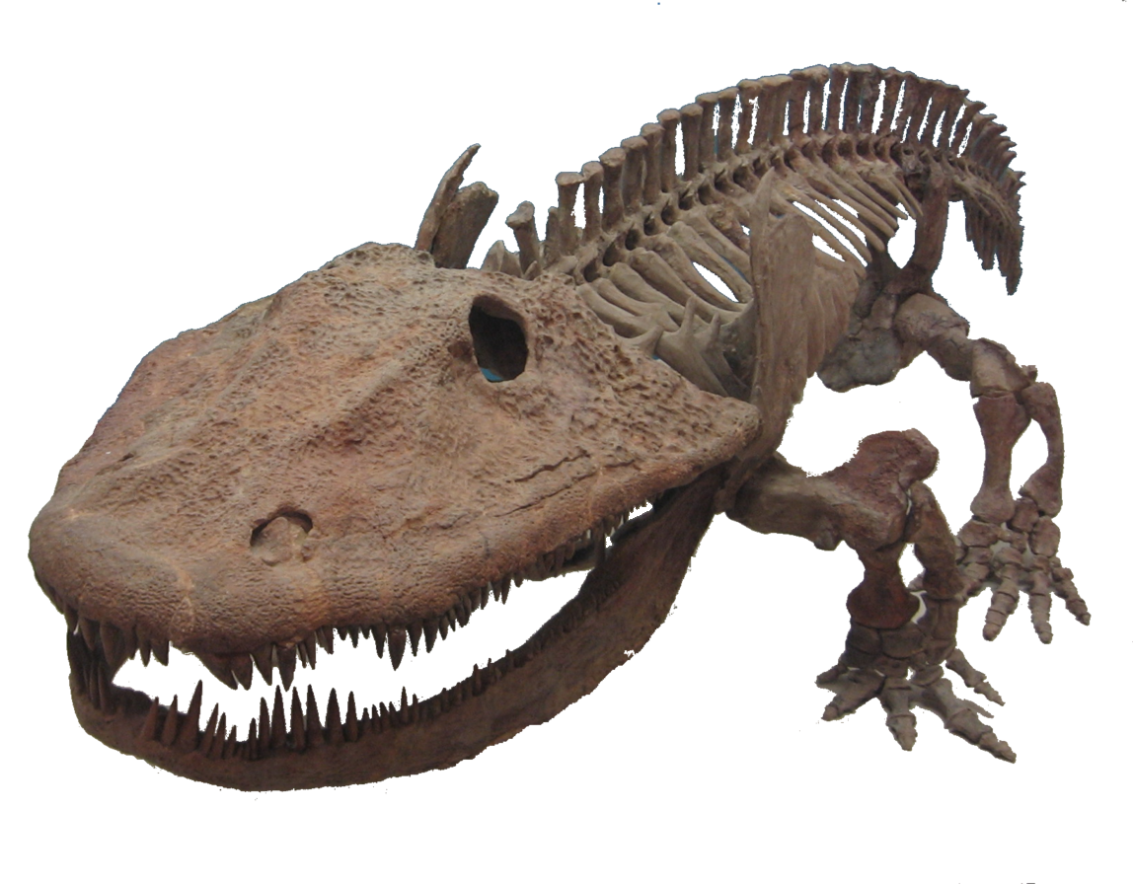
The Good

Slide 11
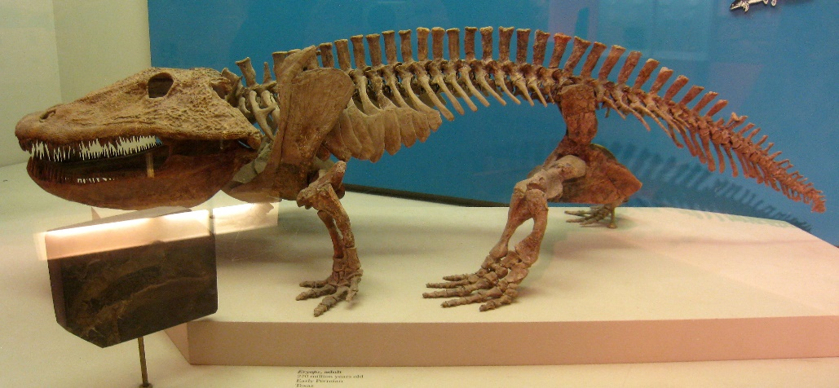
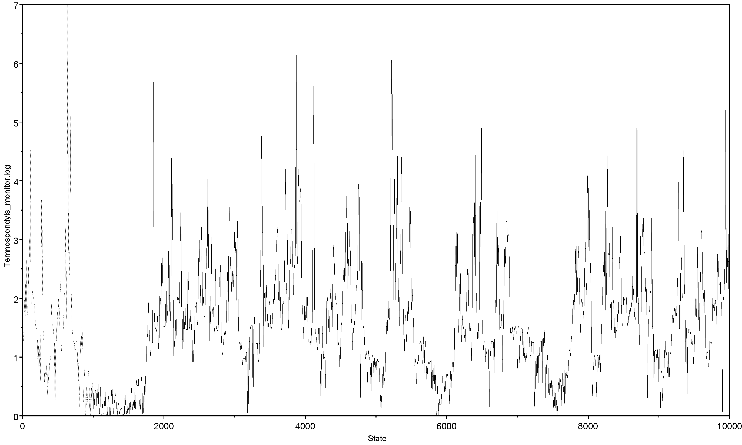
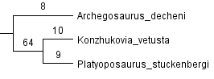
The Bad
☹

Slide 12
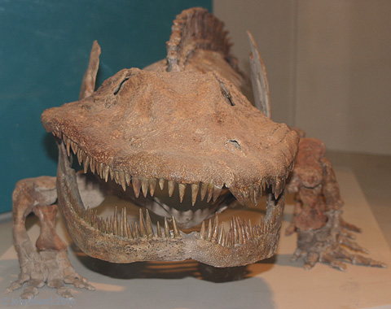
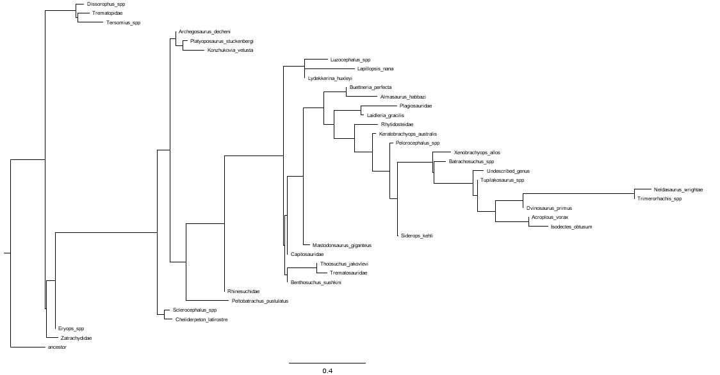
The Ugly

Slide 13

Conclusions & Discussion
Trees are generally inconclusive, but certain groups appear to be positioned correctly
ML on fossils is hard
Calling all methods developers
Amphibians – doubly so

Slide 14
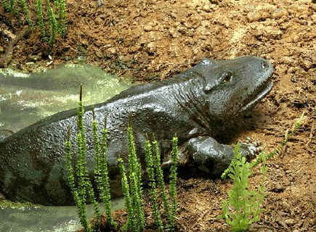
Questions?

Slide 15
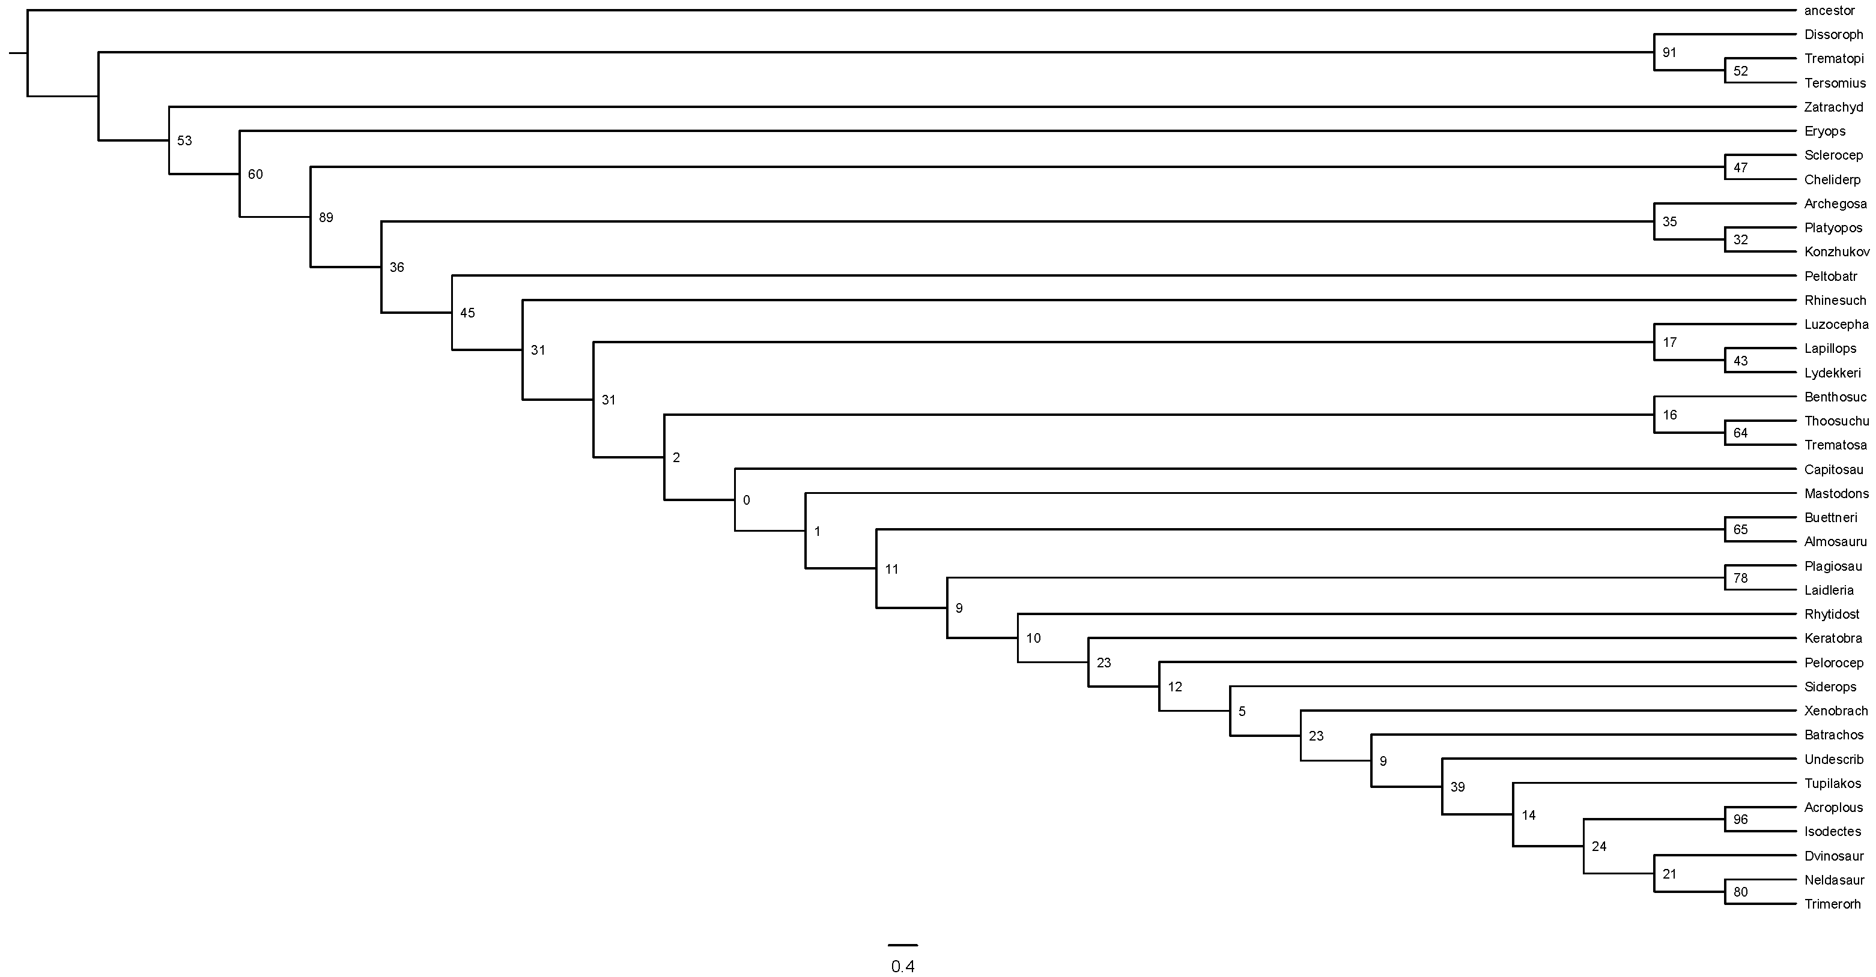
GTR seed 1

Slide 16

GTR seed 2

Slide 17

GTR seed 3

Slide 18
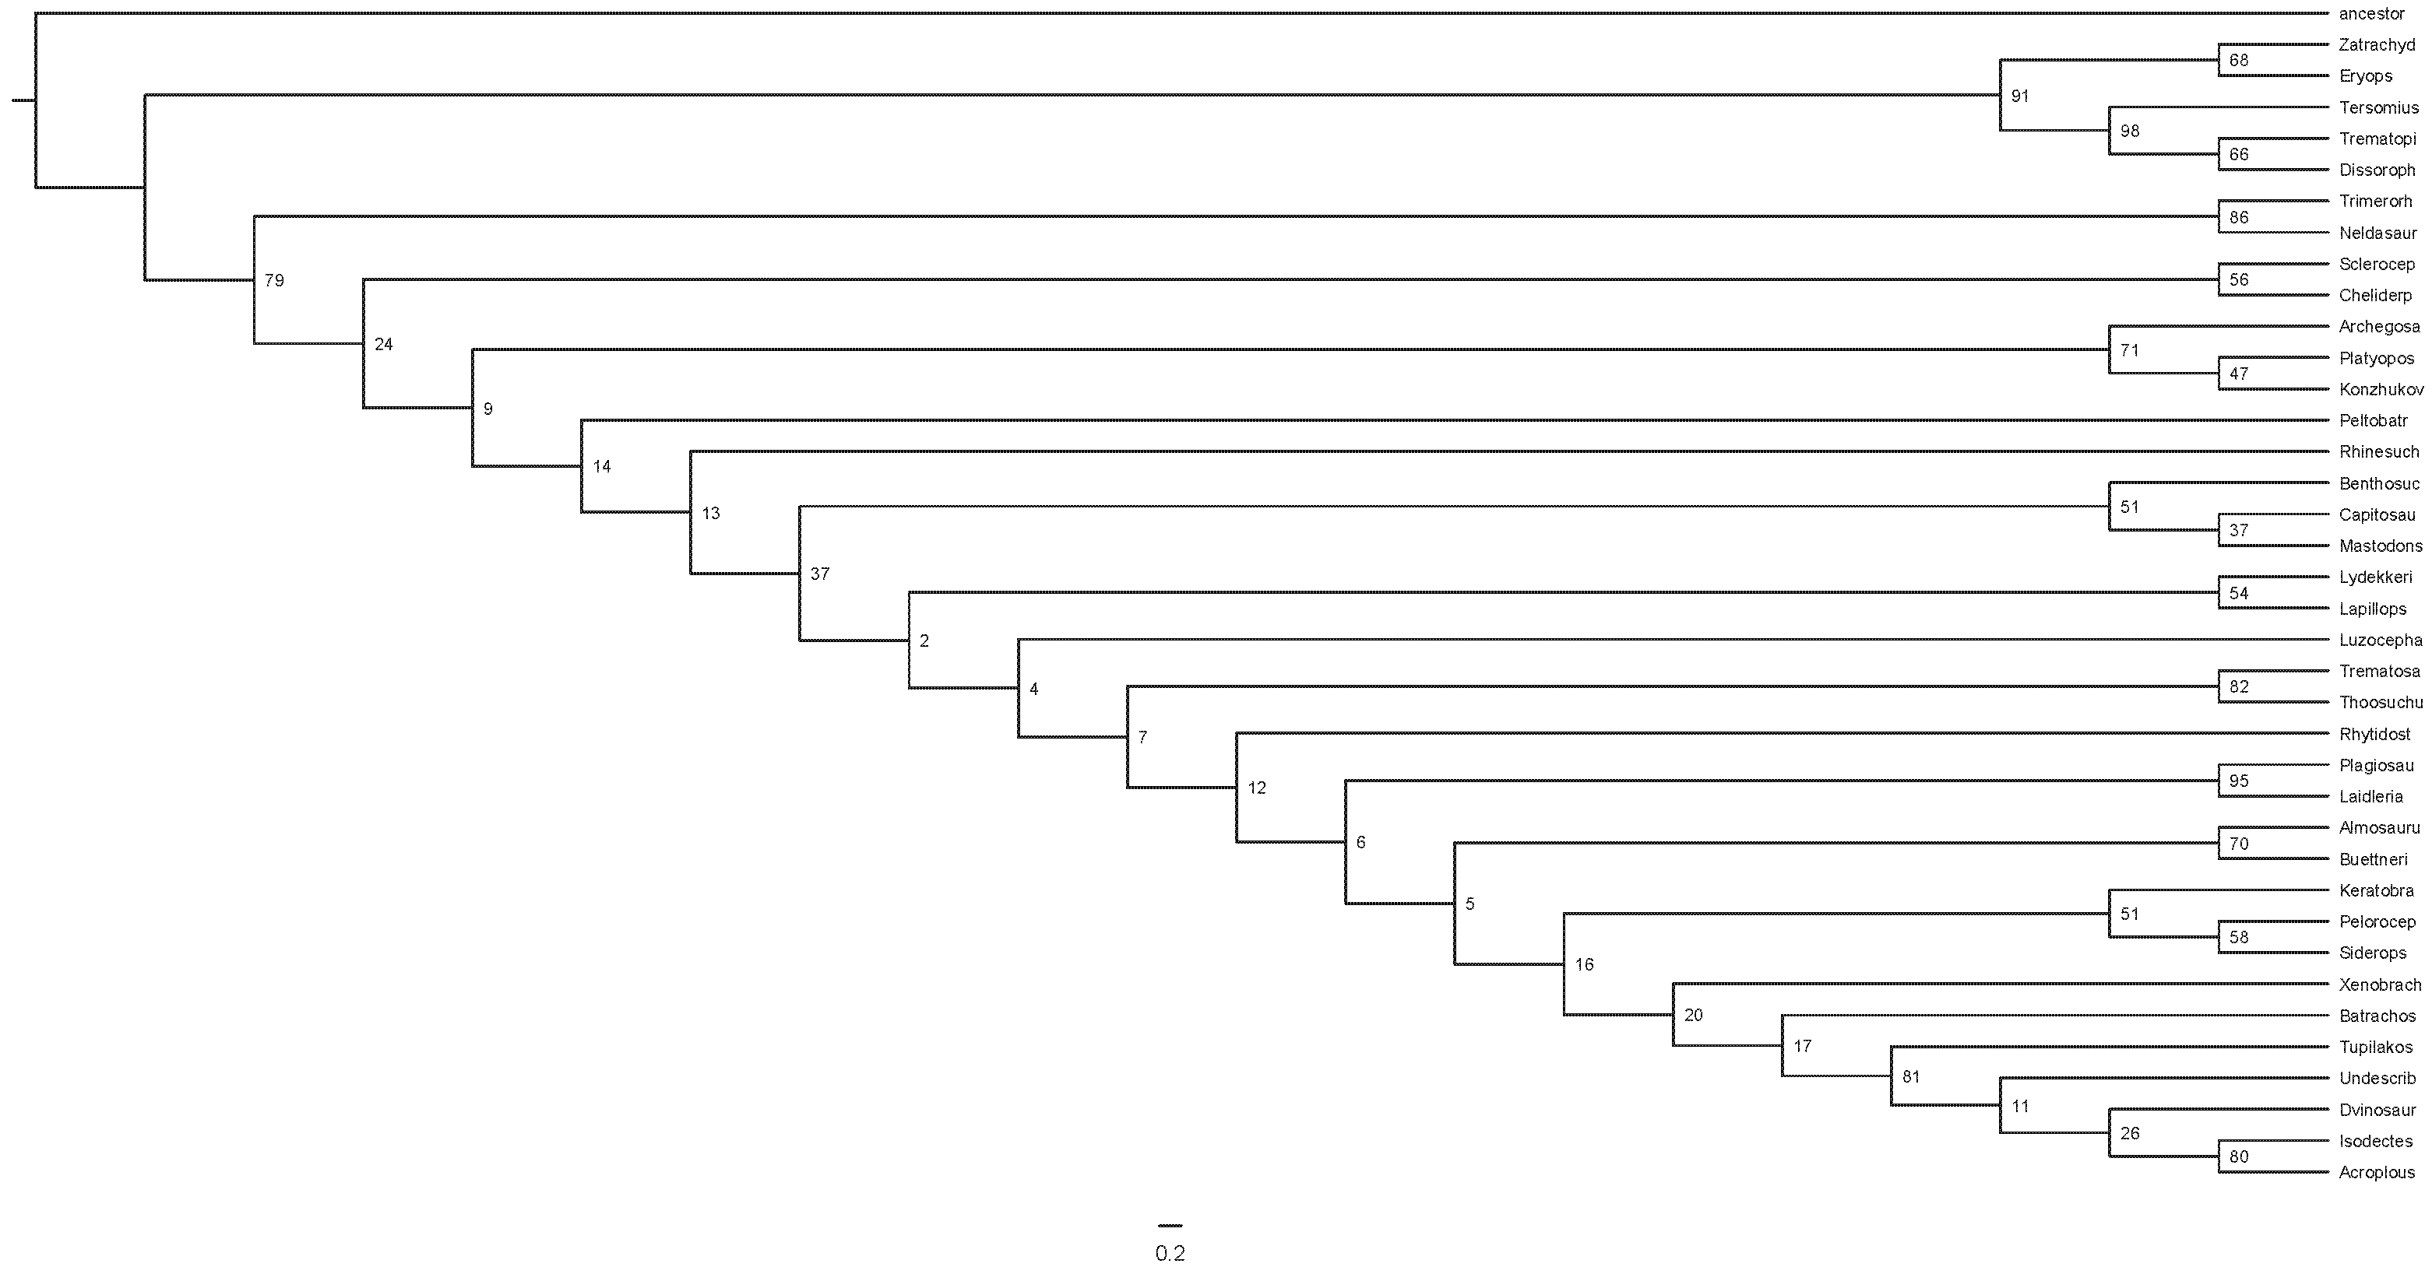
MK seed 1

Slide 19
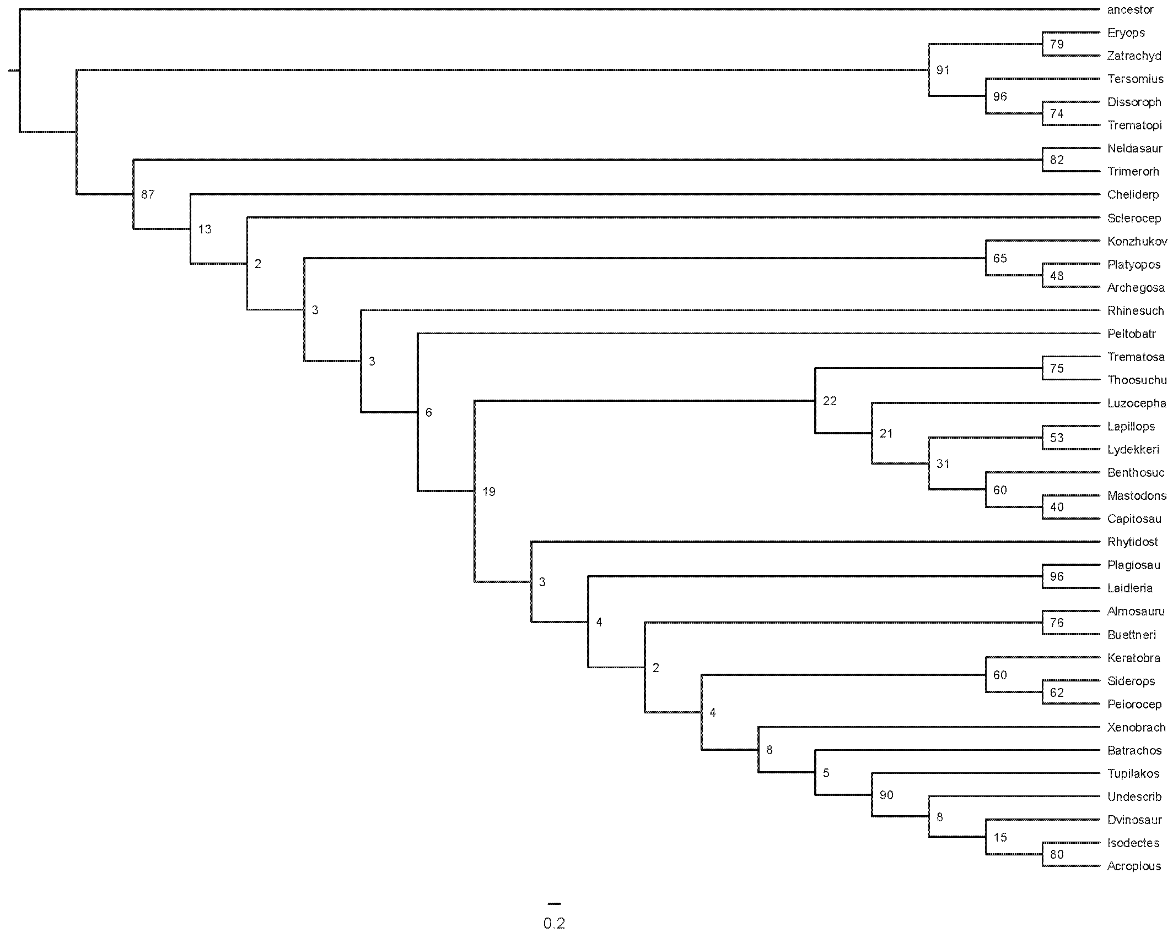
MK seed 2

Slide 20
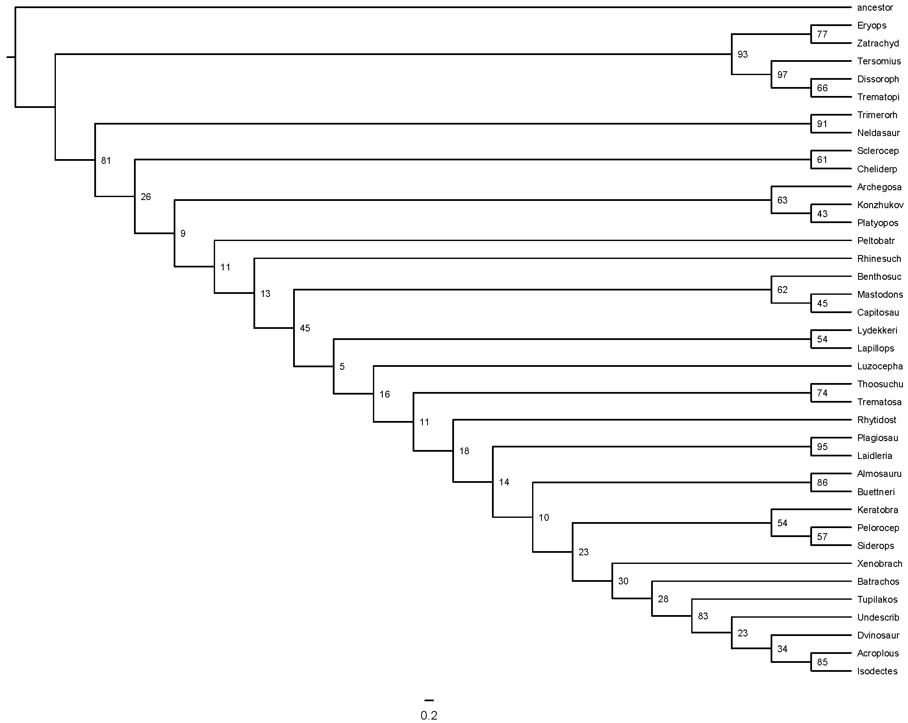
MK seed 3

Slide 21
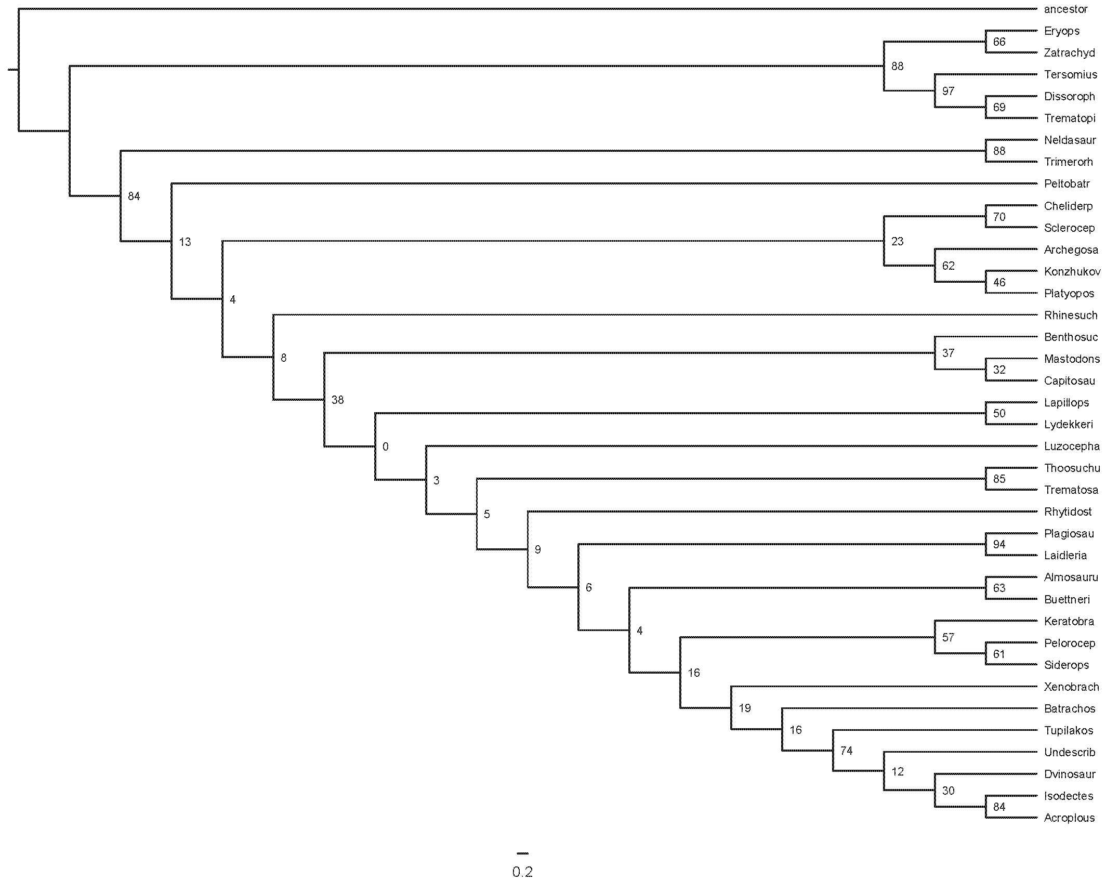
ORDERED seed 1

Slide 22

ORDERED seed 2

Slide 23

ORDERED seed 3

