Slide 1
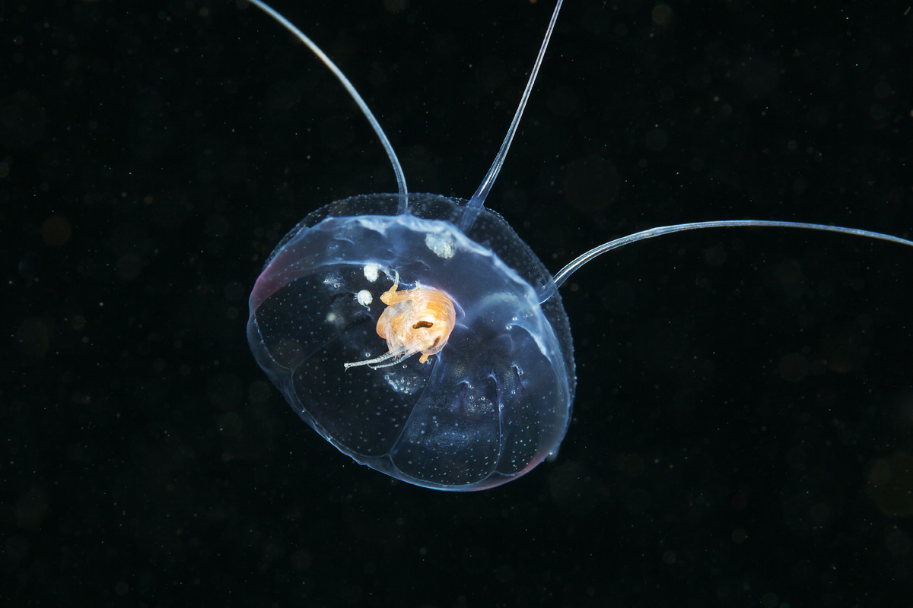
Cophylogenetic analysis of hyperiid amphipods and their gelatinous planktonic hosts.
Alejandro Damian Serrano

Slide 2
Why hyperiid amphipods?
From benthic to pelagic life
Living habitat – Gelatinous zooplankton
Food source
Associations:
  Parasites
  Parasitoids
  Predators
  Hitchhickers

Slide 3
Goals:
1) Visualize the cophylogeny.
2) Cophylogenetic analysis: measure global congruence
3) Evolution of host specificity in hyperiid amphipods, and colonization vulnerability in gelatinous hosts.
4) Identify phylogenetic patterns in the colonization of living-habitat. Test for phylogenetic structure (clustering / overdispersion).

Slide 4
Methods: Association Data
Literature review
Only fully resolved species
1 / 0: No intensity recorded
Type of association not recorded

Slide 5
Methods: Obtaining Phylogenies
NCBI accessions for 18S
Gene tree as proxy
MAFFT MSA (L-INS-i)
RAxML with bootstraping

Slide 6
Methods: Eco-Evo Analyses
R packages:
  Ape:
    Ultrametrize trees (chronos)
    Phylogenetic distance matrices (cophenetic)
    Cophylogenetic congruence test (parafit)
  Bipartite:
    Network analysis (grouplevel)
  Picante:
    Ecological distance (comdist, species.dist)
    Phylogenetic community ecology (phylostruct, psc)

Slide 7
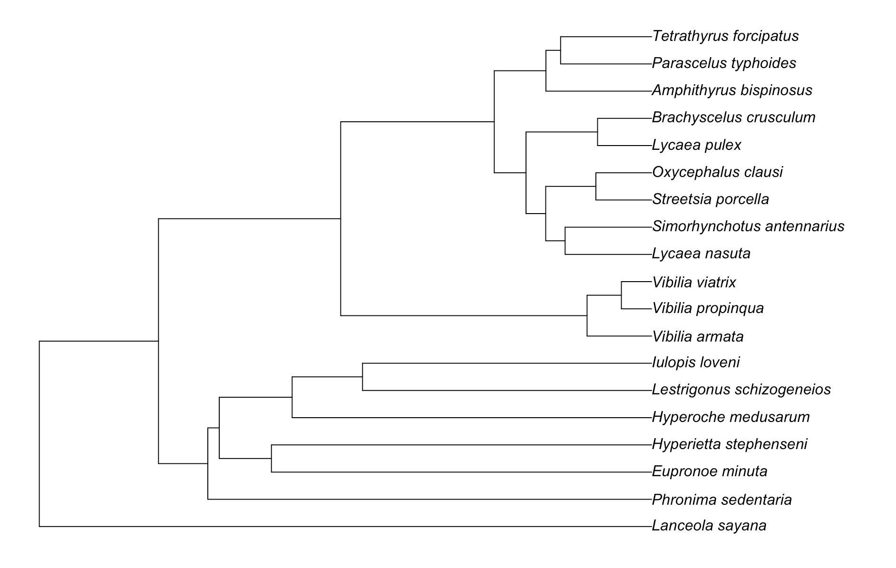
Results: Phylogenetic analyses

Slide 8
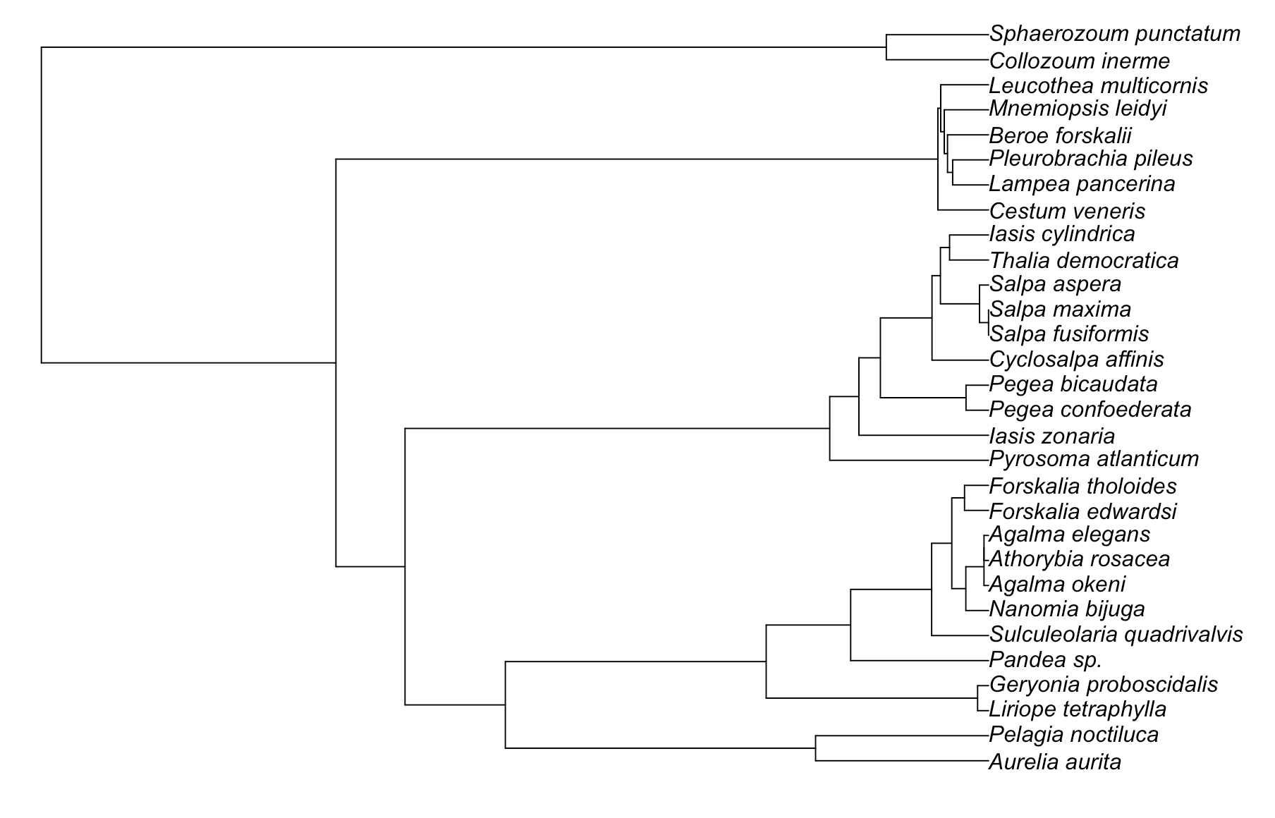
Results: Phylogenetic analyses

Slide 9
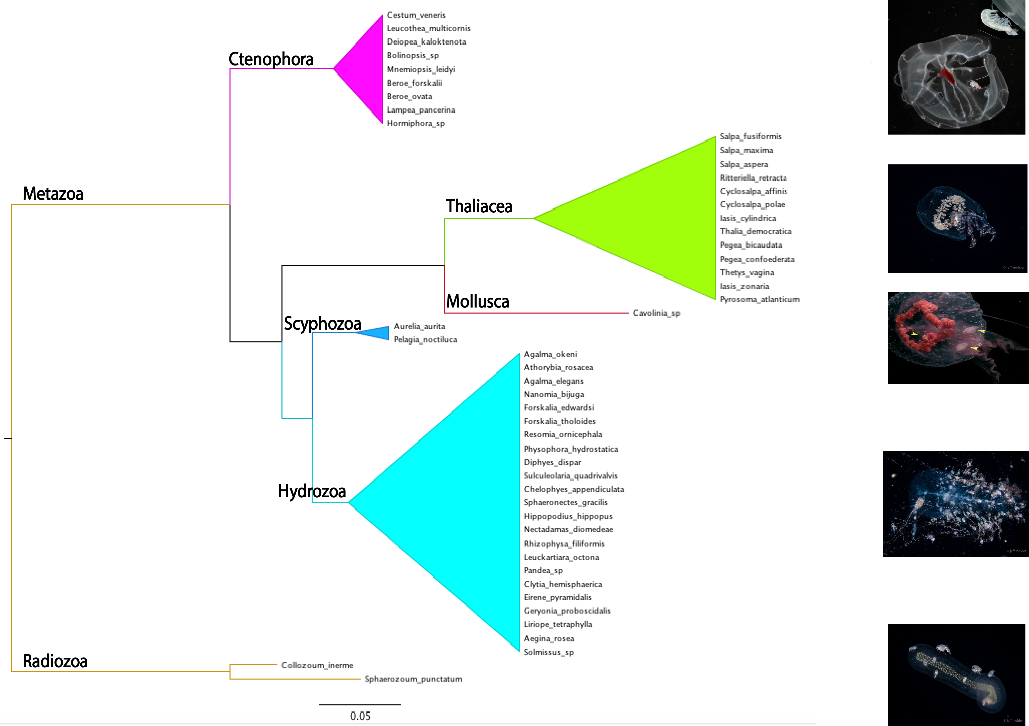

Slide 10
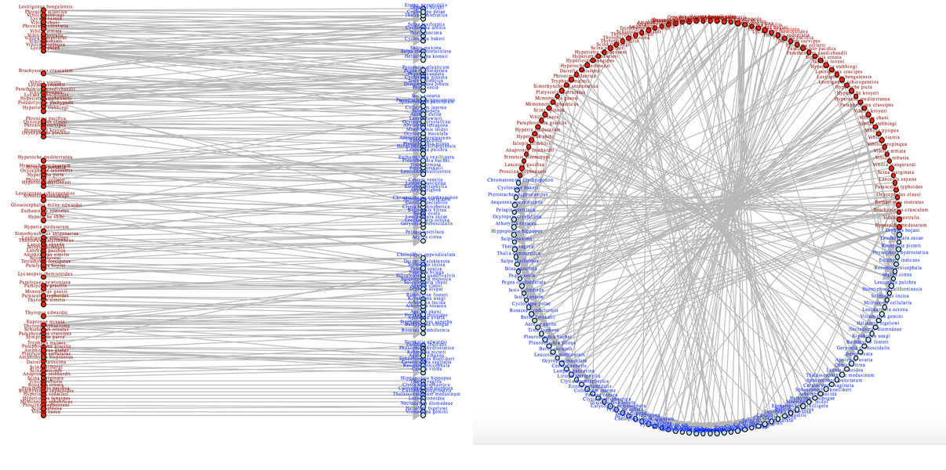
Results: Association Ecology

Slide 11
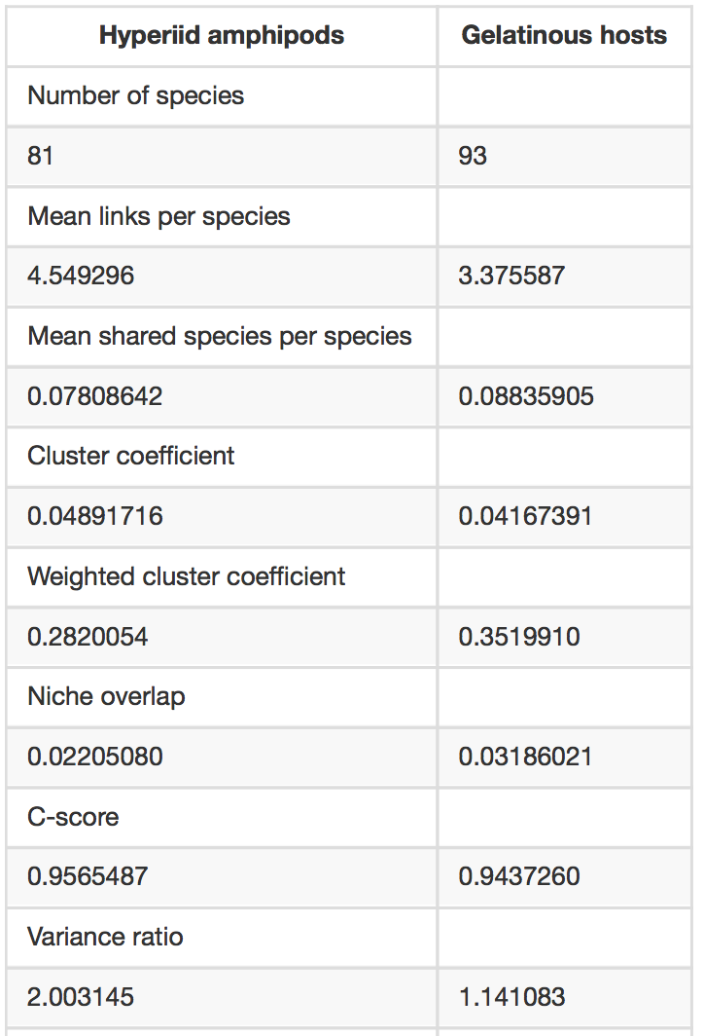
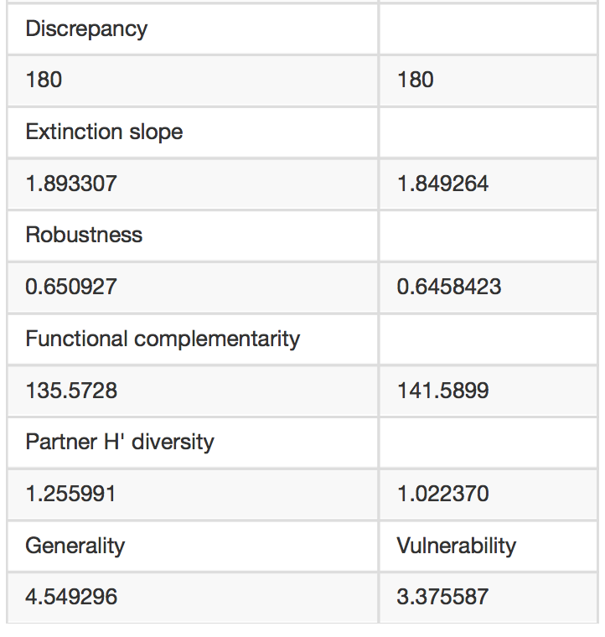
Results: Association Ecology

Slide 12
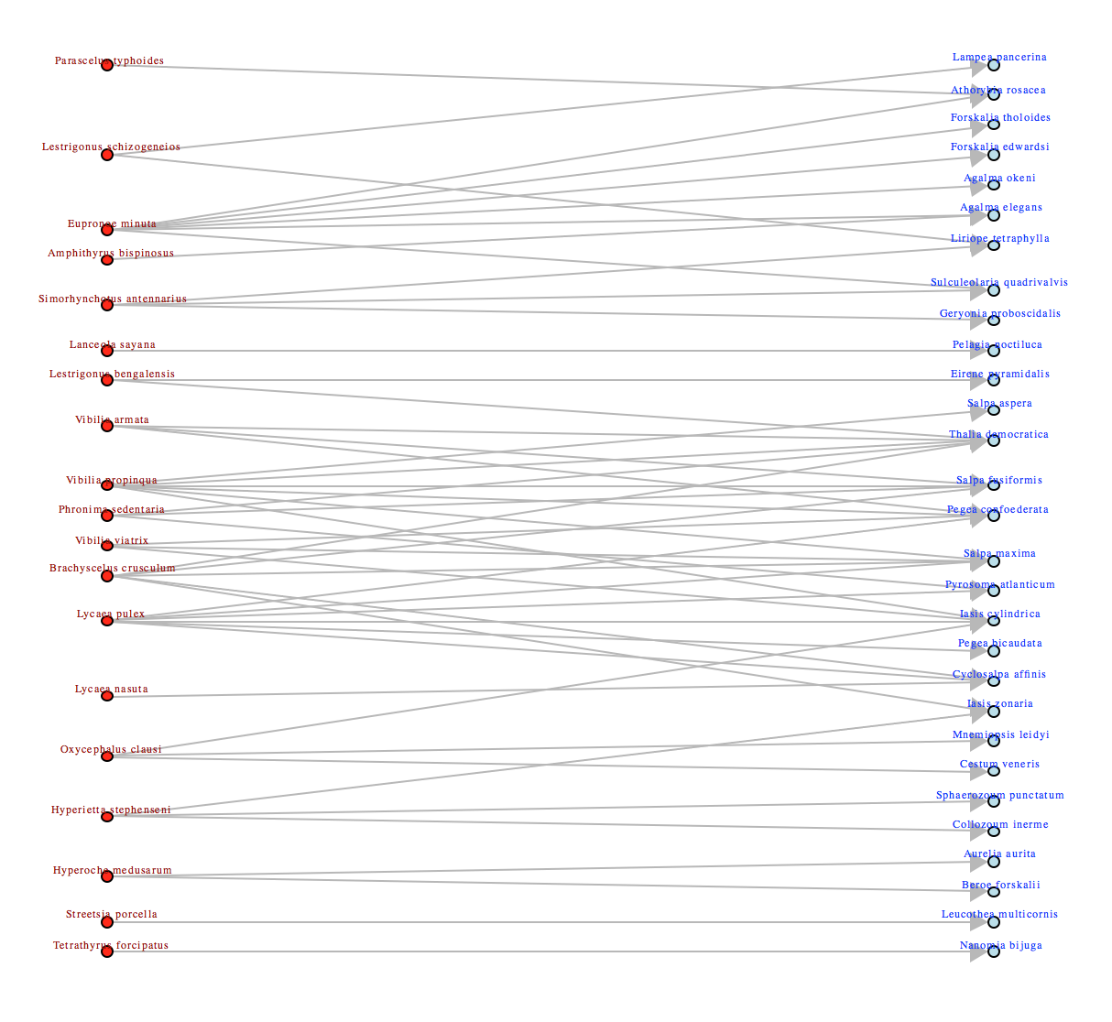
Results: Association Ecology

Slide 13
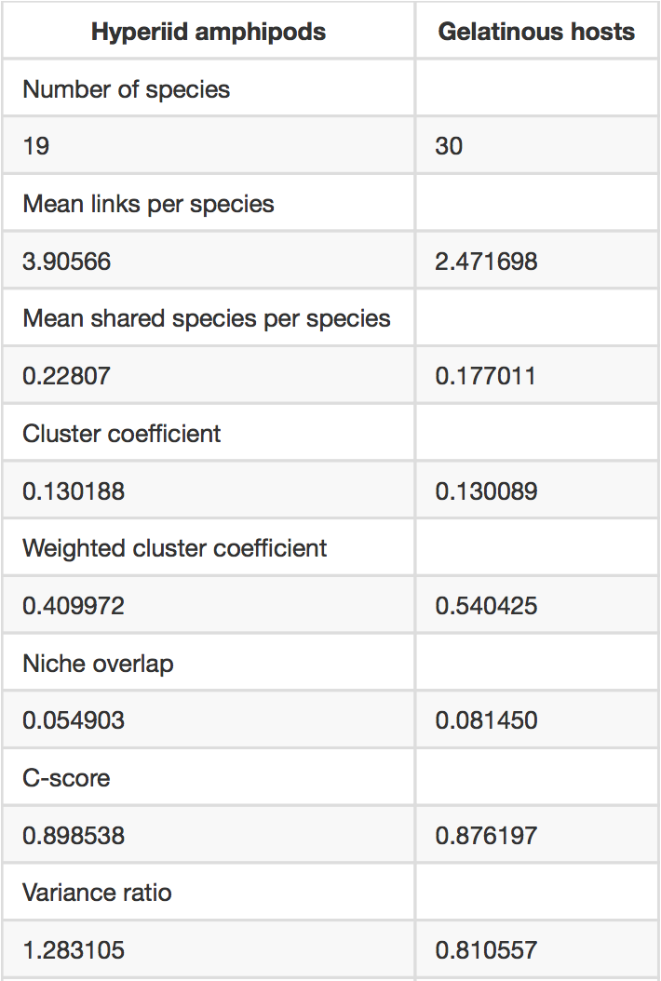
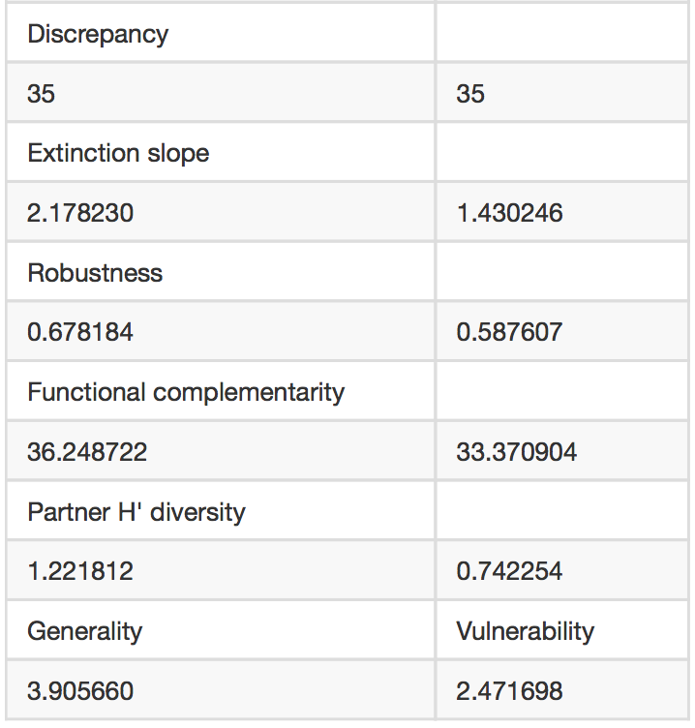
Results: Association Ecology

Slide 14
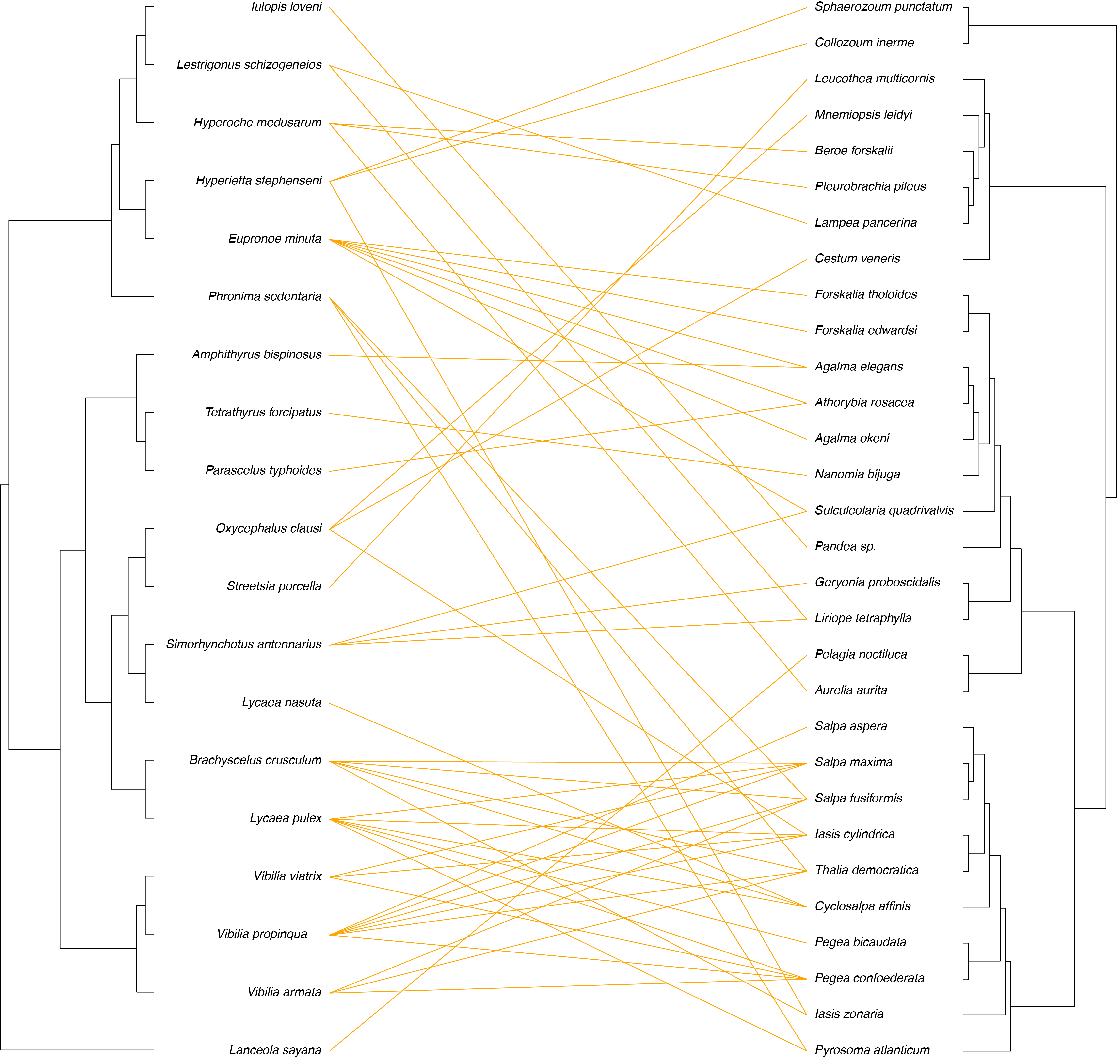
Results: Cophylogenetic analysis

Slide 15
Results: Cophylogenetic analysis
Parafit (100 permutations):
  31.17 , p-value = 0.148.
  Flat branchlengths: 124’916.00 , p-value = 0.067

Slide 16
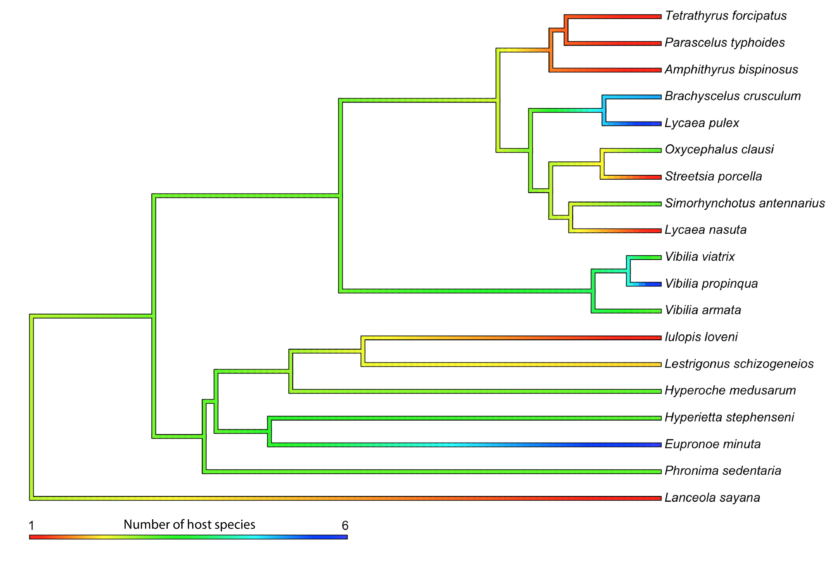
Results: Cophylogenetic analysis
Blomberg’s K: 0.3242 | BL 0.6328

Slide 17
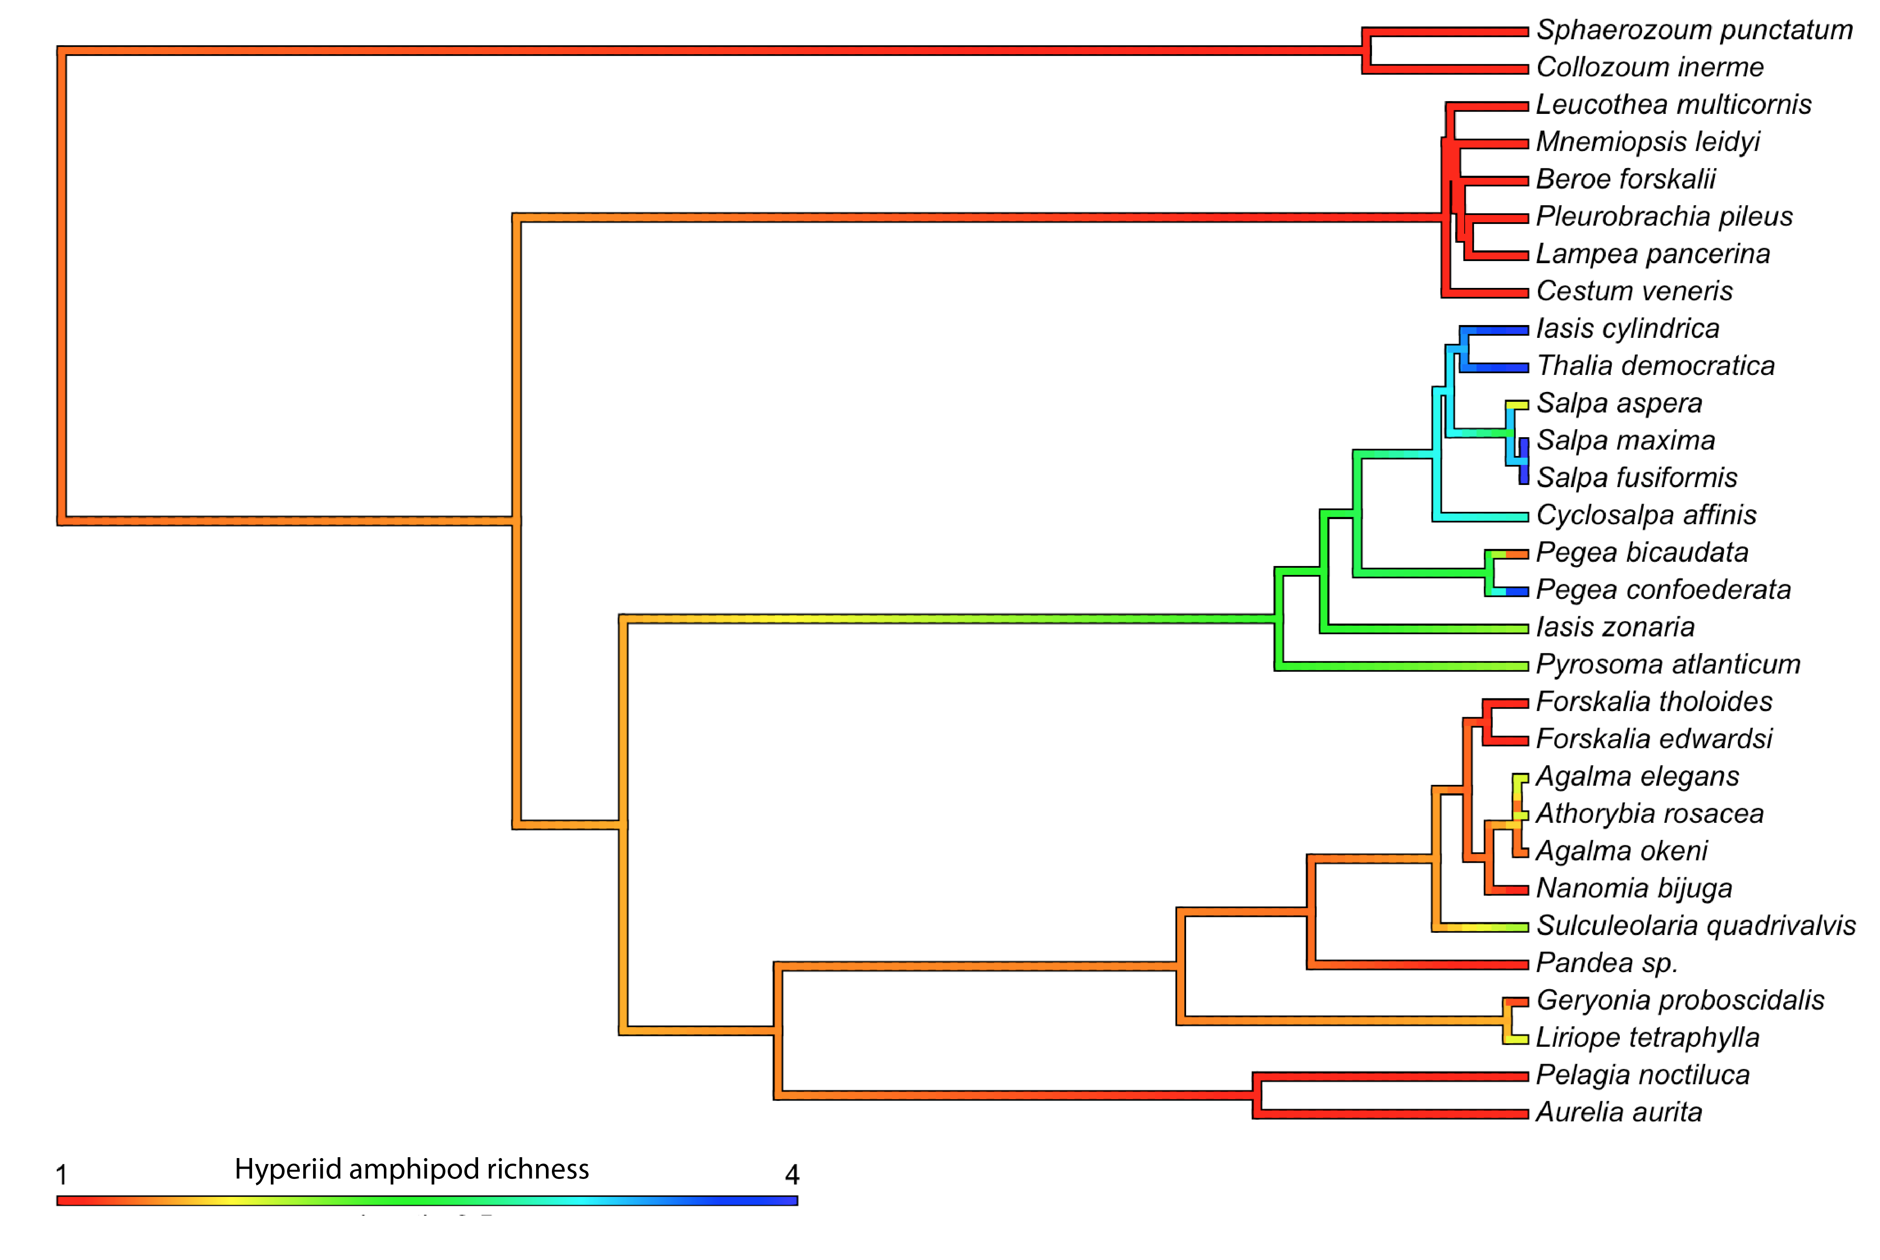
Results: Cophylogenetic analysis
Blomberg’s K: 0.0689 | BL 0.6877

Slide 18
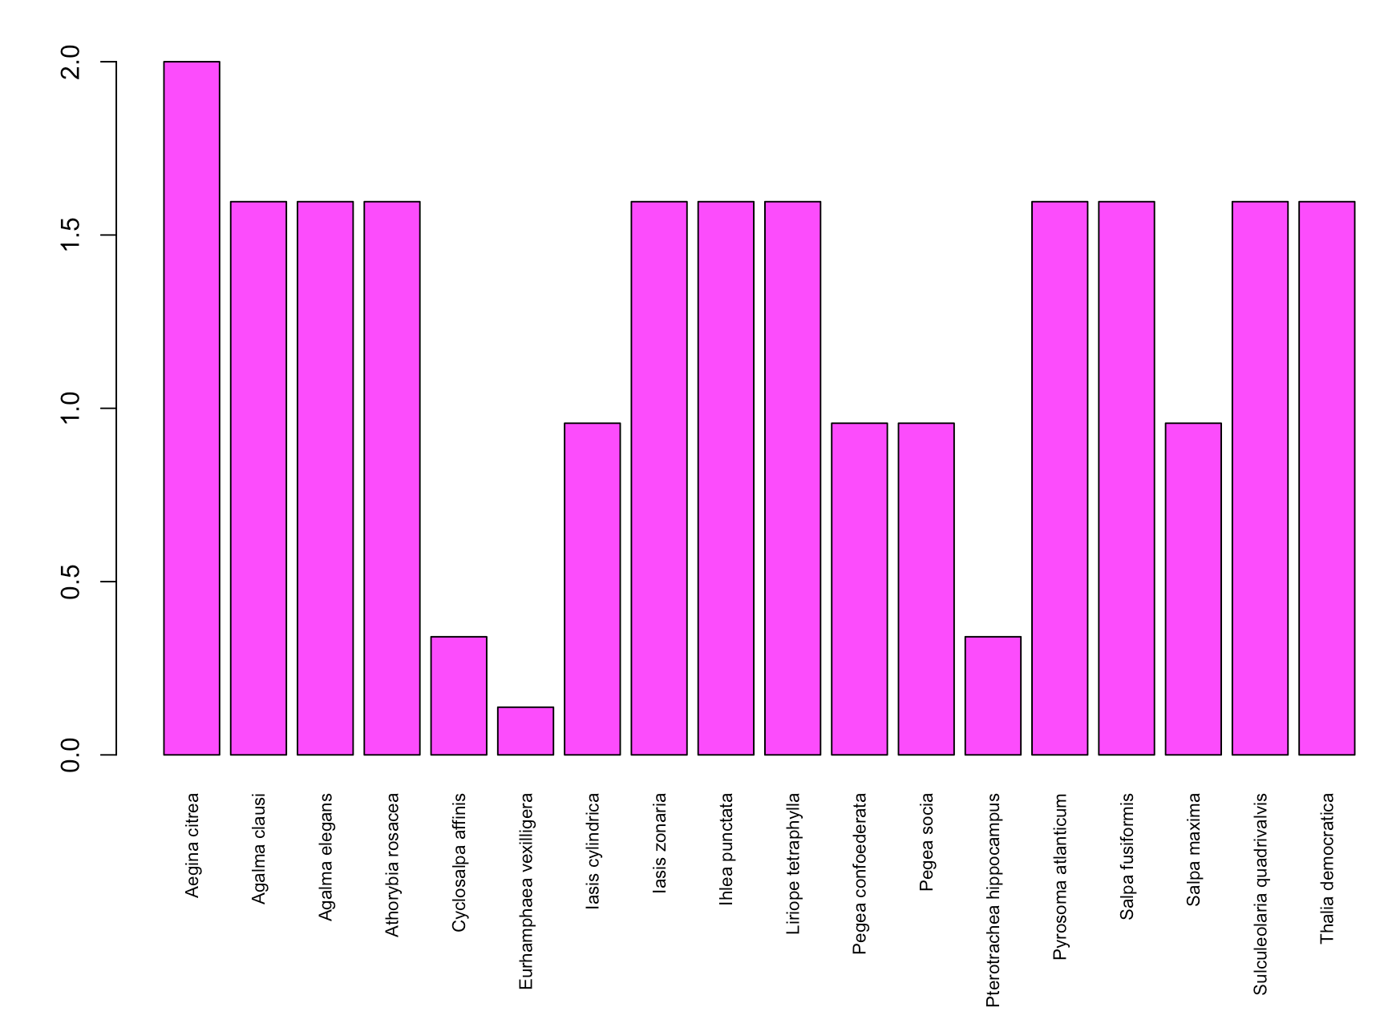
Results: Phylogenetic Community Ecology
Phylogenetic overdispersion

Slide 19
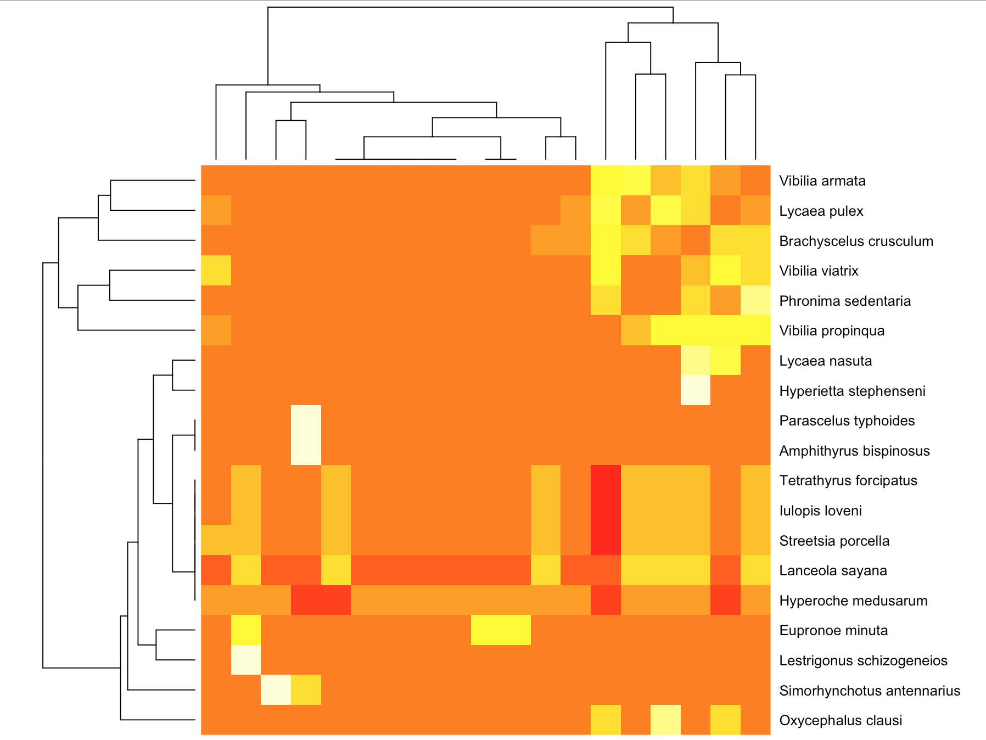
Results: Competition?

Slide 20
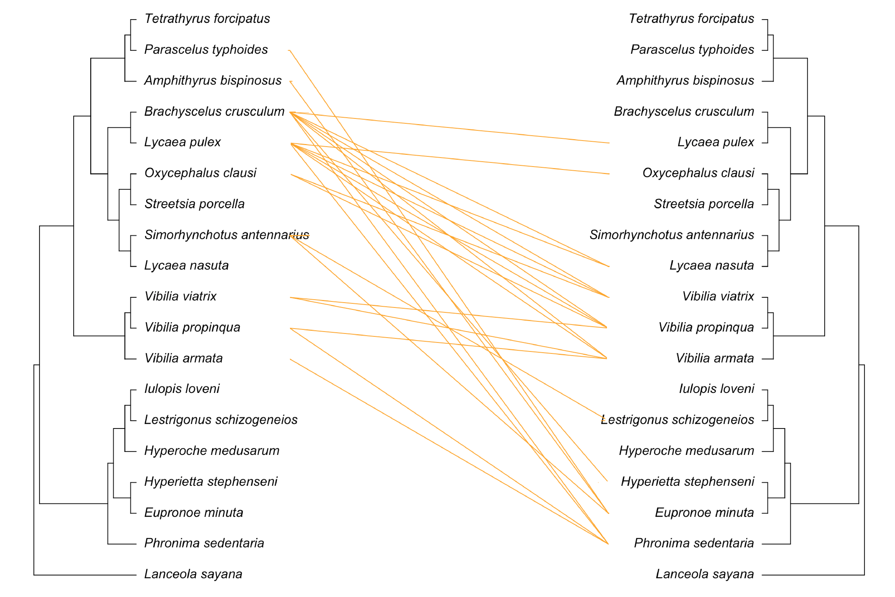
Results: Competition?

Slide 21
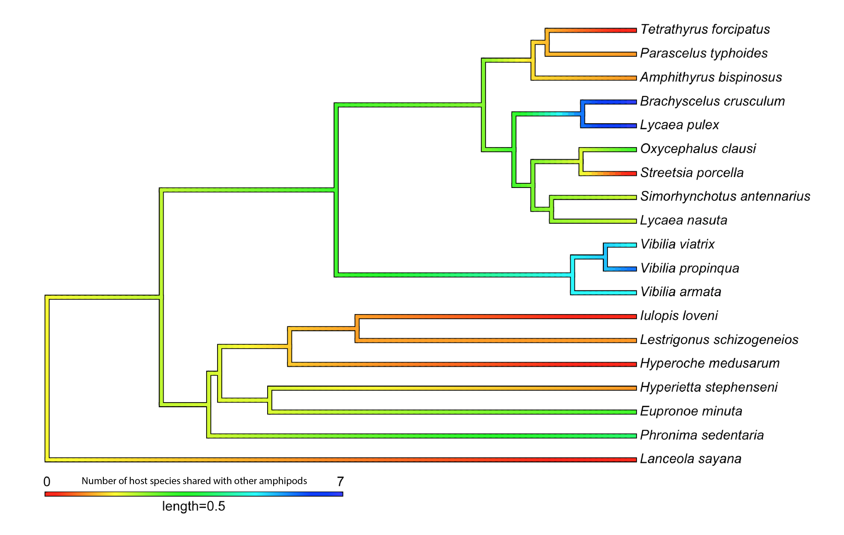
Results: Competition?

Slide 22
Results: Competition?

Slide 23
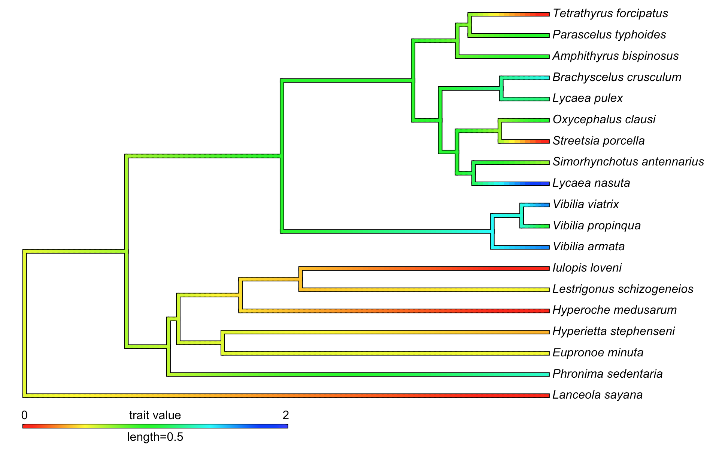
Competition?

Slide 24
Discussion:
18S reconstruct deep phylogeny better than recent divergence
Network analysis:
  Hosts have less connections than hyperiid amphipods – adaptation?
  Reduced taxon sampling biases network analyses

Slide 25
Discussion:
Incomplete cophylogenetic congruence:
  Disparate phylogenetic scales
  Host tree internal nodes older than the associations
  Amphipod 18S tree not fully reconstruct species tree
  Reduced taxon sampling, association network bias
  Low amphipod-host specificity
Molecular branch lengths blur the signal

Slide 26
Discussion:
Competition may drive overdispersion in amphipods
Competition is related to generality
Thaliaceans harbor the greatest diversity of hyperiid amphipod species
Multiple origins of specificity and generality in hyperiid amphipods – association type?

Slide 27
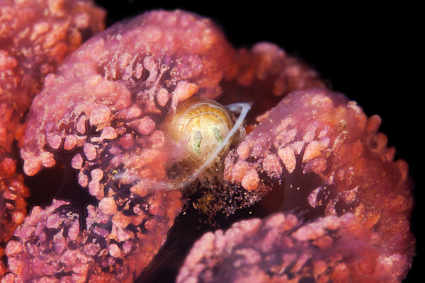
Thank you!

