Slide 1
Python and Django – The elephant in the room (Part 2)
Janosch Maier, 09.04.2015, Room BC1 2.02.01

Slide 2
What we know already?
Develop a basic application
Model
Controller
View
View
Template

Slide 3
How to proceed
Clone the Application if you want…
Take the app "webtech-skeleton"
https://github.com/Phylu/webtech-django2.git
Have a Look at some code…

Slide 4
Overview
Object Relational Mapping
Retrieving Objects
Filtering
Aggregation & Annotation
Tests
Unittests
Webserver Response Tests
Middleware
Messages
Sessions
Translation (If still time)
Defining Translation
Translation Files

Slide 5
Object Relational Mapping
ORM is a technique to map objects to a relational database.
Objects can be easily added, retrieved, changed and deleted.
Model is mapped to table. Attribute is mapped to column.
Backend Storage
Access
sqlite> select * from scorecard_course;
id l_id course_title votes
---- ------------ -----
1 2 Webtech 5
2 1 Global Softw 1
3 1 Web Applicat 0
4 2 Gründung und 1
5 4 Software Eng 0
c = Course.objects.get(pk=1)
c = get_object_or_404(Course, pk=1)
for c in Course.objects.all():
print (c)

Slide 6
Object Relational Mapping
Retrieving Objects: Course.objects.get(pk=1) Course.objects.all() Course.objects.order_by('-votes')
Filtering: Course.objects.filter(votes__gte=42)
Lecturer.objects.filter( first_name__exact=F('last_name')
Lecturer.objects.filter( Q(first_name__contains='Alex') | Q(last_name__contains='Shumaiev'))
Write some code...

Slide 7
Object Relational Mapping
Aggregation: Course.objects.aggregate(Avg('votes'))[ 'votes__avg']
Annotation: Course.objets.values('lecturer'). annotate(avg_votes=Avg('votes'))
Raw SQL: Check Documentation
Write some more code...

Slide 8
Overview
Object Relational Mapping
Retrieving Objects
Filtering
Aggregation & Annotation
Tests
Unittests
Webserver Response Tests
Middleware
Messages
Sessions
Translation (If still time)
Defining Translation
Translation Files

Slide 9
Testing
As real software engineers, we want automated testing.
Djangos test framework does:
Unittests
Direct Test of algorithmic
Mainly to test models and views
Client–Webserver Tests
Test how webserver answers requests
Mainly to test views and templates
Selenium Tests (not covered here)
Test how the page looks
Test integration of all parts

Slide 10
Testing
Productive data is not touched
Testing environment based on your needs: def setUp(self): """ Create some courses & lecturers """ pass
Run: ./manage.py test
Write even more code...

Slide 11
Overview
Object Relational Mapping
Retrieving Objects
Filtering
Aggregation & Annotation
Tests
Unittests
Webserver Response Tests
Middleware
Messages
Sessions
Translation (If still time)
Defining Translation
Translation Files

Slide 12
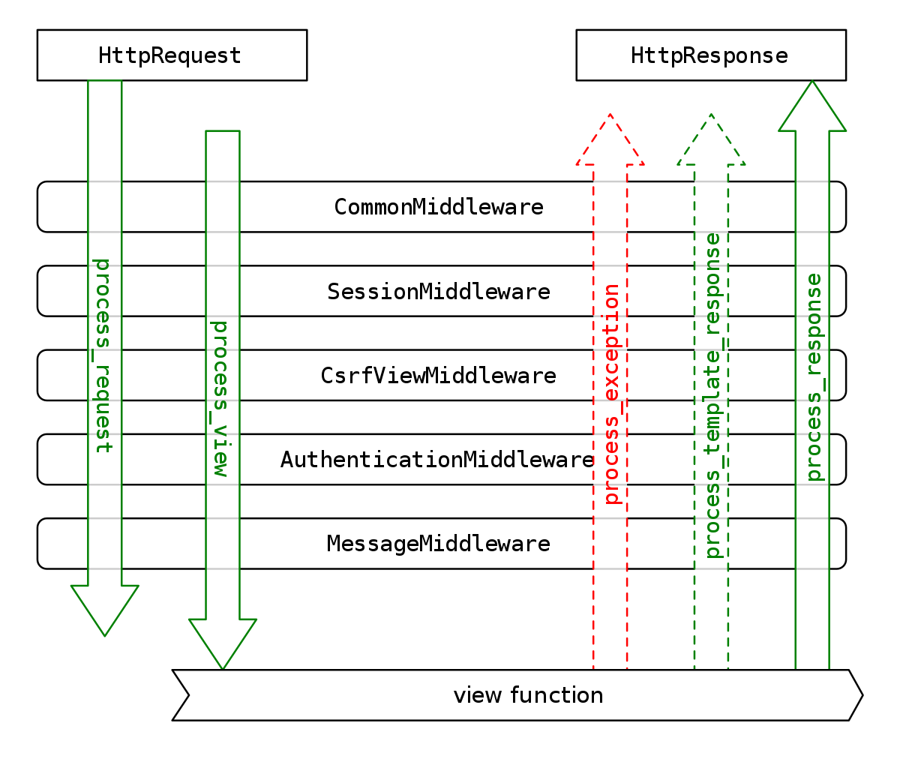
Middlewares
Middlewares hook in between HttpRequest/Response and Django view
Source: https://docs.djangoproject.com/en/1.8/topics/http/middleware/

Slide 13
Middlewares
Middlewares add functionality to request handling:
Auth: if request.user.is_authenticated():
… # Do something for authenticated users.
else:
... # Do something for anonymous users.
Message: messages.add_message(request, messages.ERROR, "You have already voted!")
Session: request.session['has_voted'] = True request.session.get('has_voted', False)
Write code, again...

Slide 14
Middlewares
Just implement (one of): process_request(request)
process_view(request, view_func, view_args, view_kwargs)
process_template_response(request, response)
process_response(request, response)
process_exception
Then rigster your middleware in the config
Want to write your own Middleware?

Slide 15
Comparison
Django vs. other Web Frameworks
Pro Django
Contra Django
It is Python! (e.g. easy readable)
Very defensive (no standard null fields)
Apps and namespaces
Probably overloaded for small pages (defaults)

Slide 16
Thank you for your time!
Any Questions?
Janosch Maier
B.Sc.
maierj@in.tum.de

Slide 17
Overview [We still have too much time…]
Object Relational Mapping
Retrieving Objects
Filtering
Aggregation & Annotation
Tests
Unittests
Webserver Response Tests
Middleware
Messages
Sessions
Translation (If still time)
Defining Translation
Translation Files

Slide 18
Translation
Internationalizing your django application for an international audience? Define your translation strings
Views: from django.utils.translation import ugettext as _ … messages.add_message(request, messages.ERROR, _("You have already voted!"))
Templates: {% load i18n %} {% trans "Home" %} {% blocktrans count counter=course.votes %} {{ counter }} vote. {% plural %} {{ counter }} votes. {% endblocktrans %}
Code the last example...

Slide 19
Translation
Create Translation File: django-admin.py makemessages -l de
This creates "/locale/de/LC_MESSAGES/django.py"
#: templates/scorecard/base.html:20 msgid "Home" msgstr "Start"
#: templates/scorecard/index.html:10 #, python-format msgid "%(counter)s vote." msgid_plural "%(counter)s votes." msgstr[0] "%(counter)s Stimme." msgstr[1] "%(counter)s Stimmen."
Add some code…

Slide 20
Translation
Compile the translation: django-admin.py compilemessages
Django determines the language by:
Cookie
Browser settings
Django application default language
Just a last command in the terminal…

Slide 21
Comparison
Django vs. other Web Frameworks
Pro Django
Contra Django
It is Python! (e.g. easy readable)
Very defensive (no standard null fields)
Apps and namespaces
Probably overloaded for small pages (defaults)

Slide 22
Thank you for your time!
Any Questions?
Janosch Maier
B.Sc.
maierj@in.tum.de

