Slide 1

CSIS-4260 Assignment - 1
Thaw, May Pyae Phyo
St_ID: 300367691

Slide 2
Abstract of Assignment -1(Storing & Retrieving)
Storing and Retrieving Data
Manipulation, Analysis and Modeling
Building a visual Dashboard
The goal is to determine the most efficient way to store and retrieve data. The provided CSV Dataset is 29MB. Other file methods as parquet is used for compression and offer better performance in terms of Storage efficiency and retrieval speed.
Research Component: Compare CSV vs. Parquet, considering file size, read/write speed, and compatibility.
Benchmarking Component: Measure performance at 1x (original size), 10x, and 100x scales to justify the best storage format.
In This section, Comparison of dataframe performance and predictive modeling are mainly focused for the research.
Comparison of Pandas vs. Polars: Evaluate both libraries in terms of speed and efficiency for handling large datasets.
Feature Engineering: Enhance the dataset by adding at least four technical indicators (e.g., Moving Average, RSI, Bollinger Bands) to improve predictions.
Predictive Modeling:
Linear Regression & Random Forest Regressor for Predictions.
The final part involves creating an interactive dashboard to present benchmarking results and prediction models.
Research Dashboarding Tools:
Compare Streamlit, Dash, and Reflex (or another approved framework).
Dashboard Sections:
Section A: Display benchmark results from Part 1 and Part 2 across different dataset scales.
Section B: Allow users to select/search for a company ticker and visualize price predictions dynamically.

Slide 3
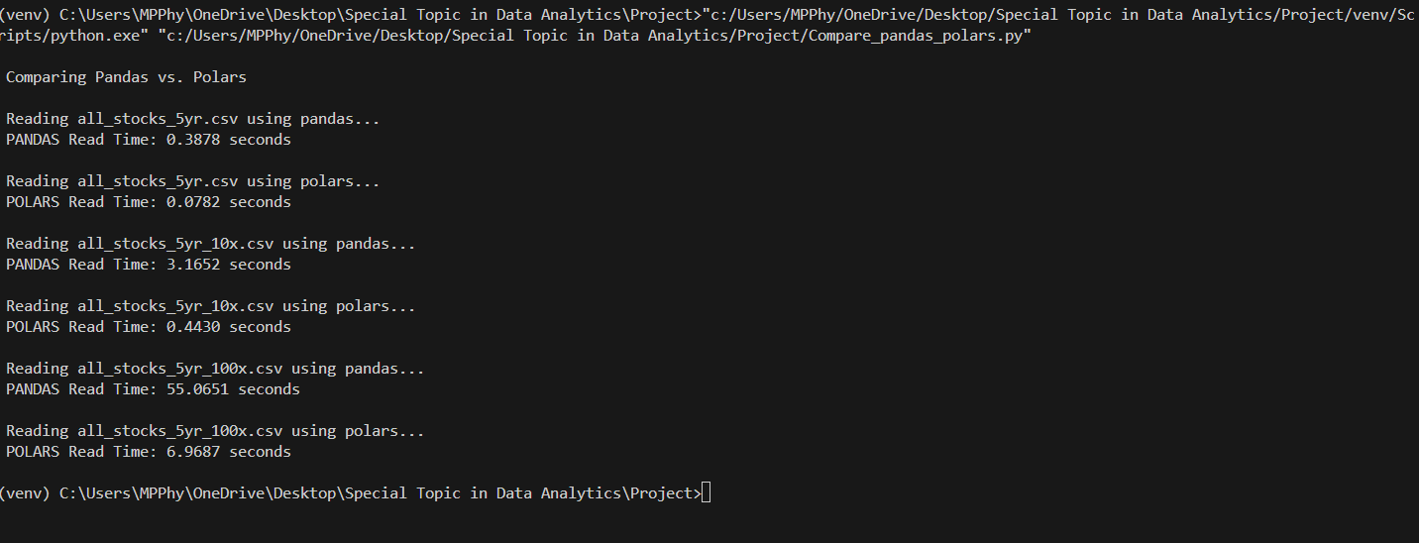
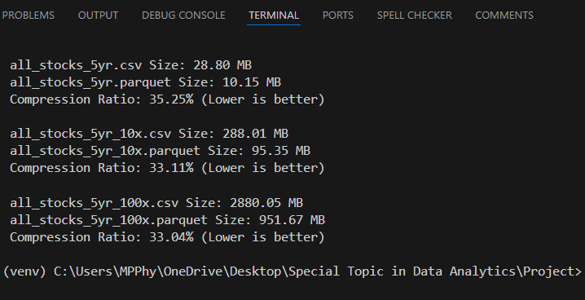
Assignment -1 : Part -1
Read Vs Write execution time comparisons
File Sizes Comparison after successfully created parquet files
Dataset | Library | Operation | Read Vs Write Time (SEC)
1x | CSV | Read | 0.4266
1x | Parquet | Read | 0.3523
1x | CSV | Write | 2.0242
1x | Parquet | Write | 0.3437
10x | CSV | Read | 3.879
10x | Parquet | Read | 0.8882
10x | CSV | Write | 20.9722
10x | Parquet | Write | 3.0576
100x | CSV | Read | 3.9515
100x | Parquet | Read | 1.1479
100x | CSV | Write | 24.6565
100x | Parquet | Write | 2.7907
 | 5yr_1x | 5yr_10x | 5yr_100x
CSV | 28.80 MB | 288.01 MB | 2880.05 MB
Parquet | 10.15 MB | 95.35 MB | 951.67 MB

Slide 4
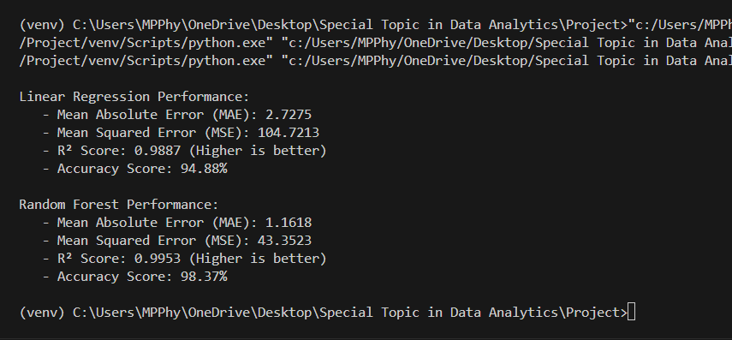
Assignment -1 : Part -2 (Analysis and Machine learning)
Data Analysis & Prediction In order to predict the stock price, the following technical indicators are added to the dataset for precise accuracy.
EMA ( Exponential Moving Average)
RSI ( Relative Strength Index)
Bollinger Bands (Upper & Lower)
OBV (On-Balance Volume)
Pipeline method is used to protect data leakage during machine learning processing together with StandardScale( ) for standardizing.

Slide 5
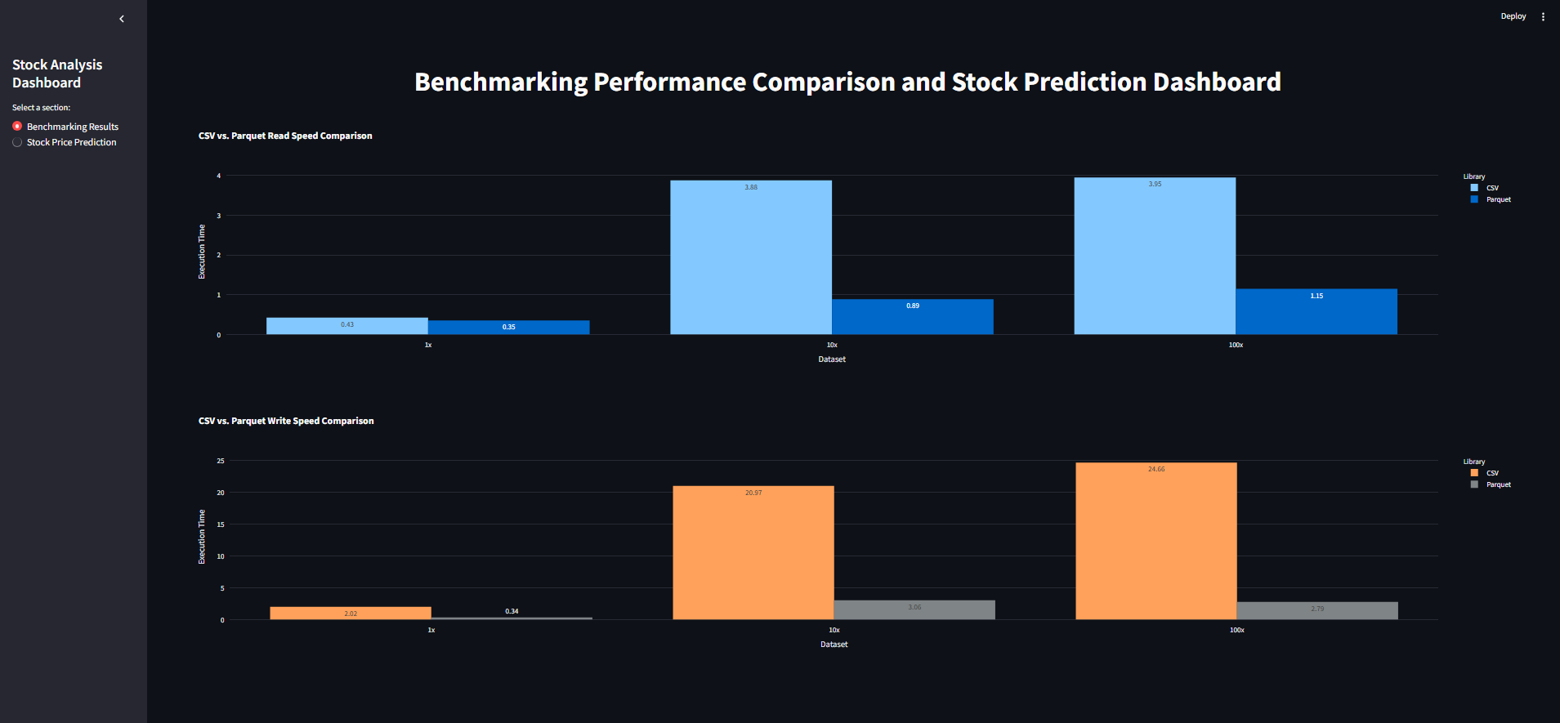
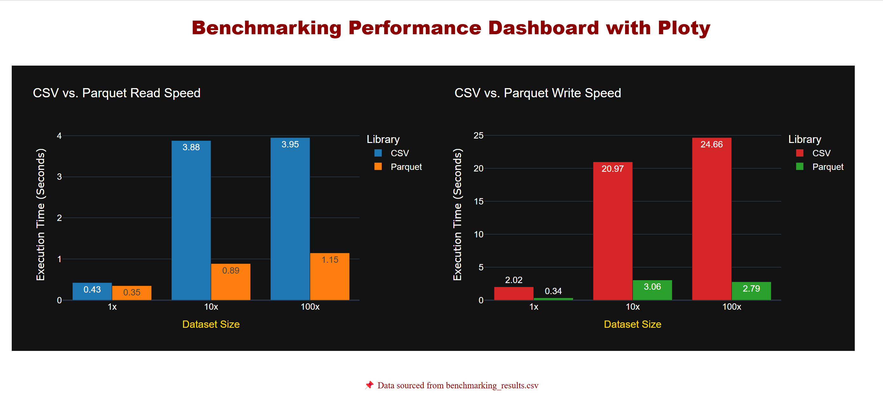
Assignment -1 : Part -3 (Visual Dashboard of Benchmarking)
Dashboard By Streamlit
Suitable for Beginner and easy configuration due to its simplicity and low code requirement.
It’s popular features as “Sidebars” is used in this dashboard.
Dashboard By Plotly Dash
Plotly.js is extremely useful for built-in support. It support a wide range of interactive chats and customizable with CSS.

Slide 6
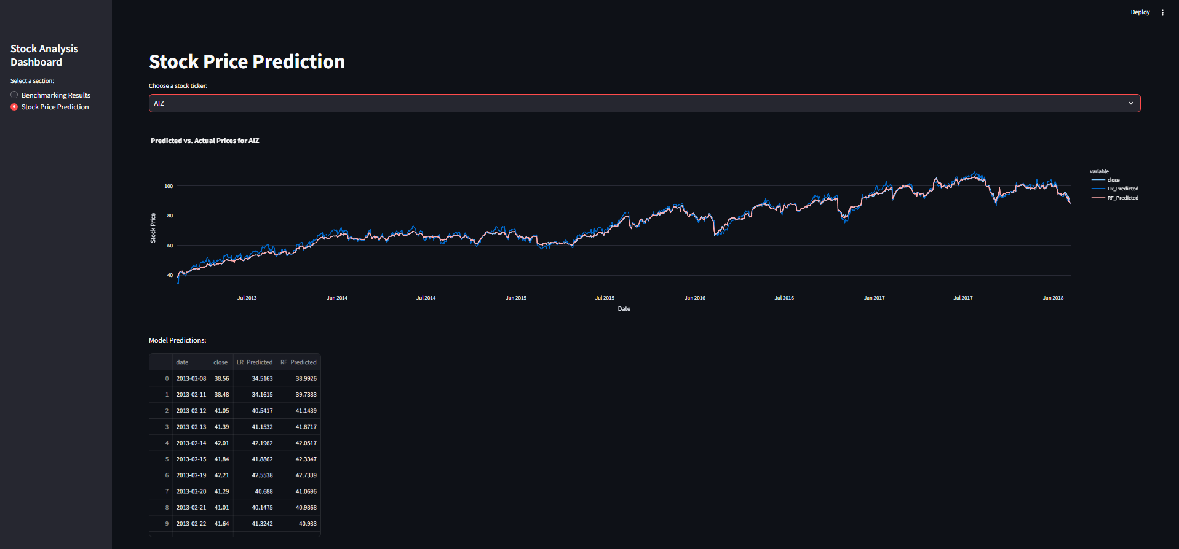
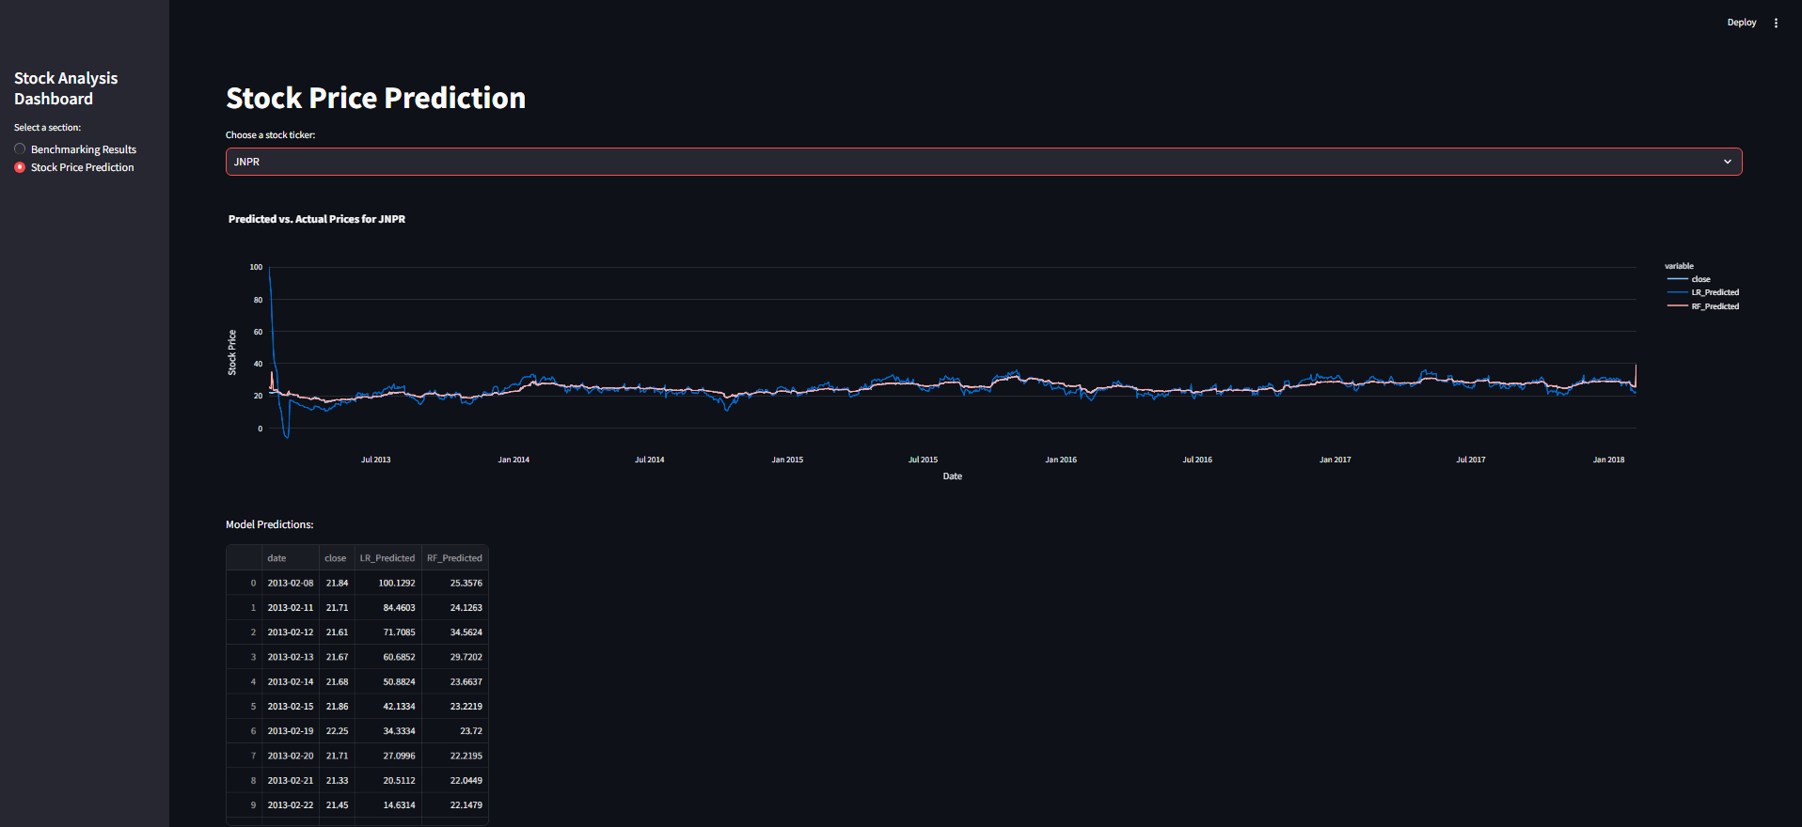
Assignment -1 : Part -3 (Visual Dashboard of Stock Prediction)
Stock Price Prediction Including Actual stock price, both prediction of Linear Regression and Random Forest Regressor predictions are shown inside both graph and table.

