Slide 1
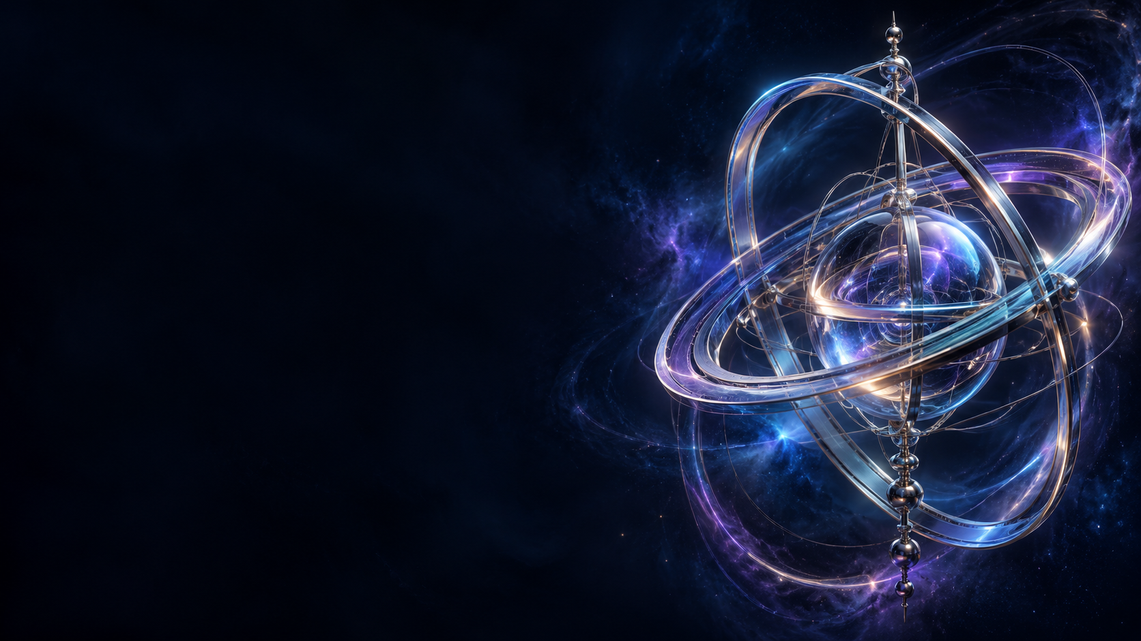
PRINCIPAL
AXES
The geometry behind a clean spin
Advanced rotational dynamics
B1.1 / PRINCIPAL AXES
01
Notes:
Source: supplied B1.1 Principal Axes in Rotational Dynamics course PDF. Introduce principal axes as directions for which angular velocity and angular momentum align. Decorative cover sculpture does not depict the example body.
Artwork: AI-generated decorative background, not a physical diagram.

Slide 2
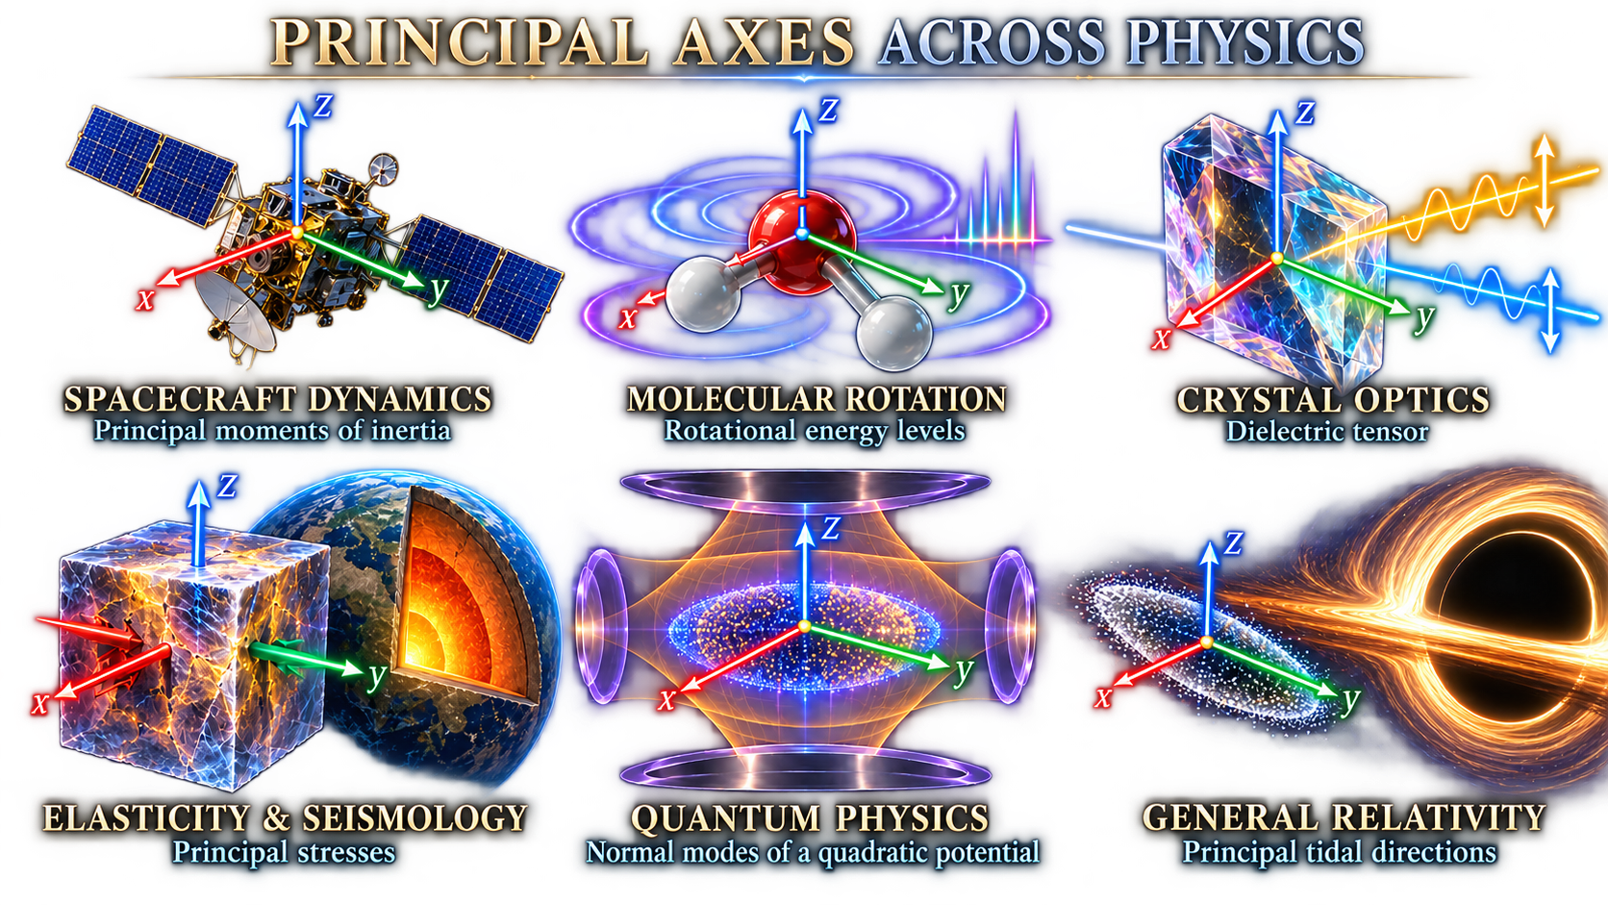
B1.1 / PRINCIPAL AXES
02
Notes:
Source: supplied B1.1 Principal Axes in Rotational Dynamics course PDF. Ask: do angular momentum and angular velocity always point in the same direction? Left schematic shows the general case, right shows a principal-axis case.
Artwork: AI-generated decorative background, not a physical diagram.
LaTeX equation:
\mathbf L=\mathbf I\boldsymbol\omega

Slide 3
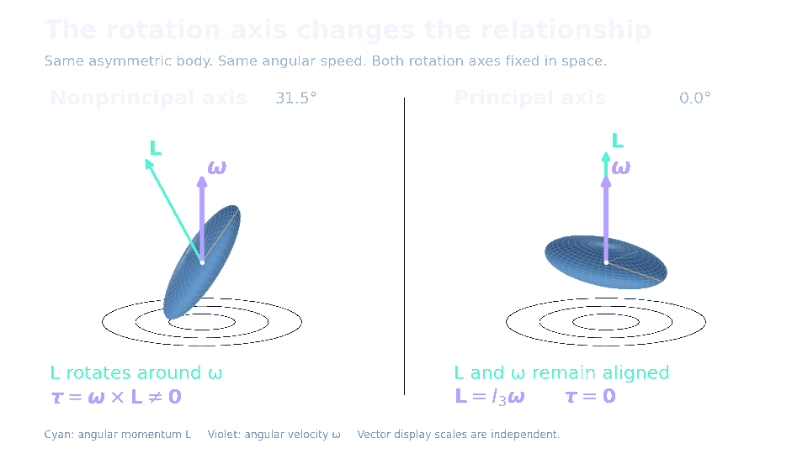

Angular velocity and angular momentum can point in different directions
B1.1 / PRINCIPAL AXES
02
Notes:
Source: supplied B1.1 Principal Axes in Rotational Dynamics course PDF. Ask: do angular momentum and angular velocity always point in the same direction? Left schematic shows the general case, right shows a principal-axis case.
Artwork: AI-generated decorative background, not a physical diagram.
LaTeX equation:
\mathbf L=\mathbf I\boldsymbol\omega

Slide 4
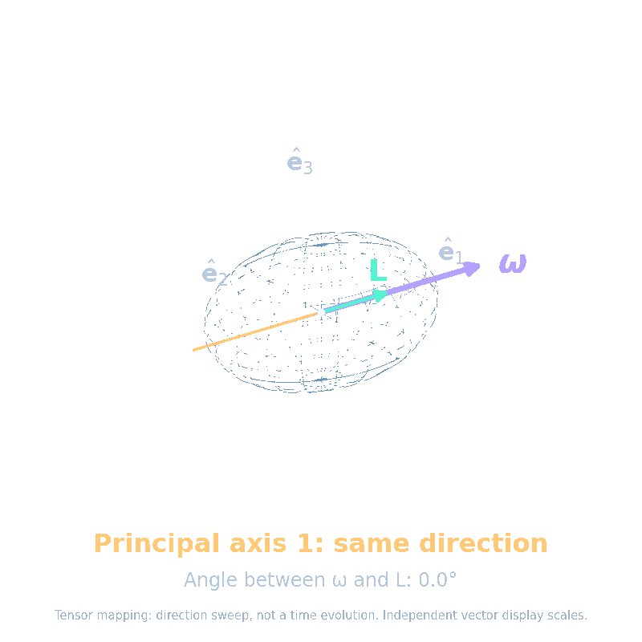


Along a principal axis, angular momentum aligns with angular velocity
Choose an angular-velocity direction ω.
The inertia tensor determines L = Iω.
Generally, L and ω point in different directions.
Along a principal axis, they align: L = Iₖω.
The animation compares possible directions, rather than showing motion over time.
The inertia tensor scales this direction without turning it.
B1.1 / PRINCIPAL AXES
03
Notes:
Source: supplied B1.1 Principal Axes in Rotational Dynamics course PDF. A principal axis is an eigenvector direction of I at a specified origin. For a free rigid body use the center of mass. Exact torque-free spin about a principal axis has constant omega direction, including the intermediate axis, though that solution is unstable to perturbations.
Artwork: AI-generated decorative background, not a physical diagram.
LaTeX equation:
\mathbf I\hat{\mathbf e}_k=I_k\hat{\mathbf e}_k
LaTeX equation:
\boldsymbol\omega=\omega\hat{\mathbf e}_k\quad\Longrightarrow\quad\mathbf L=I_k\boldsymbol\omega

Slide 5

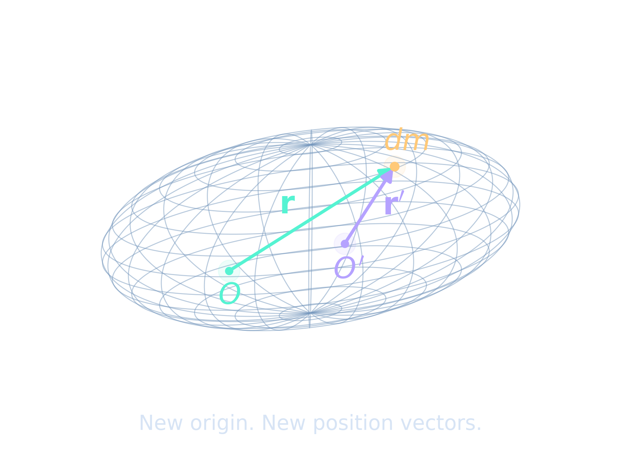
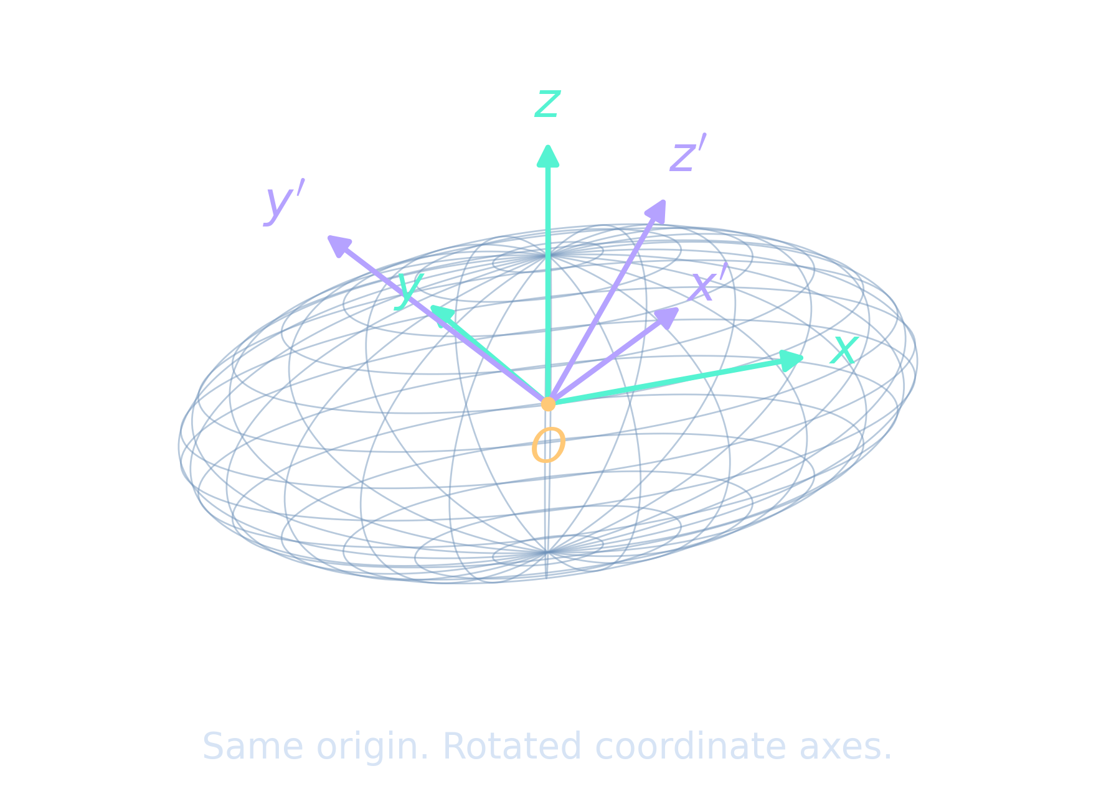
Mass geometry determines the tensor
Origin
Basis
Where do we measure r?
Which directions define x, y, z?
Left: two origins. The same mass element has different position vectors. Changing the reference point generally changes the inertia tensor.
Right: two basis sets. The origin stays fixed, but the coordinate axes rotate. The tensor represents the same physical mass distribution about that origin; its matrix components change.
Why compare them? Finding principal axes means choosing a basis that diagonalizes the tensor about a specified origin.
B1.1 / PRINCIPAL AXES
04
Notes:
Source: supplied B1.1 Principal Axes in Rotational Dynamics course PDF. All positions refer to one chosen origin. Principal axes depend on that origin. For free-body rotation use the center of mass. The tensor does not change physically when coordinates change, but its components do.
Artwork: AI-generated decorative background, not a physical diagram.
LaTeX equation:
I_{ij}=\int_V\rho(\mathbf r)\left(r^2\delta_{ij}-r_i r_j\right)\,dV

Slide 6


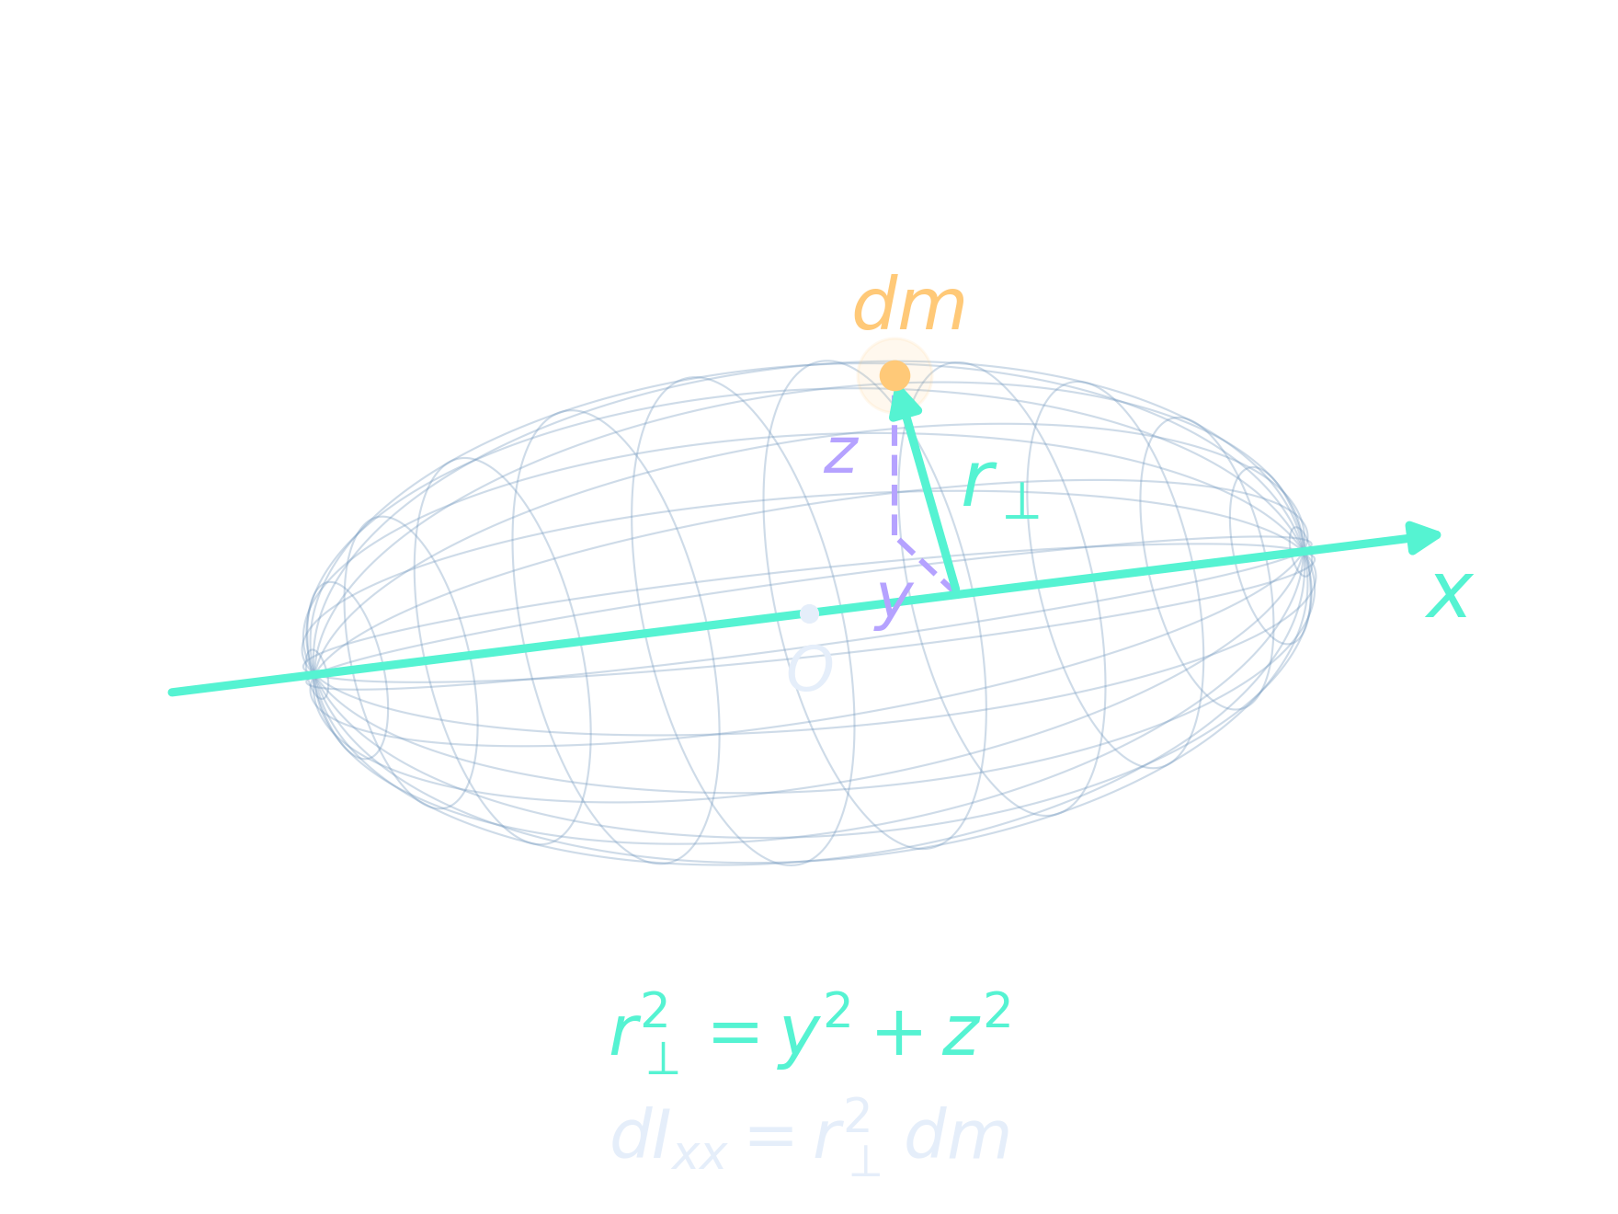
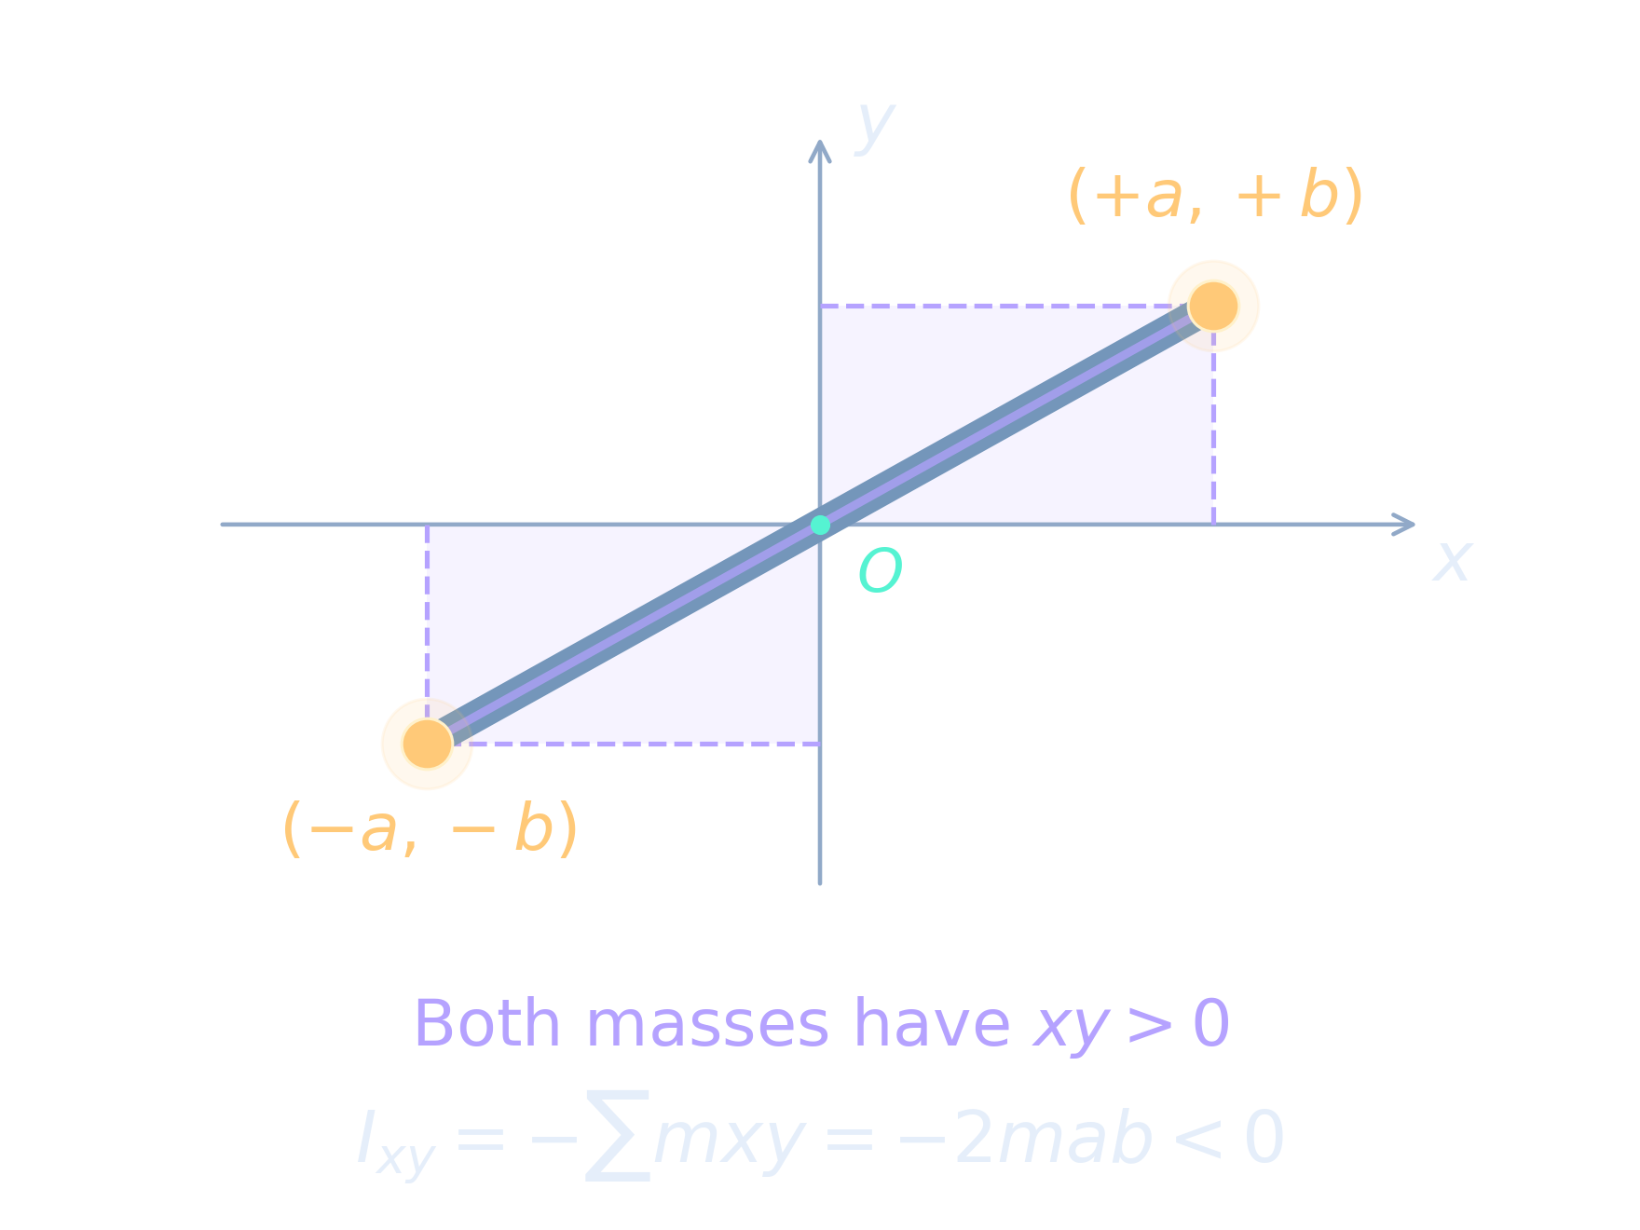
Diagonal terms and cross terms
Cross coupling: rotation about one coordinate axis produces angular momentum along another.
For rotation about \(x\), \(L_y=I_{xy}\omega_x\) and \(L_z=I_{xz}\omega_x\).
These perpendicular contributions arise from the particles’ positions and moment arms.
They may cancel or reinforce, depending on the mass distribution relative to the chosen axes.
Along a principal axis, they cancel, so \(\mathbf L\parallel\boldsymbol{\omega}\).
Diagonal terms measure spread
perpendicular to each axis.
Cross terms describe coupling
in the chosen coordinates.
B1.1 / PRINCIPAL AXES
05
Notes:
Source: supplied B1.1 Principal Axes in Rotational Dynamics course PDF. Convention: Ixy denotes the actual matrix entry, including the minus sign. The PDF matrix sometimes places a separate minus sign before products of inertia. Do not combine the conventions. I is symmetric.
Artwork: AI-generated decorative background, not a physical diagram.
LaTeX equation:
\mathbf I=\begin{pmatrix}I_{xx}&I_{xy}&I_{xz}\\I_{xy}&I_{yy}&I_{yz}\\I_{xz}&I_{yz}&I_{zz}\end{pmatrix}
LaTeX equation:
I_{xx}=\int(y^2+z^2)\,dm\qquad I_{xy}=-\int xy\,dm

Slide 7
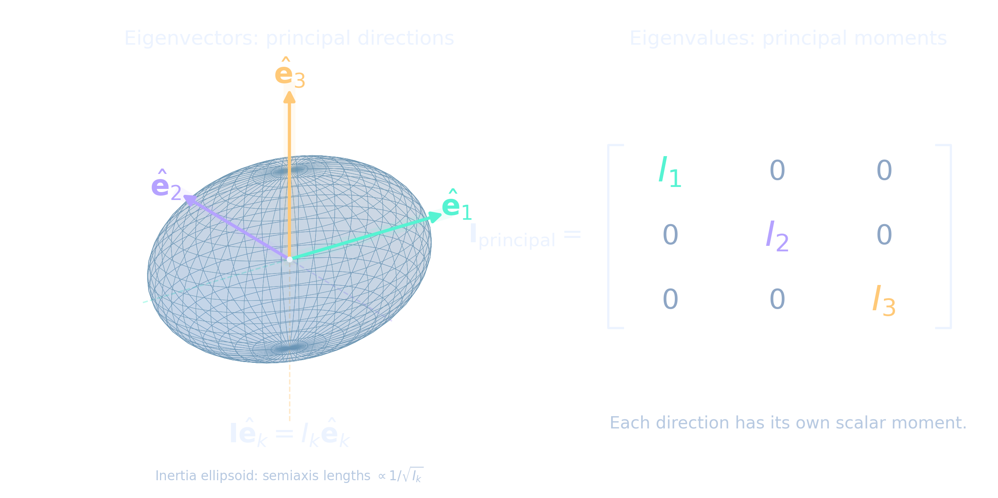

Three orthogonal directions simplify I
Eigenvalues:
Principal moments I₁, I₂, I₃
Eigenvectors:
Principal-axis directions
A real symmetric tensor gives real moments and an orthonormal basis.
B1.1 / PRINCIPAL AXES
06
Notes:
Source: supplied B1.1 Principal Axes in Rotational Dynamics course PDF. The real symmetric inertia tensor admits an orthonormal eigenbasis. For repeated eigenvalues, any orthonormal basis within the corresponding eigenspace works. Nonnegative principal moments follow from I_n = integral r_perp² dm.
Artwork: AI-generated decorative background, not a physical diagram.
LaTeX equation:
\det(\mathbf I-\lambda\mathbf 1)=0

Slide 8
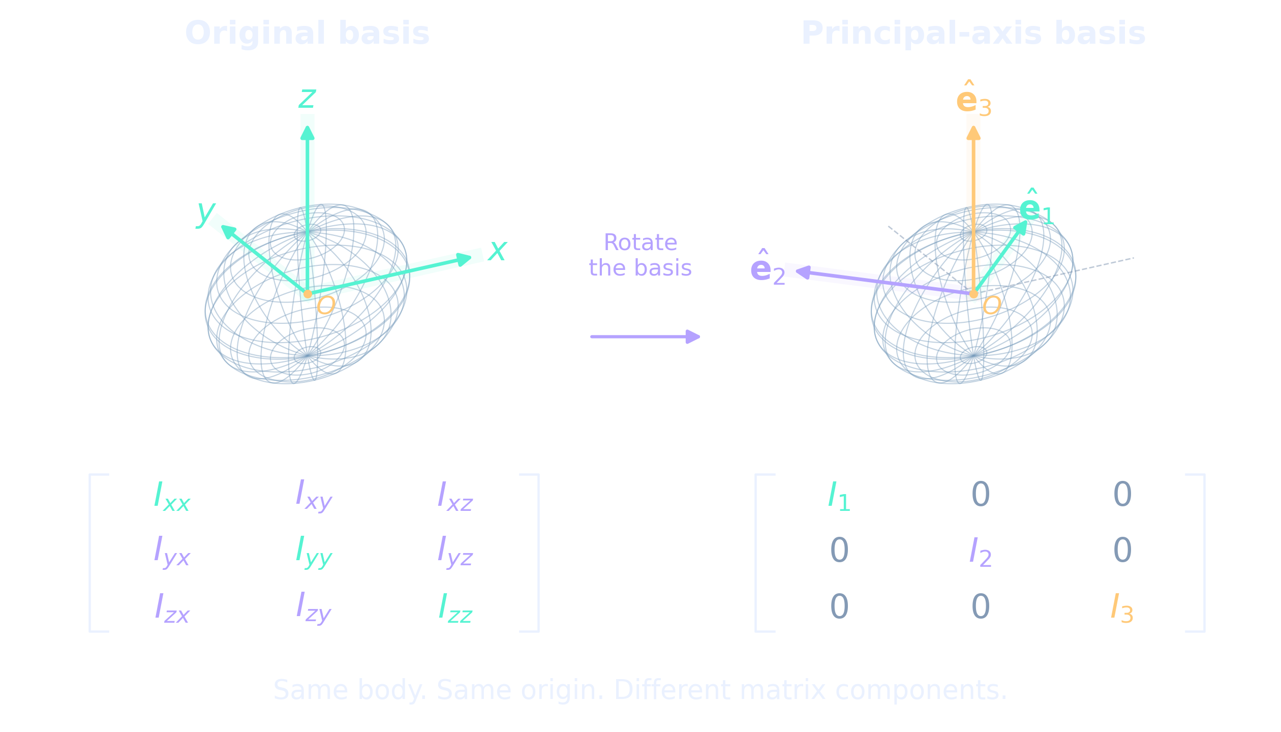



Diagonalization rotates the coordinates
B1.1 / PRINCIPAL AXES
07
Notes:
Source: supplied B1.1 Principal Axes in Rotational Dynamics course PDF. R has principal-axis unit vectors as columns, expressed in the original basis. Choose signs so det R = +1 for a proper rotation. R inverse equals R transpose. The body stays fixed while we change coordinate axes.
Artwork: AI-generated decorative background, not a physical diagram.
LaTeX equation:
\mathbf R=\begin{pmatrix}|&|&|\\\hat{\mathbf e}_1&\hat{\mathbf e}_2&\hat{\mathbf e}_3\\|&|&|\end{pmatrix}\qquad\mathbf R^T\mathbf R=\mathbf1
LaTeX equation:
\mathbf I^{\prime}=\mathbf R^T\mathbf I\mathbf R=\operatorname{diag}(I_1,I_2,I_3)
LaTeX equation:
\mathbf L^{\prime}=\mathbf R^T\mathbf L\qquad\boldsymbol\omega^{\prime}=\mathbf R^T\boldsymbol\omega

Slide 9
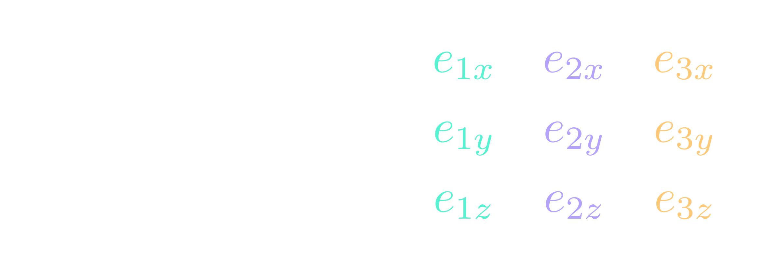
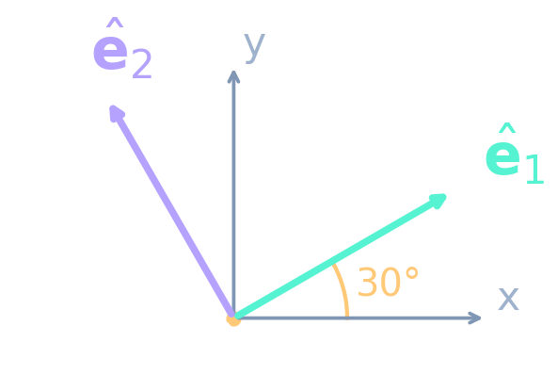
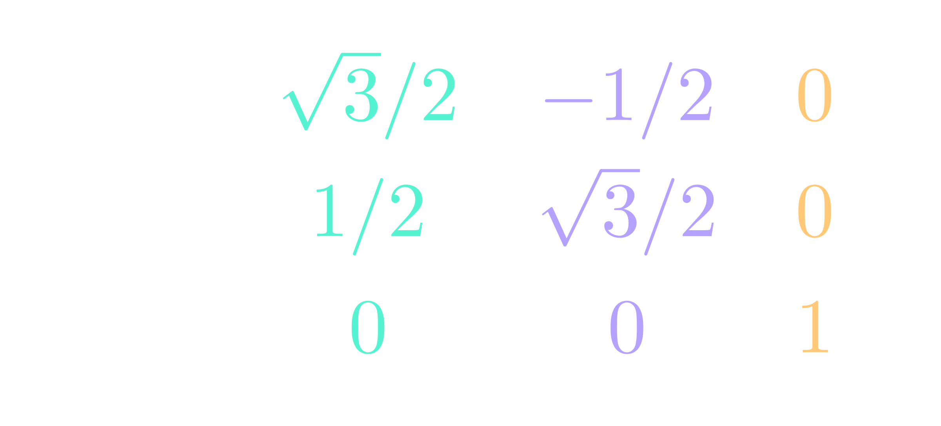

The eigenvectors become the columns of R
Each column contains one unit eigenvector’s original x, y, z components.
Example: principal basis rotated 30° about z
e₃ = z: unchanged and perpendicular to this view
B1.1 / PRINCIPAL AXES
Notes:
Illustrative change of basis with normalized principal eigenvectors as columns. The columns of R are unit principal eigenvectors expressed in the original basis. Choose a right-handed orthonormal set, giving det R = +1. This example assumes the principal basis lies 30 degrees counterclockwise about the old z axis. e1=(sqrt3/2,1/2,0), e2=(−1/2,sqrt3/2,0), e3=(0,0,1). The diagram is a view down +z with z perpendicular to the page. R maps new components to old; R transpose maps old to new. Eigenvalue ordering must match the corresponding column ordering.
Artwork: AI-generated decorative background, not a physical diagram.
LaTeX equation:
\mathbf R=\left(\hat{\mathbf e}_1\ \hat{\mathbf e}_2\ \hat{\mathbf e}_3\right)=\begin{pmatrix}{\color[HTML]{55F3D2}e_{1x}}&{\color[HTML]{B5A2FF}e_{2x}}&{\color[HTML]{FFC978}e_{3x}}\\{\color[HTML]{55F3D2}e_{1y}}&{\color[HTML]{B5A2FF}e_{2y}}&{\color[HTML]{FFC978}e_{3y}}\\{\color[HTML]{55F3D2}e_{1z}}&{\color[HTML]{B5A2FF}e_{2z}}&{\color[HTML]{FFC978}e_{3z}}\end{pmatrix}
LaTeX equation:
\mathbf R=\begin{pmatrix}{\color[HTML]{55F3D2}\sqrt3/2}&{\color[HTML]{B5A2FF}-1/2}&{\color[HTML]{FFC978}0}\\{\color[HTML]{55F3D2}1/2}&{\color[HTML]{B5A2FF}\sqrt3/2}&{\color[HTML]{FFC978}0}\\{\color[HTML]{55F3D2}0}&{\color[HTML]{B5A2FF}0}&{\color[HTML]{FFC978}1}\end{pmatrix}
LaTeX equation:
\mathbf R^T\mathbf R=\mathbf1\qquad\mathbf I^{\prime}=\mathbf R^T\mathbf I\mathbf R=\operatorname{diag}(I_1,I_2,I_3)

Slide 10
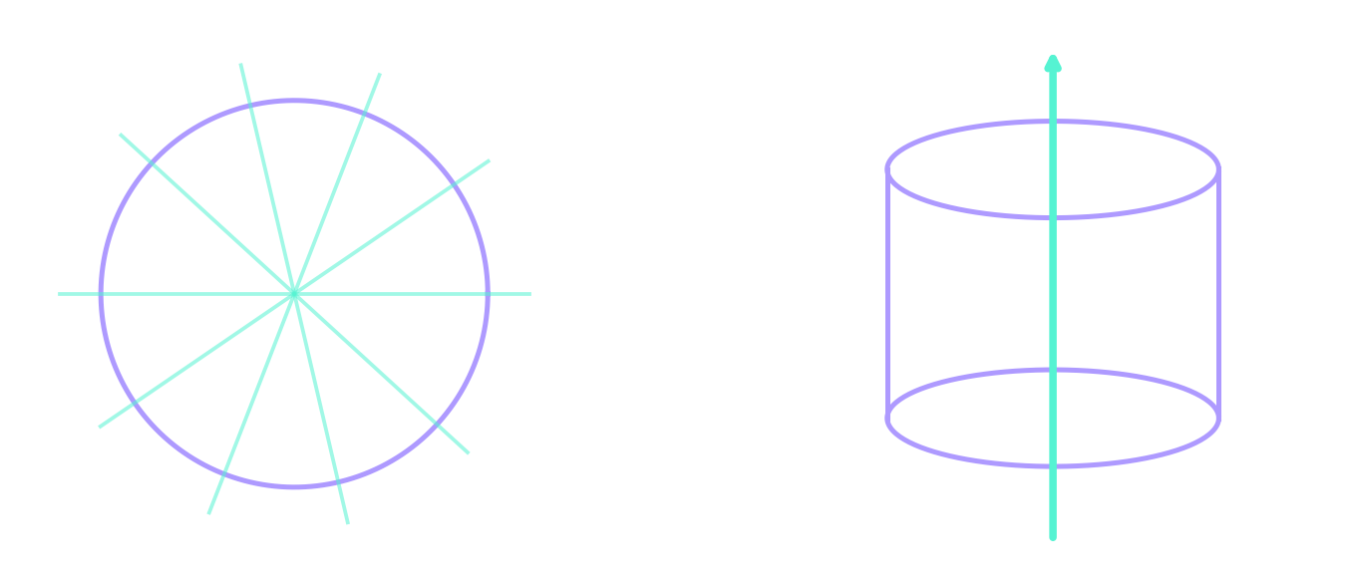
Symmetry can reveal principal axes
Uniform sphere
Axially symmetric body
Every direction is principal.
The symmetry axis is principal.
B1.1 / PRINCIPAL AXES
08
Notes:
Source: supplied B1.1 Principal Axes in Rotational Dynamics course PDF. For a uniform sphere about its center, every direction is principal. For an axially symmetric body at its CM, the symmetry axis is principal and every perpendicular direction is principal. Degenerate eigenvalues allow freedom within the perpendicular plane.
Artwork: AI-generated decorative background, not a physical diagram.

Slide 11

Equal moments leave no preferred direction
For I = 8 1 kg m², every direction is an eigenvector.
Numerical software returns one possible orthonormal set.
B1.1 / PRINCIPAL AXES
09
Notes:
Source: supplied B1.1 Principal Axes in Rotational Dynamics course PDF. Clarification of the cube-corner example: four equal masses m=1 kg at (1,1,1), (1,−1,−1), (−1,1,−1), (−1,−1,1) metres yield I=8 identity kg m². These are four alternating cube vertices. The PDF does not expose its source code or coordinates, so this is an explicit illustrative realization of its reported tensor.
Artwork: AI-generated decorative background, not a physical diagram.
LaTeX equation:
\mathbf I=I_0\mathbf1\quad\Longrightarrow\quad\mathbf I\hat{\mathbf n}=I_0\hat{\mathbf n}

Slide 12

Box 1: axes hidden in a matrix
Which axis is already principal?
How must the x- and x-axes rotate to become principal axes?
Predict the geometry before calculating.
B1.1 / PRINCIPAL AXES
10
Notes:
Source: supplied B1.1 Principal Axes in Rotational Dynamics course PDF. Box 1. Pause here. The xy block couples x and y while z is decoupled. Ask students to identify an eigenvector before finding any eigenvalues.
Artwork: AI-generated decorative background, not a physical diagram.
LaTeX equation:
\mathbf I=\begin{pmatrix}4&1&0\\1&3&0\\0&0&2\end{pmatrix}\ \mathrm{kg\,m^2}

Slide 13


The moments come from the eigenvalues
All moments in kg m². The z direction has I₁ = 2.
B1.1 / PRINCIPAL AXES
11
Notes:
Source: supplied B1.1 Principal Axes in Rotational Dynamics course PDF. Box 1 solution. det(I−lambda identity)=(2−lambda)[(4−lambda)(3−lambda)−1]. The principal moments have units kg m². They are positive and obey the inertia triangle inequality.
Artwork: AI-generated decorative background, not a physical diagram.
LaTeX equation:
(2-\lambda)(\lambda^2-7\lambda+11)=0
LaTeX equation:
I_1=2,\quad I_2=\frac{7-\sqrt5}{2}\approx2.382,\quad I_3=\frac{7+\sqrt5}{2}\approx4.618

Slide 14
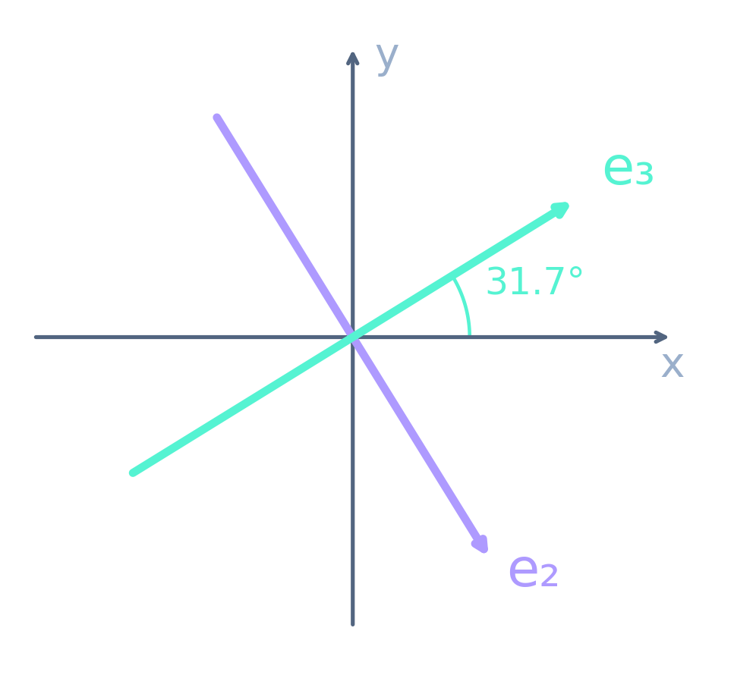

The other axes rotate within the xy plane
e₁ lies along z.
e₂ and e₃ form a perpendicular pair
in the xy plane.
B1.1 / PRINCIPAL AXES
12
Notes:
Source: supplied B1.1 Principal Axes in Rotational Dynamics course PDF. The eigenvector signs differ from one possible numerical output but define the same axes. Here the columns form a right-handed basis. e3 is 31.717 degrees counterclockwise from +x. e2 is perpendicular. z remains e1.
Artwork: AI-generated decorative background, not a physical diagram.
LaTeX equation:
\hat{\mathbf e}_1=\begin{pmatrix}0\\0\\1\end{pmatrix},\quad\hat{\mathbf e}_2=\begin{pmatrix}0.526\\-0.851\\0\end{pmatrix},\quad\hat{\mathbf e}_3=\begin{pmatrix}0.851\\0.526\\0\end{pmatrix}

Slide 15

A new basis reveals the principal moments
No cross terms
Lₖ = Iₖωₖ
ω can still have components
along all three axes.
B1.1 / PRINCIPAL AXES
13
Notes:
Source: supplied B1.1 Principal Axes in Rotational Dynamics course PDF. I prime = diag(2,2.381966,4.618034) in the principal basis. Angular momentum components are Lk = Ik omega_k. Diagonal does not mean that omega has only one nonzero component.
Artwork: AI-generated decorative background, not a physical diagram.
LaTeX equation:
\mathbf I^{\prime}=\begin{pmatrix}2&0&0\\0&2.382&0\\0&0&4.618\end{pmatrix}\ \mathrm{kg\,m^2}

Slide 16
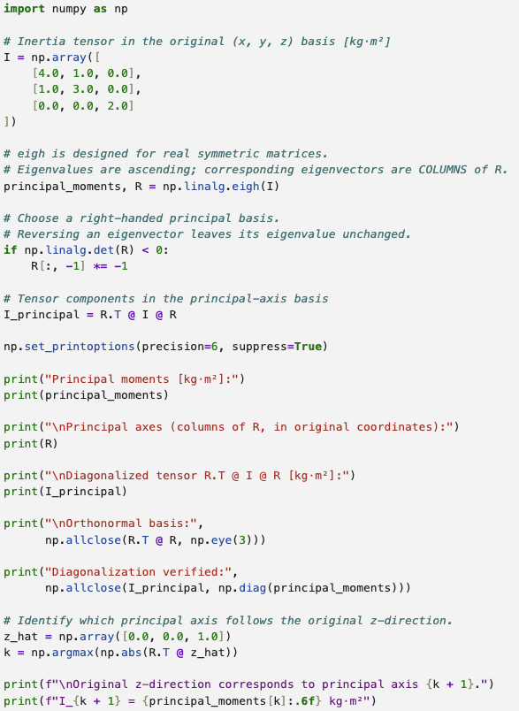
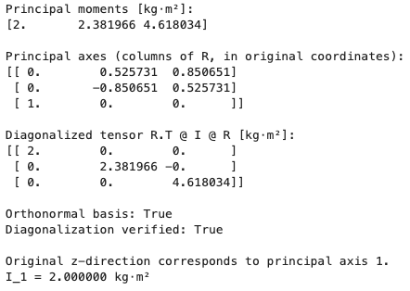
B1.1 / PRINCIPAL AXES
15
Notes:
Source: supplied B1.1 Principal Axes in Rotational Dynamics course PDF. Use numpy.linalg.eigh for a real symmetric matrix. Eigenvectors are columns, eigenvalues ascending. Eigenvector signs can change without changing the axes. Check that R transpose I R equals diag(values) and R transpose R equals identity. For a proper rotation, flip one column if det R is negative.
Artwork: AI-generated decorative background, not a physical diagram.

Slide 17

A pure spin can still be unstable
Smallest moment
Intermediate moment
Largest moment
Stable
Unstable
Stable
Torque-free rotation, distinct moments, small disturbances.
B1.1 / PRINCIPAL AXES
14
Notes:
Source: supplied B1.1 Principal Axes in Rotational Dynamics course PDF. Correction to the source summary and Box 1: for distinct principal moments I1<I2<I3, torque-free spins about smallest and largest moments are stable to small angular-velocity perturbations. The intermediate-axis spin is unstable. Exact rotation about each principal axis is possible. This concerns ideal rigid-body dynamics without dissipation.
Artwork: AI-generated decorative background, not a physical diagram.
LaTeX equation:
I_1<I_2<I_3

