Slide 1

ROTATIONAL
ENERGY
The geometry behind kinetic energy
Advanced rotational dynamics
B1.2 / ROTATIONAL ENERGY
01
Notes:
Source: supplied B1.2 Kinetic Energy in Rotational Dynamics course PDF. Introduce how the mass distribution and rotation direction determine energy.
Artwork: AI-generated decorative background, not a physical diagram.

Slide 2
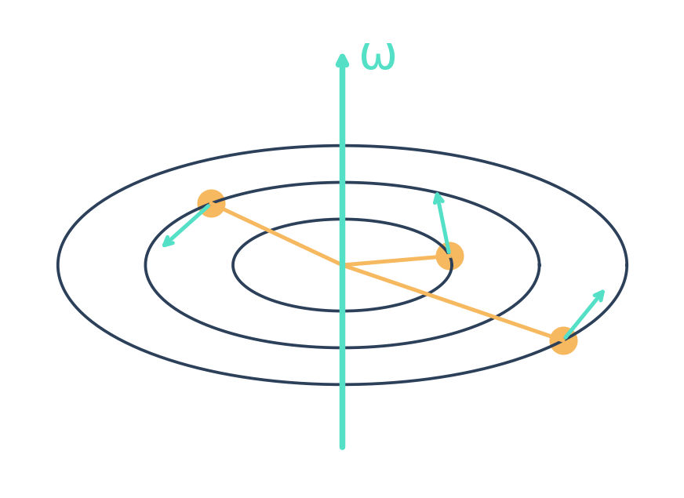
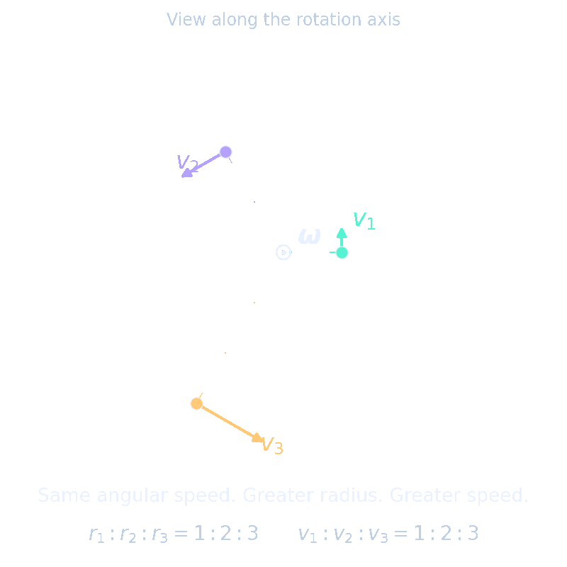
The same spin can carry different energy
Mass farther from the axis moves faster.
At fixed angular speed, moving mass outward raises kinetic energy.
At the same angular speed, kinetic energy depends on the rotation axis.
B1.2 / ROTATIONAL ENERGY
02
Notes:
Source: supplied B1.2 Kinetic Energy in Rotational Dynamics course PDF. Ask students to compare a rod spinning about its long axis with rotation about an axis through its center perpendicular to its length. Hold angular speed fixed.
Artwork: AI-generated decorative background, not a physical diagram.

Slide 3


Every mass element contributes
One rigid body shares ω. Each point has its own vᵢ.
B1.2 / ROTATIONAL ENERGY
03
Notes:
Source: supplied B1.2 Kinetic Energy in Rotational Dynamics course PDF. Use a fixed point O in an inertial frame for pure rotation. Alternatively, positions and velocities may be relative to the center of mass.
Artwork: AI-generated decorative background, not a physical diagram.
LaTeX equation:
\mathbf{v}_i=\boldsymbol{\omega}\times\mathbf{r}_i
LaTeX equation:
T=\frac{1}{2}\sum_i m_i\left|\boldsymbol{\omega}\times\mathbf{r}_i\right|^2

Slide 4


The tensor collects the geometry
The inertia tensor describes mass geometry.
Angular velocity describes rotation.
For continuous matter, replace the sum with an integral.
B1.2 / ROTATIONAL ENERGY
04
Notes:
Source: supplied B1.2 Kinetic Energy in Rotational Dynamics course PDF. Derive from the cross product identity. The tensor components shown use the convention Ixy = −Σ mxy. Replace sums by integrals for a continuous body.
Artwork: AI-generated decorative background, not a physical diagram.
LaTeX equation:
|\boldsymbol{\omega}\times\mathbf{r}|^2=\omega^2r^2-(\boldsymbol{\omega}\cdot\mathbf{r})^2
LaTeX equation:
I_{ab}=\sum_i m_i(r_i^2\delta_{ab}-r_{ia}r_{ib})

Slide 5


Rotational energy is a quadratic form
Off-diagonal terms couple angular-velocity components.
B1.2 / ROTATIONAL ENERGY
05
Notes:
Source: supplied B1.2 Kinetic Energy in Rotational Dynamics course PDF. I is symmetric, so the off-diagonal terms occur twice inside one half omega transpose I omega. Energy is a scalar and is independent of the coordinate basis.
Artwork: AI-generated decorative background, not a physical diagram.
LaTeX equation:
T=\frac{1}{2}\boldsymbol{\omega}^{T}\mathbf{I}\boldsymbol{\omega}
LaTeX equation:
T=\frac{1}{2}(I_{xx}\omega_x^2+I_{yy}\omega_y^2+I_{zz}\omega_z^2)+I_{xy}\omega_x\omega_y+I_{xz}\omega_x\omega_z+I_{yz}\omega_y\omega_z

Slide 6

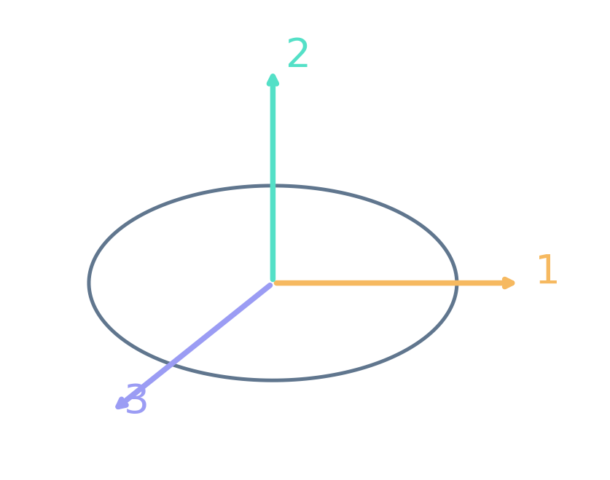
Principal axes remove the cross terms
In a principal-axis basis, each component
contributes ½Iₖωₖ².
Rotation about one principal axis leaves one term.
B1.2 / ROTATIONAL ENERGY
06
Notes:
Source: supplied B1.2 Kinetic Energy in Rotational Dynamics course PDF. A principal-axis basis diagonalizes the symmetric inertia tensor. The angular velocity may still have all three components. A diagonal tensor does not require rotation about only one principal axis.
Artwork: AI-generated decorative background, not a physical diagram.
LaTeX equation:
T=\frac{1}{2}(I_1\omega_1^2+I_2\omega_2^2+I_3\omega_3^2)

Slide 7


A scalar inertia belongs to a chosen axis
Iₙ measures mass spread perpendicular to the axis.
The axis need not be a principal axis.
B1.2 / ROTATIONAL ENERGY
07
Notes:
Source: supplied B1.2 Kinetic Energy in Rotational Dynamics course PDF. This scalar reduction is valid for pure instantaneous rotation about any specified axis through the chosen origin. For nonprincipal axes, angular momentum need not be parallel to angular velocity.
Artwork: AI-generated decorative background, not a physical diagram.
LaTeX equation:
\boldsymbol{\omega}=\omega\hat{\mathbf{n}}\qquad I_{\hat n}=\hat{\mathbf{n}}^{T}\mathbf{I}\hat{\mathbf{n}}
LaTeX equation:
T=\frac{1}{2}I_{\hat n}\omega^2

Slide 8


Angular momentum gives another route
Only the component of L along ω enters the energy.
B1.2 / ROTATIONAL ENERGY
08
Notes:
Source: supplied B1.2 Kinetic Energy in Rotational Dynamics course PDF. L and omega must refer to the same origin and frame as I. The dot product includes the angle between them. In general, L is not parallel to omega.
Artwork: AI-generated decorative background, not a physical diagram.
LaTeX equation:
\mathbf{L}=\mathbf{I}\boldsymbol{\omega}\qquad T=\frac{1}{2}\boldsymbol{\omega}\cdot\mathbf{L}
LaTeX equation:
T=\frac12\omega L\cos\theta

Slide 9

Translation and rotation separate at the CM
The center of mass carries translational energy.
Motion about the center of mass carries rotational energy.
B1.2 / ROTATIONAL ENERGY
09
Notes:
Source: supplied B1.2 Kinetic Energy in Rotational Dynamics course PDF. For general rigid-body motion, use the center-of-mass decomposition. No cross term survives because Σ m r relative to the center of mass equals zero.
Artwork: AI-generated decorative background, not a physical diagram.
LaTeX equation:
T=\frac{1}{2}Mv_{\mathrm{CM}}^2+\frac{1}{2}\boldsymbol{\omega}^{T}\mathbf{I}_{\mathrm{CM}}\boldsymbol{\omega}

Slide 10
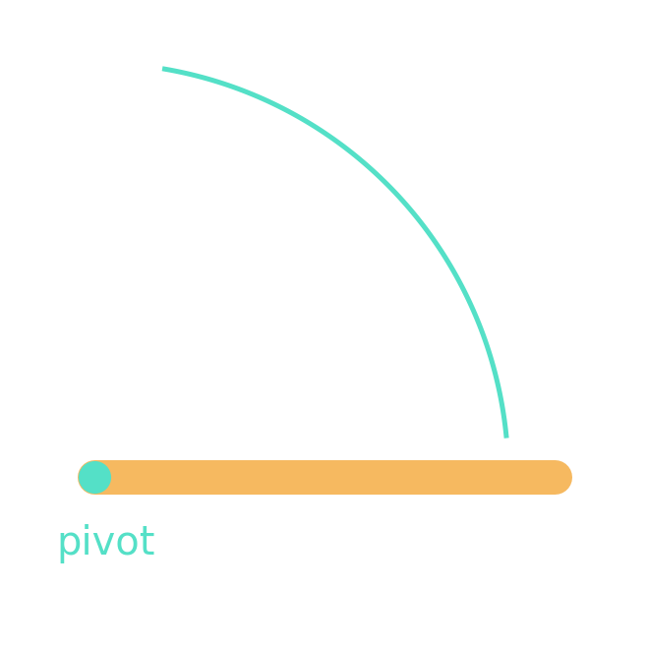

A rod rotating about one end
Uniform thin rod
Doubling the length at fixed M and ω
quadruples the energy.
B1.2 / ROTATIONAL ENERGY
10
Notes:
Source: supplied B1.2 Kinetic Energy in Rotational Dynamics course PDF. Box 1. Uniform thin rod, axis through one end and perpendicular to its length. Derive I = integral from 0 to ell of x²(M/ell) dx. At the same omega this energy is four times the energy for a parallel axis through the center.
Artwork: AI-generated decorative background, not a physical diagram.
LaTeX equation:
I_{\mathrm{end}}=\frac{1}{3}M\ell^2\qquad T=\frac{1}{6}M\ell^2\omega^2

Slide 11

Box 2: energy from a tensor
1 Find L = Iω.
2 Calculate the kinetic energy.
3 Are L and ω parallel?
B1.2 / ROTATIONAL ENERGY
11
Notes:
Source: supplied B1.2 Kinetic Energy in Rotational Dynamics course PDF. Box 2. Pause before advancing. Ask students to calculate L, compute T in two ways, and decide whether omega and L are parallel.
Artwork: AI-generated decorative background, not a physical diagram.
LaTeX equation:
\mathbf{I}=\mathrm{diag}(3,2,1)\ \mathrm{kg\,m^2}\qquad\boldsymbol{\omega}=(1,2,3)\ \mathrm{rad/s}

Slide 12

What stays fixed changes the answer
Fixed angular speed
Fixed angular momentum magnitude
Larger inertia gives larger energy.
Along a principal axis, larger inertia
gives smaller energy.
B1.2 / ROTATIONAL ENERGY
13
Notes:
Source: supplied B1.2 Kinetic Energy in Rotational Dynamics course PDF. Clarification to Box 3: compare orientations of a fixed rigid body at fixed angular momentum vector in space, equivalently fixed magnitude with variable direction in body coordinates. A fixed tensor and a fully specified L in the same coordinates uniquely determine omega, leaving no minimization.
Artwork: AI-generated decorative background, not a physical diagram.
LaTeX equation:
T=\frac{1}{2}I_{\hat n}\omega^2
LaTeX equation:
T=\frac{L^2}{2I_k}

Slide 13


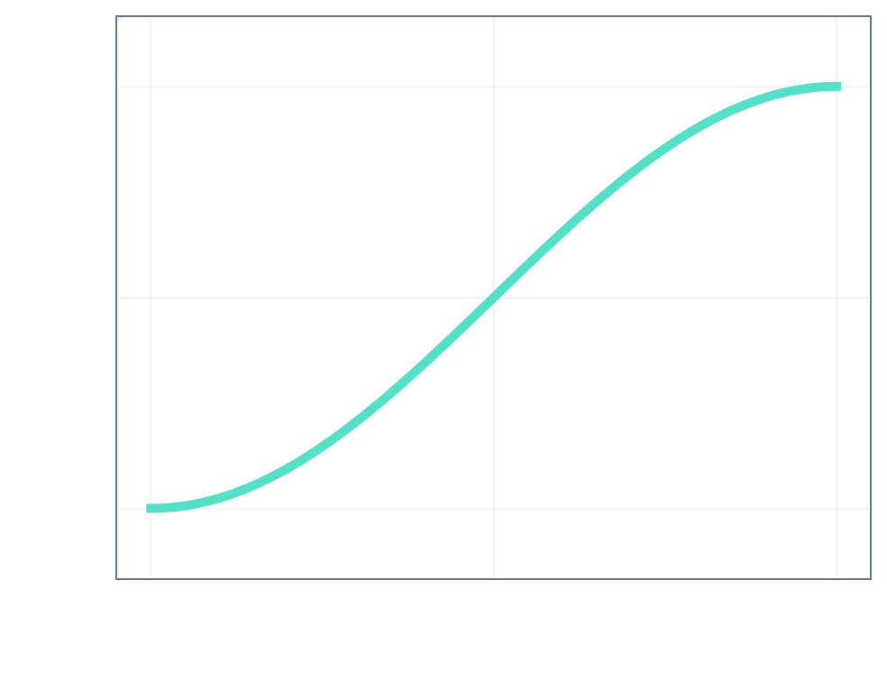
Minimum energy selects the largest inertia
Minimum: rotation about the
principal axis with Imax.
Example: L = 6, Imax = 3, Imin = 1 (SI)
B1.2 / ROTATIONAL ENERGY
14
Notes:
Source: supplied B1.2 Kinetic Energy in Rotational Dynamics course PDF. For positive definite inertia and fixed |L|, the Rayleigh quotient gives the bounds. Equality at Imax minimizes energy. Other principal axes are stationary directions, not all minima. For torque-free ideal motion both T and L are conserved, so a body does not spontaneously relax to the minimum.
Artwork: AI-generated decorative background, not a physical diagram.
LaTeX equation:
T=\frac{1}{2}\mathbf{L}^{T}\mathbf{I}^{-1}\mathbf{L}=\frac{1}{2}\sum_k\frac{L_k^2}{I_k}
LaTeX equation:
\frac{L^2}{2I_{\max}}\leq T\leq\frac{L^2}{2I_{\min}}

Slide 14
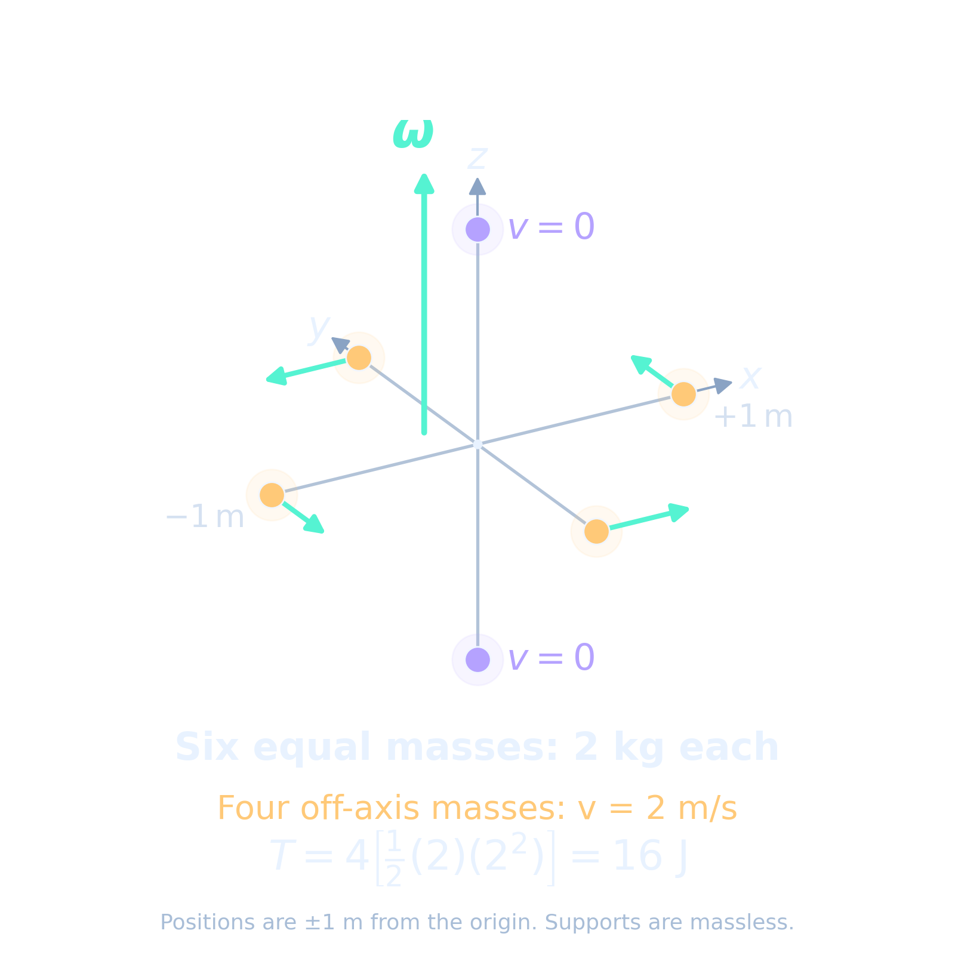


Point masses give a direct numerical check
Six 2 kg masses at ±1 m on the x, y and z axes.
B1.2 / ROTATIONAL ENERGY
15
Notes:
Source: supplied B1.2 Kinetic Energy in Rotational Dynamics course PDF. Illustrative reconstruction consistent with the PDF’s reported I=8 identity and T=16 output. Six masses, each 2 kg, at ±1 m on each coordinate axis. The PDF does not expose the Python source. Units are SI.
Artwork: AI-generated decorative background, not a physical diagram.
LaTeX equation:
\mathbf I=8\mathbf1\ \mathrm{kg\,m^2}\qquad\boldsymbol\omega=(0,0,2)\ \mathrm{rad/s}
LaTeX equation:
T=16\ \mathrm{J}

Slide 15
The essential relationships
The tensor carries geometry. The dot product gives energy.
At fixed |L|, the largest principal inertia gives the least energy.
B1.2 / ROTATIONAL ENERGY
16
Notes:
Source: supplied B1.2 Kinetic Energy in Rotational Dynamics course PDF. Exit prompt: explain why the same rigid body can have different kinetic energies at the same angular speed. Then ask which principal axis minimizes energy at fixed |L|.
Artwork: AI-generated decorative background, not a physical diagram.
LaTeX equation:
T=\frac{1}{2}\boldsymbol{\omega}^{T}\mathbf{I}\boldsymbol{\omega}
LaTeX equation:
\mathbf{L}=\mathbf{I}\boldsymbol{\omega}\qquad T=\frac{1}{2}\boldsymbol{\omega}\cdot\mathbf{L}

