Slide 1
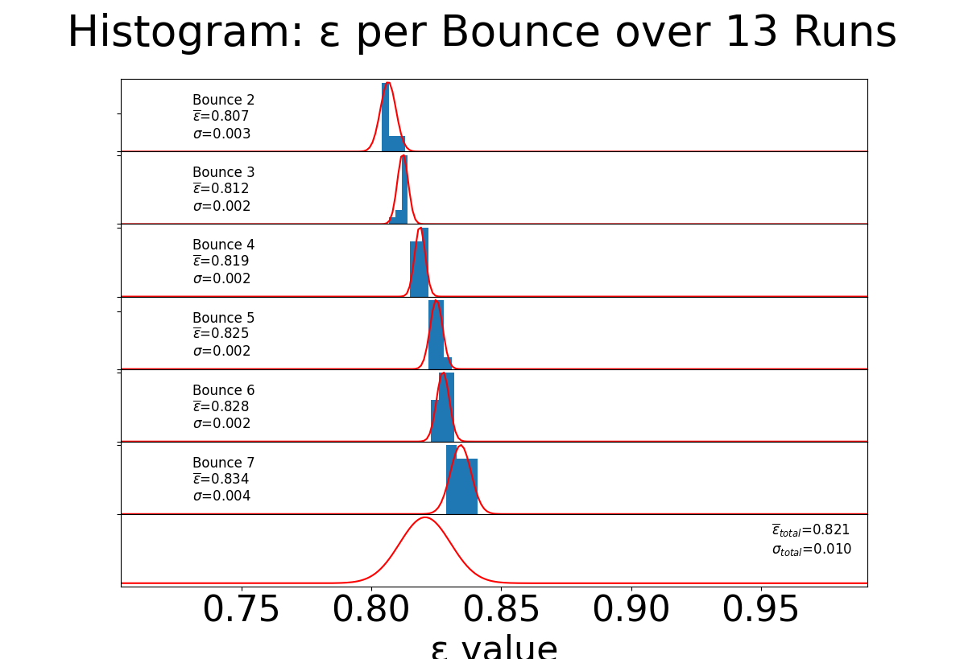

Number of Occurrences
Total
$$ε value$$

