Slide 1
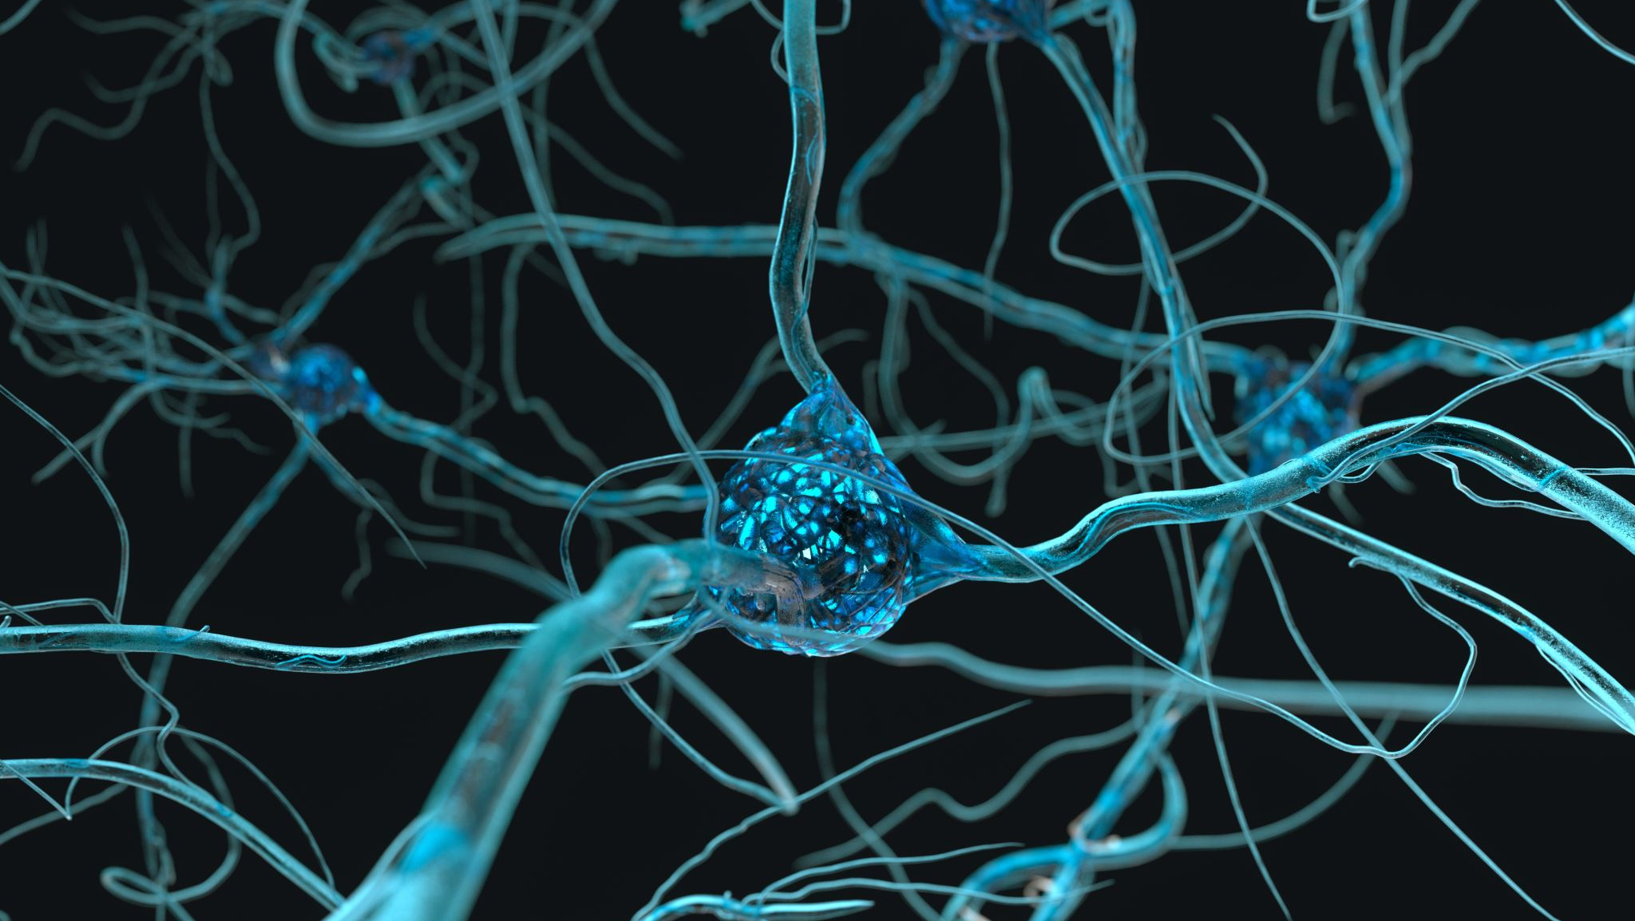
Neural Networks for Classification and Regression

Slide 2
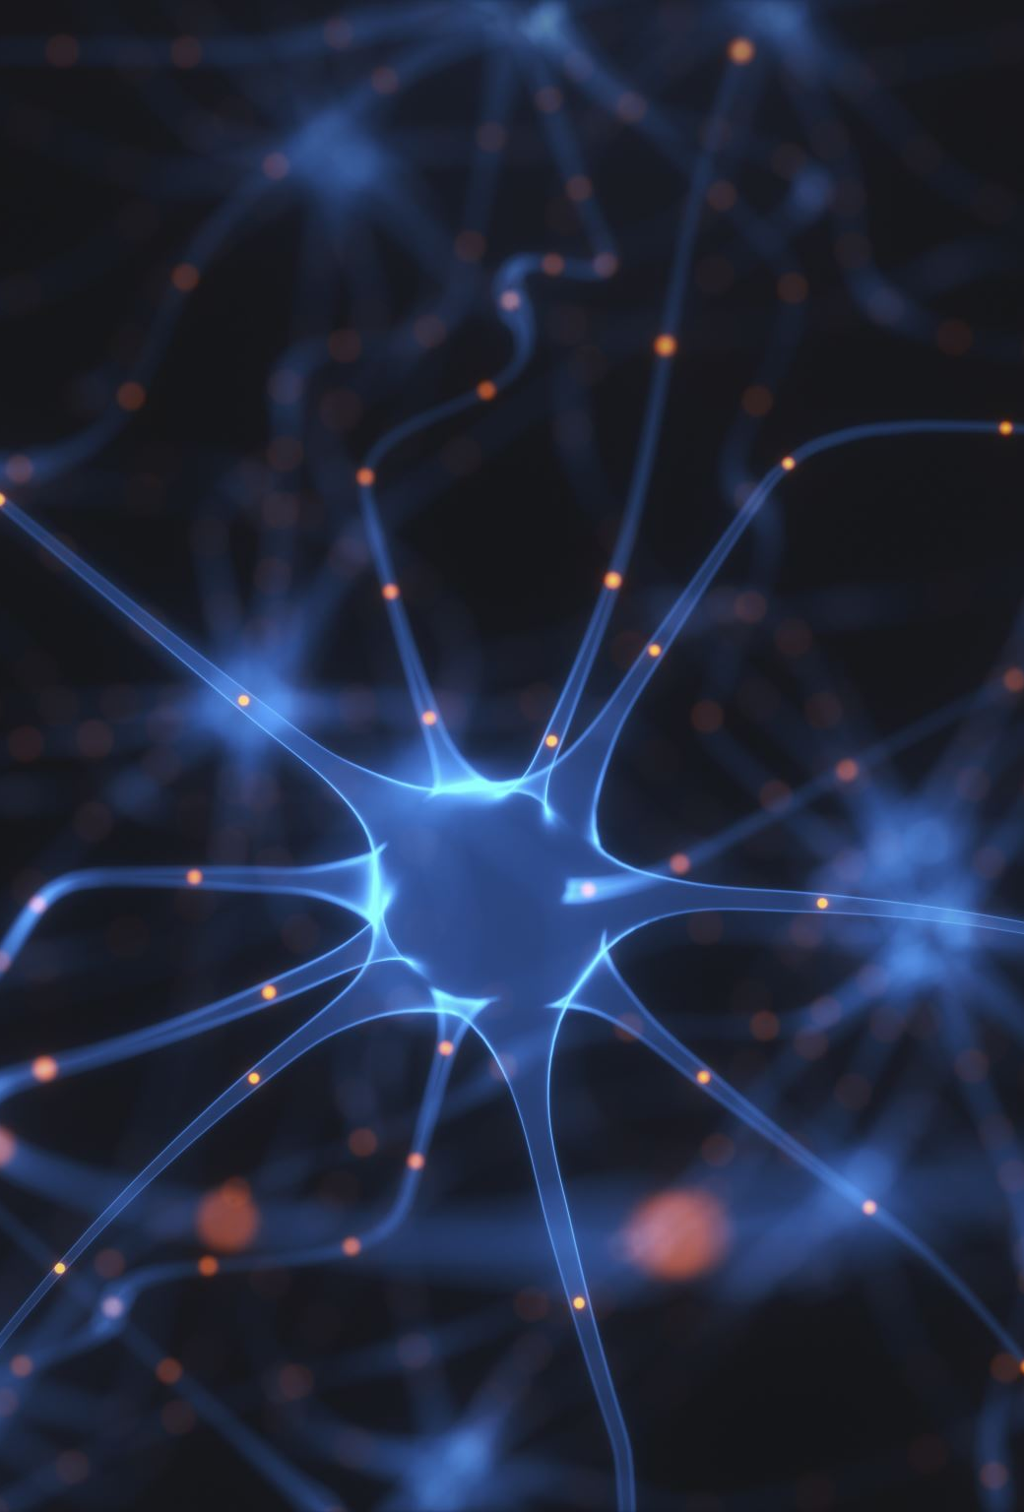
What do we need to know?
A neural network is a machine learning model inspired by the human brain. It consists of layers of artificial neurons that process information and learn patterns from data.
Key Components:
Neurons (Nodes): Basic processing units that apply mathematical functions.
Layers:
Input Layer: Receives raw data (e.g., images, text, or numerical data).
Hidden Layers: Perform computations using weights and activation functions.
Output Layer: Produces final predictions or classifications.

Slide 3
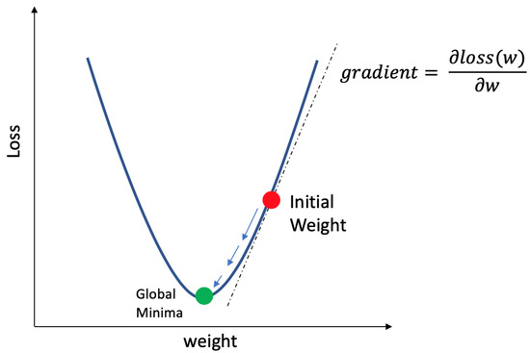

Problem X: Rendering Shapes
I wanted you to gain some understand how neural networks minimize a loss function to transform data
$$θ_{new}=θ_{old}−lr ∇_{θ}ℒ$$
Where lr is the learning rate, which influences convergence speed

Slide 4
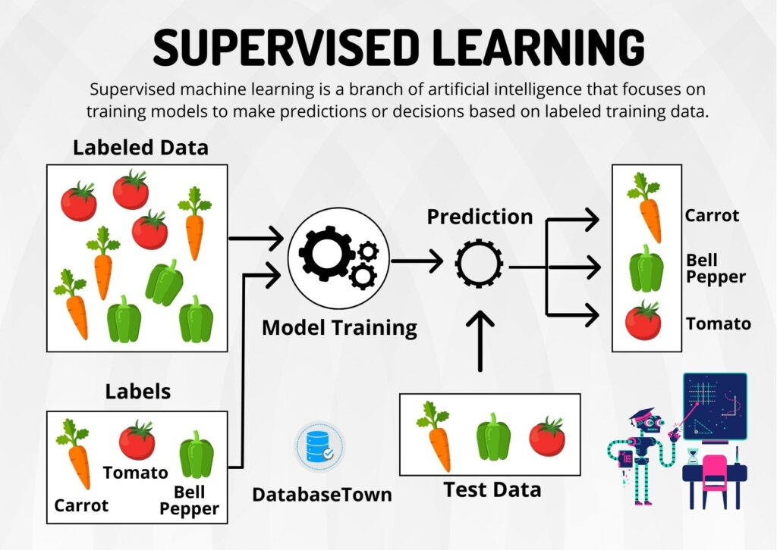
Supervised Learning
Supervised Learning: Trains a model on labeled data
Types
Classifications: Predict categories
Regression: Predict continuous values
Inputs = features
Outputs = labels (when training)

Slide 5
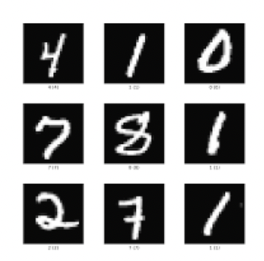
Classification Tasks
Input: 8x8 grayscale images of handwritten digits
Output: Predicted digit (0-9)
Model: Feedforward Neural Network
Input layer: 64 neurons
Hidden layer: 1 or more layers with ReLU activations
Output layer: 10 neurons + softmax (for probability)
Loss Function: Cross-Entropy Loss

Slide 6
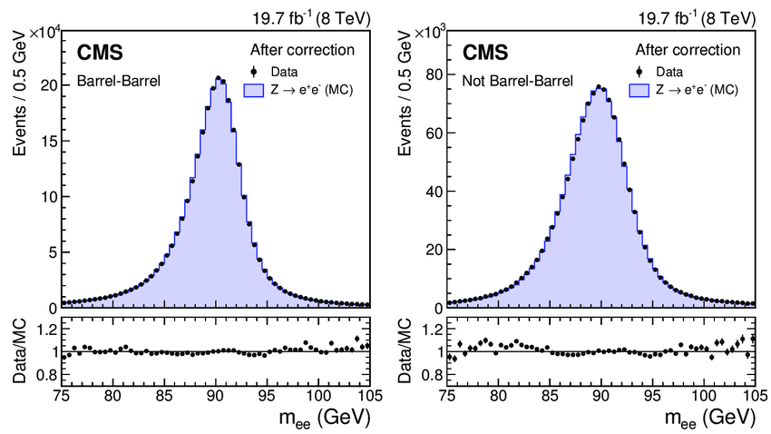


Regression Task - $Z→e^{+}e^{−}$ Decays
Input: Kinematic features of electron and position ($p_{t}, η, φ$)
Output: Predicted invariant mass of Z boson
Model: Feedforward Neural Network
Input: 6 features
Hidden layers: ReLU activations
Output: mass
Loss function: Mean Squared Error (MSE)

Slide 7
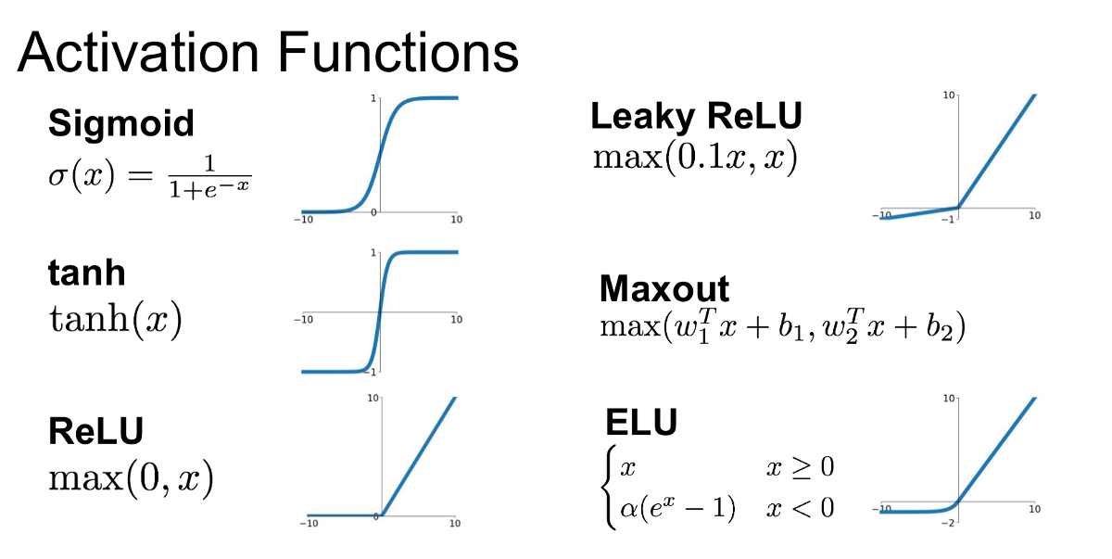

Activation Functions
ReLU:
$$f\left(x\right)=\max\left(0,x\right)$$
Introduces non-linearity
Helps model complex problems

Slide 8
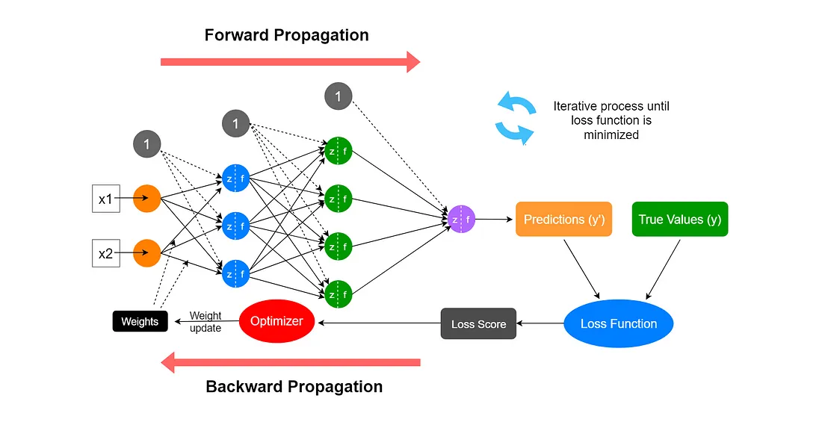
Training a Neural Network
Forward pass computes output from a batch of inputs
Compute loss and compare predictions to targets (known outcomes)
Backward pass computes gradients using backpropagation
Optimizer updates weights
Repeat for many epochs until loss decreases

Slide 9
Scikit-learn and Pytorch
Feature | scikit-learn | PyTorch
Ease of use | High (great for beginners) | Medium (more manual setup)
Customization | Low | High (fully flexible)
Neural networks | Basic (via MLPClassifier) | Full deep learning framework
GPU acceleration | No | Yes
Great for... | Classical ML, quick protos | Deep learning, full control

Slide 10
When to Use What?
scikit-learn
pytorch
Fast prototyping with standard models
Working with small and medium tabular data
Custom model architectures
Working with deep learning or large datasets
Want to explore the internal parameters of training

