Slide 1
Monte Carlo Methods

Slide 2
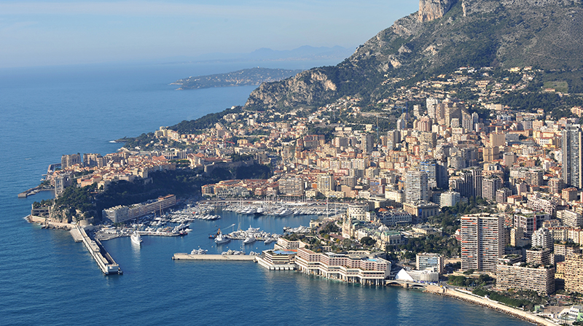
Monte Carlo Methods
Any method which solves a problem by generating suitable random numbers and observing that fraction of the numbers obeying some property or properties.
The method is useful for obtaining numerical solutions to problems which are too complicated to solve analytically.
So, we better know how to draw random numbers

Slide 3

Roadmap
Topics for this Section
Random number generators
Rejection sampling
The Metropolis algorithm --------
Monte Carlo Integration
Importance Sampling

Slide 4

Random Number Generators
Random number generators allow the user to draw pseudo random numbers from known distributions, P(x):
Uniform
Gaussian (Normal)
Exponential
Randomness can be a tool to solve deterministic problems
For example, simulating thermal fluctuations is essential to accurately modeling systems in statistical mechanics

Slide 5
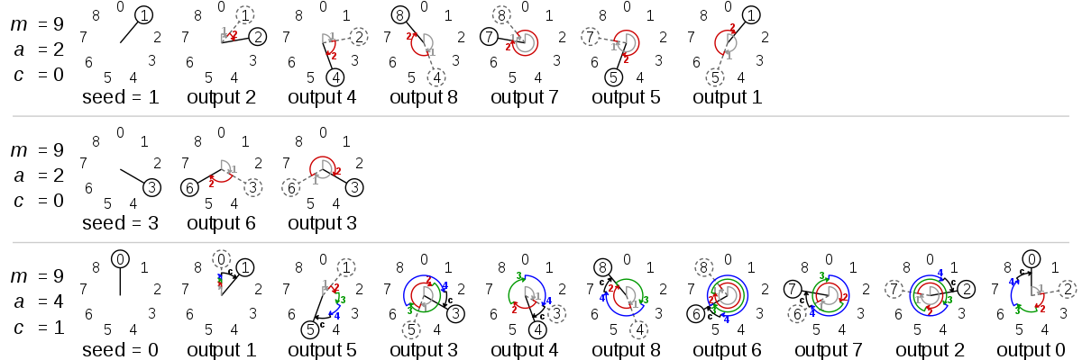

LCGs
Every random number generator produces pseudorandom numbers and thus needs a “starting point” – a seed
The most basic generator is the Linear Congruential Random Number Generator
$$r^{′}=\left(a r+c\right)mod m$$
The 'seed' being x. The numbers c, a, and m being parameters.
Optimal parameters set by Hull-Dobell Theorem

Slide 6

Limitations on LCGs/PRNGs in general
Short Cycle – poor choices of parameters can result in short periods
Correlations – some parameters lead to correlated numbers skewing scientific results
Determinism – knowing one number can revel the entire sequence

Slide 7
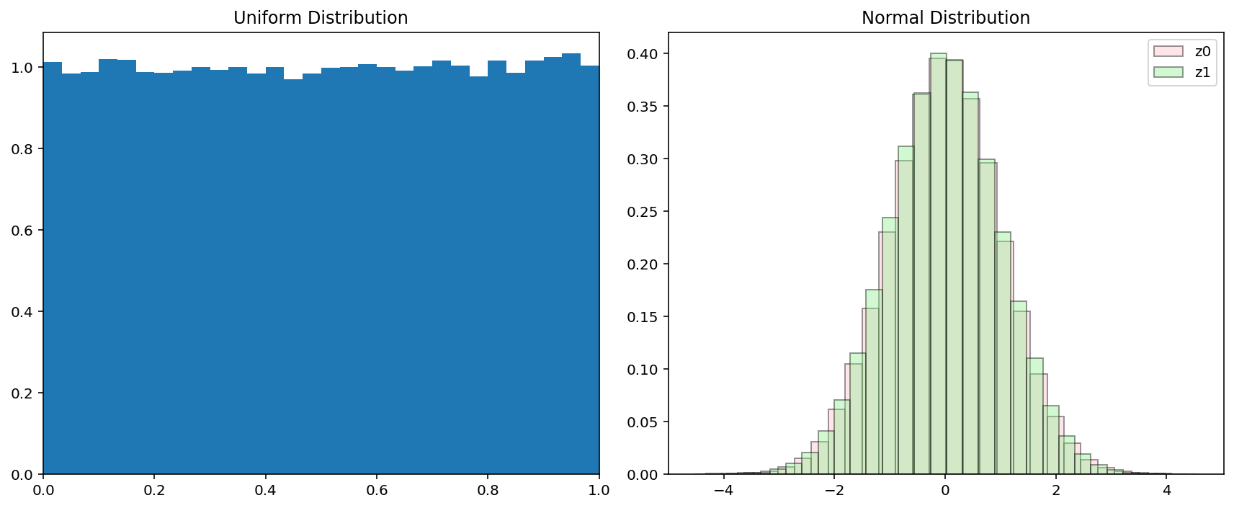
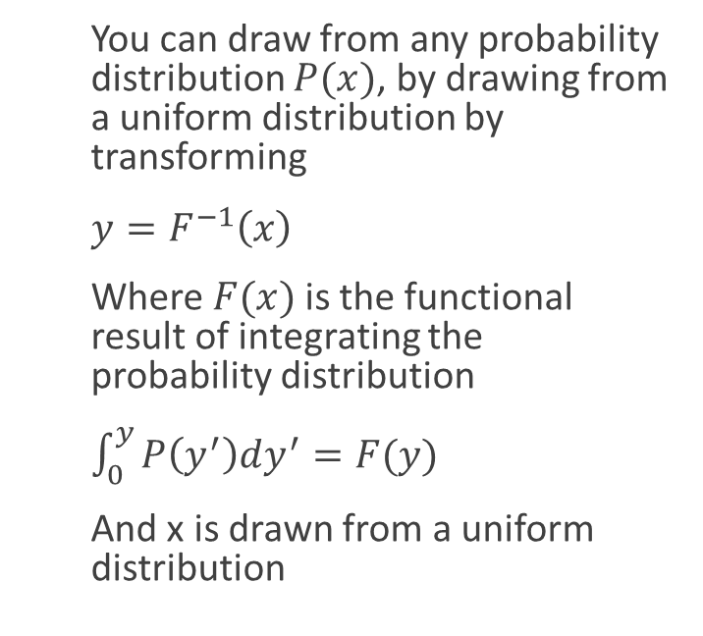
Non-Uniform Random Numbers
You can draw from any probability distribution $P(x)$, by drawing from a uniform distribution by transforming
$y=F^{−1}\left(x\right)$
Where $F(x)$is the functional result of integrating the probability distribution
$\int_{0}^{y}{P\left(y^{′}\right)dy^{′}=F(y)}$
And x is drawn from a uniform distribution

Slide 8
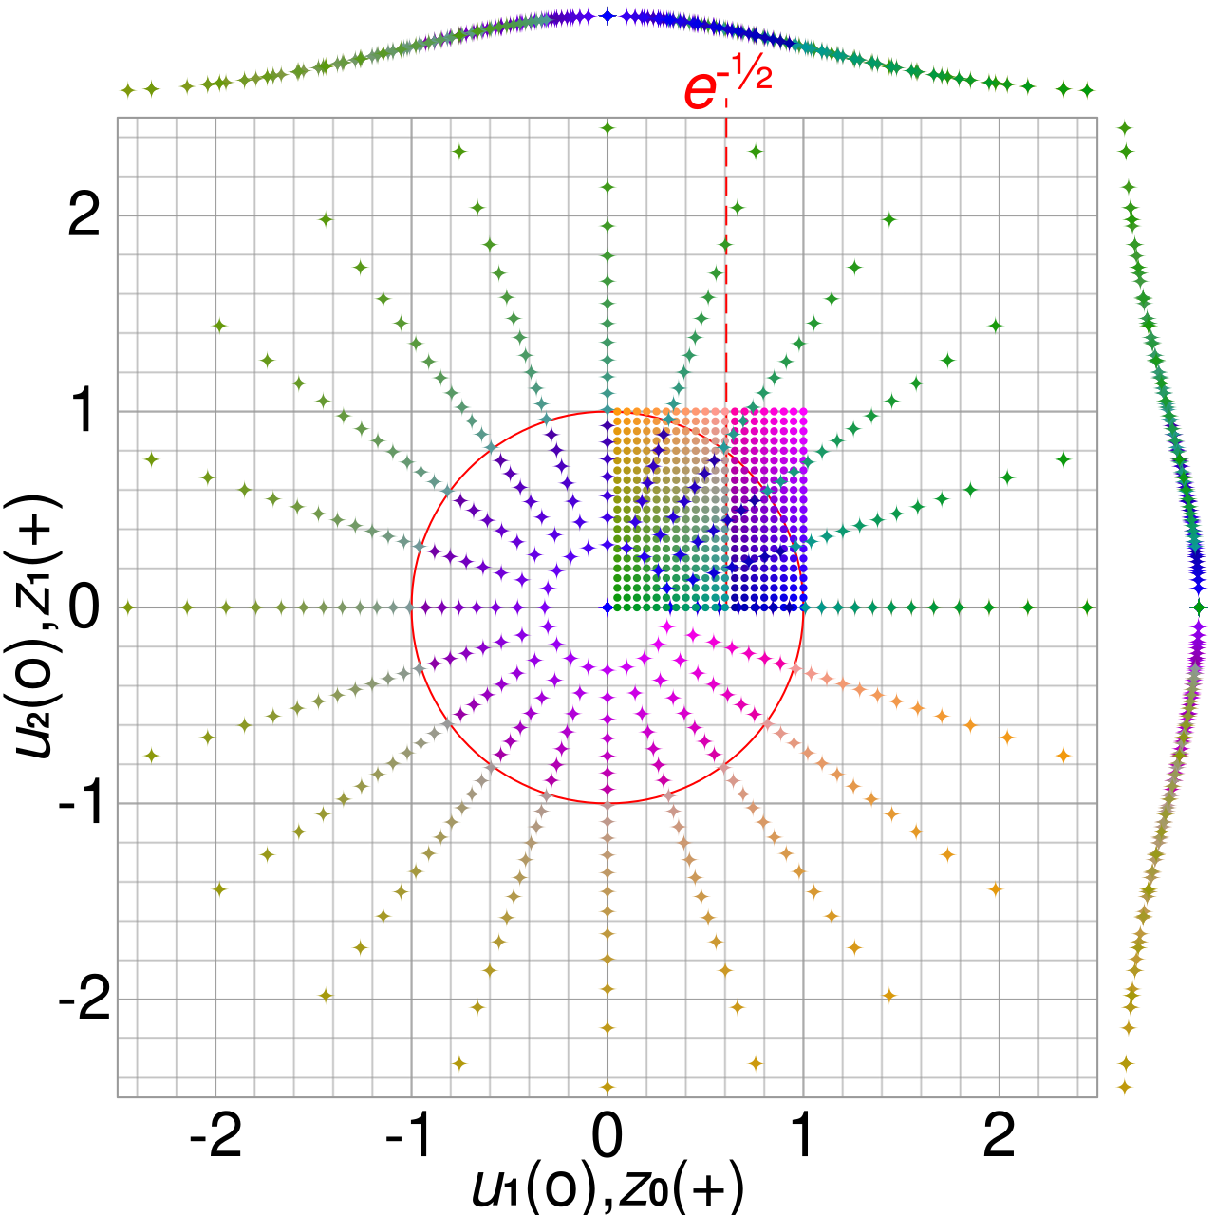
Box-Muller
is a random number sampling method for generating pairs of
Independent
normally distributed (zero expectation, unit variance)
random numbers, given a source of uniformly distributed random numbers.

Slide 9
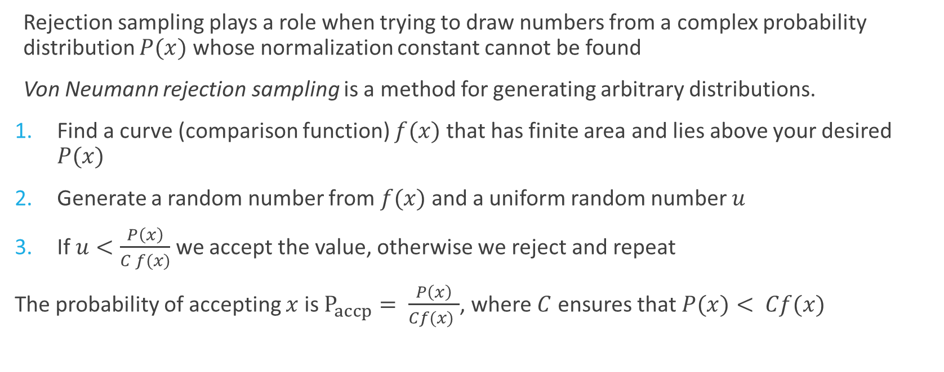
Rejection Sampling
Rejection sampling plays a role when trying to draw numbers from a complex probability distribution $P(x)$ whose normalization constant cannot be found
Von Neumann rejection sampling is a method for generating arbitrary distributions.
Find a curve (comparison function) $f(x)$ that has finite area and lies above your desired $P(x)$
Generate a random number from $f(x)$and a uniform random number $u$
If $u<\frac{P\left(x\right)}{C f(x)}$we accept the value, otherwise we reject and repeat
The probability of accepting $x$ is $P_{accp}= \frac{P\left(x\right)}{Cf(x) }$, where $C$ ensures that $P(x)< Cf(x)$

Slide 10

Metropolis Algorithm
This is a Markov Chain Monte Carlo (MCMC) technique for drawing from unknown or arbitrary probability distributions
Called Markov Chain because this produces a “random walk” of numbers that converge to a probability distribution
Steps:
Start at an initial state $x_{0}$
Generate a new candidate point $x_{i}$
Calculate $w=\frac{f\left(x_{i}\right)}{f\left(x_{0}\right)}$
Generate a uniform random number $u$
Accept if $u<w$
Reject if $u>w$
Repeat

Slide 11
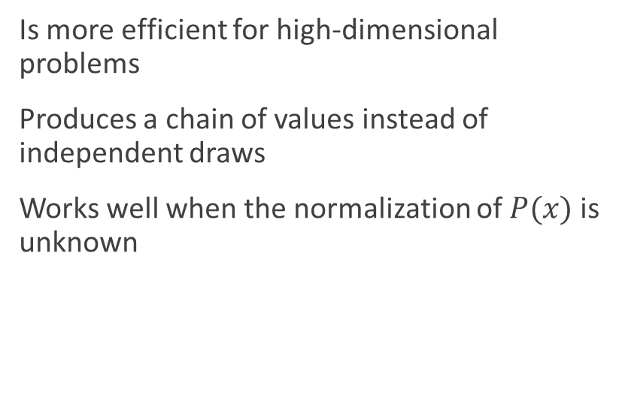

Rejection vs Metropolis
Rejection works well…
Metropolis
If there is a known bounding function $MP(x)$
If the exact proposal function is available
If M is not too large
Is more efficient for high-dimensional problems
Produces a chain of values instead of independent draws
Works well when the normalization of $P(x)$is unknown

Slide 12


Monte Carlo Integration
Monte Carlo Integration is a technique of numerical integration that uses random sampling
$I=\int_{a}^{b}{f\left(x\right)dx=\frac{b−a}{N} Σf(x_{i})}$
Uses random function evaluations to estimate integral
Works well in higher dimensional spaces

Slide 13
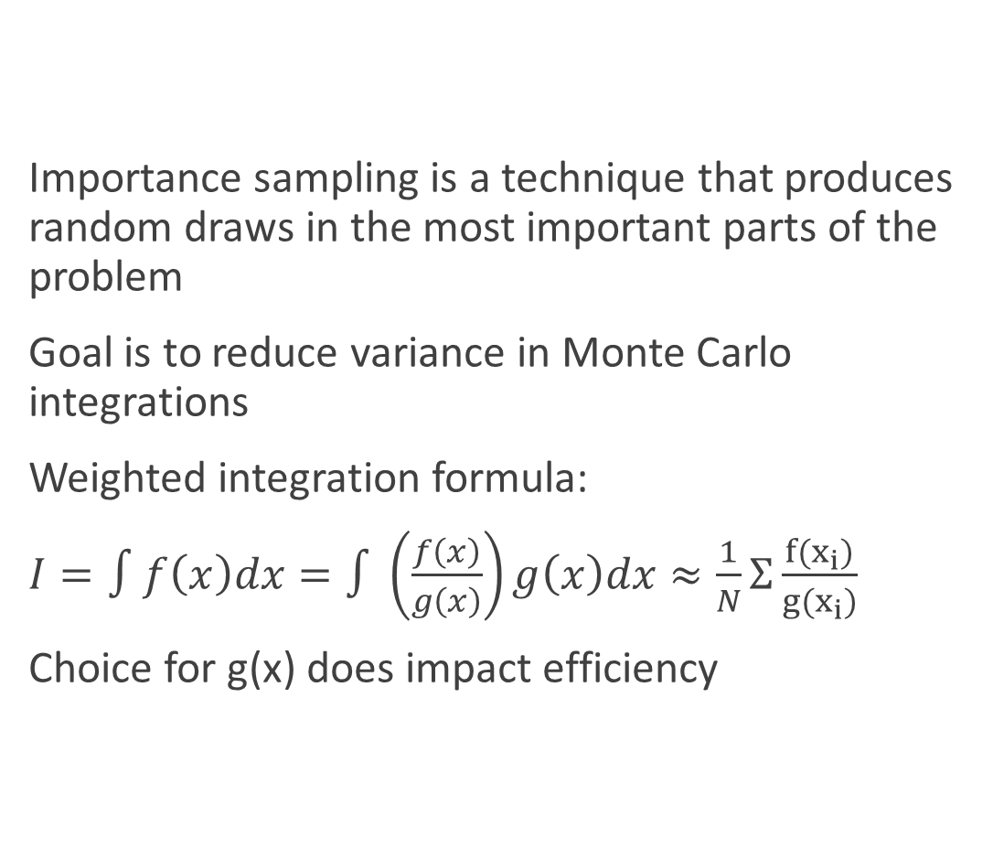
Importance Sampling
Importance sampling is a technique that produces random draws in the most important parts of the problem
Goal is to reduce variance in Monte Carlo integrations
Weighted integration formula:
$I=∫f\left(x\right)dx=∫\left(\frac{f\left(x\right)}{g\left(x\right)}\right)g\left(x\right)dx≈\frac{1}{N}Σ\frac{f(x_{i})}{g(x_{i})}$
Choice for g(x) does impact efficiency

Slide 14
Applications
Quantum mechanics: Path integral Monte Carlo for approximating propagators and wavefunctions
Particle physics: simulating detector responses
Statistical mechanics: Computing ensemble averages to simulate large systems of particles
Chaos theory: Random walk simulations to analyze diffusion processes, chaotic transport and fractal structures in nonlinear systems

