Slide 1
Differential Equations Methods

Slide 2
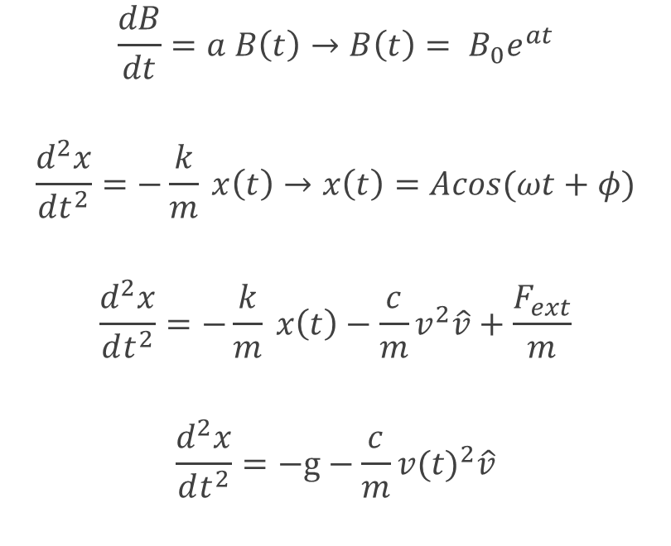
Differential Equations in Physics
Exponential decay/growth
Simple Harmonic Motion
Damped, driven Harmonic Motion
Projectile motion with Air Resistance
$$\frac{dB}{dt}=a B\left(t\right)→B\left(t\right)= B_{0}e^{at}$$
$$\frac{d^{2}x}{dt^{2}}=−\frac{k}{m} x\left(t\right)→x\left(t\right)=Acos(ωt+φ)$$
$$\frac{d^{2}x}{dt^{2}}=−\frac{k}{m} x\left(t\right)−\frac{c}{m}v^{2}\hat{v}+\frac{F_{ext}}{m}$$
$$\frac{d^{2}x}{dt^{2}}=−g−\frac{c}{m}{v(t)}^{2}\hat{v}$$

Slide 3
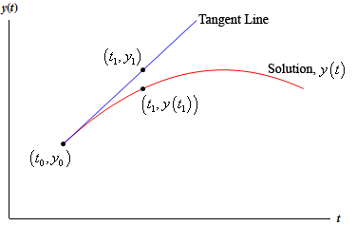
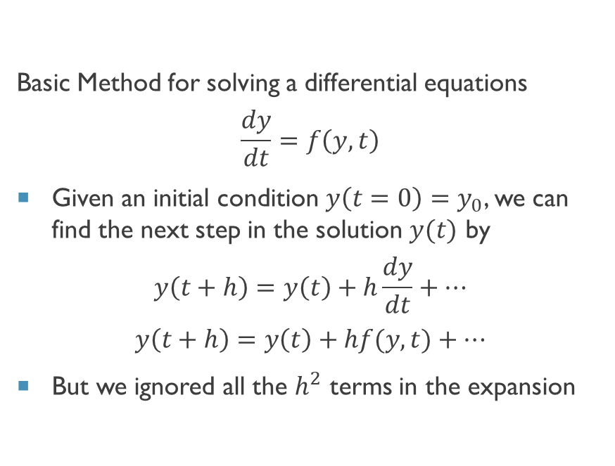
Euler’s Method (1st Order Runge-Kutta)
Basic Method for solving a differential equations
$$\frac{dy}{dt}=f\left(y,t\right)$$
Given an initial condition $y\left(t=0\right)=y_{0}$, we can find the next step in the solution $y(t)$ by
$$y\left(t+h\right)=y\left(t\right)+h\frac{dy}{dt}+⋯$$
$$y\left(t+h\right)=y\left(t\right)+hf(y,t)+⋯$$
But we ignored all the $h^{2}$ terms in the expansion

Slide 4
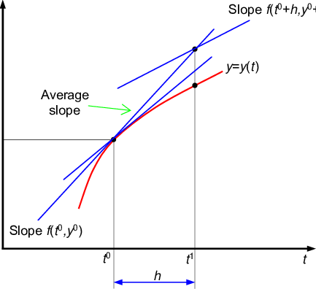
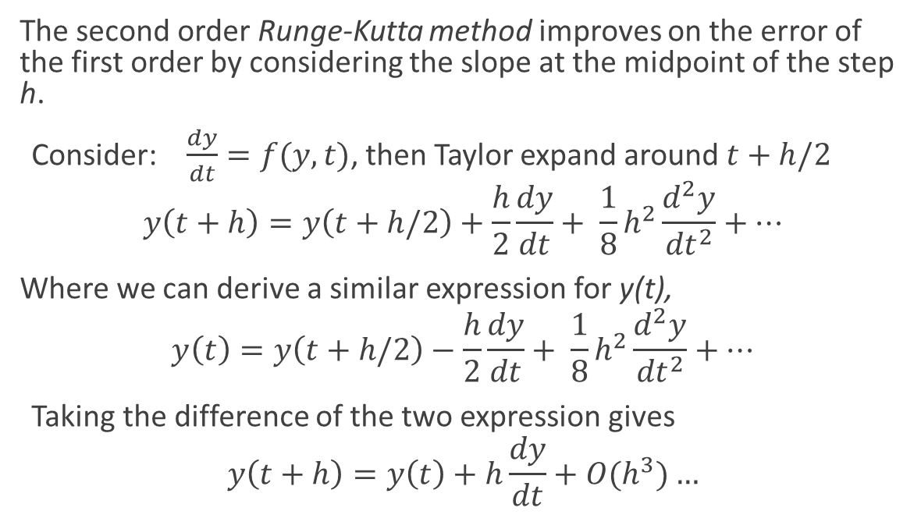
2nd order Runge Kutta
The second order Runge-Kutta method improves on the error of the first order by considering the slope at the midpoint of the step h.
Consider: $\frac{dy}{dt}=f(y,t)$, then Taylor expand around $t+h/2$
$$y\left(t+h\right)=y\left(t+h/2\right)+\frac{h}{2}\frac{dy}{dt}+ \frac{1}{8}h^{2}\frac{d^{2}y}{{dt}^{2}}+…$$
Where we can derive a similar expression for y(t),
$$y\left(t\right)=y\left(t+h/2\right)−\frac{h}{2}\frac{dy}{dt}+ \frac{1}{8}h^{2}\frac{d^{2}y}{{dt}^{2}}+…$$
Taking the difference of the two expression gives
$$y\left(t+h\right)=y\left(t\right)+h\frac{dy}{dt}+O(h^{3})…$$

Slide 5
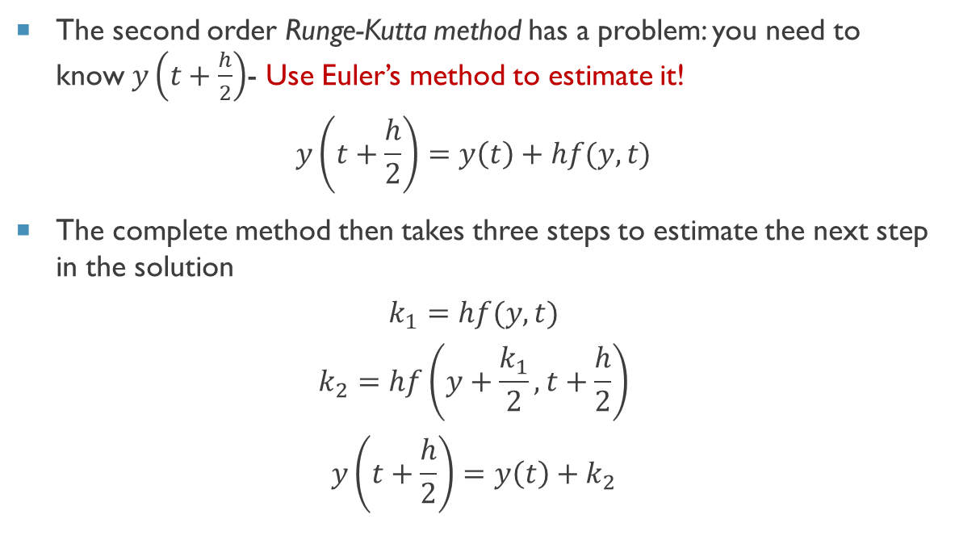
2nd order Runge Kutta
The second order Runge-Kutta method has a problem: you need to know $y\left(t+\frac{h}{2}\right)$- Use Euler’s method to estimate it!
$$y\left(t+\frac{h}{2}\right)=y\left(t\right)+hf(y,t)$$
The complete method then takes three steps to estimate the next step in the solution
$$k_{1}=hf(y,t)$$
$$k_{2}=hf\left(y+\frac{k_{1}}{2},t+\frac{h}{2}\right)$$
$$y\left(t+\frac{h}{2}\right)=y\left(t\right)+k_{2}$$

Slide 6
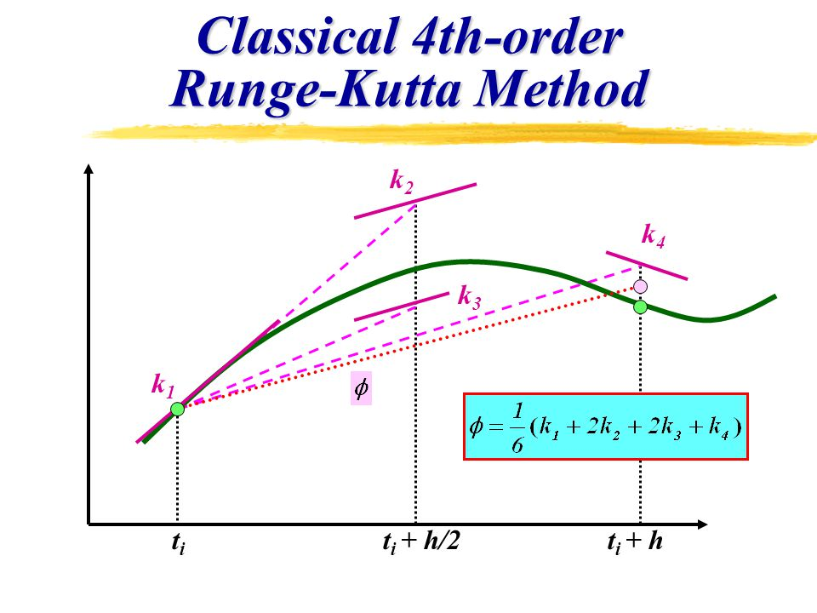
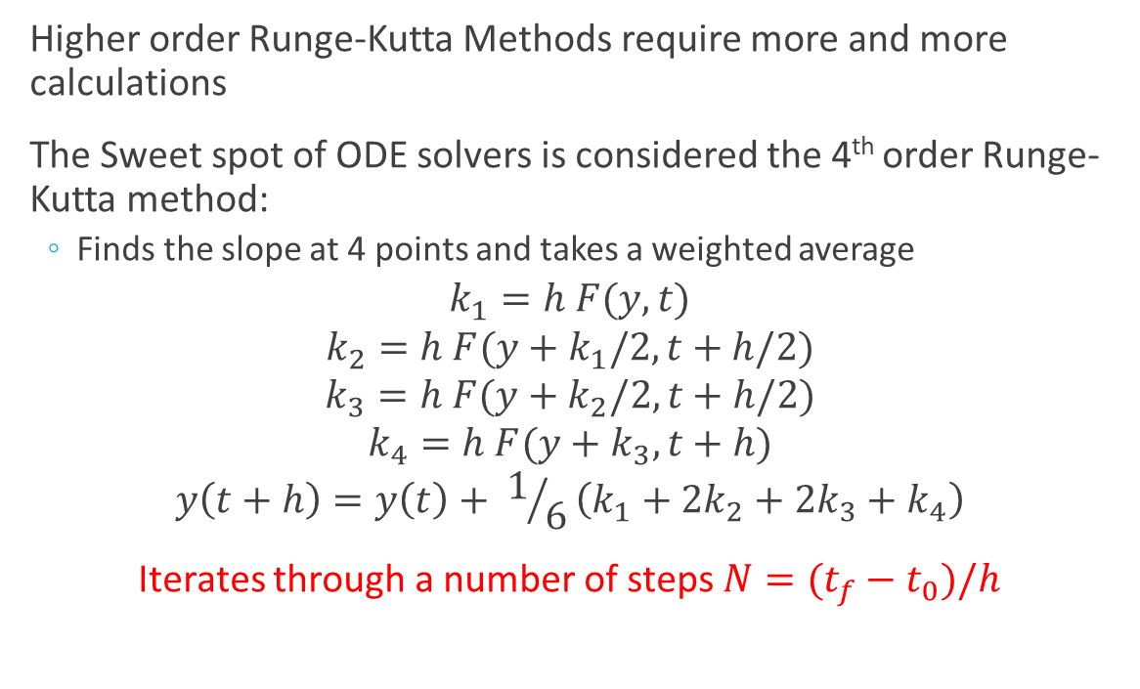
4th order Runge Kutta (the sweet Spot)
Higher order Runge-Kutta Methods require more and more calculations
The Sweet spot of ODE solvers is considered the 4th order Runge-Kutta method:
Finds the slope at 4 points and takes a weighted average
$$k_{1}=h F(y,t)$$
$$k_{2}=h F(y+k_{1}/2,t+h/2)$$
$$k_{3}=h F(y+k_{2}/2,t+h/2)$$
$$k_{4}=h F(y+k_{3},t+h)$$
$$y\left(t+h\right)=y\left(t\right)+ 1/6\left(k_{1}+{2k}_{2}+{2k}_{3}+k_{4}\right)$$
Iterates through a number of steps $N=(t_{f}−t_{0})/h$

Slide 7
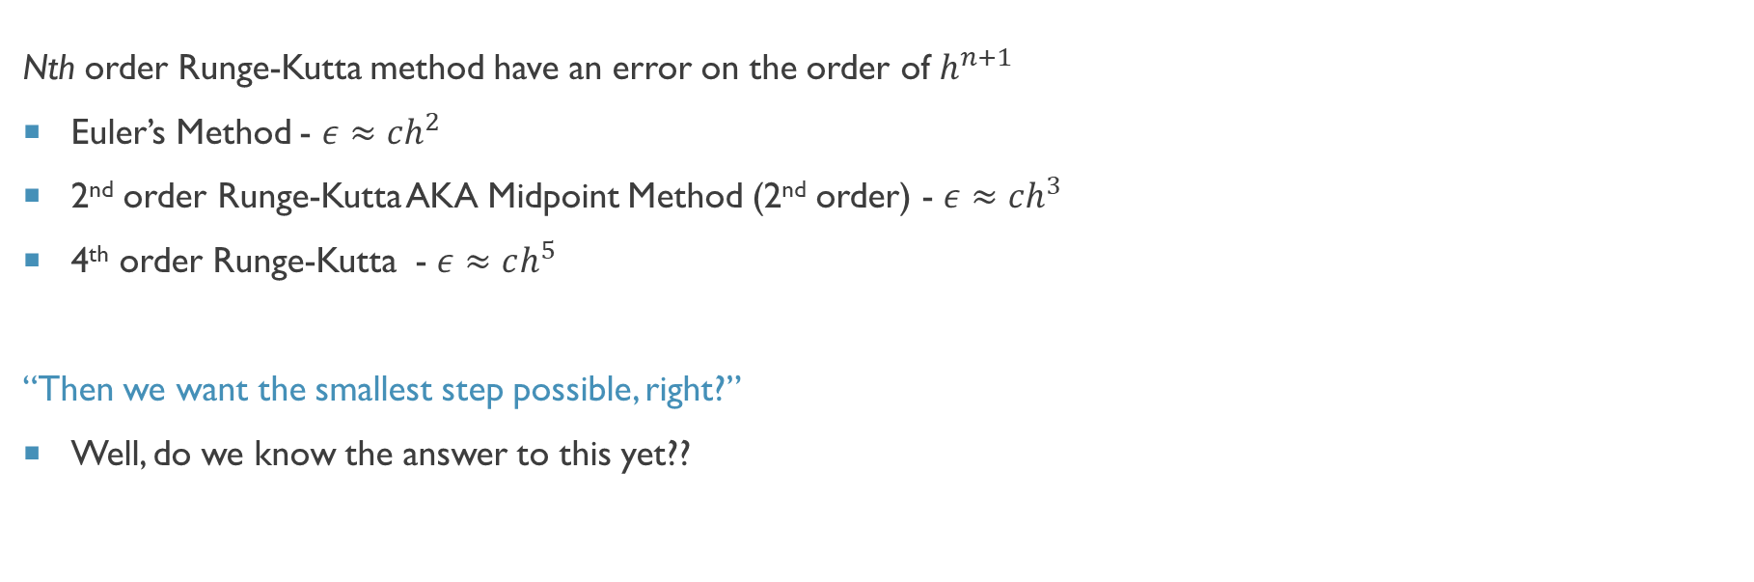
How accurate are These methods
Nth order Runge-Kutta method have an error on the order of $h^{n+1}$
Euler’s Method - $ε≈ch^{2}$
2nd order Runge-Kutta AKA Midpoint Method (2nd order) - $ε≈ch^{3}$
4th order Runge-Kutta - $ε≈ch^{5}$
“Then we want the smallest step possible, right?”
Well, do we know the answer to this yet??

Slide 8
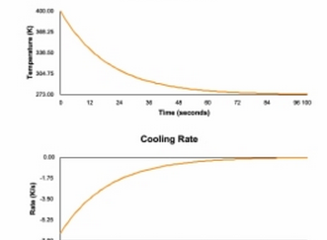
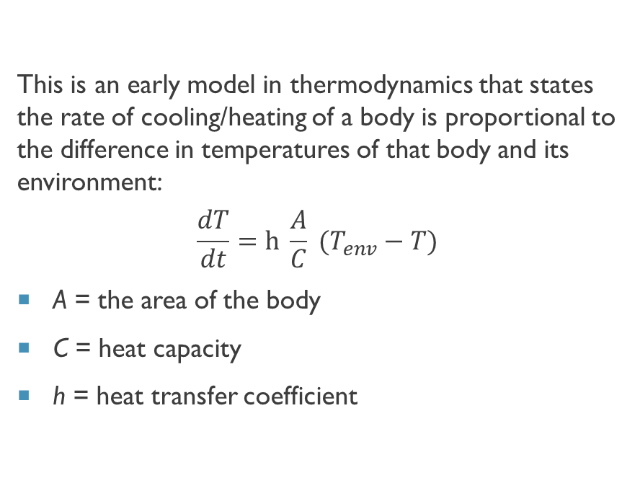
Newton’s Heating/Cooling Law
This is an early model in thermodynamics that states the rate of cooling/heating of a body is proportional to the difference in temperatures of that body and its environment:
$$\frac{dT}{dt}=h \frac{A}{C} (T_{env}−T)$$
A = the area of the body
C = heat capacity
h = heat transfer coefficient

Slide 9
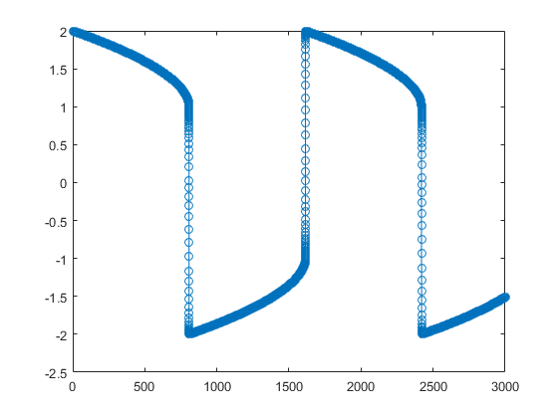
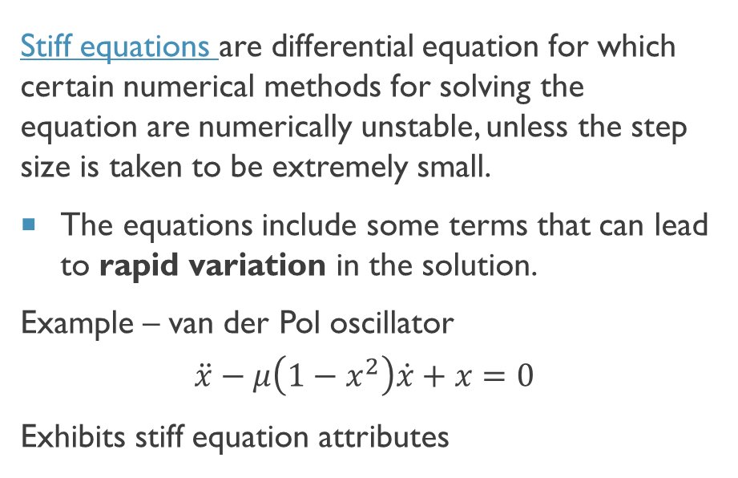
Stiff equations
Stiff equations are differential equation for which certain numerical methods for solving the equation are numerically unstable, unless the step size is taken to be extremely small.
The equations include some terms that can lead to rapid variation in the solution.
Example – van der Pol oscillator
$$\ddot{x}−μ\left(1−x^{2}\right)\dot{x}+x=0$$
Exhibits stiff equation attributes
Solution to van der Pol oscillator

