Slide 1
Laplace’s Equation
And to a lesser extent Poisson’s equation

Slide 2
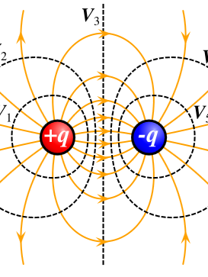

Fundamentals
Electric fields arise from charge distributions
$∇⋅\vec{E}=\frac{ρ}{ε_{0}}$ (Gauss’s law)
Electrostatic fields are conservative
$∇×\vec{E}=0$
Because electrostatic fields are conservative, we can specify a scalar potential that relates to the electric field,
$E=−∇ V$
$∇^{2}V=−\frac{ρ}{ε_{0}}$

Slide 3
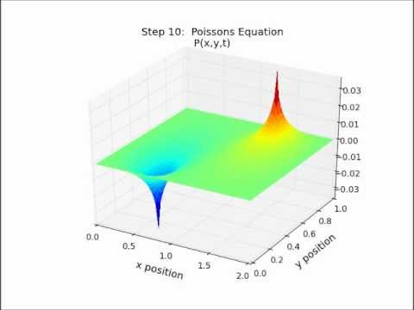
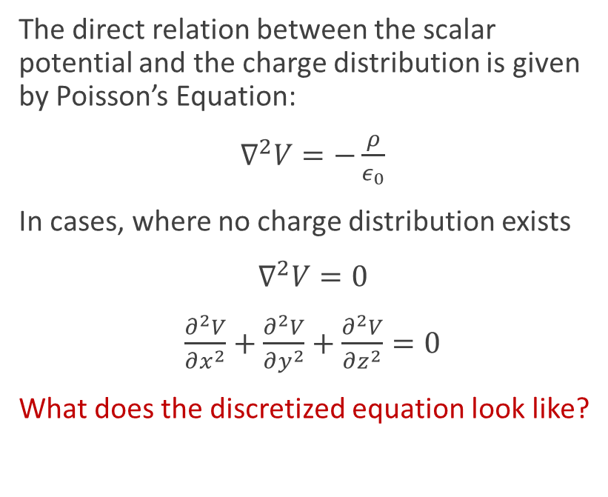
Poisson’s and Laplace’s Equation
The direct relation between the scalar potential and the charge distribution is given by Poisson’s Equation:
$∇^{2}V=−\frac{ρ}{ε_{0}}$
In cases, where no charge distribution exists
$∇^{2}V=0$
$\frac{∂^{2}V}{∂x^{2}}+\frac{∂^{2}V}{∂y^{2}}+\frac{∂^{2}V}{∂z^{2}}=0$
What does the discretized equation look like?

Slide 4
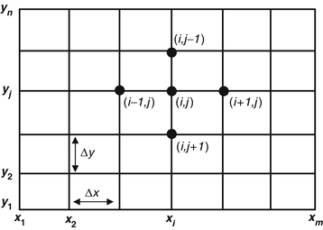

Numerically Solving Equations
Analytic solutions only exist for simple geometries
Discretized, Laplace’s equation becomes an averaging exercise that can work even in Excel
$V_{i,j}=\frac{1}{4}(V_{i+1,j}+V_{i−1,j}+V_{i,j+1}+V_{i,j−1})$
Generating solutions to Laplace’s equation requires iterative processes
Jacobi method
Gauss-Seidel method
Successive Over-Relaxation method

Slide 5
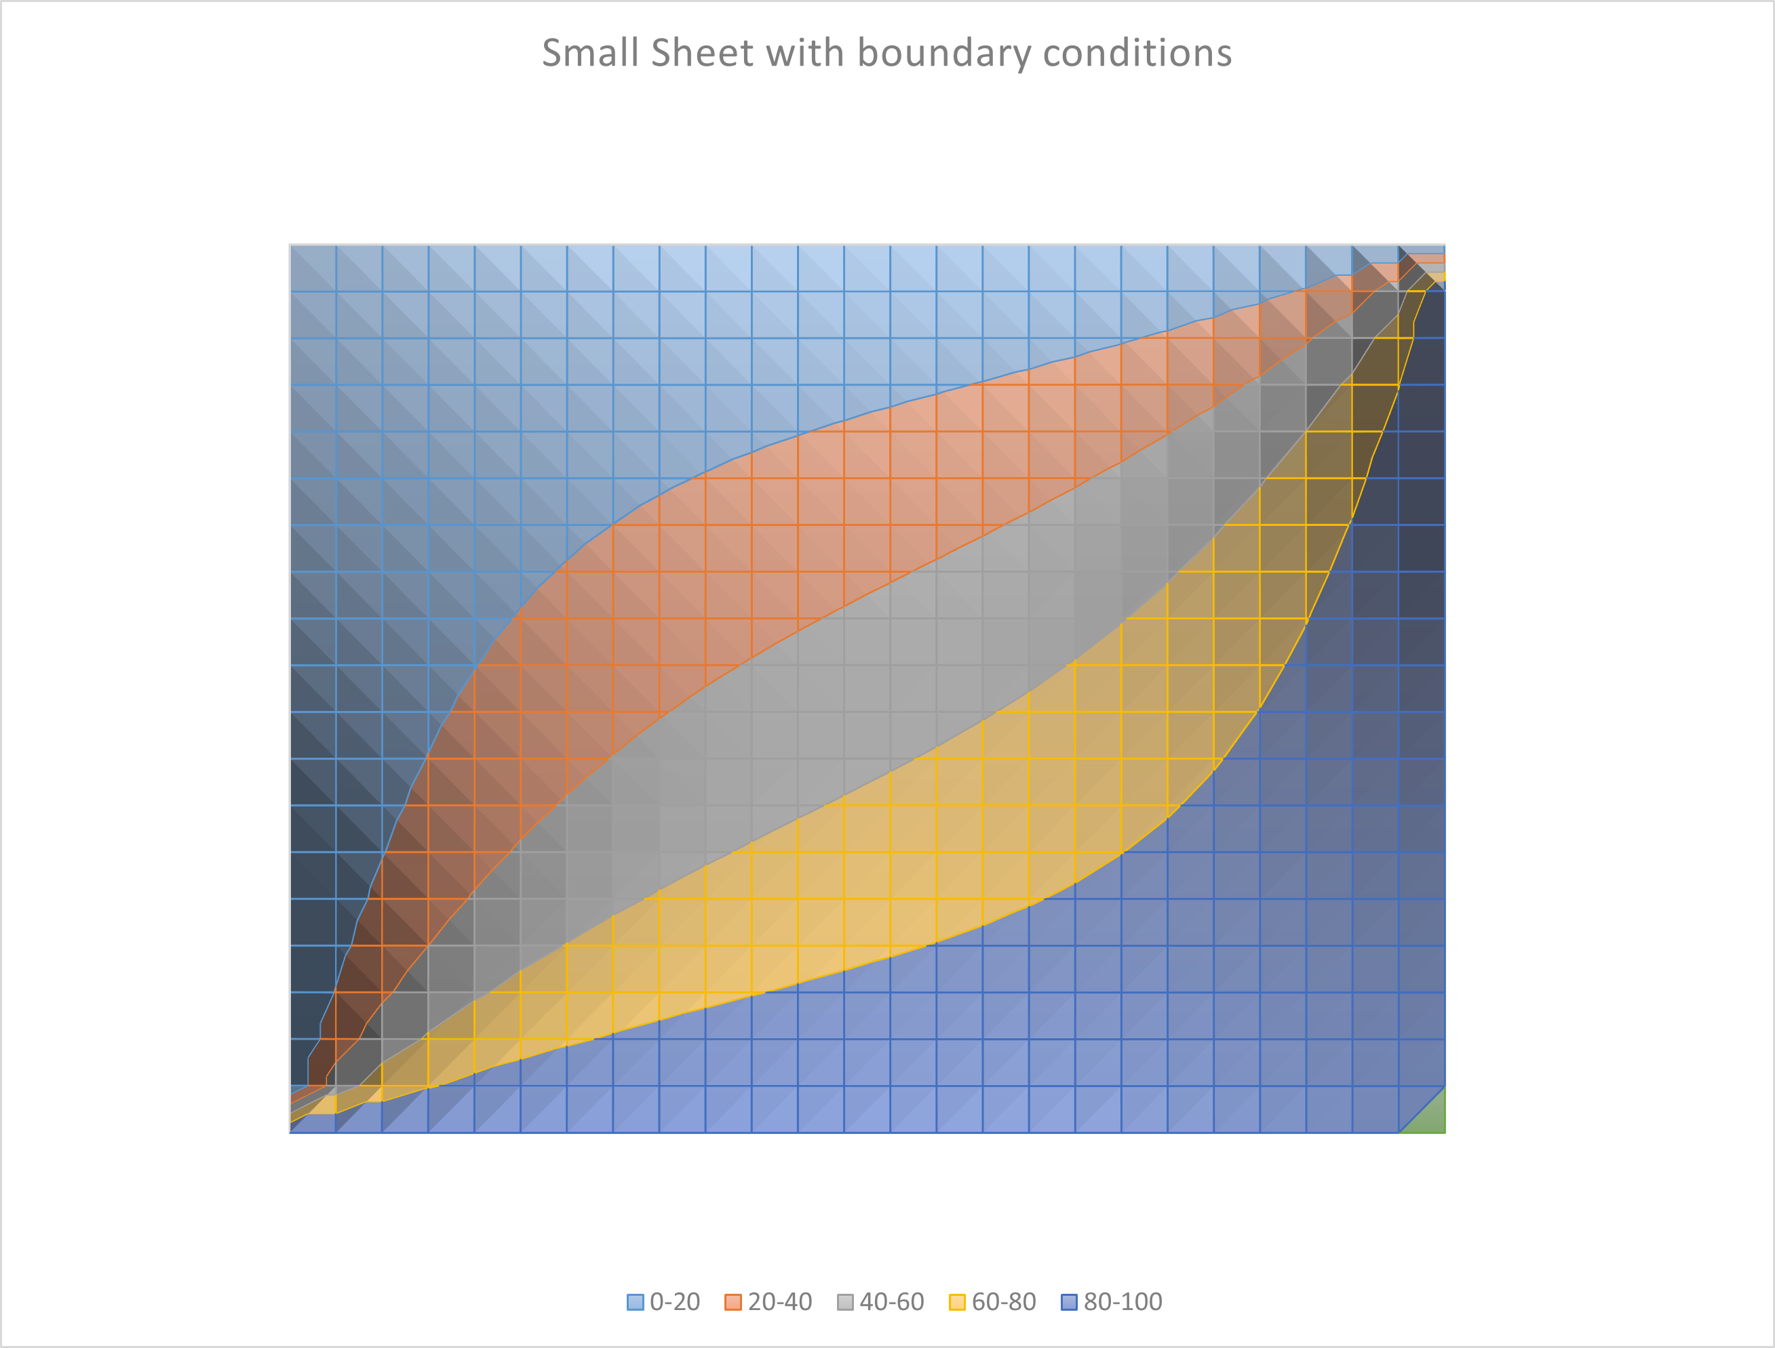
Using Excel
Look at LaplaceEqu.xlsx

Slide 6
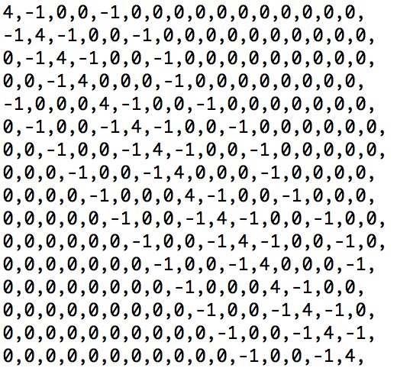
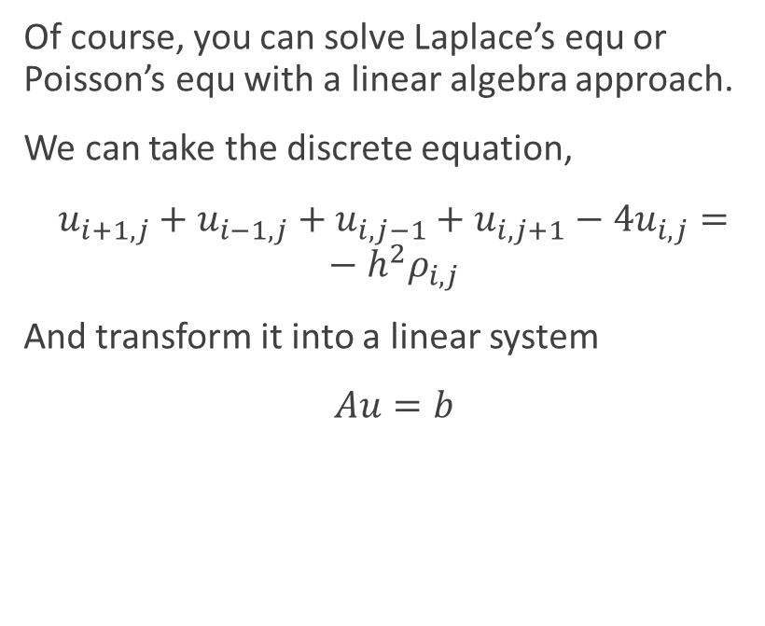
Linear Algebra
Of course, you can solve Laplace’s equ or Poisson’s equ with a linear algebra approach.
We can take the discrete equation,
$u_{i+1,j}+u_{i−1,j}+u_{i,j−1}+u_{i,j+1}−4u_{i,j}=−h^{2}ρ_{i,j}$
And transform it into a linear system
$Au=b$

