Slide 1
Verlet Algorithms

Slide 2

Why the Verlet algorithms
We have seen that many systems require solving their equations of motion numerically
Some methods can lead to large errors over time
Verlet and its related methods improve stability, especially for long simulation times

Slide 3
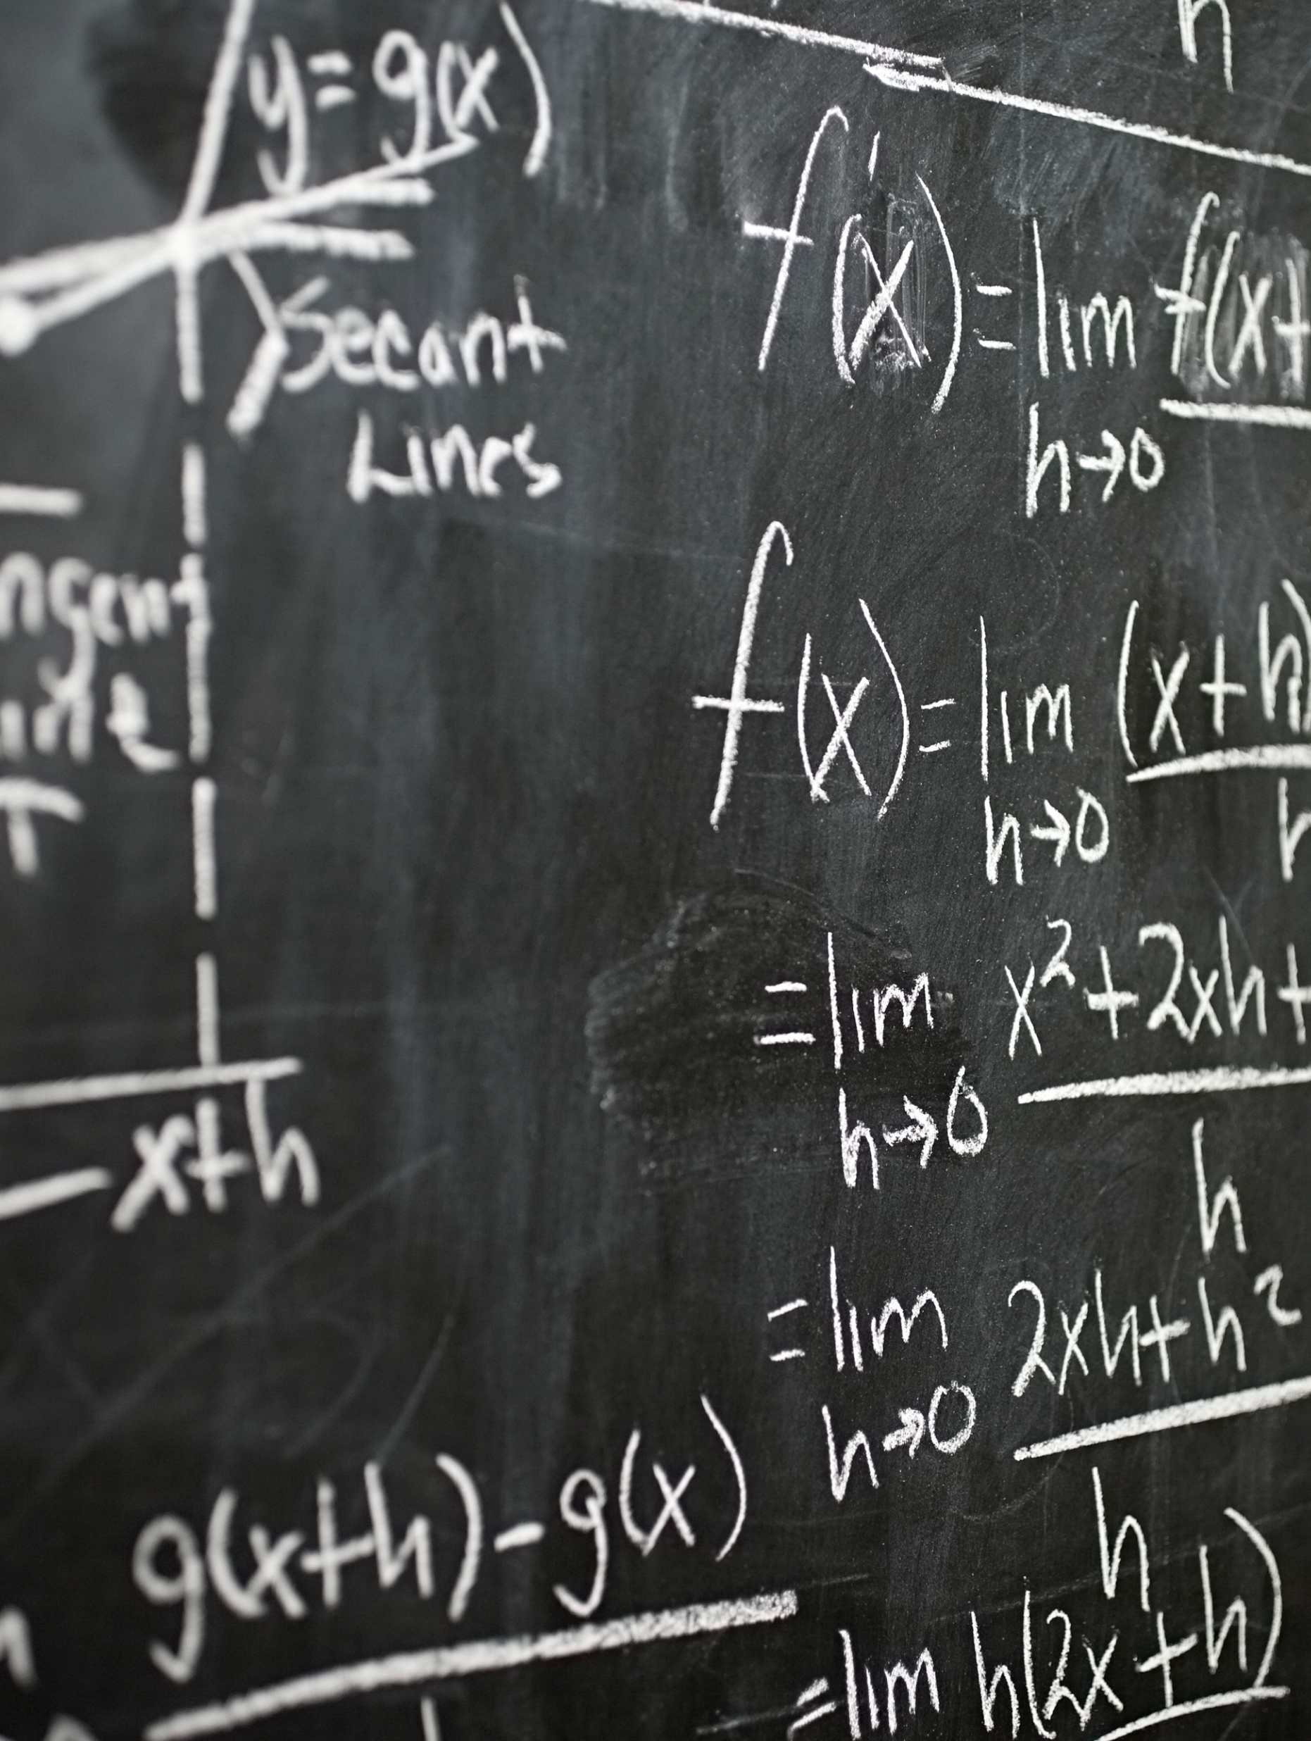

The Verlet Algorithm
A second-order integration method for solving equations of motion
Uses position information from previous and current times to compute the next step
$x_{n+1}=2x_{n}−x_{n−1}+\frac{F_{n}}{m}Δt^{2}$
The velocity may be calculated explicitly,
$v_{n}=\frac{x_{n+1} −x_{n−1}}{2Δt}$

Slide 4
Properties of Verlet Integration
Advantages
Disadvantages
Symplectic
Time-reservable
second-order accuracy
No explicit velocity storage necessary
Requires storing multiple positions
Velocity computation is indirect
Position and velocity are decoupled

Slide 5
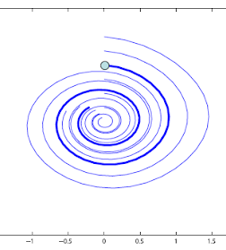
Symplectic Integration?
Symplectic integrators preserve phase space volume (needed for Hamiltonian systems)
Avoids artificial energy drift
Ensures long-terms stability in orbits or molecular dynamics simulations

Slide 6
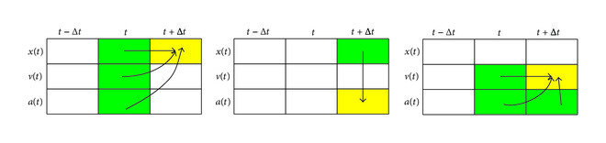

Velocity Verlet Algorithm
Modification to the calculation that explicitly uses velocity information
$x_{n+1}=x_{n}+v_{n}Δt+a_{n}Δt^{2}$
$v_{n+1}=v_{n}+{\frac{1}{2}(a}_{n}+a_{n+1})Δt$
This is still symplectic and second-order accurate
Avoids needing two previous positions

Slide 7
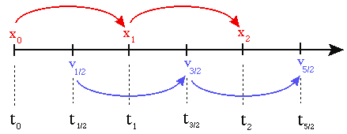

Leapfrog Integration
Alternative form of verlet where velocity and position update at staggered time steps
$v_{n+1/2}=v_{n}+\frac{1}{2}a_{n}Δt$
$x_{n+1}=x_{n}+v_{n+1/2}Δt$
$v_{n+1}=v_{n+1/2}+\frac{1}{2}a_{n+1}Δt$
The velocity and position updates are intertwined
This is frequently used in astrophysical and/or molecular simulations

Slide 8

Which one should you use?

