Slide 1
Quantum Mechanics and Schoedinger’s Equation

Slide 2
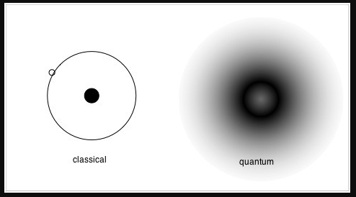
Quantum World
Classical mechanics are deterministic
Quantum Mechanics describes the microscopic world in a probabilistic way
Wavefunctions describe the state of quantum systems, such as particles

Slide 3
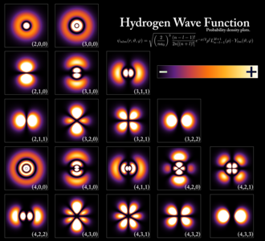
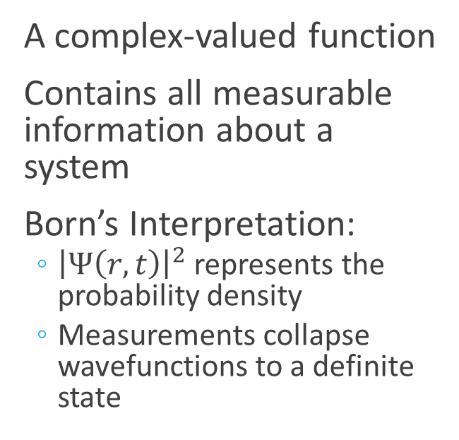
The Wavefunction
A complex-valued function
Contains all measurable information about a system
Born’s Interpretation:
${\left|Ψ\left(r,t\right)\right|}^{2}$ represents the probability density
Measurements collapse wavefunctions to a definite state

Slide 4
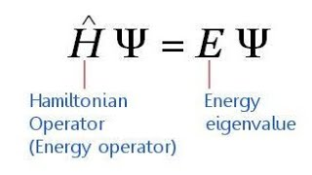

Schroedinger’s Equation
Schroedinger’s Equation is expressed as
$iℏ\frac{∂Ψ}{∂t}=\left(−\frac{ℏ^{2}}{2m}∇^{2}+V\left(\vec{r},t\right)\right)Ψ(\vec{r},t)$
Which can put in operator terms
$\hat{H}Ψ=iℏ\frac{∂Ψ}{∂t}$
Where the Hamiltonian is
$\hat{H}=−\frac{ℏ^{2}}{2m}∇^{2}+V(r)$
Which other equation looks like this one?

Slide 5
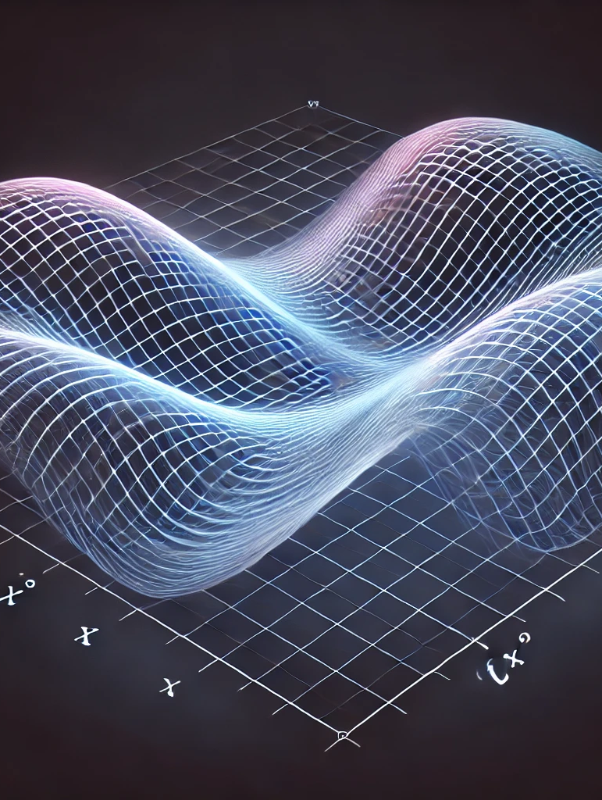

The Free Particle Case (1D)
For the V(x) = 0 case gives plane wave solutions
$Ψ\left(x,t\right)=Ae^{i\left(kx−ωt\right)}$
Is this Normalizable?
With momentum and energy relations
$p=ℏk$
$E=\frac{ℏ^{2}{ k}^{2}}{2m}$

Slide 6
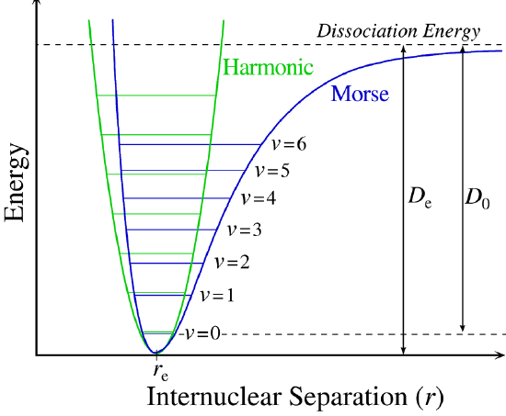
More Complicated V(x)
For complicated problems, we need to solve Schoedinger’s equation with numerical methods
What makes this different from the heat equation?

Slide 7
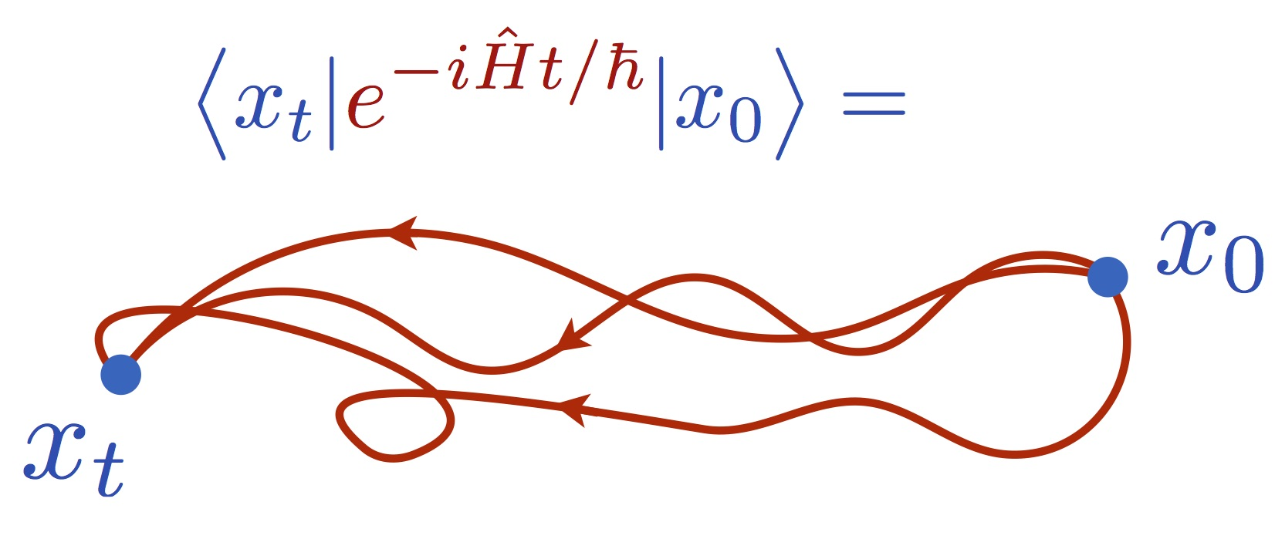

Evolution of the Wavefunction
We know that the wavefunction evolves according to the Schoedinger Equation, but we can express this with operators,
$Ψ\left(x,t\right)=U\left(t\right)Ψ\left(x,t=0\right)$
Where the time-evolution propagator is defined
$U\left(t\right)=e^{−i\hat{H}t}$
$U{\left(t\right)}^{−1}=U(−t)$

Slide 8
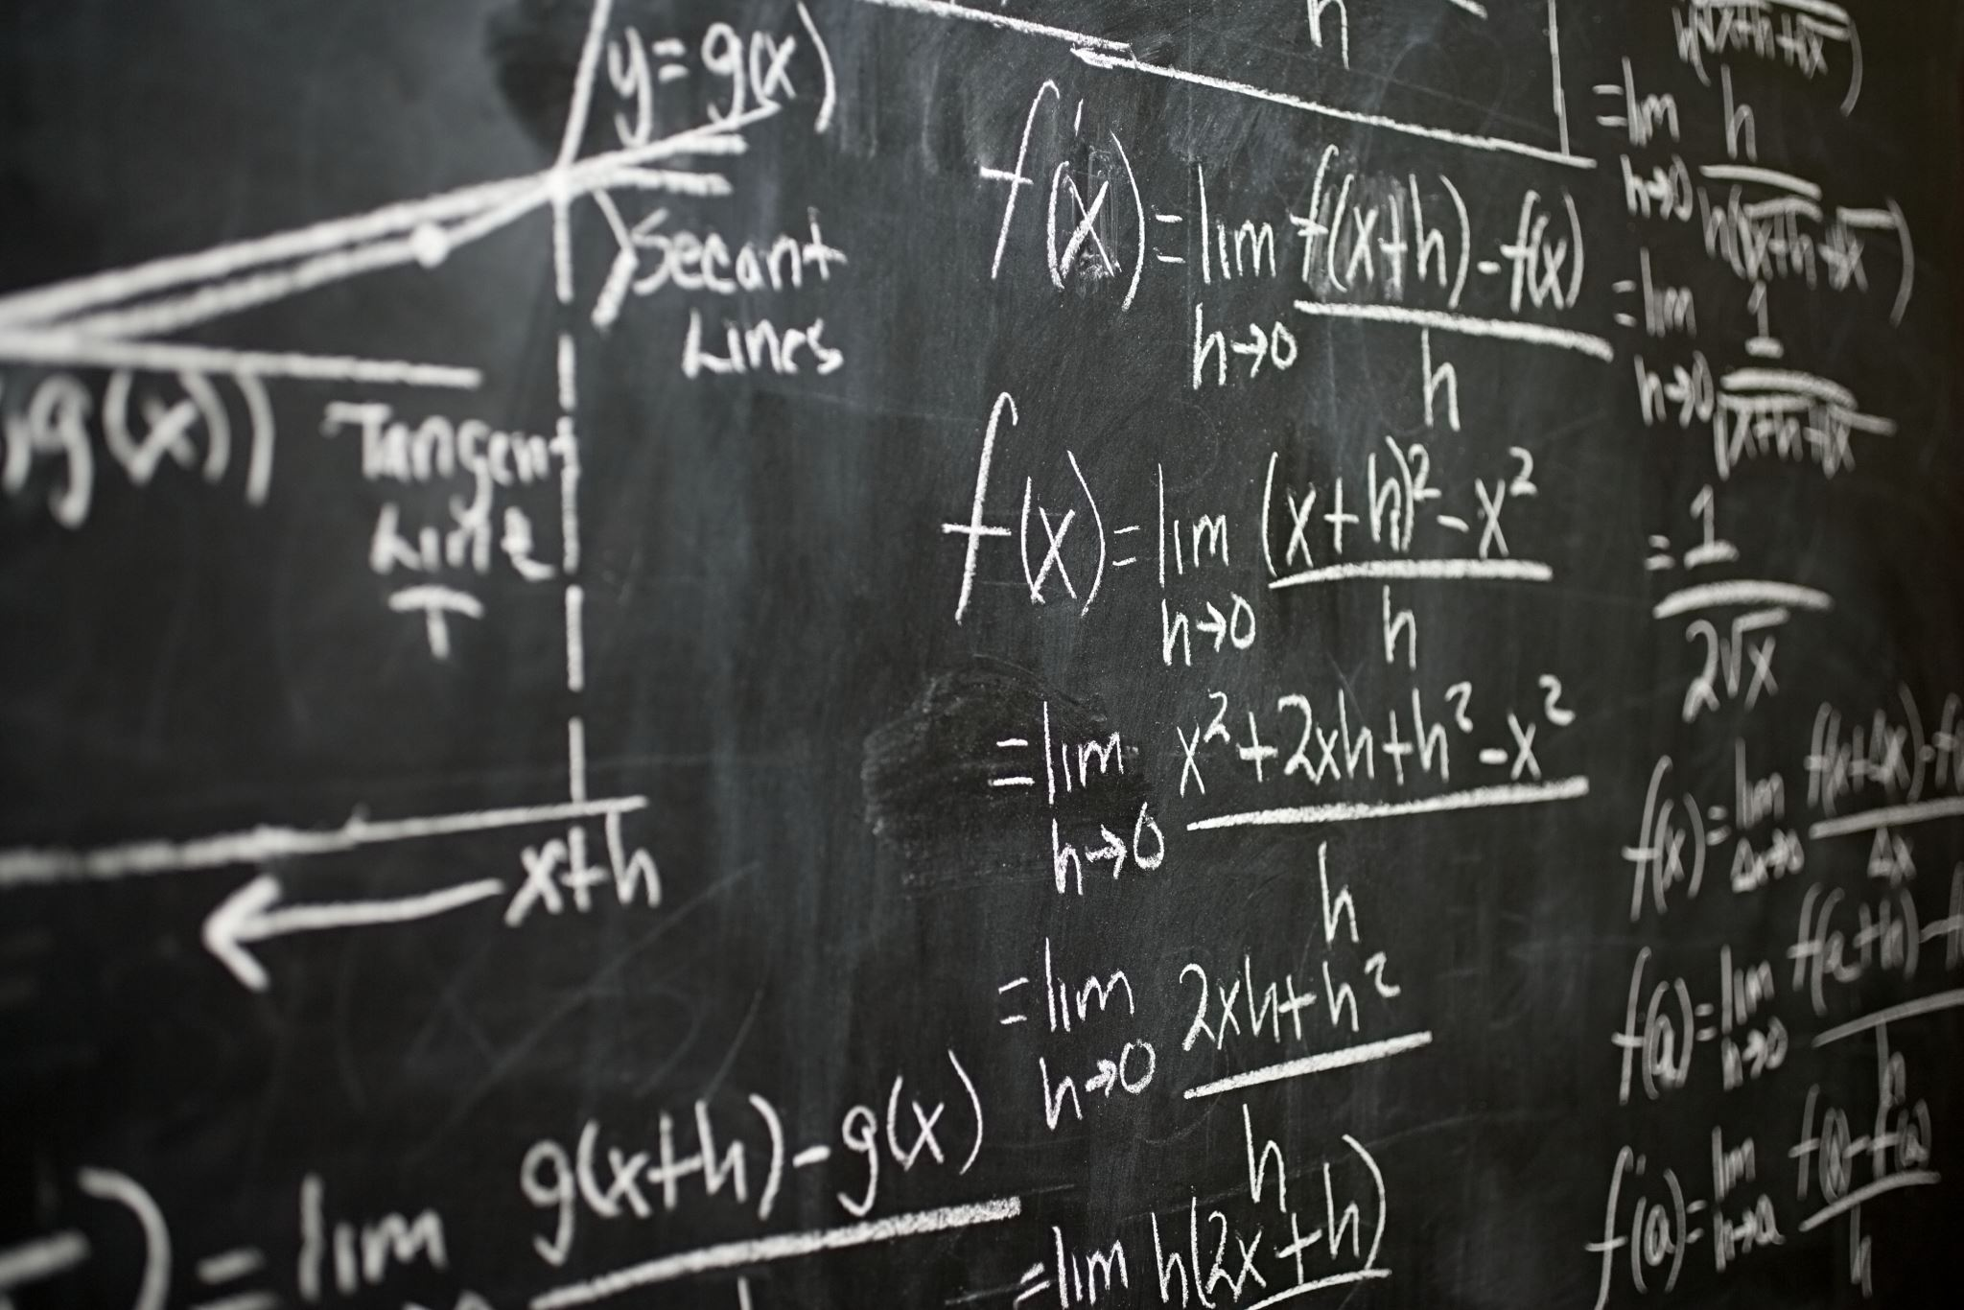

Discretizing the Equation
We can directly discretize Schoedinger’s equation
We can also step through with the operator expansion
$U\left(t\right)≈e^{−iHt}=e^{−iHΔt}e^{−iHΔt}…$
$≈\left(1−iHΔt\right)\left(1−iHΔt\right)\left(…\right)…$

Slide 9
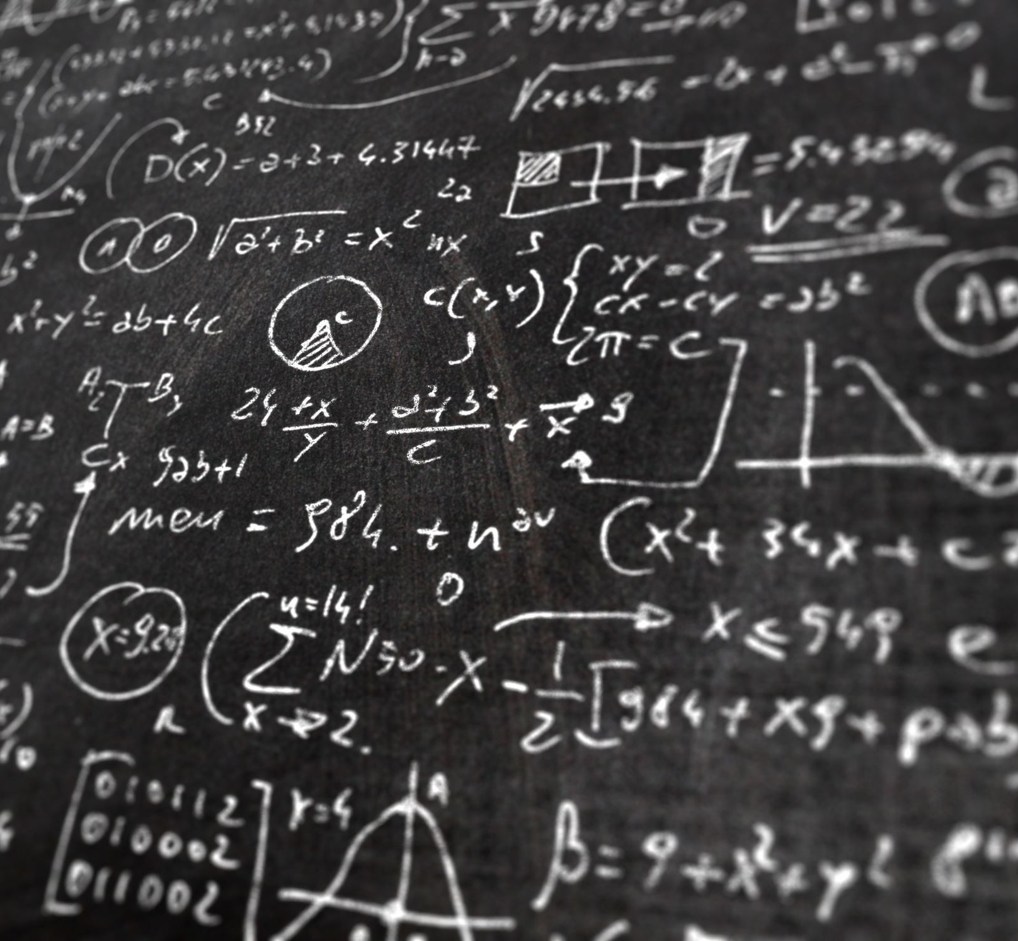
What do we get?

Slide 10
How do we calculate Energy?

