Slide 1
Reinforcement Learning

Slide 2
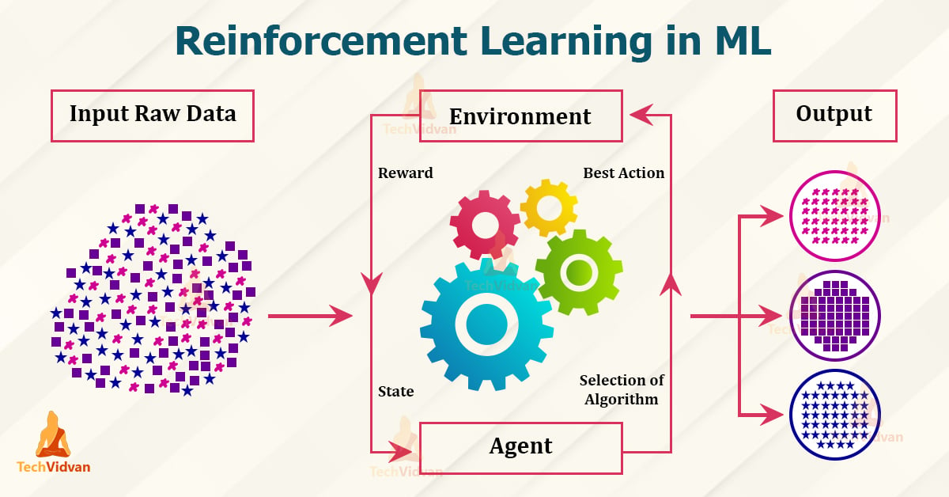
Reinforcement Learning (RL)
Reinforcement Learning brings us closer to what many people traditionally imagine as “Artificial Intelligence”
Not classifying images or predicting numbers
RL help programs learn chess and robots learn to walk
RL is a field of machine learning that tackles problems where an agent learns by interacting with an environment

Slide 3
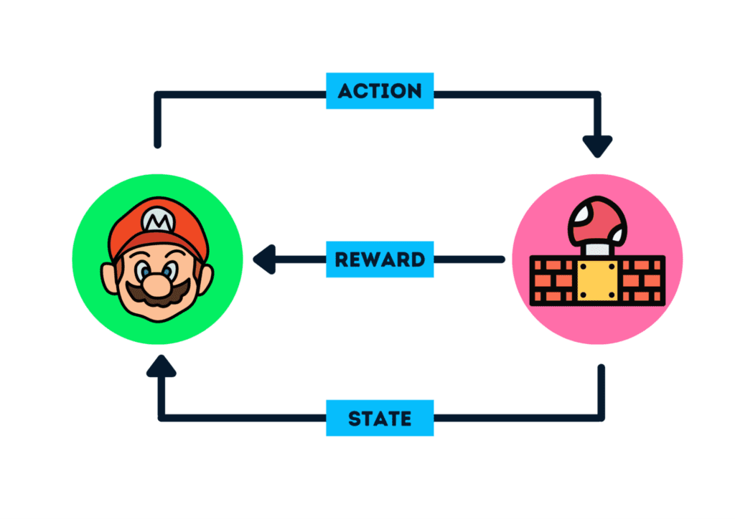

The agent-environment loop
An agent explores an environment
It perceives a state $s∈S$
It chooses an action $a∈A$
The environment transitions to a new state and returns a reward $r_{t}$
Think: Teaching a dog to sit

Slide 4
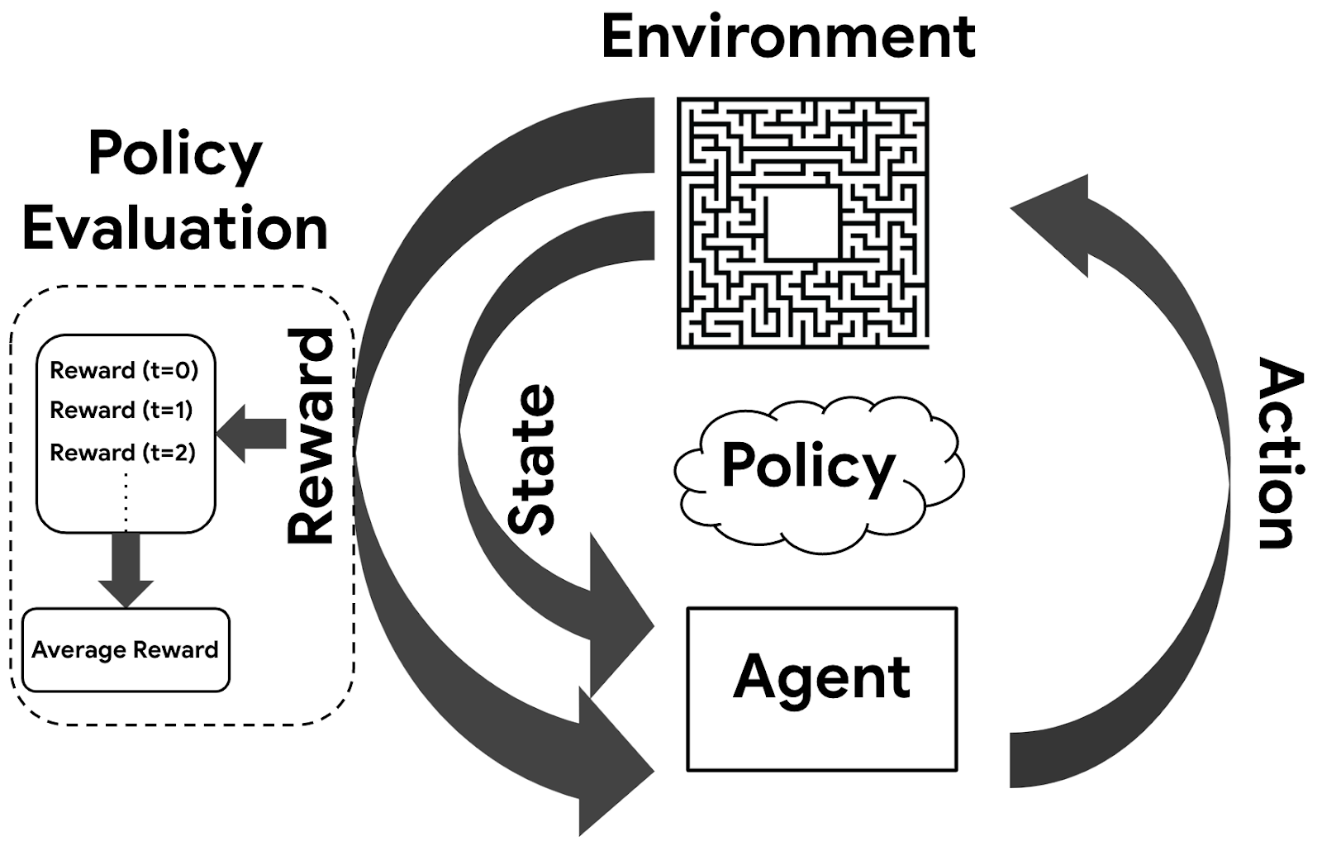
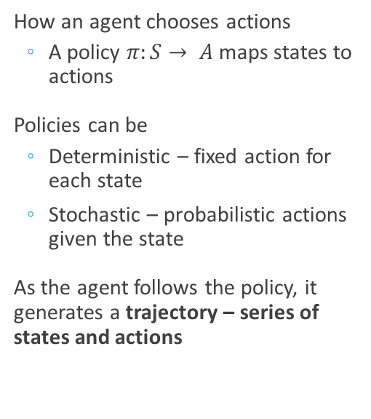
Policy Functions
How an agent chooses actions
A policy $π:S→ A$maps states to actions
Policies can be
Deterministic – fixed action for each state
Stochastic – probabilistic actions given the state
As the agent follows the policy, it generates a trajectory – series of states and actions

Slide 5


Rewards and Return
The agent gets a reward at each time step
Rewards accumulate into a return
$G_{t}=Σ_{0}^{∞}γ r_{t+k+1}$
$γ$is a discount factor
$γ =0$looking for short-term gains
$γ≈ 1$planning for future

Slide 6
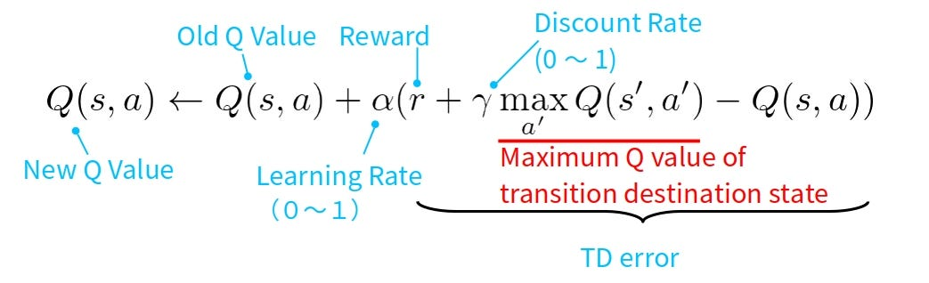

Value Functions
We estimate how good it is to be in a state $s$ with
State Value Function: $v_{π}\left(s\right)=E_{π}\left[G_{t} | S_{t}=s\right]$
Action Value Function: $q_{π}\left(s,a\right)=E_{π}\left[G_{t} | S_{t}=s,A_{t}=a \right]$
Guides agent toward better decisions

Slide 7
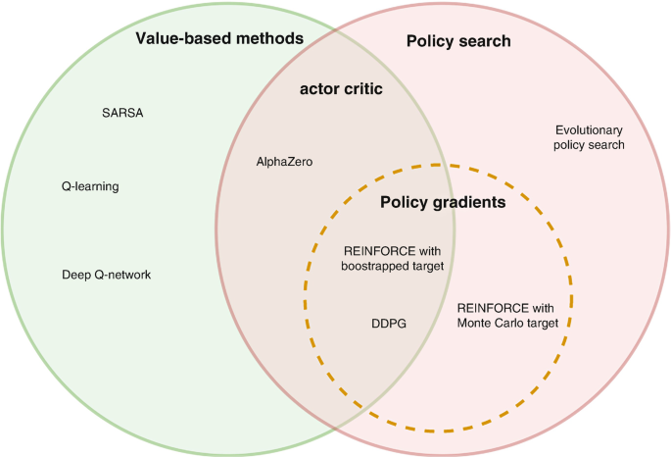
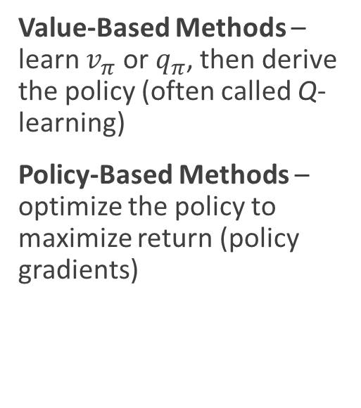
Types of RL Algorithms
Value-Based Methods – learn $v_{π}$ or $q_{π}$, then derive the policy (often called Q-learning)
Policy-Based Methods – optimize the policy to maximize return (policy gradients)

Slide 8
Using Reinforcement Learning
When answering yes to the following questions, RL may be the method to use
Can the problem be conceptualized as an agent interacting with an environment?
Can the agent take actions that affect the outcomes?
Is there a clear notion of reward?
RL is best when the environment is too large to explore exhaustively (Deep-Q learning)

Slide 9
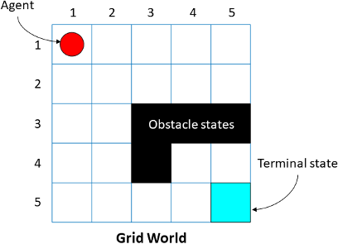
Gridworld
Simple RL environment to explore these concepts
Grid-based world
Agent moves up/down/left/right
Goal is to reach a designated target square
Rewards: +1 for reaching goal, -1 for invalid moves
We should be looking for
Agent Behavior
Different policy effects
How value functions evolve during training

