Slide 1
The Heat Equation
Introduction to the heat equation and Numerical Solutions

Slide 2
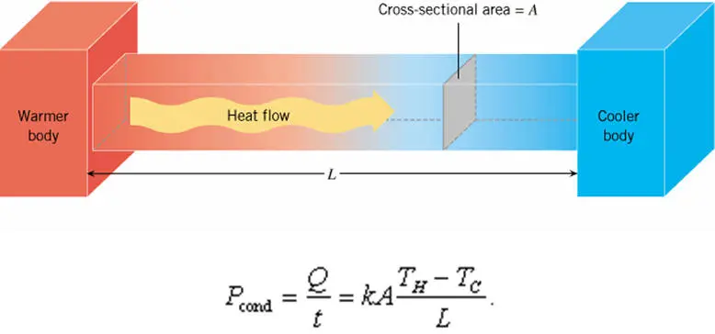
Was this in your old physics textbook?

Slide 3
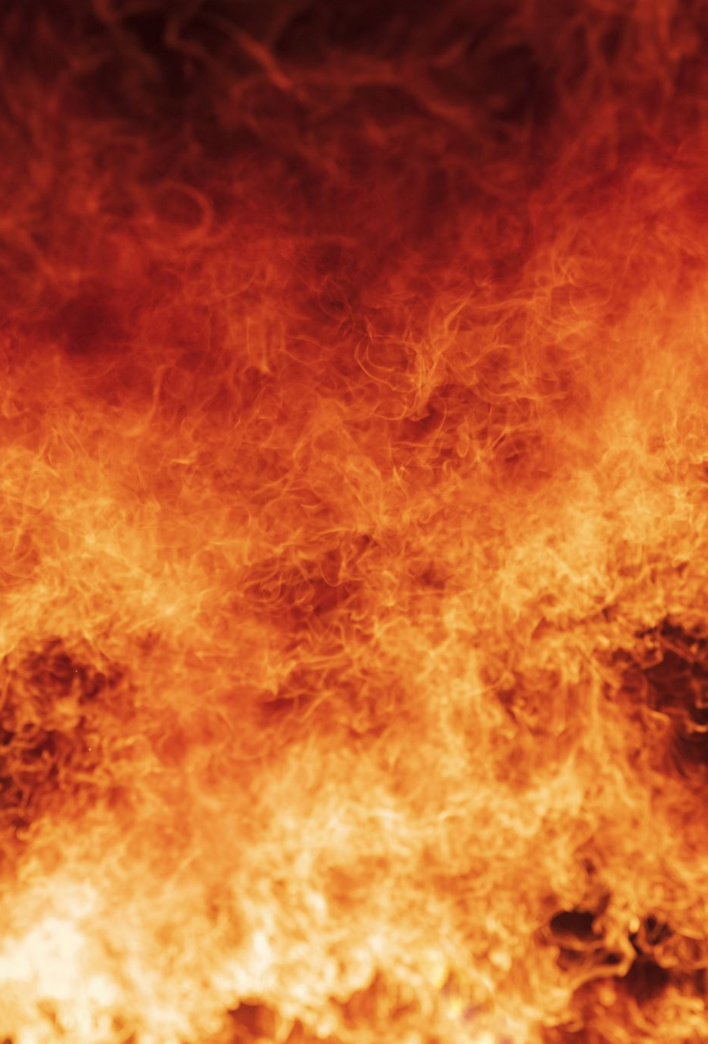
Heat
Heat is the movement of energy between two objects at different temperatures
Three methods of heat transfer
Conduction
Convection
Radiation
We are focused on conduction
How does heat propagate via conduction?

Slide 4
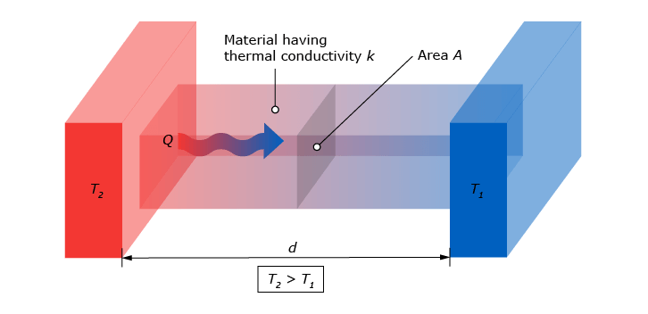

Fourier’s Law of Heat Conduction
Heat flux is proportional to the temperature gradient
$\vec{Q}=−k∇T$
Q = heat flux (W/m²)
k = thermal conductivity (?)
T = temperature (?)
Heat flows from high temperatures to low temperatures
Can you think of analogs to this behavior?

Slide 5
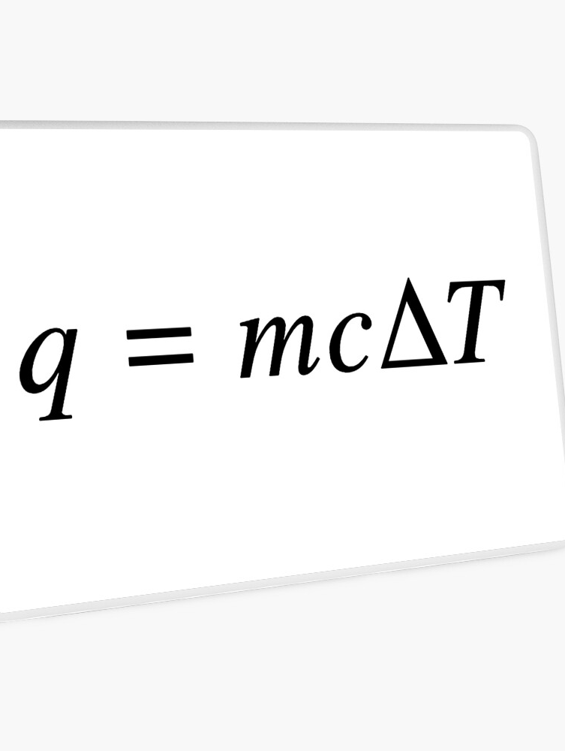

Deriving the Heat Equation
The conservation of energy dictates
$∇⋅Q=−\frac{dE}{dt}$
Where the internal energy can be quantified as
$E=ρ c T$
Specifying the parameter $α=\frac{k}{ρc}$ called the thermal diffusivity, we can express the heat equation as
$\frac{dT}{dt}=α∇^{2}T$

Slide 6
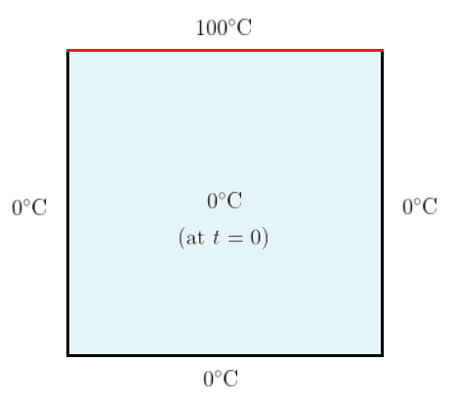

Solving the problem
To uniquely solve the heat equation, we need
Initial conditions:
$T\left(x,0\right)=f(x)$
Boundary conditions:
$T\left(0,t\right)=T_{1}$
$T\left(L,t\right)=T_{2}$

Slide 7
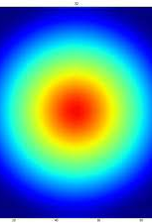

Numerical Solution: FDM
Discretize space and time
Grid points: $x_{i}=iΔx$
Time steps: $t_{n}=nΔt$
Rearranging, you find the recursion relation
$T_{i}^{n+1}=T_{i}^{n}+r(T_{i+1}^{n} −2T_{i}^{n}+T_{i−1}^{n})$
Where $r=α\frac{Δt}{{\left(Δx\right)}^{2}}$ and subject to a stability condition of
$$r<\frac{1}{2d}$$

Slide 8
Steps to our Solution
Define
Define spatial and temporal discretization
Set up
Set up initial and boundary conditions
Iterate
Iterate using the finite difference method
Visualize
Visualize evolution

