Slide 1
Refocus and Animation

Slide 2
Animation function
anim = animation.FuncAnimation(fig, animate, init_func=init, frames=200, interval=3)
fig – set of axes that has been defined earlier
animate – function that updates the plot/picture
init_func – function that initializes the plot/picture
frames – number of frames
interval – number of milliseconds between frames. It sets the frame rate of the animation

Slide 3
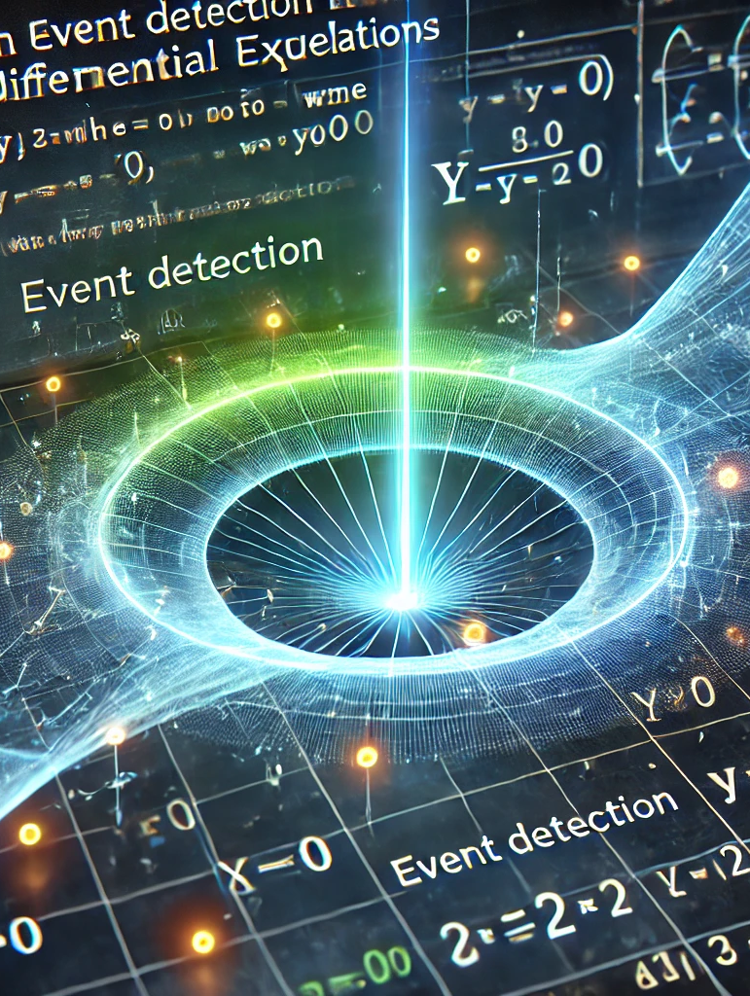
Event Detection in solve_ivp
Events allow stopping or tracking specific conditions when solving
Example: Detecting when y = 0 in projectile motion.
Define an event function
def hit_ground(t, y):
return y
Stop at y=0
hit_ground.terminal = True
Detect direction
hit_ground.direction = -1
Pass to `solve_ivp`
solve_ivp(fun, (t0, tf), y0, events=hit_ground)

