Slide 1
Parallel Processing
Phys 3211

Slide 2

Three types of Parallelism
Multi-Threading
Multi-Processing
Asynchronous Programming

Slide 3
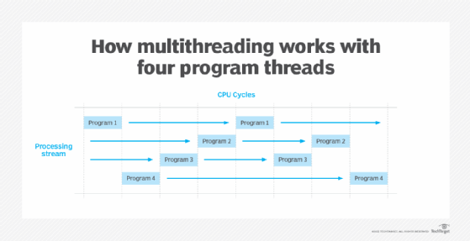
Multi-Threading
Multi-threading is a form of parallelism that allows programs to execute multiple commands concurrently

Slide 4
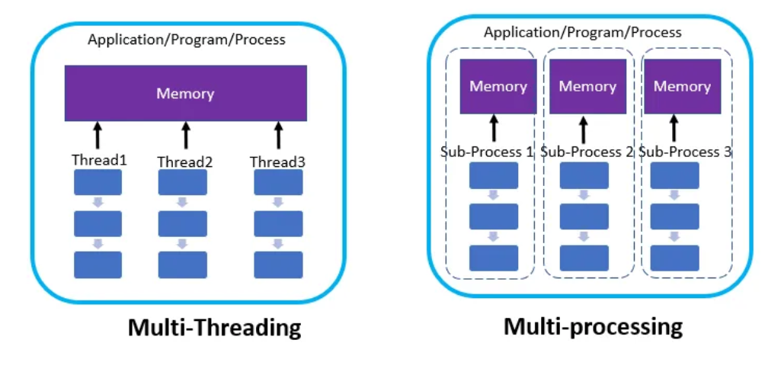
Multiprocessing
Multiprocessing is another form of parallelism that allows multiple processes to run simultaneously

Slide 5
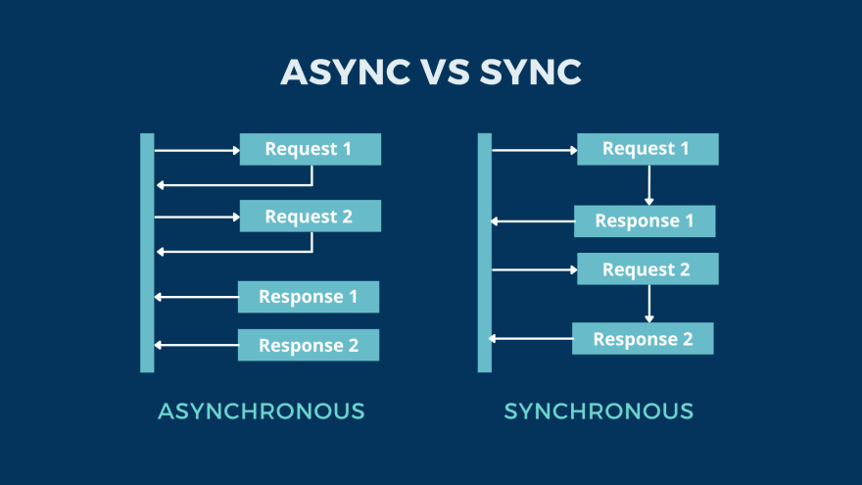
Asynchronous Programming
Asynchronous programming is a form of concurrent programming that involves executing tasks in a non-blocking manner
It requires a different way of thinking about the program's flow

