Slide 1
Phys 3211: Advanced Computational Problem Solving
Prof. Tom Kelley

Slide 2

Contact Info
Tom Kelley
th.kelley@northeastern.edu
Office: Dana 101
Phone: 617-373-8789
Office Hours:
Mon 13:00-14:30 (Dana 101) Wed 14:30-16:00 (Dana 101) Thur 11:00-12:00 (Dana 101) and by appointment

Slide 3


This Course…
Topics…
Numerical Computing
Physics applications
Standard and useful algorithms and methods
Languages …
Python
Mathematica*

Slide 4

What’s the Textbook for this Course?
Well… let’s see…

Slide 5
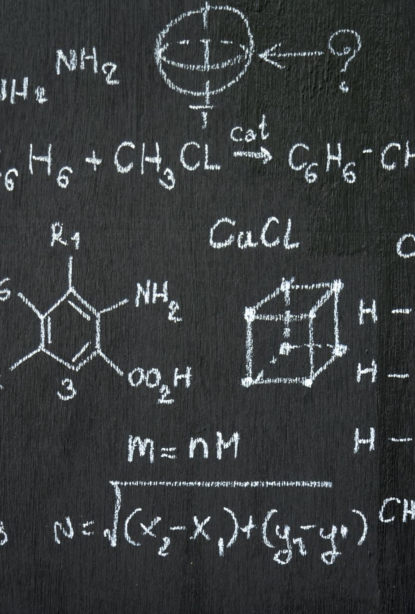
Components of the Class
Physics Toolbox (10%)
Short presentations by the students
Problems (40%)
Formative assignments
Checkpoints (10%)
Smaller problems, usually done in class
Projects (20%)
More complex problems involving novel/classic physics problems/subjects
Final Project (20%)
An extended program incorporating many topics from the course
Details: TBA

Slide 6

Canvas Page
Assignments will be submitted through Canvas/Gradescope AND uploaded to GitHub
I do want everyone to maintain repositories on GitHub Classroom

Slide 7
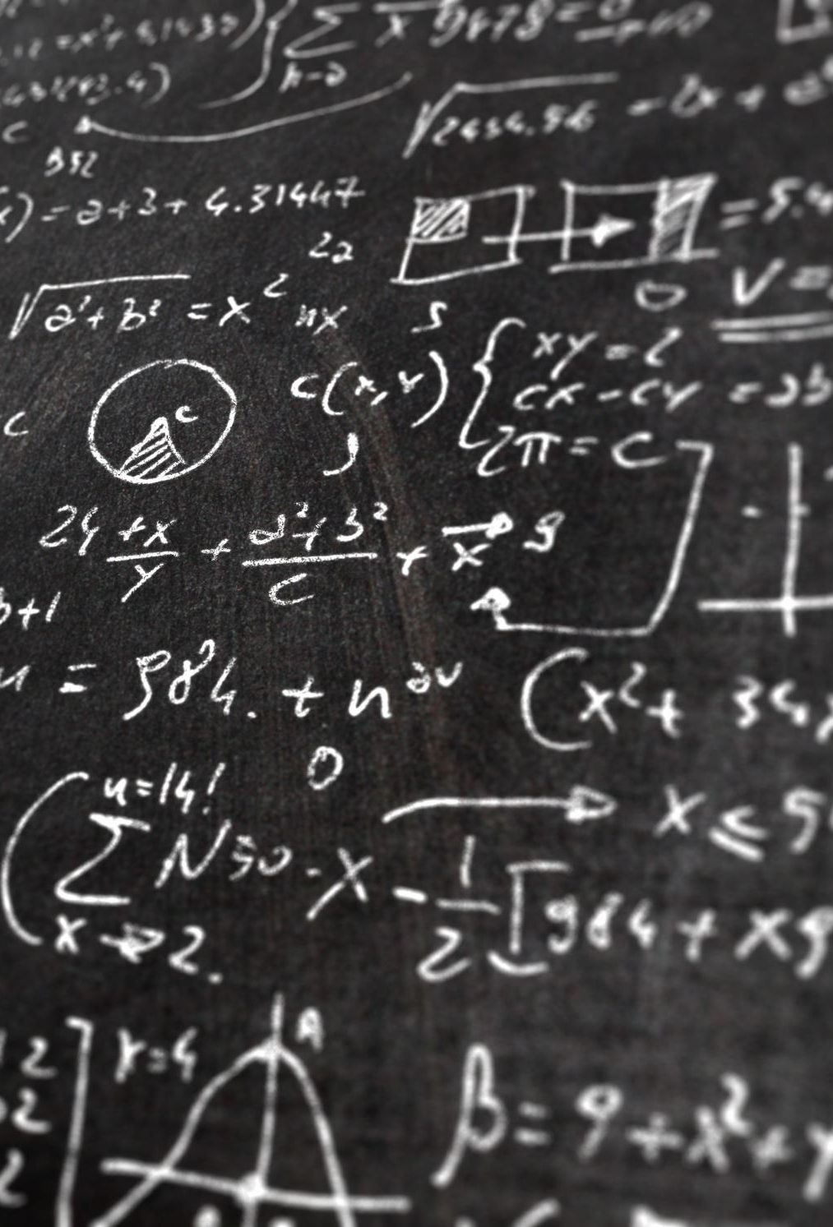
Typical Class
Troubleshooting
I want you all to interact and share knowledge/tips/tricks
Presentations by you
Physics toolbox contributions
Live Coding Presentation with breakouts
Topic of the Day (or Week)
Problem of the Day (Week)
Work on various problem(s) applying the Topic of the Day (Week)

Slide 8

Computation – The Third Leg
Modern physics is built on three pillars
Theory
Experiment
Computation
Computation has become indispensable part of physics since physical models and theories require millions/billions of calculations/simulations

Slide 9
Modern Computing in Physics
How is programming used in Physics
Calculate numerical solutions of equations that cannot be done analytically
Directly study complex systems using models to “simulate” a system
Monte Carlo Simulations
Micro-Simulations
Large Data Problems (Data Wrangling)
LHC (writes ~2 petabytes of data/day)
Network data
Astrophysical data
Machine Learning/AI/Neural Networks
Most subfields of physics use some computational modeling
Dynamics of solar systems, galaxies, etc
Studies of mechanical models of earthquakes
Fluid dynamics; turbulence
Molecular dynamics of gases, fluids
Electrostatics and dynamics (Maxwell’s equations)
Electronic structure of materials
Statistical mechanics of polymers, magnetic systems, etc.
Lattice gauge theory (numerical QCD)

Slide 10
Defining Terms
Programming
Coding
Developing a fully functioning software solution
Requires
Knowledge
Intuition
Imagination
Approach
Methodical planning
Attention to detail
Translating natural language into machine commands through an intermediary coding language
Requires
Basic knowledge of syntax and keywords
Approach
Trial and error

Slide 11
Group Discussion Topic
What’s one problem or phenomenon in the physical world that you’ve always been curious about, and how do you think scientific computing could help explore or solve it?

Slide 12
What’s happening today?
Coding Activity
Survey
Installation Issues
GitHub registration and desktop app (?)

