Slide 1

Solving Systems of Differential Equations Numerically

Slide 2
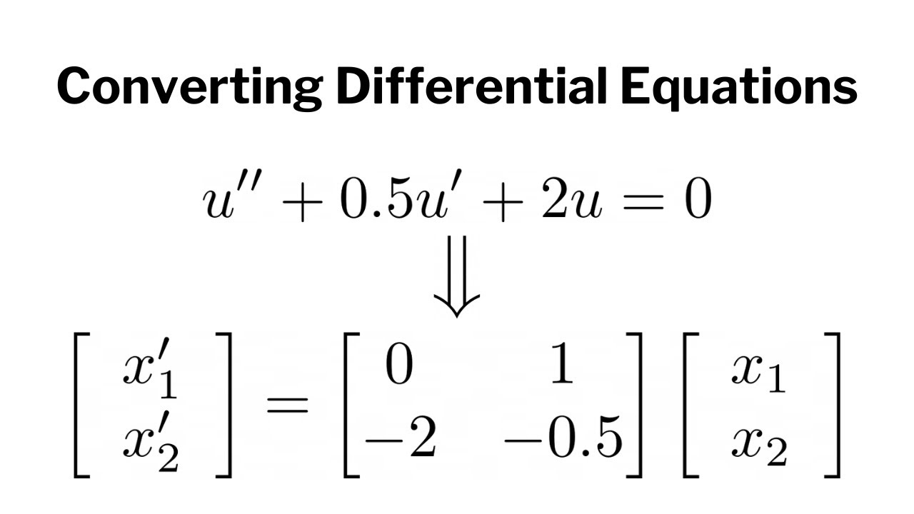

Converting Higher-Order ODEs to First-Order Systems
A higher-order differential equation can be rewritten as a system of first-order equations.
Example: Consider a second-order ODE:
$y^{′′}=f(t,y,y′)$
Introduce auxiliary variables: $y= x_{1}$ $y^{′}=x_{2}$
Rewrite as:
$x_{2}^{′}=f\left(t,x_{1},x_{2}\right)$
$x_{1}^{′}=x_{2}$
In this way, an nth-order ODE can become n first-order equations.

Slide 3
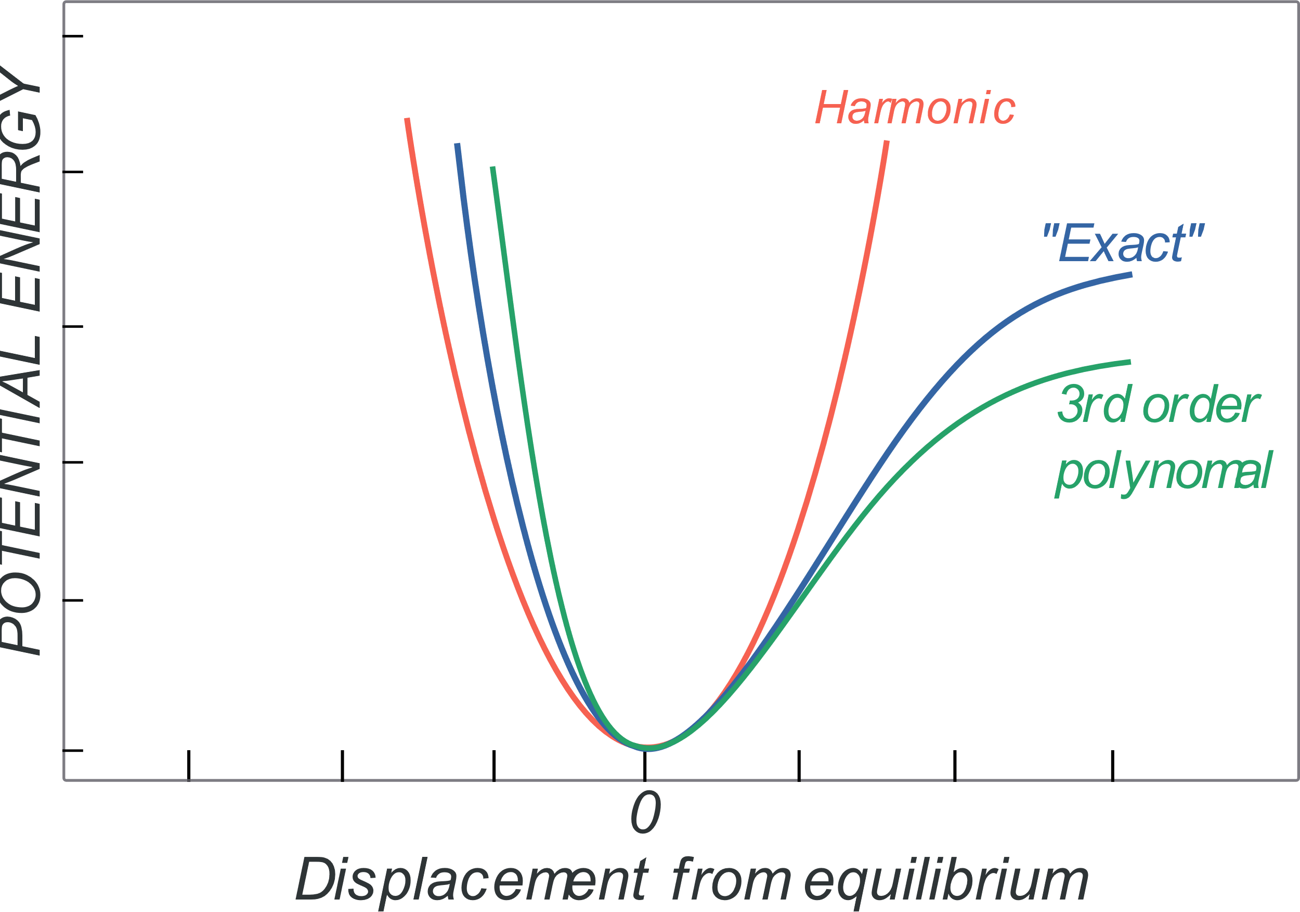
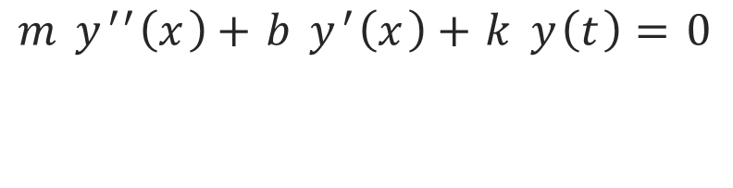
Example: Harmonic Oscillator
$${m y}^{′′}\left(x\right)+b y^{′}\left(x\right)+k y\left(t\right)=0$$

Slide 4
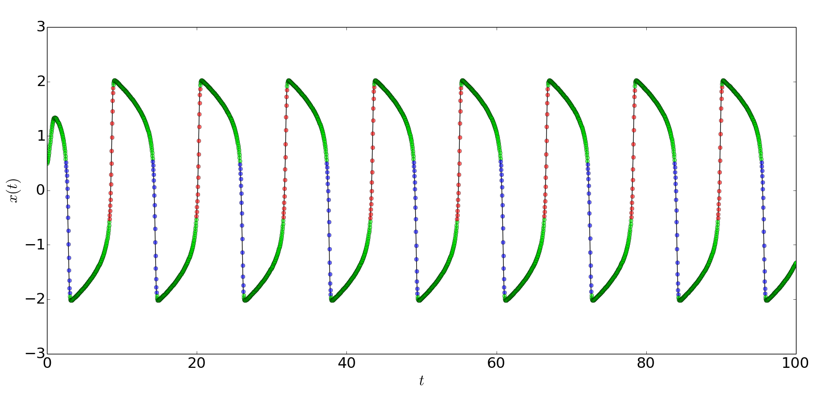
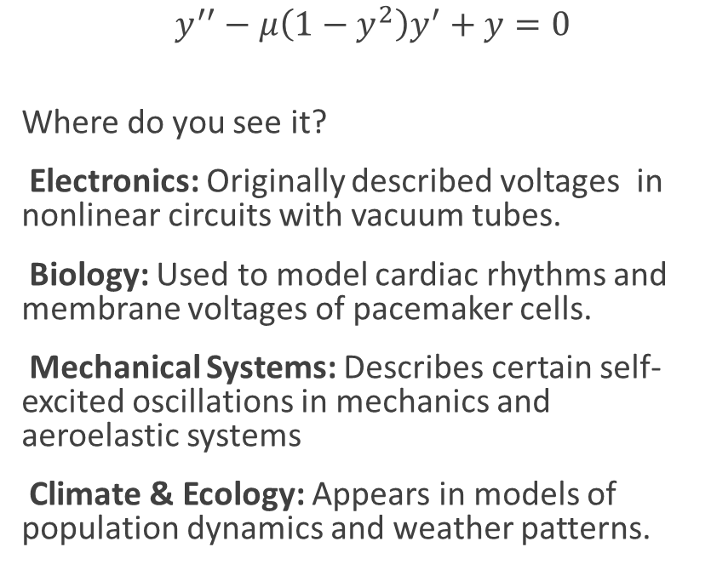
Van Der Pol Oscillator
$y^{′′}−μ\left(1−y^{2}\right)y^{′}+y=0$
Where do you see it?
Electronics: Originally described voltages in nonlinear circuits with vacuum tubes.
Biology: Used to model cardiac rhythms and membrane voltages of pacemaker cells.
Mechanical Systems: Describes certain self-excited oscillations in mechanics and aeroelastic systems
Climate & Ecology: Appears in models of population dynamics and weather patterns.

Slide 5

Event Detection in solve_ivp
Events allow stopping or tracking specific conditions when solving
Example: Detecting when y = 0 in projectile motion.
Define an event function
def hit_ground(t, y):
return y
Stop at y=0
hit_ground.terminal = True
Detect direction
hit_ground.direction = -1
Pass to `solve_ivp`
solve_ivp(fun, (t0, tf), y0, events=hit_ground)

