Slide 1
Differentials
Material taken from Computation Physics by Mark Newman

Slide 2
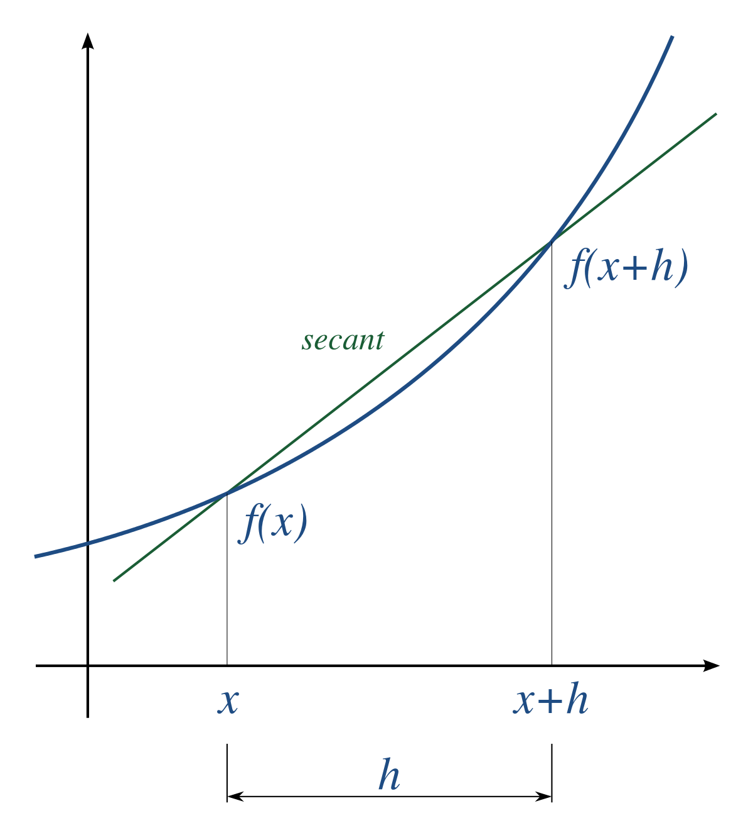
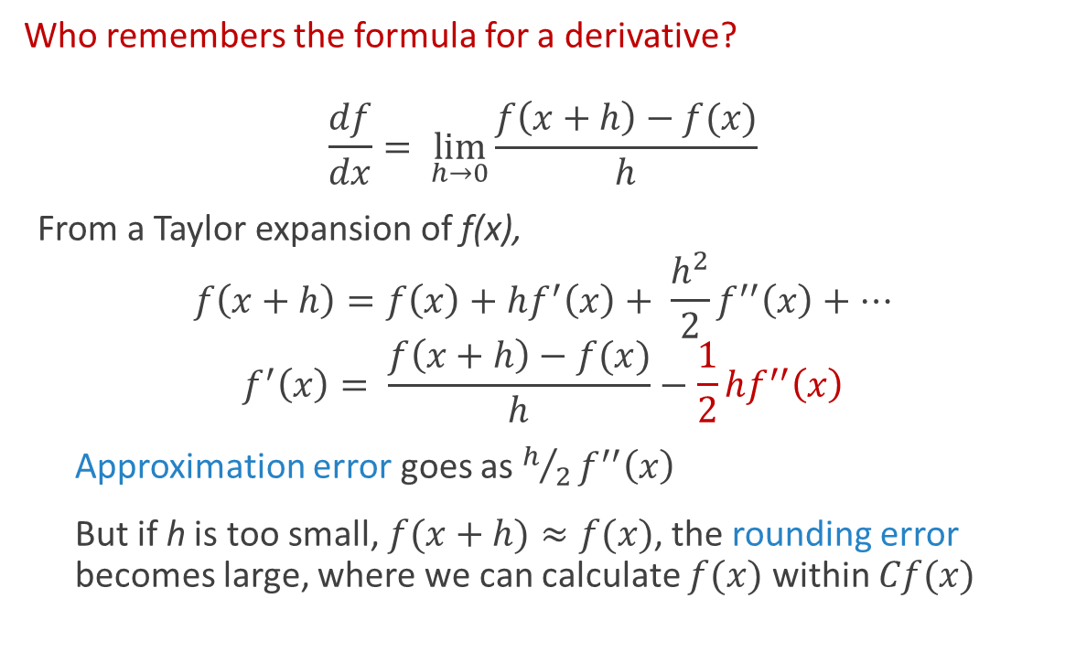

Forward Difference
Who remembers the formula for a derivative?
$$\frac{df}{dx}= \lim_{h→0}{\frac{f\left(x+h\right)−f(x)}{h}}$$
From a Taylor expansion of f(x),
$$f\left(x+h\right)=f\left(x\right)+hf^{′}\left(x\right)+ \frac{h^{2}}{2}f^{′′}\left(x\right)+⋯$$
$$f^{′}\left(x\right)= \frac{f\left(x+h\right)−f(x)}{h}−\frac{1}{2}hf^{′′}\left(x\right)$$
Approximation error goes as $h/2f^{′′}\left(x\right)$
But if h is too small, $f(x+h)≈f(x)$, the rounding error becomes large, where we can calculate $f(x)$ within $Cf(x)$
Error goes as $h$

Slide 3

Error in the derivative
The total error in the derivative calculation, in the worst case
$$ε=\left|\frac{2Cf\left(x\right)}{h}+\frac{h}{2}f′′(x)\right|$$
To minimize the error with respect to h
$$\frac{∂ε}{∂h}=\frac{−2C}{h^{2}}f\left(x\right)+\frac{1}{2}f^{′′}\left(x\right)=0$$
$$h= \sqrt{4C\left|\frac{f(x)}{f′′(x)}\right|}⇒h∼C^{1/2}$$
The total error is then
$$ε≈h\left|f^{′′}\left(x\right)\right|= \sqrt{4C\left|f\left(x\right)f^{′′}\left(x\right)\right|}⇒ε∼C^{1/2}$$

Slide 4
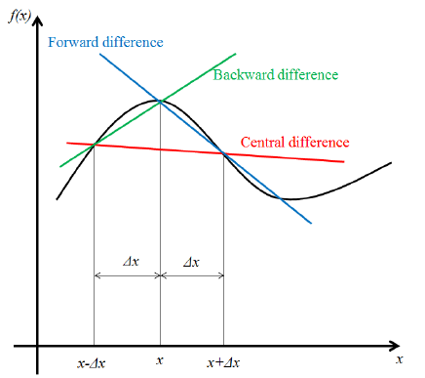
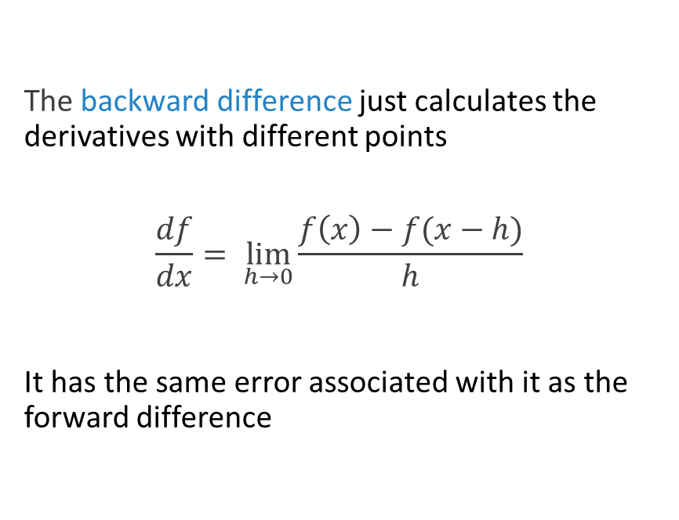
Backward Difference
The backward difference just calculates the derivatives with different points
$$\frac{df}{dx}= \lim_{h→0}{\frac{f\left(x\right)−f(x−h)}{h}}$$
It has the same error associated with it as the forward difference

Slide 5

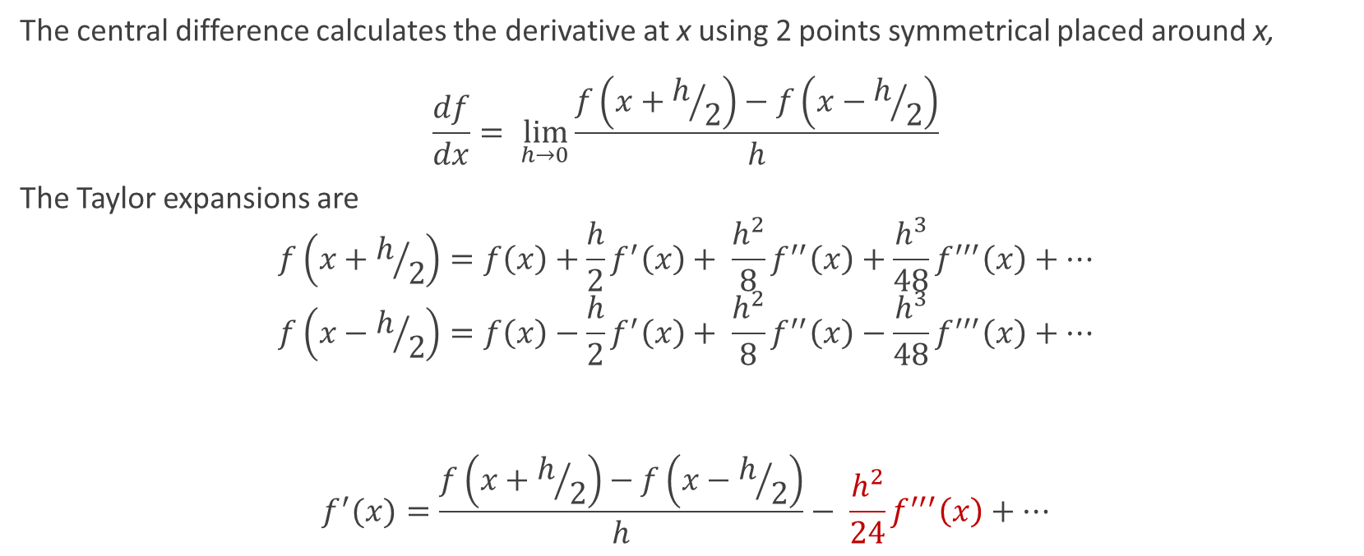
Central difference
The central difference calculates the derivative at x using 2 points symmetrical placed around x,
$$\frac{df}{dx}= \lim_{h→0}{\frac{f\left(x+h/2\right)−f\left(x−h/2\right)}{h}}$$
The Taylor expansions are
$$f\left(x+h/2\right)=f\left(x\right)+\frac{h}{2}f^{′}\left(x\right)+ \frac{h^{2}}{8}f^{′′}\left(x\right)+\frac{h^{3}}{48}f^{′′′}\left(x\right)+⋯$$
$$f\left(x−h/2\right)=f\left(x\right)−\frac{h}{2}f^{′}\left(x\right)+ \frac{h^{2}}{8}f^{′′}\left(x\right)−\frac{h^{3}}{48}f^{′′′}\left(x\right)+⋯$$
$$f^{′}(x)=\frac{f\left(x+h/2\right)−f\left(x−h/2\right)}{h}− \frac{h^{2}}{24}f^{′′′}\left(x\right)+⋯$$
Error goes as $h^{2}$

Slide 6
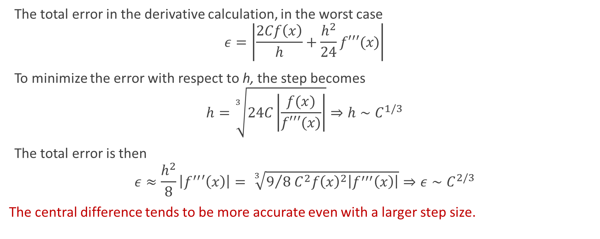
Minimizing the total error again
The total error in the derivative calculation, in the worst case
$$ε=\left|\frac{2Cf\left(x\right)}{h}+\frac{h^{2}}{24}f′′′(x)\right|$$
To minimize the error with respect to h, the step becomes
$$h=\sqrt[3]{24C\left|\frac{f(x)}{f′′′(x)}\right|}⇒h∼C^{1/3}$$
The total error is then
$$ε≈\frac{h^{2}}{8}\left|f^{′′}′\left(x\right)\right|= \sqrt[3]{9/{8 C^{2}{f\left(x\right)}^{2}\left|f^{′′′}\left(x\right)\right|}}⇒ε∼C^{2/3}$$
The central difference tends to be more accurate even with a larger step size.

Slide 7
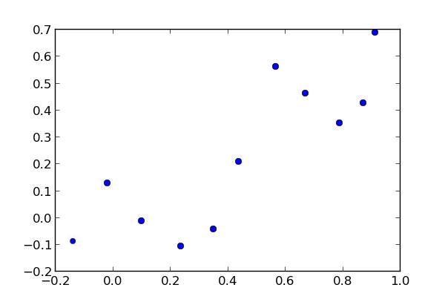
So there is a clear winner?
If the central difference tends to be more accurate, then why use forward or backward difference?
Well consider a set of data:
To find the derivative at some x, the central difference has to use points x-h and x+h, using 3 points to calculate what it takes the forward difference 2 points (should compare the error between the two methods)
Calculating the derivative at a point between two x’s now allows you to evaluate the function at two symmetric points

Slide 8
Higher Order Approximations for Derivatives
Numerical derivatives described here are essential fitting a straight line between two points, and then calculating the slope between them
Could we fit higher-order polynomials?
Of course, but
it involves more points
the error on the approximation improves slowly
Computational Physics contains a table of coefficients you can use to calculate the derivative a function using higher order fits on page 196 (Table 5.1)

Slide 9
Useful Coefficients

Slide 10
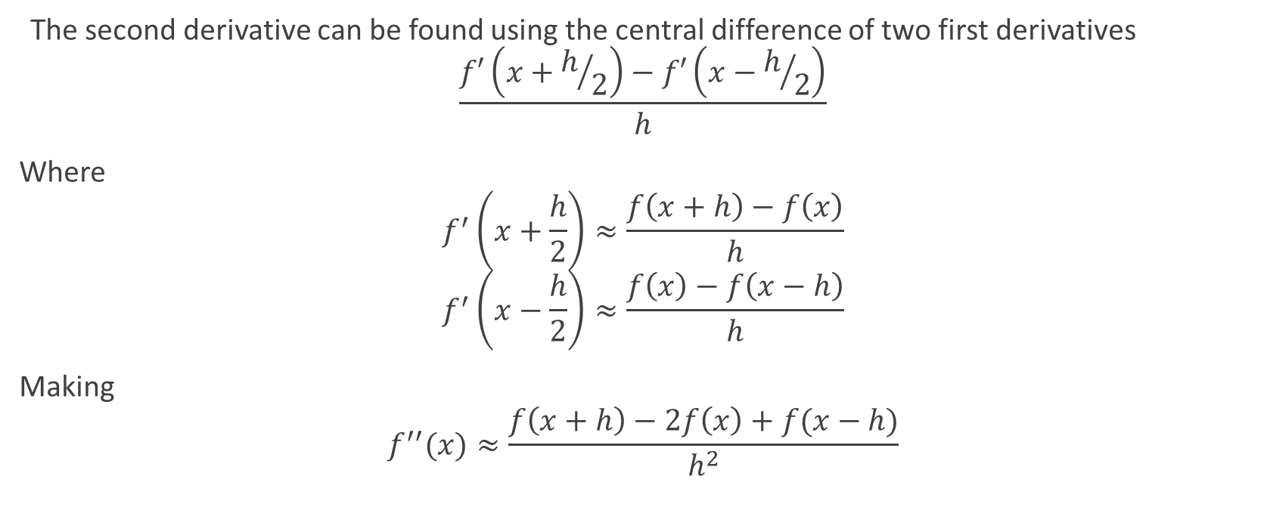
Second Derivatives
The second derivative can be found using the central difference of two first derivatives
$$\frac{f′\left(x+h/2\right)−f′\left(x−h/2\right)}{h}$$
Where
$$f^{′}\left(x+\frac{h}{2}\right)≈\frac{f\left(x+h\right)−f\left(x\right)}{h}$$
$$f^{′}\left(x−\frac{h}{2}\right)≈\frac{f\left(x\right)−f\left(x−h\right)}{h}$$
Making
$$f^{′′}(x)≈\frac{f\left(x+h\right)−2f\left(x\right)+f(x−h)}{h^{2}}$$

Slide 11

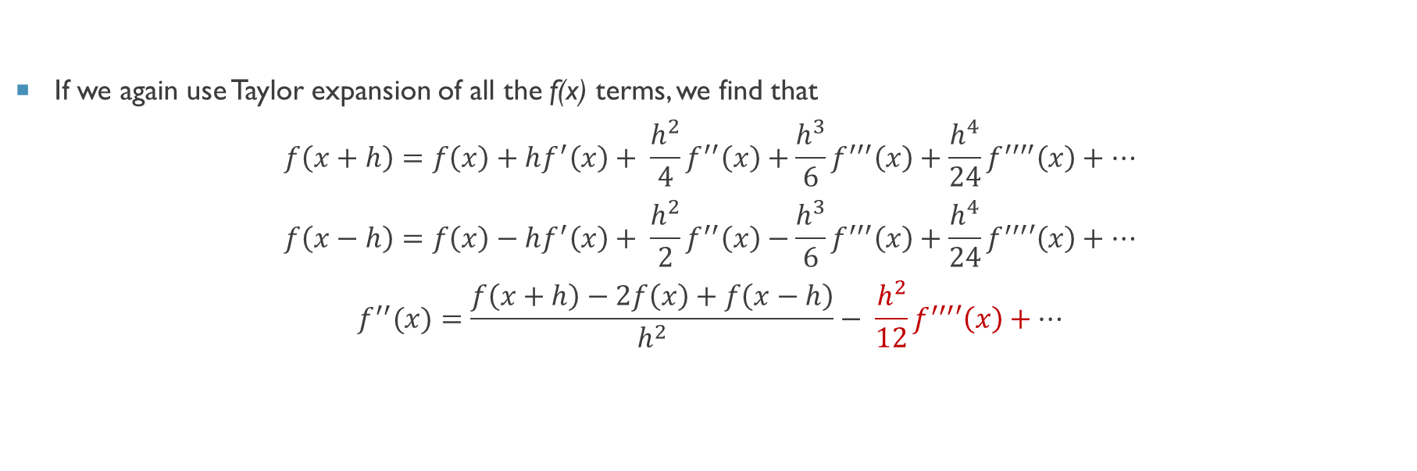
Second Derivatives
If we again use Taylor expansion of all the f(x) terms, we find that
$$f\left(x+h\right)=f\left(x\right)+hf^{′}\left(x\right)+ \frac{h^{2}}{4}f^{′′}\left(x\right)+\frac{h^{3}}{6}f^{′′′}\left(x\right)+\frac{h^{4}}{24}f^{′′′′}\left(x\right)+⋯$$
$$f\left(x−h\right)=f\left(x\right)−hf^{′}\left(x\right)+ \frac{h^{2}}{2}f^{′′}\left(x\right)−\frac{h^{3}}{6}f^{′′′}\left(x\right)+\frac{h^{4}}{24}f^{′′′}′\left(x\right)+⋯$$
$$f^{′′}(x)=\frac{f\left(x+h\right)−2f\left(x\right)+f\left(x−h\right)}{h^{2}}− \frac{h^{2}}{12}f^{′′′}′\left(x\right)+⋯$$
Error goes as $h^{2}$

Slide 12
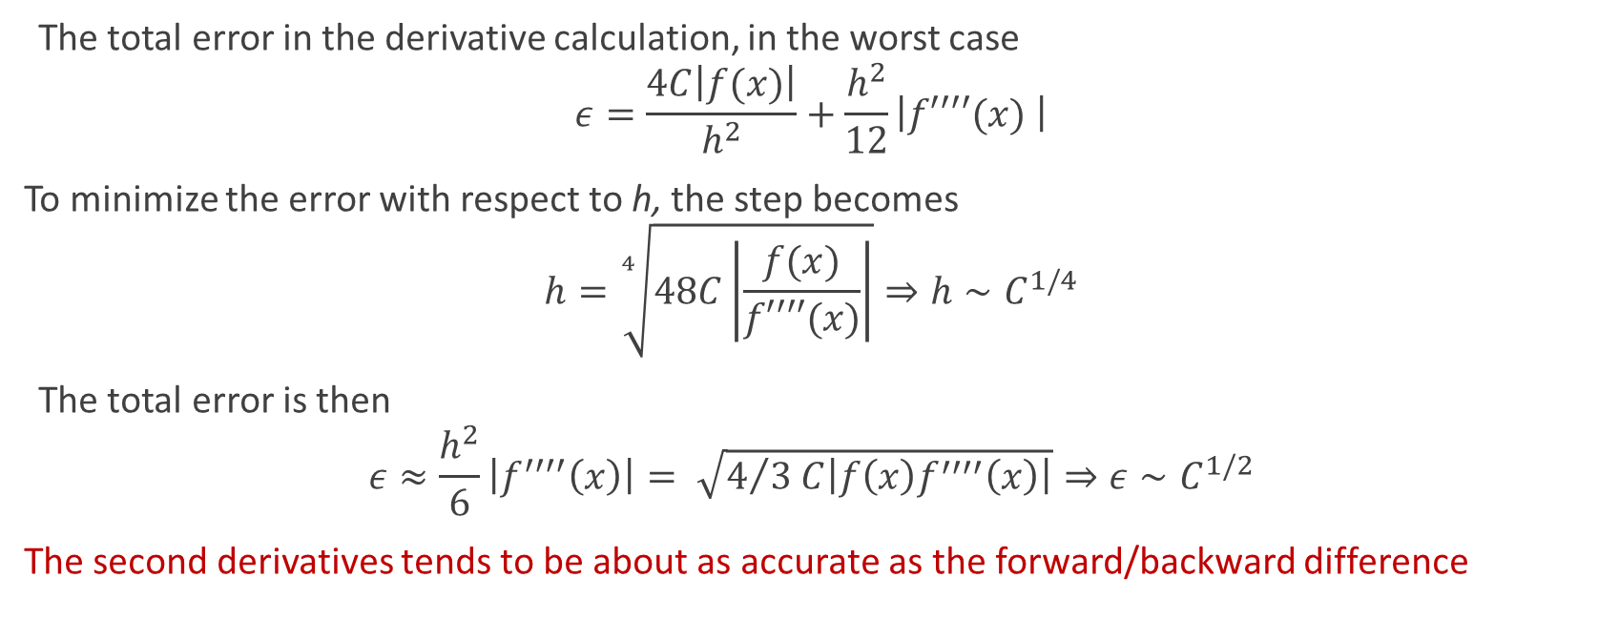
Minimizing the total error Yet again
The total error in the derivative calculation, in the worst case
$$ε=\frac{4C\left|f(x)\right|}{h^{2}}+\frac{h^{2}}{12}\left|f′′′′(x) \right|$$
To minimize the error with respect to h, the step becomes
$$h=\sqrt[4]{48C\left|\frac{f(x)}{f′′′′(x)}\right|}⇒h∼C^{1/4}$$
The total error is then
$$ε≈\frac{h^{2}}{6}\left|f^{′′′′}\left(x\right)\right|= \sqrt{4/{3 C\left|f\left(x\right)f^{′′′′}\left(x\right)\right|}}⇒ε∼C^{1/2}$$
The second derivatives tends to be about as accurate as the forward/backward difference

Slide 13

Take home messages
Central difference appears to be the most accurate
You can optimize step size by knowing the machine precision of the numbers you use (many build-in algorithms do this automatically)
You can use higher-order methods, but you sacrifice speed
Second derivatives are no more accurate than central differences methods

