Slide 1
Floating-Point Notation
Storing Real numbers since 1985 (2008) (2019)

Slide 2

Binary Storage
N bits can store integers ranging from 0 to 2^{N} (0 to 2^{N-1} for signed integers)
Most languages contains 32-bit and 64-bit floats
Python has a 16, 32, or 64-bit float
Side note – Python will automatically assign integers as 32- of 64-bit type

Slide 3
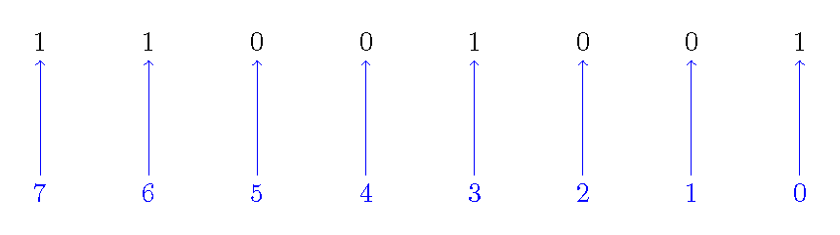
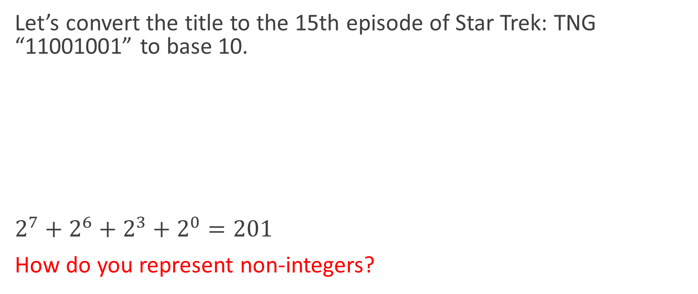
Binary Storage
Let’s convert the title to the 15th episode of Star Trek: TNG “11001001” to base 10.
$2^{7}+2^{6}+2^{3}+2^{0}=201$
How do you represent non-integers?

Slide 4

Floating-Point Notation
As of 1987, IEEE and ANSI adopted the IEEE-754 standard for floating-point arithmetic
$x={\left(−1\right)}^{s}×1.f×2^{e −bias}$
s = one-bit sign
f = fraction (mantissa)
e = exponent
bias = 127 (32-bit), 1023 (64-bit)

Slide 5
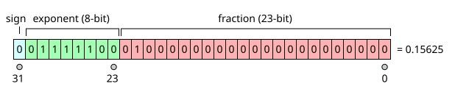
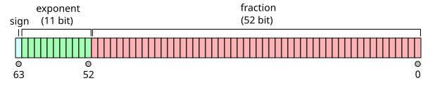
IEEE floating point notation
Sign = stored in 1-bit
Exponent = stored in 8/11 bits
Fraction = stored in 23/52 bits

Slide 6
Range of Values
32-bit
64-bit
s = [?]
e (8-bit)= [?]
f (23-bit) = [?]
bias=?
s = [?]
e (11-bit)= [?]
f (52-bit) = [?]
bias=?

Slide 7
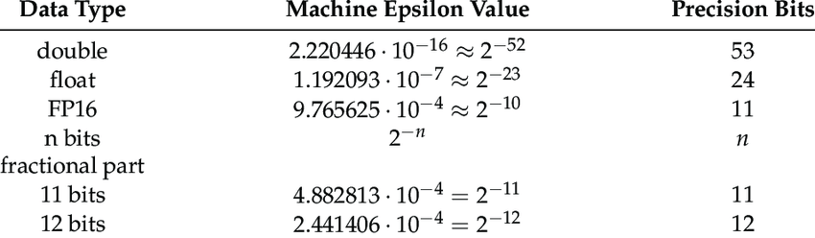
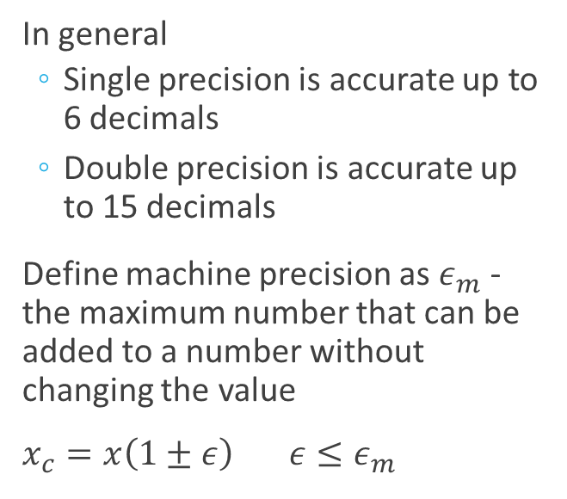
Machine Precision
In general
Single precision is accurate up to 6 decimals
Double precision is accurate up to 15 decimals
Define machine precision as $ε_{m}$ - the maximum number that can be added to a number without changing the value
$x_{c}=x\left(1±ε\right) ε≤ε_{m}$

Slide 8
Examples
Represent 7.54
Represent 10⁻⁷

Slide 9
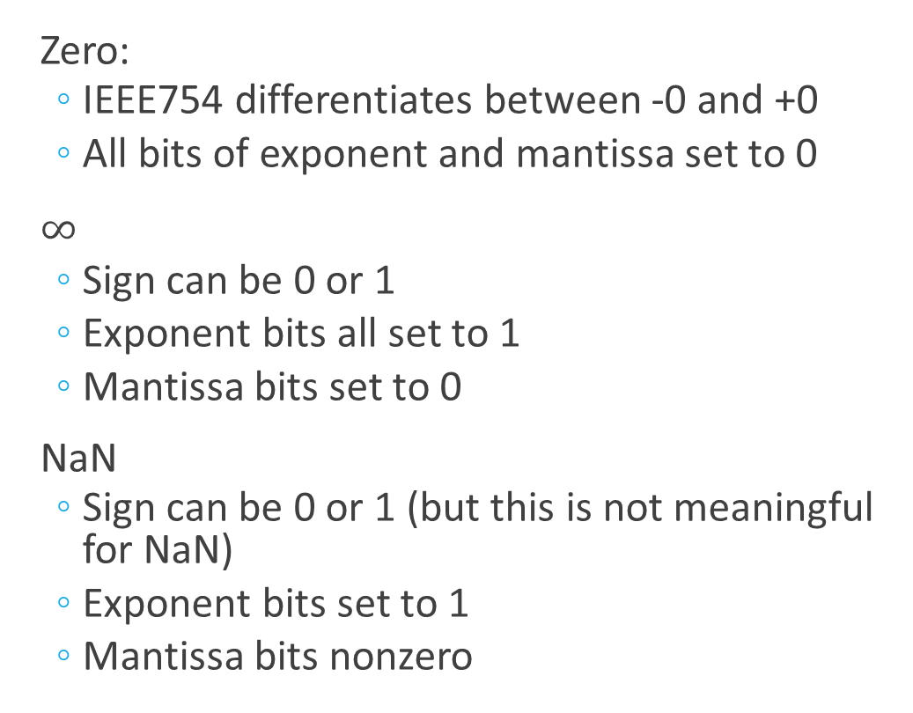
Special Cases
Zero:
IEEE754 differentiates between -0 and +0
All bits of exponent and mantissa set to 0
$∞$
Sign can be 0 or 1
Exponent bits all set to 1
Mantissa bits set to 0
NaN
Sign can be 0 or 1 (but this is not meaningful for NaN)
Exponent bits set to 1
Mantissa bits nonzero

